Slide 1
Emulation of Guitar Effects Using Machine Learning
Luka Ivanković
UNIVERSITY OF ZAGREB
FACULTY OF ELECTRICAL ENGINEERING AND COMPUTING

Slide 2
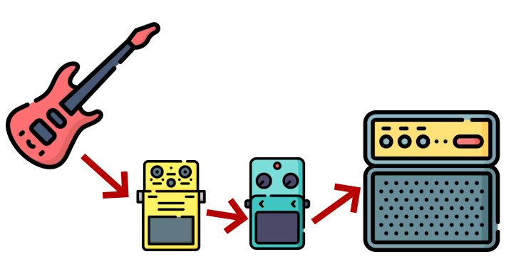
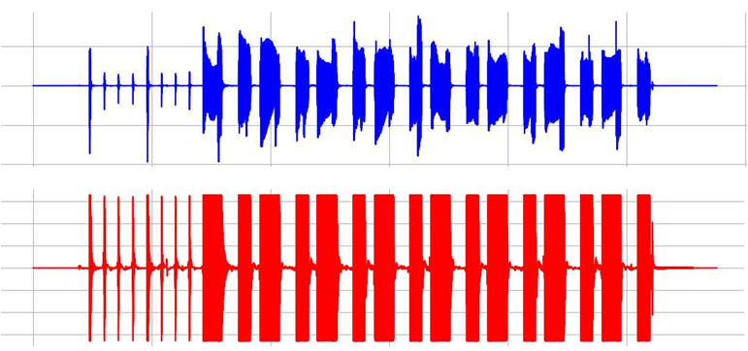
Introduction to the problem
Classical audio signal chain
Sound before and after the pedal

Slide 3
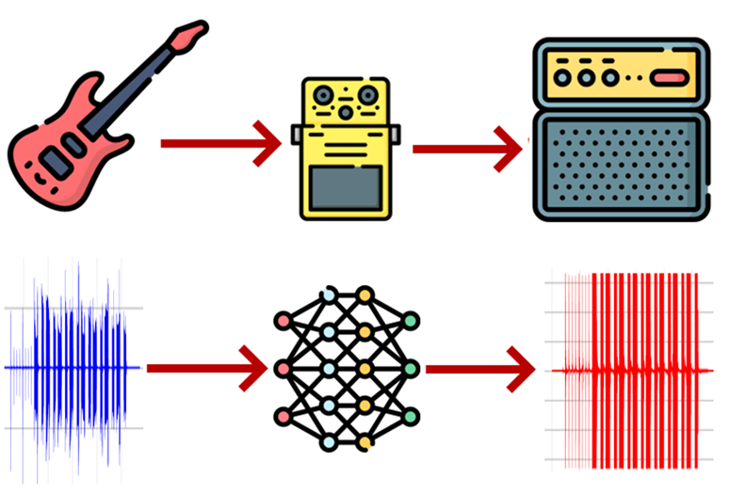
What are we trying to learn?
The model should learn the audio transformations introduced by the effect pedal
Types of transformations:
Short (distortion), < 10ms
Long (equalizer, flanger), < 1s
Very long (delay, reverb), > 1s

Slide 4
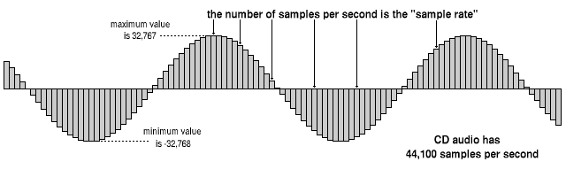
Digital audio representation

Slide 5
Lengths of effects
 | Duration (seconds) | Duration (samples)
Simple Distortion | 0 ms | 0
Raging Demon Distortion | 0.188 s | 8271
Dragonfly Plate Reverb | 2.844 s | 125413
Dragonfly Room Reverb | 6.738 s | 297165

Slide 6
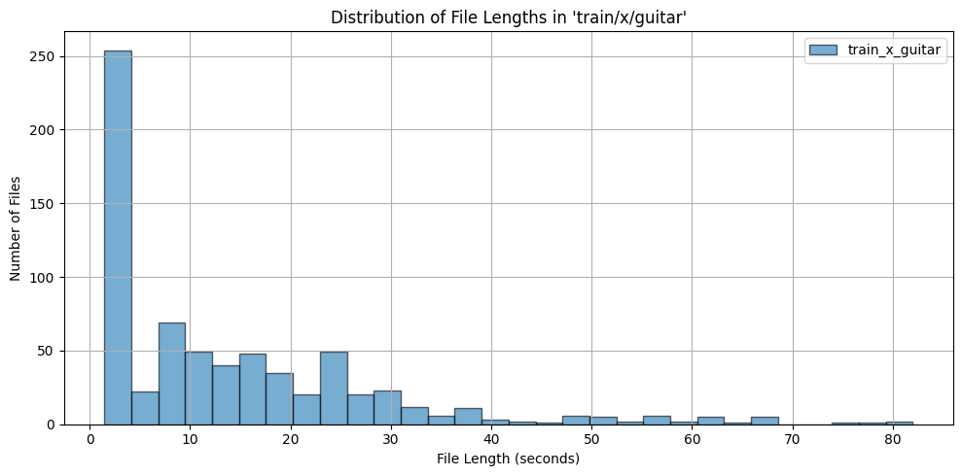
Dataset
Musical Instruments Sound Dataset by Soumen dra Prasad, KaggleHub
Train set: 700 recordings of guitar, drums and violin each, and 528 recordings of piano
Test set: 80 recordings, 20 from each class
Applied effects via Spotify’s PedalBoard library

Slide 7
Approaches
White box
Black box
Models every analog component inside pedal. Very time consuming.
No assumptions about internal structure of guitar pedals
Fully connected
Reccurent networks (LSTM)
WaveNet
Temporal Convolutional Network
Structured State Space Models
Gray box
Assumes some internal structure, but still relies on optimization methods to fill out unknown parameters
Genetic algorithm
Gradient-based optimization

Slide 8
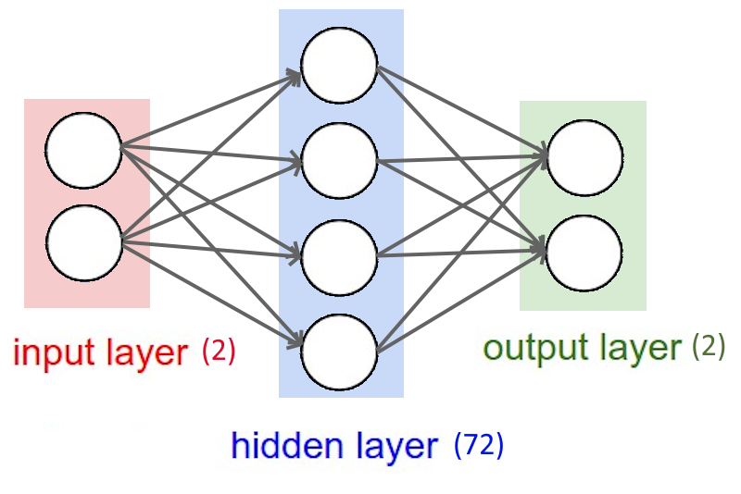
Fully connected Network
Works one sample at a time
Succesfully learns only the simplest distortion effect
For reverb tasks it minimizes MSE by only estimating the dry part of the signal
PROBLEM: no memory, can’t rely on previous samples to model longer effects

Slide 9
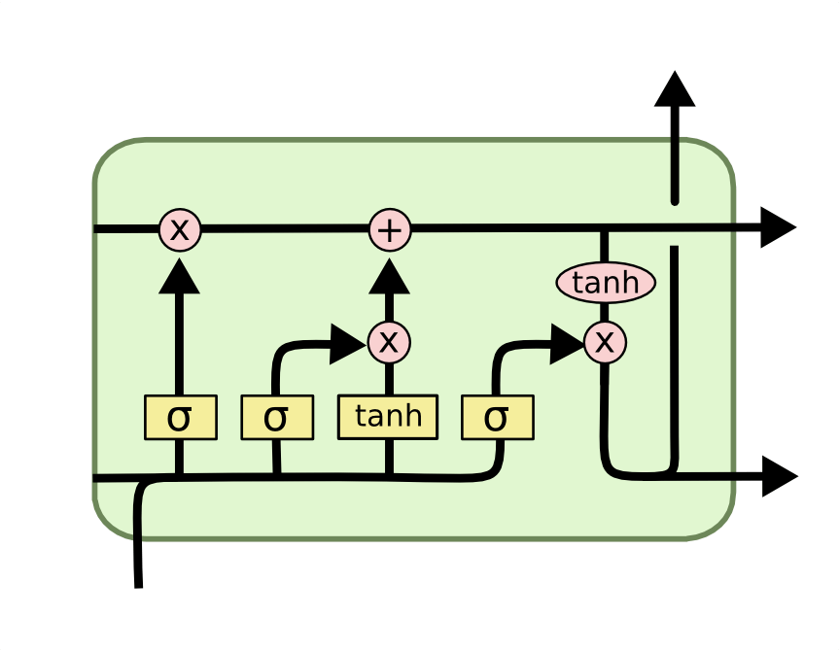
Long Short-Term Memory
Type of reccurrent neural network
Introduces memory
For reverb tasks it does better than FCN, capturing a small part of the reverb tail, but fails to emulate the complete effect
LIMIATION: Hardly parallelizable, slow training

Slide 10
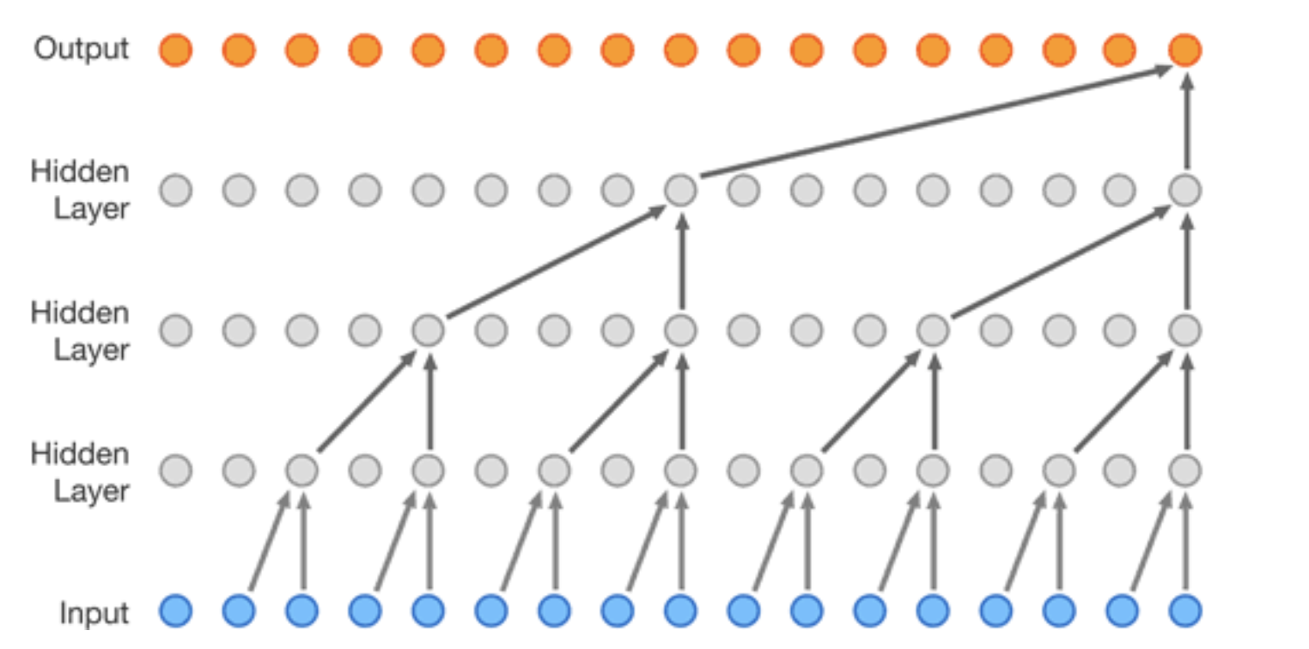
WaveNet
Introduces dilated convolutions
Has limited receptive window
Results simmilar to LSTM
Converges faster than LSTM due to paralelization
LIMIATION: Limited receptive field

Slide 11
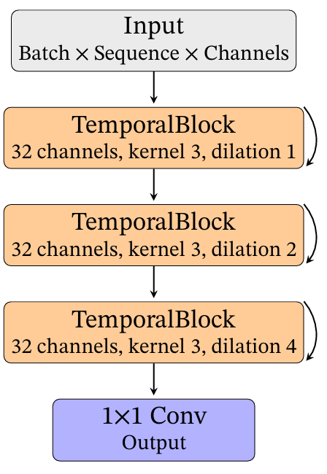
Temporal Convolutional Networks
More stable and easier to train than WaveNet, also better results
LIMIATION: Limited receptive field

Slide 12
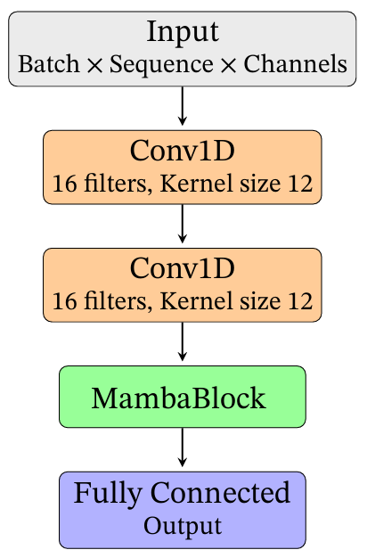
Structured State Space Models (Mamba)
Differentiable realization of an infinite impulse response (IIR) system in state space form
Both parallelizable, and theoretically unlimited receptive field.
Mamba is a recent implementation of SSSMs designed for efficiency and ease of integration in audio tasks

Slide 13
Results (MSE Loss)
 | Simple Dist | Raging Demon | Plate Reverb | Room Reverb
FCN | 0.00095 | 0.028 | 0.3537 | 0.4633
LSTM | 0.00043 | 0.0013 | 0.0143 | 0.0941
WaveNet | 0.00028 | 0.0010 | 0.0112 | 0.0933
TCN | 0.00035 | 0.00093 | 0.0115 | 0.0452
SSSM | 0.00037 | 0.00022 | 0.0089 | 0.0312

Slide 14
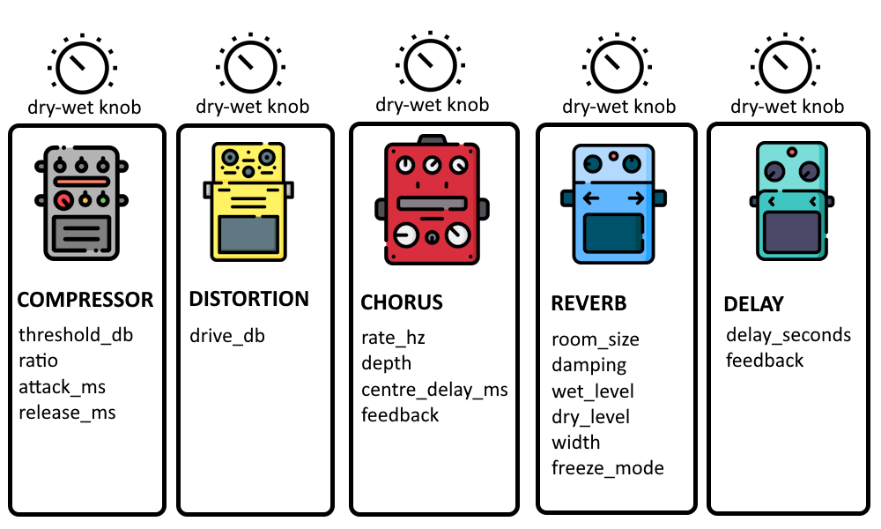
Gray-box optimizaton
We define an individual as a chain of 5 pedals
Each pedal has a fixed number of parameters and a dry-wet knob
We assume that the effect we are trying to emulate can be expressed as this effect chain with correct parameters
We now need to learn just the correct parameters

Slide 15
Genetic algorithm
Initialize population: 400 random individuals
Selection: Favoring individuals with higher fitness (lower MSE)
Crossover: Each child inherits one effect from either parent at each position in the chain
Mutation: Each effect has a chance to mutate. This may modify a parameter slightly or adjust the dry/wet mix

Slide 16
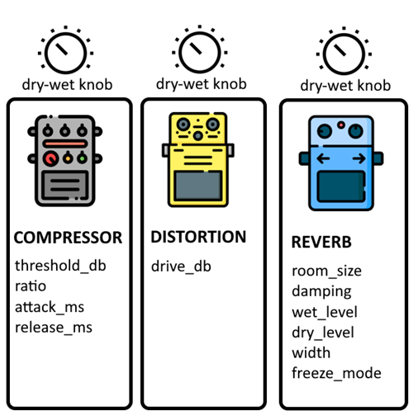

Gradient-Based Optimization
DASP python library offers differentiable effect
This library doesn’t have some effects that were used in individuals for GA
Less expressable
Faster convergence due to more direct optimization

Slide 17
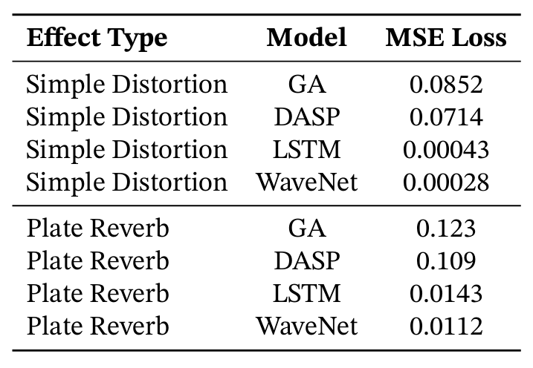
Results

Slide 18

Additional experiments and notes
Modeling knobs on the pedal was excluded from this research, knobs are fixed-value
Modeling LFO-based effects (phaser, flanger) is harder then modeling other effects
Learning process without guitar recordings also works
Transformer architecture would work great, but are very computationally expensive

Slide 19
Conclusion
Black-box methods outperform gray-box methods in emulating guitar effects
SSSM offer both fast training and unlimited receptive field thus beating other black-box networks

Slide 20

Thank you for your attention, bye

