Slide 1
Population and Migration Estimates April 2023
Cathal Doherty, Population Estimates and Projections
25/09/2023

Slide 2
Annual Estimates and Census of Population
As is standard practice, the intercensal period (2017 – 2022) for the population and migration estimates series (PME) has been revised based on a thorough analysis of the Census of Population results
Data on the registration of vital events (births and deaths) has been replaced by data on the occurrence of these events
Migration flows in the period have been adjusted and updated
Fully updated series can be viewed on PXSTAT:
https://data.cso.ie/product/PME

Slide 3
Important points on 2022
1a. People from households that were temporarily absent outside Ireland on Census night are included in the 2022 data for the first time
1b. Additivity of population change components has been impacted between 2021 and 2022
2. The 2022 immigration flow has been adjusted to ensure accurate estimation of those who arrived to the end of April
Further details can be found in the PME 2023 background notes

Slide 4
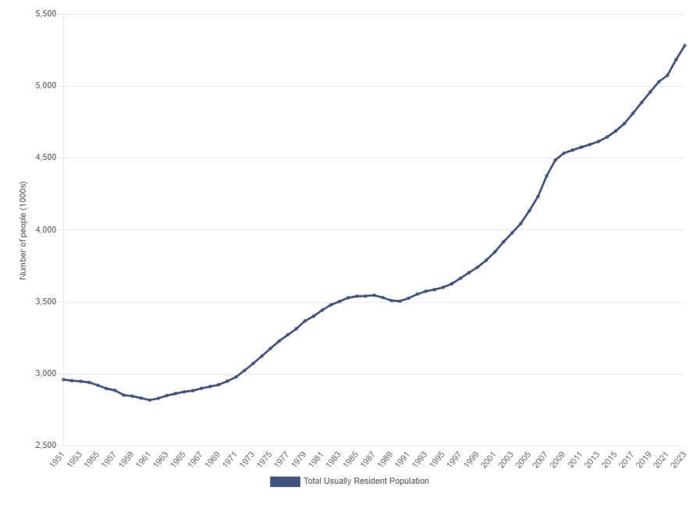
Population 1951 – 2023
5,281,600
Generally increasing population since 1961
Population stock passed the 5.2 million people threshold between 2022 and 2023
2,818,300

Slide 5
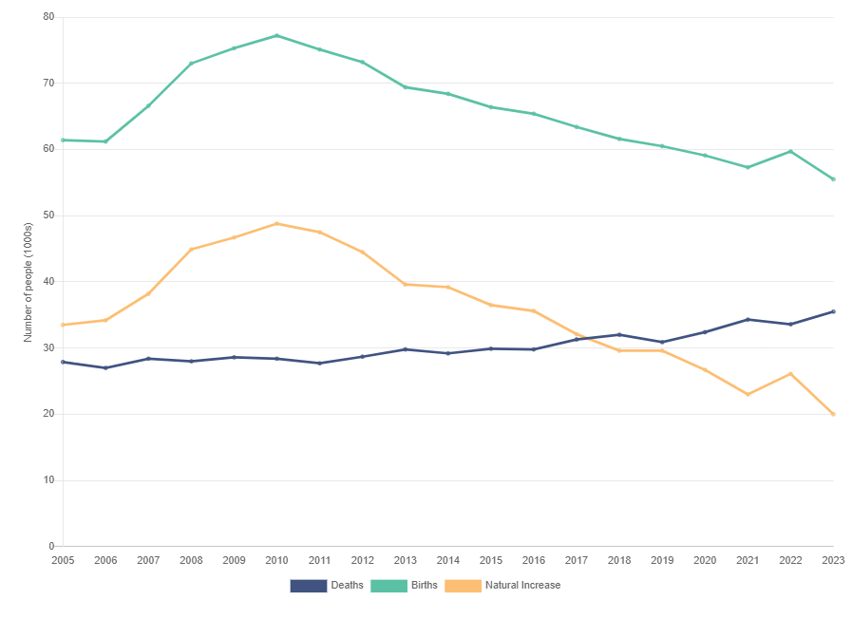
Vital Events, 2005 – 2023
Annual deaths above 30,000 since 2017
Annual births in steady decline since peak in 2010
Natural increase trend match the annual births trend

Slide 6
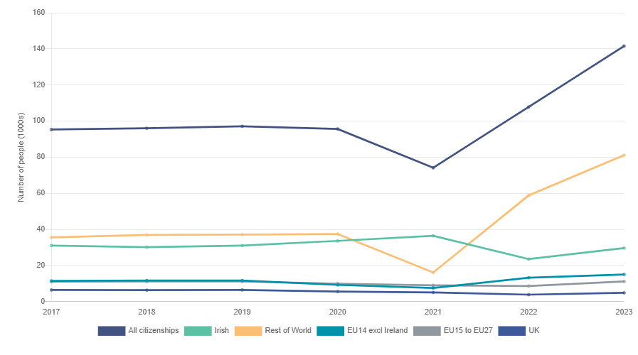
Immigration by Citizenship, 2017 – 2023
Drop in inward flows after 2020 with increases since 2021
Consecutive 12-month periods with over 100,000 people
Increases driven by Rest of the World flows
Returning Irish consistent apart from decline between 2021 and 2022

Slide 7
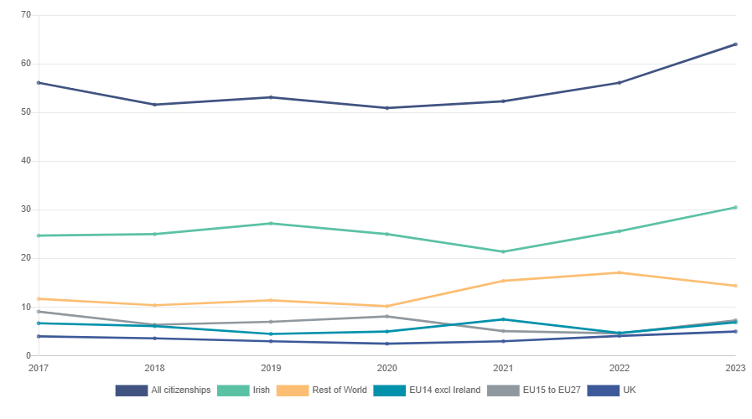
Emigration by Citizenship, 2017 – 2023
Emigration flow above 60,000 people in 2023
Number of Irish emigrants larger than other citizenship groupings
Rest of the World flows are the next largest
Approximately zero net migration of Irish and +65,000 net migration for Rest of the World

Slide 8
Estimated Net Migration by Citizenship
 | Broad citizenship breakdown
Citizenship
 | 2017 | 2018 | 2019 | 2020 | 2021 | 2022 | 2023
 | Persons ('000)
Irish | +6.3 | +5.1 | +3.8 | +8.6 | +15.0 | -2.1 | -0.9
Non-Irish | +32.9 | +39.3 | +40.2 | +36.1 | +6.8 | +53.8 | +78.5
Total | +39.2 | +44.4 | +44.0 | +44.7 | +21.8 | +51.7 | +77.6

Slide 9
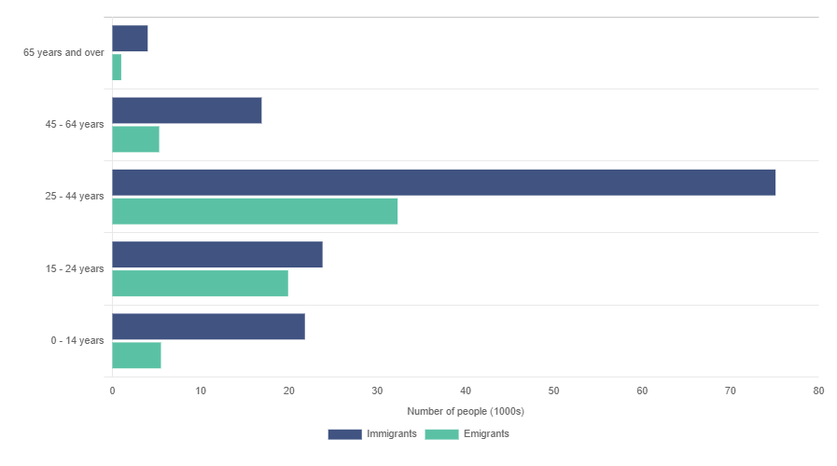
Migrant Age Distribution, 2023
53% of immigrants and 50% of the emigrants aged 25-44
31% of emigrants and 17% of immigrants aged 15-24
15% of immigrants and 9% of emigrants aged 0-14

Slide 10
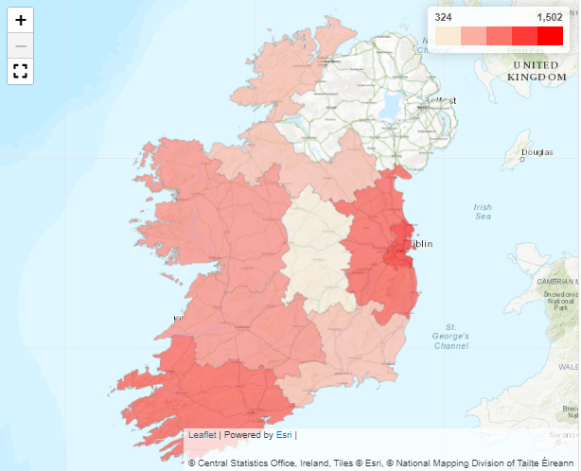
Regional Population Distribution, 2023
1.5 million people usually resident in Dublin
780,000 in the Mid-East
760,000 in the South-West
325,000 in the Midlands
430,000 in the Border
470,000 in the South-East
500,000 in the West
520,000 in the Mid-West

Slide 11
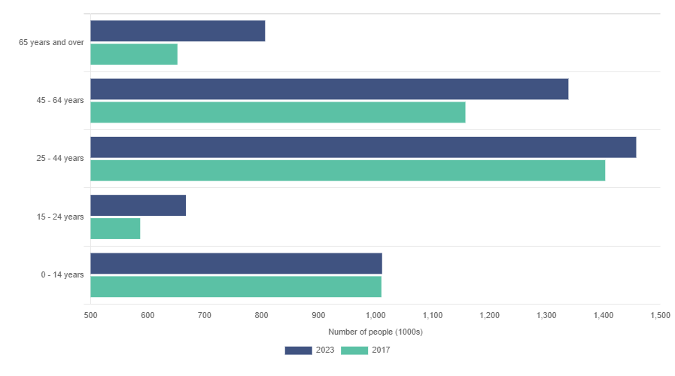
Population Age Distribution, 2017 vs 2023
Over 800,000 people in Ireland aged 65+, this is a volume increase of over 150,000 since 2017
1.3 million people now aged 45-64, a volume increase of over 180,000 since 2017
Similar volume of the population aged 0-14 and 25-44 between 2017 and 2023

Slide 12
Estimated Population by Citizenship
 | Broad citizenship breakdown
Citizenship
 | 2017 | 2018 | 2019 | 2020 | 2021 | 2022 | 2023
 | Persons ('000)
Irish | 4245.3 | 4292.3 | 4336.5 | 4384.8 | 4430.8 | 4495.4 | 4524.6
Non-Irish | 565.6 | 592.6 | 622 | 645.1 | 643.9 | 688.6 | 757
 | %
Irish | 88.2% | 87.9% | 87.5% | 87.2% | 87.3% | 86.7% | 85.7%
Non-Irish | 11.8% | 12.1% | 12.5% | 12.8% | 12.7% | 13.3% | 14.3%

Slide 13
Next Major Output – Population Projections 2023/2024 timeline
September 2023
Q4 2023
Q1 2024
Q2 2024
2023 URESPOP estimated
Formation of expert group
Agree on assumptions
CSO Projections Published
Series revised and published
Mortality
Fertility
Migration

Slide 14
demography@cso.ie
Population Estimates and Projections
Central Statistics Office
Ireland

