Slide 1
SearchAndDelete
Ivo handzhiyski f104792

Slide 2
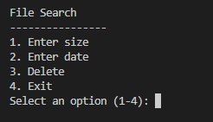
Introduction
The File Search script is a Bash script designed to help users search for files based on their size, creation date, and delete files if needed. It provides a simple menu-driven interface for ease of use.

Slide 3
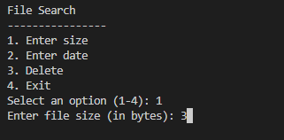
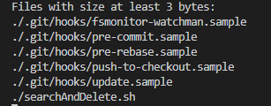
Search by size
The first option allows you to search files by size

Slide 4
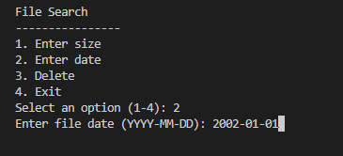
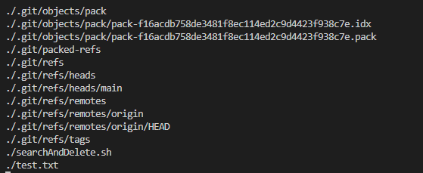
Search by Date
Second option allows you to search all the files by the Date (after creation)

Slide 5
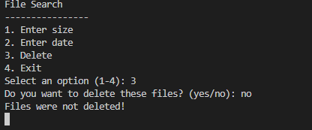

Delete
Third option allows you to delete the files

Slide 6
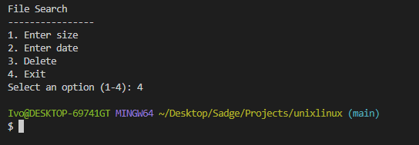
Exit
And lastly but not least, the 4th option allows you to exit the program

Slide 7
Thank you for your attention

