Slide 1
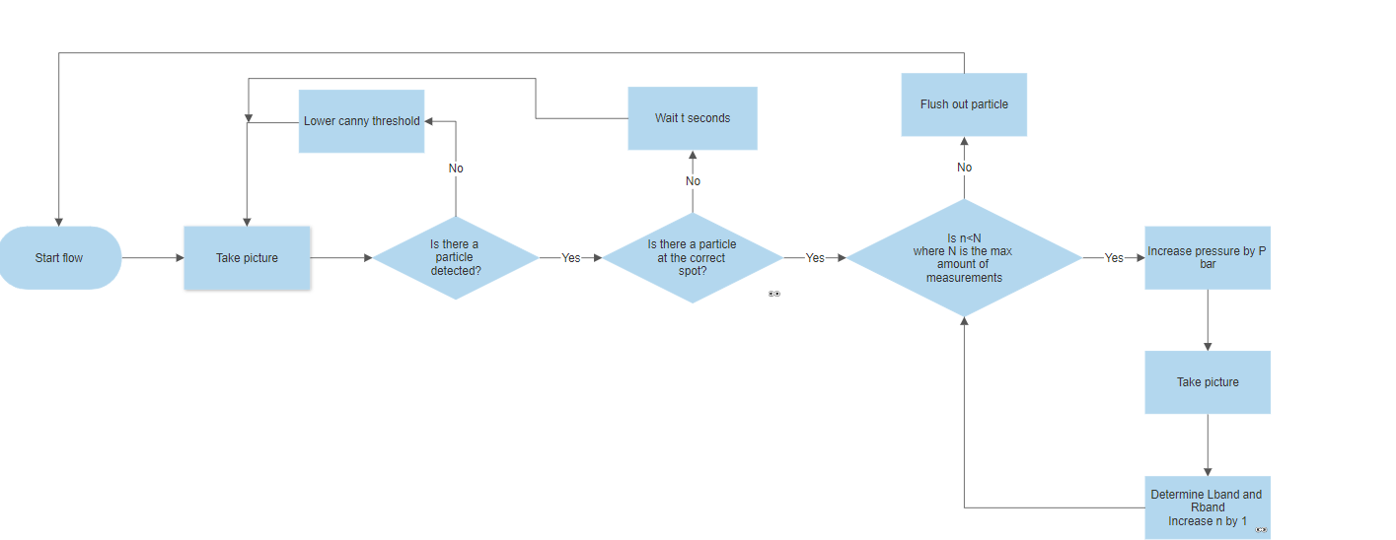
Flow chart

Slide 2
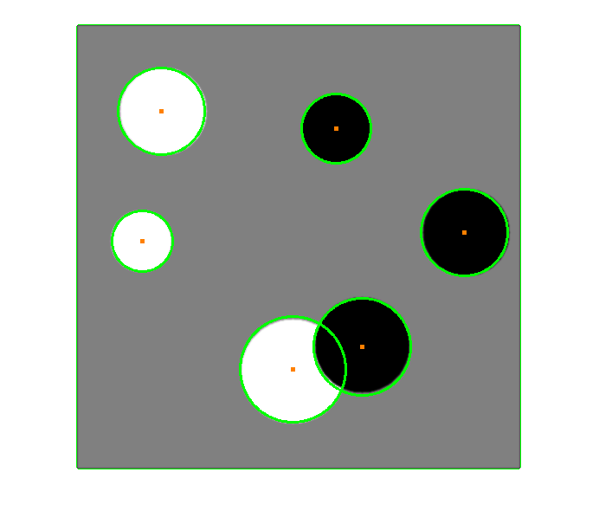
Using houghlines/houghcircles

Slide 3

Bad quality

Slide 4
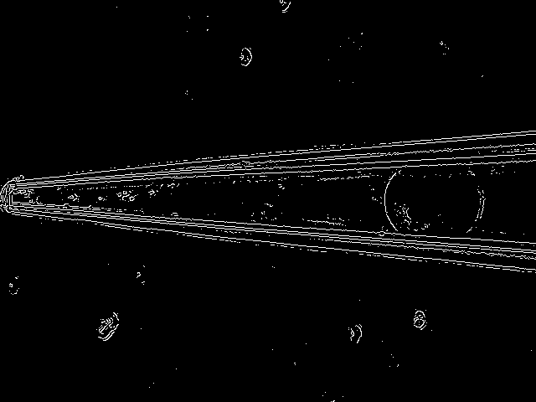
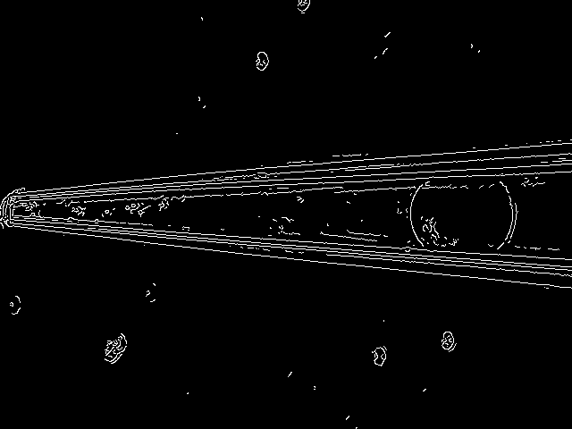
Canny edges
Ap=3 50/50
Ap=5 500/600

Slide 5
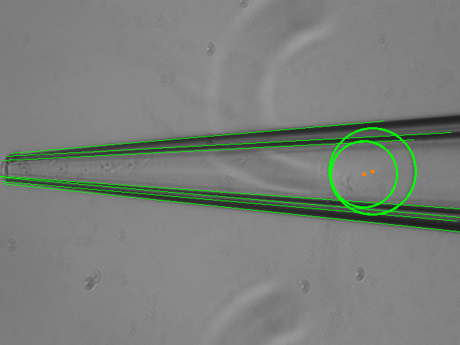
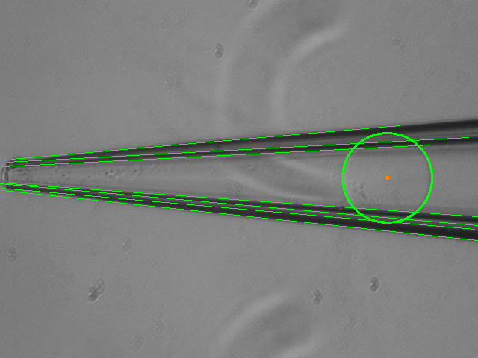
Ap=5 param=43
Ap=5 param=44

Slide 6
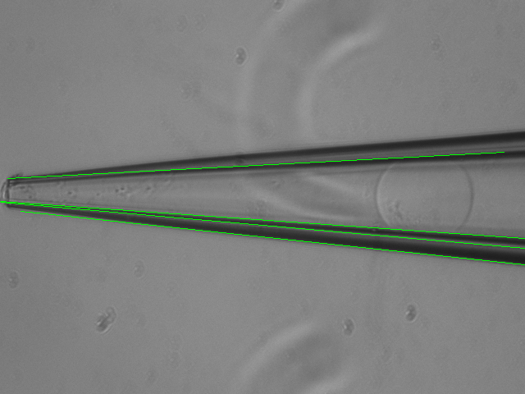
What is the right Rband?

Slide 7
Questions
What exact pressure pump is used/how to control it?
What exact camera is used/how to control it?
What exactly is Rband?
Is the capillary constantly at the same place or does it move?

Slide 8
15-02
Comments:
Understand the python functions/parameters
Create github/surfdrive accounts
Look into labview
Use raspberry pi to control or laptop?

Slide 9
Current approach-A
Detect if particle is at the right place
Take a picture
Check if particle is detected and save center coordinates
Wait for time t
Take a picture
Check if particle is detected and compare center coordinates

Slide 10
Current Approach-B
Determining L-band/R-band
Detect the capillary walls and create lines
Detect particle by drawing 2 circles
Determine L-band from intersection of circles and wall-line
Possible improvement: detect particle by drawing 2 ellipses

Slide 11
19-2

Slide 12
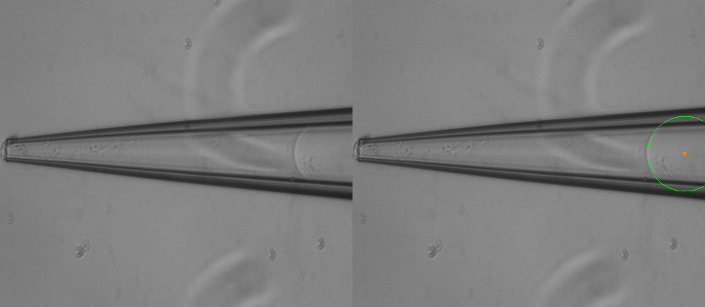
Detect 2 sides separately-left

Slide 13
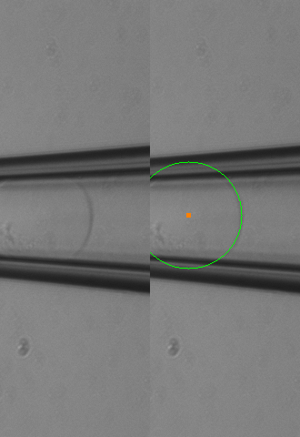
Detect 2 sides separately-right

Slide 14
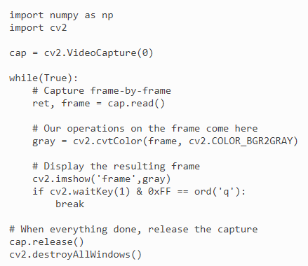
Using live-feed or videos

Slide 15
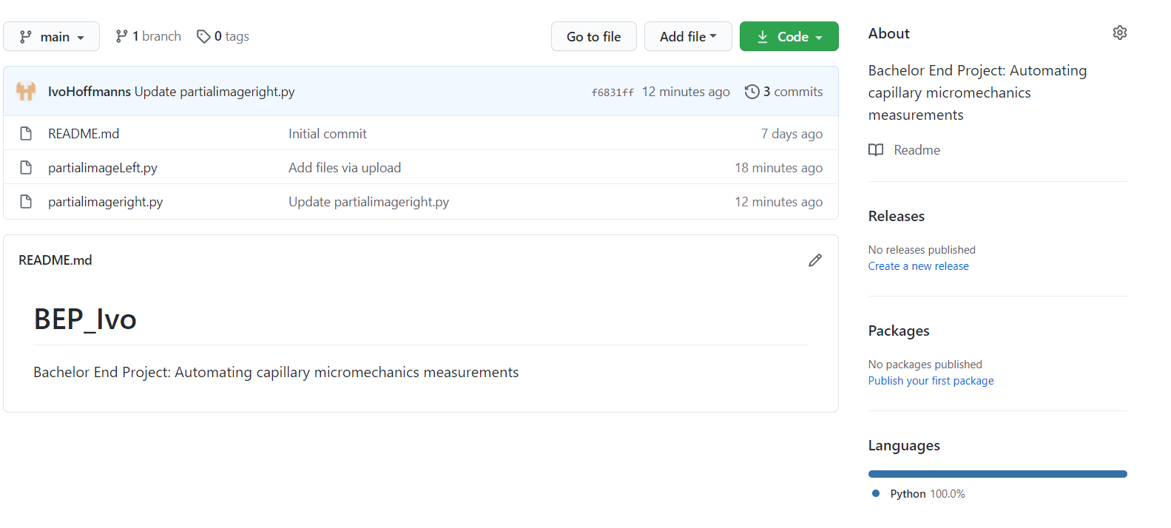
Github

Slide 16
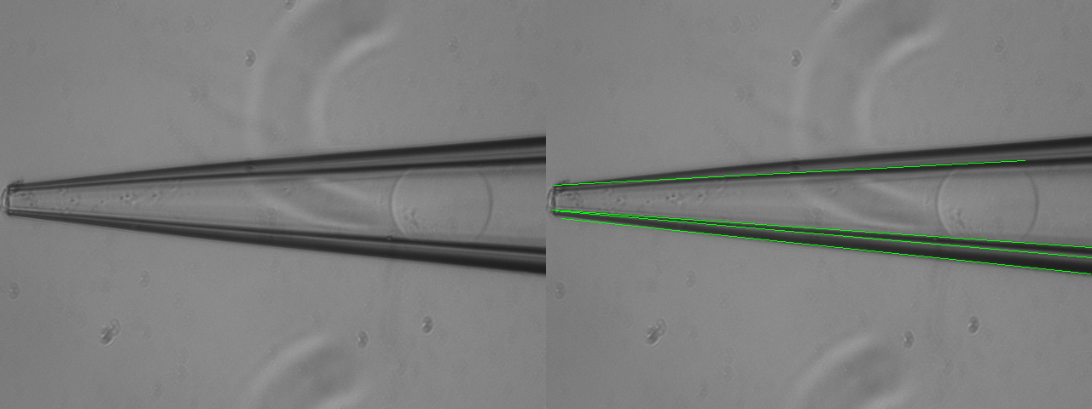
How to select line?

