Slide 1

Fundamentals Test Process
QA
Fundamentals
SoftUni Team
Technical Trainers
Software University
http://softuni.bg

Slide 2

Table of Contents
Fundamental Test Process
Test Planning and Control
Test Analysis and Design
Test Implementation and Execution
Evaluating Exit Criteria and Reporting
Test Closure Activities

Slide 3
Test Plan
Begin
Test Planning and Control
Test Analysis and Design
Test Implementation and Execution
Evaluating Exit Criteria and Reporting
Test Closure Activities
End

Slide 4

Test Planning and Control

Slide 5

Test Plan
The results from the planning activities should be documented in a test plan
The test plan is a formal document that describes how tests will be performed
List of test activities to be performed to ensure meeting the requirements
Features to be tested, testing approach, schedule, acceptance criteria

Slide 6

Planning of The Resources
Necessary resources:
Which employees are needed, for what, when?
How much time is needed?
Which tools, equipment and utilities?
Necessary training of the employees
Organizational structure
With the appropriate test management

Slide 7

Test Control
Monitoring of the test activities
Comparing with the plan
Reporting status of deviations from the plan
Taking actions for correction
Updating the test plan according to the feedback

Slide 8
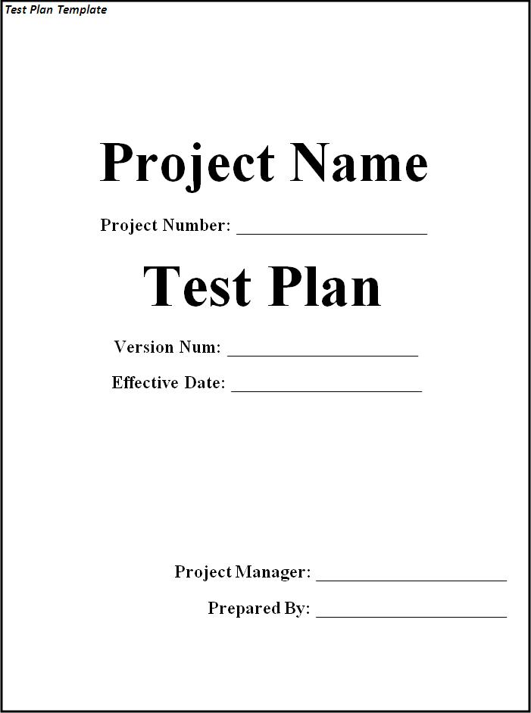
Example
Test plans usually are written with templates
Example test plan

Slide 9

Test Analysis And Design

Slide 10
Test Analysis And Design
Identify test conditions
Product specification may not be testable
Defining what should be tested starts with reviewing the test basis
Designing test cases

Slide 11
Designing Test Cases
According to the level of concreteness test cases can be logical and concrete
Logical test cases
They have to be defined first
Do not include concrete input/output values
Concrete test cases
The actual inputs that are chosen
Priority of the next phase of the test proces

Slide 12
Designing Test Cases (2)
Initial situation (precondition) must be described
Needed environmental conditions
Which results and behavior are expected
Outputs
Changes to global (persistent) data and states
Any other consequences of the test case

Slide 13
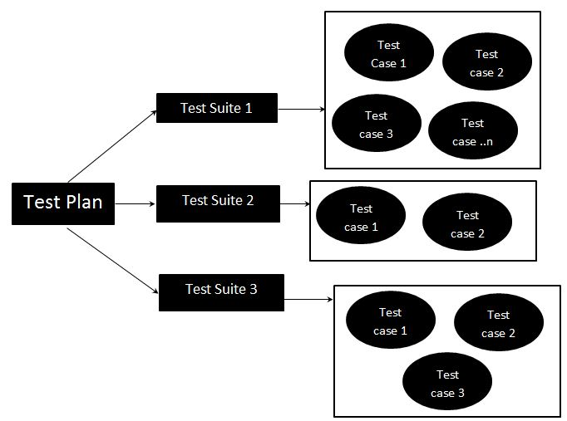
Test Suites
Test cases can be part of a Test suite
Test suite is a group of similar Test cases
Login functionality test cases leads to Login test suite
Test suites can be
Abstract test suites
Executable test suites

Slide 14
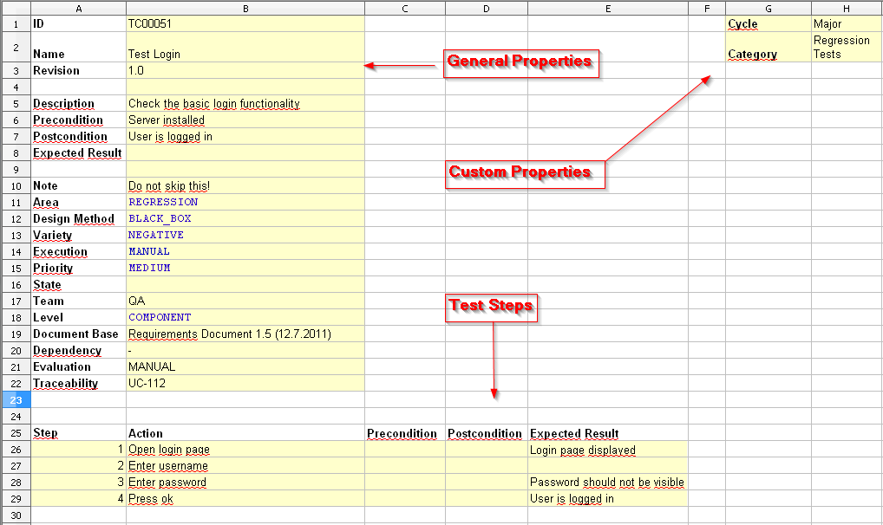
Test Case
Sequence of steps to check the correct behavior
At least two cases to fully test a requirement
A positive test
A negative test
Consist of
Title
Steps to follow
Expected result

Slide 15

Test Case (2)
Optionally may consist of
ID
Description
Related requirements
Test category
Author
Is automated
Pass/fail

Slide 16
Test Case (3)
Example test case
Step No: 1
Step description: Login to the app with user: “XXX” and password: “YYY”
Expected result: Home page is displayed
Step No: 2
Step description: Click “Logout”
Expected result: Login page is displayed

Slide 17

Test Implementation and Execution

Slide 18

What This Phase Includes?
Test conditions and logical test cases are transformed into concrete test cases
The environment is set up to support the test execution activity
Tests are executed and logged

Slide 19
Test Execution
How the tests will be executed?
Follows the priority of the test cases set in the test plan
Grouping test cases into test suites
For efficient test execution
For easier overview
Time pressure may cause running just a subset of all tests
Having tests prioritized is important

Slide 20
Test Execution
How the tests will be executed?
Follows the priority of the test cases set in the test plan
Grouping test cases into test suites
For efficient test execution
For easier overview

Slide 21
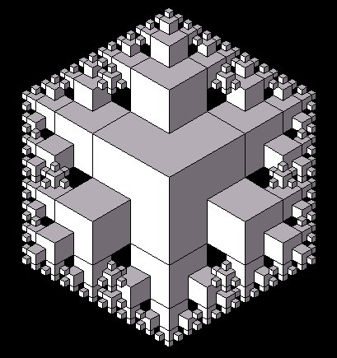
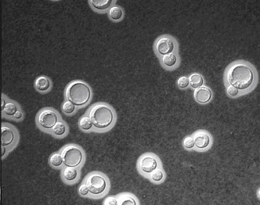
Reproducibility
The tests must be easily repeated
Test environment
Input data
Test logs
Etc.

Slide 22

Failure Found?
Is it really a failure?
Erroneous or inexact test specification
Problematic test infrastructure or test case
Incorrect test execution
If it is a failure:
The failure must be documented
Rough analysis of possible causes
Additional test cases might be required

Slide 23
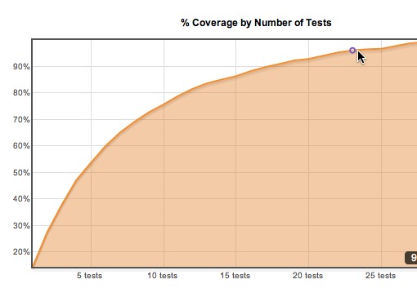
Evaluating Exit Criteria and Reporting

Slide 24

Exit Criteria
What is exit criteria?
The set of generic and specific conditions for permitting a process to be officially completed
Agreed upon with the stakeholders
Used to report against and to plan when to stop testing

Slide 25
Exit Criteria - Example
100% statement coverage
100% requirement coverage
all screens / dialogue boxes / error messages seen
100% of test cases have been run
100% of high severity faults fixed
80% of low & medium severity faults fixed
maximum of 50 known faults remain
maximum of 10 high severity faults predicted
time has run out
testing budget is used up

Slide 26

Test Summary Report
Summary reports might have different size
Simple message to the project manager
Used in lower level tests
E.g., component tests
Formal reports for the stakeholders
Used in higher-level tests
E.g., integration tests, system tests

Slide 27

Test Closure Activities

Slide 28

Test Summary Report
The experience gathered should be analyzed and made available for further projects
Achieved results
Unexpected events
What were their causes?
Open change requests
Why were they not implemented?
User acceptance after deploying

Slide 29
Exercises
Which activity in the fundamental test process creates test suites for efficiency of testing?
Implementation and execution
Planning and control
Analysis and design
Test closure

Slide 30
Exercises
What is the purpose of exit criteria?
To define when a test level is complete
To determine when a test has completed
To identify when a software system should be retired
To determine whether a test has passed

Slide 31
Exercises
Which is not a test Oracle
The existing system (for a benchmark)
The code
Individual’s knowledge
User manual

Slide 32
Exercises
Reviewing the test basis is a part of which phase
Test Analysis and Design
Test Implementation and execution
Test Closure Activities
Evaluating exit criteria and reporting

Slide 33
Exercises
A test plan defines
What is selected for testing
Objectives and results
Expected results
Targets and misses

Slide 34
Exercises
Which of the following is most important to promote and maintain good relationships between testers and developers?
Understanding what managers value about testing
Explaining test results in a neutral fashion
Identifying potential customer workarounds for bugs
Promoting better quality software whenever possible

Slide 35
Exercises
Which of the following is not a part of the Test Implementation and Execution Phase
Creating test suites from the test cases
Executing test cases either manually or by using test execution tools
Comparing actual results
Designing the Tests

Slide 36

Summary
…
…
…
Test Planning and Control
Test Analysis and Design
Test Implementation and Execution
Evaluating Exit Criteria and Reporting
Test Closure Activities

Slide 38
Diamond Partners

Slide 39
Diamond Partners

Slide 40





Trainings @ Software University (SoftUni)
Software University – High-Quality Education, Profession and Job for Software Developers
softuni.bg
Software University Foundation
http://softuni.foundation/
Software University @ Facebook
facebook.com/SoftwareUniversity
Software University Forums
forum.softuni.bg

Slide 41

License
This course (slides, examples, demos, videos, homework, etc.) is licensed under the "Creative Commons Attribution-NonCommercial-ShareAlike 4.0 International" license

