Slide 1

Schwarz it bulgaria
CSS Advanced: SCSS, Media Queries
Sofia, 2022

Slide 2
Agenda
What are CSS Preprocessors?
SCSS/SASS
Media Queries
Demo

Slide 3
What are css preporcessors?

Slide 4
What are CSS Preprocessors?
CSS preprocessors are scripting languages that extend the default capabilities of CSS. They enable us to use logic in our CSS code, such as variables, nesting, inheritance, mixins, functions, and mathematical operations. CSS preprocessors make it easy to automate repetitive tasks, reduce the number of errors and code bloat, create reusable code snippets, and ensure backward compatibility
List of Preprocessors
SASS/SCSS
LESS
Stylus

Slide 5
Scss/SASS

Slide 6
Add Sass to your project
You can install Sass on Windows, Mac, or Linux by downloading the package for your operating system from GitHub and adding it to PATH.
Node.js as npm package - npm install -g sass
Chocolatey package manager - choco install sass
Homebrew package manager - brew install sass/sass/sass

Slide 7
Features
Variables
Nesting
Partials
Modules
Mixins
Extend/Inheritance
Operators

Slide 8
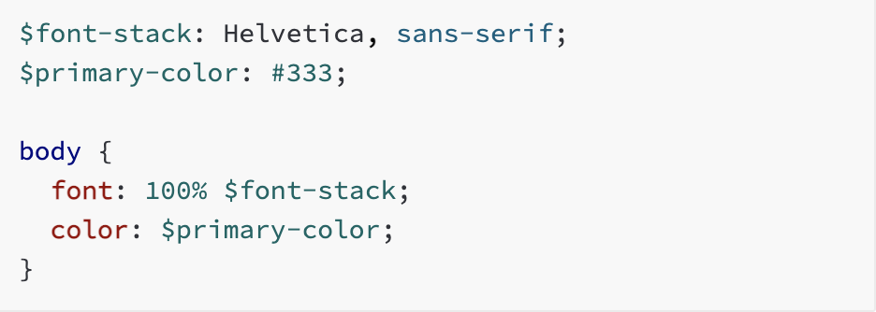
Variables
Variables are a way to store colors, font, stacks and other csss values. Sass uses the $ symbol to make something a variable.

Slide 9
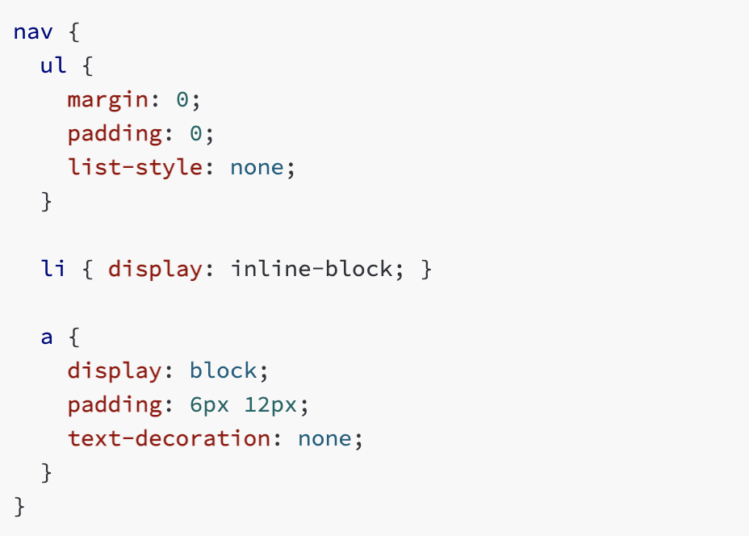
Nesting
Sass provides you with nesting that follows the same visual hierarchy of Html. It is important not to overly nest and not create over-qualified CSS that is hard to read and maintain

Slide 10
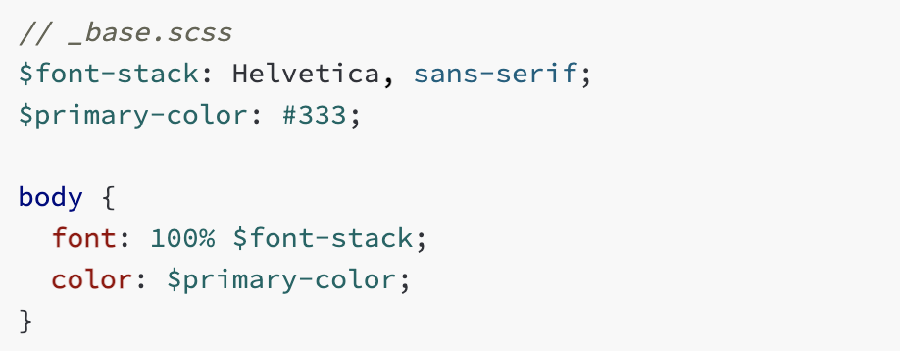
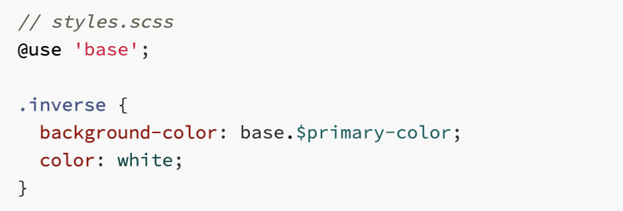
Partials and Modules
You can create partial Sass files that contain little snippets of CSS that you can include in other Sass files. A partial is a Sass file named with a leading underscore. You might name it something like _partial.scss. The underscore lets Sass know that the file is only a partial file and that it should not be generated into a CSS file. Sass partials are used with the @use rule.

Slide 11
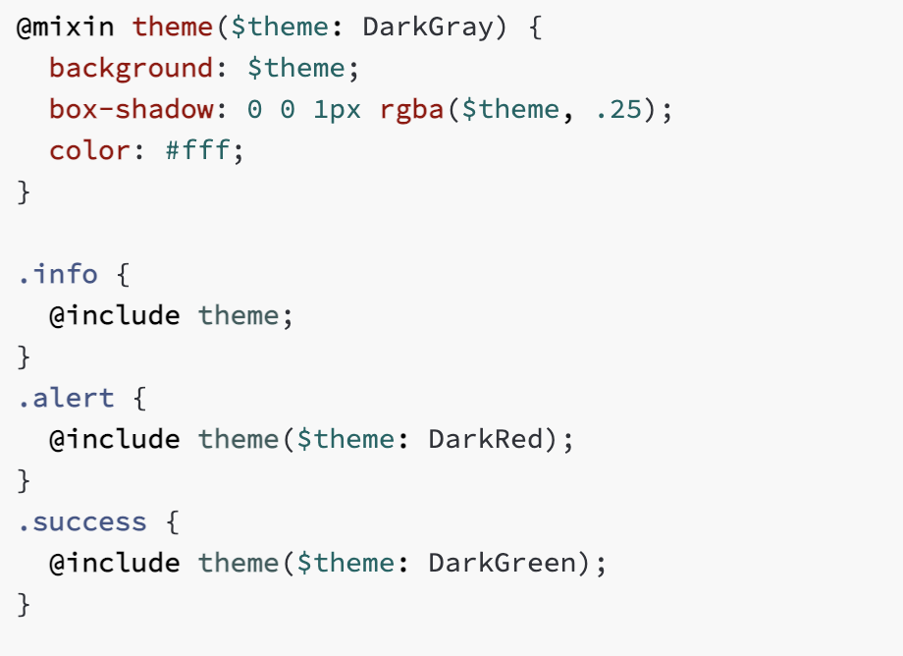
Mixins
Things in CSS are a bit tedious to write, especially with CSS3 and the many vendor prefixes that exist. A mixin lets you make groups of CSS declarations that you want to reuse throughout your site. You can even pass in values to make your mixin more flexible.

Slide 12
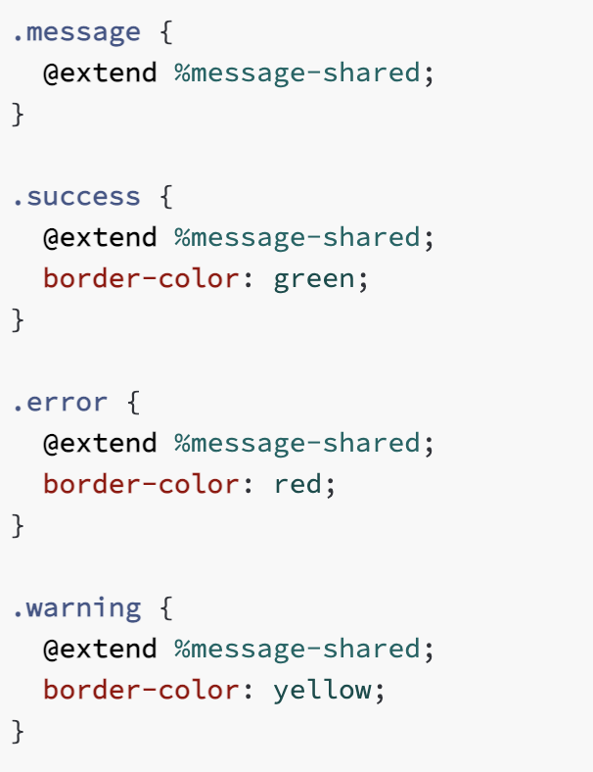
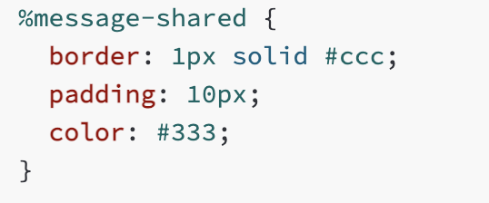
Extend/Inheritance
Using @extend lets you share a set of CSS properties from one selector to another. A placeholder class is a special type of class that only prints when it is extended, and can help keep your compiled CSS neat and clean.

Slide 13
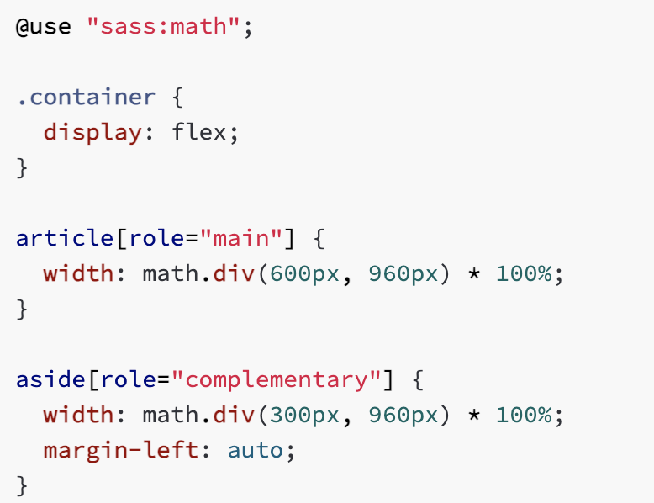
Operators
Sass has a handful of standard math operators like +, -, *, math.div(), and %

Slide 14
MEDIA QUERIES

Slide 15
Mobile First Design/Development
Coined by Luke Wroblewski in 2009 and made famous by the CEO of Google, Eric Schmidt, in 2010, Mobile First Design/Development refers to the practice of designing for mobile first. Essentially, the aim of mobile first is to switch the workflow from tackling desktop designs first and addressing the mobile design head on, working towards the desktop version as the project evolves.

Slide 16
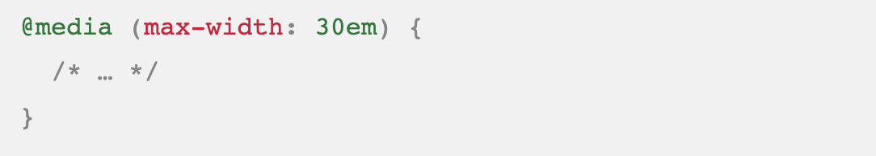
Media Queries
Media queries are used when the css needs to be modified based on a device’s general type or specific characteristics and parameters. A media query has a type and a feature. The type if not defined is always all. In the past there we additional types such as tv, projection braille and others; now they are deprecated and only all, print and screen have remained.

Slide 17
Media Features
any-hover
any-pointer
aspect-ration
color
color-gamut
color-index
device-aspect-ratio
device-height
device-width
display-mode
dynamic-range
forced-colors
grid
height
hover
inverted-colors
monochrome
orientation
overflow-block
pointer
prefers-contrast
prefers-reduced-motion
resolution
scripting
update
video-dynamic-range
width

Slide 18
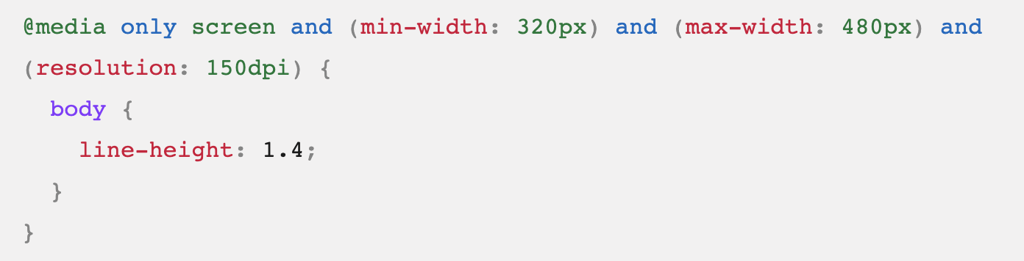
Logical operators
Media queries support logical operators. The logical operators not, and, only can be used to compose complex media query. Multiple media queries can be combined in a single rule by separating them with commas

Slide 19
DEMO

Slide 20
Sources
CSS Preprocessors:
https://developer.mozilla.org/en-US/docs/Glossary/CSS_preprocessor
https://medium.com/@raaechelb/css-precompilers-which-one-is-better-5e6ba831c0ed
SCSS/SASS
https://sass-lang.com/
Media Queries
https://developer.mozilla.org/en-US/docs/Web/CSS/@media#media_types

Slide 21
Thank you for your attention!

