Slide 1
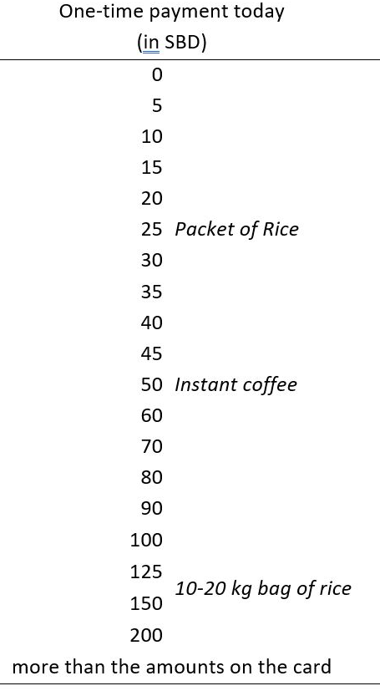
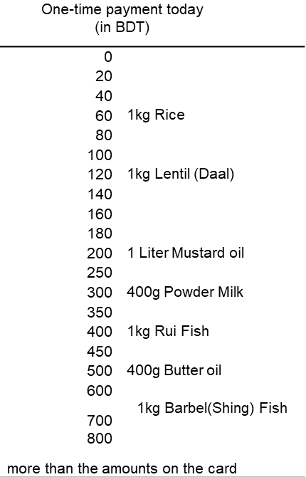
A Solomon Islands
B Bangladesh

Slide 2
One-time payment today (in BDT)
0
20
40
60 | 1kg Rice
80
100
120 | 1kg Lentil (Daal)
140
160
180
200 | 1 Liter Mustard oil
250
300 | 400g Powder Milk
350
400 | 1kg Rui Fish
450
500 | 400g Butter oil
600 | 1kg Barbel(Shing) Fish
700 800
more than the amounts on the card

