Slide 2
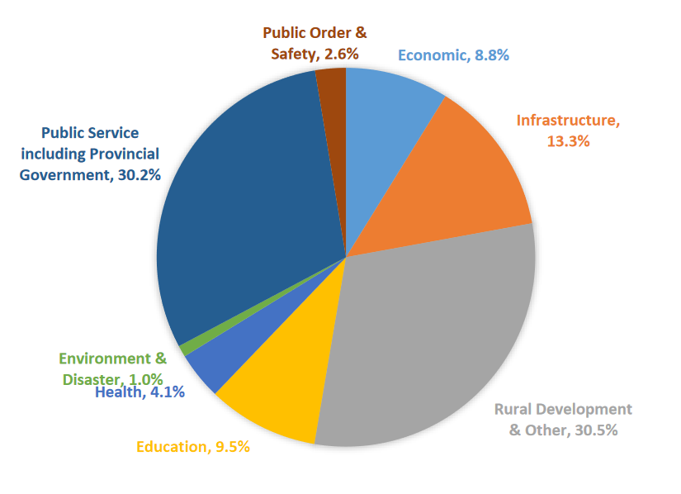
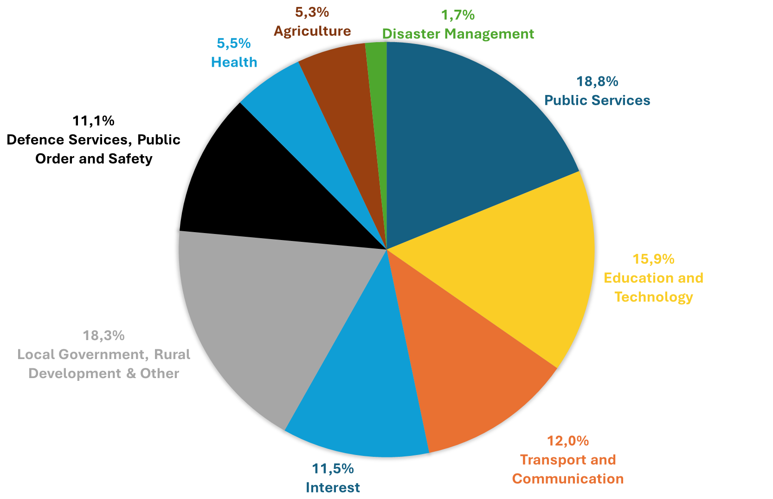
A Solomon Islands (2018)
B Bangladesh (2021-22)

