Slide 2
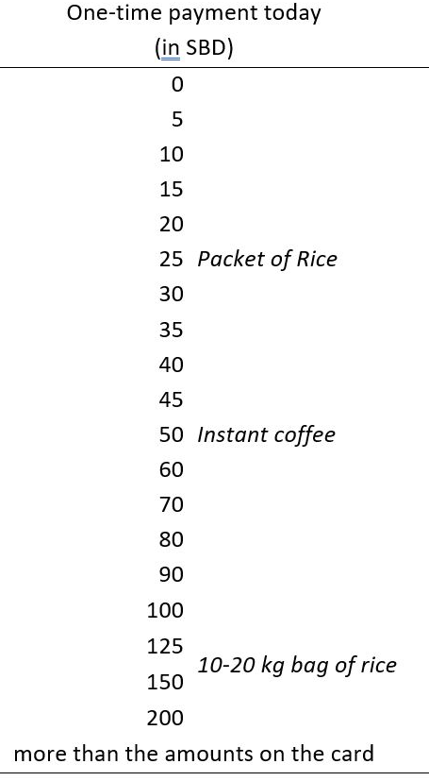
A: Payment Card
B: WTP distribution

Slide 3
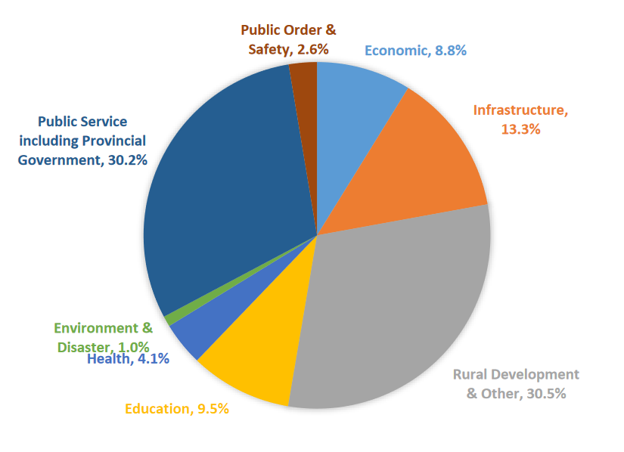
A: Development budget spending in 2018
B: Increases in budget spending on Environment & Disaster management

