Slide 1

Ivory Blakley
7 November 2018
Charlotte Bots and AI

Slide 2
Overview
I wish more people would do Kaggle challenges with me.
Why you might want to
How to get started
I wish more people were fluent with git.
My git journey
Why I didn’t like git and why I love it now.
Your git journey
don’t memorize a string of commands: understand the model
see the immediate benefits, not just the big ones
a GUI is a crutch, you have to learn the words
a few notes about teams and workflows

Slide 3
Overview
I wish more people would do Kaggle challenges with me.
Why you might want to
How to get started
I wish more people were fluent with git.
My git journey
Why I didn’t like git and why I love it now.
Your git journey
don’t memorize a string of commands: understand the model
see the immediate benefits, not just the big ones
a GUI is a crutch, you have to learn the words
a few notes about teams and workflows

Slide 4
Kaggle
Online platform for data science / ML
sandbox, chance to practice skills from classes in a closer-to-realistic level than “homework”.
A chance to showcase skills in a public-facing place.
Competitions are a very convenient unit for coming together in small groups for focused practice/discussion.

Slide 5





Kaggle’s “progression system”
Easy:
“novice” sign up
“contributor” 2 hour checklist
Real work and prestige:
Competitions
Kernels
Discussions
Expert
Master
Grandmaster
see more: https://www.kaggle.com/progression

Slide 6
Kaggle’s “progression system”
Easy:
“novice” sign up
“contributor” 2 hour checklist
Real work and prestige:
start by getting here
Competitions
Kernels
Discussions
see more: https://www.kaggle.com/progression

Slide 7
Kaggle’s “progression system”
Easy:
“novice” sign up
“contributor” 2 hour checklist
Real work and prestige:
start by getting here
Competitions
Kernels
Discussions
Competitions are a dataset with a little background and an objective.
Scoring parameters vary by competition, often scoring is based entirely on your results submission, generally a two-column table of sample and prediction. Scoring may not involve your kernel at all.
Gives you a very direct comparison against other programmers.
see more: https://www.kaggle.com/progression

Slide 8
Kaggle’s “progression system”
Easy:
“novice” sign up
“contributor” 2 hour checklist
Real work and prestige:
start by getting here
Competitions
Kernels
Discussions
Kernels are jupyter notebooks, R notebooks, R scripts, etc.
Kernels are little analysis programs that you write and run through Kaggle
easiest way to showcase your skills.
Can be shared between users.
Can be “forked”, or copied, from other users.
Kernels do not have to be associated with a competition.
In some competitions the kernel is judged (subjective).
see more: https://www.kaggle.com/progression

Slide 9
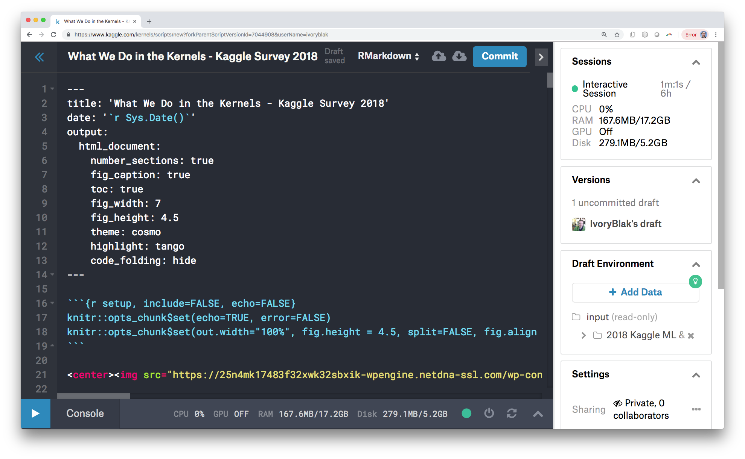
The kernel work environment
gives you some computing power and allows you to work with real data from a chrome book.
You don’t have to edit this here.
Version control reminiscent of git…
but not git.
Notes:
we’ll touch on this ”versions” bit when we talk about git.
For now, lets resume the kaggle tour.

Slide 10
Kaggle’s “progression system”
Easy:
“novice” sign up
“contributor” 2 hour checklist
Real work and prestige:
start by getting here
Competitions
Kernels
Discussions
Discussions are pretty much what they sound like.
judging for discussions is subjective, generally based on other users responses.
allow you to display a lot of insight, but are not exactly a good ‘showcase’ tool.
see more: https://www.kaggle.com/progression

Slide 11
Kaggle’s “progression system”
Easy:
“novice” sign up
“contributor” 2 hour checklist
Real work and prestige:
start by getting here
Competitions
Kernels
Discussions
Not all datasets are part of a competition.
Users can add data sets.
There is no progression or ranking associated directly with datasets.
Datasets
see more: https://www.kaggle.com/progression

Slide 12
Kaggle’s “progression system”
Easy:
“novice” sign up
“contributor” 2 hour checklist
Real work and prestige:
start by getting here
Competitions
Kernels
Discussions
“Learn”
Similar to Coursera, EdX, Udemy, etc.
Kaggle offers online courses on topics in data science.
The course materials are hosted on kaggle in the form of Kernels, Discussions, etc.
see more: https://www.kaggle.com/progression
Notes:
I have not used this, but I have heard a couple say they have they liked it.

Slide 13

To get started…
(do these in any order)
Explore the site, reach “contributor”
Look for a competition or dataset that you think is interesting
Get your feet wet playing with the data.
Come find friends at one of our Kaggle meetups.

Slide 14

Overview
I wish more people would do Kaggle challenges with me.
Why you might want to
How to get started
I wish more people were fluent with git.
My git journey
Why I didn’t like git and why I love it now.
Your git journey
don’t memorize a string of commands: understand the model
see the immediate benefits, not just the big ones
a GUI is a crutch, you have to learn the words
a few notes about teams and workflows

Slide 15
Git is…
Distributed version control system --unlike svn, which is centralized version control system
A snapshot of your repository is stored as a series of changes, or “commits”.
Git can store any type of file, but some features (such as showing diffs) only work with text-based files.

Slide 16
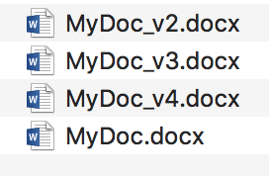



Styles of Version Control
instant update, no save button
click save, overwriting existing copy
saves when you click “commit”
selectable version history
no associated messages
commit and run are sometimes tied
Git really shines when changes in multiple files need to be linked as one change.

Slide 17




note: git is not GitHub. GitHub is a hosting service.
There are many hosting services.
By the far the most popular are
(older logo)
recently purchased by Microsoft
see more: https://www.git-tower.com/blog/git-hosting-services-compared/

Slide 18


note: git is not GitHub. GitHub is a hosting service.
There are many hosting services.
By the far the most popular are
Both offer free accounts.
Both offer private repositories.
Both support collaboration, and maintain links between forks
see more: https://www.git-tower.com/blog/git-hosting-services-compared/

Slide 19
Overview
I wish more people would do Kaggle challenges with me.
Why you might want to
How to get started
I wish more people were fluent with git.
My git journey
Why I didn’t like git and why I love it now.
Your git journey
don’t memorize a string of commands: understand the model
see the immediate benefits, not just the big ones
a GUI is a crutch, you have to learn the words
a few notes about teams and workflows

Slide 20
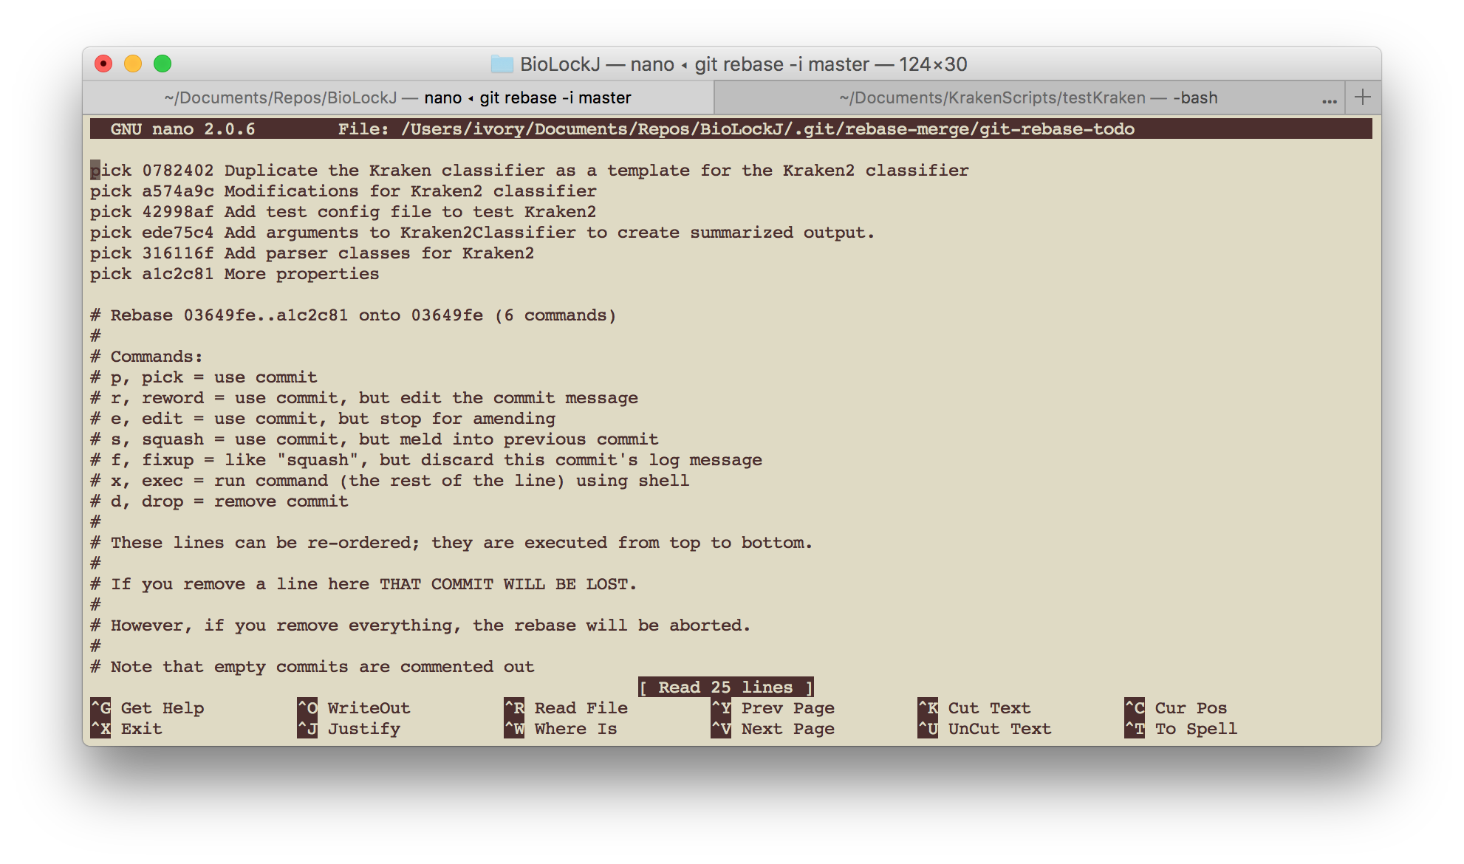
Command line text editors

Slide 21
Command line text editors
vim
default on most systems
TO EXIT:
hit escape
type “:sq”
hit enter
nano
available on most systems
you can set it as the default in the config file
to exit: (prompts are shown at the bottom of the screen)
ctrl + x
Y (to keep the file name)
hit enter (to confirm the file name)
System specific:
may or may not allow mouse control
copy paste may be restricted to key-board only OR mouse only

Slide 22
Command line text editors
vim
default on most systems
TO EXIT:
hit escape
type “:sw”
hit enter
nano
available on most systems
you can set it as the default in the config file
to exit: (prompts are shown at the bottom of the screen)
ctrl + x
Y (to keep the file name)
hit enter (to confirm the file name)
System specific:
may or may not allow mouse control
copy paste may be restricted to key-board only OR mouse only
Take the time early on to
configure your text editor and to get comfortable with it.

Slide 23
Overview
I wish more people would do Kaggle challenges with me.
Why you might want to
How to get started
I wish more people were fluent with git.
My git journey
Why I didn’t like git and why I love it now.
Your git journey
don’t memorize a string of commands: understand the model
see the immediate benefits
a GUI is a crutch, you have to learn the words
a few notes about teams and workflows

Slide 24
The git journey
I should use git
I benefit from git
I use git

Slide 25
The git journey
I use MORE git
I benefit from git
I should use git
cleaner HISTORY
More advanced git commands give you higher tiers of git benefits.
cleaner PRODUCT
cleaner PROCESS
Notes:
A process is only as valuable as the products it makes.
To start with, git has to be part of your process.
You have to have a process that is strong enough to support the higher tiers of git benefits.
Your history may be part of your product. IF that is the case, then a clean history is part of a clean product.
Examples:
Sometimes, using git only benefits my process ---this is only possible because I am already familiar with it and I like. In general, if git does not create an improvement in the product, then it is not worth the overhead. In a Kaggle project where I am just trying out a model, I might benefit from the ability to go back to earlier versions to compare to them. But I won’t keep the project long, I won’t share it, I won’t need to document WHY anything is the way it is beyond whats in my code comments.
Most often, git benefits the product. Your improved process is reflected in a clean product. You are able to deliver this product faster because you can recover from mistakes more quickly. You can track down bugs because you can return to previous versions to see which change introduced the bug. You can separate out comments that explain the code in its current form (comments in the code) from comments explaining why you changed it from how it was (the occassional detailed git commit messages).
Sometimes, your product is something you want to share with its git entirety. You want others to quickly adapt to your changes, so they need a clean history to guide them through the change. You may have other developers or deeply involved users who need to understand the complete evolution of the project. They may want to be directed to key changes of interest, such as “does this version include the fix for the rsync bug?” or “How did they fix the rsync bug? I have the same problem elsewhere.”

Slide 26
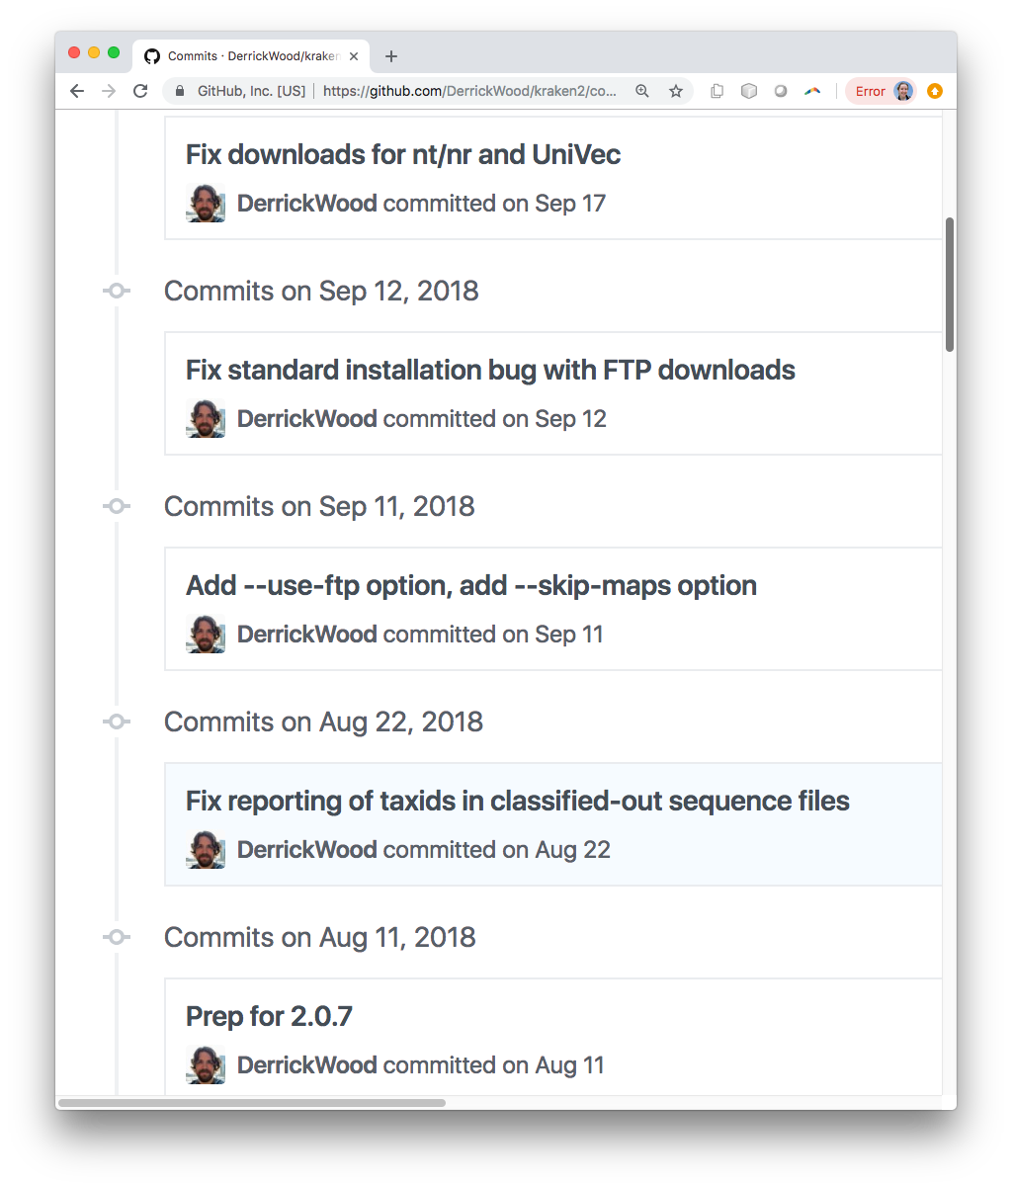
changes I don’t need
the other fix I need
the fix I need
last release
Notes:
For next slide, add history of a single file in IGB

Slide 27
The git journey
I use MORE git
I benefit from git
I should use git
cleaner HISTORY
More advanced git commands give you higher tiers of git benefits.
cleaner PRODUCT
cleaner PROCESS
Notes:
A process is only as valuable as the products it makes.
To start with, git has to be part of your process.
You have to have a process that is strong enough to support the higher tiers of git benefits.
Your history may be part of your product. IF that is the case, then a clean history is part of a clean product.
Examples:
Sometimes, using git only benefits my process ---this is only possible because I am already familiar with it and I like. In general, if git does not create an improvement in the product, then it is not worth the overhead. In a Kaggle project where I am just trying out a model, I might benefit from the ability to go back to earlier versions to compare to them. But I won’t keep the project long, I won’t share it, I won’t need to document WHY anything is the way it is beyond whats in my code comments.
Most often, git benefits the product. Your improved process is reflected in a clean product. You are able to deliver this product faster because you can recover from mistakes more quickly. You can track down bugs because you can return to previous versions to see which change introduced the bug. You can separate out comments that explain the code in its current form (comments in the code) from comments explaining why you changed it from how it was (the occassional detailed git commit messages).
Sometimes, your product is something you want to share with its git entirety. You want others to quickly adapt to your changes, so they need a clean history to guide them through the change. You may have other developers or deeply involved users who need to understand the complete evolution of the project. They may want to be directed to key changes of interest, such as “does this version include the fix for the rsync bug?” or “How did they fix the rsync bug? I have the same problem elsewhere.”

Slide 28
The git journey
I should use git
I benefit from git
I use git
I want to show you some specific examples the benefits of git.
Then I want to look at those examples in the context of the model.
Notes:
I mentioned the resume example as clean product with no history, but you may say “I already make clean documents”.
I mentioned the Kraken2 example as clean history being part of the product, but you may say ”I’m not there yet”.
So I’d like to focus on benefits to the process—something you can benefit from immediately. When I started to use git diff, and git history and git rebase, I started to love git. AND these were the keys to enjoying the benefits of a clean product, and a clean history.
Then I want to look at those examples in the context of the model.

Slide 29
The git journey
I should use git
I benefit from git
I use git
There are loads of tutorials.
I will recommend a few, but what I really recommend is:
Go through multiple tutorials
Don’t just memorize commands, understand the model
My aim here is help you understand the model so that the various resources you might go to make more sense.

Slide 30
Benefits
The unit-of-change mind set
Changes to many files are grouped in one unit of change, the “commit”.
work is never lost
“diff” visualization
easy cloud storage/backup
easy cloud-based, public-facing front
(easy) cloud-based tool integration
docker image builds, automated pipelines,
classroom tools, markup rendering, io

Slide 31
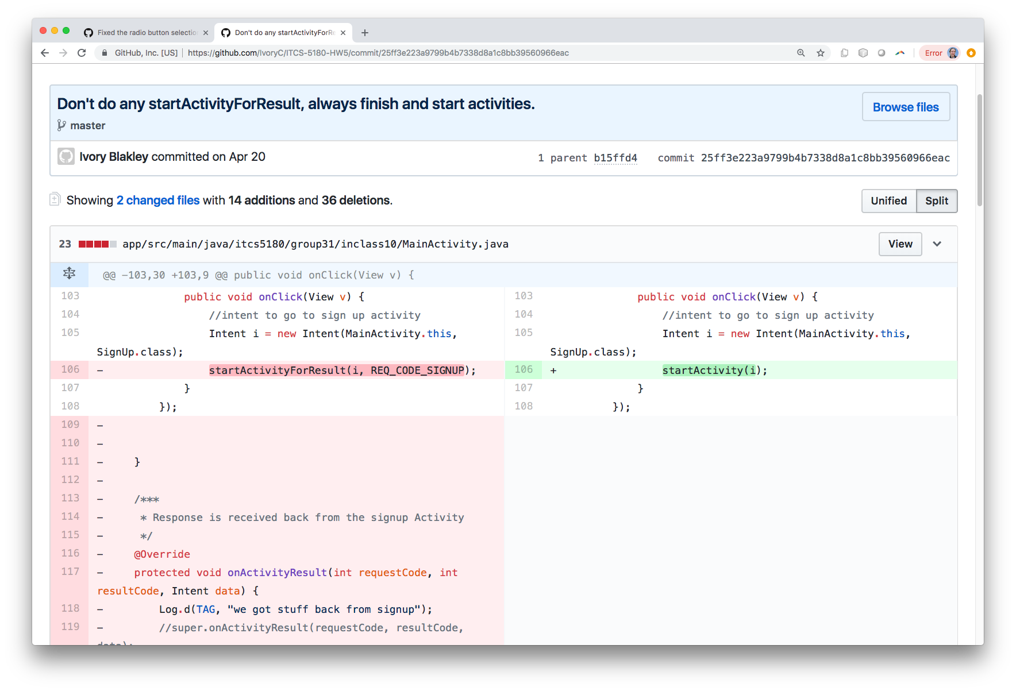
Example diff
Notes:
Discuss the frustrations of Android multi-file example

Slide 32
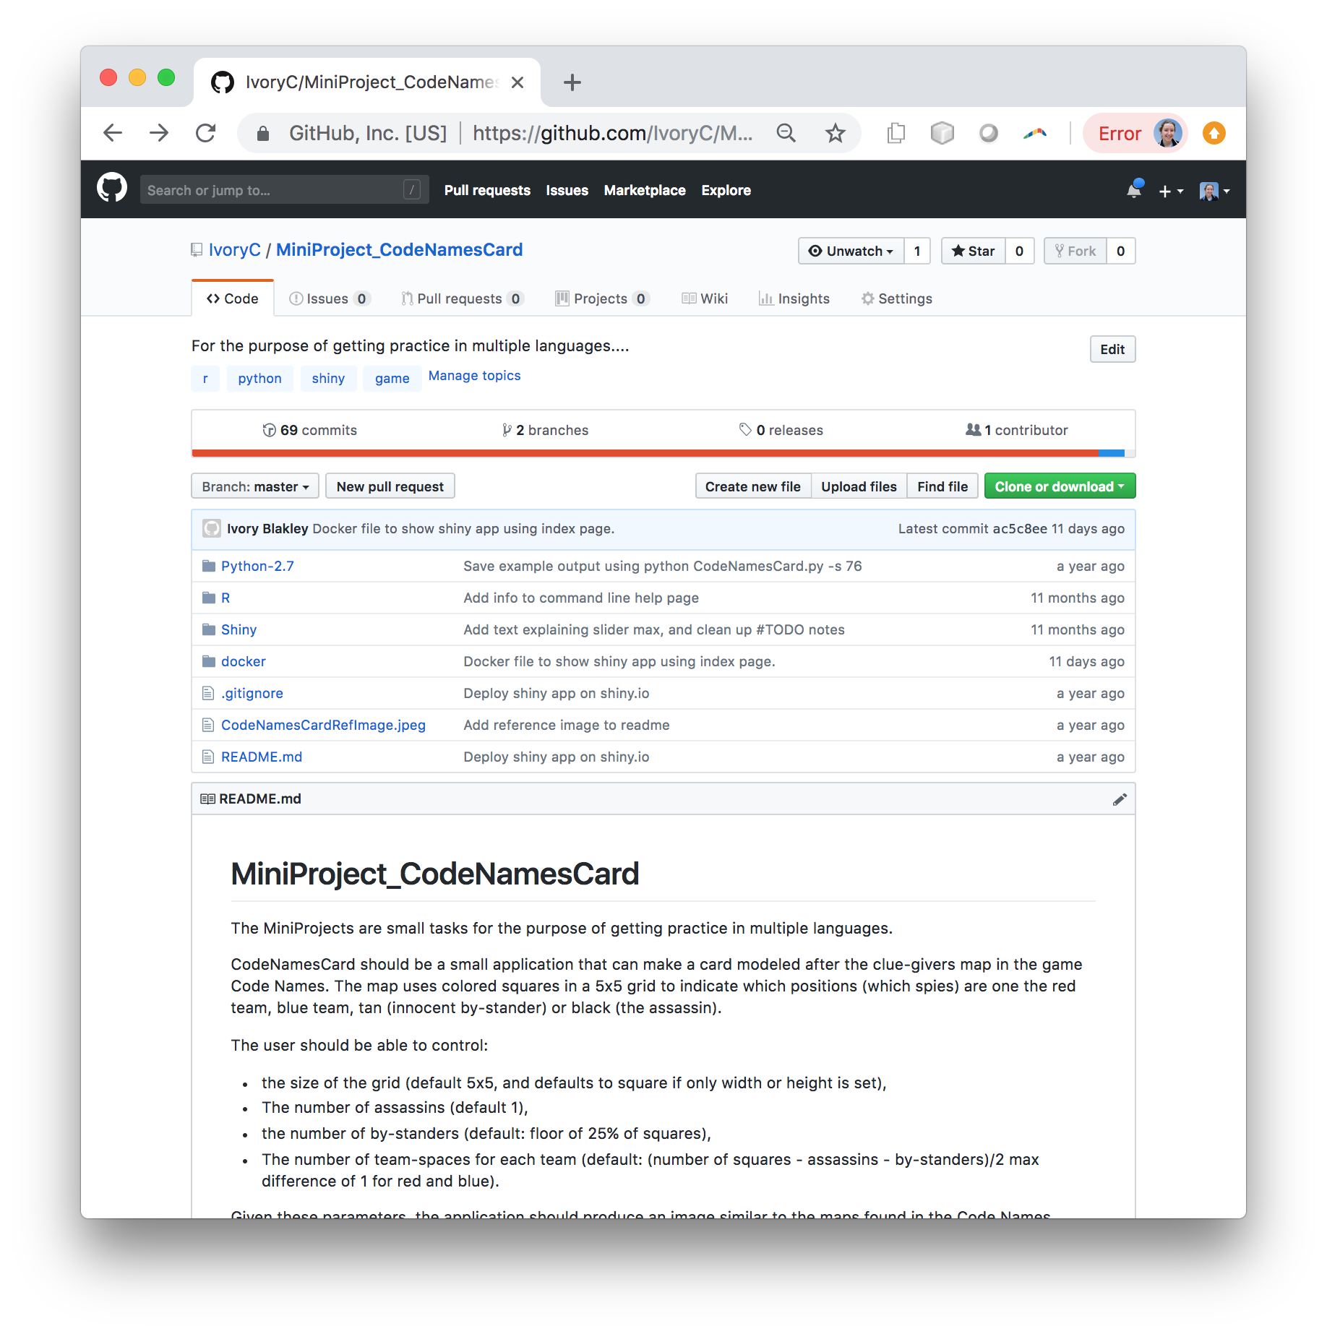
Notes:
Public facing, no web-hosting on my part.

Slide 33
the commit
The Git Model
Save changes to files.
Use git add <file> to add changes to the stage
id: 6efg453g
Use git commit –m “<meaningful message>” to solidify the stage into a commit.
changes
M
git init
Blank slate
Each commit includes a pointer the parent commit.
This trails all the way back to an initial commit, a blank slate.
The commit only contains the changes, but id:6efg453g represents a snapshot of the project.

Slide 34
The Git Model
head
master
id3
id2
id4
id3
id1
id2
id4
id1
git init <name>
Blank slate

Slide 35
The Git Model
master
head
id3
git checkout id2
id2
id4
id1
id2
git init <name>
Blank slate

Slide 36
The Git Model
master
id3
id2
id4
head
id1
id5
ifSad
git checkout –b ifSad
id5
git init <name>
Blank slate

Slide 37
The Git Model
master
id3
id2
id4
id1
id5
ifSad
git init <name>
Blank slate

Slide 38
The Git Model
master
id3
id2
id4
id1
id5
ifSad
id6
id7
id8
git init <name>
Blank slate
id6
id7
id8
myFeature
head

Slide 39
The Git Model
master
id3
id2
id4
id1
id6
id7
id8
git init <name>
Blank slate
id6
id7
id8
myFeature
head

Slide 40
The Git Model
master
id3
id2
id4
id1
git checkout myFeature
git rebase master
id7
id8
id6
git init <name>
Blank slate
id6
id7
id8
myFeature
head

Slide 41
The Git Model
master
id3
id2
id4
id1
git checkout myFeature
git rebase master
id10
id11
id9
git init <name>
Blank slate
id9
id10
id11
myFeature
head

Slide 42

Features done independently live together happily.

Slide 43
Learn Git - Resources
Hands on web tutorial of major git concepts:
https://learngitbranching.js.org/
Video series on git concepts:
Plurisight free course: https://www.pluralsight.com/courses/code-school-git-real
https://www.youtube.com/watch?v=ltzQbZrWLds&t=12s
6 videos, ~5-10 min each.
The seven rules of a great Git commit message

