Slide 1


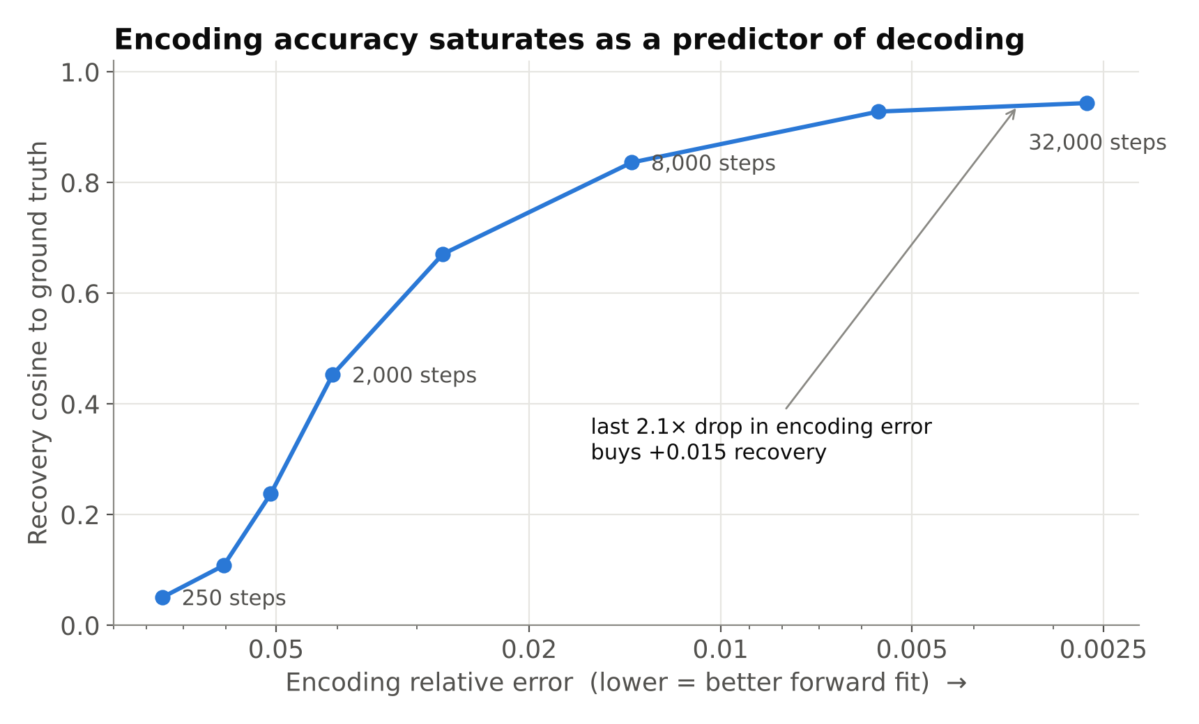
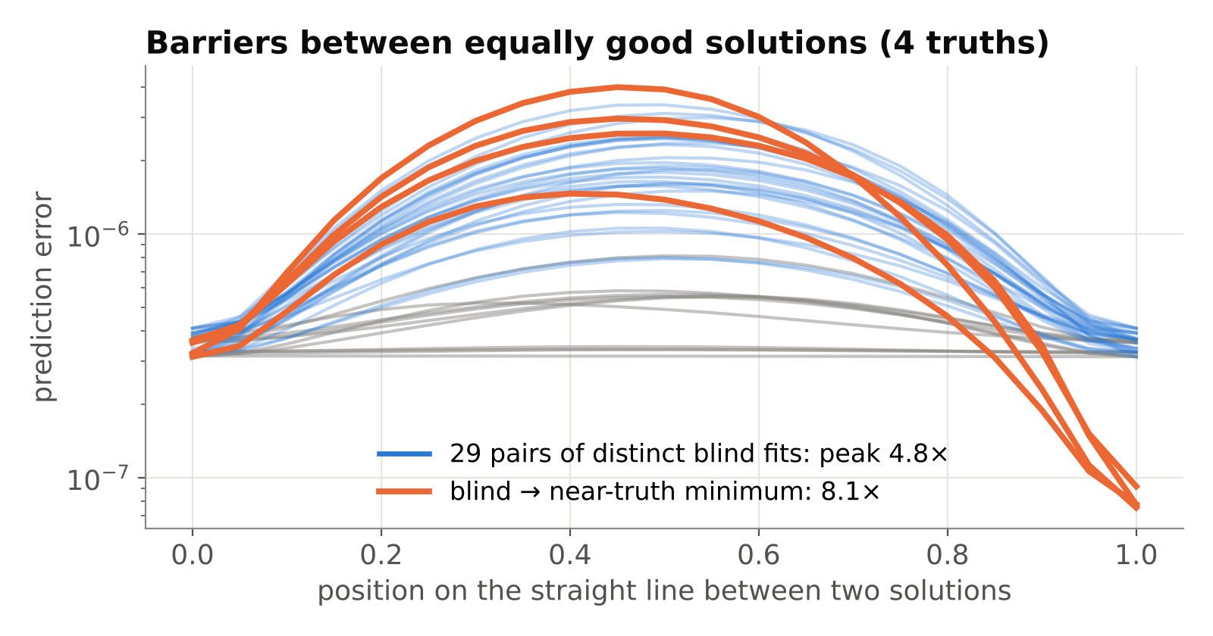
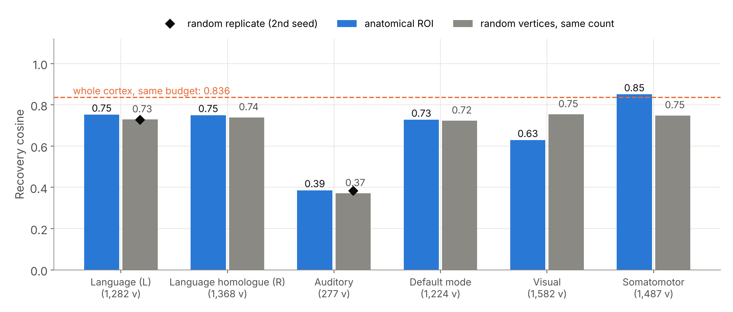
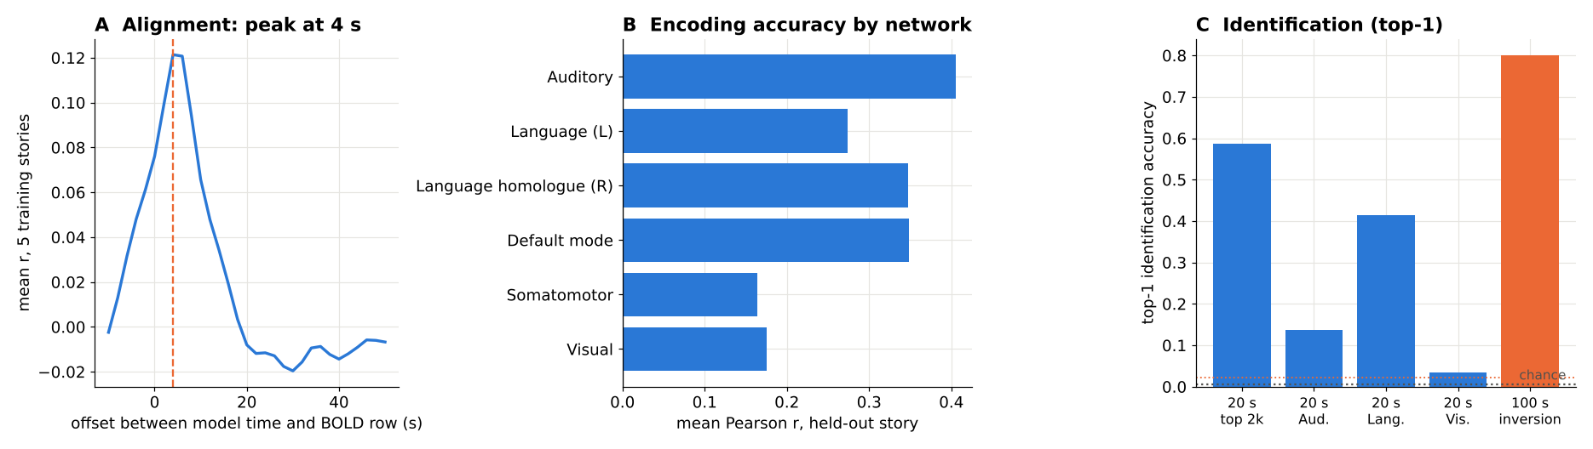
School of Electronics Engineering (SENSE)
B.Tech. Electronics and Communication Engineering (specialisation in Biomedical Engineering)
BECE497J Project-I · Final Review and Poster Presentation · 29 October 2026
Code, data and demo
github.com/Ivxn404/semantic-decoding-tribe-inversion
Conditioning and Non-Convexity of Semantic Decoding by Inversion of Deep Brain Encoding Models
Predictable is not recoverable: inverting Meta's TRIBE v2 foundation brain encoder on synthetic and real fMRI
Team members and Guide
Abhranil Sarkar (23BML0077) · computational track: model instrumentation, inversion engine, experiments, real-fMRI pipeline
Tanisha Choudhuri (23BML0081) · neurobiological track: cortical networks and ROI definition, dataset curation, interpretation
Guide: Dr. Sharmila Nageswaran, Associate Professor, School of Electronics Engineering (SENSE), VIT Vellore
Effort: 580 person-hours (330 + 250), seven stages, August–October 2026
Project Overview
Encoding models predict fMRI from what a person sees and hears; decoding runs the other way. Can a near-perfect encoder simply be inverted to read meaning back out?
We invert Meta's open 177 M-parameter TRIBE v2 encoder by gradient descent, measure uniqueness, conditioning and regional recoverability with exact ground truth, and validate on real fMRI from a held-out story.
Answer: no. Error falls 28.4× while recovery saturates; on real fMRI 4 of 5 held-out segments are identified (chance 2.2%), yet cosine to the truth is only 0.02.
Justification of Complex Engineering Problem
No closed-form answer. The forward model is a 177 M-parameter nonlinear transformer mapping a 32 × 1,152 representation to 20,484 cortical vertices; its inverse cannot be written down and must be measured.
Ill-posed by nature. Existence, uniqueness and stability of the inverse (Hadamard) are all open: fMRI is slow, blurred and noisy.
No ground truth in real data. The true meaning behind a brain recording is unknown, so we built a synthetic framework with exact error, then a real-fMRI test with identification at a known chance level.
Engineering obstacle. The released pipeline is not differentiable (speech synthesis, transcription, frozen extractors); we found and re-entered the one differentiable boundary.
Conflicting requirements. Decoding fidelity vs non-invasive, low-cost acquisition vs mental privacy cannot all be maximised.
Interdisciplinary. Inverse-problem theory, deep learning, neuroimaging (surface registration, atlases) and neuroanatomy must work together.
Scale on free hardware. 20,484 × 100 outputs per pass, tens of thousands of passes per experiment, one 15 GB GPU.
Proposed Block Diagram
Stimulus
story audio + words
Feature extractors
w2v-BERT, Llama-3.2-3B
Representation x
32 × 1,152 (free)
TRIBE v2, frozen
177 M parameters
Adam update
gradient to x only
Target fMRI y
synthetic or real BOLD
Loss
‖f(x) − y‖² or 1 − r
Predicted fMRI f(x)
20,484 vertices
Evaluate x̂: cosine to truth, identification rank
Controls: 8 inits × 4 truths, barrier, ROI vs random
Only x is optimised; network weights stay frozen. Re-entering after feature aggregation reproduces TRIBE v2's predictions exactly (r = 1.0000).
Design Methodology and Novelty
1 Forward operator. TRIBE v2 (trained on 451.6 h of fMRI from 25 people watching films and video clips and listening to stories), frozen.
2 Inversion. x̂ = argmin ‖f(x) − y‖², Adam (lr 0.05, cosine schedule), weights frozen.
3 Exact evaluation. Known x in TRIBE v2's input space (8-D, unit scale; real stimuli: 4.9-D) → y = f(x) → recover x; budget, noise, extent, priors, 8 inits × 4 truths; re-checked with a real stimulus as truth.
4 Mechanism tests. Agreement of fit-matched solutions; forward-only straight-path barrier test; Jacobian sensitivity vs 200 random directions.
5 Regions. 6 Destrieux networks vs size-matched random vertex sets, with a second random seed as the control spread.
6 Real fMRI. LeBel 2023 subject UTS03 projected to fsaverage5; lag and vertices chosen on five training stories; held-out story inverted and ranked among 45 segments.
Why fMRI, not EEG: millimetre detail on 20,484 vertices, the only deep encoder large enough to invert, and one inverse problem instead of two (EEG adds source localisation). EEG is faster and cheaper, which matters for a device, not for this measurement.
Project Results
A good fit is not a good decode, and the inverse identifies but does not reconstruct.
Novelty: closest prior work | Deep encoder | Optimises input | Tests uniqueness | Per region
Kay et al. 2008 | ○ | ○ | ○ | ○
Gardner & Liu 2019 (linear IEM) | ○ | ● | ● | ○
Tang et al. 2023 | ○ | ● | ○ | ●
TRIBE v2 (2026) and its two follow-ups | ● | ○ / ● | ○ | ○
This work | ● | ● | ● | ●
Literature search (9 Oct 2026, arXiv / Google Scholar / web): no published uniqueness or conditioning analysis of a deep foundation brain encoder.
Synthetic: error ↓28.4× but recovery saturates (0.944); equal fits disagree (0.817) and sit in separate minima (barrier 4.8×; 8.1× to a deeper one; 4 truths). Regions: visual −0.125, somatomotor +0.102 vs random. Real fMRI: r = 0.48 (56% of ceiling); 4/5 segments identified (chance 2.2%), cosine 0.02.
PO and PSO mapping
PO1 Linear algebra, optimisation and inverse-problem theory.
PO2 Formulated decoding as an ill-posed inverse problem and analysed its causes.
PO3 Designed the inversion pipeline and its controls.
PO4 Designed controlled experiments with exact ground truth and matched controls.
PO5 PyTorch, TRIBE v2, ANTs, nilearn, GPU (Colab) computing.
PO6, PO8 Mental privacy and clinical use; licences respected.
PO9, PO10 Two-track teamwork; IEEE manuscript, poster, reviews.
PO12 Self-taught foundation models and neuroimaging tools.
PSO2, PSO3 fMRI analysis and imaging with modern tools.
WP mapping
WP1 Depth of knowledge: neuroscience, fMRI, deep learning and inverse-problem theory together.
WP2 Conflicting requirements: fidelity vs non-invasiveness vs privacy.
WP3 Depth of analysis: separates non-convexity from information loss with falsifiable tests.
WP4 Familiarity of issues: slow, noisy, blurred BOLD; no ground truth in real data.
WP7 Interdependence: ROI anatomy and computation depend on each other.
Knowledge profile: WK3 signals and systems, WK4 inverse problems, WK5 design of the inversion pipeline, WK6 modern tools, WK8 current research literature.
SDG mapping
SDG 3 (Target 3.4): well-being for people with ALS, stroke or locked-in syndrome who keep comprehension but lose speech: we measure what non-invasive decoding can deliver.
SDG 9 (Target 9.5): open, reproducible research capability in neural-interface engineering on free compute.
SDG 10 (Target 10.2): communication access is a precondition for inclusion of people with severe motor disability.
Scope: enabling research, not a deployed device; the contribution is evidence of what non-invasive decoding can and cannot achieve.
Responsible use: the inverse identifies which known moment was heard but does not reconstruct thought, evidence for mental-privacy policy (OECD 2019, UNESCO 2025). No new human data collected.
References
[1] S. d'Ascoli et al., TRIBE v2, arXiv:2605.04326, 2026. [2] J. L. Gardner, T. Liu, eNeuro 6(2), 2019. [3] J. Tang et al., Nat. Neurosci. 26, 858–866, 2023. [4] A. LeBel et al., Sci. Data 10, 555, 2023. [5] K. N. Kay et al., Nature 452, 352–355, 2008. [6] P. C. Hansen, Discrete Inverse Problems, SIAM, 2010. [7] J. Lévy et al., arXiv:2502.17480, 2025. [8] C. Destrieux et al., NeuroImage 53, 1–15, 2010. [9] T. Naselaris et al., NeuroImage 56, 400–410, 2011. [10] A. G. Huth et al., Nature 532, 453–458, 2016. [11] R. Antonello et al., NeurIPS 36, 2023. [12] A. T. Gifford et al., arXiv:2501.00504, 2025. [13] B. Lahner et al., Nat. Commun. 15, 6241, 2024. [14] Q. K. Telesford et al., Sci. Data 10, 554, 2023. [15] C. M. Michel et al., Clin. Neurophysiol. 115, 2195–2222, 2004.
Project outcome
Manuscript: IEEE-format paper, A. Sarkar*, T. Choudhuri*, S. Nageswaran; ready for submission. Report: final Project-I report in the 2026 VIT format.
Open release: GitHub repository (QR code above) with all code, logged results, an interactive live demo and four Colab notebooks, including a live run of TRIBE v2. Cost: ₹0 compute on free GPUs.
Finding: encoding accuracy does not certify decoding; recoverability must be measured, region by region.

