Slide 1
Conditioning and Non-Convexity of Semantic Decoding by Inversion of Deep Brain Encoding Models
Project-I (BECE497J) · Review II · 40% milestone
Abhranil Sarkar (23BML0077) · Tanisha Choudhuri (23BML0081)
Guide: Dr. Sharmila Nageswaran, Associate Professor, School of Electronics Engineering
Panel SBT_PANEL_3 · TT501 · 14 October 2026
Notes:
Open with one sentence: we take Meta's open-weight brain encoder, which predicts fMRI from meaning, and run it backwards to measure how much meaning can actually be recovered from brain activity. Then say what Review II covers: literature and gap, objectives, the analytical model, implementation, and preliminary results that already exceed the 40% milestone.

Slide 2
Where the project stands at Review II
177 M
20 484
28×
26
parameter brain encoder made differentiable end-to-end from its feature boundary
cortical vertices recovered from, on the fsaverage5 surface
fall in encoding error while decoding recovery saturates
experimental stages logged with exact ground truth
Completion against the project plan
Formulation
Instrumentation
Core characterisation
Controls & validation
Regional analysis
Real-data study
Write-up
Status: ≈ 45% complete. The method, the analytical model and the core synthetic characterisation are finished and reproducible. Controls, regional analysis and the real-data study are scheduled for Review III and the final review.
Notes:
The 40% requirement is met with margin. Formulation, instrumentation and the core characterisation (convergence, encoding-decoding dissociation, noise, spatial extent, priors, bandwidth) are complete. If asked how 45% is computed: it is the share of planned person-hours in Table-3 of Report I attached to completed activities. Do not over-claim the remaining phases.

Slide 3
1 · Problem and motivation
Why decoding meaning from brain activity matters, and why it is harder than predicting brain activity

Slide 4



An open problem with conflicting interests
Clinical need
Engineering goal
Ethical constraint
ALS, brainstem stroke, locked-in syndrome and severe aphasia can leave comprehension intact while removing speech and writing. A non-invasive decoder would restore a channel without neurosurgery.
Maximise decoding fidelity from fMRI, a measurement that is slow (seconds), spatially blurred and indirect: it records blood oxygenation, not neurons.
Neural data is uniquely private. Higher fidelity and stronger mental privacy pull in opposite directions; a system tuned only for accuracy may be clinically or socially unacceptable.
This is the open-ended, multi-stakeholder problem the capstone rubric asks for: electronics/signal processing meets biomedicine and ethics.
Notes:
Three stakeholders, three objectives that cannot all be maximised at once. This maps to WP2 (conflicting requirements) in Report I. If asked for patient numbers, do not quote figures you cannot source; say the motivation is the existence of a cognitively intact but motor-locked population, documented in the BCI literature (e.g. Willett et al. 2023 for invasive speech BCIs).

Slide 5
Encoding predicts the brain; decoding inverts it
ENCODING (well studied, highly accurate)
Stimulus meaning
words heard, story context
Encoding model
learned from fMRI
Predicted BOLD
20 484 vertices
Inverse
this project
DECODING (the inverse problem: is it well posed?)
Key point. A forward model can be highly accurate and still be hard or impossible to invert: accuracy in the forward direction says nothing about conditioning, uniqueness or stability of the inverse (Hadamard's three conditions for a well-posed problem [14]). Nobody has measured these properties for a modern deep brain encoder.
Notes:
Analogy for non-specialist panel members: blurring a photo is easy; un-blurring it is not, because the blur destroys information. fMRI is a heavy blur of neural activity. The question is not 'can we build a decoder' but 'how much information survives the forward map, and can it be recovered'. Hadamard (1902): a problem is well posed if a solution exists, is unique, and depends continuously on the data.

Slide 6
2 · Literature survey and research gap
Two decades of encoding and decoding, and the question that was skipped

Slide 7
Literature survey I: encoding and decoding with fMRI
Work | Contribution | Limitation relevant to us
Mitchell et al., Science 2008 [1] | Linear model predicts fMRI for unseen nouns from word co-occurrence features | Single words, hand-built features, linear
Kay et al., Nature 2008 [2] | Identified viewed images by matching measured to predicted responses | Identification among candidates, not recovery
Naselaris et al., NeuroImage 2011 [3] | Unified framework: encoding models as the route to decoding | Assumes invertibility; not characterised
Huth et al., Nature 2016 [4] | Voxelwise semantic maps tiling cortex from natural speech | Linear encoding; no inverse analysis
Antonello, Vaidya & Huth, NeurIPS 2023 [5] | Encoding accuracy scales log-linearly with model size and data | Scaling shown for encoding only
Tang et al., Nat. Neurosci. 2023 [6] | Continuous language reconstructed from fMRI via LM-guided search | Decoder trained per subject (~16 h); search, not inversion
LeBel et al., Sci. Data 2023 [7] | Open naturalistic-listening fMRI corpus (8 subjects, ~86 h) | Our real-data target (final phase)
Notes:
Arc of the field: from linear features (Mitchell) to identification (Kay) to semantic maps (Huth) to full reconstruction (Tang). Every step improved encoding or trained a separate decoder. Antonello 2023 showed encoding scales with data; nobody checked whether decoding scales the same way. That is exactly what our dissociation experiment measures.

Slide 8
Literature survey II: non-invasive decoding and foundation encoders
Work | Contribution | Limitation relevant to us
Défossez et al., Nat. Mach. Intell. 2023 [8] | Contrastive decoding of perceived speech from MEG/EEG | MEG far stronger than EEG; segment identification
Scotti et al. (MindEye2), ICML 2024 [9] | fMRI-to-image with 1 h of subject data via shared-subject model | Vision; trained decoder, no operator analysis
d'Ascoli et al., Nat. Commun. 2025 [10] | Single-word decoding across 723 participants (MEG/EEG) | Word level; accuracy limited by modality
Lévy et al. (Brain2Qwerty), Nat. Neurosci. 2026 [11] | Typed sentences decoded: CER 29% with MEG vs 65% with EEG | Shows EEG is too weak for language decoding
d'Ascoli et al. (TRIBE), ICLR 2026 [12] | Trimodal encoder; 1st of 263 teams, Algonauts 2025 | Encoding only
d'Ascoli et al. (TRIBE v2), 2026 [13] | Open-weight foundation encoder: 1 117.7 h fMRI, 720 subjects, 20 484 vertices | Explicitly an encoder; inverse never studied
Hansen, SIAM 2010 [14] | Theory of discrete ill-posed problems: conditioning, regularisation | Our analytical lens
Notes:
Brain2Qwerty is the decisive reason we dropped EEG: even Meta, with 35 participants and a purpose-built architecture, gets 65% character error with EEG versus 29% with MEG. TRIBE v2's own paper frames it for in-silico neuroscience and lists decoders separately (Tang, Défossez); it never inverts itself. Weights and code are public (CC BY-NC 4.0), which makes our study possible.

Slide 9



Research gap
Encoding keeps improving
Accuracy scales log-linearly with data with no plateau (Antonello 2023 [5]; TRIBE v2 2026 [13]).
Decoding is studied separately
Decoders are trained per subject and judged by proxy metrics, because the true stimulus representation behind real fMRI is unknown.
The inverse is never characterised
No study measures conditioning, uniqueness or stability of a deep encoder's inverse, or whether encoding gains transfer to decoding. Linear inverted encoding models are identifiable only up to a linear transform [16]; deep encoders have never been tested.
Gap. Does improving a brain encoding model make meaning more recoverable from fMRI, and if not, what limits the inverse: information loss, non-convexity, or noise?
Notes:
State the gap in one breath: the field optimises encoders and assumes decoding follows; we test that assumption directly. If challenged ('surely someone has inverted an encoder'): Kay 2008 and many others use encoders for identification among candidates, which is different from recovering the representation and characterising the inverse operator. TRIBE v2's release (March 2026) is recent enough that its inverse has not been characterised.

Slide 10
Problem statement and objectives
Characterise semantic decoding from fMRI as the inverse of a frozen, differentiable deep encoder (TRIBE v2), and quantify its conditioning, uniqueness and stability under exact ground truth.
O1
Formulate decoding as inversion and locate the point where the encoder becomes differentiable
Done
O2
Build a synthetic framework with exact ground truth for error measurement
Done
O3
Characterise the inverse vs. budget, noise, cortical extent and priors
Done
O4
Discriminate non-identifiability vs. non-convexity vs. optimiser limits
In progress
O5
Benchmark against a linear decoder; map recoverability by anatomical region
In progress
O6
Validate on real naturalistic fMRI (LeBel 2023)
Planned
Notes:
Objectives are measurable: each maps to an experiment and a number. O1-O3 are complete and shown today. O4-O5 are partly run (results at Review III). O6 is the final phase. This slide directly addresses the 'Research problem and objectives' rubric line.

Slide 11




What is new in this work: four claims
First inverse analysis of a foundation brain encoder
Exact evaluation, not proxy metrics
TRIBE v2 [13] was released for in-silico neuroscience. We treat it as a forward operator and study its inverse; its authors and both 2026 follow-ups [17, 18] did not (proof on the next two slides).
Synthetic ground truth lets us measure recovery error exactly. Real-data decoders can only score proxies such as retrieval rank.
A differentiable entry point into a closed pipeline
Decoder-independent limits
The public pipeline (TTS → Whisper → LLaMA) is not differentiable. We identified the aggregate_features boundary and re-entered the network there.
Results describe the measurement, not one decoder's architecture, so they bound what any decoder built on this encoder can achieve.
Notes:
If asked 'what is novel if the model is Meta's?': the model is the instrument, not the contribution. Analogy: characterising a published sensor's transfer function is a contribution even though the sensor was built elsewhere. The aggregate_features finding is practical novelty: it is why gradient inversion is possible at all.

Slide 12
Proof of novelty I: prior-art comparison
Closest prior work | Nonlinear deep encoder | Optimises encoder input | Tests uniqueness / conditioning | Region-wise recoverability
Kay et al., Nature 2008 [2] | ○ | ○ | ○ | ○
Gardner & Liu, eNeuro 2019 [16] | ○ | ● | ● | ○
Tang et al., Nat. Neurosci. 2023 [6] | ○ | ● | ○ | ●
d'Ascoli et al., TRIBE v2, 2026 [13] | ● | ○ | ○ | ○
Bladon & Bent, arXiv May 2026 [17] | ● | ● | ○ | ○
Benchetrit et al., arXiv Jun 2026 [18] | ● | ○ | ○ | ○
This work | ● | ● | ● | ●
Only this work fills all four columns. The closest result, Gardner & Liu [16], proves that a linear inverted encoding model recovers the stimulus only up to an invertible linear transform. We ask the same question of a 177 M-parameter nonlinear encoder, where no closed-form answer exists, and answer it empirically with exact ground truth.
Notes:
● = the paper does this; ○ = it does not. Tang 2023 optimises over word sequences (beam search scored by a linear encoder on GPT features) and compares cortical networks, so it gets two marks; its encoder is linear in the LM features, and it never asks whether the answer is unique. Gardner & Liu is the theoretical ancestor of our question, for linear models only. If a reviewer names another paper, ask which column it fills; none we found fills the third column for a deep encoder.

Slide 13
Proof of novelty II: search protocol and the closest TRIBE v2 work
Search protocol
Bladon & Bent, May 2026 [17]
Date: 9 October 2026
Sources: arXiv, Google Scholar, general web
Queries: "TRIBE v2"; invert / inversion / identifiability / conditioning / non-convex + "brain encoding model" / "fMRI encoder"
Inclusion: any work that inverts, optimises the input of, or analyses the identifiability of a brain encoding model
Result: two TRIBE v2 follow-ups (right). Neither tests whether the inverse is unique or how it is conditioned.
What it does: Feature visualisation: optimises inputs to maximise a region's predicted response and recovers known cortical selectivity.
Difference: Asks what a region prefers. Does not ask whether the input can be recovered, or whether the answer is unique.
Benchetrit et al., June 2026 [18]
What it does: Uses TRIBE v2 forwards to synthesise fMRI that augments training of a brain-to-image decoder.
Difference: The encoder is only run forwards; its inverse is never analysed.
Notes:
This is the evidence behind the word 'first'. Say it carefully: 'we found no published inverse or identifiability analysis of a deep foundation encoder as of 9 October 2026', not 'nobody has ever done this'. Both TRIBE v2 follow-ups are from 2026 and are the closest possible competitors; neither touches uniqueness or conditioning.

Slide 14
Novel contributions, each with its evidence
# | Contribution | Evidence | Status
1 | First inverse (uniqueness and conditioning) analysis of a deep foundation brain encoder | Prior-art matrix and dated search protocol (previous two slides) | Shown
2 | A differentiable re-entry point into the closed TRIBE v2 pipeline | Gradient reaches every entry of x at the aggregate_features boundary: ‖∂y/∂x‖ = 7.97 × 10³ | Shown
3 | Exact, decoder-independent measurement of decodability | Synthetic ground truth: recovery measured as cosine to the true x, not a proxy rank | Shown
4 | Encoding accuracy and decodability dissociate | Encoding error falls 28.4×; final halving buys +0.015 recovery | Shown
5 | Cause of incomplete recovery: non-convexity, not information loss | Fit-matched solutions differ (min cosine 0.817); barrier test 2.6× → 0.6× | Shown (early)
Notes:
Each claim is paired with the number that supports it, so a reviewer can challenge the evidence rather than the wording. Status 'Shown' means the evidence is on a slide in this deck.

Slide 15



Alignment with specific SDG targets
SDG 3 · Target 3.4
“…promote mental health and well-being.” Restoring communication to cognitively intact, motor-impaired patients (ALS, stroke, locked-in) addresses well-being directly; limits we measure tell clinicians what non-invasive decoding can and cannot deliver.
SDG 9 · Target 9.5
“Enhance scientific research, upgrade the technological capabilities…” Methodological contribution to neural-interface engineering using open models and open data, reproducible on free compute.
SDG 10 · Target 10.2
“…empower and promote the social, economic and political inclusion of all, irrespective of… disability…” Communication access is a precondition for inclusion of people with severe motor disability.
Notes:
Specific targets, not just goals, because the rubric's top band requires 'specific SDG target(s)'. Be honest about the link: this is enabling research, not a deployed device. The well-being link (3.4) is through assistive communication; 9.5 through research capability; 10.2 through disability inclusion. Target texts are quoted from the UN SDG indicator framework.

Slide 16
3 · Methodology and analytical model
Block diagram, mathematical formulation, algorithm and implementation

Slide 17
Functional block diagram
REFERENCE PATH (TRIBE v2 as released — not differentiable before the boundary)
aggregate_features boundary
Stimulus
speech / text
Feature extractors
LLaMA-3.2-3B · Wav2Vec-BERT · V-JEPA2 (frozen)
Projectors
per modality → 384 d
Frozen forward operator f(x)
Transformer → low-rank head → subject layer → pool
OUR PIPELINE (everything differentiable)
Ground-truth generator
x* ∈ ℝ^(32×1152)
Measurement model
y = M ⊙ f(x*) + η
Inversion engine
Adam on x, θ frozen
f(x̂) via autograd
∂L/∂x back-propagated to the input
Experiment controller
budget · noise η · vertex mask M · prior R · init
Evaluation
cosine · relative error · retrieval · directional sensitivity
Results store
results.json (26 stages) · figures · Drive backup
Notes:
Read top to bottom. Top row is TRIBE v2 as Meta ships it: text is converted to speech, transcribed with Whisper, embedded with LLaMA; none of that is differentiable, and the published predict() runs under torch.inference_mode(), which blocks gradients permanently. The orange dashed line is the boundary we found in the source: aggregate_features is the only function that touches the input batch. Everything to its right is tensor arithmetic, so we feed our own x there. Bottom row is our system: generate a known x*, push it through the frozen operator with optional noise and vertex masking, invert by gradient descent on x only, evaluate against x*.

Slide 18
Analytical model
Forward operator
Inverse problem
y = f_θ(x) = P ∘ S ∘ L ∘ E (x)
x ∈ ℝ^(T×H), T = 32, H = 1152
y ∈ ℝ^(V×T′), V = 20 484, T′ = 100
E: 8-layer transformer encoder (127.5 M)
L: low-rank head 1152 → 2048
S: shared subject layer 2048 → 20 484
P: adaptive average pooling to T′
θ frozen (177.21 M parameters)
x̂ = argminₓ ‖M ⊙ (f_θ(x) − y)‖² + λ R(x)
R(x) = ‖x‖² (ℓ2) or Σₜ ‖xₜ − xₜ₋₁‖² (smoothness)
Linearised: f(x + δ) ≈ f(x) + J δ, so error grows along directions with small singular values of the Jacobian J (ill-conditioning).
Metrics
Recovery: (1/T) Σₜ cos(x̂ₜ, x*ₜ)
Relative error: ‖x̂ − x*‖ / ‖x*‖
Encoding error: ‖f(x̂) − f(x*)‖ / ‖f(x*)‖
Directional sensitivity: s(v) = ‖f(x+εv) − f(x)‖ / ε
Ground truth: x*_t = Σₖ cos(2π k c t) bₖ , k = 1…8, normalised; c sets the rate of semantic change
Notes:
This is the analytical model the rubric asks for. Hadamard well-posedness has three parts and each maps to an experiment: existence (does inversion fit the data: yes, MSE to 1e-7), uniqueness (do different starts agree: tested by initialisation control), stability (does output degrade gracefully with noise: tested by noise sweep). Why cosine: semantic embeddings are compared by direction in NLP; we also report relative error, which captures magnitude, because the two can disagree. M is a 0/1 vertex mask used for the spatial-extent experiment; eta is additive Gaussian noise scaled to the BOLD standard deviation.

Slide 19
The forward operator and where we enter it
Component | Type | Parameters
encoder | Transformer encoder (x-transformers) | 127.47 M
predictor | SubjectLayersModel (shared 'unseen subject' layer) | 41.97 M
projectors | Per-modality MLPs (text 2×3072, audio 2×1024, video 2×1408) | 4.23 M
low_rank_head | Linear 1152 → 2048, no bias | 2.36 M
pooler | AdaptiveAvgPool1d → 100 time points | —
Total |  | 177.21 M
Why inversion needed a new entry point
predict() runs inside torch.inference_mode(): its tensors can never carry gradients
Text is turned into speech (gTTS), re-transcribed (WhisperX) and embedded (LLaMA): non-differentiable
In FmriEncoderModel.forward, aggregate_features(batch) is the only call that reads the batch
We re-implement forward() from that line onward and optimise its output x directly
Verified: ‖∂y/∂x‖ = 7.97 × 10³, every entry non-zero
Configuration read from the checkpoint: hidden = 1152, low_rank_head = 2048, modality_dropout = 0.3, temporal_smoothing = None, linear_baseline = False.
Consequence: x is the aggregated multimodal representation, one stage after raw LLaMA embeddings. Results characterise the operator from that point onward.
Notes:
These numbers come from inspecting the loaded network, and we have since reproduced them independently on CPU from the raw checkpoint. Likely question: 'so you are not decoding words?' Correct, and deliberately: we decode the representation the encoder actually consumes. Mapping x back to words is a separate, easier step (nearest-neighbour search in embedding space) and is not where the information is lost. temporal_smoothing = None matters later: it explains the bandwidth null result.

Slide 20
Algorithm
1
Generate ground truth x* (seeded)
x = 0.01 * randn(1, 32, 1152) # seed 999
x.requires_grad_(True)
opt = Adam([x], lr=5e-2)
sched = CosineAnnealingLR(opt, T_max=steps)
for i in range(steps):
opt.zero_grad()
pred = forward_from_x(x) # frozen θ
loss = mse(pred[:, mask], y)
loss = loss + lam * R(x)
loss.backward() # ∂L/∂x
opt.step(); sched.step()
score(x, x_true) → results.json
2
Compute target y = M ⊙ f(x*) + η
3
Initialise x₀ = 0.01·N(0, I)
4
Loss L(x) = masked MSE + λR(x)
5
∂L/∂x by autograd; θ frozen
6
Adam update, cosine-annealed lr
7
Score x̂ against x*; log to results.json
Notes:
Hyperparameters: Adam lr 0.05, cosine annealing over the full budget, budgets from 250 to 64 000 steps. Why Adam: the loss is a 36 864-dimensional non-convex function of x; Adam's per-coordinate scaling handles very different gradient magnitudes across the three modality slots. Why not a trained decoder: training a decoder conflates the decoder's capacity with the operator's invertibility; direct inversion isolates the operator.

Slide 21
Implementation: tools, platform and status
Layer | Tools
Model | TRIBE v2 (open weights, CC BY-NC 4.0), PyTorch, x-transformers, neuralset / neuraltrain
Features (reference path) | LLaMA-3.2-3B (gated, access granted), Wav2Vec-BERT 2.0, V-JEPA2
Compute | Google Colab T4 GPU (16 GB); CPU replication (2 cores) for the regional analysis
Neuroimaging | Nilearn, fsaverage5 surface, Destrieux atlas
Analysis | NumPy, SciPy, Matplotlib; results.json checkpointed to Google Drive
Engineering problems solved
numpy ABI mismatch after install: pinned numpy < 2.1
Package shadowed by repo folder: sys.path fix
WhisperX missing punkt_tab: NLTK data path
torchaudio ABI break: bypassed entirely via the boundary
Runtime resets wiped results: per-condition checkpoints + Drive
Free-GPU quota: experiments staged and resumable
Development status: pipeline complete and reproducible · 26 stages logged · all figures generated from logged numbers
Notes:
If asked about reproducibility: every experiment is seeded (ground truth, initialisation, masks, noise), results are written after every condition, and the network has been rebuilt independently on CPU from the raw checkpoint with identical parameter counts. Licence: TRIBE v2 is CC BY-NC 4.0, which permits non-commercial academic research.

Slide 22
4 · Preliminary results
Screenshots, outputs and tabulated measurements from the core characterisation

Slide 23
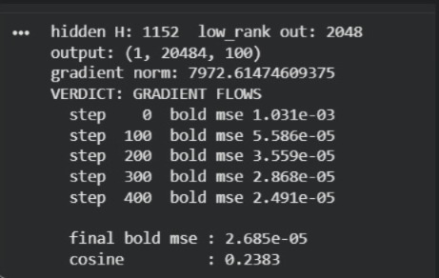
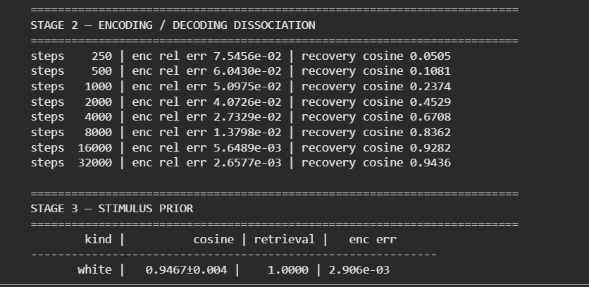
Evidence: the inverse is computable
Colab output: gradient reaches the input (norm 7 972.6); first 500-step inversion
Colab output: Stage 2 dissociation run (encoding error vs recovery)
Output shape (1, 20 484, 100) confirms we drive the real network: 20 484 fsaverage5 vertices over 100 pooled time points. The verdict line is the make-or-break test for the whole project.
Notes:
These are unedited screenshots from our Colab sessions. Left: the first time the gradient flowed (norm 7972) and the first inversion. Right: the Stage 2 run that produced the dissociation curve on the next slides.

Slide 24
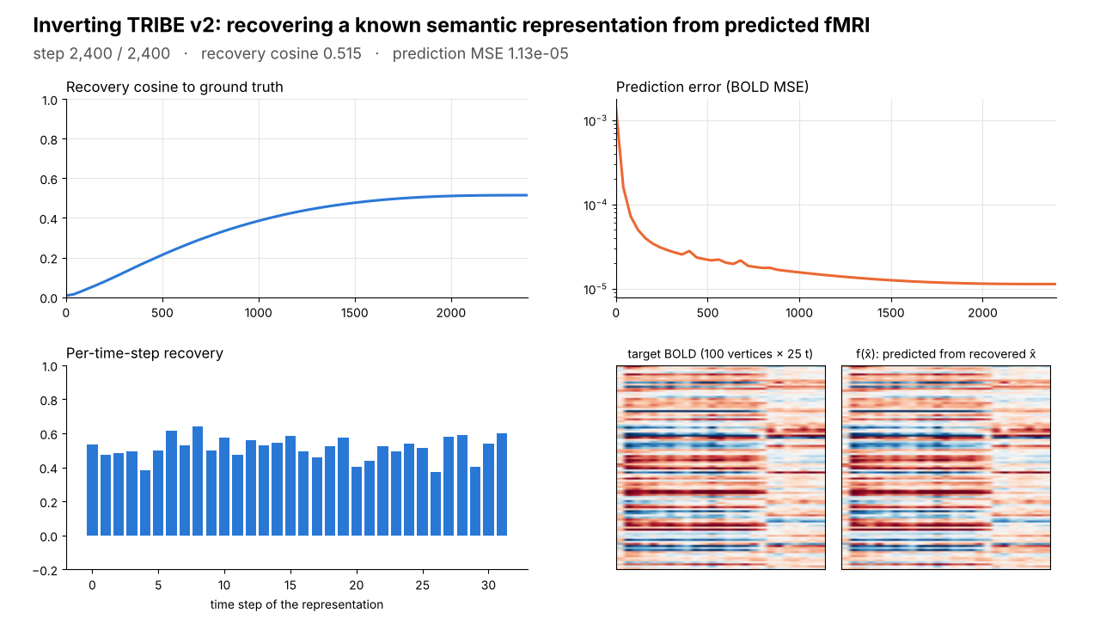
Demonstration: a live inversion
What to watch
Bottom right: the target BOLD and the BOLD predicted from the recovered representation become almost identical within a few hundred steps.
Top left: the representation itself is still only about half recovered (cosine 0.52 at 2 400 steps).
That gap is the dissociation, visible in real time.
Recorded run through frozen TRIBE v2 (CPU, whole cortex, 2 400 steps). Every frame is drawn from logged values.
Notes:
Click to play (about 13 seconds). This is a short-budget recording for demonstration; with the full 32 000-step budget the same procedure reaches 0.944. The point is the contrast between the two BOLD panels (matching) and the cosine curve (incomplete). If the video does not play on the venue PC, the poster frame shows the final state and the MP4 is supplied separately.

Slide 25
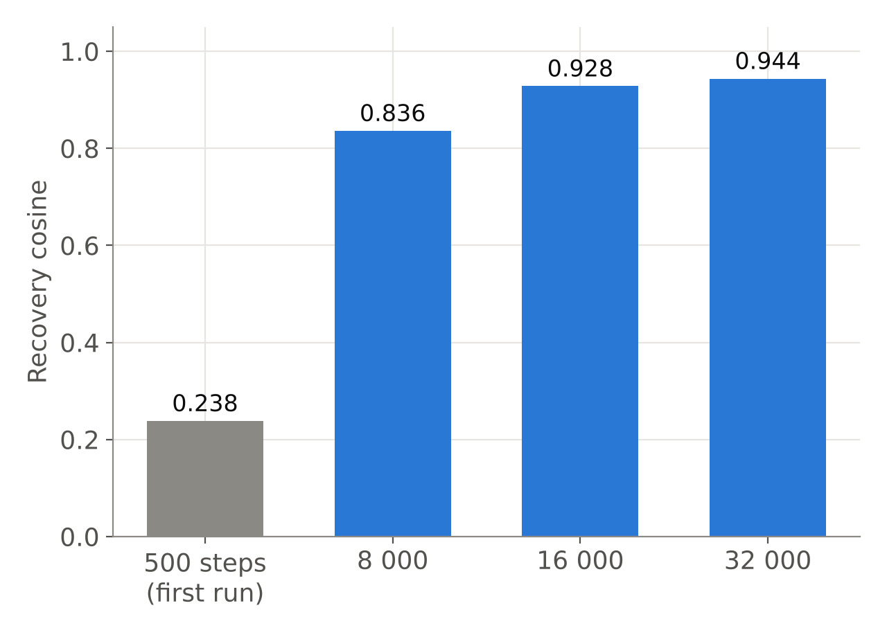
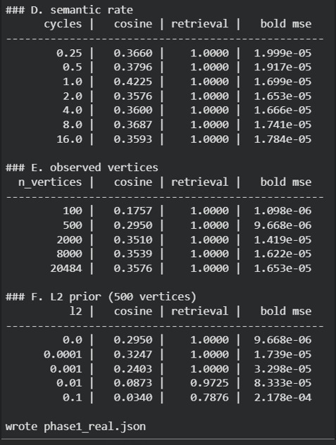
Our first result was wrong, and we caught it
Diagnosis
At 500 steps cosine was 0.238 and every condition looked flat. Recovery was still climbing: we were measuring the optimiser, not the operator.
Fix
Find convergence first, then run every condition at a converged budget.
Early 1 500-step sweeps: everything stuck near 0.35
Lesson built into the method: no claim about the operator is accepted until the optimiser has converged.
Notes:
This slide pre-empts the hardest methodological question ('how do you know you are not just measuring your optimiser?'). We fell into exactly that trap, recognised it from the flat curves, and rebuilt the protocol. Convergence: 4000 → 0.77, 8000 → 0.87, 16000 → 0.89, 32000 → 0.89 (plateau), from a single annealed run; independent runs to completion are on the next slide.

Slide 26
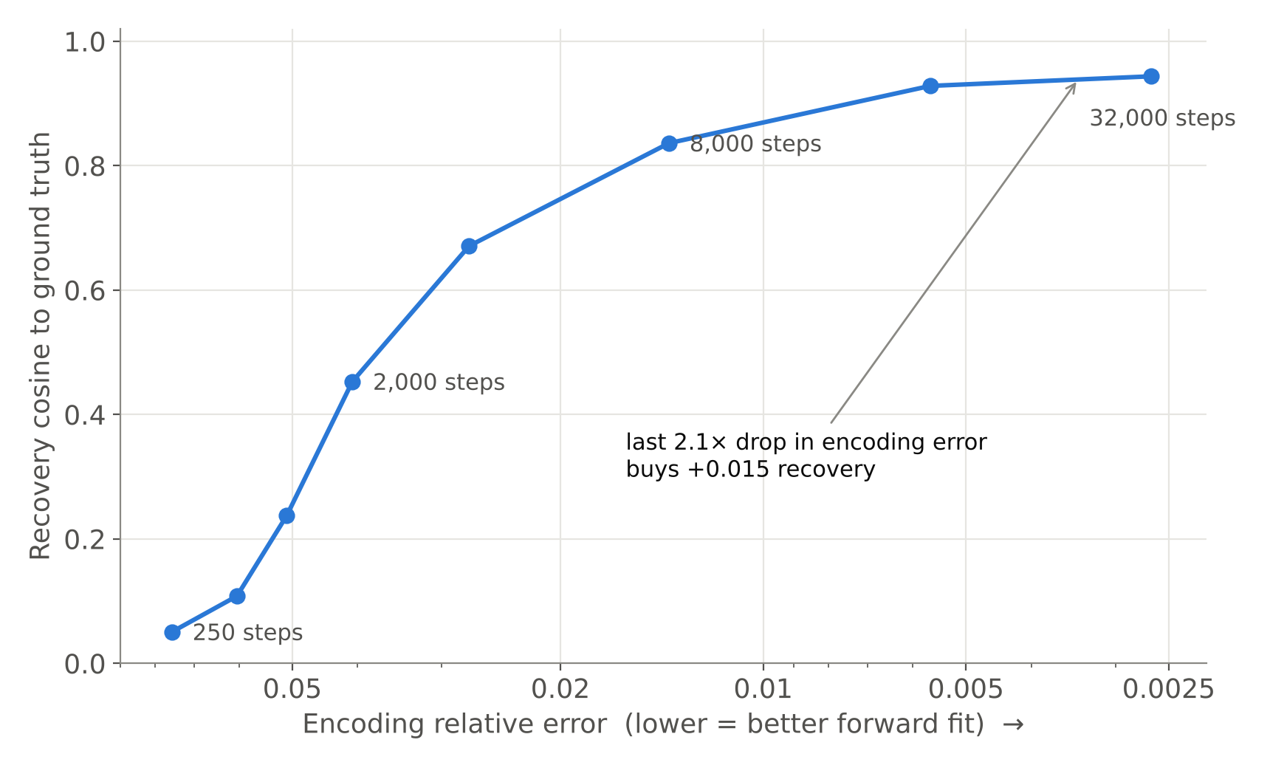
Encoding accuracy does not predict decoding
28.4×
reduction in encoding error, 250 → 32 000 steps
+0.015
recovery gained from the final 2.1× drop in encoding error (0.928 → 0.944)
Forward fit and recoverability are different quantities. Past a point, a better-fitting forward model buys almost nothing in decoding.
Notes:
Central result. Eight independent inversions, each run to the end of its own cosine schedule. Encoding error falls from 7.55e-2 to 2.66e-3 (28.4x); recovery rises then saturates at 0.944. The last halving of encoding error (5.65e-3 → 2.66e-3) adds only 0.015 to recovery. Implication for the field: scaling encoders (Antonello 2023, TRIBE v2's log-linear scaling) should not be expected to deliver proportional decoding gains.

Slide 27
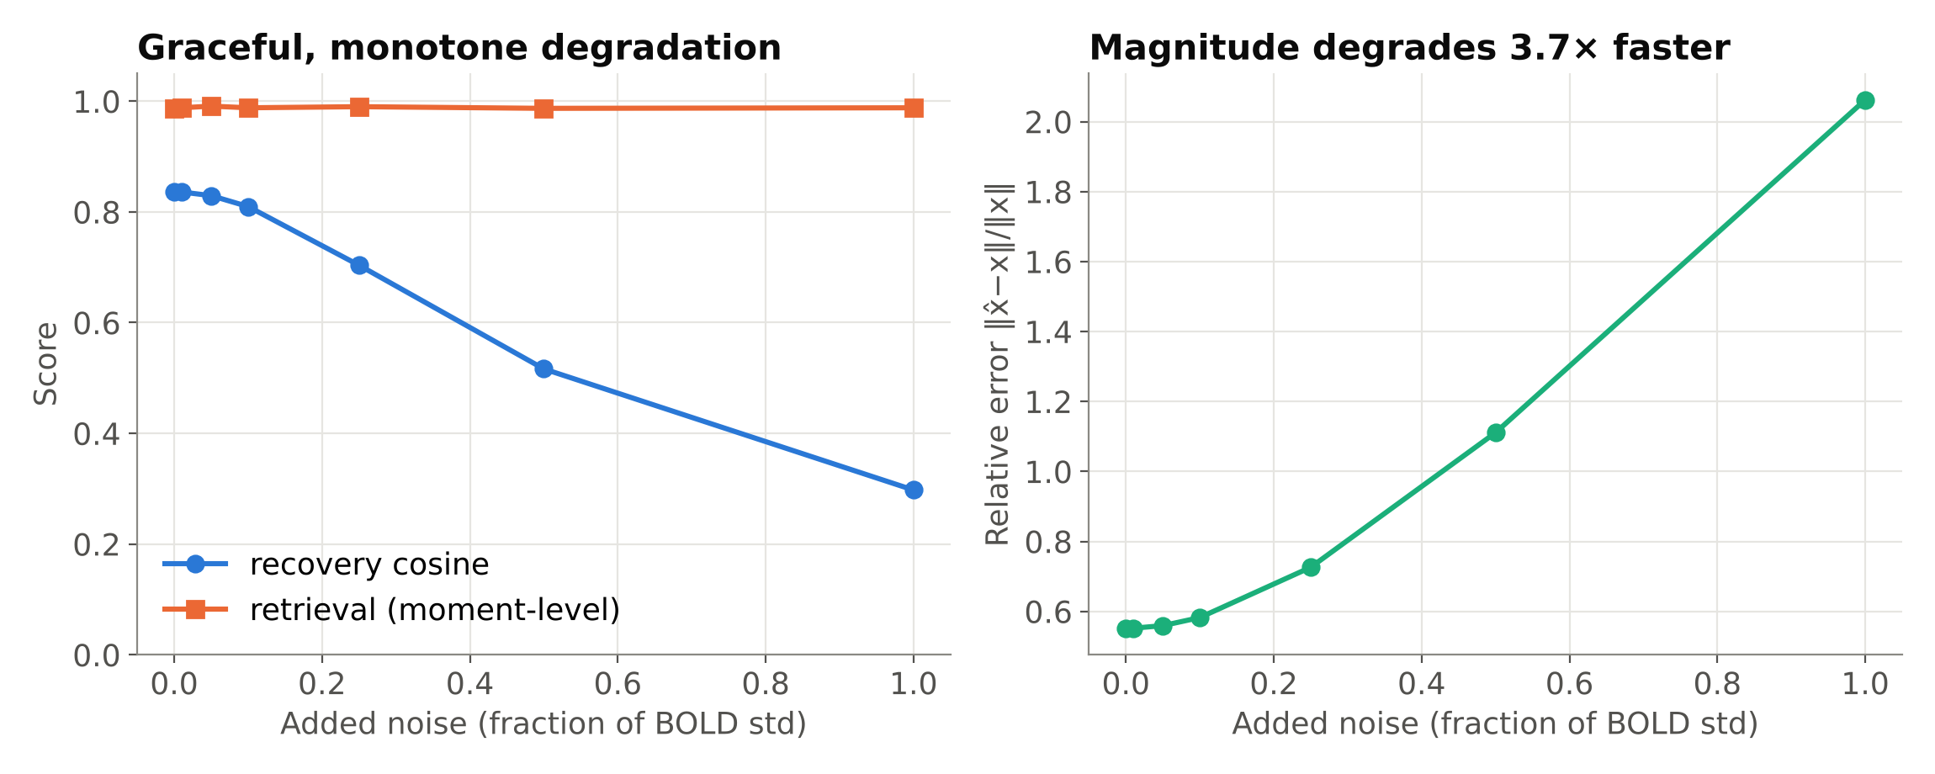
Stability: the inverse degrades gracefully with noise
No cliff: cosine 0.836 → 0.298 at noise equal to the signal's own standard deviation. Direction and timing survive (retrieval ≈ 0.99 throughout) while magnitude does not (relative error 0.55 → 2.06).
Notes:
Hadamard's stability condition, tested empirically. Graceful monotone decay means the inverse is reasonably well conditioned against additive noise. The split between retrieval and relative error is important: noise mostly corrupts the magnitude of the recovered representation, not which moment it corresponds to. Retrieval here asks whether the recovered vector at time t is closest to the true vector at time t among the other 31 time points.

Slide 28
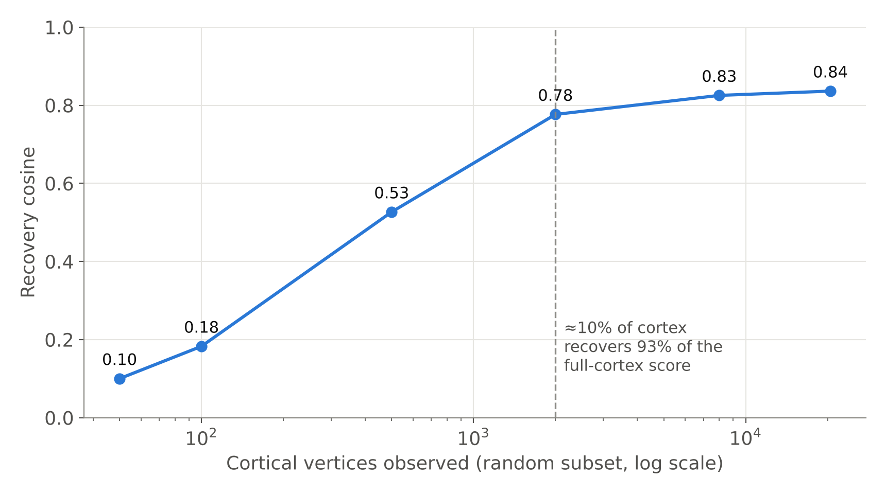
Ten percent of cortex carries most of the recoverable signal
Vertices | Cosine | Enc. error
50 | 0.100 | 8.69e-2
100 | 0.183 | 6.44e-2
500 | 0.527 | 3.82e-2
2 000 | 0.777 | 1.94e-2
8 000 | 0.825 | 1.48e-2
20 484 | 0.836 | 1.38e-2
Random subsets saturate near 2 000 vertices. This makes the next question well posed: which anatomical 10%? That is the regional analysis (Review III).
Notes:
Vertices sampled uniformly at random (seeded). Below ~500 vertices the problem is genuinely underdetermined. Note that encoding error on the observed vertices is lowest for the smallest subsets, while recovery is worst: fitting a few vertices perfectly says little about the representation.

Slide 29
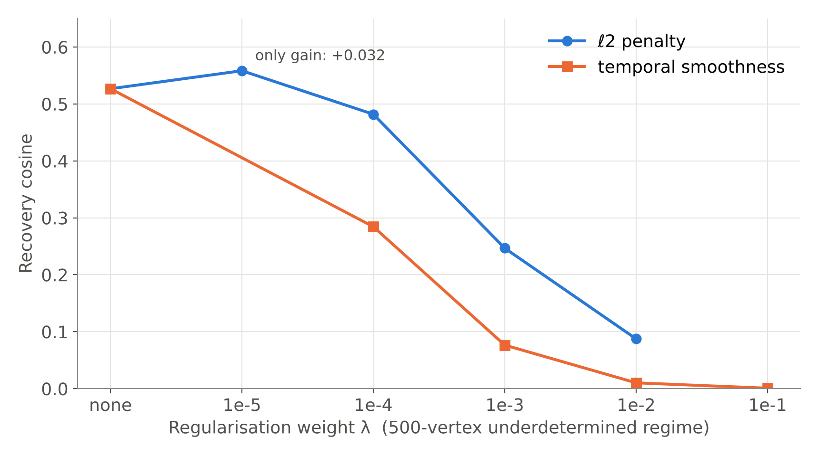
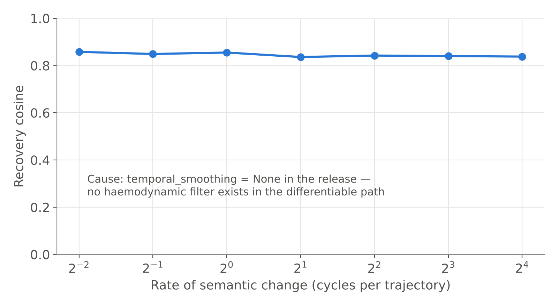
Generic priors hurt; bandwidth is a structural null
ℓ2 helps only at λ = 1e-5 (+0.032). Smoothness drives cosine to 0.0008 and retrieval to chance (0.499).
Flat across 64× because the release has no haemodynamic filter in the differentiable path (temporal_smoothing = None).
Notes:
Priors: tested in the 500-vertex regime where a prior should help most. Neither small norm nor temporal smoothness describes semantic representations under this operator; better priors must come from the structure of language embeddings. Bandwidth: we report this as a null with its cause, not as 'bandwidth does not matter'. The haemodynamic low-pass was learned into the training data, not built as an operator, so this experiment cannot measure HRF bandwidth. Pooling was checked and excluded as the cause (pooled vs unpooled output separation 49.9 vs 28.8).

Slide 30
Tabulation of Review II results
Experiment | Condition range | Key measurement | Interpretation
Gradient check | random x | ‖∂y/∂x‖ = 7.97×10³ | Operator invertible by gradient
Convergence | 250 – 64 000 steps | plateau ≈ 0.89–0.91 (single run) | Budget ≥ 8 000 needed
Dissociation | 8 independent budgets | enc. error ↓ 28.4×; recovery → 0.944 | Encoding ≠ decoding
Stimulus manifold | white vs smooth | 0.947 ± 0.004 vs 0.942 ± 0.005 | No manifold advantage
Noise | 0 – 100% of BOLD std | 0.836 → 0.298, monotone | Stable, well conditioned
Spatial extent | 50 – 20 484 vertices | saturates ≈ 2 000 (0.777) | ≈10% of cortex suffices
ℓ2 prior | λ 0 – 1e-2 (500 v) | best +0.032 at 1e-5 | Small-norm prior invalid
Smoothness prior | λ 0 – 1e-1 (500 v) | 0.527 → 0.0008 | Catastrophic
Bandwidth | 0.25 – 16 cycles | 0.858 – 0.838 (flat) | Null: no HRF operator
Notes:
One table the panel can refer back to during viva. Every number is from results.json. Mean ± sd for the manifold comparison is over three seeds.

Slide 31
5 · Early results beyond the milestone
Why recovery is incomplete: first tests of the competing explanations

Slide 32
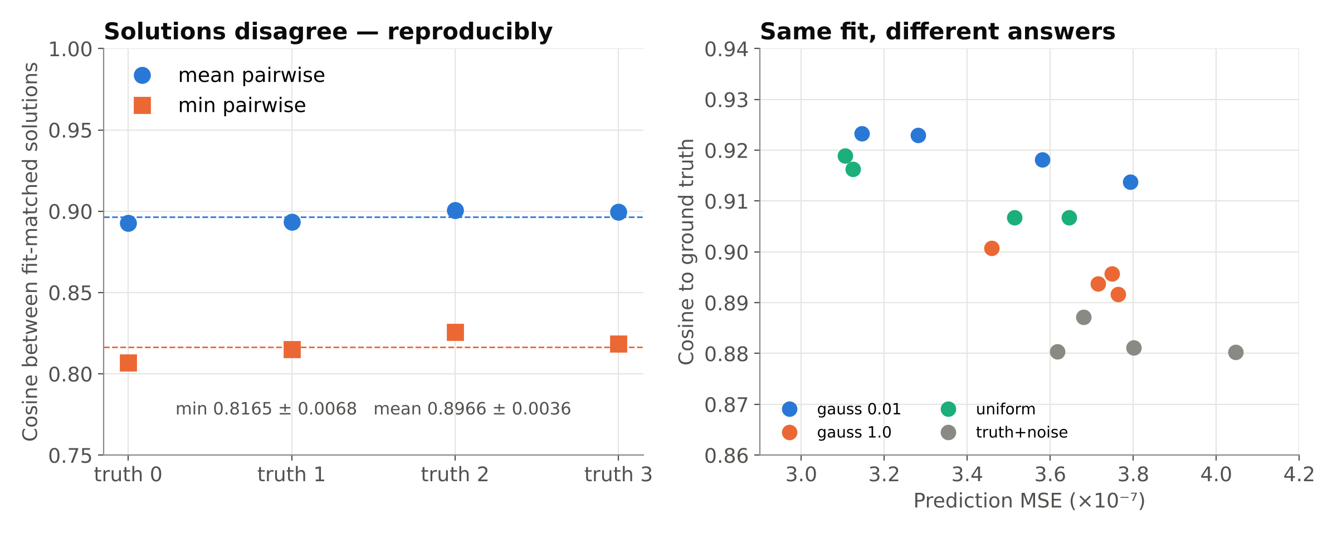
Same fit, different answers: the inverse is non-convex
Ground truth | Best fit | Mean pairwise | Min pairwise
0 | 3.51e-7 | 0.8928 | 0.8068
1 | 3.65e-7 | 0.8934 | 0.8151
2 | 3.11e-7 | 0.9007 | 0.8257
3 | 3.13e-7 | 0.8996 | 0.8186
Notes:
Different initialisations reach the same prediction error (fit-matched within 2x) yet agree with each other only at 0.82-0.90 cosine. Replicated across four ground truths (min pairwise 0.8165 +/- 0.0068). This is the first sign that the limit is the shape of the problem, not lost information.

Slide 33
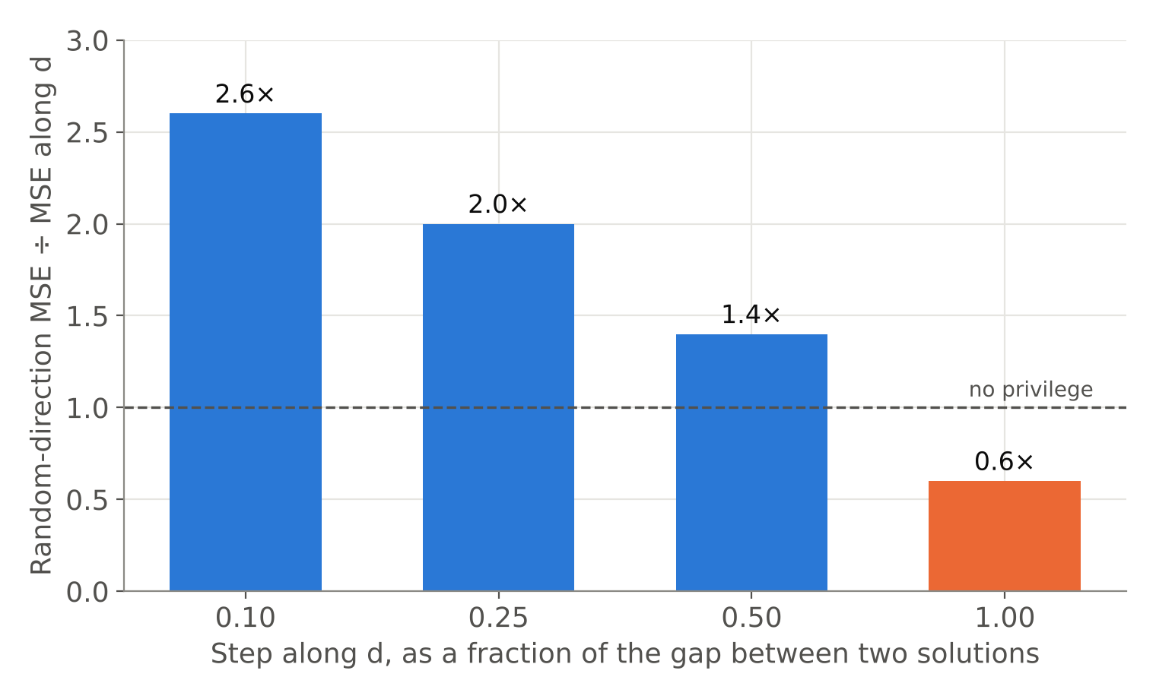
Information-loss hypothesis rejected
Test
Move one solution towards the other along their difference d, and compare with random directions of equal length.
Result
d is cheap only for small steps (2.6x); at the full separation it changes the response more than random (0.6x).
Meaning
The answers are separate minima with a barrier between them: non-convexity, not a null space.
Notes:
A null space would keep d cheap at every scale. It does not, so information is not destroyed. The test uses forward passes only, so it does not depend on the optimiser.

Slide 34
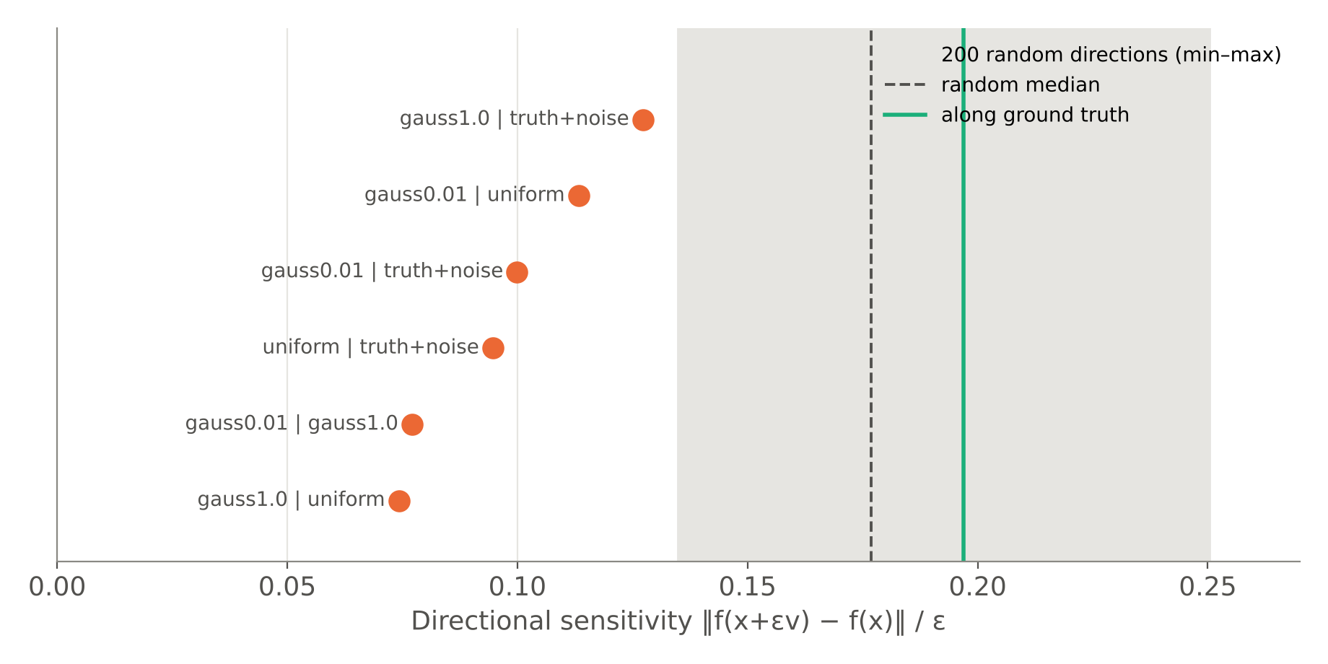
Errors concentrate in the operator's weakest directions
1.9×
lower sensitivity along d than the random median
6 / 6
pairwise difference directions below the random median
What the inverse fails to pin down is exactly what the operator responds to least: anisotropic ill-conditioning, measured.
Notes:
Directional sensitivity = finite-difference probe of the Jacobian along a direction. The solution-difference direction falls below every one of 200 random directions sampled.

Slide 35
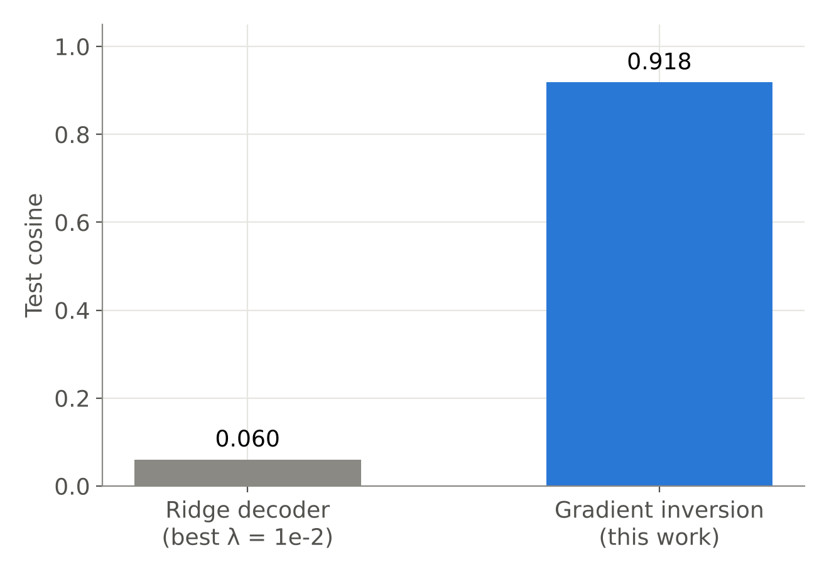
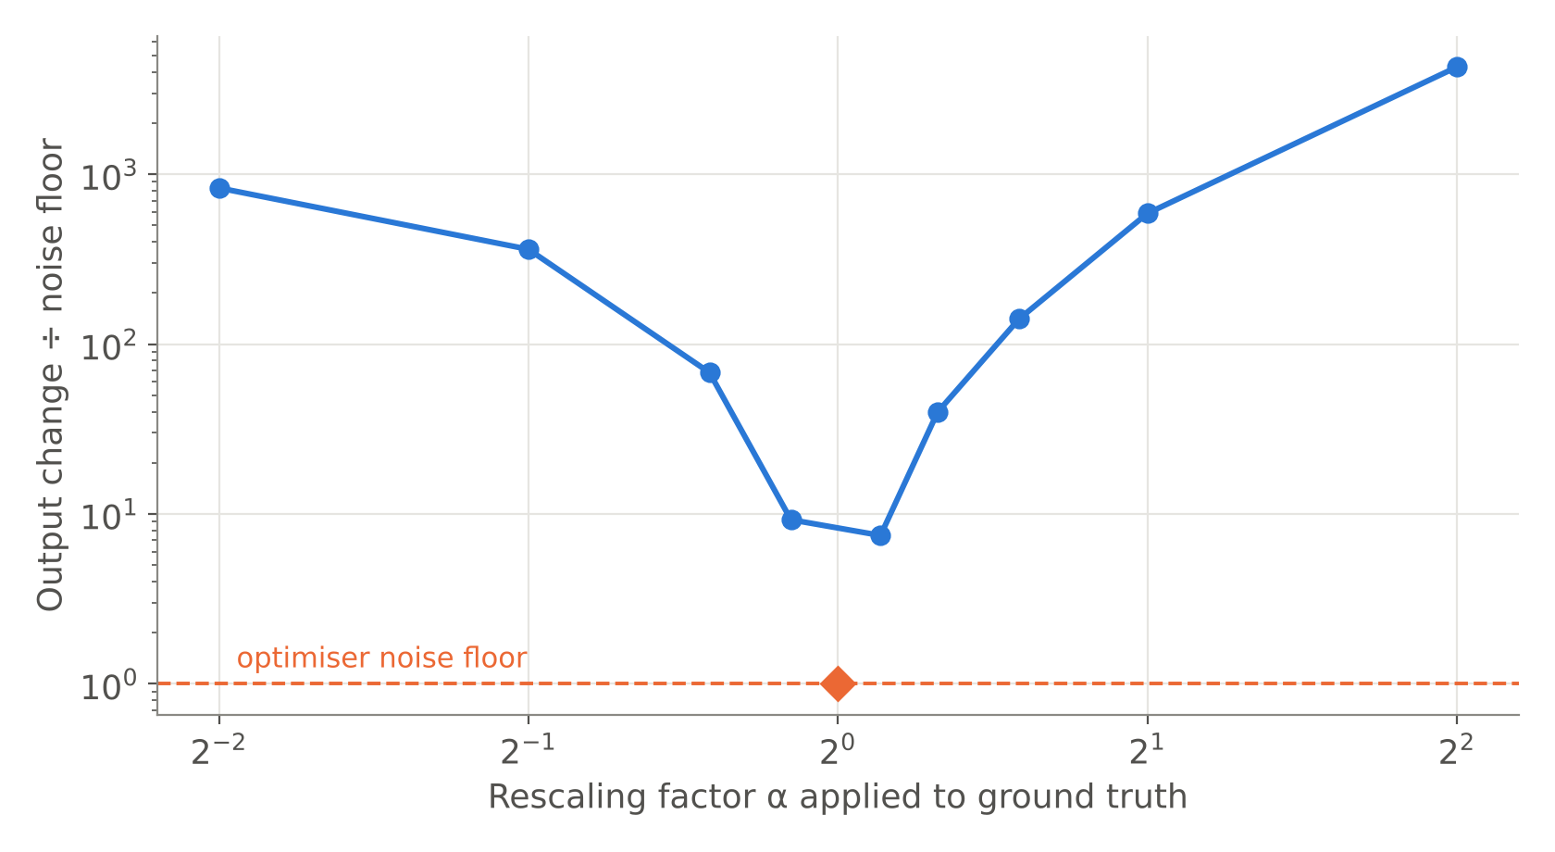
Gain is identifiable; nonlinear inversion beats a linear decoder
Only the true scale fits: a 10% rescale gives 7.5× the noise floor.
Gradient inversion 0.918 vs best ridge decoder 0.060 (≈15×; ridge target is easier, so a floor).
Notes:
Two simple alternative explanations excluded early: the decoder is not just losing overall magnitude, and a linear readout fitted on the same model does far worse.

Slide 36
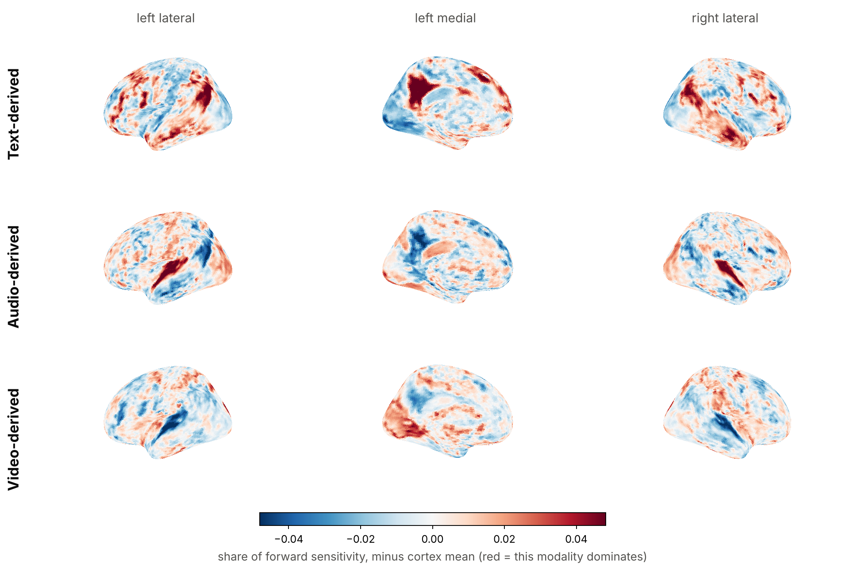
First look at regions: the operator's topography matches anatomy
Network | text z | audio z | video z
Language (L) | +26.6 | -12.5 | -18.5
Language (R) | +28.5 | -10.6 | -23.3
Auditory | -3.8 | +34.7 | -32.8
Default mode | +26.9 | -15.1 | -16.1
Visual | -38.4 | +7.5 | +40.7
Somatomotor | -3.5 | +6.9 | -3.5
Each network is driven by the modality it should be: language and default mode by text, auditory cortex by audio, visual cortex by video. Recovery per network follows at Review III.
Notes:
Forward sensitivity per vertex to perturbations confined to each modality slot of x, 16 directions each, forward passes only. z against 2 000 random vertex sets of the same size (ignores spatial autocorrelation, so read as effect sizes). Independent check that the operator we invert is neuroanatomically sensible.

Slide 37
6 · Plan to completion
Timeline, division of work and what Review III will show

Slide 38
Timeline
Aug
Sep
Oct
Nov
Dec
S1 Literature, problem formulation
S2 Instrumentation, inversion boundary
S3 Core synthetic characterisation
S4 Controls: init, null-space, gain, baseline
S5 Regional (ROI) analysis
S6 Real-data study (LeBel 2023)
S7 Paper and final report
completed
in progress
planned
Review II
Review III (planned)
Notes:
S1-S3 are complete. S4 and S5 are already running (some control experiments have results we will present at Review III). S6 uses the LeBel 2023 corpus (OpenNeuro ds003020), the same corpus TRIBE v2 was trained on, so the encoder is in-distribution. S7 overlaps S6 so the write-up does not wait for the last experiment.

Slide 39

Division of work
Abhranil Sarkar
Tanisha Choudhuri
23BML0077 · Computational and machine-learning track
23BML0081 · Neurobiological track
Model instrumentation and the differentiable boundary
Inversion engine, optimisation, experiment design
Synthetic characterisation and controls
Quantitative evaluation and figures
Functional neuroanatomy and ROI definition (Destrieux atlas)
Network topology: language, default-mode, auditory, visual
Real-data curation and preprocessing (LeBel 2023)
Interpretation of regional findings
Notes:
Split as declared in Report I. The two tracks meet at the regional analysis: the ROI definitions come from the neurobiology side and the inversion from the computational side. Both members should be ready to explain the whole pipeline at a high level.

Slide 40
Summary and what Review III will show
Established today
Coming at Review III
A deep brain encoder can be inverted by gradient descent from its feature boundary
Encoding accuracy and decodability dissociate (28× vs +0.015)
The inverse is stable under noise; magnitude is the fragile part
≈10% of cortex carries most recoverable signal
Generic priors fail; bandwidth needs an explicit HRF model
Early: the inverse is non-convex, not a null space; errors lie in weak directions
Full controls and replication of the early results
Regional recoverability by anatomical network
Is the most predictable cortex the most decodable?
First validation on real fMRI (LeBel 2023)
Notes:
Close on the finding: recovery is incomplete because the inverse is non-convex and anisotropically conditioned, not because information is destroyed. Review III completes the controls, adds the regional analysis and starts the real-data validation.

Slide 41
Backup · Anticipated questions
Slides held in reserve for the viva

Slide 42
Q: Why fMRI and not EEG? Why not simultaneous EEG–fMRI?
Why not EEG?
Brain2Qwerty (Nat. Neurosci. 2026): the same architecture reaches 29% character error with MEG but 65% with EEG. EEG lacks the spatial resolution to separate semantic regions.
Why not EEG–fMRI fusion?
The best open simultaneous dataset (NKI, 22 adults) contains rest, Inscapes and short movie clips, with no sustained language. The approach is data-limited, not method-limited.
Why TRIBE v2?
Largest open-weight encoder: trained on 451.6 h, evaluated on 1 117.7 h from 720 subjects, first of 263 teams at Algonauts 2025, and it predicts all 20 484 cortical vertices.
Notes:
Telesford et al., Sci. Data 2023 is the NKI simultaneous EEG-fMRI dataset if they ask for the source.

Slide 43
Q: Isn't inverting a model circular? Why synthetic data?
Aren't you just inverting Meta's model, not the brain?
Yes, deliberately. Any model-based decoder on fMRI inherits the forward model's limits. Characterising the operator bounds every decoder built on it, and the operator reproduces classic findings (FFA, PPA, Broca's area) in its own paper.
Why synthetic ground truth?
With real fMRI the true representation behind the signal is unknown, so error can only be estimated through proxies. Synthetic ground truth gives exact error. Real data (LeBel 2023) is the final validation step, not the instrument.
Is synthetic x realistic?
We compared off-manifold white noise against smooth low-dimensional trajectories: 0.947 vs 0.942. Results do not depend on the stimulus prior.
Notes:
Key phrase: the model is the instrument; the contribution is the characterisation of its inverse.

Slide 44
Q: Methodological choices
Why cosine similarity?
Semantic embeddings are compared by direction in NLP. We also report relative error (magnitude) and retrieval (temporal identity), because they can disagree; under noise they do.
Why gradient descent instead of a trained decoder?
A trained decoder conflates its own capacity with the operator's invertibility. Direct inversion isolates the operator. A trained (ridge) baseline is reported at Review III.
Why decode x, not words?
x is what the encoder consumes. Mapping x to words is a nearest-neighbour lookup and not where information is lost.
Notes:
If asked about Adam's bias: the Review III initialisation and perturbation experiments address this; the perturbation test does not depend on any optimiser.

Slide 45
Q: Ethics, privacy and licensing
Is this 'mind reading'?
No subject data is collected. Results show the opposite risk profile: even with a near-perfect forward model, recovery is incomplete and noise-sensitive. Ethics frameworks (OECD 2019; UNESCO 2025) inform the discussion at Review III.
Consent and data protection?
Synthetic data contains no personal data. The real-data phase uses a de-identified public corpus (OpenNeuro) released for research.
Licences?
TRIBE v2 weights and code: CC BY-NC 4.0 (non-commercial research permitted). LLaMA-3.2: Meta community licence, access granted to the team.
Notes:
UNESCO adopted its Recommendation on the Ethics of Neurotechnology on 12 November 2025; OECD Recommendation on Responsible Innovation in Neurotechnology, 2019.

Slide 46
References
[1] T. M. Mitchell et al., “Predicting human brain activity associated with the meanings of nouns,” Science, vol. 320, pp. 1191–1195, 2008.
[2] K. N. Kay, T. Naselaris, R. J. Prenger, J. L. Gallant, “Identifying natural images from human brain activity,” Nature, vol. 452, pp. 352–355, 2008.
[3] T. Naselaris, K. N. Kay, S. Nishimoto, J. L. Gallant, “Encoding and decoding in fMRI,” NeuroImage, vol. 56, no. 2, pp. 400–410, 2011.
[4] A. G. Huth et al., “Natural speech reveals the semantic maps that tile human cerebral cortex,” Nature, vol. 532, pp. 453–458, 2016.
[5] R. Antonello, A. Vaidya, A. G. Huth, “Scaling laws for language encoding models in fMRI,” in Proc. NeurIPS, vol. 36, 2023.
[6] J. Tang, A. LeBel, S. Jain, A. G. Huth, “Semantic reconstruction of continuous language from non-invasive brain recordings,” Nat. Neurosci., vol. 26, pp. 858–866, 2023.
[7] A. LeBel et al., “A natural language fMRI dataset for voxelwise encoding models,” Sci. Data, vol. 10, art. 555, 2023.
[8] A. Défossez, C. Caucheteux, J. Rapin, O. Kabeli, J.-R. King, “Decoding speech perception from non-invasive brain recordings,” Nat. Mach. Intell., vol. 5, pp. 1097–1107, 2023.
[9] P. S. Scotti et al., “MindEye2: Shared-subject models enable fMRI-to-image with 1 hour of data,” in Proc. ICML, 2024.
[10] S. d’Ascoli et al., “Towards decoding individual words from non-invasive brain recordings,” Nat. Commun., vol. 16, art. 10521, 2025.
[11] J. Lévy, M. Zhang, S. Pinet, J. Rapin, H. Banville, S. d’Ascoli, J.-R. King, “Noninvasive decoding of typed sentences from human brain activity,” Nat. Neurosci., 2026.
[12] S. d’Ascoli, J. Rapin, Y. Benchetrit, H. Banville, J.-R. King, “TRIBE: TRImodal Brain Encoder for whole-brain fMRI response prediction,” in Proc. ICLR, 2026.
[13] S. d’Ascoli et al., “A foundation model of vision, audition, and language for in-silico neuroscience,” arXiv:2605.04326, 2026.
[14] P. C. Hansen, Discrete Inverse Problems: Insight and Algorithms. Philadelphia, PA: SIAM, 2010.
[15] D. P. Kingma, J. Ba, “Adam: A method for stochastic optimization,” in Proc. ICLR, 2015.
[16] J. L. Gardner, T. Liu, “Inverted encoding models reconstruct an arbitrary model response, not the stimulus,” eNeuro, vol. 6, no. 2, ENEURO.0363-18.2019, 2019.
[17] Bladon, Bent, “Feature visualization recovers known cortical selectivity from TRIBE v2,” arXiv:2605.13904, 2026.
[18] Y. Benchetrit et al., “Boosting brain-to-image decoding with TRIBE v2 data augmentation,” arXiv:2606.06345, 2026.
Notes:
IEEE format, peer-reviewed sources and three arXiv preprints (TRIBE v2 and its two 2026 follow-ups, needed as novelty evidence). No websites. Placed last so it stays on screen during questions.

