Slide 1
Conditioning and Non-Convexity of Semantic Decoding by Inversion of Deep Brain Encoding Models
Project-I (BECE497J) · Final Review, Poster and Demonstration · 29 October 2026
Abhranil Sarkar (23BML0077) · Tanisha Choudhuri (23BML0081)
Guide: Dr. Sharmila Nageswaran, Associate Professor, School of Electronics Engineering
Notes:
The complete project in one deck: problem, data, method, every result on synthetic and real fMRI, the verification re-run of 19 October, deliverables, mappings and future work. Backup slides at the end answer the questions we expect.

Slide 2
Contents
1
Problem, motivation and objectives
why decoding by inversion, the gap, six objectives, literature, novelty
2
Method and validation
TRIBE v2 and its data, why fMRI, the re-entry point, inversion, synthetic protocol, hypotheses, constraints, tools
3
Results on exact ground truth
dissociation, non-convexity, verified barriers, weak directions, gain, robustness, linear baseline
4
Regional analysis
six anatomical networks, topography, predictable vs recoverable, response diversity
5
Real fMRI
LeBel 2023 pipeline, encoding, identification vs reconstruction, multi-start run on the real model
6
Standards, ethics and SDGs
BIDS, IEEE P2731 / P2794, FAIR, licences, neuro-ethics, SDG 3.4 / 9.5 / 10.2
7
Outcomes
deliverables, live demo, schedule, cost, contributions, PO / PSO / WP mapping, impact, limitations, future work
Notes:
Seven parts. Backup slides with anticipated questions and the full reference list follow the conclusion.

Slide 3



Motivation: reading meaning back out of the brain
Clinical need
Encoders are now very good
The untested step
ALS, brainstem stroke, locked-in syndrome and severe aphasia can leave comprehension intact while removing speech and writing. A non-invasive decoder would restore a channel without neurosurgery.
Deep encoding models predict whole-cortex fMRI from video, audio and language, and accuracy keeps rising with model size and data [3, 7]. Decoding is usually assumed to follow.
A forward model can be highly predictive and still have an inverse that is non-unique or unstable (Hadamard; Hansen [8]). Nobody had measured this for a deep foundation encoder.
Question. When an encoder becomes very accurate, does it become invertible? We answer it for Meta's open 177 M-parameter TRIBE v2.
Notes:
Mental privacy is the other side of the same question: the limits of what can be decoded matter as much as the successes.

Slide 4
Project at a glance: complete
28.4×
3.8×
−0.125
4 / 5
lower encoding error, while recovery saturates at 0.944
error barrier between equally good blind solutions (7.2× to a deeper one)
visual cortex, most responsive, recovers worst vs random vertices
held-out real-fMRI segments identified (chance 2.2%), cosine 0.02
Completion against the project plan
Formulation
Instrumentation
Core characterisation
Controls & validation
Regional analysis
Real-data study
Write-up and release
Status: 100% complete. All six objectives met. Delivered: IEEE-format manuscript, final report (VIT 2026 format), A3 poster, open GitHub repository with code, logged results, an interactive live demo and four Colab notebooks. Key claims re-verified on the real model on 19 October 2026.
Notes:
Everything planned in Report I is done: 580 person-hours across seven stages. The four headline numbers each come from a different part of the project: synthetic dissociation, the corrected barrier test, the regional analysis and real fMRI.

Slide 5
Problem, gap and objectives
Gap. Encoders keep improving [3, 7], but nobody has measured whether that makes meaning more recoverable from fMRI, or what limits the inverse. Linear encoders are invertible only up to a linear transform [18]; deep encoders were never tested.
O1
Formulate decoding as inversion; find the differentiable entry point
Done
O2
Synthetic framework with exact ground truth
Done
O3
Characterise the inverse vs. budget, noise, extent, priors
Done
O4
Discriminate non-identifiability vs. non-convexity vs. optimiser limits
Done
O5
Linear baseline; recoverability by anatomical network
Done
O6
Validate on real naturalistic fMRI (LeBel 2023)
Done
Notes:
All six objectives complete. O6, the real-data validation, came last on purpose: synthetic ground truth is the instrument, real data the external check.

Slide 6
Literature review
Work | Contribution | Limitation relevant here
Mitchell et al., 2008 | Linear model predicts fMRI for unseen nouns | Single words, hand-built features
Kay et al., 2008 [21] | Identifies viewed images via predicted responses | Identification, not recovery
Naselaris et al., 2011 [1] | Encoding models as the route to decoding | Assumes invertibility
Huth et al., 2016 [2] | Semantic maps across cortex from natural speech | Linear; no inverse analysis
Antonello et al., 2023 [3] | Encoding accuracy scales with model size | Scaling shown for encoding only
Tang et al., 2023 [4] | Continuous language from fMRI via LM search | Per-subject decoder; search, not inversion
Gardner & Liu, 2019 [18] | Linear IEMs identifiable only up to a transform | Linear models only
Lévy et al., 2025 [6] | Typed sentences from MEG (CER 32%) and EEG (67%) | Shows EEG's limits for language
d'Ascoli et al., 2026, TRIBE v2 [7] | Open foundation encoder, 720 subjects | Encoder only; inverse never studied
Bladon & Bent; Benchetrit et al., 2026 [19, 20] | Feature visualisation; synthetic training data | Neither tests uniqueness of the inverse
Notes:
The arc: encoders went from linear maps on hand-built features to deep foundation models; decoding was always evaluated by proxies (rank, retrieval, word error) because the true representation behind real fMRI is unknown. Inverse analysis existed only for linear models.

Slide 7
Objectives anchored to the literature
Prior work | What it assumed or left open | What we add
Naselaris et al. 2011 [1] | Encoding models are the route to decoding | Measure when that route fails: dissociation of 28× vs +0.015
Antonello et al. 2023 [3]; TRIBE v2 2026 [7] | Encoding accuracy scales log-linearly with data | Show decoding saturates while encoding error keeps falling
Tang et al. 2023 [4] | Decoding via LM-guided search, per-subject decoder | Decoder-free inversion; exact error under ground truth
Hansen 2010 [8] (inverse problems) | Ill-posedness via conditioning and null spaces | Test both on a 177 M-parameter operator: non-convex, not null-space
Huth 2016 [2]; Fedorenko 2024 [10]; Buckner 2008 [11] | Semantic, language and default-mode networks | Recoverability and modality sensitivity per network
Brain2Qwerty 2026 [6]; Défossez 2023 [22] | Non-invasive decoding limited by modality | Limits that hold even for a near-perfect fMRI forward model
Notes:
Rubric line 'objectives well aligned to literature': each row is one prior result, the assumption it made, and the specific measurement we contribute.

Slide 8
Proof of novelty I: prior-art comparison
Closest prior work | Nonlinear deep encoder | Optimises encoder input | Tests uniqueness / conditioning | Region-wise recoverability
Kay et al., Nature 2008 [21] | ○ | ○ | ○ | ○
Gardner & Liu, eNeuro 2019 [18] | ○ | ● | ● | ○
Tang et al., Nat. Neurosci. 2023 [4] | ○ | ● | ○ | ●
d'Ascoli et al., TRIBE v2, 2026 [7] | ● | ○ | ○ | ○
Bladon & Bent, arXiv May 2026 [19] | ● | ● | ○ | ○
Benchetrit et al., arXiv Jun 2026 [20] | ● | ○ | ○ | ○
This work | ● | ● | ● | ●
Only this work fills all four columns. The closest result, Gardner & Liu [18], proves that a linear inverted encoding model recovers the stimulus only up to an invertible linear transform. We ask the same question of a 177 M-parameter nonlinear encoder, where no closed-form answer exists, and answer it empirically with exact ground truth.
Notes:
● = the paper does this; ○ = it does not. Tang 2023 optimises over word sequences (beam search scored by a linear encoder on GPT features) and compares cortical networks, so it gets two marks; its encoder is linear in the LM features, and it never asks whether the answer is unique. Gardner & Liu is the theoretical ancestor of our question, for linear models only. If a reviewer names another paper, ask which column it fills; none we found fills the third column for a deep encoder.

Slide 9
Proof of novelty II: search protocol and the closest TRIBE v2 work
Search protocol
Bladon & Bent, May 2026 [19]
Date: 9 October 2026
Sources: arXiv, Google Scholar, general web
Queries: "TRIBE v2"; invert / inversion / identifiability / conditioning / non-convex + "brain encoding model" / "fMRI encoder"
Inclusion: any work that inverts, optimises the input of, or analyses the identifiability of a brain encoding model
Result: two TRIBE v2 follow-ups (right). Neither tests whether the inverse is unique or how it is conditioned.
What it does: Feature visualisation: optimises inputs to maximise a region's predicted response and recovers known cortical selectivity.
Difference: Asks what a region prefers. Does not ask whether the input can be recovered, or whether the answer is unique.
Benchetrit et al., June 2026 [20]
What it does: Uses TRIBE v2 forwards to synthesise fMRI that augments training of a brain-to-image decoder.
Difference: The encoder is only run forwards; its inverse is never analysed.
Notes:
This is the evidence behind the word 'first'. Say it carefully: 'we found no published inverse or identifiability analysis of a deep foundation encoder as of 9 October 2026', not 'nobody has ever done this'. Both TRIBE v2 follow-ups are from 2026 and are the closest possible competitors; neither touches uniqueness or conditioning.

Slide 10
Novel contributions, each with its evidence
# | Contribution | Evidence | Status
1 | First uniqueness and conditioning analysis of a deep foundation brain encoder | Prior-art matrix and dated search protocol (previous two slides) | Shown
2 | Encoding accuracy and decodability dissociate | Encoding error falls 28.4×; the final halving buys +0.015 recovery | Shown
3 | Incomplete recovery is non-convexity, not a null space | Equal fits disagree (min cosine 0.817 ± 0.007, 4 truths); straight paths between them rise 3.8× (7.2× to a deeper minimum) | Shown
4 | Error concentrates in the operator's least-sensitive directions | Solution difference 2.1× below the random median (1.9× originally); below all 200 random directions | Shown
5 | Predictable is not recoverable, region by region | Visual −0.125, somatomotor +0.102 vs size-matched random sets; ≈10× the control spread | Shown
6 | Nonlinear inversion beats linear decoding | 0.918 vs 0.060 for the best ridge decoder (≈15×) | Shown
7 | On real fMRI the inverse identifies but does not reconstruct | Held-out story: 4/5 segments among 45 (chance 2.2%), cosine 0.02; oracle 5/5, 0.22 | Shown
Notes:
Each claim is paired with the number that supports it, so a reviewer can challenge the evidence rather than the wording. Status 'Shown' means the evidence is on a slide in this deck.

Slide 11
Methodology, analytical model and validation
How every claim is tested, and what would have falsified it

Slide 12
Functional block diagram (final)
Ground-truth generator
seeded, 32 × 1152
Frozen operator f(x)
TRIBE v2, 177.21 M params
Measurement model
y = M ⊙ f(x*) + η
Inversion engine
Adam on x, θ frozen, gradients by autograd
Anatomical ROI masks
Destrieux atlas → 6 networks on fsaverage5
Forward sensitivity maps
per-vertex response to text / audio / video dims
Hypothesis tests
init control · perturbation · sensitivity · gain
Controls
size-matched random masks · 2nd seed · whole-cortex anchor
Evaluation
cosine · per-modality cosine · rel. error · retrieval
Results store
results.json + ROI json · figures from logged numbers
New since Review II: ROI masks, sensitivity maps, hypothesis tests and controls (green / violet / grey).
Notes:
Top row: the core loop. Middle: the neurobiology track (anatomical masks, sensitivity maps) and the hypothesis tests. Bottom: controls, evaluation and the results store from which every figure is regenerated.

Slide 13
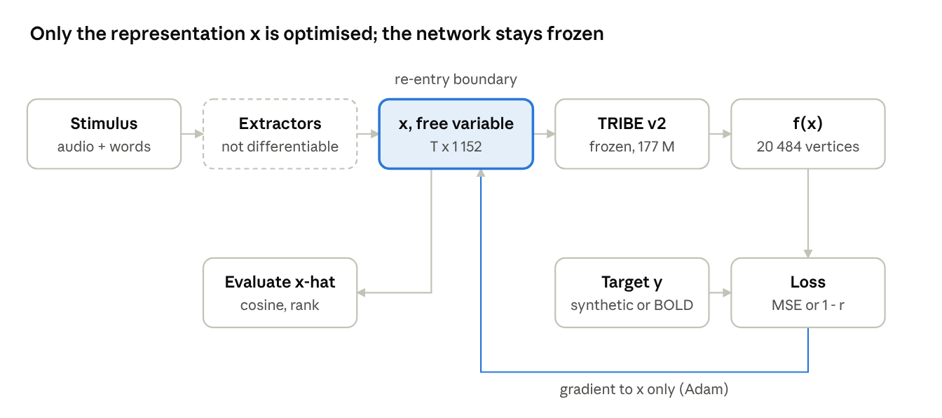
Where we cut into the network
Fact | Value
Parameters (all frozen) | 177.21 M: encoder 127.47 M, low-rank head 1 152 → 2 048, subject layer 41.97 M, temporal pooler
Input we optimise | x ∈ ℝ^(T × 1 152): text | audio | video slots of 384 each, 2 Hz
Output | 20 484 fsaverage5 vertices × 100 steps at 1 Hz
Re-entry check | reproduces the released predictions exactly (r = 1.0000); ‖∂f/∂x‖ = 7.97 × 10³, no zero entries
Notes:
The public inference path runs speech synthesis, transcription and frozen extractors under inference mode, so it is not differentiable end to end. The input batch is consumed at one point only, the aggregation of extractor features into x; everything after is tensor arithmetic. We re-enter there: f(x) = pool(predictor(head(encoder(x)))).

Slide 14
Inversion and the synthetic protocol
x̂ = argmin_x ‖f(x) − y‖² + λ R(x) · s(v) = ‖f(x + εv) − f(x)‖ / ε
Setting | Value
Optimiser | Adam [17], lr 5 × 10⁻², cosine annealing over the budget; θ frozen, gradients by autograd
Initialisation | 0.01·N(0, I), seed 999 (default); eight distributions for the uniqueness study
Ground truth | smooth trajectory in a random 8-D subspace of ℝ^1152, two cosine cycles, T = 32; white noise as off-manifold control
Target | y = f(x), so recovery error is exact; real data: 1 − Pearson r over time (scale-free)
Metrics | mean per-step cosine to x, relative error, encoding error, retrieval rank among time steps
Priors tested | ℓ₂ and temporal smoothness, λ swept; none by default
Notes:
s(v) is a finite-difference probe of the Jacobian along a unit direction v, used for the sensitivity analysis.

Slide 15
What TRIBE v2 learned from: its fMRI training data
Dataset (train) | What participants did in the scanner | Subjects | Sessions | fMRI (h) | TR (s)
CNeuroMod / Algonauts 2025 [23] | Watched TV (Friends, seasons 1–6) and 4 feature films: video + audio + dialogue | 4 | 1 408 | 268.7 | 1.49
BOLD Moments [24] | Watched 1 102 three-second naturalistic video clips (1 000 train, 102 test × 10) | 10 | 520 | 61.9 | 1.75
LeBel et al. 2023 [5] | Listened to spoken autobiographical stories (podcasts); 82 stories for 3 subjects | 8 | 432 | 85.8 | 2.0
Wen et al. 2018 [25] | Watched natural movie clips (8-min segments, test segments ×10) | 3 | 258 | 35.2 | 2.0
Training total | All 3T; passive viewing / listening, no task | 25 | 2 618 | 451.6 | —
Evaluation (never trained on). NNDb (86 subjects, films), Le Petit Prince (112, audiobook), Narratives (321, spoken stories), HCP 7T (176, movie clips): 695 subjects, 666.1 h. With training: 720 subjects, 5 094 sessions, 1 117.7 h of fMRI [7].
What this means for us. Our real-data subject UTS03 is one of the 8 LeBel training subjects, but our test story (wheretheressmoke) is TRIBE v2's own held-out test split, so the encoder never saw the responses we invert. The released weights use one averaged 'unseen subject' layer, so we invert the population model.
Notes:
Numbers from Table 1 of d'Ascoli et al. 2026 (arXiv 2605.04326) and the study definitions shipped with the TRIBE v2 code (subject IDs and TRs: Algonauts2025 sub-01/02/03/05, BOLD Moments 10 subjects, LeBel UTS01-08, Wen subject1-3). All participants were healthy adults scanned at 3T (HCP at 7T) while passively watching or listening; no task, no button presses. Consent and ethics are those of the original studies; all four training sets are public. Modalities: CNeuroMod has video, audio and text; BOLD Moments video and audio; LeBel audio and text; Wen video only.

Slide 16
Why fMRI, not EEG
Criterion | fMRI (this work) | EEG
Spatial detail | ≈2–3 mm voxels; 20 484 cortical vertices | 32–128 scalp channels, cm-scale, blurred
Foundation encoder to invert | TRIBE v2: 177 M parameters, 1 117.7 h, 720 subjects | No open whole-brain encoder of naturalistic EEG at this scale
Number of inverse problems | One: response → representation | Two: scalp → cortical sources (itself ill-posed) → representation
Measured language-decoding evidence | Continuous language reconstructed from fMRI [4] | Same decoder: 67% character error with EEG vs 32% with MEG [6]
Open naturalistic language data | LeBel 2023: 8 subjects, 85.8 h of stories | No open simultaneous EEG–fMRI set with sustained speech
Temporal resolution | 1.5–2 s samples, ≈5 s haemodynamic lag (cost) | Milliseconds (EEG advantage)
Cost and portability | Scanner-bound (cost) | Wearable, low cost (EEG advantage)
Decision. fMRI is where the question can be answered today: it has the spatial detail, the data and the only deep encoder large enough to invert. EEG's real advantages (speed, cost) matter for a deployed device, not for measuring how invertible an encoder is. The method transfers to EEG once a comparable EEG encoder exists.
Notes:
Answer in one breath: EEG would add a second ill-posed inverse problem (source localisation) on top of the one we study, and no EEG foundation encoder exists to invert. We considered simultaneous EEG-fMRI (Report I, Solution 3): the open NKI simultaneous dataset has rest, Inscapes and short movie clips but no sustained language. Brain2Qwerty numbers are from the arXiv preprint (Lévy et al. 2025). Be honest about the two rows in red: fMRI is slow and expensive, which is why a clinical device would eventually need EEG or MEG; our contribution is to measure the limits first.

Slide 17
Four explanations for incomplete recovery
Hypothesis | Predicted signature | Test | Verdict
H1 Information loss (null space) | Error stays flat on the line between fit-matched solutions | Straight-path error profile, forward passes only | Rejected
H2 Non-convexity | Distinct minima at equal fit, separated by a barrier | Init control at matched fit (× 4); path rise; near-truth control | Supported
H3 Optimiser artefact (under-convergence) | Recovery keeps rising with budget | Convergence curve; fit-matched inclusion | Controlled
H4 Unidentifiable gain | Rescaled x produces the same output | Forward-only rescaling test | Rejected
H5 Errors along weak directions | Difference directions have low Jacobian response | Directional sensitivity vs 200 random | Supported
Notes:
Pre-registered style: each hypothesis has a signature that would show up if it were true and a test that could falsify it. Two were rejected by our own experiments, which is the strongest evidence that the method can discriminate.

Slide 18
Validation built into the method
Risk to validity | Safeguard | Outcome
Measuring the optimiser, not the operator | Converge first; independent runs to schedule end | Plateau ≈ 0.94 by 32 000 steps
Under-converged runs posing as alternative solutions | Only blind solutions within 2× of the best blind fit | Gaussian s.d. 5 excluded (3.2× worse fit)
One trajectory being special | Replicate across 4 independent ground truths | min pairwise 0.8165 ± 0.0068
Inference instead of demonstration | Straight-path error between fit-matched solutions | Rises 1.5–6.0× (median 3.8×): H1 rejected
Solutions that were told the answer | Near-truth starts used only as a control | Deeper minimum, 4.6× lower error
ROI size confound | Random vertex sets of identical size | Paired comparison per network
Random-seed luck in controls | Second random seed for two networks | Δ between seeds ≤ 0.013
Platform dependence | Whole-cortex anchor re-run on CPU vs earlier GPU | 0.836 vs 0.836 (GPU)
Notes:
This is the 'with validation' part of the top rubric band for methodology. The CPU anchor is the same ground truth, initialisation and budget as the Stage 6 GPU run; agreement shows results are not a platform artefact.

Slide 19
Constraints, alternatives and trade-offs
Constraint | Effect | Trade-off adopted
No local GPU | Large models cannot run on laptops | Free Colab T4 for GPU work; CPU for regional analysis; Llama in half precision
12 GB RAM / 15 GB GPU | Llama-3.2-3B and w2v-BERT cannot load together | One story per process; audio and text in separate passes
Released pipeline not differentiable | Raw stimuli cannot be optimised | Invert the aggregated representation x
No ground truth in real fMRI | Recovery cannot be measured directly | Exact synthetic evaluation + identification at a known chance level
Only an averaged subject layer | No per-subject analysis | Invert the population model; stated as a limitation
Synthetic x in a random subspace | Absolute values may not transfer | Real-data validation confirms the qualitative pattern
Alternatives from Report I. (1) End-to-end supervised decoder: needs large per-subject data and cannot explain failures. (2) Inversion of a pretrained encoder: selected. (3) Simultaneous EEG–fMRI fusion decoder: blocked, since no open simultaneous dataset contains sustained language.
Notes:
These are the engineering decisions a reviewer will ask about; each constraint maps to one concrete design choice.

Slide 20
Hardware and software tools
Category | Tool | Use
Compute (GPU) | Google Colab, NVIDIA T4 (15 GB), 12 GB RAM | Synthetic characterisation, real-data features and inversion, verification
Compute (CPU) | Linux cloud CPU | Regional analysis, surface projection, recorded multi-start run, figures
Deep learning | PyTorch, HuggingFace Transformers and Hub | Autograd through the frozen encoder; Llama-3.2-3B, w2v-BERT 2.0
Encoder | TRIBE v2 code and weights (Meta FAIR, CC BY-NC 4.0) | Frozen forward operator
Neuroimaging | nilearn, nibabel, ANTsPy, pycortex transforms | Atlas, surfaces, registration, surface projection
Scientific Python | NumPy, SciPy, scikit-learn, h5py, Matplotlib | Analysis, ridge baseline, figures
Data | OpenNeuro ds003020 (LeBel et al., 2023) | Real naturalistic fMRI
Delivery | GitHub, Colab notebooks, WebGL demo page, PowerPoint, Word | Release, live demo, reviews and report
Notes:
No hardware was built: the project is computational. Total compute spend was zero rupees.

Slide 21
Results and interpretation
Why recovery is incomplete, and where in cortex meaning is recoverable

Slide 22
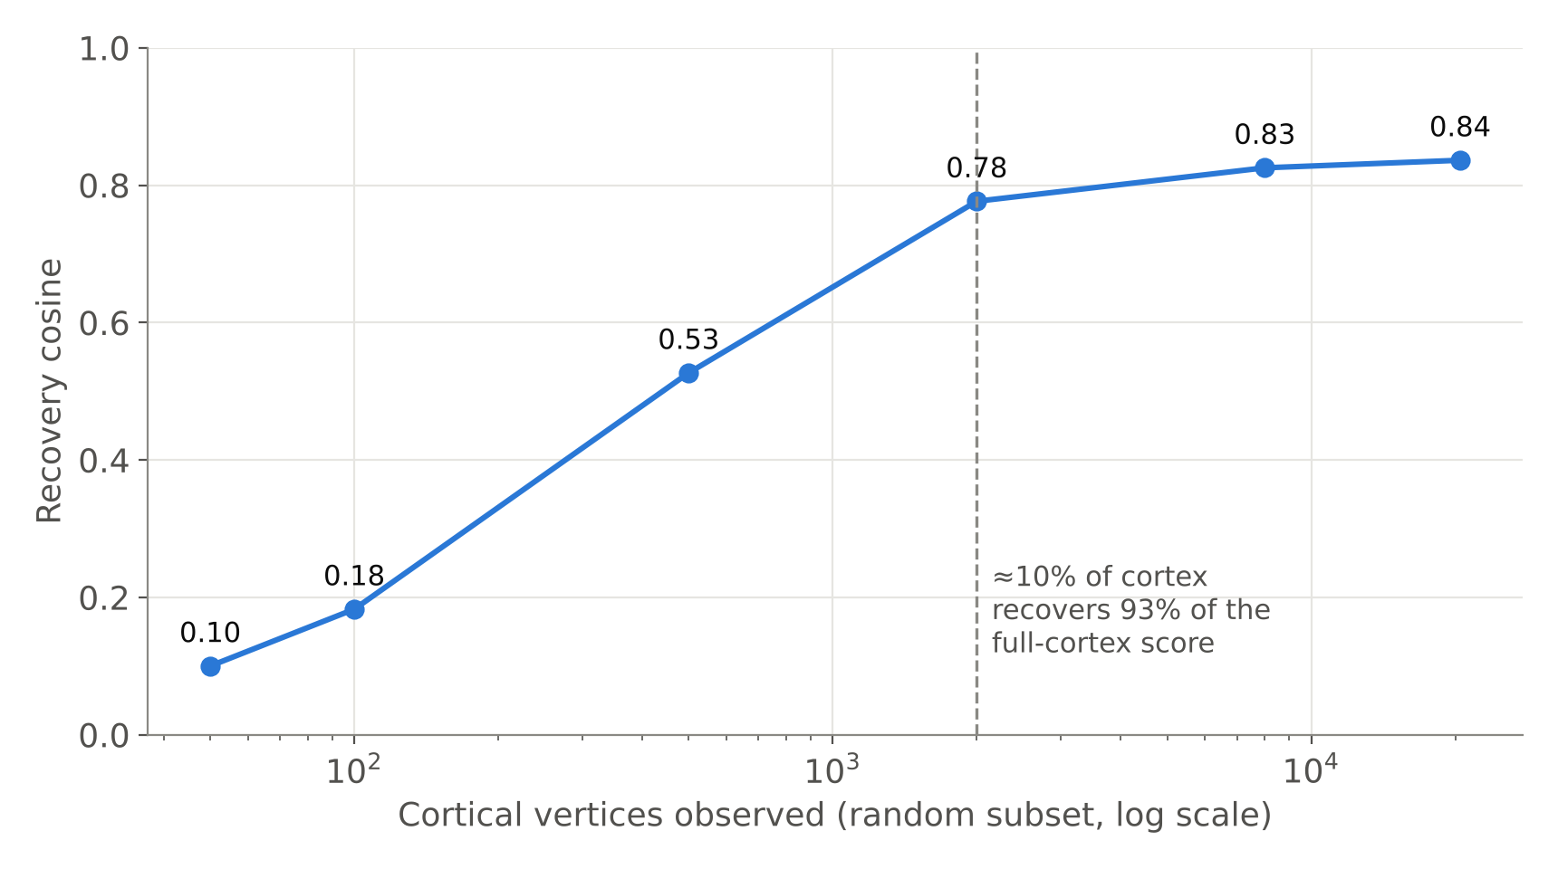
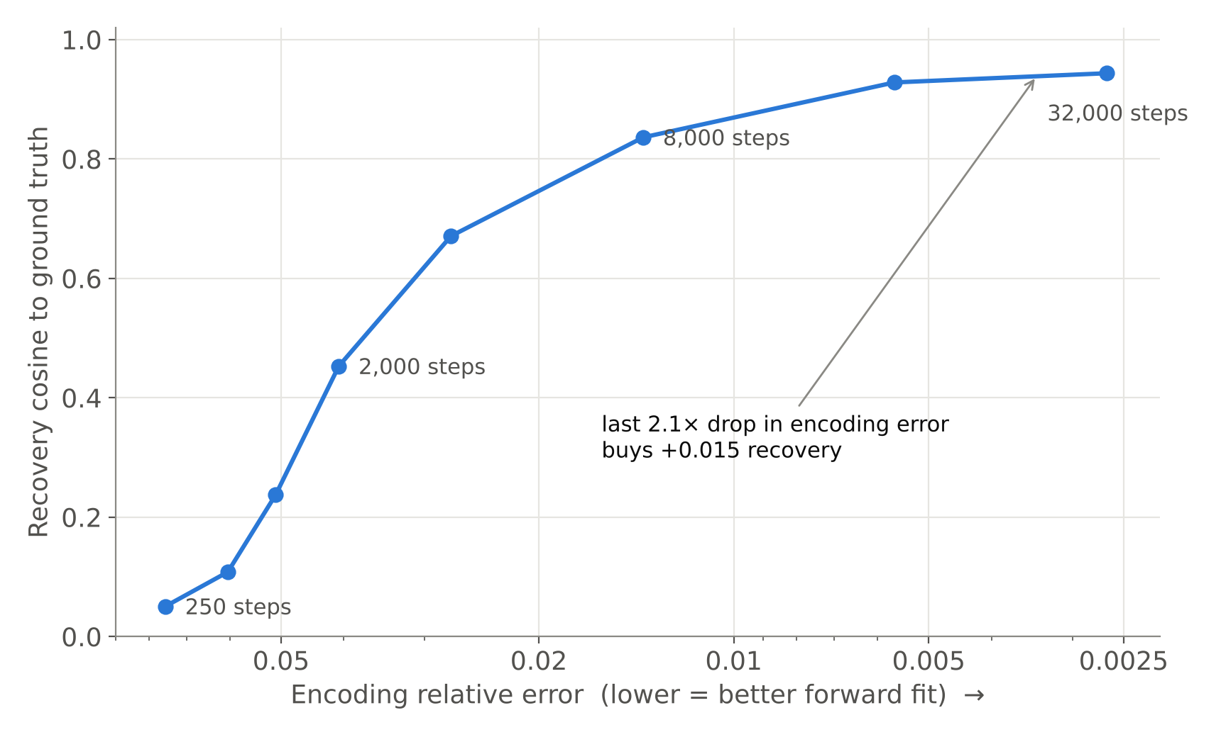
Recap: encoding and decoding dissociate
Encoding error falls 28.4× while recovery saturates at 0.944. Recovery saturates near 2 000 random vertices. Both established at Review II.
Notes:
One-slide recap so the panel has the baseline facts before the new results.

Slide 23
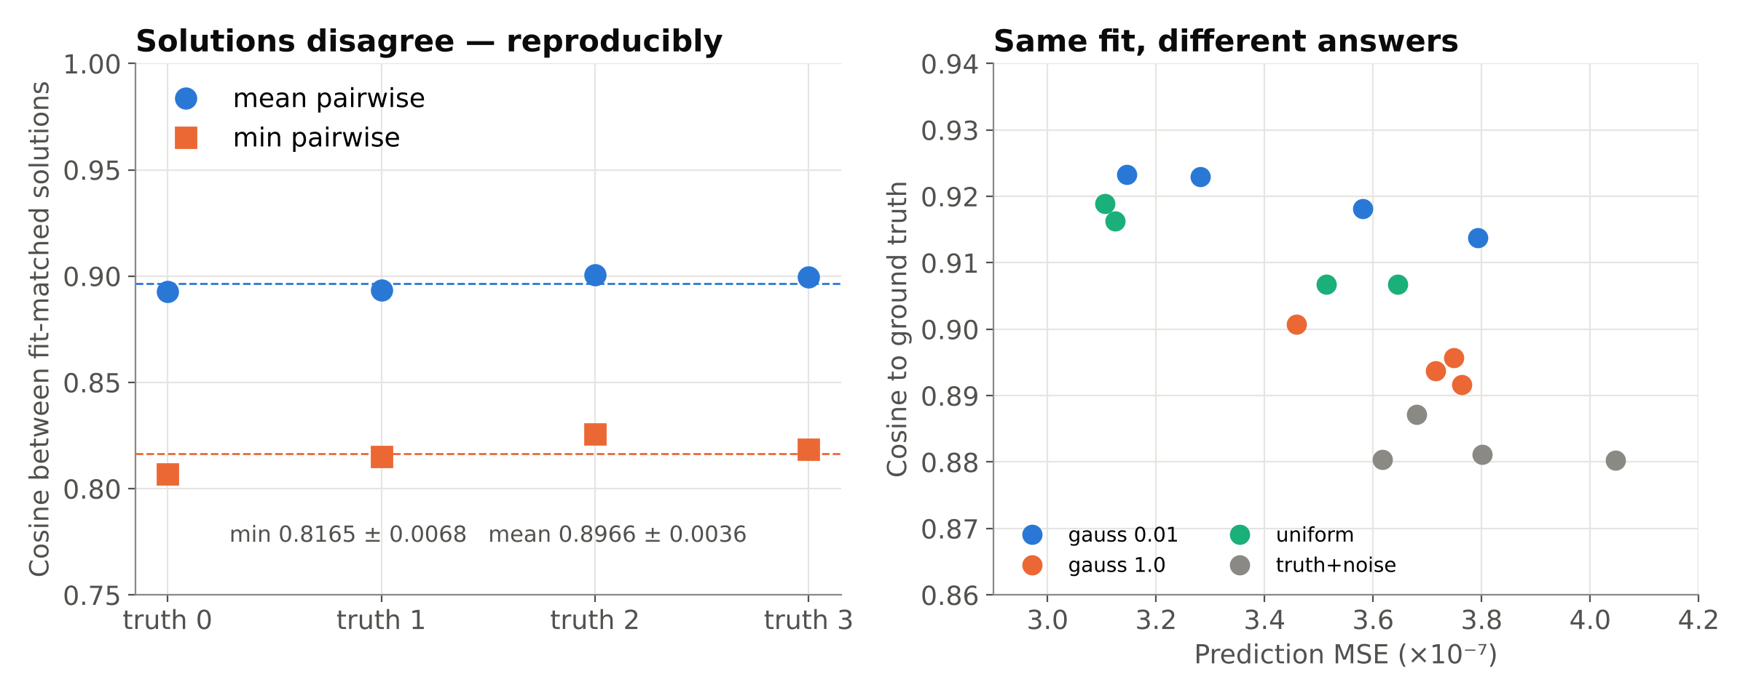
Same fit, different answers: the inverse is non-convex
Ground truth | Best fit | Mean pairwise | Min pairwise | Worst pair
0 | 3.51e-7 | 0.8928 | 0.8068 | uniform vs truth+noise
1 | 3.65e-7 | 0.8934 | 0.8151 | uniform vs truth+noise
2 | 3.11e-7 | 0.9007 | 0.8257 | uniform vs truth+noise
3 | 3.13e-7 | 0.8996 | 0.8186 | uniform vs truth+noise
Notes:
Four initialisation distributions, 14 000 steps each, all reach prediction MSE within 3.1-4.0e-7 (fit-matched), yet agree with each other only at 0.82-0.90 cosine. Reproduced across four independent ground truths with sd 0.0068. The same pair disagrees most every time, and recovered norms cluster by initialisation (0.90, 0.99, 0.94, 1.17 in every run): solutions separate along a consistent, structured direction, not randomly.

Slide 24
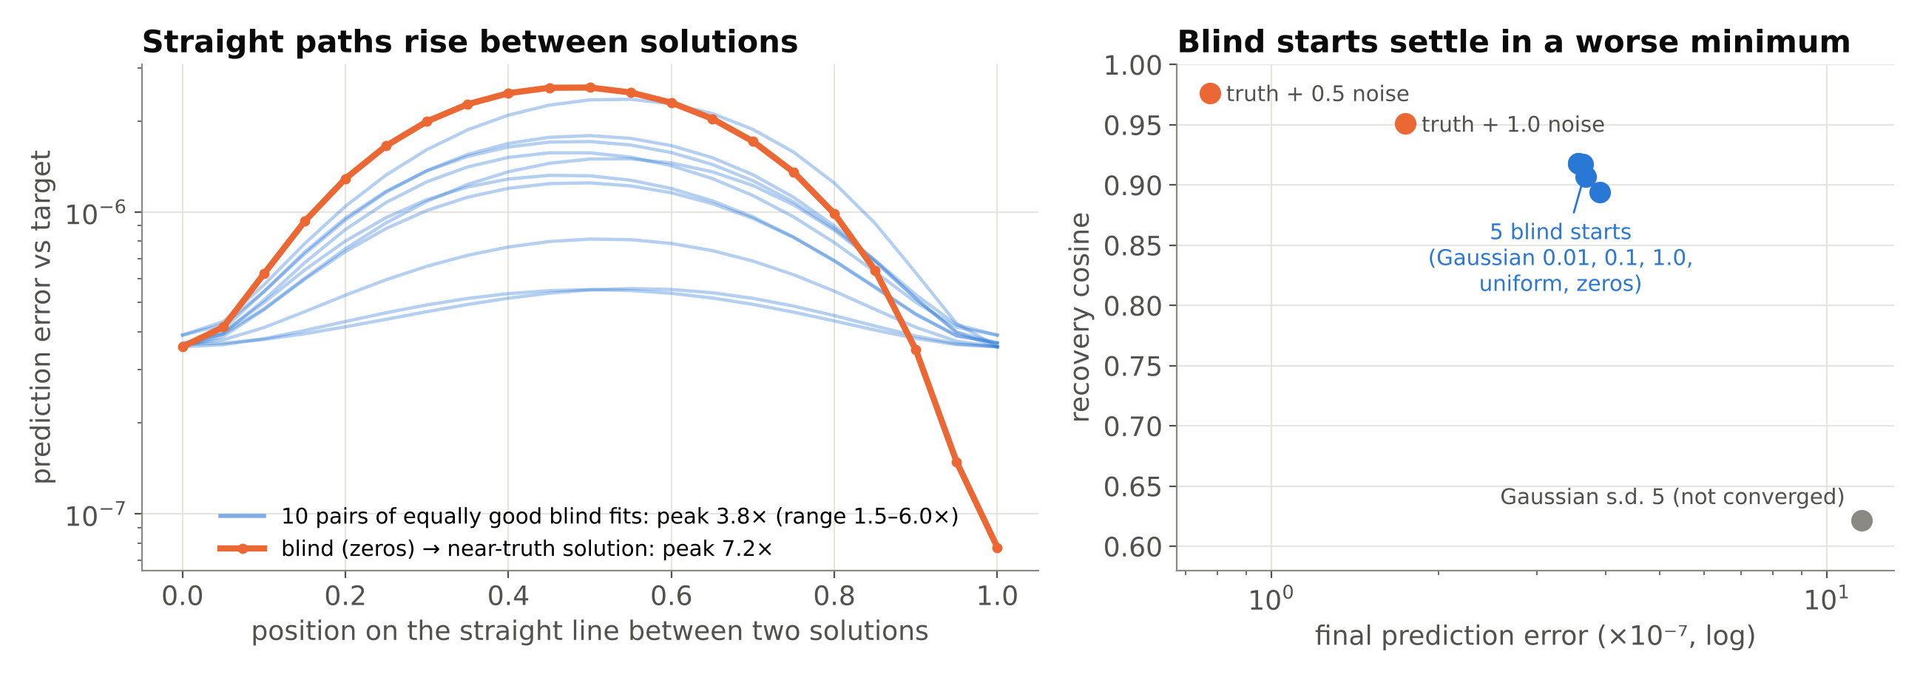
Barriers, not a null space (verified on the real model)
Result. On the straight line between any two of the five equally good blind fits the error rises 1.5–6.0× (median 3.8×). A flat null space would stay level. Starts near the truth find a minimum with 4.6× lower error, 7.2× barrier away.
Correction. Our earlier perturbation test (2.6× → 0.6×) paired an unconverged solution (Gaussian s.d. 5). It is withdrawn; the selection rule is fixed and the test was re-run on a T4 on 19 Oct 2026.
Notes:
Verification notebook, ground truth 0, 14 000 steps, eight starts inverted together. Blind fit-matched starts: Gaussian 0.01, 0.1, 1.0, uniform, zeros (3.57-3.90e-7). Error measured against the target at 21 points on each straight line. The rise grows as the pair becomes less similar (cosine 0.999 gives 1.5x, 0.890 gives 4.6x). If asked about the old test: once both endpoints fit the target, moving along d barely changes the prediction compared with a random direction (2.6x, 6.0x, 13x, 258x), so that comparison cannot detect a barrier; the path profile can.

Slide 25
Blind starts settle in a worse minimum
Start | Told the truth? | Final error (×10⁻⁷) | × best blind | Recovery cosine
Gaussian, s.d. 0.01 | no | 3.63 | 1.02 | 0.917
Gaussian, s.d. 0.1 | no | 3.57 | 1.00 | 0.918
zeros | no | 3.57 | 1.00 | 0.918
uniform on [−1, 1] | no | 3.68 | 1.03 | 0.907
Gaussian, s.d. 1.0 | no | 3.90 | 1.09 | 0.894
Gaussian, s.d. 5.0 | no | 11.5 (not converged) | 3.23 | 0.621
truth + 1.0 noise | yes (control) | 1.74 | 0.49 | 0.951
truth + 0.5 noise | yes (control) | 0.77 | 0.22 | 0.976
What it means
Every start a real decoder could use (no knowledge of the answer) ends at almost the same error, 3.6–3.9 × 10⁻⁷, and agrees with the others only at 0.89–1.00.
A deeper minimum exists: starting near the truth reaches 4.6× lower error and recovery 0.976.
Between them the error rises 7.2×, so gradient descent cannot slide from one to the other. Better search, not a better encoder, is what decoding needs.
Notes:
Numbers from results/verification/testA.json (Colab T4, 19 Oct 2026). The near-truth starts are controls only: they tell us a deeper minimum exists, which a blind decoder cannot reach by local search.

Slide 26
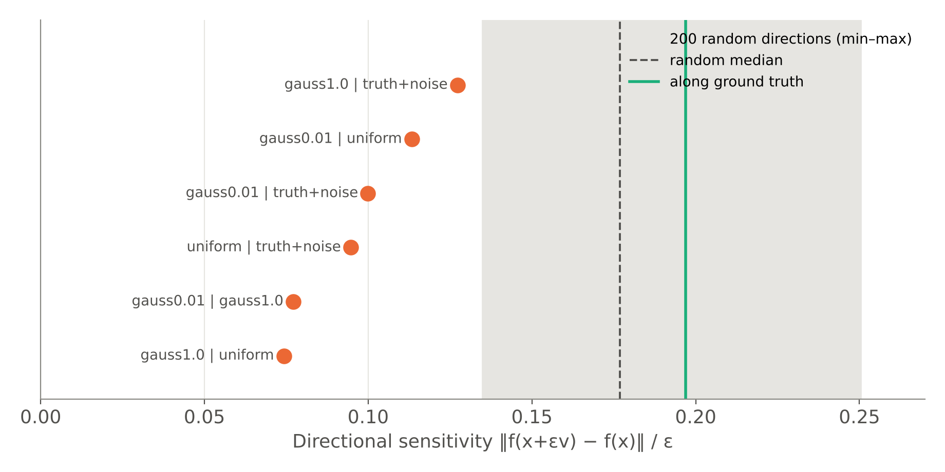
Errors concentrate in the operator's weakest directions
2.1×
lower sensitivity along d than the random median (corrected pair; 1.9× originally, shown)
9 / 10
blind pairs below the random median; d below all 200 random directions
Anisotropic ill-conditioning: what the inverse fails to pin down is what the operator responds to least (corrected pair s = 0.081 vs random 0.122–0.239; actual error 1.8× below).
Notes:
Directional sensitivity is a finite-difference probe of the Jacobian. All six pairwise difference directions fall 1.4-2.4× below the random median and below the random minimum. So the inverse is not singular (H1 rejected) but it is anisotropic: some directions are weakly constrained, and that is where different minima differ. This links non-convexity to conditioning.

Slide 27
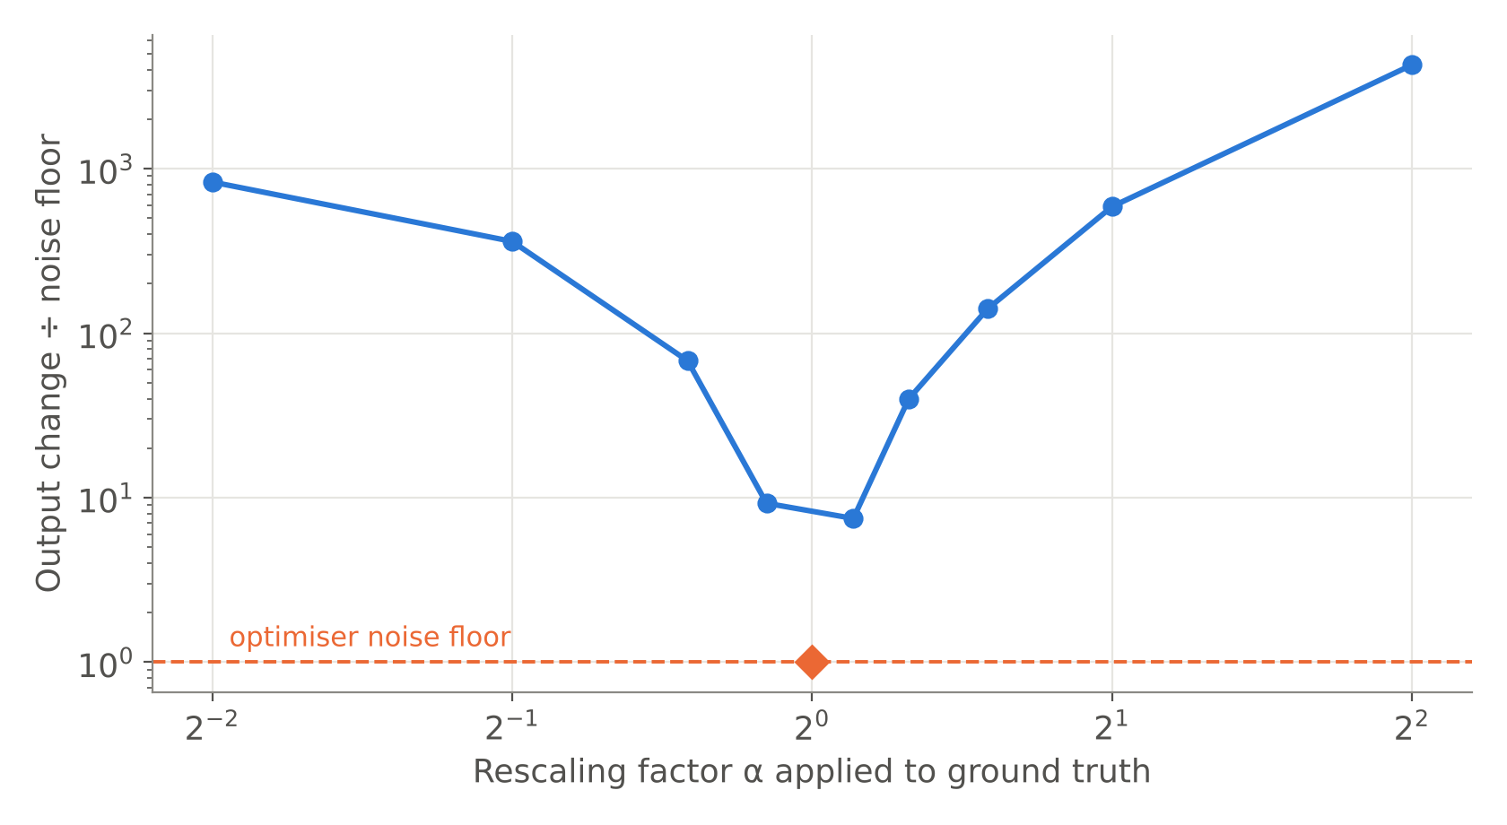
Gain is identifiable; error is not a single scale factor
Quantity | Value
Direction cosine | 0.8362
Mean norm ratio ‖x̂‖/‖x*‖ | 0.747 (sd 0.046)
Norm correlation over time | 0.915
Relative error, raw | 0.5516
Relative error after optimal rescale | 0.5675
Rescaling makes error slightly worse, so the shortfall is not a global gain. Even ±10% scaling is 7–9× above the noise floor.
Two simple explanations excluded: the decoder is not merely losing the overall magnitude of the representation.
Notes:
Forward-only test: scale the ground truth by alpha and compare the output change to the optimiser's residual floor (1.3e-6). Only alpha = 1 sits within the floor; alpha = 0.9 and 1.1 are 9.2× and 7.5× above it. Separately, rescaling the recovered trajectory to the true norm changes relative error from 0.5516 to 0.5675. Both rule out 'gain is unidentifiable'.

Slide 28
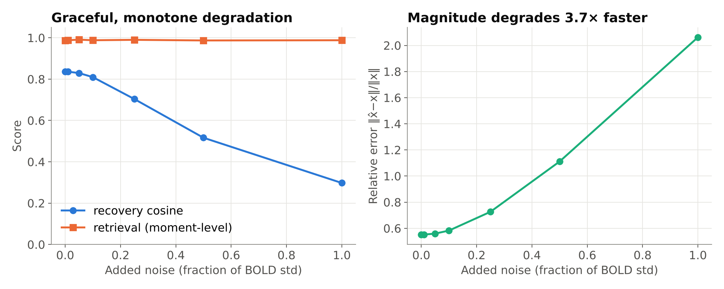
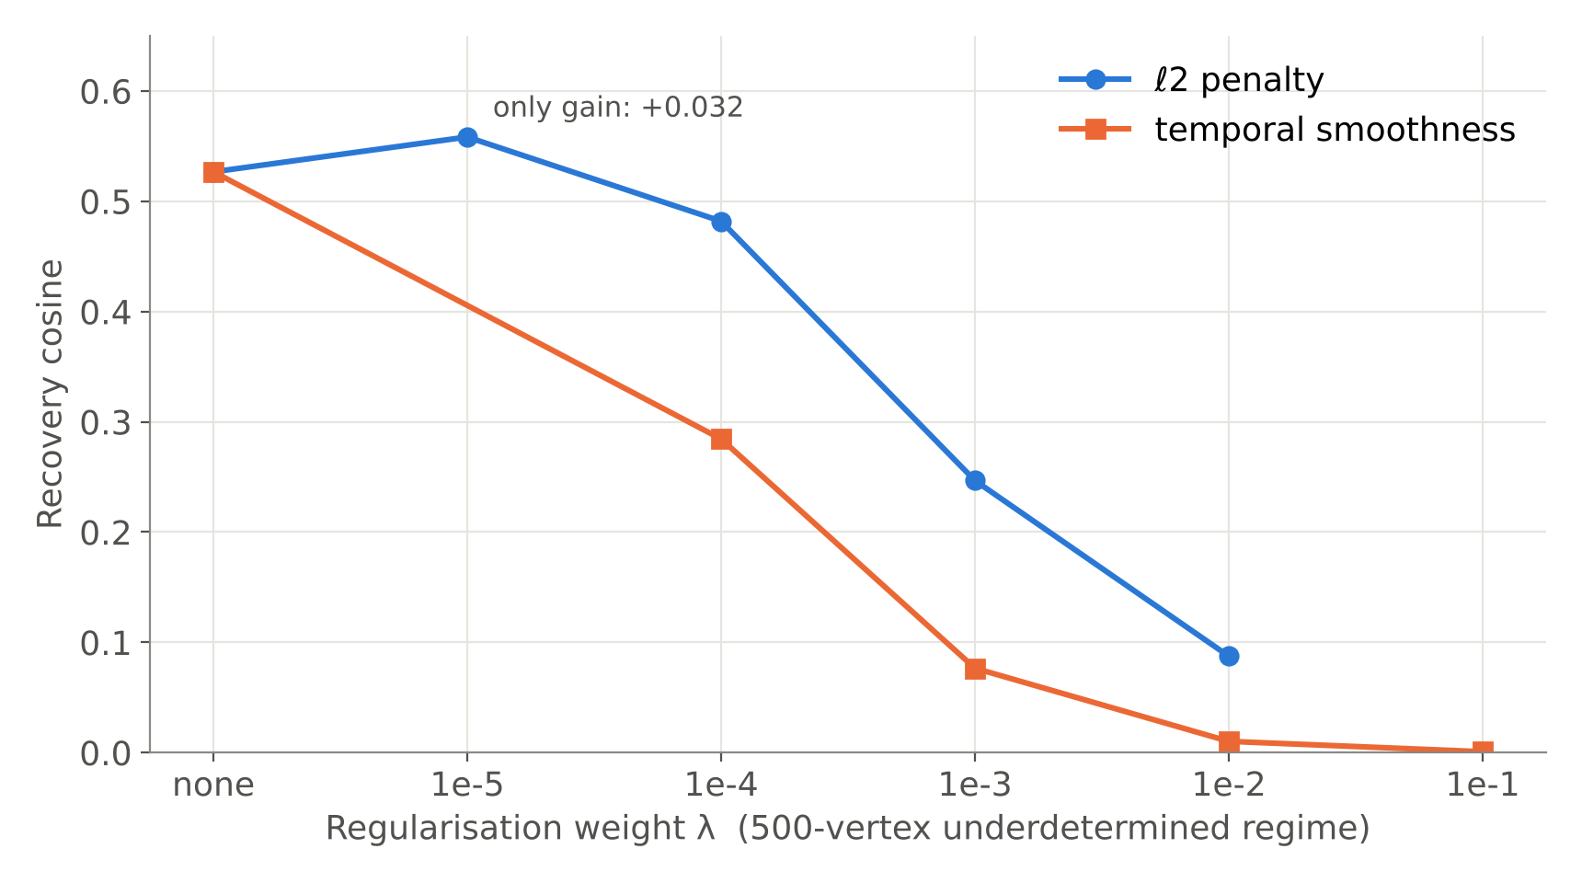
Robustness: noise, observed cortex and priors
Test | Result
Noise 0 → 100% of BOLD s.d. | recovery 0.836 → 0.298, monotone; retrieval ≈ 0.99
Observed cortex 50 → 20 484 | 0.100 → 0.836; 2 000 random vertices reach 0.777
ℓ₂ prior | best +0.032 at λ = 10⁻⁵, harmful above
Smoothness prior | 0.527 → 0.0008
Stimulus manifold | white 0.947 vs smooth 0.942
Rate of change, 64× | 0.836–0.858, no trend
Notes:
The inverse degrades gracefully with noise: direction is kept, magnitude is lost (relative error 0.55 to 2.06). About 10% of cortex carries most of the recoverable signal. Generic priors do not help; priors matched to the operator's weak directions are future work.

Slide 29
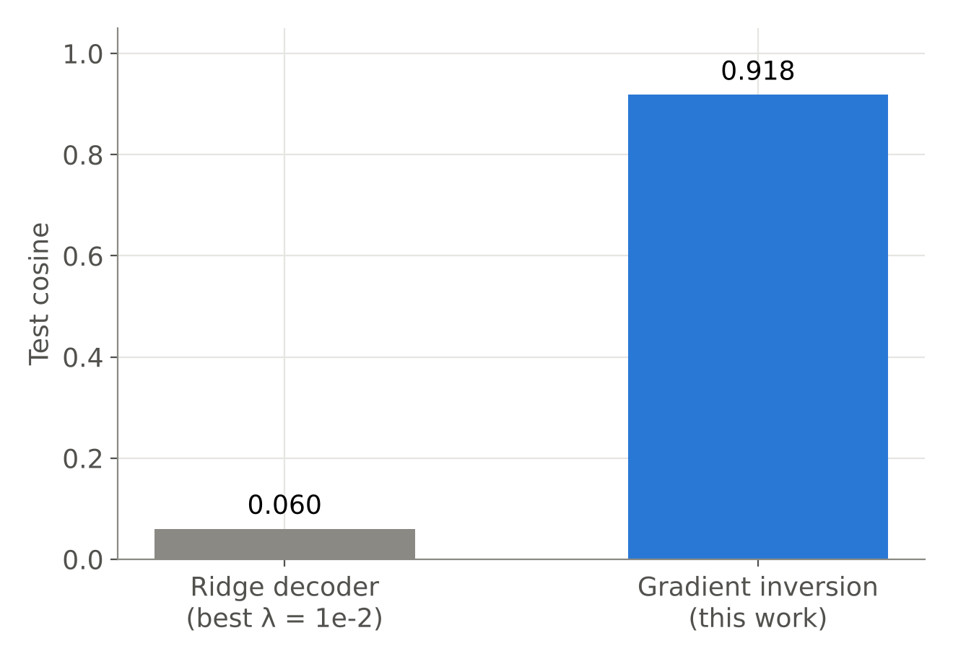
Nonlinear inversion vs a linear decoder
Ridge λ | Test cosine
1e-2 | 0.0599
1e-1 | 0.0310
1e0 | 0.0205
1e1 | 0.0133
1e2 | 0.0103
Caveat stated plainly. Ridge (240 train / 60 test pairs) predicts the time-averaged representation from time-averaged BOLD, a strictly easier target than the time-resolved trajectory inversion recovers. Read 0.060 as a floor; the 15× gap exceeds what the mismatch can explain.
Notes:
The operator is strongly nonlinear (transformer + pooling), so a linear decoder fitted on the same forward model barely beats chance. This justifies inverting the operator instead of training a linear readout. The comparison is indicative, not exact, and we say so before they do.

Slide 30
What did not work, reported as such
Experiment | Outcome | Why | How we report it
Optimiser control (SGD, L-BFGS) | Fits 1.4e-4 / 2.8e-5 vs Adam 3.5e-7 | Hyperparameters did not converge | Invalid control; limitation
Bandwidth sweep | Flat 0.838–0.858 over 64× | No HRF operator in the release | Structural null result
Stimulus manifold | 0.947 vs 0.942 | Operator indifferent to prior | Null result
Smoothness prior | 0.527 → 0.0008 | Wrong prior for semantics | Negative result
Original barrier test | Paired an unconverged solution | Pair chosen among all 8 starts | Withdrawn; re-run correctly
Why this slide exists: the non-convexity claim does not rest on the failed optimiser control. It rests on the straight-path barrier and sensitivity tests (forward passes only), the near-truth control and replication across four ground truths. A converged second optimiser would strengthen it, and is listed as future work.
Notes:
Reviewers often look for what was hidden. Showing it first takes the question away. If pressed on Adam's implicit bias: different initialisation distributions reach different minima reproducibly, and the barrier between them is shown with forward passes; neither depends on Adam.

Slide 31
Regional analysis (neurobiology track)
Which networks the operator listens to, and where meaning is recoverable

Slide 32
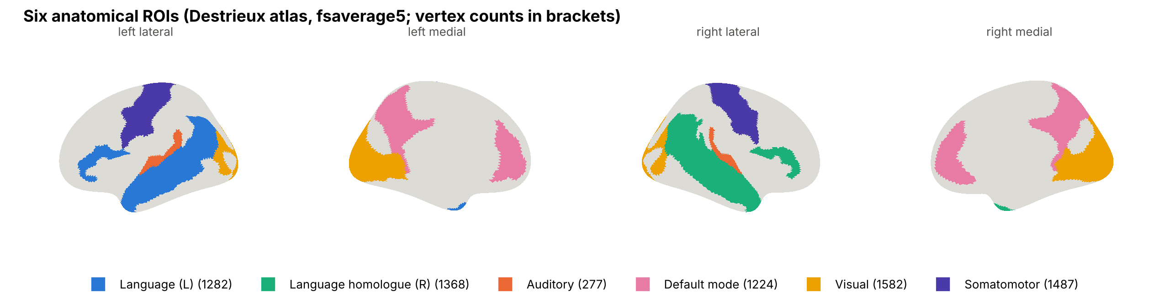
Six anatomical networks on fsaverage5
Network | Destrieux labels | Vertices
Language (L) | IFG opercular/triangular/orbital, STG lateral, STS, MTG, temporal pole, angular gyrus | 1 282
Language homologue (R) | Same labels, right hemisphere (lateralisation test) | 1 368
Auditory | Heschl's gyrus, transverse temporal sulcus, planum temporale | 277
Default mode | Precuneus, posterior cingulate (dorsal, ventral), anterior cingulate, subparietal | 1 224
Visual | Occipital pole, cuneus, calcarine, middle/superior occipital, lingual | 1 582
Somatomotor | Precentral, postcentral gyri, central sulcus (low-semantic control) | 1 487
Notes:
Atlas: Destrieux et al. (NeuroImage 2010), the anatomical parcellation shipped with Nilearn for fsaverage5 (74 labels per hemisphere); TRIBE v2 vertex order is left 0-10241 then right. Network membership follows Fedorenko et al. 2024 (language) and Buckner et al. 2008 (default mode). Angular gyrus is assigned to language only, so ROIs are disjoint. Somatomotor is the control network that should carry little semantic signal.

Slide 33
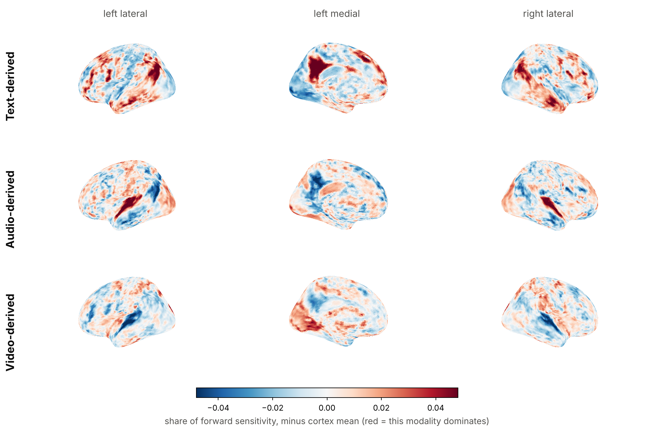
The operator's functional topography matches anatomy
Network | text z | audio z | video z
Language (L) | +26.6 | -12.5 | -18.5
Language homologue (R) | +28.5 | -10.6 | -23.3
Auditory | -3.8 | +34.7 | -32.8
Default mode | +26.9 | -15.1 | -16.1
Visual | -38.4 | +7.5 | +40.7
Somatomotor | -3.5 | +6.9 | -3.5
Each network is dominated by the modality it should be: language and default-mode by text-derived dimensions, auditory cortex by audio, visual cortex by video. Somatomotor is least sensitive overall (0.73× cortex mean).
Notes:
Per-vertex forward sensitivity to random perturbations confined to each third of x (text-, audio-, video-derived projector outputs), 16 directions per modality, forward passes only. Map shows each modality's share minus its cortical mean. z-scores compare each network's mean share to 2 000 random vertex sets of the same size; these nulls ignore spatial autocorrelation, so treat the z values as effect sizes and the sign pattern as the result. A spin-permutation test is the stricter next step. This is an independent check that the operator we invert is neuroanatomically sensible.

Slide 34
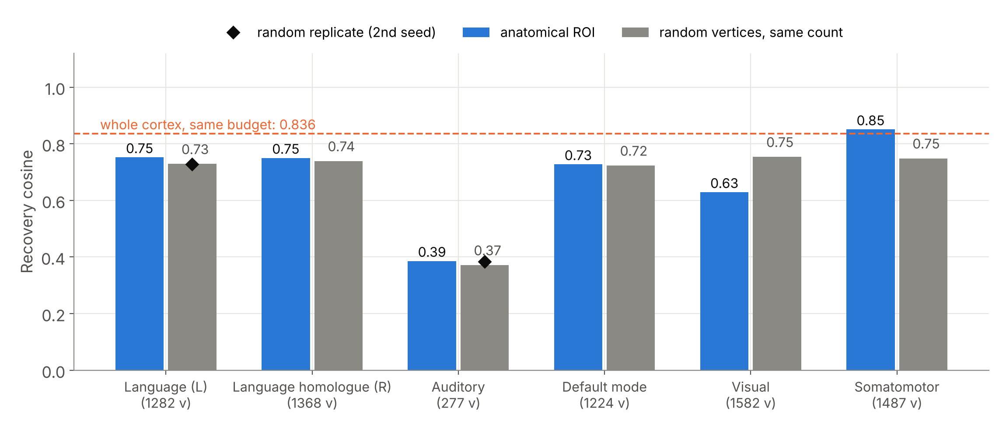
Where you look matters: visual cortex hurts, somatomotor helps
Network | ROI | Random | Δ
Language (L) | 0.752 | 0.729 | +0.023
Language homologue (R) | 0.750 | 0.739 | +0.011
Auditory | 0.386 | 0.371 | +0.015
Default mode | 0.727 | 0.723 | +0.004
Visual | 0.629 | 0.754 | −0.125
Somatomotor | 0.851 | 0.748 | +0.102
Visual cortex recovers 0.125 worse than random vertices of the same count; somatomotor 0.102 better, beating the whole cortex at the same budget (0.851 vs 0.836). Both effects are ~10× the control seed spread (≤ 0.013). Left language +0.023; homologue, auditory, default mode within noise.
Notes:
Each network is inverted observing only its own vertices; each has a random control of identical size (same seeding scheme as the extent sweep), and two networks have a second random seed: language controls differ by 0.0014, auditory controls by 0.0126, which bounds control variability. Whole-cortex anchor reproduces the earlier GPU value exactly (0.8362), so the CPU run is comparable. All values at a fixed 8 000-step budget and one ground truth: we claim relative differences within this run, not converged absolute values. Auditory is low in absolute terms simply because it has only 277 vertices (cf. extent curve).

Slide 35
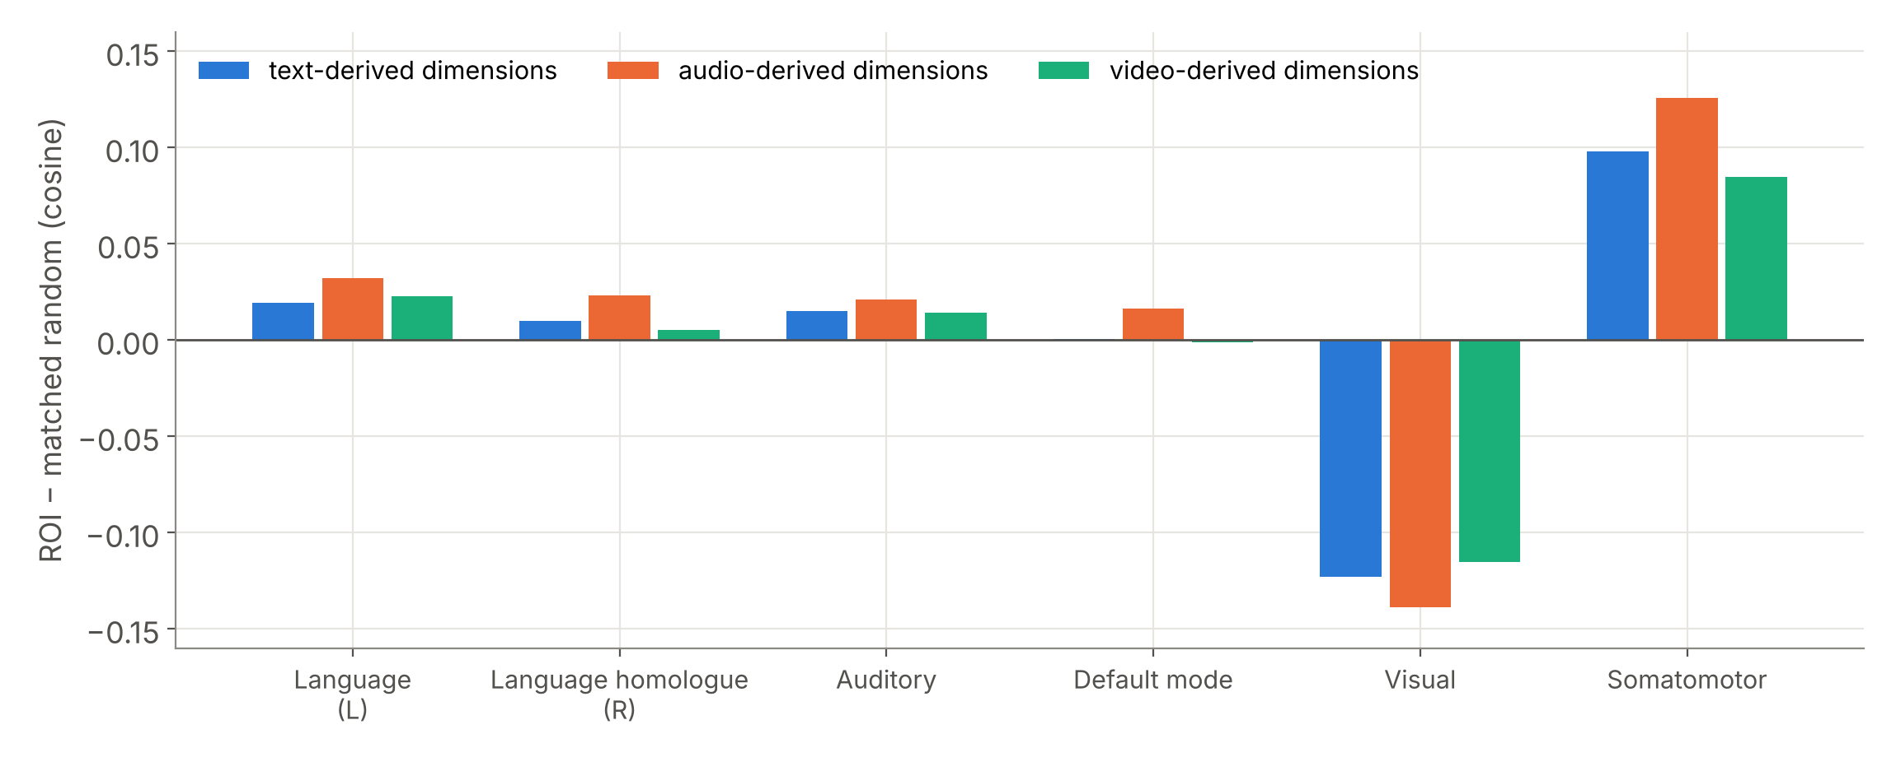
The regional effect is not modality-specific
Split recovery into the text-, audio- and video-derived thirds of x. If a network helped only with the modality it encodes, visual cortex would recover video dimensions well. Instead, every network shifts all three thirds together: visual cortex loses text, audio and video alike; somatomotor gains all three.
Regional recoverability is a property of how a region's response is shaped, not of which modality it is tuned to.
Notes:
Contrast with the topography slide: visual cortex is the most video-dominated network (z = +40.7), yet recovering the video-derived dimensions from visual cortex is worse than from random vertices (−0.116). Predictable is not the same as recoverable, even within a region's preferred modality.

Slide 36
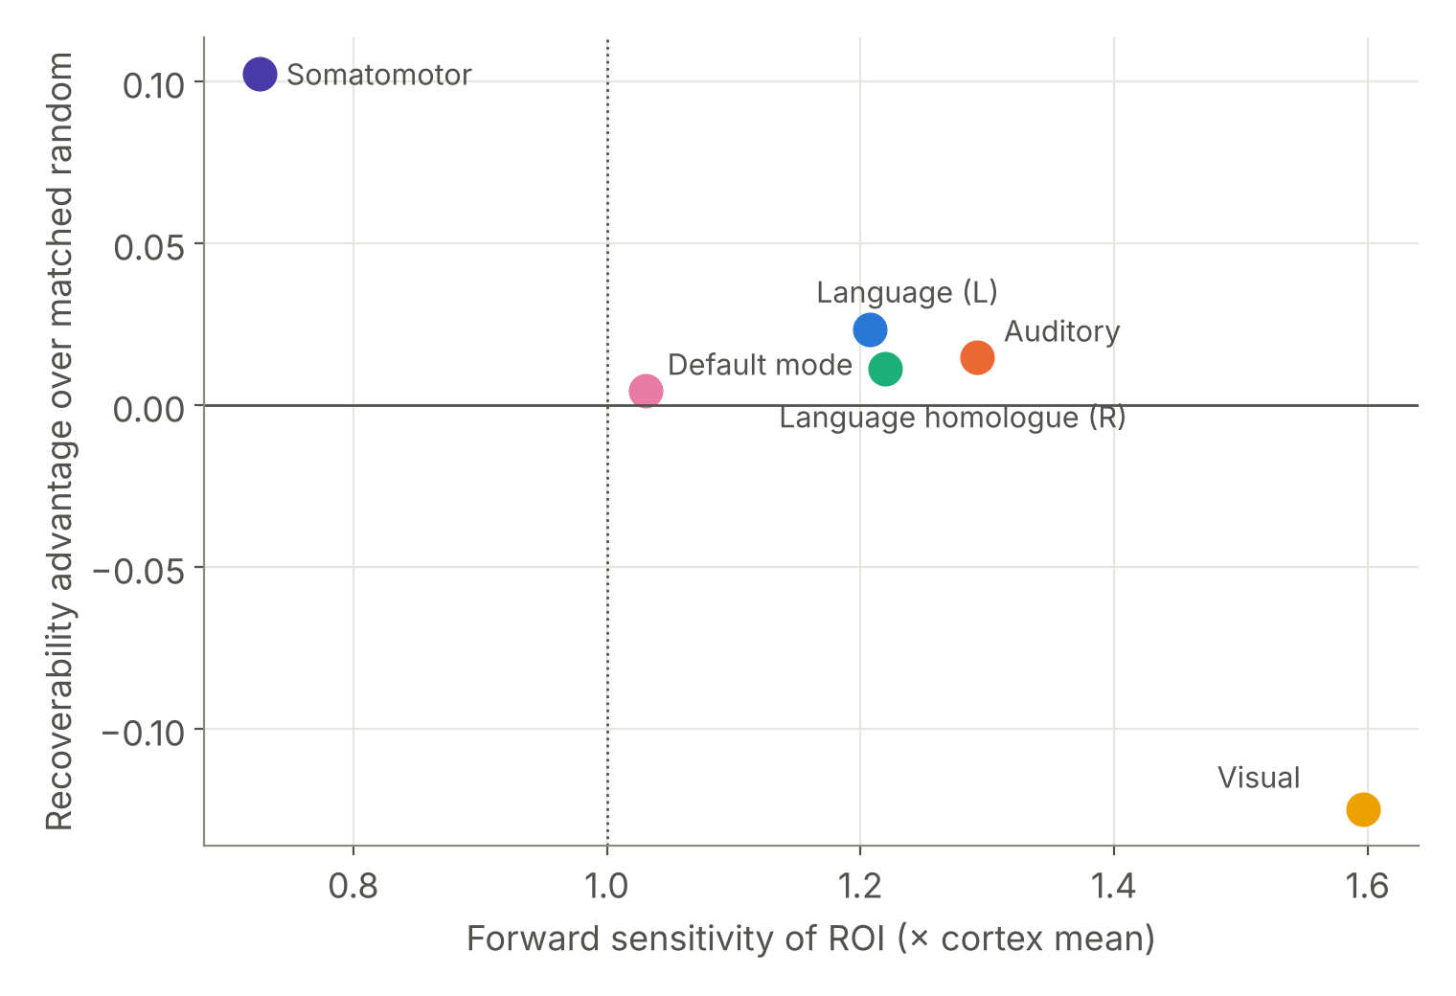
Predictable is not recoverable
Visual cortex responds most strongly to the representation (1.60× cortex mean) and is the worst place to decode it from. Somatomotor responds least (0.73×) and is the best.
Partial mechanism: response diversity. Somatomotor's response spans the most independent directions (participation ratio 18.6 vs 15.2 matched; top direction carries 15% of variance). Visual responses are strong but concentrated (PR 10.3; top direction 27%).
Language and auditory are also concentrated yet near their controls, so diversity explains the extremes, not every network. Six networks are too few for a correlation claim.
Notes:
Participation ratio = (sum of squared singular values)^2 / sum of fourth powers, of the ROI's response matrix to 128 random input directions: the number of independent input directions the region can tell apart. Practical implication worth stating: a uniform whole-cortex MSE is dominated by high-gain, low-diversity regions such as visual cortex; this predicts that down-weighting them could improve whole-cortex decoding. That is a testable next step, not a result. Caveat: at a fixed 8 000-step budget we cannot separate 'better optimum' from 'faster convergence' for somatomotor.

Slide 37
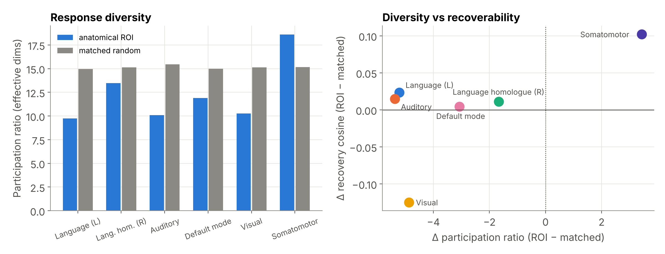
A partial mechanism: response diversity
Somatomotor spans the most independent input directions (PR 18.6 vs 15.2) and recovers best; visual is concentrated (PR 10.3) and recovers worst. Language and auditory are concentrated too but near their controls: diversity explains the extremes only.
Notes:
Participation ratio from the singular values of each region's response to 128 random input directions (forward passes only). Every anatomical network except somatomotor is less diverse than random vertices of the same count, which is expected: anatomically coherent regions respond in correlated ways. A testable prediction follows: whole-cortex decoding should improve if the loss down-weights high-gain, low-diversity regions such as visual cortex.

Slide 38


What limits semantic decoding from fMRI
Not destroyed information
No null space: the error rises 3.8× between equal fits, 7.2× towards a deeper minimum.
Non-convexity
Equally good fits disagree at 0.82 cosine, reproducibly; the answer depends on where the search starts.
Anisotropic conditioning
Disagreement lives in directions the operator barely responds to (0th percentile).
Measurement noise
Graceful loss of direction, steep loss of magnitude (rel. error 0.55 → 2.06).
Where you look
Strong responses are not the best evidence: visual cortex decodes worst, somatomotor best (−0.125 / +0.102 vs matched).
Notes:
The one-slide answer to 'so what did you find?'. Encoding accuracy is not the bottleneck; the geometry of the inverse is. Practical consequence: better decoders on fMRI need better search (multiple restarts, priors learned from language structure, ensembling over minima) more than better encoders.

Slide 39
Tabulation of all results
Claim | Evidence | Key number | Status
Encoding ≠ decoding | 8 independent budgets | 28.4× vs +0.015 | Established
Inverse is non-convex | Fit-matched init control, 4 truths | min pairwise 0.8165 ± 0.0068 | Established
No null space | Straight-path error, 10 blind pairs | rise 3.8× (1.5–6.0×); 7.2× to deeper | Verified 19 Oct
Errors in weak directions | 200 random directions | 2.1× below median; 9/10 pairs | Verified 19 Oct
Gain identifiable | Forward rescaling | ±10% → 7–9× floor | Established
Stable under noise | 7 noise levels | 0.836 → 0.298 monotone | Established
≈10% cortex suffices | 6 extents | 0.777 at 2 000 vertices | Established
Beats linear decoding | Ridge baseline | 0.918 vs 0.060 | Indicative
Anatomical topography | Sensitivity maps, 6 networks | z +27 to +41 in matching modality | Established
Regional recoverability | ROI vs matched random | Visual −0.125, somatomotor +0.102 vs matched | Established (1 truth)
Real-data decodability | LeBel 2023, held-out story | 4/5 segments (chance 2.2%), cosine 0.02 | Established
Multi-start on the real model | Recorded CPU run, 3 starts | R² 0.995, recovery ≤ 0.51, agreement 0.37 | Demonstrated
Notes:
The ledger the panel can interrogate. 'Established' means replicated or tested against a control; 'Indicative' means the comparison has a stated caveat.

Slide 40
Validation on real naturalistic fMRI
LeBel et al. 2023 · subject UTS03 · held-out story wheretheressmoke

Slide 41
Real-fMRI pipeline
Stage | What was done | Check
Data | UTS03, LeBel et al. 2023 (OpenNeuro ds003020): 6 stories, 66.6 min, 10 363 words, TR 2 s; held-out story = mean of 10 repeats | Held-out story is TRIBE v2's own test split
Registration | MNI → subject T1 by ANTs SyN; T1 → functional voxels by the pycortex transform | Visual QC of overlays
Surface projection | TRIBE v2 projector settings: 3-mm ball, 20 points per vertex, trilinear in the cortical mask → sparse 20 484 × 95 556 sampler | Homotopic r 0.635 vs −0.017 heterotopic (> 97% of pairings); scrambled control at chance
Features | w2v-BERT 2.0 audio + Llama-3.2-3B text, TRIBE v2's own pipeline with the dataset's word timings; 45 segments of 100 s | Forward re-entry r = 1.0000
Alignment | Lag maximising prediction–response r on the 5 training stories | Peak at 4 s
Evaluation | Encoding r vs split-half ceiling; forward identification of 20-s windows (194); inversion of 100-s segments ranked among 45; noise-free oracle | Chance 0.5% and 2.2%
Notes:
Every tuning choice (lag, the 2 000 analysis vertices) was fitted on the five training stories only. The audio-only CPU run gave the same pattern (5/5 identified, cosine 0.06).

Slide 42
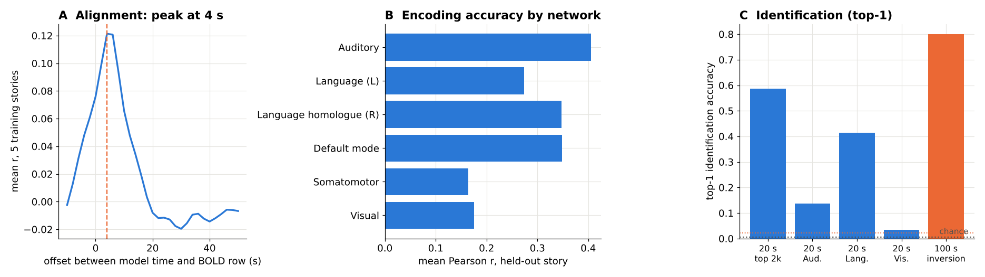
Real fMRI: results on the held-out story (LeBel 2023)
OpenNeuro ds003020
UTS03 · 6 stories · TR 2 s
Surface projection
validated sampler → fsaverage5
Stimulus features
LLaMA-3.2-3B text + w2v-BERT audio
Inversion
held-out BOLD → x̂ through frozen f
Identification
rank the true moment among all stories
0.48
59%
4/5
0.02
encoding r, top 2 000 vertices (56% of noise ceiling)
forward identification of 20-s windows, chance 0.5% (194 windows)
held-out segments identified by inverting real BOLD, chance 2.2%
cosine of x̂ to the true x: the moment is identifiable, the representation is not recovered
Notes:
Everything tunable (the 4-s alignment offset, the 2 000 vertices) was fitted on the five training stories; wheretheressmoke is held out and is not in TRIBE v2's training set. Text + audio features (LLaMA-3.2-3B and w2v-BERT, TRIBE v2's own pipeline) on a Colab T4, 2 000 inversion steps. Oracle (inverting the model's own prediction, same budget): 5/5 identified, cosine 0.22, so even noise-free inversion recovers little of x. An earlier audio-only CPU run gave the same pattern (5/5, cosine 0.06). The key real-data finding mirrors the synthetic one: identification succeeds while cosine recovery is low, i.e. the inverse pins down which moment was heard but not the full representation. Avatar fails alignment QC (no lag peak) and is kept only as a distractor, which makes identification harder, not easier.

Slide 43
Real fMRI: prediction accuracy by story and network
Story | Top 2 000 | Aud. | Lang. L | Lang. R | DMN | SomMot | Visual | Whole
wheretheressmoke (held out) | 0.48 | 0.41 | 0.27 | 0.35 | 0.35 | 0.16 | 0.18 | 0.20
adollshouse | 0.42 | 0.33 | 0.24 | 0.25 | 0.32 | 0.14 | 0.14 | 0.16
avatar | 0.21 | 0.17 | 0.11 | 0.12 | 0.12 | -0.00 | 0.09 | 0.05
legacy | 0.31 | 0.20 | 0.23 | 0.19 | 0.18 | 0.09 | 0.06 | 0.12
souls | 0.29 | 0.13 | 0.20 | 0.19 | 0.14 | 0.06 | 0.08 | 0.10
undertheinfluence | 0.41 | 0.28 | 0.31 | 0.27 | 0.24 | 0.15 | 0.26 | 0.18
Held out and in-distribution alike. On the held-out story the encoder reaches r = 0.48 on the 2 000 vertices chosen from the other stories, 56% of the split-half noise ceiling (0.86). Auditory, language and default-mode networks lead; visual and somatomotor trail, as expected for spoken stories.
Adding language features. Text + audio vs audio only on the held-out story: top-2 000 r 0.48 vs 0.27; default mode 0.35 vs 0.10. One story (avatar) shows no clear alignment peak and is kept only as a distractor, which makes identification harder, not easier.
Notes:
Pearson r between predicted and measured BOLD per vertex, averaged within each network. The alignment offset (4 s) and the 2 000 vertices were fitted on the five training stories only. Noise ceiling from the ten repeats of the held-out story, split-half with Spearman-Brown correction.

Slide 44
Real fMRI: the inverse identifies, but does not reconstruct
Inversion target | Top-1 identification | Ranks of the true segment | Cosine of x̂ to true x | Fit (1 − r)
Measured BOLD, held-out story | 4 / 5 | 0, 0, 6, 0, 0 | 0.02 | 0.14
Oracle: model's own prediction | 5 / 5 | 0, 0, 0, 0, 0 | 0.22 | 0.0008
Chance | 2.2% (1 of 45) | — | — | —
Two limits, separated.
Without noise (oracle), inversion identifies every segment yet recovers only 0.22 of the representation: most of the loss is the operator's conditioning, not measurement noise. With real BOLD, recovery drops further to 0.02 while identification survives (4/5, ranked against all 45 segments of six stories, including the other six of the same story).
This is the synthetic result, reproduced on a real brain: under noise, retrieval stayed near 0.99 while cosine fell. Identification needs only the directions the operator transmits well.
Notes:
Each held-out 100-s segment of measured BOLD is inverted through the frozen model (2 000 Adam steps, correlation loss on the 2 000 training-selected vertices, only the filled modality slots optimised). The recovered x-hat is ranked against the true representations of all 45 segments by mean per-time-step cosine. The oracle inverts the model's own noise-free prediction under the same budget.

Slide 45
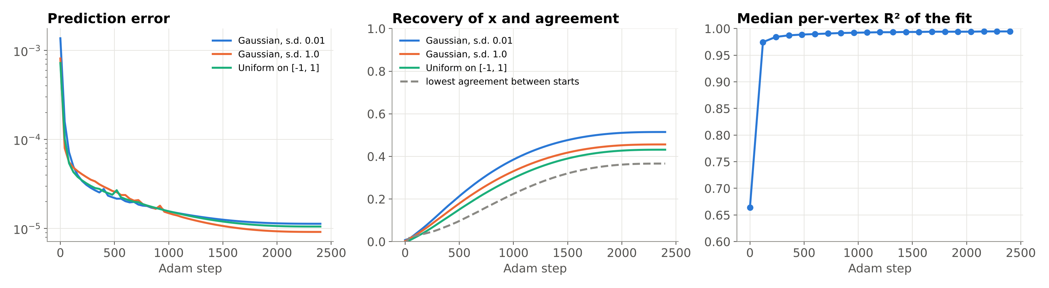
The same experiment on the real model, recorded
0.995
0.51
0.37
121×
median per-vertex R² of the fit across cortex
best recovery of x after 2 400 steps
lowest agreement between the three starts
error reduction, start 1
Notes:
Three starts (Gaussian 0.01, Gaussian 1.0, uniform) inverted together through frozen TRIBE v2 on CPU, every value logged; cortical maps every 120 steps feed the 'Real run' scene of the live demo. The fit becomes near-perfect across cortex while recovery and agreement stay low, the dissociation and non-convexity seen live on the real model.

Slide 46
Standards, ethics and SDG justification
Where the work sits against data, reporting and neuro-ethics frameworks

Slide 47
Alignment with relevant standards
Standard / framework | Scope | How this project aligns
BIDS (Gorgolewski et al., 2016) | Neuroimaging data organisation | Real-data phase uses OpenNeuro ds003020, a BIDS dataset; derivatives kept in BIDS layout
IEEE P2794 (draft, active PAR 2022) | Reporting standards for in vivo neural interface research | Report adopts its minimum-reporting approach: model, data, preprocessing, metrics, failures
IEEE P2731 working group | Unified BCI terminology (functional model) | Block diagram uses its functional decomposition: acquisition → features → decoding → output
FAIR principles (Wilkinson et al., 2016) | Findable, accessible, interoperable, reusable data | Seeded scripts, results.json, open model and data; figures regenerated from logs
Licences: CC BY-NC 4.0; Llama 3.2 licence; CC0 | TRIBE v2; text encoder; OpenNeuro data | Non-commercial academic use only; gated access obtained
Digital Personal Data Protection Act 2023 (India) | Personal data processing | No personal data processed: synthetic ground truth; de-identified public corpus
Notes:
IEEE P2794 is still a draft (active PAR since Dec 2022), so we say 'adopts its approach' rather than 'complies with'. P2731 is a working group whose functional-model paper (IEEE OJEMB 2021) defines BCI terminology. If asked about ISO/IEC medical-device standards (IEC 62304, ISO 14971): those apply to a deployed device; this is pre-device research, and they would apply at a translation stage.

Slide 48



Neuro-ethics: what our results imply
OECD Recommendation on Responsible Innovation in Neurotechnology (2019)
UNESCO Recommendation on the Ethics of Neurotechnology (adopted 12 Nov 2025)
Implication of our findings
Calls for safety assessment and protection of personal brain data. Our limits are a form of safety assessment: they quantify how much a decoder on fMRI can actually recover.
Treats neural data as uniquely sensitive and requires informed consent and protection against misuse. No new neural data was collected in this project.
Even with a near-perfect forward model, recovery is incomplete, depends on initialisation, and degrades with noise. Claims of fMRI 'mind reading' should be read against these limits.
Notes:
Conflicting interests from Review I (fidelity vs privacy) are addressed here: our contribution measures fidelity limits, which is exactly the evidence privacy frameworks need. UNESCO adoption date: 12 November 2025, General Conference.

Slide 49
SDG justification, target by target
SDG target | Link | Evidence from this project
3.4 promote mental health and well-being | Assistive communication for cognitively intact, motor-impaired patients | Limits tell clinicians what non-invasive fMRI decoding can and cannot deliver; non-convexity points to better search, not bigger encoders
9.5 enhance scientific research and technological capability | Method for characterising neural-interface models | Reusable, open pipeline: differentiable entry into a 177 M-parameter encoder; runs on free compute
10.2 inclusion irrespective of disability | Communication access as a precondition for inclusion | Regional result guides which cortex a future low-cost or partial-coverage system should target
Honest scope: this is enabling research. The SDG contribution is evidence about what is achievable, not a deployed assistive device.
Notes:
Top rubric band asks for clear justification. Each row links a specific target to a specific project output.

Slide 50
Outcomes, mappings and impact
Deliverables, demonstration, schedule, cost, contributions and programme mapping

Slide 51





Deliverables
Manuscript
Final report
IEEE-format paper: “Predictable Is Not Recoverable: Conditioning and Non-Convexity of Inverting a Foundation Brain Encoding Model”. A. Sarkar*, T. Choudhuri* (joint first), S. Nageswaran. Ready for submission.
43 pages, VIT 2026 Project-I format: 13 chapters, 16 figures, 19 tables, 42 IEEE references, TRIBE v2 data and why-fMRI sections.
A3 poster
Open repository
VIT template, every box filled; print-ready A3 PDF.
github.com/Ivxn404/semantic-decoding-tribe-inversion: all scripts, logged results, figures, demo video, verification results; MIT-licensed code.
Four Colab notebooks
Interactive live demo
Demo & synthetic suite · real fMRI (text + audio) · 10-minute live demo on TRIBE v2 · verification tests.
Ten-scene presenter page: 3-D cortex, in-browser inversion lab, real-run replay, findings, networks, real-fMRI ranking; works offline.
Notes:
Everything is public except the VIT templates and the gated model weights, which are downloaded from their original sources.

Slide 52

Live demonstration
Scene | What the panel sees | Live?
Question | Rotating cortex coloured by TRIBE v2's measured text / audio / video sensitivity | interactive
Data · Why fMRI | Clickable training and test datasets; fMRI vs simulated EEG at 32 / 64 / 128 electrodes | interactive
Live lab | A small encoder inverted in the browser: starts, spread, noise, observed cortex, prior; sensitivity probe | computed live
Real run | Replay of three starts through frozen TRIBE v2: target, prediction and R² maps on the cortex | recorded, real
Findings · Regions | Five findings incl. verified barriers; clickable networks with recovery vs random | interactive
Real fMRI | Lag, encoding and identification charts; held-out segments ranked among 45 | animated, real
Colab Live_Demo | The real 177 M model inverted on a T4 in ≈ 3 min, with ridge test and sensitivity probe | computed live
Repository, demo page and notebooks
Notes:
Run-sheet: demo/DEMO_SCRIPT.md. Before the panel arrives: open the offline demo page and run Steps 1-3 of the Colab notebook so the weights are loaded.

Slide 53
Schedule and milestones: complete
Aug
Sep
Oct
S1 Literature, formulation
S2 Instrumentation
S3 Core characterisation
S4 Controls and hypothesis tests
S5 Regional analysis
S6 Real-fMRI study
S7 Paper, report, poster, demo, verification
Review II · 14 Oct
Final · 29 Oct
Review III
Notes:
All seven stages complete. Manpower: 580 planned person-hours (330 Abhranil, 250 Tanisha).

Slide 54
Cost analysis
Item | Estimate in Report I (₹) | Incurred (₹) | Remark
Hosted GPU compute (subscription) | 5 500 | 0 | Free Colab T4 tier was sufficient
Additional on-demand GPU credits | 4 000 | 0 | Memory-saving changes avoided paid tiers
Cloud storage (≈ 200 GB) | 1 500 | 0 | Free quotas and local storage
Neuroimaging datasets | 0 | 0 | Open licence (OpenNeuro)
Pretrained encoder weights | 0 | 0 | Open-weight, non-commercial licence
Documentation and reprographics | 1 500 | printing | Report binding, A3 poster
Contingency (≈ 15%) | 2 000 | 0 | Not required
Total | 14 500 | printing only
Manpower: 580 planned person-hours (330 + 250), as in Report I.

Slide 55
Individual contributions
Abhranil Sarkar (23BML0077)
Tanisha Choudhuri (23BML0081)
Computational track
Neurobiological track
Model instrumentation; the differentiable re-entry point
Inversion engine and optimisation
Synthetic and control experiments; verification tests
Real-fMRI pipeline: registration, surface projection, features, evaluation
Figures, code release, live demo, manuscript and reports
Functional neuroanatomy; six networks from the Destrieux atlas
Curation of the LeBel dataset
Interpretation of the regional and real-data findings
Ethics and SDG framing
Reports, reviews and the poster

Slide 56
PO and PSO mapping
Outcome | Justification from this project
PO1 Engineering knowledge | Linear algebra, optimisation and inverse-problem theory applied to a 177 M-parameter neural operator
PO2 Problem analysis | Decoding formulated as an ill-posed inverse problem; causes of incomplete recovery separated by falsifiable tests
PO3 Design of solutions | Inversion pipeline, its controls and the real-fMRI surface projection
PO4 Investigation | Controlled experiments with exact ground truth, matched random controls, verification re-run
PO5 Modern tools | PyTorch, TRIBE v2, ANTs, nilearn, GPU (Colab) computing
PO6, PO8 Society and ethics | Mental-privacy and clinical-use implications; licences and data-use terms respected
PO9, PO10 Teamwork, communication | Two-track team; IEEE manuscript, report, poster, reviews, live demo
PO11 Project management | Seven-stage schedule met at ₹0 compute cost
PO12 Life-long learning | Self-taught foundation models and neuroimaging tools
PSO2, PSO3 | Analysis and imaging of biosignals (fMRI) with modern computational tools

Slide 57
WP and WK mapping (complex engineering problem)
Attribute | How the project meets it
WP1 Depth of knowledge | Neuroscience, fMRI physics, deep learning and inverse-problem theory together
WP2 Conflicting requirements | Decoding fidelity vs non-invasive, low-cost acquisition vs mental privacy
WP3 Depth of analysis | No closed-form inverse; non-convexity separated from information loss by forward-only tests
WP4 Familiarity of issues | Slow, noisy, blurred BOLD; no ground truth in real data
WP7 Interdependence | Anatomical ROI definition and computation depend on each other
WK3 / WK4 | Signals and systems; inverse problems and conditioning
WK5 / WK6 | Design of the inversion and projection pipeline; modern computational tools
WK8 | Current research literature (2023–2026 encoders and decoders)

Slide 58
Social and environmental impact
Social
Concerns people who keep comprehension but lose speech; measuring what fMRI decoding can and cannot recover directs effort towards approaches that can work and away from over-promising.
Mental privacy: a near-perfect encoder identifies which known moment was heard but does not reconstruct the representation, evidence for neural-data policy (OECD 2019, UNESCO 2025). No new human data collected.
Environmental
Re-used a pretrained model instead of training a foundation encoder, avoiding its large energy cost.
All computation ran on one shared cloud GPU and CPUs for a modest number of GPU-hours; the public release lets others reproduce results without re-running everything.

Slide 59
Limitations
Synthetic ground truth lives in a random low-dimensional subspace, not real language embeddings; qualitative findings are expected to transfer, absolute values may not.
Inversion targets the aggregated representation x, one stage after raw LLaMA embeddings.
All solutions from Adam; the SGD / L-BFGS control did not converge under the settings tried.
No haemodynamic operator in the released model, so temporal bandwidth limits cannot be measured.
Release ships only the shared 'average subject' layer, so per-subject analysis is not possible with public weights.
Regional z-scores use a random-vertex null that ignores spatial autocorrelation; a spin test is stricter.
Regional inversion uses one ground truth and one budget (8 000 steps, CPU); comparisons are internal to that run, and faster convergence cannot yet be separated from a better optimum.
Real-data test: one subject (UTS03), one held-out story, 5 inversion queries; per-network inversion on real data needs held-out stories from more subjects.
Corrected barrier test so far on one ground truth (four-truth repeat optional); original perturbation test withdrawn.
Notes:
State limitations before they are raised. None of them affects the central claims (dissociation, non-convexity, rejected null space), which were replicated or re-verified with optimiser-independent forward passes.

Slide 60
Future work
1
Real data at scale
Inversion across all eight LeBel subjects; per-network real-data test on genuinely held-out stories.
2
Better search
Optimisers and priors matched to the operator's weak directions; restarts and ensembling over minima; loss re-weighting away from high-gain, low-diversity regions.
3
Earlier entry point
Invert the raw extractor features and add an explicit haemodynamic model.
4
Stricter statistics
Barrier test on four ground truths; spin-permutation nulls for regional z-scores; a converged second-order optimiser control.
5
Other modalities
Apply the same identifiability tests to EEG and MEG encoders as they appear.

Slide 61
Conclusion
A near-perfect brain encoder does not by itself make meaning recoverable from fMRI. Recoverability has to be measured, not inferred from predictivity.
Encoding error falls 28.4× while recovery saturates at 0.944: accuracy does not certify decoding
Equal fits disagree (0.817) and are separated by barriers (3.8×; 7.2× to a deeper minimum): the inverse is non-convex
What is not recovered lies in the operator's weakest directions (2.1× below random)
Visual cortex, the most responsive, recovers worst (−0.125); somatomotor, the least, best (+0.102)
Real fMRI: 56% of the noise ceiling; 4 of 5 held-out segments identified among 45, yet cosine 0.02
Everything is released: manuscript, report, poster, code, results, live demo and four notebooks
Notes:
Close with the one-sentence finding, then stop.

Slide 62
Backup · Anticipated questions
Slides held in reserve for the viva

Slide 63
Q: Is the non-convexity just Adam?
Couldn't Adam's implicit bias create the different answers?
The barrier is shown with forward passes only: the error along the straight line between two equal fits rises 3.8×. The weak-direction result is a Jacobian probe. Neither involves an optimiser. Different initialisation distributions reach different minima reproducibly across four ground truths.
Then why did SGD and L-BFGS give different answers?
They never reached comparable fit (1.4e-4 and 2.8e-5 vs 3.5e-7), so they are not valid comparisons. We report the control as failed rather than interpret it.
What would settle it?
A tuned second-order method reaching ~1e-7 fit from the same initialisations. Listed as future work.
Notes:
Keep this answer short and calm: the claim rests on optimiser-independent tests.

Slide 64
Q: Regional analysis details
Why Destrieux and not Glasser or Schaefer?
Destrieux ships with Nilearn on the same fsaverage5 mesh TRIBE predicts on, with standard anatomical names. Network membership comes from the language (Fedorenko) and default-mode (Buckner) literature. HCP-MMP (Glasser) is a natural robustness check.
Are the regional differences just ROI size?
No: every ROI is compared with a random vertex set of exactly the same size, and two networks have a second random seed to bound control variability.
Why no left-lateralisation of language?
The release is an average-subject model; TRIBE v2's own paper finds lateralisation in contrasts (sentences vs word lists), not in raw sensitivity. Our homologue result is consistent with bilateral responses to natural speech.
Notes:
If asked for the null of the z-scores: random-vertex sets of the same size, 2 000 draws; a spin test respects spatial autocorrelation and is the stricter next step.

Slide 65
Q: The surprising regional result
How can 1 487 somatomotor vertices beat the whole cortex (0.851 vs 0.836)?
With a uniform MSE, the whole-cortex loss is dominated by high-gain, low-diversity regions such as visual cortex, which steer the search badly. Observing only diverse, low-gain vertices removes that pull. It suggests re-weighting the objective, a testable next step.
Isn't the visual result an artefact of the synthetic video dimensions?
Visual cortex is worse than its matched control on text- and audio-derived dimensions too (−0.12 and −0.14), so it is not specific to the video third of x.
Would it hold at convergence?
Unknown: all regional runs use one 8 000-step budget and one ground truth. Faster convergence and a better optimum cannot yet be separated; we claim relative differences within the run.
Notes:
Values: visual text −0.123, audio −0.139, video −0.115 relative to matched random; somatomotor +0.098, +0.126, +0.085.

Slide 66
Q: What does 0.82 cosine mean? Is any of this real?
Is 0.82 good or bad?
It is the agreement between two equally good answers, so it bounds how reproducible a single decoded answer is. It is a property of the inverse, not a score to maximise.
Your results are all synthetic. Are they real findings?
They are exact measurements of a real, published operator, and the real-fMRI test on a held-out story shows the same pattern: identification 4/5, cosine 0.02.
Why should a clinician care?
Because the bottleneck is search, not encoder size: better decoders will come from restarts, ensembling over minima and language-derived priors.
Notes:
Return to the conclusion slide after this one if the discussion drifts.

Slide 67
Q: Why fMRI, not EEG? Why TRIBE v2?
Why not EEG?
Brain2Qwerty (Lévy et al., arXiv 2502.17480): 32% character error with MEG vs 67% with EEG on the same architecture.
Why not simultaneous EEG–fMRI?
The best open simultaneous dataset (NKI, 22 adults) has rest, Inscapes and short movie clips, no sustained language: data-limited, not method-limited.
Why TRIBE v2?
Largest open-weight encoder: 451.6 h training, 1 117.7 h evaluation across 720 subjects, all 20 484 cortical vertices, first at Algonauts 2025.
Notes:
Same answers as Review II, kept for continuity.

Slide 68
Q: Your barrier result changed. Why should we trust it now?
What was wrong?
The original test picked the least similar pair among all eight starts, which included an unconverged one (Gaussian s.d. 5, error 3.2× the best). Its 2.6× → 0.6× numbers are withdrawn.
What did the re-run do?
Eight starts for 14 000 steps on a T4; only the five blind starts within 2× were compared; the error was measured at 21 points on each straight line between them. All ten pairs rise (1.5–6.0×, median 3.8×).
Does it change the conclusion?
No, it strengthens it: equal fits are separate minima, and near-truth starts reveal a deeper minimum 7.2× barrier away. The selection rule is fixed in the code and the results are in the repository.
Notes:
Say it plainly: we found and fixed our own error before submission, and the corrected test is cleaner.

Slide 69
References
[1] T. Naselaris, K. N. Kay, S. Nishimoto, J. L. Gallant, “Encoding and decoding in fMRI,” NeuroImage, vol. 56, no. 2, pp. 400–410, 2011.
[2] A. G. Huth et al., “Natural speech reveals the semantic maps that tile human cerebral cortex,” Nature, vol. 532, pp. 453–458, 2016.
[3] R. Antonello, A. Vaidya, A. G. Huth, “Scaling laws for language encoding models in fMRI,” in Proc. NeurIPS, vol. 36, 2023.
[4] J. Tang, A. LeBel, S. Jain, A. G. Huth, “Semantic reconstruction of continuous language from non-invasive brain recordings,” Nat. Neurosci., vol. 26, pp. 858–866, 2023.
[5] A. LeBel et al., “A natural language fMRI dataset for voxelwise encoding models,” Sci. Data, vol. 10, art. 555, 2023.
[6] J. Lévy, M. Zhang, S. Pinet, J. Rapin, H. Banville, S. d’Ascoli, J.-R. King, “Brain-to-text decoding: A non-invasive approach via typing,” arXiv:2502.17480, 2025.
[7] S. d’Ascoli et al., “A foundation model of vision, audition, and language for in-silico neuroscience,” arXiv:2605.04326, 2026.
[8] P. C. Hansen, Discrete Inverse Problems: Insight and Algorithms. Philadelphia, PA: SIAM, 2010.
[9] C. Destrieux, B. Fischl, A. Dale, E. Halgren, “Automatic parcellation of human cortical gyri and sulci using standard anatomical nomenclature,” NeuroImage, vol. 53, no. 1, pp. 1–15, 2010.
[10] E. Fedorenko, A. A. Ivanova, T. I. Regev, “The language network as a natural kind within the broader landscape of the human brain,” Nat. Rev. Neurosci., vol. 25, pp. 289–312, 2024.
[11] R. L. Buckner, J. R. Andrews-Hanna, D. L. Schacter, “The brain’s default network,” Ann. N.Y. Acad. Sci., vol. 1124, pp. 1–38, 2008.
[12] K. J. Gorgolewski et al., “The brain imaging data structure,” Sci. Data, vol. 3, art. 160044, 2016.
[13] M. D. Wilkinson et al., “The FAIR Guiding Principles for scientific data management and stewardship,” Sci. Data, vol. 3, art. 160018, 2016.
[14] IEEE P2731 Working Group, “A functional model for unifying brain computer interface terminology,” IEEE Open J. Eng. Med. Biol., vol. 2, 2021.
[15] OECD, Recommendation of the Council on Responsible Innovation in Neurotechnology, OECD/LEGAL/0457, 2019.
[16] UNESCO, Recommendation on the Ethics of Neurotechnology, adopted 12 Nov. 2025.
[17] D. P. Kingma, J. Ba, “Adam: A method for stochastic optimization,” in Proc. ICLR, 2015.
[18] J. L. Gardner, T. Liu, “Inverted encoding models reconstruct an arbitrary model response, not the stimulus,” eNeuro, vol. 6, no. 2, ENEURO.0363-18.2019, 2019.
[19] Bladon, Bent, “Feature visualization recovers known cortical selectivity from TRIBE v2,” arXiv:2605.13904, 2026.
[20] Y. Benchetrit et al., “Boosting brain-to-image decoding with TRIBE v2 data augmentation,” arXiv:2606.06345, 2026.
[21] K. N. Kay, T. Naselaris, R. J. Prenger, J. L. Gallant, “Identifying natural images from human brain activity,” Nature, vol. 452, pp. 352–355, 2008.
[22] A. Défossez, C. Caucheteux, J. Rapin, O. Kabeli, J.-R. King, “Decoding speech perception from non-invasive brain recordings,” Nat. Mach. Intell., vol. 5, pp. 1097–1107, 2023.
[23] A. T. Gifford et al., “The Algonauts Project 2025 challenge: How the human brain makes sense of multimodal movies,” arXiv:2501.00504, 2025.
[24] B. Lahner et al., “Modeling short visual events through the BOLD Moments video fMRI dataset and metadata,” Nat. Commun., vol. 15, art. 6241, 2024.
[25] H. Wen, J. Shi, Y. Zhang, K.-H. Lu, J. Cao, Z. Liu, “Neural encoding and decoding with deep learning for dynamic natural vision,” Cereb. Cortex, vol. 28, no. 12, pp. 4136–4160, 2018.

Slide 70
References (continued)
[26] T. M. Mitchell et al., “Predicting human brain activity associated with the meanings of nouns,” Science, vol. 320, no. 5880, pp. 1191–1195, 2008.
[27] J. Hadamard, “Sur les problèmes aux dérivées partielles et leur signification physique,” Princeton Univ. Bull., vol. 13, pp. 49–52, 1902.
[28] N. K. Logothetis, “What we can do and what we cannot do with fMRI,” Nature, vol. 453, pp. 869–878, 2008.
[29] C. M. Michel et al., “EEG source imaging,” Clin. Neurophysiol., vol. 115, no. 10, pp. 2195–2222, 2004.
[30] Q. K. Telesford et al., “An open-access dataset of naturalistic viewing using simultaneous EEG-fMRI,” Sci. Data, vol. 10, art. 554, 2023.
[31] G. J. Brouwer, D. J. Heeger, “Decoding and reconstructing color from responses in human visual cortex,” J. Neurosci., vol. 29, no. 44, pp. 13992–14003, 2009.
[32] A. Mahendran, A. Vedaldi, “Understanding deep image representations by inverting them,” in Proc. IEEE CVPR, 2015, pp. 5188–5196.
[33] P. S. Scotti et al., “MindEye2: Shared-subject models enable fMRI-to-image with 1 hour of data,” in Proc. ICML, 2024.
[34] B. Fischl, M. I. Sereno, R. B. H. Tootell, A. M. Dale, “High-resolution intersubject averaging and a coordinate system for the cortical surface,” Hum. Brain Mapp., vol. 8, no. 4, pp. 272–284, 1999.
[35] B. B. Avants, C. L. Epstein, M. Grossman, J. C. Gee, “Symmetric diffeomorphic image registration with cross-correlation,” Med. Image Anal., vol. 12, no. 1, pp. 26–41, 2008.
[36] J. S. Gao, A. G. Huth, M. D. Lescroart, J. L. Gallant, “Pycortex: An interactive surface visualizer for fMRI,” Front. Neuroinform., vol. 9, art. 23, 2015.
[37] Y.-A. Chung et al., “W2v-BERT: Combining contrastive learning and masked language modeling for self-supervised speech pre-training,” in Proc. IEEE ASRU, 2021, pp. 244–250.
[38] A. Grattafiori et al., “The Llama 3 herd of models,” arXiv:2407.21783, 2024.
[39] P. Gao et al., “A theory of multineuronal dimensionality, dynamics and measurement,” bioRxiv 214262, 2017.
[40] A. Paszke et al., “PyTorch: An imperative style, high-performance deep learning library,” in Proc. NeurIPS, vol. 32, 2019.
[41] A. Abraham et al., “Machine learning for neuroimaging with scikit-learn,” Front. Neuroinform., vol. 8, art. 14, 2014.
Notes:
IEEE format. OECD and UNESCO entries are normative instruments, cited as such.

