Slide 1
Conditioning and Non-Convexity of Semantic Decoding by Inversion of Deep Brain Encoding Models
Project-I (BECE497J) · Review III · 60–70% milestone
Abhranil Sarkar (23BML0077) · Tanisha Choudhuri (23BML0081)
Guide: Dr. Sharmila Nageswaran, Associate Professor, School of Electronics Engineering
Notes:
Since Review II we answered the question we left open: why is recovery incomplete? Short answer: not because information is destroyed, but because the inverse problem is non-convex, with errors concentrated in the operator's least-sensitive directions. We also completed the regional analysis on anatomical networks.

Slide 2
Progress since Review II
0.817
0th
15×
6
min agreement between fit-matched solutions, 4 ground truths (sd 0.007)
percentile: solution-difference directions vs 200 random directions
gradient inversion over a ridge decoder (0.918 vs 0.060)
anatomical networks mapped and inverted on fsaverage5
Completion against the project plan
Formulation
Instrumentation
Core characterisation
Controls & validation
Regional analysis
Real-data study
Write-up
Status: ≈ 68% complete. Synthetic characterisation, controls and the regional analysis are finished; real-fMRI validation is under way with first results on a held-out story. Remaining: completing the real-data study and the final report and paper.
Notes:
≈68% = completed person-hours in Report I Table-3 over 580 (literature, setup, framework, characterisation, regional analysis, part of real data and reporting). Remaining: the rest of the real-data study and the write-up.

Slide 3
Problem, gap and objectives
Gap. Encoders keep improving [3, 7], but nobody has measured whether that makes meaning more recoverable from fMRI, or what limits the inverse. Linear encoders are invertible only up to a linear transform [18]; deep encoders were never tested.
O1
Formulate decoding as inversion; find the differentiable entry point
Done
O2
Synthetic framework with exact ground truth
Done
O3
Characterise the inverse vs. budget, noise, extent, priors
Done
O4
Discriminate non-identifiability vs. non-convexity vs. optimiser limits
Done
O5
Linear baseline; recoverability by anatomical network
Done
O6
Validate on real naturalistic fMRI (LeBel 2023)
In progress
Notes:
Five of six objectives complete. O6 is the real-data validation, deliberately last because synthetic ground truth is the instrument and real data the external check.

Slide 4
Objectives anchored to the literature
Prior work | What it assumed or left open | What we add
Naselaris et al. 2011 [1] | Encoding models are the route to decoding | Measure when that route fails: dissociation of 28× vs +0.015
Antonello et al. 2023 [3]; TRIBE v2 2026 [7] | Encoding accuracy scales log-linearly with data | Show decoding saturates while encoding error keeps falling
Tang et al. 2023 [4] | Decoding via LM-guided search, per-subject decoder | Decoder-free inversion; exact error under ground truth
Hansen 2010 [8] (inverse problems) | Ill-posedness via conditioning and null spaces | Test both on a 177 M-parameter operator: non-convex, not null-space
Huth 2016 [2]; Fedorenko 2024 [10]; Buckner 2008 [11] | Semantic, language and default-mode networks | Recoverability and modality sensitivity per network
Brain2Qwerty 2026 [6]; Défossez 2023 [22] | Non-invasive decoding limited by modality | Limits that hold even for a near-perfect fMRI forward model
Notes:
Rubric line 'objectives well aligned to literature': each row is one prior result, the assumption it made, and the specific measurement we contribute.

Slide 5
Proof of novelty I: prior-art comparison
Closest prior work | Nonlinear deep encoder | Optimises encoder input | Tests uniqueness / conditioning | Region-wise recoverability
Kay et al., Nature 2008 [21] | ○ | ○ | ○ | ○
Gardner & Liu, eNeuro 2019 [18] | ○ | ● | ● | ○
Tang et al., Nat. Neurosci. 2023 [4] | ○ | ● | ○ | ●
d'Ascoli et al., TRIBE v2, 2026 [7] | ● | ○ | ○ | ○
Bladon & Bent, arXiv May 2026 [19] | ● | ● | ○ | ○
Benchetrit et al., arXiv Jun 2026 [20] | ● | ○ | ○ | ○
This work | ● | ● | ● | ●
Only this work fills all four columns. The closest result, Gardner & Liu [18], proves that a linear inverted encoding model recovers the stimulus only up to an invertible linear transform. We ask the same question of a 177 M-parameter nonlinear encoder, where no closed-form answer exists, and answer it empirically with exact ground truth.
Notes:
● = the paper does this; ○ = it does not. Tang 2023 optimises over word sequences (beam search scored by a linear encoder on GPT features) and compares cortical networks, so it gets two marks; its encoder is linear in the LM features, and it never asks whether the answer is unique. Gardner & Liu is the theoretical ancestor of our question, for linear models only. If a reviewer names another paper, ask which column it fills; none we found fills the third column for a deep encoder.

Slide 6
Proof of novelty II: search protocol and the closest TRIBE v2 work
Search protocol
Bladon & Bent, May 2026 [19]
Date: 9 October 2026
Sources: arXiv, Google Scholar, general web
Queries: "TRIBE v2"; invert / inversion / identifiability / conditioning / non-convex + "brain encoding model" / "fMRI encoder"
Inclusion: any work that inverts, optimises the input of, or analyses the identifiability of a brain encoding model
Result: two TRIBE v2 follow-ups (right). Neither tests whether the inverse is unique or how it is conditioned.
What it does: Feature visualisation: optimises inputs to maximise a region's predicted response and recovers known cortical selectivity.
Difference: Asks what a region prefers. Does not ask whether the input can be recovered, or whether the answer is unique.
Benchetrit et al., June 2026 [20]
What it does: Uses TRIBE v2 forwards to synthesise fMRI that augments training of a brain-to-image decoder.
Difference: The encoder is only run forwards; its inverse is never analysed.
Notes:
This is the evidence behind the word 'first'. Say it carefully: 'we found no published inverse or identifiability analysis of a deep foundation encoder as of 9 October 2026', not 'nobody has ever done this'. Both TRIBE v2 follow-ups are from 2026 and are the closest possible competitors; neither touches uniqueness or conditioning.

Slide 7
Novel contributions, each with its evidence
# | Contribution | Evidence | Status
1 | First uniqueness and conditioning analysis of a deep foundation brain encoder | Prior-art matrix and dated search protocol (previous two slides) | Shown
2 | Encoding accuracy and decodability dissociate | Encoding error falls 28.4×; the final halving buys +0.015 recovery | Shown
3 | Incomplete recovery is non-convexity, not a null space | Fit-matched solutions disagree (min cosine 0.817 ± 0.007, 4 ground truths); perturbations show barriers | Shown
4 | Error concentrates in the operator's least-sensitive directions | Solution-difference direction 1.9× below the random median; 0th percentile of 200 | Shown
5 | Predictable is not recoverable, region by region | Visual −0.125, somatomotor +0.102 vs size-matched random sets; ≈10× the control spread | Shown
6 | Nonlinear inversion beats linear decoding | 0.918 vs 0.060 for the best ridge decoder (≈15×) | Shown
Notes:
Each claim is paired with the number that supports it, so a reviewer can challenge the evidence rather than the wording. Status 'Shown' means the evidence is on a slide in this deck.

Slide 8
Methodology, analytical model and validation
How every claim is tested, and what would have falsified it

Slide 9
Functional block diagram (final)
Ground-truth generator
seeded, 32 × 1152
Frozen operator f(x)
TRIBE v2, 177.21 M params
Measurement model
y = M ⊙ f(x*) + η
Inversion engine
Adam on x, θ frozen, gradients by autograd
Anatomical ROI masks
Destrieux atlas → 6 networks on fsaverage5
Forward sensitivity maps
per-vertex response to text / audio / video dims
Hypothesis tests
init control · perturbation · sensitivity · gain
Controls
size-matched random masks · 2nd seed · whole-cortex anchor
Evaluation
cosine · per-modality cosine · rel. error · retrieval
Results store
results.json + ROI json · figures from logged numbers
New since Review II: ROI masks, sensitivity maps, hypothesis tests and controls (green / violet / grey).
Notes:
Same core as Review II (top row). Added: the anatomical masks and sensitivity maps from the neurobiology track, the hypothesis-testing layer, and explicit controls for every regional comparison.

Slide 10
Four explanations for incomplete recovery
Hypothesis | Predicted signature | Test | Verdict
H1 Information loss (null space) | Fit-matched solutions differ along a direction the operator ignores | Perturb along the difference d vs random directions | Rejected
H2 Non-convexity | Distinct minima at equal fit, separated by a barrier | Init control at matched fit; replicate × 4 | Supported
H3 Optimiser artefact (under-convergence) | Recovery keeps rising with budget | Convergence curve; fit-matched inclusion | Controlled
H4 Unidentifiable gain | Rescaled x produces the same output | Forward-only rescaling test | Rejected
H5 Errors along weak directions | Difference directions have low Jacobian response | Directional sensitivity vs 200 random | Supported
Notes:
Pre-registered style: each hypothesis has a signature that would show up if it were true and a test that could falsify it. Two were rejected by our own experiments, which is the strongest evidence that the method can discriminate.

Slide 11
Validation built into the method
Risk to validity | Safeguard | Outcome
Measuring the optimiser, not the operator | Converge first; independent runs to schedule end | Plateau ≈ 0.94 by 32 000 steps
Under-converged runs posing as alternative solutions | Only solutions within 2× of best fit compared | gauss_5.0 excluded (3.4× worse fit)
One trajectory being special | Replicate across 4 independent ground truths | min pairwise 0.8165 ± 0.0068
Inference instead of demonstration | Direct perturbation test along d | Ratio 2.6× → 0.6×: H1 rejected
ROI size confound | Random vertex sets of identical size | Paired comparison per network
Random-seed luck in controls | Second random seed for two networks | Δ between seeds ≤ 0.013
Platform dependence | Whole-cortex anchor re-run on CPU vs earlier GPU | 0.836 vs 0.836 (GPU)
Notes:
This is the 'with validation' part of the top rubric band for methodology. The CPU anchor is the same ground truth, initialisation and budget as the Stage 6 GPU run; agreement shows results are not a platform artefact.

Slide 12
Results and interpretation
Why recovery is incomplete, and where in cortex meaning is recoverable

Slide 13
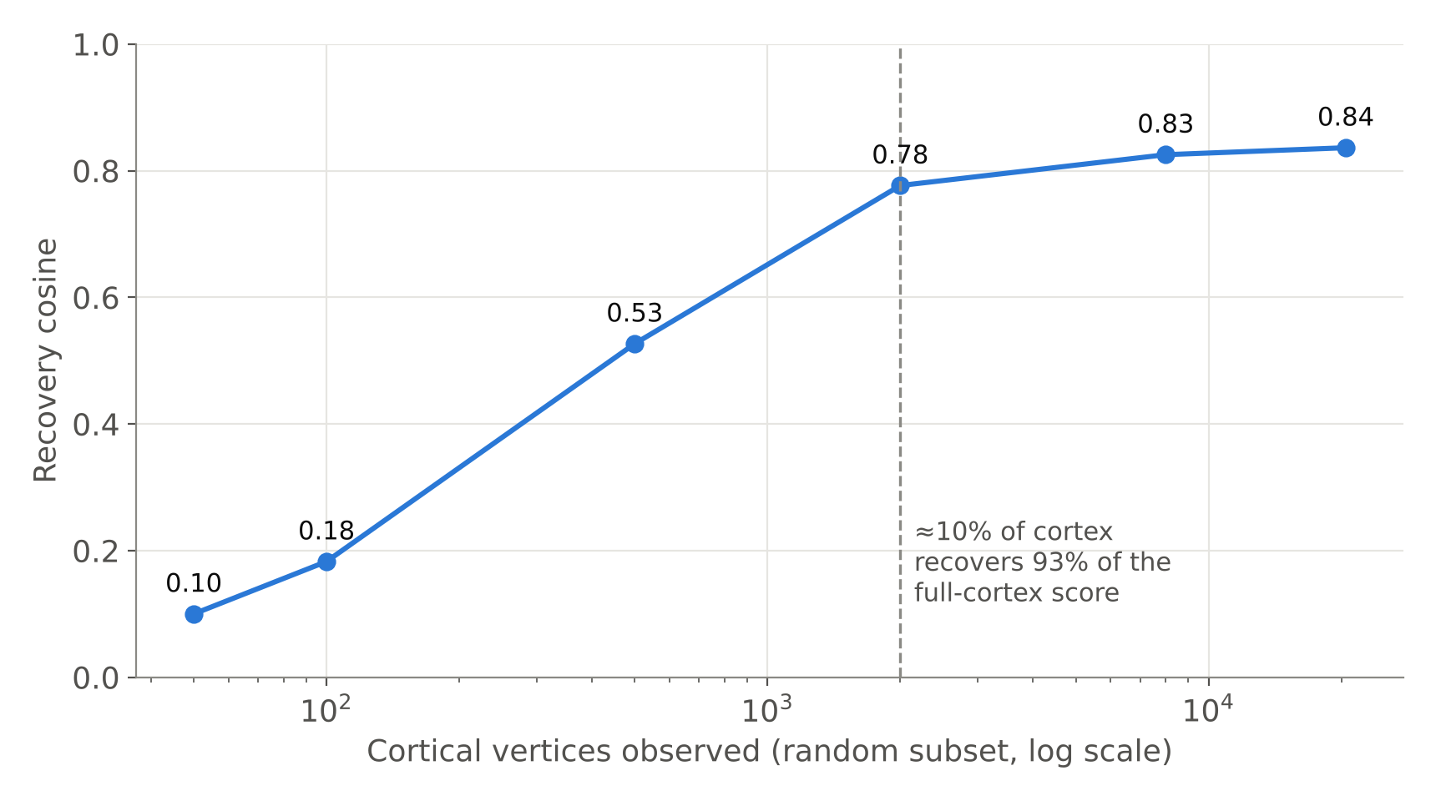
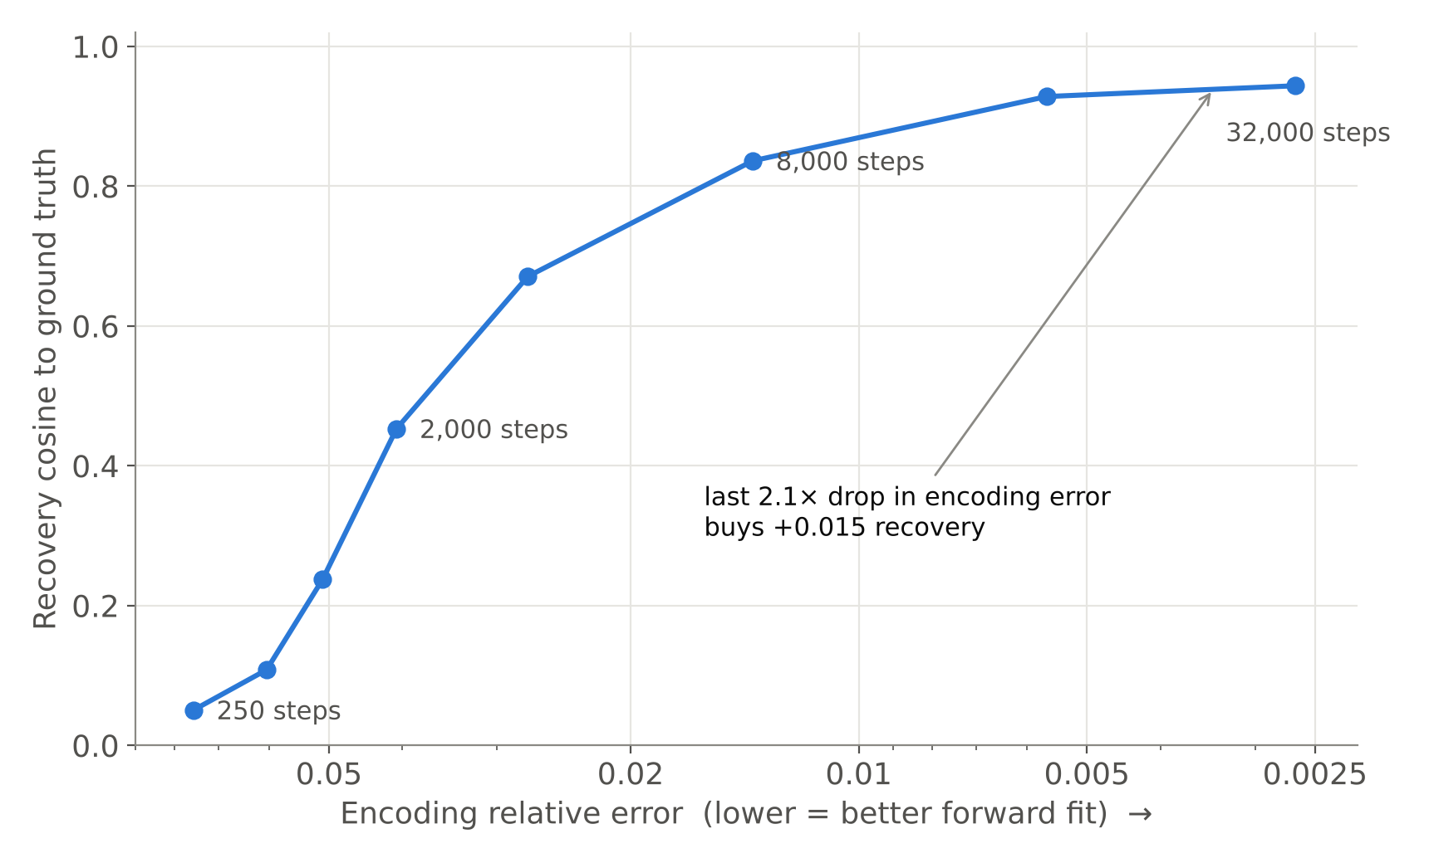
Recap: encoding and decoding dissociate
Encoding error falls 28.4× while recovery saturates at 0.944. Recovery saturates near 2 000 random vertices. Both established at Review II.
Notes:
One-slide recap so the panel has the baseline facts before the new results.

Slide 14
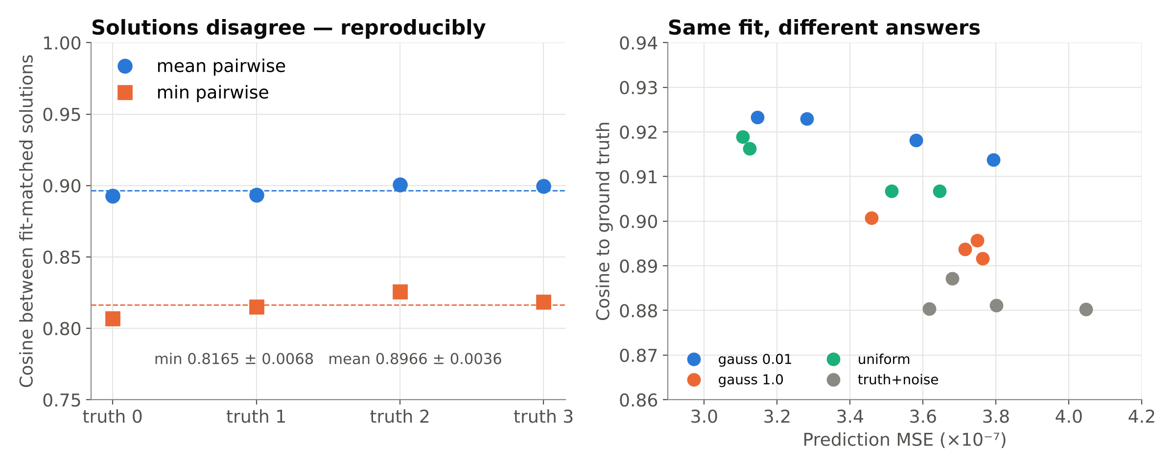
Same fit, different answers: the inverse is non-convex
Ground truth | Best fit | Mean pairwise | Min pairwise | Worst pair
0 | 3.51e-7 | 0.8928 | 0.8068 | uniform vs truth+noise
1 | 3.65e-7 | 0.8934 | 0.8151 | uniform vs truth+noise
2 | 3.11e-7 | 0.9007 | 0.8257 | uniform vs truth+noise
3 | 3.13e-7 | 0.8996 | 0.8186 | uniform vs truth+noise
Notes:
Four initialisation distributions, 14 000 steps each, all reach prediction MSE within 3.1-4.0e-7 (fit-matched), yet agree with each other only at 0.82-0.90 cosine. Reproduced across four independent ground truths with sd 0.0068. The same pair disagrees most every time, and recovered norms cluster by initialisation (0.90, 0.99, 0.94, 1.17 in every run): solutions separate along a consistent, structured direction, not randomly.

Slide 15
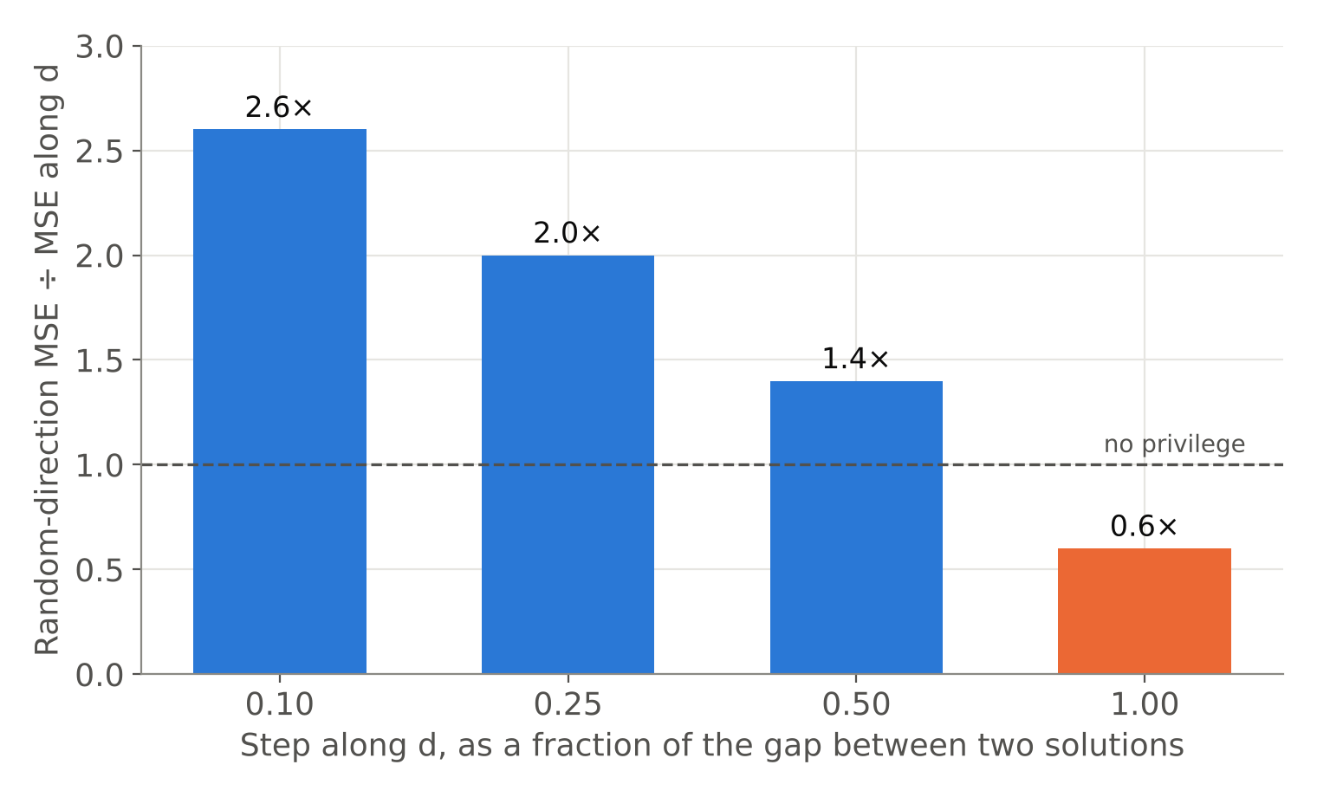
Information-loss hypothesis rejected
Test
Let d be the difference between two fit-matched solutions. If d lay in a null space, moving along d would barely change the predicted response, at every scale.
Result
Privileged only for small steps (2.6×). At the full separation, moving along d changes the response more than a random direction (0.6×).
Meaning
The two answers are separate minima with a barrier between them, not points on a flat valley. Recovery is limited by optimisation geometry, not destroyed information.
Notes:
This is the result that changed the project's framing. We expected a null space and designed the test to confirm it; it falsified it. Locality check: the advantage of d drops from 2.0× at the point where it was found to 1.0-1.1× at two other ground truths. This test uses only forward passes, so it does not depend on any optimiser.

Slide 16
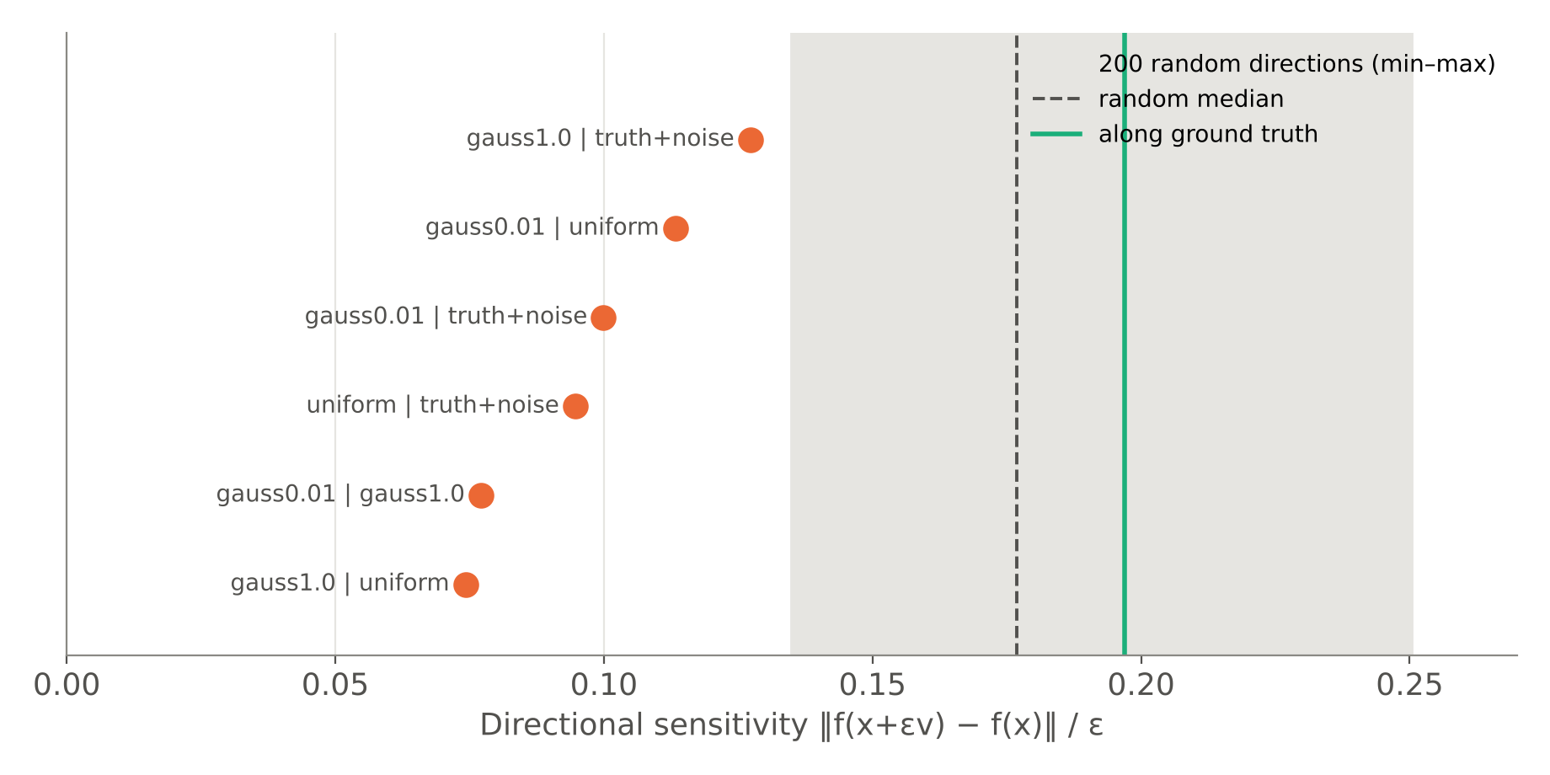
Errors concentrate in the operator's weakest directions
1.9×
lower sensitivity along d than the random median
6 / 6
pairwise difference directions below every random direction
Anisotropic ill-conditioning, quantified: what the inverse fails to pin down is exactly what the operator responds to least (s = 0.095 vs random 0.135–0.250).
Notes:
Directional sensitivity is a finite-difference probe of the Jacobian. All six pairwise difference directions fall 1.4-2.4× below the random median and below the random minimum. So the inverse is not singular (H1 rejected) but it is anisotropic: some directions are weakly constrained, and that is where different minima differ. This links non-convexity to conditioning.

Slide 17
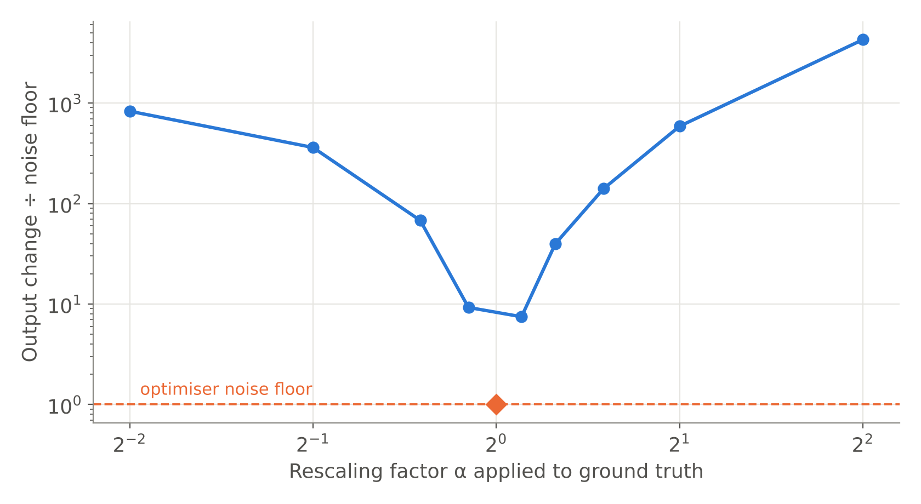
Gain is identifiable; error is not a single scale factor
Quantity | Value
Direction cosine | 0.8362
Mean norm ratio ‖x̂‖/‖x*‖ | 0.747 (sd 0.046)
Norm correlation over time | 0.915
Relative error, raw | 0.5516
Relative error after optimal rescale | 0.5675
Rescaling makes error slightly worse, so the shortfall is not a global gain. Even ±10% scaling is 7–9× above the noise floor.
Two simple explanations excluded: the decoder is not merely losing the overall magnitude of the representation.
Notes:
Forward-only test: scale the ground truth by alpha and compare the output change to the optimiser's residual floor (1.3e-6). Only alpha = 1 sits within the floor; alpha = 0.9 and 1.1 are 9.2× and 7.5× above it. Separately, rescaling the recovered trajectory to the true norm changes relative error from 0.5516 to 0.5675. Both rule out 'gain is unidentifiable'.

Slide 18
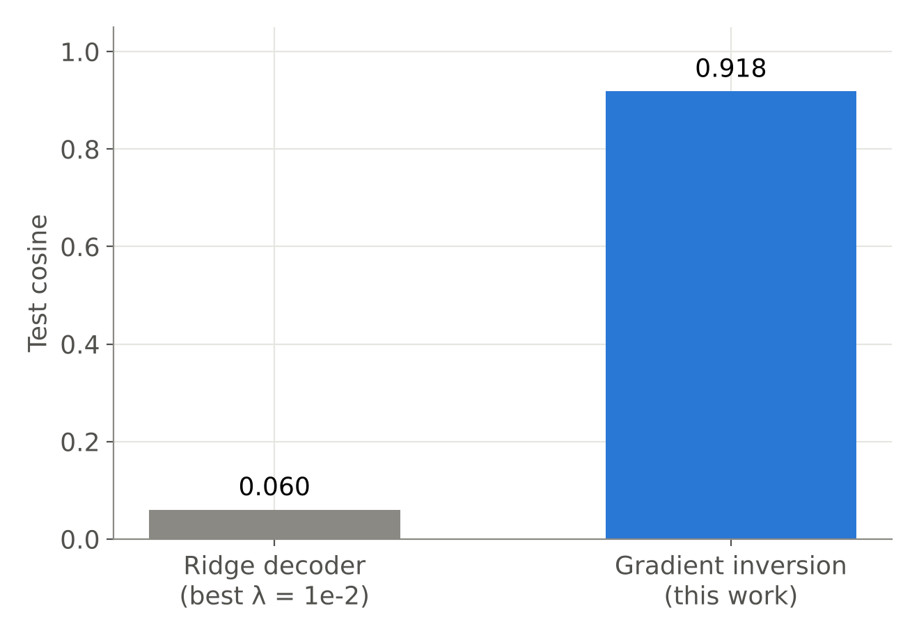
Nonlinear inversion vs a linear decoder
Ridge λ | Test cosine
1e-2 | 0.0599
1e-1 | 0.0310
1e0 | 0.0205
1e1 | 0.0133
1e2 | 0.0103
Caveat stated plainly. Ridge (240 train / 60 test pairs) predicts the time-averaged representation from time-averaged BOLD, a strictly easier target than the time-resolved trajectory inversion recovers. Read 0.060 as a floor; the 15× gap exceeds what the mismatch can explain.
Notes:
The operator is strongly nonlinear (transformer + pooling), so a linear decoder fitted on the same forward model barely beats chance. This justifies inverting the operator instead of training a linear readout. The comparison is indicative, not exact, and we say so before they do.

Slide 19
What did not work, reported as such
Experiment | Outcome | Why | How we report it
Optimiser control (SGD, L-BFGS) | Fits 1.4e-4 / 2.8e-5 vs Adam 3.5e-7 | Hyperparameters did not converge | Invalid control; limitation
Bandwidth sweep | Flat 0.838–0.858 over 64× | No HRF operator in the release | Structural null result
Stimulus manifold | 0.947 vs 0.942 | Operator indifferent to prior | Null result
Smoothness prior | 0.527 → 0.0008 | Wrong prior for semantics | Negative result
Why this slide exists: the non-convexity claim does not rest on the failed optimiser control. It rests on the perturbation and sensitivity tests (forward passes only) and on replication across four ground truths. A converged second optimiser would strengthen it, and is listed as future work.
Notes:
Reviewers often look for what was hidden. Showing it first takes the question away. If pressed on Adam's implicit bias: different initialisation distributions reach different minima reproducibly, and the barrier between them is shown with forward passes; neither depends on Adam.

Slide 20
Regional analysis (neurobiology track)
Which networks the operator listens to, and where meaning is recoverable

Slide 21
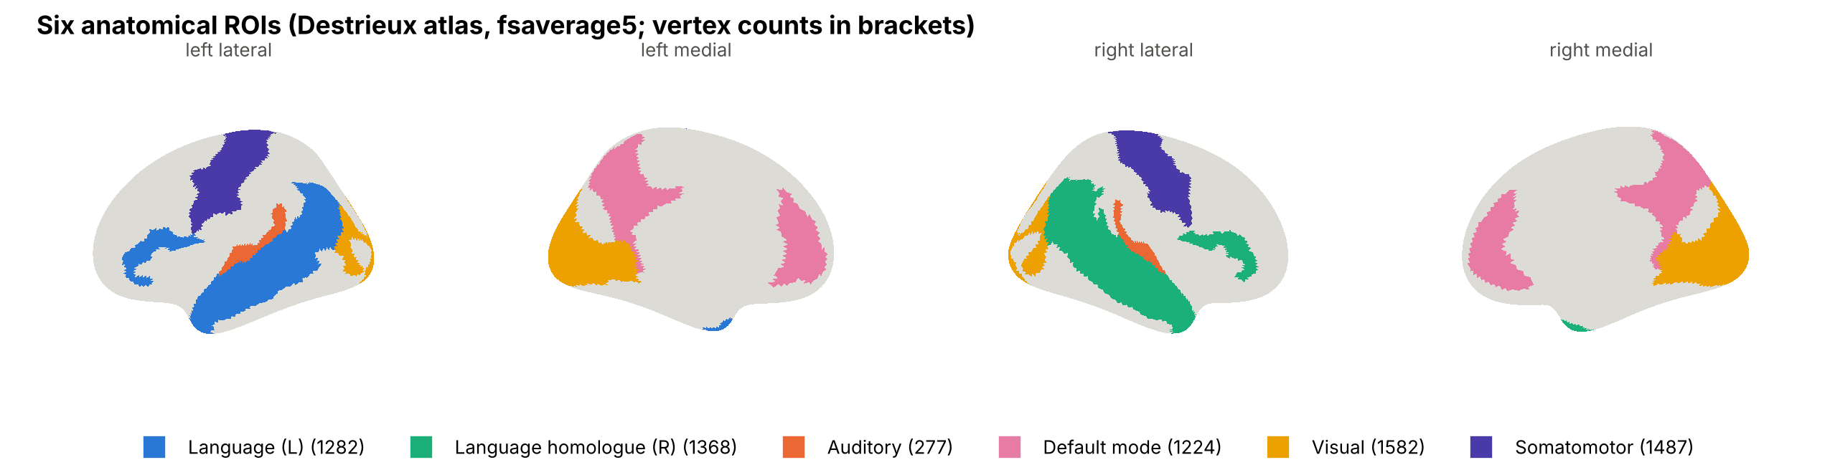
Six anatomical networks on fsaverage5
Network | Destrieux labels | Vertices
Language (L) | IFG opercular/triangular/orbital, STG lateral, STS, MTG, temporal pole, angular gyrus | 1 282
Language homologue (R) | Same labels, right hemisphere (lateralisation test) | 1 368
Auditory | Heschl's gyrus, transverse temporal sulcus, planum temporale | 277
Default mode | Precuneus, posterior cingulate (dorsal, ventral), anterior cingulate, subparietal | 1 224
Visual | Occipital pole, cuneus, calcarine, middle/superior occipital, lingual | 1 582
Somatomotor | Precentral, postcentral gyri, central sulcus (low-semantic control) | 1 487
Notes:
Atlas: Destrieux et al. (NeuroImage 2010), the anatomical parcellation shipped with Nilearn for fsaverage5 (74 labels per hemisphere); TRIBE v2 vertex order is left 0-10241 then right. Network membership follows Fedorenko et al. 2024 (language) and Buckner et al. 2008 (default mode). Angular gyrus is assigned to language only, so ROIs are disjoint. Somatomotor is the control network that should carry little semantic signal.

Slide 22
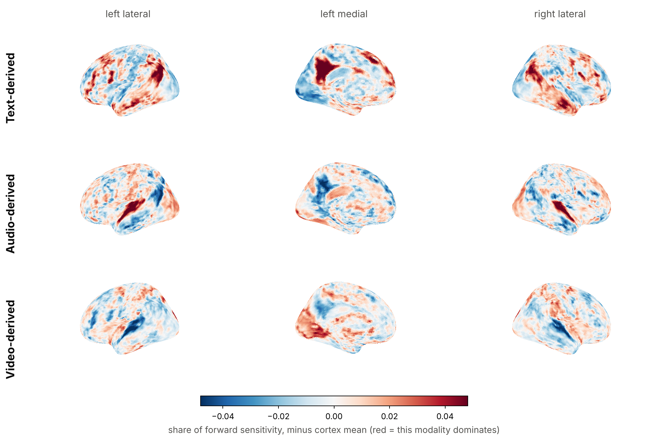
The operator's functional topography matches anatomy
Network | text z | audio z | video z
Language (L) | +26.6 | -12.5 | -18.5
Language homologue (R) | +28.5 | -10.6 | -23.3
Auditory | -3.8 | +34.7 | -32.8
Default mode | +26.9 | -15.1 | -16.1
Visual | -38.4 | +7.5 | +40.7
Somatomotor | -3.5 | +6.9 | -3.5
Each network is dominated by the modality it should be: language and default-mode by text-derived dimensions, auditory cortex by audio, visual cortex by video. Somatomotor is least sensitive overall (0.73× cortex mean).
Notes:
Per-vertex forward sensitivity to random perturbations confined to each third of x (text-, audio-, video-derived projector outputs), 16 directions per modality, forward passes only. Map shows each modality's share minus its cortical mean. z-scores compare each network's mean share to 2 000 random vertex sets of the same size; these nulls ignore spatial autocorrelation, so treat the z values as effect sizes and the sign pattern as the result. A spin-permutation test is the stricter next step. This is an independent check that the operator we invert is neuroanatomically sensible.

Slide 23
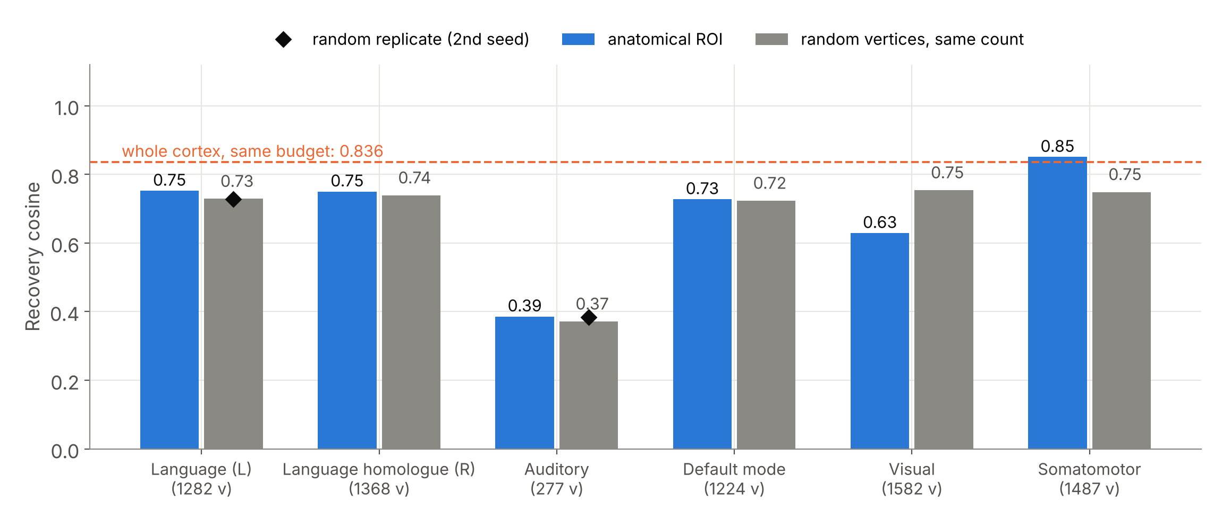
Where you look matters: visual cortex hurts, somatomotor helps
Network | ROI | Random | Δ
Language (L) | 0.752 | 0.729 | +0.023
Language homologue (R) | 0.750 | 0.739 | +0.011
Auditory | 0.386 | 0.371 | +0.015
Default mode | 0.727 | 0.723 | +0.004
Visual | 0.629 | 0.754 | −0.125
Somatomotor | 0.851 | 0.748 | +0.102
Visual cortex recovers 0.125 worse than random vertices of the same count; somatomotor 0.102 better, beating the whole cortex at the same budget (0.851 vs 0.836). Both effects are ~10× the control seed spread (≤ 0.013). Left language +0.023; homologue, auditory, default mode within noise.
Notes:
Each network is inverted observing only its own vertices; each has a random control of identical size (same seeding scheme as the extent sweep), and two networks have a second random seed: language controls differ by 0.0014, auditory controls by 0.0126, which bounds control variability. Whole-cortex anchor reproduces the earlier GPU value exactly (0.8362), so the CPU run is comparable. All values at a fixed 8 000-step budget and one ground truth: we claim relative differences within this run, not converged absolute values. Auditory is low in absolute terms simply because it has only 277 vertices (cf. extent curve).

Slide 24
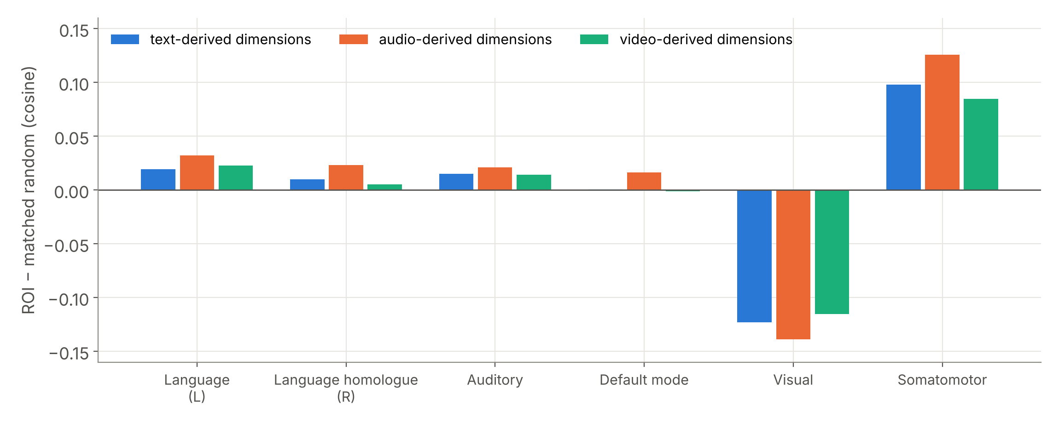
The regional effect is not modality-specific
Split recovery into the text-, audio- and video-derived thirds of x. If a network helped only with the modality it encodes, visual cortex would recover video dimensions well. Instead, every network shifts all three thirds together: visual cortex loses text, audio and video alike; somatomotor gains all three.
Regional recoverability is a property of how a region's response is shaped, not of which modality it is tuned to.
Notes:
Contrast with the topography slide: visual cortex is the most video-dominated network (z = +40.7), yet recovering the video-derived dimensions from visual cortex is worse than from random vertices (−0.116). Predictable is not the same as recoverable, even within a region's preferred modality.

Slide 25
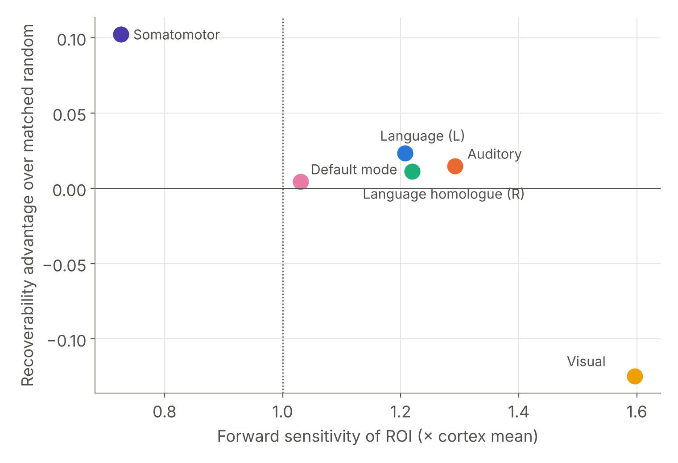
Predictable is not recoverable
Visual cortex responds most strongly to the representation (1.60× cortex mean) and is the worst place to decode it from. Somatomotor responds least (0.73×) and is the best.
Partial mechanism: response diversity. Somatomotor's response spans the most independent directions (participation ratio 18.6 vs 15.2 matched; top direction carries 15% of variance). Visual responses are strong but concentrated (PR 10.3; top direction 27%).
Language and auditory are also concentrated yet near their controls, so diversity explains the extremes, not every network. Six networks are too few for a correlation claim.
Notes:
Participation ratio = (sum of squared singular values)^2 / sum of fourth powers, of the ROI's response matrix to 128 random input directions: the number of independent input directions the region can tell apart. Practical implication worth stating: a uniform whole-cortex MSE is dominated by high-gain, low-diversity regions such as visual cortex; this predicts that down-weighting them could improve whole-cortex decoding. That is a testable next step, not a result. Caveat: at a fixed 8 000-step budget we cannot separate 'better optimum' from 'faster convergence' for somatomotor.

Slide 26
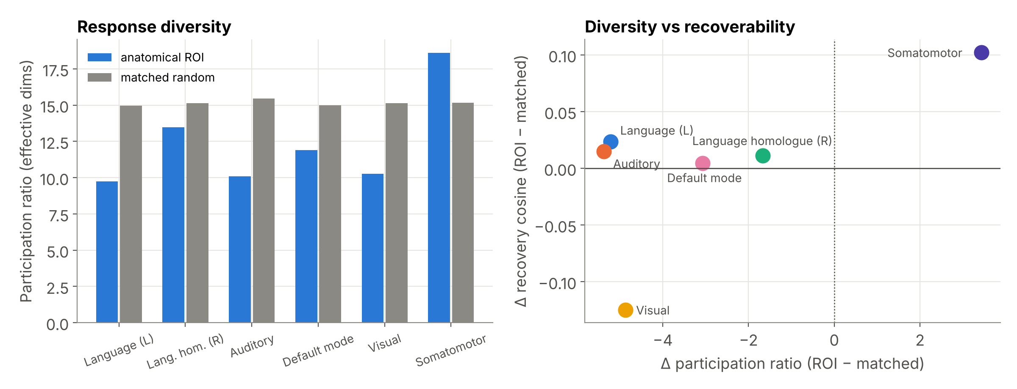
A partial mechanism: response diversity
Somatomotor spans the most independent input directions (PR 18.6 vs 15.2) and recovers best; visual is concentrated (PR 10.3) and recovers worst. Language and auditory are concentrated too but near their controls: diversity explains the extremes only.
Notes:
Participation ratio from the singular values of each region's response to 128 random input directions (forward passes only). Every anatomical network except somatomotor is less diverse than random vertices of the same count, which is expected: anatomically coherent regions respond in correlated ways. A testable prediction follows: whole-cortex decoding should improve if the loss down-weights high-gain, low-diversity regions such as visual cortex.

Slide 27


What limits semantic decoding from fMRI
Not destroyed information
No null space: the barrier test rejects it (0.6× at full separation).
Non-convexity
Equally good fits disagree at 0.82 cosine, reproducibly; the answer depends on where the search starts.
Anisotropic conditioning
Disagreement lives in directions the operator barely responds to (0th percentile).
Measurement noise
Graceful loss of direction, steep loss of magnitude (rel. error 0.55 → 2.06).
Where you look
Strong responses are not the best evidence: visual cortex decodes worst, somatomotor best (−0.125 / +0.102 vs matched).
Notes:
The one-slide answer to 'so what did you find?'. Encoding accuracy is not the bottleneck; the geometry of the inverse is. Practical consequence: better decoders on fMRI need better search (multiple restarts, priors learned from language structure, ensembling over minima) more than better encoders.

Slide 28
Tabulation of all results
Claim | Evidence | Key number | Status
Encoding ≠ decoding | 8 independent budgets | 28.4× vs +0.015 | Established
Inverse is non-convex | Fit-matched init control, 4 truths | min pairwise 0.8165 ± 0.0068 | Established
No null space | Perturbation along d | 0.6× at full separation | Established
Errors in weak directions | 200 random directions | 6/6 below random minimum | Established
Gain identifiable | Forward rescaling | ±10% → 7–9× floor | Established
Stable under noise | 7 noise levels | 0.836 → 0.298 monotone | Established
≈10% cortex suffices | 6 extents | 0.777 at 2 000 vertices | Established
Beats linear decoding | Ridge baseline | 0.918 vs 0.060 | Indicative
Anatomical topography | Sensitivity maps, 6 networks | z +27 to +41 in matching modality | Established
Regional recoverability | ROI vs matched random | Visual −0.125, somatomotor +0.102 vs matched | Established (1 truth)
Real-data decodability | LeBel 2023 | — | Final phase
Notes:
The ledger the panel can interrogate. 'Established' means replicated or tested against a control; 'Indicative' means the comparison has a stated caveat.

Slide 29
Standards, ethics and SDG justification
Where the work sits against data, reporting and neuro-ethics frameworks

Slide 30
Alignment with relevant standards
Standard / framework | Scope | How this project aligns
BIDS (Gorgolewski et al., 2016) | Neuroimaging data organisation | Real-data phase uses OpenNeuro ds003020, a BIDS dataset; derivatives kept in BIDS layout
IEEE P2794 (draft, active PAR 2022) | Reporting standards for in vivo neural interface research | Report adopts its minimum-reporting approach: model, data, preprocessing, metrics, failures
IEEE P2731 working group | Unified BCI terminology (functional model) | Block diagram uses its functional decomposition: acquisition → features → decoding → output
FAIR principles (Wilkinson et al., 2016) | Findable, accessible, interoperable, reusable data | Seeded scripts, results.json, open model and data; figures regenerated from logs
Licences: CC BY-NC 4.0; Llama 3.2 licence; CC0 | TRIBE v2; text encoder; OpenNeuro data | Non-commercial academic use only; gated access obtained
Digital Personal Data Protection Act 2023 (India) | Personal data processing | No personal data processed: synthetic ground truth; de-identified public corpus
Notes:
IEEE P2794 is still a draft (active PAR since Dec 2022), so we say 'adopts its approach' rather than 'complies with'. P2731 is a working group whose functional-model paper (IEEE OJEMB 2021) defines BCI terminology. If asked about ISO/IEC medical-device standards (IEC 62304, ISO 14971): those apply to a deployed device; this is pre-device research, and they would apply at a translation stage.

Slide 31



Neuro-ethics: what our results imply
OECD Recommendation on Responsible Innovation in Neurotechnology (2019)
UNESCO Recommendation on the Ethics of Neurotechnology (adopted 12 Nov 2025)
Implication of our findings
Calls for safety assessment and protection of personal brain data. Our limits are a form of safety assessment: they quantify how much a decoder on fMRI can actually recover.
Treats neural data as uniquely sensitive and requires informed consent and protection against misuse. No new neural data was collected in this project.
Even with a near-perfect forward model, recovery is incomplete, depends on initialisation, and degrades with noise. Claims of fMRI 'mind reading' should be read against these limits.
Notes:
Conflicting interests from Review I (fidelity vs privacy) are addressed here: our contribution measures fidelity limits, which is exactly the evidence privacy frameworks need. UNESCO adoption date: 12 November 2025, General Conference.

Slide 32
SDG justification, target by target
SDG target | Link | Evidence from this project
3.4 promote mental health and well-being | Assistive communication for cognitively intact, motor-impaired patients | Limits tell clinicians what non-invasive fMRI decoding can and cannot deliver; non-convexity points to better search, not bigger encoders
9.5 enhance scientific research and technological capability | Method for characterising neural-interface models | Reusable, open pipeline: differentiable entry into a 177 M-parameter encoder; runs on free compute
10.2 inclusion irrespective of disability | Communication access as a precondition for inclusion | Regional result guides which cortex a future low-cost or partial-coverage system should target
Honest scope: this is enabling research. The SDG contribution is evidence about what is achievable, not a deployed assistive device.
Notes:
Top rubric band asks for clear justification. Each row links a specific target to a specific project output.

Slide 33
Limitations and remaining work
Validation on real naturalistic fMRI and the final write-up

Slide 34
Limitations
Synthetic ground truth lives in a random low-dimensional subspace, not real language embeddings; qualitative findings are expected to transfer, absolute values may not.
Inversion targets the aggregated representation x, one stage after raw LLaMA embeddings.
All solutions from Adam; the SGD / L-BFGS control did not converge under the settings tried.
No haemodynamic operator in the released model, so temporal bandwidth limits cannot be measured.
Release ships only the shared 'average subject' layer, so per-subject analysis is not possible with public weights.
Regional z-scores use a random-vertex null that ignores spatial autocorrelation; a spin test is stricter.
Regional inversion uses one ground truth and one budget (8 000 steps, CPU); comparisons are internal to that run, and faster convergence cannot yet be separated from a better optimum.
Real-data test: one subject (UTS03), one held-out story, 5 inversion queries; per-network inversion on real data not yet run.
Notes:
State limitations before they are raised. None of them affects the central claims (dissociation, non-convexity, rejected null space), which were replicated and tested with optimiser-independent forward passes.

Slide 35
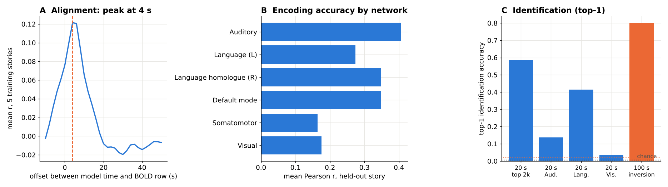
Real-data validation in progress: first results (LeBel 2023)
OpenNeuro ds003020
UTS03 · 6 stories · TR 2 s
Surface projection
validated sampler → fsaverage5
Stimulus features
LLaMA-3.2-3B text + w2v-BERT audio
Inversion
held-out BOLD → x̂ through frozen f
Identification
rank the true moment among all stories
0.48
59%
4/5
0.02
encoding r, top 2 000 vertices (56% of noise ceiling)
forward identification of 20-s windows, chance 0.5% (194 windows)
held-out segments identified by inverting real BOLD, chance 2.2%
cosine of x̂ to the true x: the moment is identifiable, the representation is not recovered
Notes:
Everything tunable (the 6-s alignment offset, the 2 000 vertices) was fitted on the five training stories; wheretheressmoke is held out and is not in TRIBE v2's training set. Text + audio features (LLaMA-3.2-3B and w2v-BERT, TRIBE v2's own pipeline) on a Colab T4, 2 000 inversion steps. Oracle (inverting the model's own prediction, same budget): 5/5 identified, cosine 0.22, so even noise-free inversion recovers little of x. An earlier audio-only CPU run gave the same pattern (5/5, cosine 0.06). The key real-data finding mirrors the synthetic one: identification succeeds while cosine recovery is low, i.e. the inverse pins down which moment was heard but not the full representation. Avatar fails alignment QC (no lag peak) and is kept only as a distractor, which makes identification harder, not easier.

Slide 36
Timeline to completion
Aug
Sep
Oct
Nov
Dec
S1 Literature, formulation
S2 Instrumentation
S3 Core characterisation
S4 Controls and hypothesis tests
S5 Regional analysis
S6 Real-data study
S7 Paper and final report
Review II
Review III
Notes:
S1-S5 complete. S6 runs on Colab GPU with checkpointed stages; S7 drafting has started from the computational methods and results write-up.

Slide 37
Conclusion
A better brain encoder does not, by itself, make meaning more decodable. The limit is the geometry of the inverse, not lost information.
Encoding error falls 28× while recovery saturates (0.944)
Inverse is non-convex: equal fits disagree at 0.82 cosine, reproducibly; no null space
Disagreement lies in the operator's least-sensitive directions
The operator's topography matches anatomy; regional recoverability measured against matched controls
First real-fMRI result: inverting held-out BOLD identifies the heard moment, yet recovers little of x, as the synthetic analysis predicts
Next: complete the real-data study, then the final report and paper
Notes:
Close with the one-sentence finding, then stop.

Slide 38
Backup · Anticipated questions
Slides held in reserve for the viva

Slide 39
Q: Is the non-convexity just Adam?
Couldn't Adam's implicit bias create the different answers?
The barrier between minima is shown with forward passes only (perturbation test), and the weak-direction result is a Jacobian probe; neither involves an optimiser. Different initialisation distributions reach different minima reproducibly across four ground truths.
Then why did SGD and L-BFGS give different answers?
They never reached comparable fit (1.4e-4 and 2.8e-5 vs 3.5e-7), so they are not valid comparisons. We report the control as failed rather than interpret it.
What would settle it?
A tuned second-order method reaching ~1e-7 fit from the same initialisations. Listed as future work.
Notes:
Keep this answer short and calm: the claim rests on optimiser-independent tests.

Slide 40
Q: Regional analysis details
Why Destrieux and not Glasser or Schaefer?
Destrieux ships with Nilearn on the same fsaverage5 mesh TRIBE predicts on, with standard anatomical names. Network membership comes from the language (Fedorenko) and default-mode (Buckner) literature. HCP-MMP (Glasser) is a natural robustness check.
Are the regional differences just ROI size?
No: every ROI is compared with a random vertex set of exactly the same size, and two networks have a second random seed to bound control variability.
Why no left-lateralisation of language?
The release is an average-subject model; TRIBE v2's own paper finds lateralisation in contrasts (sentences vs word lists), not in raw sensitivity. Our homologue result is consistent with bilateral responses to natural speech.
Notes:
If asked for the null of the z-scores: random-vertex sets of the same size, 2 000 draws; a spin test respects spatial autocorrelation and is the stricter next step.

Slide 41
Q: The surprising regional result
How can 1 487 somatomotor vertices beat the whole cortex (0.851 vs 0.836)?
With a uniform MSE, the whole-cortex loss is dominated by high-gain, low-diversity regions such as visual cortex, which steer the search badly. Observing only diverse, low-gain vertices removes that pull. It suggests re-weighting the objective, a testable next step.
Isn't the visual result an artefact of the synthetic video dimensions?
Visual cortex is worse than its matched control on text- and audio-derived dimensions too (−0.12 and −0.14), so it is not specific to the video third of x.
Would it hold at convergence?
Unknown: all regional runs use one 8 000-step budget and one ground truth. Faster convergence and a better optimum cannot yet be separated; we claim relative differences within the run.
Notes:
Values: visual text −0.123, audio −0.139, video −0.115 relative to matched random; somatomotor +0.098, +0.126, +0.085.

Slide 42
Q: What does 0.82 cosine mean? Is any of this real?
Is 0.82 good or bad?
It is the agreement between two equally good answers, so it bounds how reproducible a single decoded answer is. It is a property of the inverse, not a score to maximise.
Your results are all synthetic. Are they real findings?
They are exact measurements of a real, published operator. Real fMRI adds subject and measurement noise on top; the noise sweep shows how much that costs. Real-data identification is the final phase.
Why should a clinician care?
Because the bottleneck is search, not encoder size: better decoders will come from restarts, ensembling over minima and language-derived priors.
Notes:
Return to the conclusion slide after this one if the discussion drifts.

Slide 43
Q: Why fMRI, not EEG? Why TRIBE v2?
Why not EEG?
Brain2Qwerty (Nat. Neurosci. 2026): 29% character error with MEG vs 65% with EEG on the same architecture.
Why not simultaneous EEG–fMRI?
The best open simultaneous dataset (NKI, 22 adults) has rest, Inscapes and short movie clips, no sustained language: data-limited, not method-limited.
Why TRIBE v2?
Largest open-weight encoder: 451.6 h training, 1 117.7 h evaluation across 720 subjects, all 20 484 cortical vertices, first at Algonauts 2025.
Notes:
Same answers as Review II, kept for continuity.

Slide 44
References
[1] T. Naselaris, K. N. Kay, S. Nishimoto, J. L. Gallant, “Encoding and decoding in fMRI,” NeuroImage, vol. 56, no. 2, pp. 400–410, 2011.
[2] A. G. Huth et al., “Natural speech reveals the semantic maps that tile human cerebral cortex,” Nature, vol. 532, pp. 453–458, 2016.
[3] R. Antonello, A. Vaidya, A. G. Huth, “Scaling laws for language encoding models in fMRI,” in Proc. NeurIPS, vol. 36, 2023.
[4] J. Tang, A. LeBel, S. Jain, A. G. Huth, “Semantic reconstruction of continuous language from non-invasive brain recordings,” Nat. Neurosci., vol. 26, pp. 858–866, 2023.
[5] A. LeBel et al., “A natural language fMRI dataset for voxelwise encoding models,” Sci. Data, vol. 10, art. 555, 2023.
[6] J. Lévy et al., “Noninvasive decoding of typed sentences from human brain activity,” Nat. Neurosci., 2026.
[7] S. d’Ascoli et al., “A foundation model of vision, audition, and language for in-silico neuroscience,” arXiv:2605.04326, 2026.
[8] P. C. Hansen, Discrete Inverse Problems: Insight and Algorithms. Philadelphia, PA: SIAM, 2010.
[9] C. Destrieux, B. Fischl, A. Dale, E. Halgren, “Automatic parcellation of human cortical gyri and sulci using standard anatomical nomenclature,” NeuroImage, vol. 53, no. 1, pp. 1–15, 2010.
[10] E. Fedorenko, A. A. Ivanova, T. I. Regev, “The language network as a natural kind within the broader landscape of the human brain,” Nat. Rev. Neurosci., vol. 25, pp. 289–312, 2024.
[11] R. L. Buckner, J. R. Andrews-Hanna, D. L. Schacter, “The brain’s default network,” Ann. N.Y. Acad. Sci., vol. 1124, pp. 1–38, 2008.
[12] K. J. Gorgolewski et al., “The brain imaging data structure,” Sci. Data, vol. 3, art. 160044, 2016.
[13] M. D. Wilkinson et al., “The FAIR Guiding Principles for scientific data management and stewardship,” Sci. Data, vol. 3, art. 160018, 2016.
[14] IEEE P2731 Working Group, “A functional model for unifying brain computer interface terminology,” IEEE Open J. Eng. Med. Biol., vol. 2, 2021.
[15] OECD, Recommendation of the Council on Responsible Innovation in Neurotechnology, OECD/LEGAL/0457, 2019.
[16] UNESCO, Recommendation on the Ethics of Neurotechnology, adopted 12 Nov. 2025.
[17] D. P. Kingma, J. Ba, “Adam: A method for stochastic optimization,” in Proc. ICLR, 2015.
[18] J. L. Gardner, T. Liu, “Inverted encoding models reconstruct an arbitrary model response, not the stimulus,” eNeuro, vol. 6, no. 2, ENEURO.0363-18.2019, 2019.
[19] Bladon, Bent, “Feature visualization recovers known cortical selectivity from TRIBE v2,” arXiv:2605.13904, 2026.
[20] Y. Benchetrit et al., “Boosting brain-to-image decoding with TRIBE v2 data augmentation,” arXiv:2606.06345, 2026.
[21] K. N. Kay, T. Naselaris, R. J. Prenger, J. L. Gallant, “Identifying natural images from human brain activity,” Nature, vol. 452, pp. 352–355, 2008.
[22] A. Défossez, C. Caucheteux, J. Rapin, O. Kabeli, J.-R. King, “Decoding speech perception from non-invasive brain recordings,” Nat. Mach. Intell., vol. 5, pp. 1097–1107, 2023.
Notes:
IEEE format. OECD and UNESCO entries are normative instruments, cited as such.

