Slide 1
Sudoku Solver
Group Members
Aung Zar Lin (st121956)
Win Win Phyo (st122314)

Slide 2
Outlines
Objectives
Methods to solve Sudoku
Sudoku Datasets
Real time sudoku solver
Demo

Slide 3
Objectives
To learn multi-agent systems based on RL algorithms and analysis of ways to establish interaction within the system, based on intelligent agents
To know the comparisons and findings between simple recursive algorithm, monte carlo tree search and deep Q Learning algorithm
To make an implementation of Real Time Sudoku Solver

Slide 4
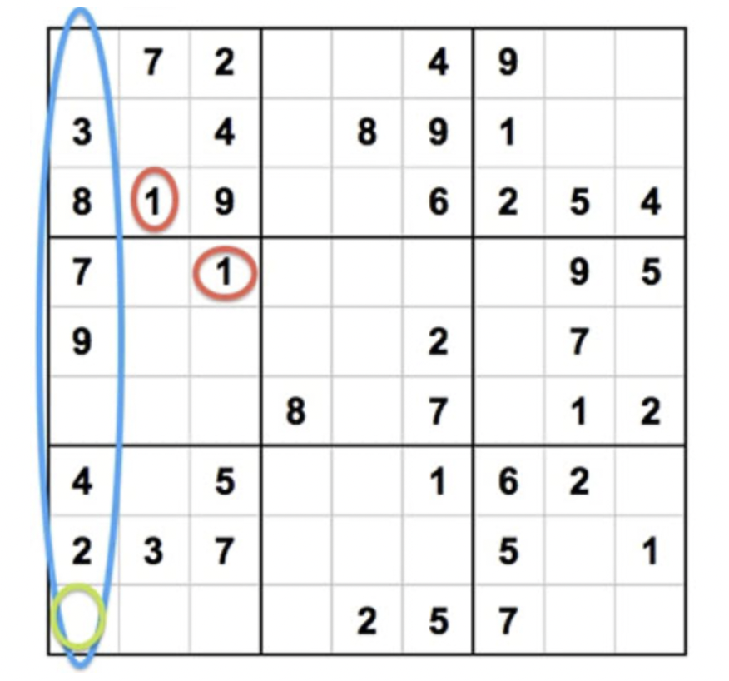
What is Sudoku?
Sudoku is played on a grid of 9*9 spaces.
Within the rows and columns are 9 squares (made up of 3*3 spaces).
Each row, column and square (9 spaces each) needs to be filled out with the numbers 1-9,without repeating any numbers within the row, column or square.
Sudoku-level
Easy - 43 guesses
Medium - 51 guesses
Hard- 53 guesses

Slide 5
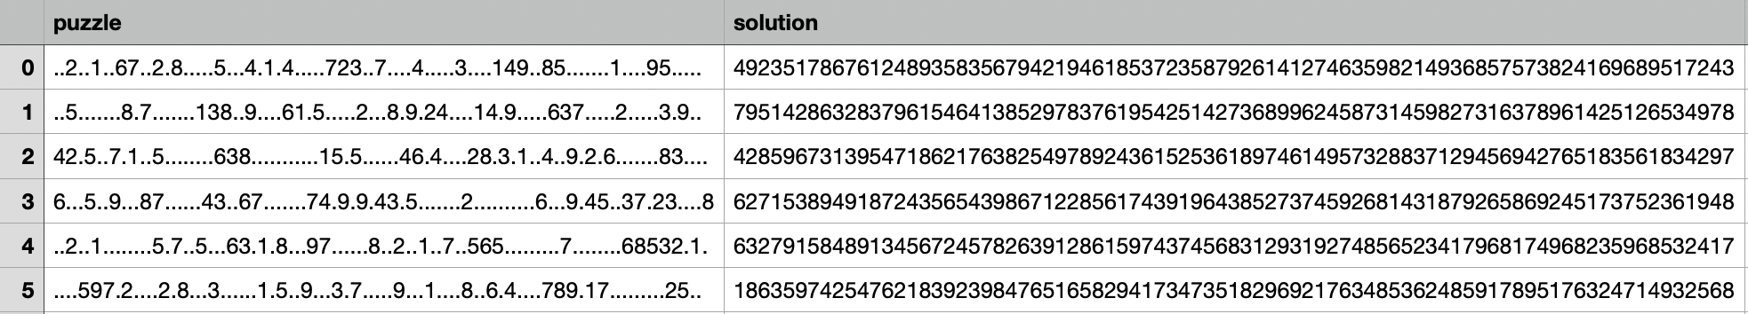
Dataset
This dataset contains 3 millions sudoku puzzles and their solutions.
https://www.kaggle.com/datasets/radcliffe/3-million-sudoku-puzzles-with-ratings
Puzzle: The puzzle as a string of 81 characters. Dotted signs indicate unknown values.
Solution: The completed Sudoku grid as a string of 81 digits between 1 and 9

Slide 6
The Methods we used to Solve Sudoku
BackTracking Algorithm
Monte Carlo Tree Search
Deep Q Learning Algorithm

Slide 7
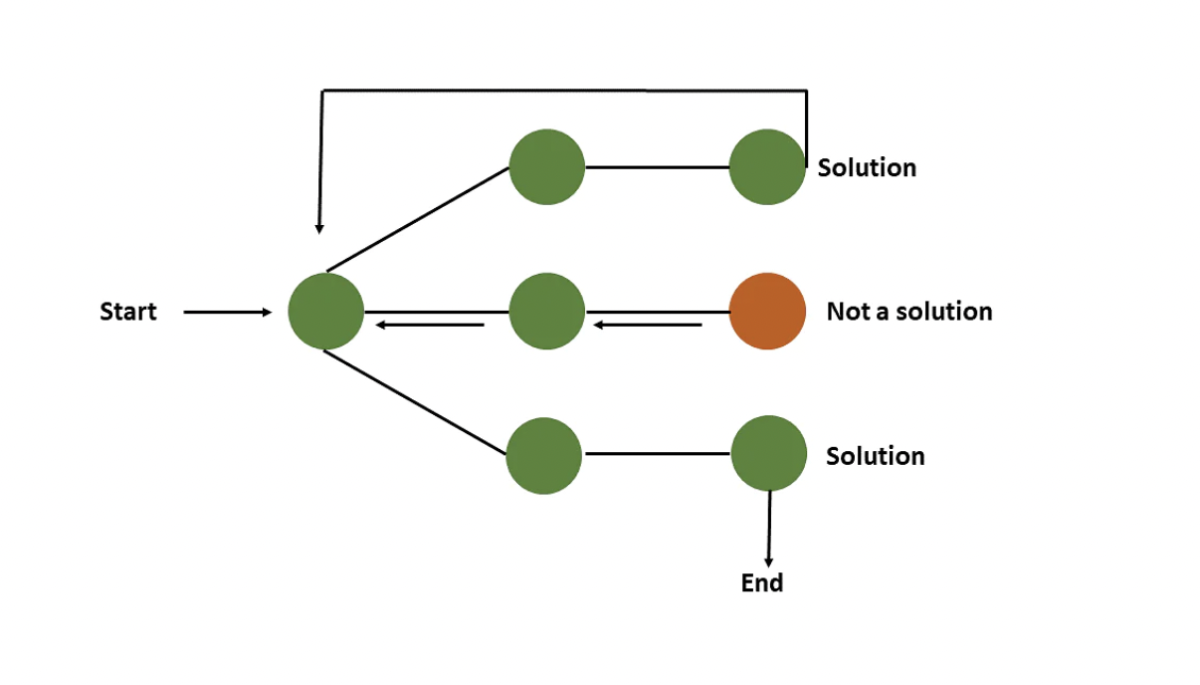
BackTracking Algorithm
An algorithmic technique where the goal is to get all solutions to a problem using the brute force approach.
It is a recursive algorithm that attempts to solve by testing all possible paths until a solution is found.
If the solution is not found , the algorithm backtracks to test another possible path.

Slide 8
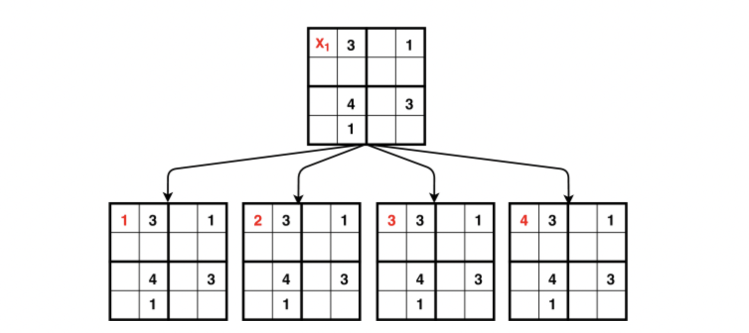
Monte Carlo Tree Search
MCTS is a method usually used in games to predict the path(moves) that should be taken by the policy to reach the final winning solution.
MCTS combines nested calls with randomness in the playouts and memorization of the best sequence of moves.
In rollouts, it uses probabilistic and heuristic driven search algorithm

Slide 9
Reinforce Method
It belongs to a special class of Reinforcement Learning methods called Policy Gradient algorithms.
It creates the Policy: a model that takes a state as input and generates the probability of taking an action as output .
The object of the policy is to maximize the “Expected reward”.

Slide 10
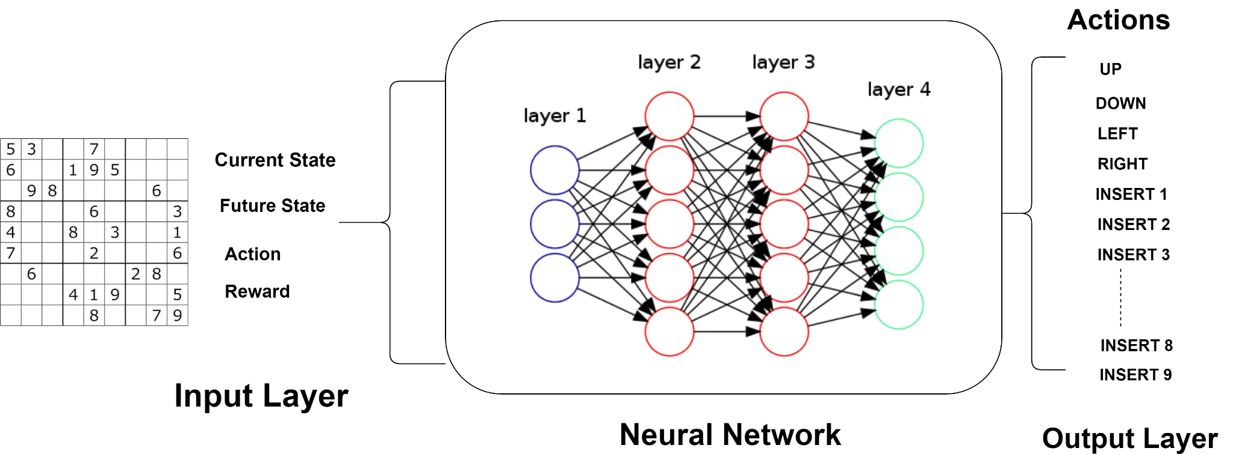
Deep Q Learning
Combination of Q-Learning with a neural network to break the chain and find the optimal Q-value function.
It is used the states as input and optimal Q-value of all possible actions as the output.

Slide 11
Restrictions for agents in the environment
Agents do not know | Agent know
The line must be filled with numbers from 1 to 9 without repeat | About the existence of rows columns, squares
The column should be filled with numbers from 1 to 9 without repeat | They can put a number in an empty cell
The square should be filled with numbers from 1 to 9 without repeat | They can move the Sudoku board one step away from the current one

Slide 12
Actions available to the agents
Action | Description
Number placement(1-9) | The agent tries to place the number on the field
Move in one of the directions (10- 13) | The agent moves in one of the allowed directions (up, down, left, right)

Slide 13
Reward
Correct filling of an empty cell | 1
Incorrect filling of an empty cell | -1
Attempt to fill an filled cell | -2
Movement | 0
Sudoku solving | 0

Slide 14
Result
 | Backtrack | MCTS | DQN
Easy | 43 iters | 56 iters | More than 200 (fail to solve)
Medium | 51 iters | 101 iters | More than 300 (Fail to solve)
Hard | 91 iters | 216 iters | More than 400 (Fail to solve)
*** In DQN, agent moves more than 400 moves to solve easy level, so we consider it is fail.

Slide 15
Conclusions
Backtracking algorithm and Monte Carlo Tree Search show good results and appropriate movings.
For the Deep Q-Learning, it is very complex environment which is based on the complex implicit rules . Finding the dependencies is too challenging for Q-Learning methods using Deep Network.
In solving with DQN, it can well solve only less than 5 guesses.

Slide 16
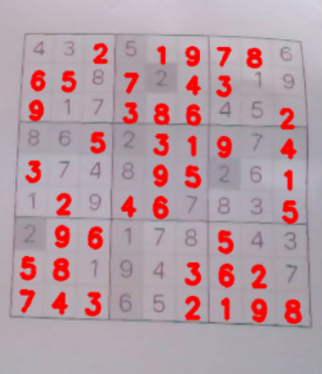
Real-Time Implementation
Step 1 : Reading image from real-time video
Step 2 : Get Sudoku matrix
Step 3 : Detect number
Step 4 : Solve Sudoku by using backtracking algorithm
Step 5 : show result on live video

Slide 17
Digit Recognition (CNN Network)
Input image
(28, 28, 1)
(MNIST)
Conv2D
(10, 10, 16)
MaxPool (5, 5, 16)
Conv2D
(24, 24,32)
Flatten (400)
FC (128)
FC(64)
out(10)

Slide 18
Demo

