Slide 1
Monthly Meeting
Student: Qian Hong
Supervisor Team : Simon. P. Platt , Stephen. J . Mein
Date: 2013 Nov 27
University of Central Lancashire

Slide 2
Content
Current Plan
Progress against Plan
Achievements since last meeting
Difficulties
Next steps
Actions
University of Central Lancashire

Slide 3
Current Plan
Comparison of neutron flux of LANSCE results and Geant4 simulation results attached collimator at 30 degree.
Comparison of neutron flux of ANITA measurement with Geant4 simulation results attached collimator at 0 degree.
Comparison neutron flux of Geant4 simulation results at @ degree without collimator attached and with collimator attached.
@ can be 0, 15, 30, 60 or 90
Comparison gamma flux of Geant4 simulation results at @ degree without collimator attached and with collimator attached.
@ can be 0, 15, 30, 60 or 90
University of Central Lancashire

Slide 4
Progress against Plan
Collimator construction : does not go well
Detectors construction : 3 neutron detectors have attached; 3 gamma detectors have not attached
Source management : Git is installed and used for this project
University of Central Lancashire

Slide 5
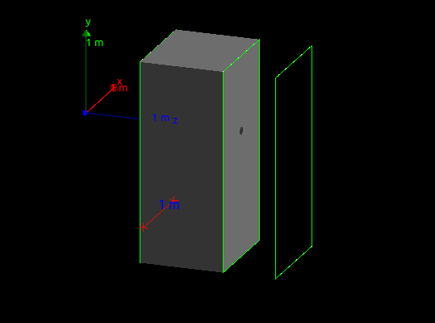

Achievements 1 _ Geometry Construction
Geometry, position, material of collimator
Geometry, position of material of Detector
University of Central Lancashire

Slide 6
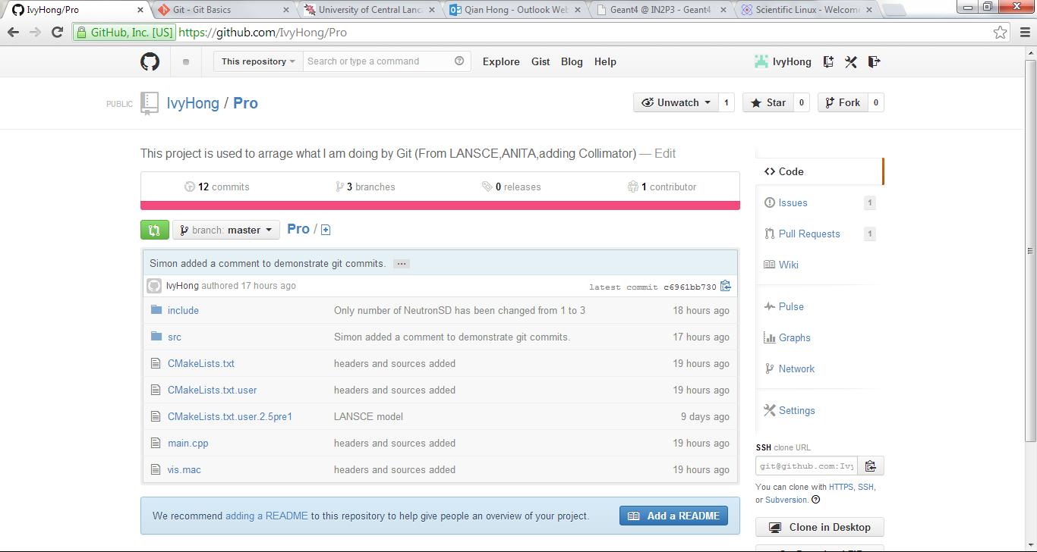
Achievements 2_ Git
Git, version control system, which used to record changes and easily go back to any version.

Slide 7
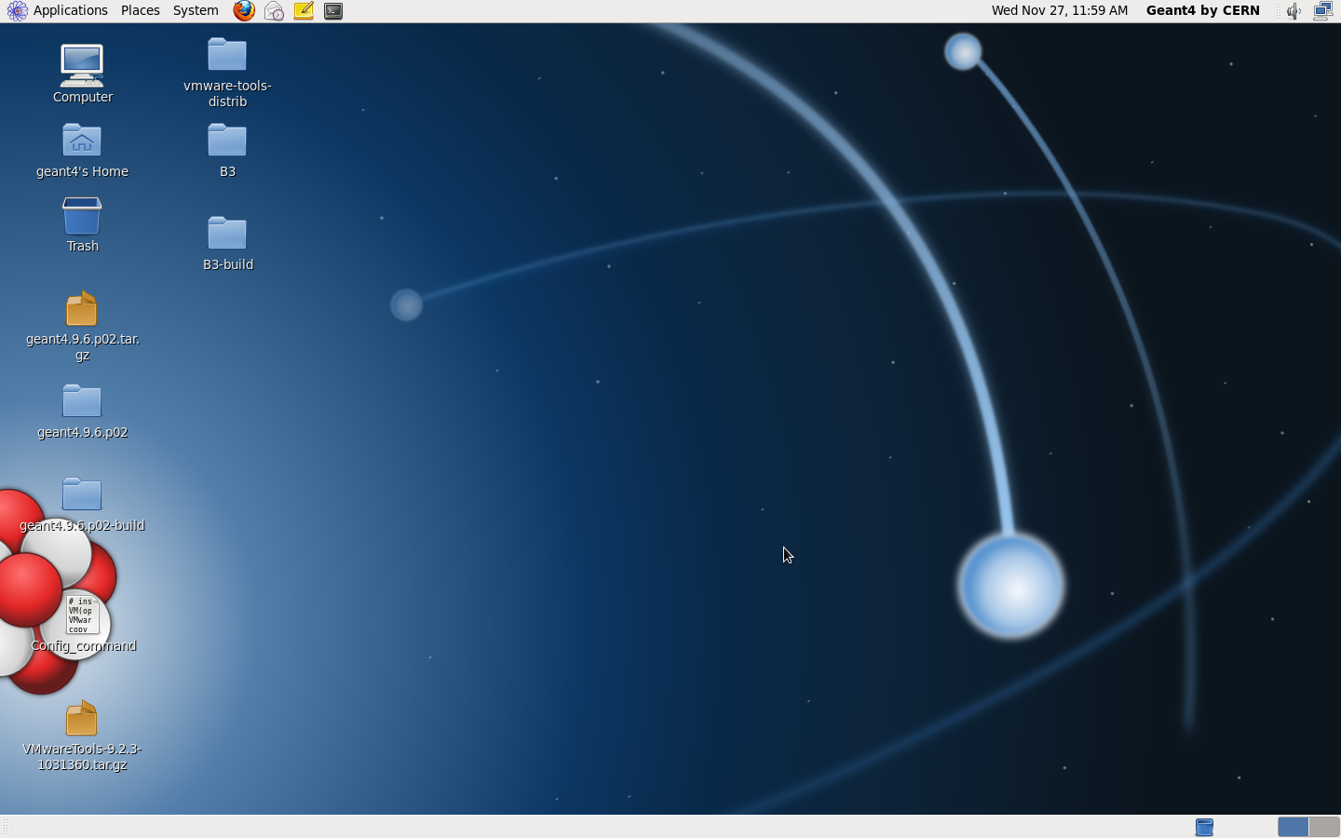
Achievement 3_Geant4 support
New, the Geant4 officially supported on Scientific Linux 5 with gcc 4.1.2 or 4.3X, 32/64bit and Scientific Linux 6 with gcc 4.6X, 64bit
Scientific Linux 6 has been install in the virtual machine Vmware Workstation.
Integrated Development Environment has not installed yet, some choices : Eclipse, Xcode

Slide 8
Difficulties 1
Qt Debugger, it fails to bebug.
commands in macro file cannot compile by Qt creator debugger
The following commands lead to failure.
/vis/open OGL
/vis/drawVolume
University of Central Lancashire

Slide 9
Difficulties 2
Access to skill Git gui
Geometry of collimator, aperture does not penetrate through collimator
Records more database, in separate output csv file. How to do that……

Slide 10
Next steps
To solve the collimator geometry, minimal working example method is considered
The visualization can be controlled by compiled code (Geant4 User Manual), it is possible to try to avoid debug fails
Find out Xcode and Eclipse in linux and install one IDE for Scientific Linux 6 – help me be familiar with using Geant4 in different operating system
University of Central Lancashire

Slide 11
Revised plan
Meeting record will be sent on the same day of meeting, as well as next month meeting request.

