Slide 1
Weekly Meeting
Student: Qian Hong
Supervisor Team : Simon. P. Platt , Stephen. J . Mein
Date: 2013 Dec 06
University of Central Lancashire

Slide 2
Content
Current Plan
Progress against Plan
Achievements since last meeting
Next steps
Actions
University of Central Lancashire

Slide 3
Current Plan
Collimator Validation Testing
Learning how to use ROOT
Add Collimator to TSL_ANITA model
University of Central Lancashire

Slide 4
Progress against Plan
ROOT Learning progress : slow
One thing important : We are thinking about why TSL_ANITA model getting less neutrons and gammas?
One reason be sensible: in the codes (wrong).
SetTrackStatus(fStopAndKill) : kill the current track.
Results: all specified particles are stopped
University of Central Lancashire
Notes:
Codes: aStep->GetTrack()->SetTrackStatus(fStopAndKill) which let specific particles stopped at sensitive detectors

Slide 5
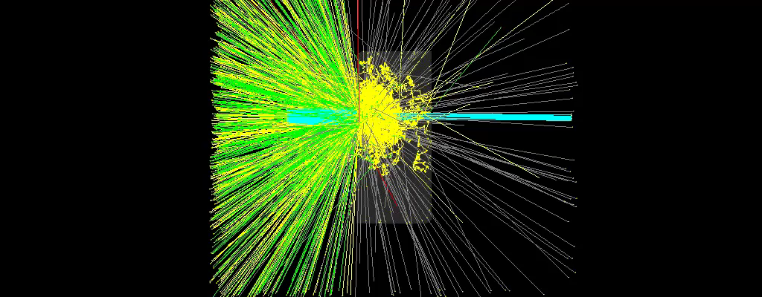
Achievements 1 _ TSL collimator geometry
University of Central Lancashire
Notes:
Yellow line : neutron
Green line : gamma

Slide 6
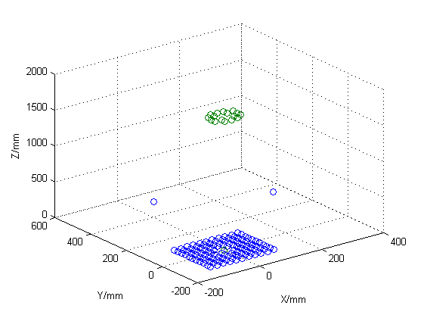
Achievements 2 _ Collimator testing results*
Matlab, “scatter3D” function has been used.
Aperture diameter: 102mm
Gun particle area : square (side length: 2*aperture diameter)
Gun is away from target : 976mm.
Run times : 100
University of Central Lancashire
Notes:
Yellow line : neutron
Green line : gamma

Slide 7
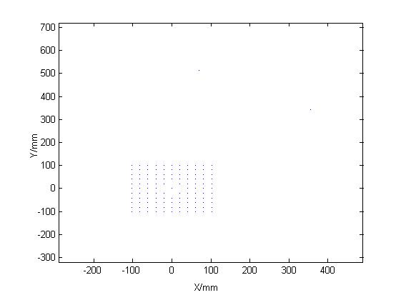
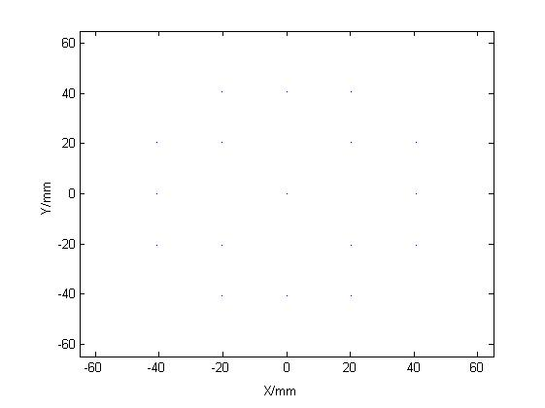
Achievements 2 _ Collimator testing results*
Figure.1 Particle Gun before passing through collimator
Figure.2 Particle Gun after passing through collimator
University of Central Lancashire
Notes:
Yellow line : neutron
Green line : gamma

Slide 8
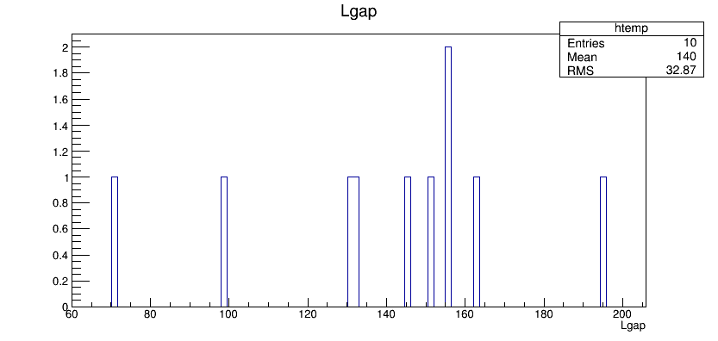
Achievements 3_ ROOT
Installation ROOT on Ubuntu operating system
Root Object Browser comes out by typing:
root[0] new Tbrowser
University of Central Lancashire
Notes:
Yellow line : neutron
Green line : gamma

Slide 9
Difficulties
Learning ROOT by reading ROOTUserGuide
Does ROOT can be used to analyse or record during executable file running
How to know “Qt” visualization driver default setting
University of Central Lancashire

Slide 10
Next steps
Collimator testing model is validated, so that collimator testing branch will merge to TSL_ANITA model
Updating TSL_ANITA model, make sure enough sensitive detectors to measure interesting parameters (e.g. position , energy)
ROOT output format will be used in ANITA model to analyse data.
Monthly Meeting preparing for next Wednesday
University of Central Lancashire

Slide 11
Revised plan
Monthly Meeting in the December will be held in next Wednesday.
Next weekly meeting will be held in next Friday.

