Slide 1
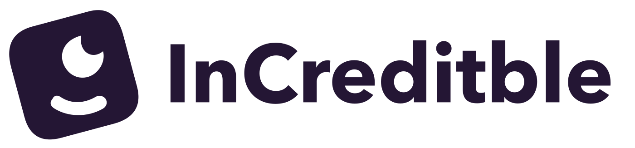

Your first
bond.
At your pace.
Corporate bonds for people starting from zero
Ivy Pei / Product pitch / October 2026
01
Notes:
LIVE PITCH · 5 seconds
InCreditble makes a first corporate-bond investment easier to understand.
REFERENCE NOTES
TIMING: 10 seconds
InCreditble helps first-time investors understand and buy corporate bonds, starting with a small amount. We are designing for people like our parents, who want a clear first step.
SOURCES AND CONTEXT
Product positioning from founder and current prototype. All functionality shown is simulated.

Slide 2
The first step is the hard part
“I want to invest
in bonds, but
don’t know
where to start.”
“Finding a bond’s CUSIP
is such a pain.”
“Fidelity’s bond account
is not for me.”
“I only want to invest
a small amount.”
Customer discovery comments, edited for clarity
02
Notes:
LIVE PITCH · 16 seconds
In more than ten customer conversations, people told us they wanted bonds but did not know where to start. Bond codes, unfamiliar platforms and minimum amounts made the first step feel difficult. Here is how we simplify it.
REFERENCE NOTES
TIMING: 22 seconds
Across more than ten customer discovery conversations, I heard frustration about finding bonds, not knowing where to begin, and wanting to invest only a small amount. These comments shaped our question: can a beginner understand a bond purchase without someone coaching them?
SOURCES AND CONTEXT
10+ conversations: founder report in this chat, October 10, 2026. Quotes: founder-supplied customer comments, edited for clarity. No participant demographics, prevalence or conversion rates established.

Slide 3
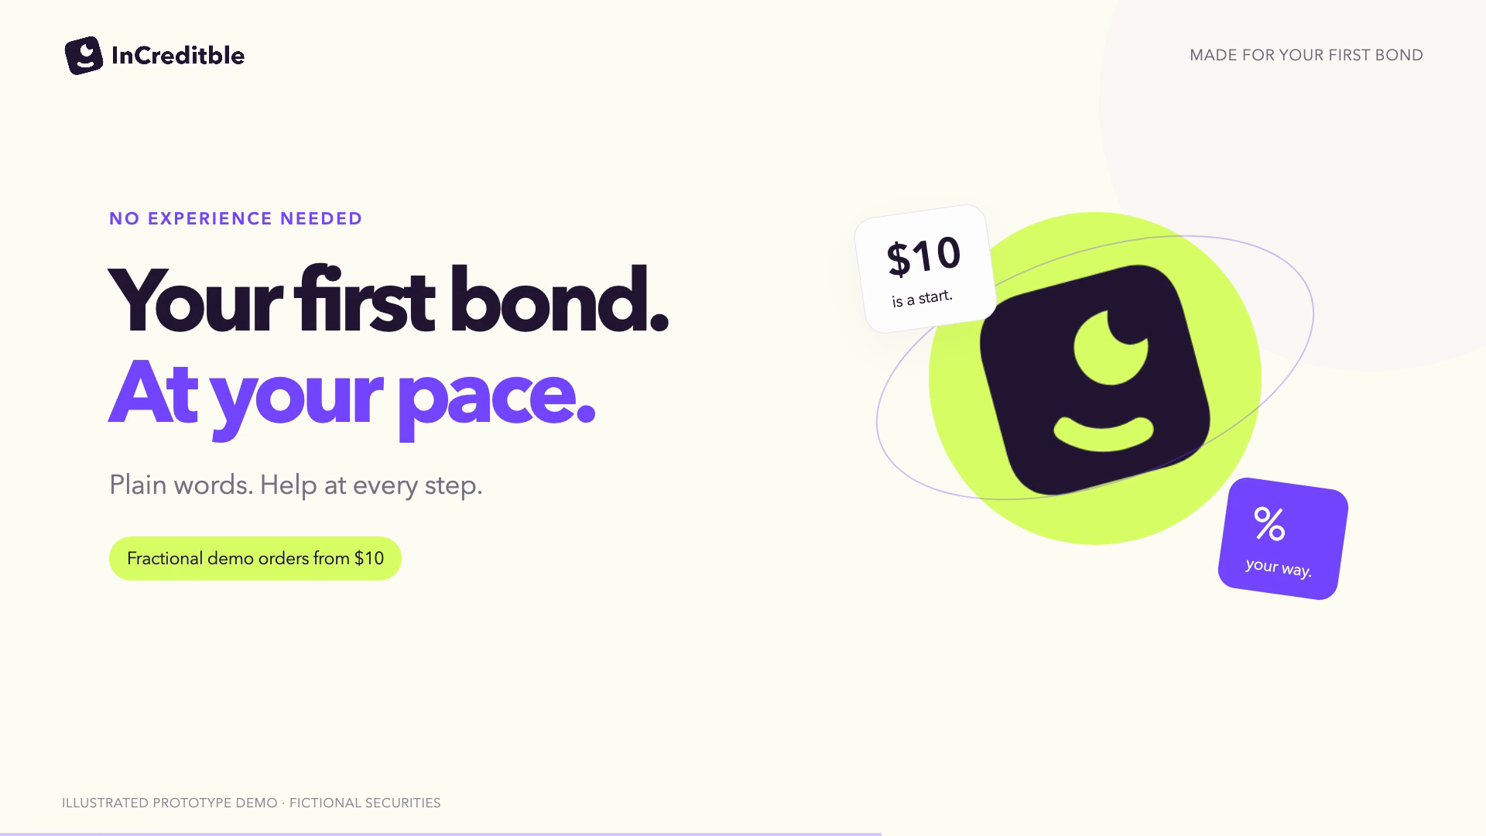
Notes:
LIVE PITCH · 68.0667 seconds
Click the video once. Let the 68-second product journey play. When it finishes, advance to Market. The standalone 2:25 demo remains available on the sharing page.
REFERENCE NOTES

Slide 4
A large market. A personal first step.
$12.1T
Our first
customer
U.S. corporate bonds outstanding
U.S. adults new to
individual bonds,
including older adults
Q2 2026
$66.7B
Average daily trading
Jan–Sep 2026
SIFMA, Oct 5, 2026. Asset market size does not represent addressable platform revenue.
04
Notes:
LIVE PITCH · 10 seconds
The U.S. corporate-bond market is over twelve trillion dollars. Our starting audience is adults new to individual bonds, including older investors.
REFERENCE NOTES
TIMING: 18 seconds
The U.S. corporate bond market has twelve point one trillion dollars outstanding. That is the underlying asset market, not our revenue opportunity. Our initial customer is a U.S. adult with savings who is new to individual bonds, especially an older investor seeking a simpler experience.
SOURCES AND CONTEXT
SIFMA, US Corporate Bonds Statistics, published October 5, 2026: outstanding $12.1T as of 2Q26; $66.7B average daily trading volume, YTD through September 2026. https://www.sifma.org/research/statistics/us-corporate-bonds-statistics
Initial customer segment is a founder hypothesis. No serviceable market or revenue TAM quantified.

Slide 5
Our place in a busy market
Fewer choices. More explanation before a decision.
PRODUCT | HOW IT WORKS | STARTING AMOUNT
Fidelity | Filtered inventory, investor chooses | Varies by offering
Robinhood | Bond ETFs, no individual bonds | $1 on eligible ETF shares
Webull managed | Portfolio selects bonds for a strategy | $2,000 corporate strategy
InCreditble prototype | Up to 3 explained matches User approves each trade | $10 simulated order
Official product pages, Oct 10, 2026. InCreditble is a prototype. Sources in speaker notes.
05
Notes:
LIVE PITCH · 14 seconds
Existing platforms offer inventory, ETFs or managed portfolios. We are testing a different entry point: a small amount, three explained matches, and a decision the user understands.
REFERENCE NOTES
TIMING: 20 seconds
Fidelity supports filtered bond search. Robinhood offers bond exposure through ETFs, while Webull offers managed bond portfolios. Our focus is an explained path to an individual corporate bond. We are testing whether fewer choices and visible payment terms help beginners make a decision they understand.
SOURCES AND CONTEXT
Official sources checked October 10, 2026.
Fidelity: https://www.fidelity.com/webcontent/ap002390-mlo-content/20.04/help/learn_searching_fixed_income_inventory.shtml
Robinhood supported investments: https://robinhood.com/us/en/support/articles/investments-you-can-make-on-robinhood/
Robinhood fractional shares: https://robinhood.com/us/en/support/articles/fractional-shares/
Robinhood example bond ETF: https://robinhood.com/us/en/stocks/DFSD/
Webull managed corporate High Income portfolio: https://www.webull.com/help/faq/11139
Robinhood is an adjacent retail investing alternative. The ETF-share minimum is not an individual bond minimum. Robinhood lists bonds and fixed-income trading as unsupported. Eligible stocks and ETFs support fractional orders from $1. Comparisons summarize documented workflows, not execution quality or absence of other competitor features. Webull also offers separate self-directed bonds. InCreditble $10 minimum is a prototype design, not a live brokerage offering.

Slide 6
How it works
Goals in. Explained choices out.
01
02
03
Filter
Rank & explain
Review & approve
Yield, timeframe, industry
and separate risk limits
Up to three matches,
with company context and risks
Price and fractional amount,
then an explicit user decision
Current prototype: deterministic matching and scripted explanations. Execution and accounts are simulated.
06
Notes:
LIVE PITCH · 20 seconds
The prototype filters by goals and risk limits, ranks a fictional bond pool, and explains the matches. Fractional orders show cost and expected payments before approval. Today, matching is deterministic and the assistant is scripted. Live data and execution come later.
REFERENCE NOTES

Slide 7
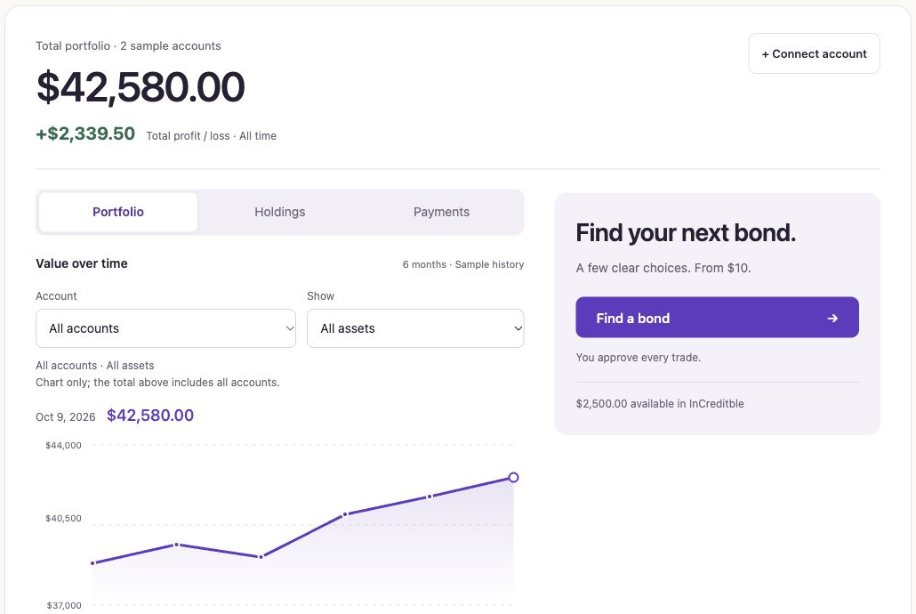
Early traction
10+
Customer discovery
conversations
Feedback narrowed the product
to a focused bond trading flow.
A working, end-to-end prototype
Founder-reported discovery count. Portfolio, connections and trades are simulated.
07
Notes:
LIVE PITCH · 15 seconds
Our evidence so far is discovery, not revenue: ten-plus conversations and a working prototype. Those conversations shaped the priorities: plain language, small starting amounts, payment visibility, and keeping existing accounts visible.
REFERENCE NOTES
TIMING: 18 seconds
Our progress is early but concrete: more than ten discovery conversations and a working prototype with a complete simulated transaction. Mentor feedback helped narrow the scope from wealth management to bond trading. We still need behavioral evidence of understanding, demand and willingness to pay.
SOURCES AND CONTEXT
10+ customer discovery conversations: founder report, October 10, 2026. Prototype and mentor-directed iterations are visible in the local project and conversation. No paid users, revenue, funded accounts or waitlist count has been established in supplied evidence.

Slide 8


Next comes
real people.
10 unassisted tests
Seeking pilot participants
and bond infrastructure
introductions
Can beginners explain the cost,
payment timing and loss risk?
Next: measure opt-in interest, test pricing and explore execution partners.
08
Notes:
LIVE PITCH · 12 seconds
Next, we want ten beginners to test the flow without help. Can they explain the cost, payment timing and loss risk? We are seeking pilot participants and bond-infrastructure introductions.
REFERENCE NOTES
TIMING: 22 seconds
Next, we will run unassisted tests with ten first-time investors and check whether they can explain the cost, payment timing and loss risk. We will measure opt-in interest, test pricing, and explore brokerage partners for real execution. I am looking for pilot participants and introductions to bond infrastructure partners.
SOURCES AND CONTEXT
Proposed next milestones, not completed traction: ten unassisted tests; demand and pricing research; execution, custody and fractional economics exploration. No partnership, launch approval or sustainable revenue model claimed. Read-only aggregation and standalone versus embedded distribution remain hypotheses.

Slide 9
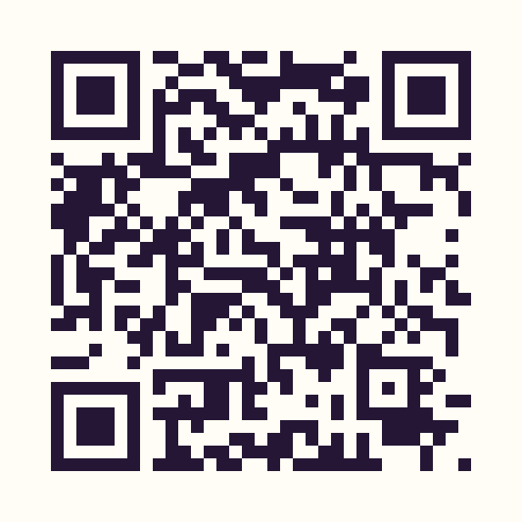
Try your
first bond.
Tell us what feels clear—
and what still needs explaining.
increditble.vercel.app
Demo only · No account or real money required
09
Notes:
LIVE PITCH · 8 seconds
Scan here to try it. We would love feedback on what feels clear and what still needs explaining.
REFERENCE NOTES

Slide 10


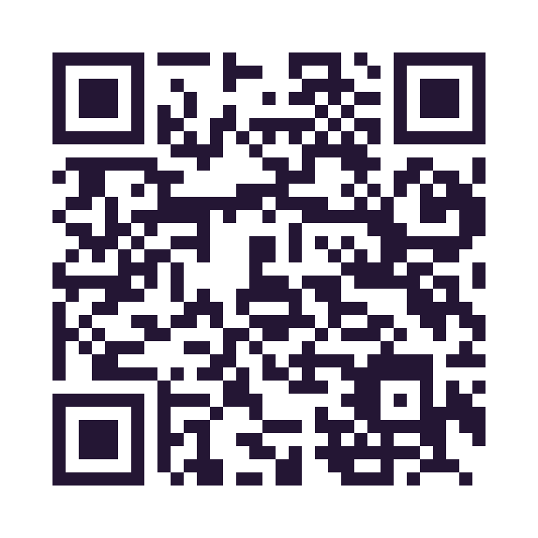


Contact our team
Scan to connect on LinkedIn
Ivy Pei
Ren Jie T.
Founder
CTO
Special thanks to our mentor
Pink Pan
Notes:
LIVE PITCH · 5 seconds
I am Ivy, our CTO is Ren Jie, and special thanks to our mentor, Pink Pan. Thank you.
REFERENCE NOTES
Contact our team on LinkedIn. Ivy Pei, Founder. Ren Jie T., CTO. Special thanks to Pink Pan, our mentor.
Portraits supplied by the founder on October 10, 2026. Original photos retained; circular crops are native layout masks. Only team members have QR codes.
Founder: https://www.linkedin.com/in/ivypei/
CTO: https://www.linkedin.com/in/ren-jie-t-619a6b1aa/
Mentor: https://www.linkedin.com/in/t-h-p/

