Slide 1
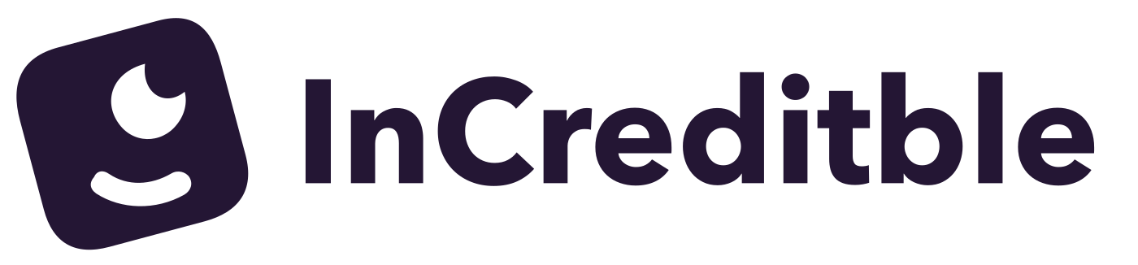

Your first
bond.
At your pace.
Corporate bonds for people starting from zero
Ivy Pei / Product pitch / October 2026
01
Notes:
TIMING: 10 seconds
InCreditble helps first-time investors understand and buy corporate bonds, starting with a small amount. We are designing for people like our parents, who want a clear first step.
SOURCES AND CONTEXT
Product positioning from founder and current prototype. All functionality shown is simulated.

Slide 2
The first step is the hard part
“I want to invest
in bonds, but
don’t know
where to start.”
“Finding a bond’s CUSIP
is such a pain.”
“Fidelity’s bond account
is not for me.”
“I only want to invest
a small amount.”
Customer discovery comments, edited for clarity
02
Notes:
TIMING: 22 seconds
Across more than ten customer discovery conversations, I heard frustration about finding bonds, not knowing where to begin, and wanting to invest only a small amount. These comments shaped our question: can a beginner understand a bond purchase without someone coaching them?
SOURCES AND CONTEXT
10+ conversations: founder report in this chat, October 10, 2026. Quotes: founder-supplied customer comments, edited for clarity. No participant demographics, prevalence or conversion rates established.

Slide 3
A large market. A personal first step.
$12.1T
Our first
customer
U.S. corporate bonds outstanding
U.S. adults new to
individual bonds,
including older adults
Q2 2026
$66.7B
Average daily trading
Jan–Sep 2026
SIFMA, Oct 5, 2026. Asset market size does not represent addressable platform revenue.
03
Notes:
TIMING: 18 seconds
The U.S. corporate bond market has twelve point one trillion dollars outstanding. That is the underlying asset market, not our revenue opportunity. Our initial customer is a U.S. adult with savings who is new to individual bonds, especially an older investor seeking a simpler experience.
SOURCES AND CONTEXT
SIFMA, US Corporate Bonds Statistics, published October 5, 2026: outstanding $12.1T as of 2Q26; $66.7B average daily trading volume, YTD through September 2026. https://www.sifma.org/research/statistics/us-corporate-bonds-statistics
Initial customer segment is a founder hypothesis. No serviceable market or revenue TAM quantified.

Slide 4
Our place in a busy market
Fewer choices. More explanation before a decision.
PRODUCT | HOW IT WORKS | STARTING AMOUNT
Fidelity | Filtered inventory, investor chooses | Varies by offering
Robinhood | Bond ETFs, no individual bonds | $1 on eligible ETF shares
Webull managed | Portfolio selects bonds for a strategy | $2,000 corporate strategy
InCreditble prototype | Up to 3 explained matches User approves each trade | $10 simulated order
Official product pages, Oct 10, 2026. InCreditble is a prototype. Sources in speaker notes.
04
Notes:
TIMING: 20 seconds
Fidelity supports filtered bond search. Robinhood offers bond exposure through ETFs, while Webull offers managed bond portfolios. Our focus is an explained path to an individual corporate bond. We are testing whether fewer choices and visible payment terms help beginners make a decision they understand.
SOURCES AND CONTEXT
Official sources checked October 10, 2026.
Fidelity: https://www.fidelity.com/webcontent/ap002390-mlo-content/20.04/help/learn_searching_fixed_income_inventory.shtml
Robinhood supported investments: https://robinhood.com/us/en/support/articles/investments-you-can-make-on-robinhood/
Robinhood fractional shares: https://robinhood.com/us/en/support/articles/fractional-shares/
Robinhood example bond ETF: https://robinhood.com/us/en/stocks/DFSD/
Webull managed corporate High Income portfolio: https://www.webull.com/help/faq/11139
Robinhood is an adjacent retail investing alternative. The ETF-share minimum is not an individual bond minimum. Robinhood lists bonds and fixed-income trading as unsupported. Eligible stocks and ETFs support fractional orders from $1. Comparisons summarize documented workflows, not execution quality or absence of other competitor features. Webull also offers separate self-directed bonds. InCreditble $10 minimum is a prototype design, not a live brokerage offering.

Slide 5
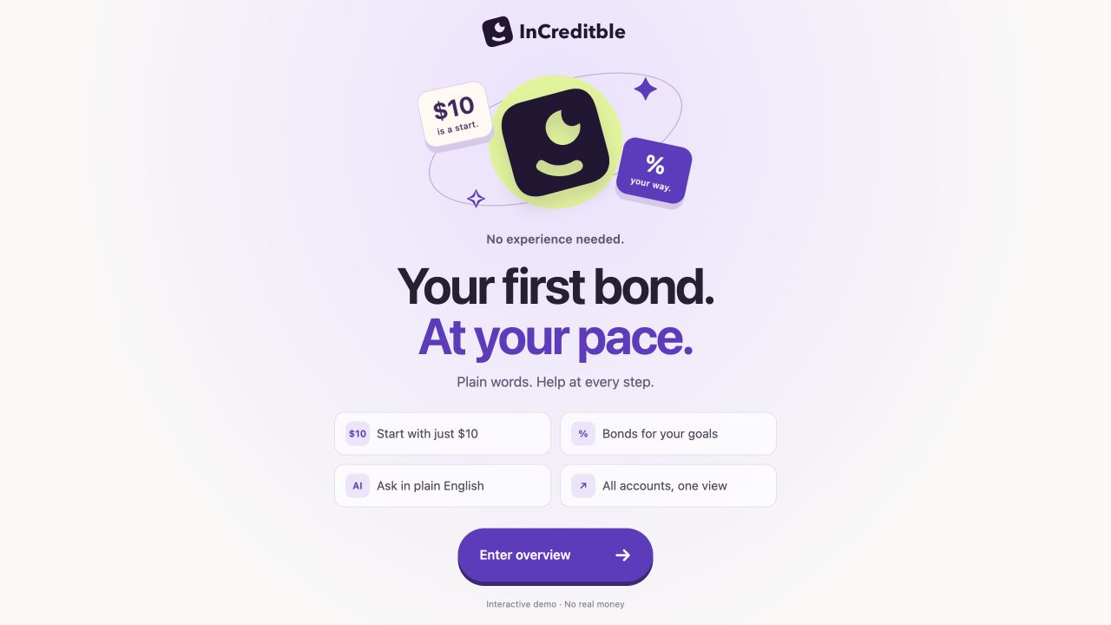
Notes:
TIMING: 10 seconds
Meet InCreditble: a corporate-bond trading experience for first-time investors. Start small, choose bonds around your goals, and get help in plain English.
Source: actual prototype opening, demo/media/welcome.jpg. Static screenshot. All trading, account connections and assistant responses are simulated.

Slide 6
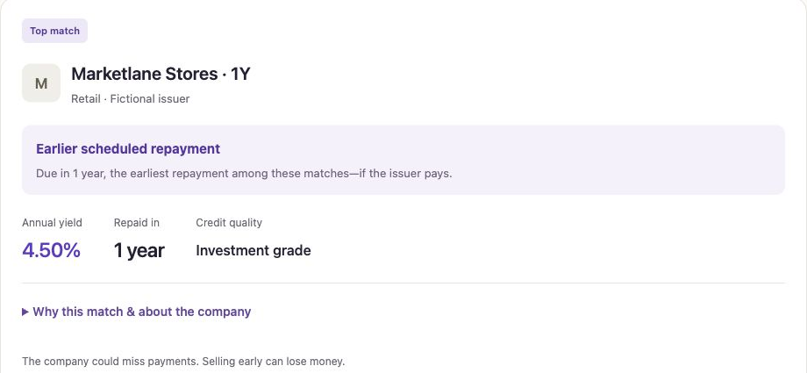
Three choices.
Room to
understand.
Your goals first.
Experience, yield, timeframe,
industry and budget
Optional help, in plain English
Company context and risks when you need them
Actual prototype. Fictional bonds and simulated assistant responses.
06
Notes:
TIMING: 20 seconds
Users tell us their experience, yield target, timeframe, industry and budget. The prototype returns up to three matches and explains the differences. Optional assistant responses help users understand a company and what could go wrong. Explanation depth adapts to experience.
SOURCES AND CONTEXT
Current prototype and actual demo screenshot. Matching uses deterministic filters and ranking. Assistant responses are simulated; no live model connected. Three matches are a selection limit, not a claim of market-wide optimality.

Slide 7
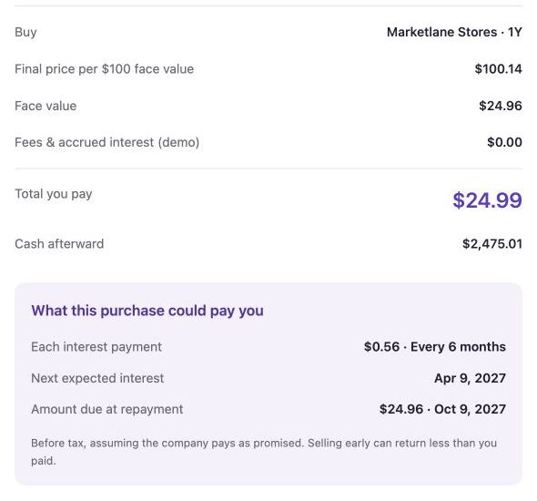
Small amount. Clear terms.
$25
A first purchase
can be small
Review the cost.
See expected payments.
Approve it yourself.
$25 budget, $24.99 simulated cost. Expected payments depend on the issuer paying.
07
Notes:
TIMING: 20 seconds
A twenty-five-dollar budget buys part of a bond in the demo. Before approval, the user sees the final cash cost, expected interest and repayment date. After confirmation, cash and holdings update, and the payment schedule includes the new position.
SOURCES AND CONTEXT
Actual prototype transaction captured October 10, 2026: $25 budget, $24.99 cost, $24.96 face, $2,475.01 cash remaining, $0.56 expected semiannual interest. Prices and dates are fictional demo data. Fractional execution and custody in a live product remain unvalidated.

Slide 8
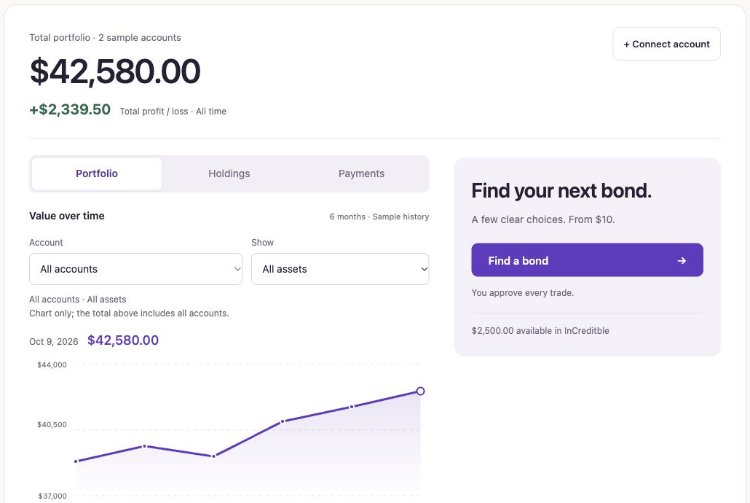
Early traction
10+
Customer discovery
conversations
Feedback narrowed the product
to a focused bond trading flow.
A working, end-to-end prototype
Founder-reported discovery count. Portfolio, connections and trades are simulated.
08
Notes:
TIMING: 18 seconds
Our progress is early but concrete: more than ten discovery conversations and a working prototype with a complete simulated transaction. Mentor feedback helped narrow the scope from wealth management to bond trading. We still need behavioral evidence of understanding, demand and willingness to pay.
SOURCES AND CONTEXT
10+ customer discovery conversations: founder report, October 10, 2026. Prototype and mentor-directed iterations are visible in the local project and conversation. No paid users, revenue, funded accounts or waitlist count has been established in supplied evidence.

Slide 9
The customer
wishlist
Understand the choice
Plain words and optional explanations
Begin with a small amount
Fractional purchases in the prototype
See when money may arrive
Working hypotheses
from discovery and
mentor feedback
Interest and repayment dates
Keep existing accounts visible
Account connections to test next
Wishlist priorities still need testing. This slide does not claim waitlist signups.
09
Notes:
TIMING: 10 seconds
The wishlist we are testing is simple: explain unfamiliar terms, let me start small, and show when I might receive money. We also want to test whether keeping existing accounts visible makes a second platform worthwhile.
SOURCES AND CONTEXT
Working wishlist synthesized from founder-supplied customer comments and mentor feedback, not a ranked customer survey. Small starting amounts and unfamiliarity came from customer quotes. Payment clarity is a product response. Existing-account visibility follows mentor feedback and the second-platform objection. No waitlist signup total is claimed.

Slide 10


Next comes
real people.
10 unassisted tests
Seeking pilot participants
and bond infrastructure
introductions
Can beginners explain the cost,
payment timing and loss risk?
Next: measure opt-in interest, test pricing and explore execution partners.
10
Notes:
TIMING: 22 seconds
Next, we will run unassisted tests with ten first-time investors and check whether they can explain the cost, payment timing and loss risk. We will measure opt-in interest, test pricing, and explore brokerage partners for real execution. I am looking for pilot participants and introductions to bond infrastructure partners.
SOURCES AND CONTEXT
Proposed next milestones, not completed traction: ten unassisted tests; demand and pricing research; execution, custody and fractional economics exploration. No partnership, launch approval or sustainable revenue model claimed. Read-only aggregation and standalone versus embedded distribution remain hypotheses.

Slide 11


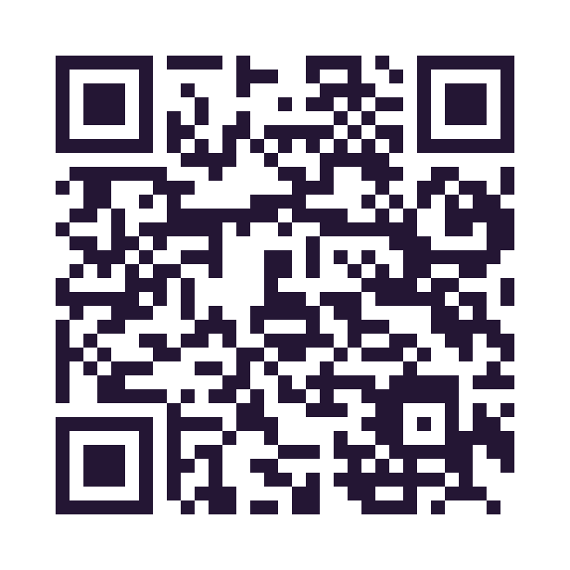


Contact our team
Scan to connect on LinkedIn
Ivy Pei
Ren Jie T.
Founder
CTO
Special thanks to
Pink Pan
· Mentor
Notes:
Contact our team on LinkedIn. Ivy Pei, Founder. Ren Jie T., CTO. Special thanks to Pink Pan, our mentor.
Portraits supplied by the founder on October 10, 2026. Original photos retained; circular crops are native layout masks. Only team members have QR codes.
Founder: https://www.linkedin.com/in/ivypei/
CTO: https://www.linkedin.com/in/ren-jie-t-619a6b1aa/
Mentor: https://www.linkedin.com/in/t-h-p/

