Slide 1

04
Data assimilation
01
02
03
Final presentation
R12229001
Yu Ming, Liu

Slide 2
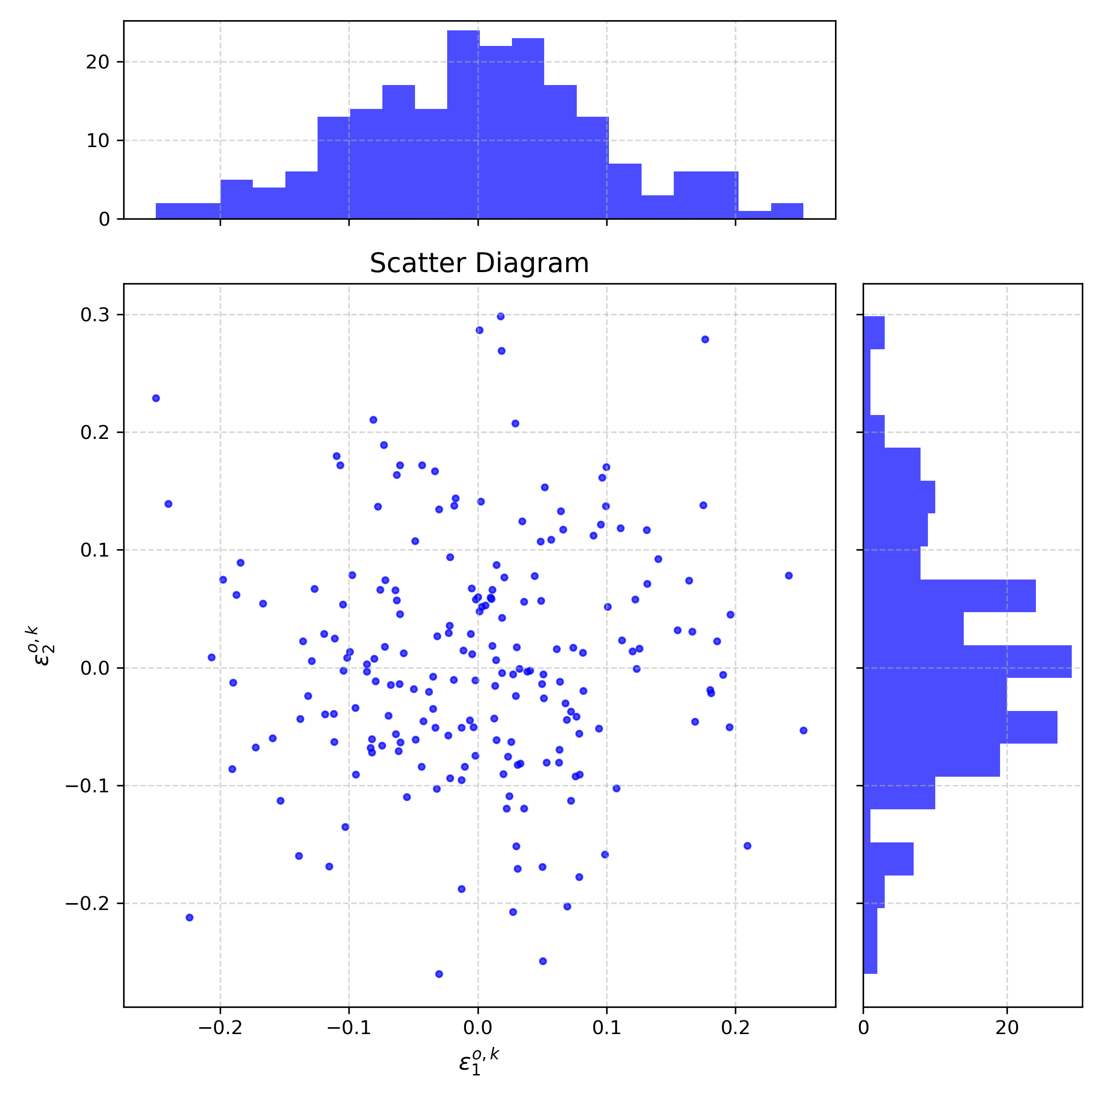
04
Model: Lorenz 96 model(40 variables; F=8 )
Observation error: 0.1 R = 0.01 (diagonal matrix)
Assimilation method: OI, incremental 3Dvar(linear H), EKF
Data assimilation
Method
assimilation period
T = 0.05, 1.0, 2.0
observation
obs = 40, 20, 10 P
R12229001
Yu Ming, Liu
EKF with/without Q

Slide 3
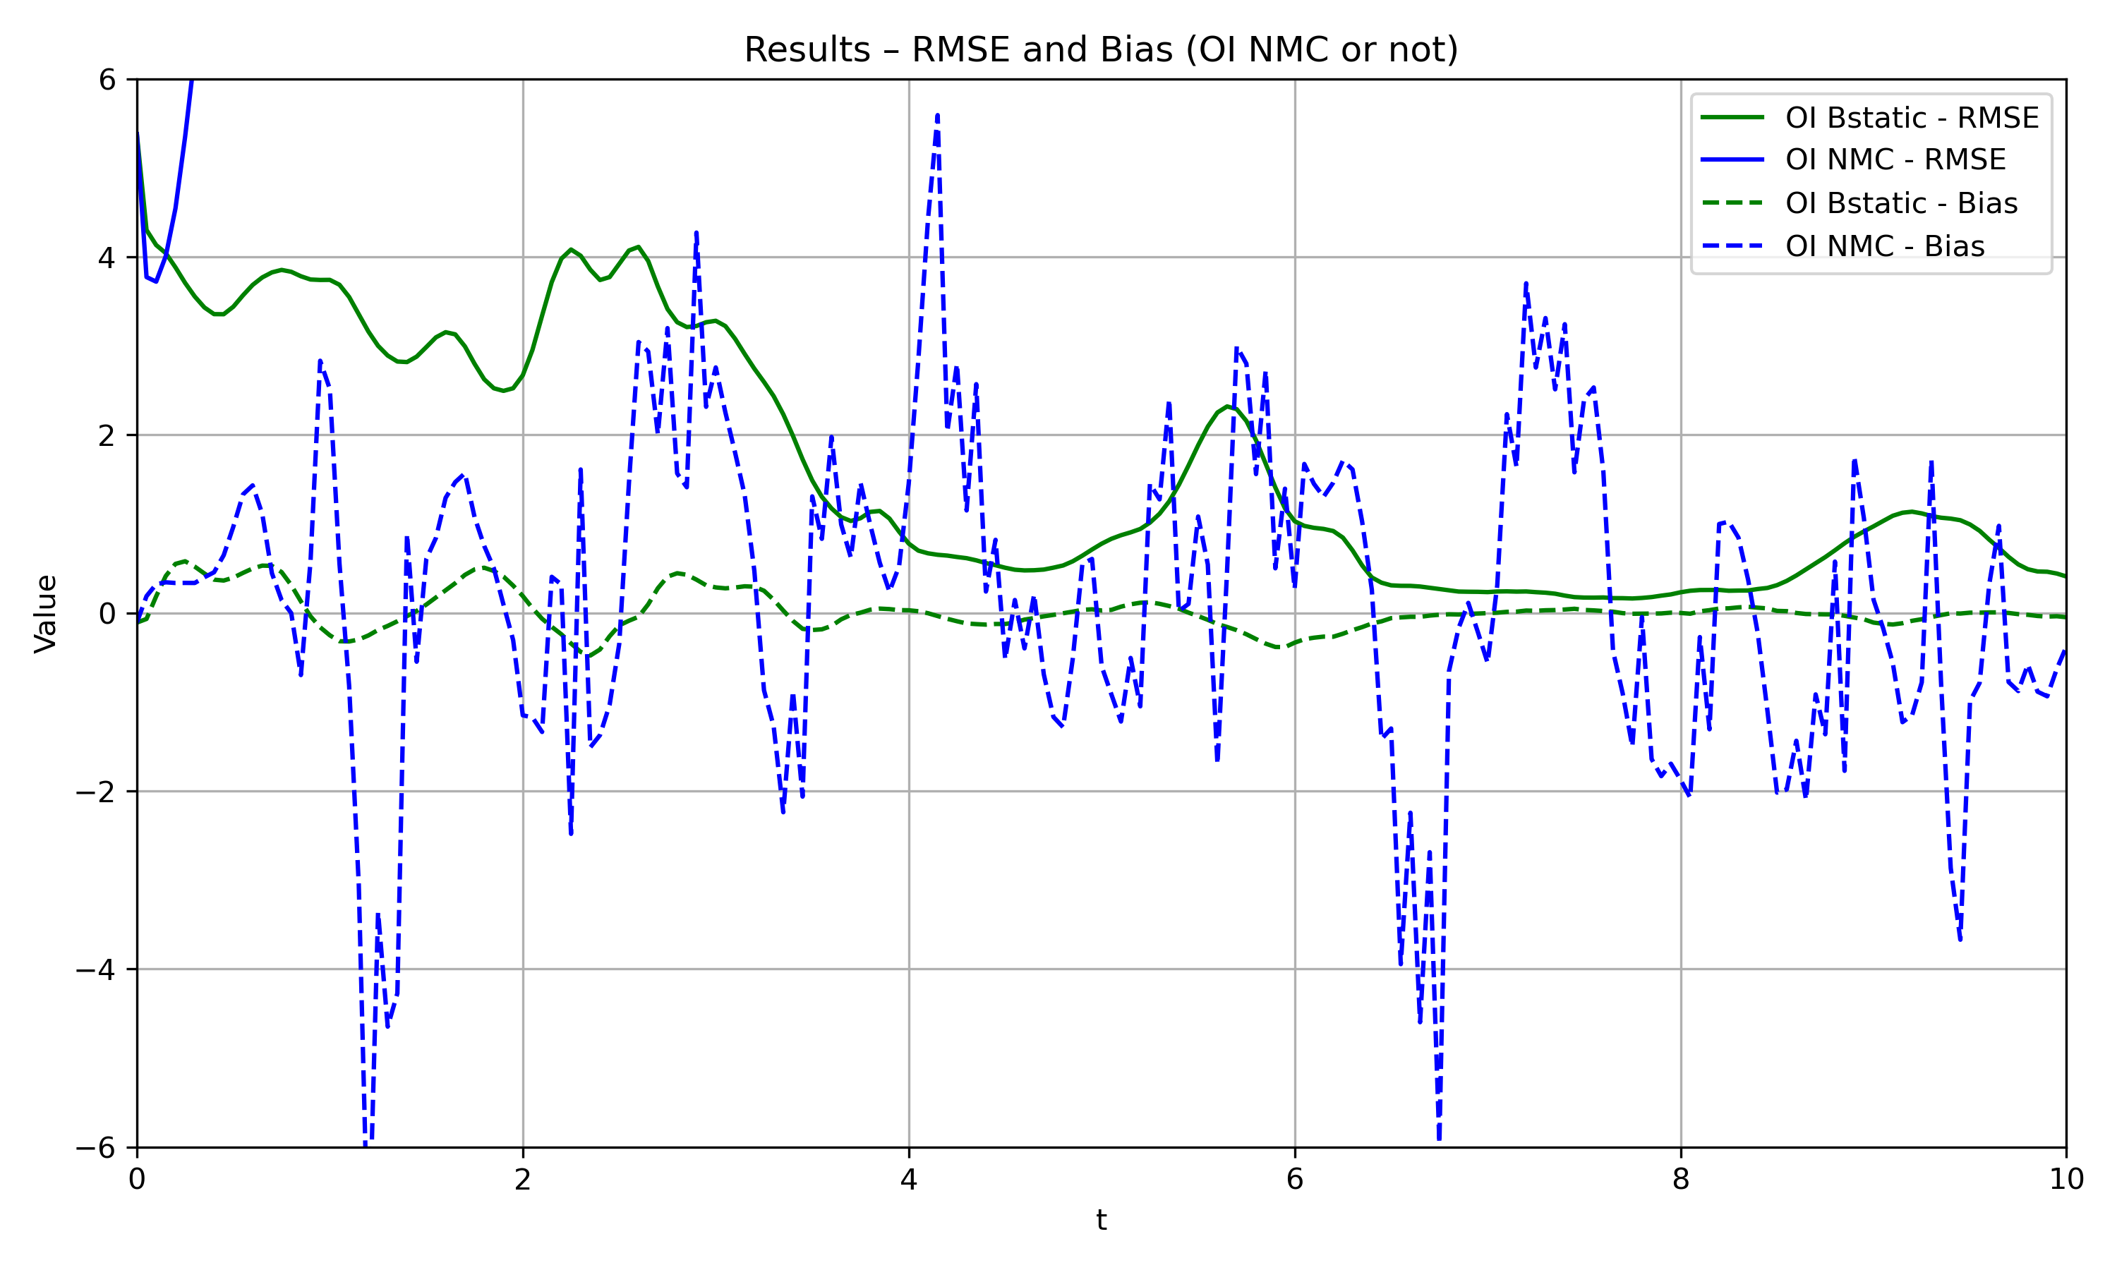
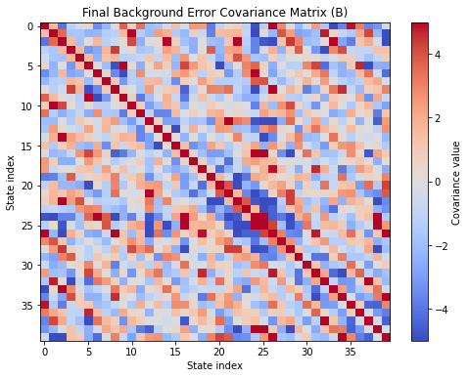
assimilation period
T = 0.05, 1.0, 2.0
04
observation
obs = 40, 20, 10 P
EKF with/without Q
Model: Lorenz 96 model(40 variables; F=8 )
Observation error: 0.1
Assimilation method: OI, incremental 3Dvar(linear H), EKF
Data assimilation
About B
B is always a diagonal matrix with all diagonal elements equal to 0.01.
R12229001
Yu Ming, Liu

Slide 4
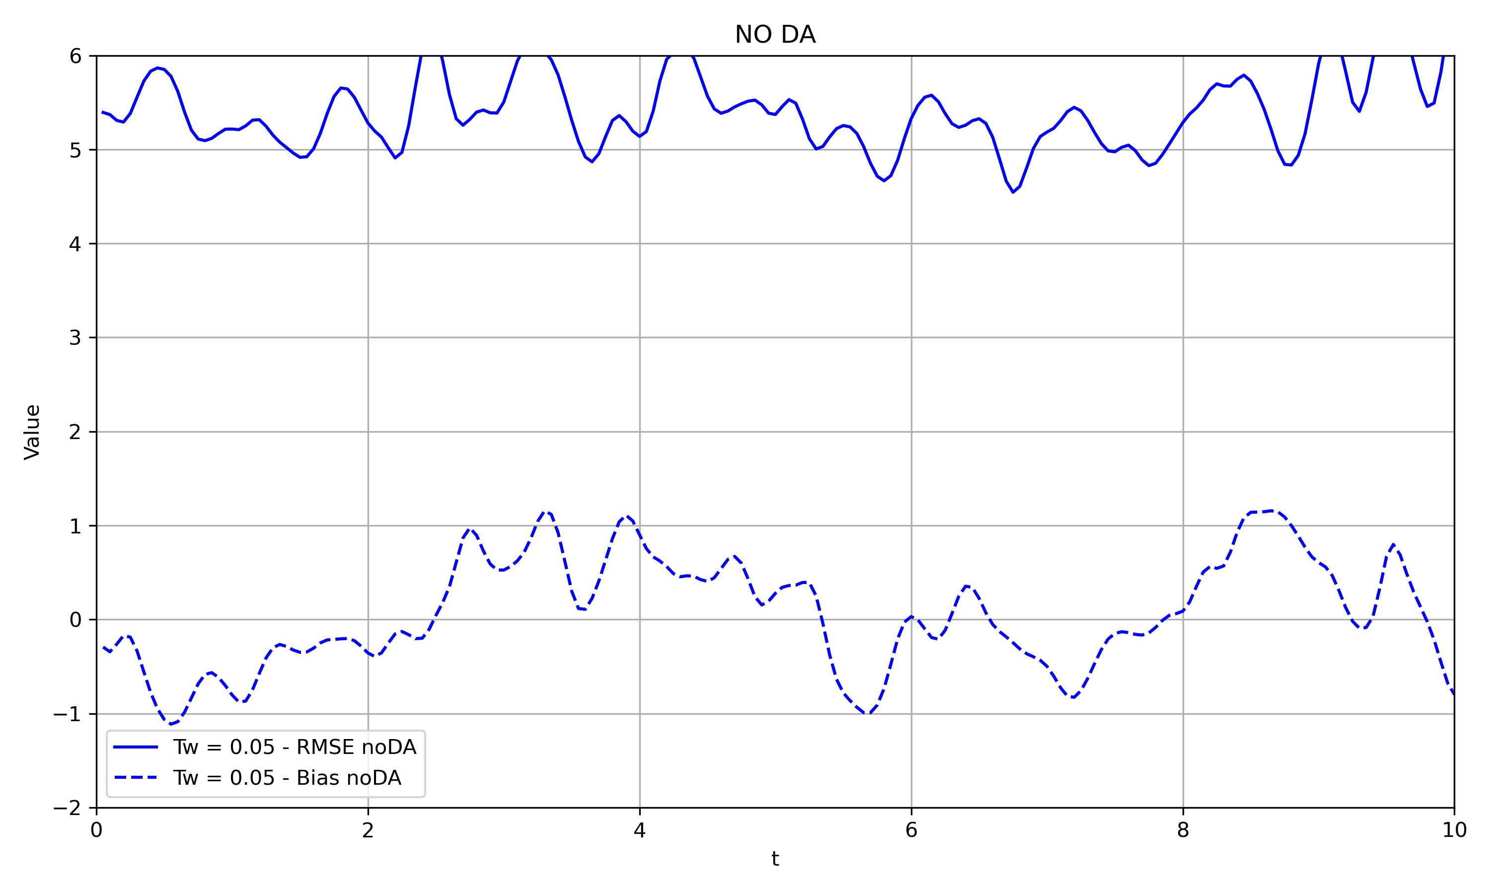
04
Data assimilation
01
02
03
No DA
R12229001
Yu Ming, Liu

Slide 5
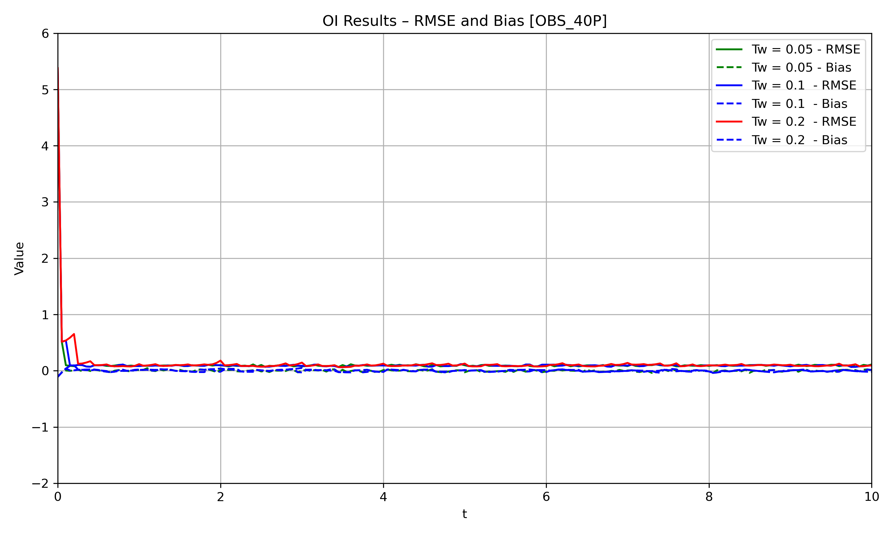
Data assimilation
OI
R12229001
Yu Ming, Liu

Slide 6
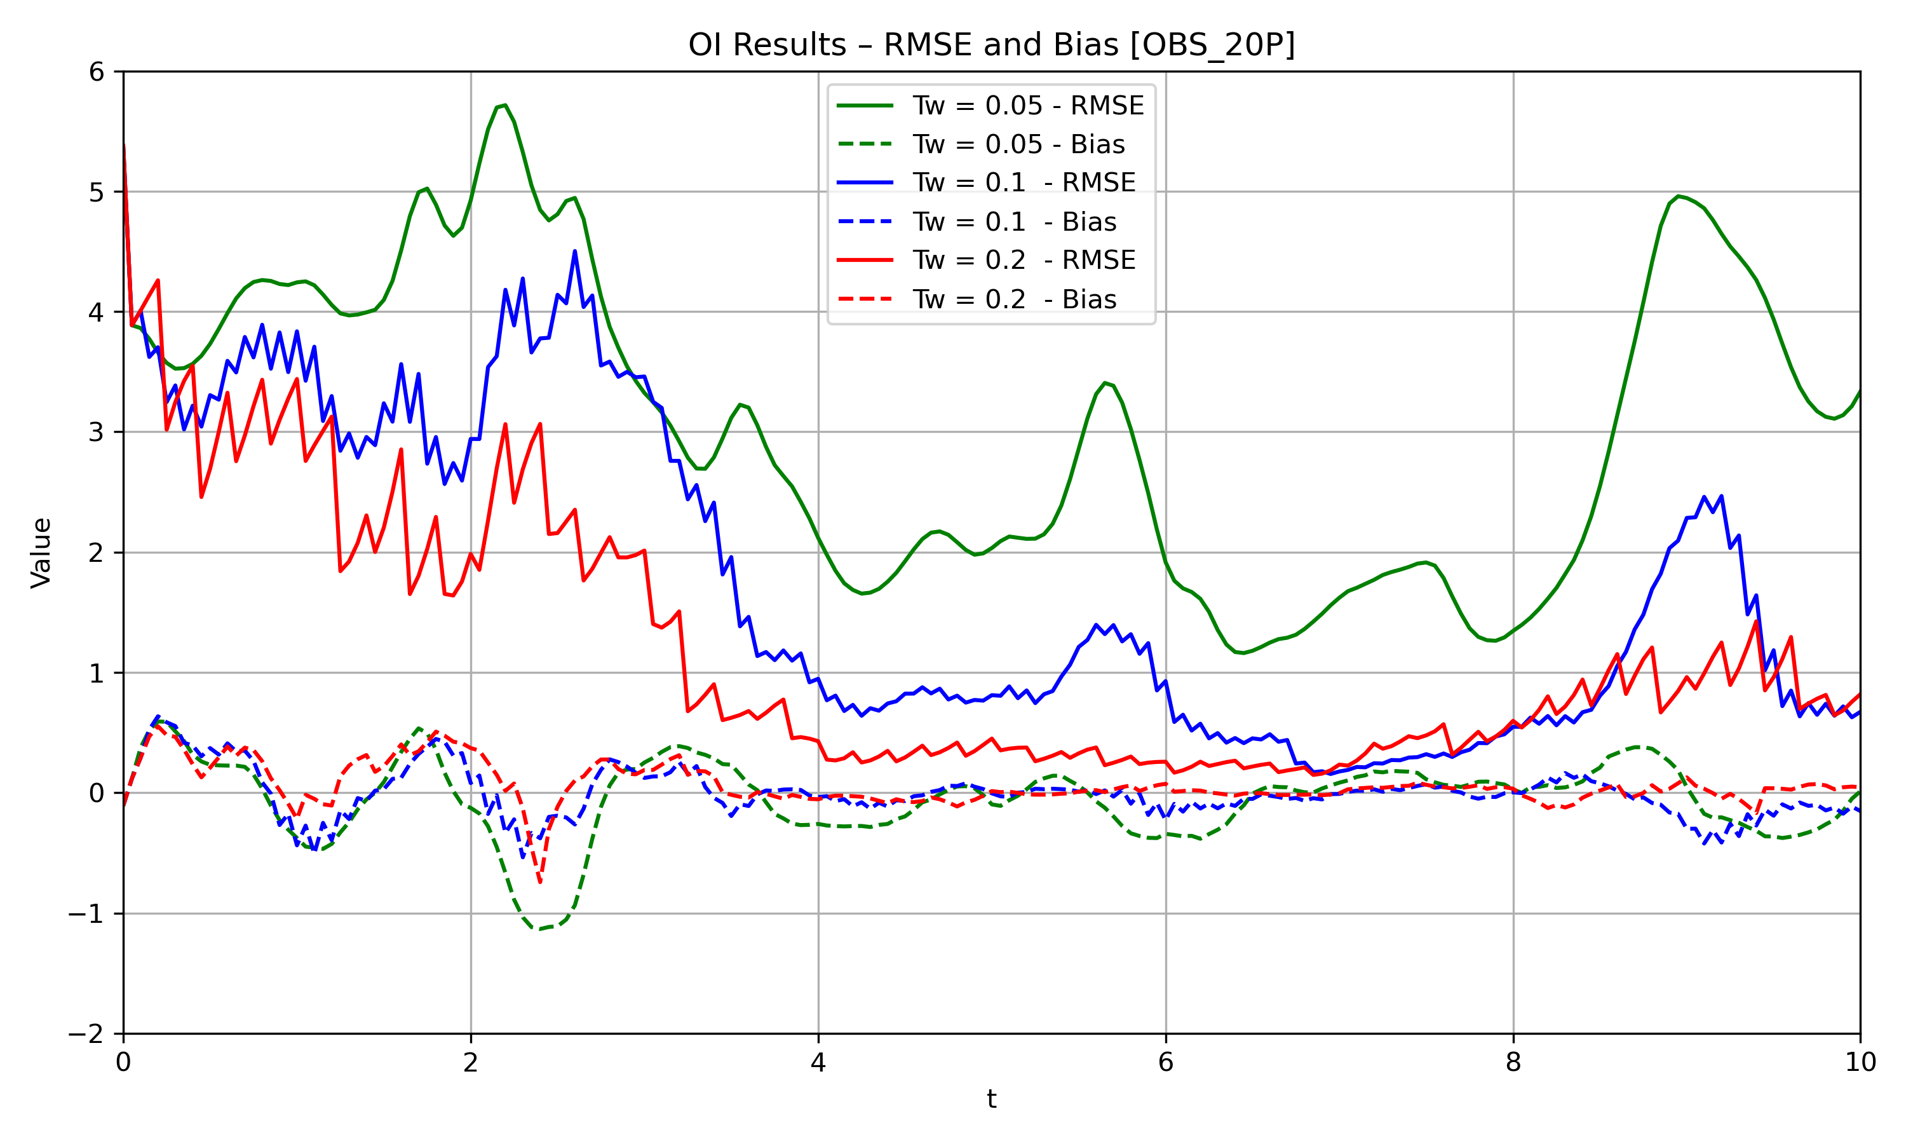
Data assimilation
OI
R12229001
Yu Ming, Liu

Slide 7
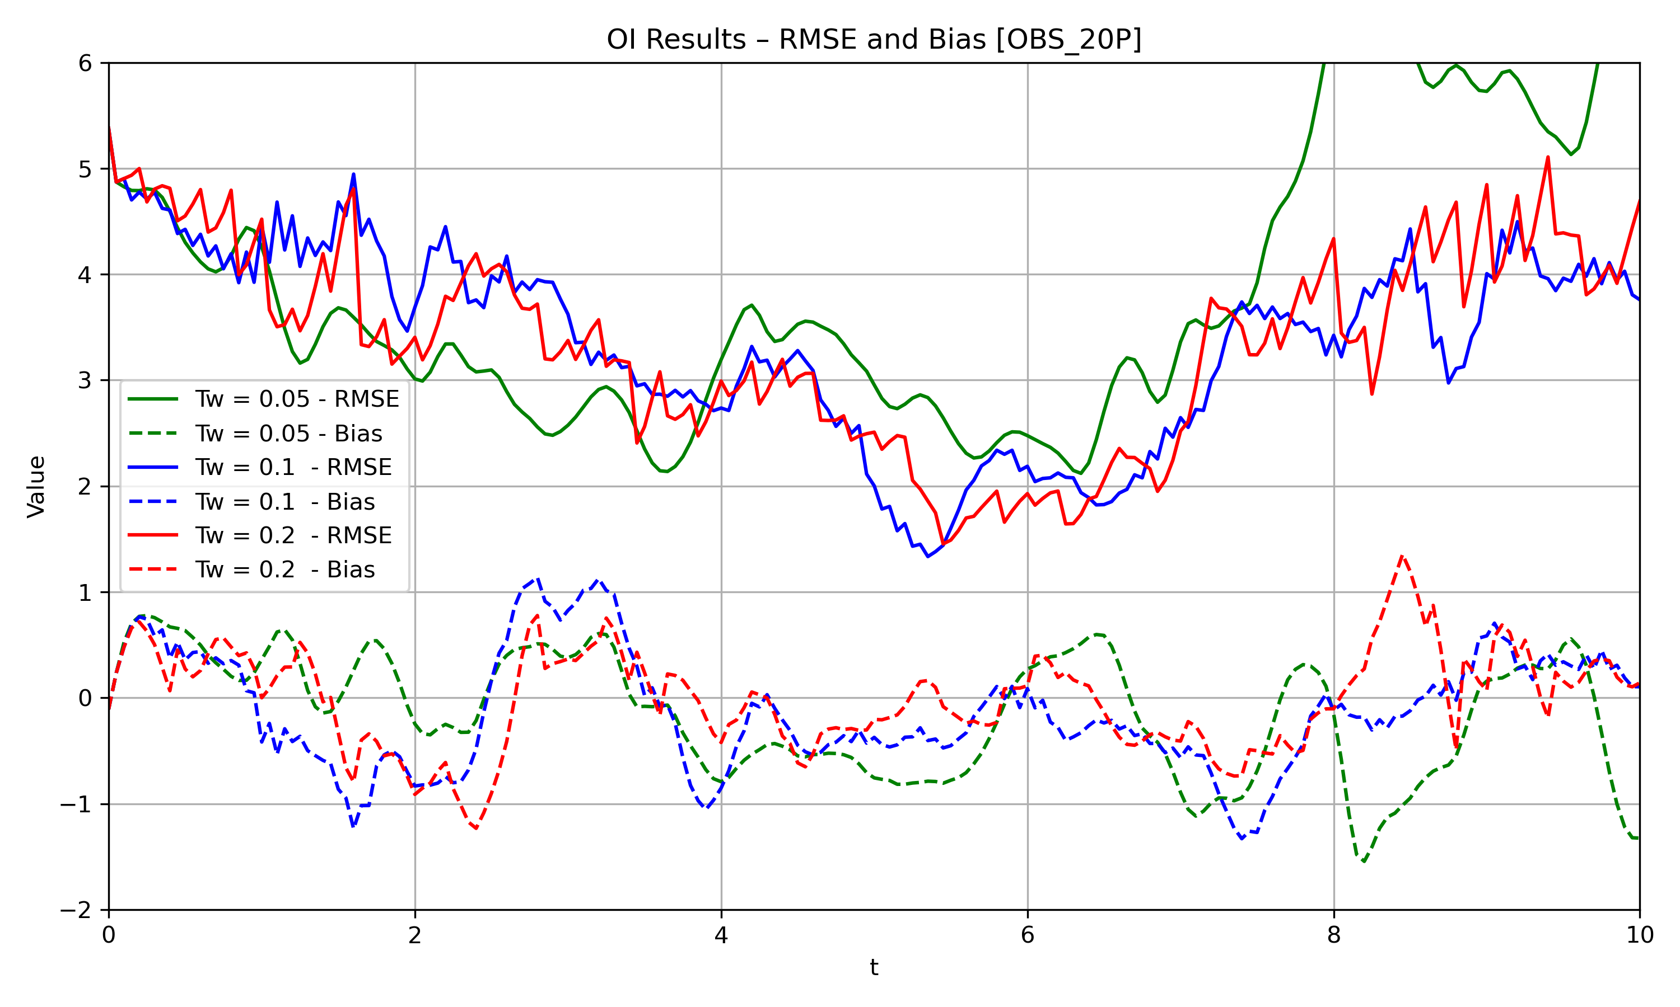
Data assimilation
OBS_10P
OI
R12229001
Yu Ming, Liu

Slide 8
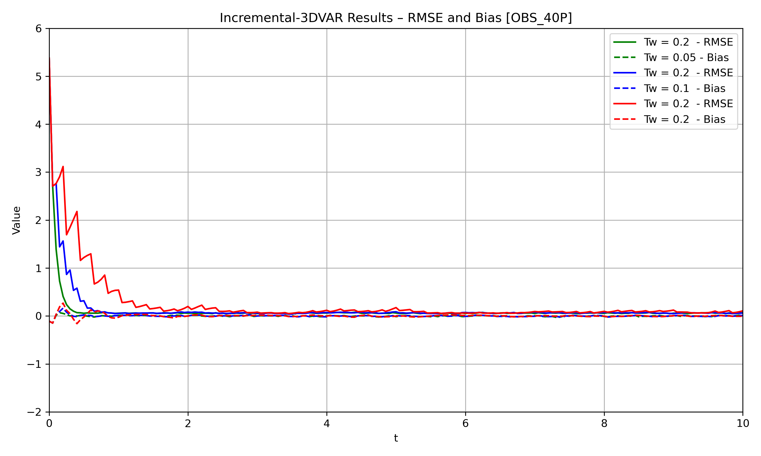

Data assimilation
3DVAR
learning rate=0.001
tol = 1e-6
R12229001
Yu Ming, Liu
Notes:
給到0.01會爆掉，無法收斂
迴圈大概跑個100上下

Slide 9
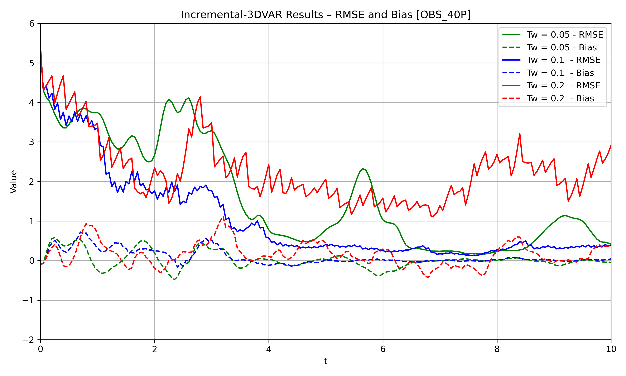
Data assimilation
OBS_20P
3DVAR
learning rate=0.001
tol = 1e-6
R12229001
Yu Ming, Liu
Notes:
給到0.01會爆掉，無法收斂
迴圈大概跑個100上下

Slide 10
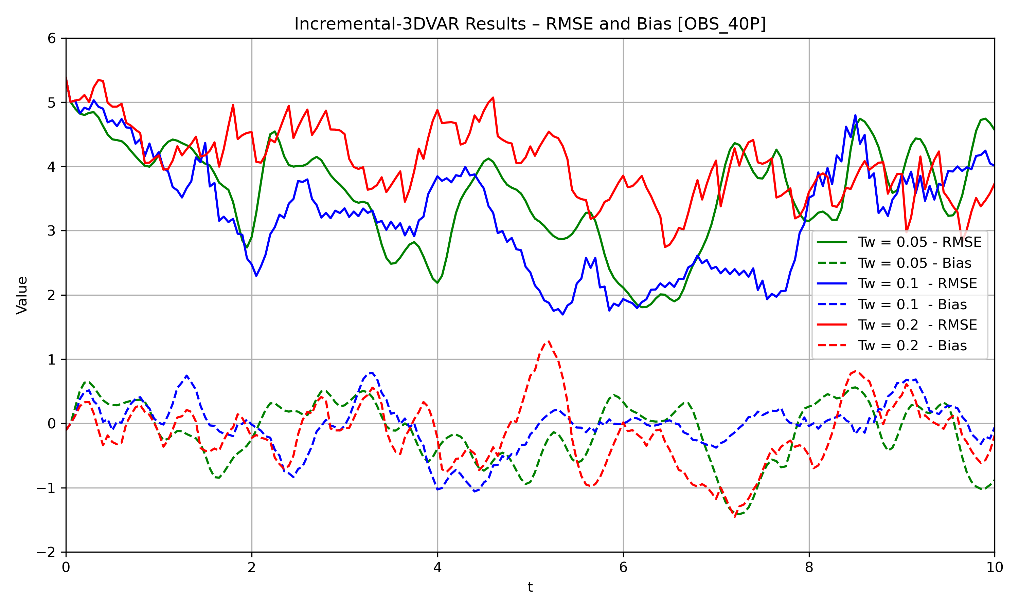
Data assimilation
OBS_10P
learning rate=0.001
tol = 1e-6
R12229001
Yu Ming, Liu
Notes:
給到0.01會爆掉，無法收斂
迴圈大概跑個100上下

Slide 11
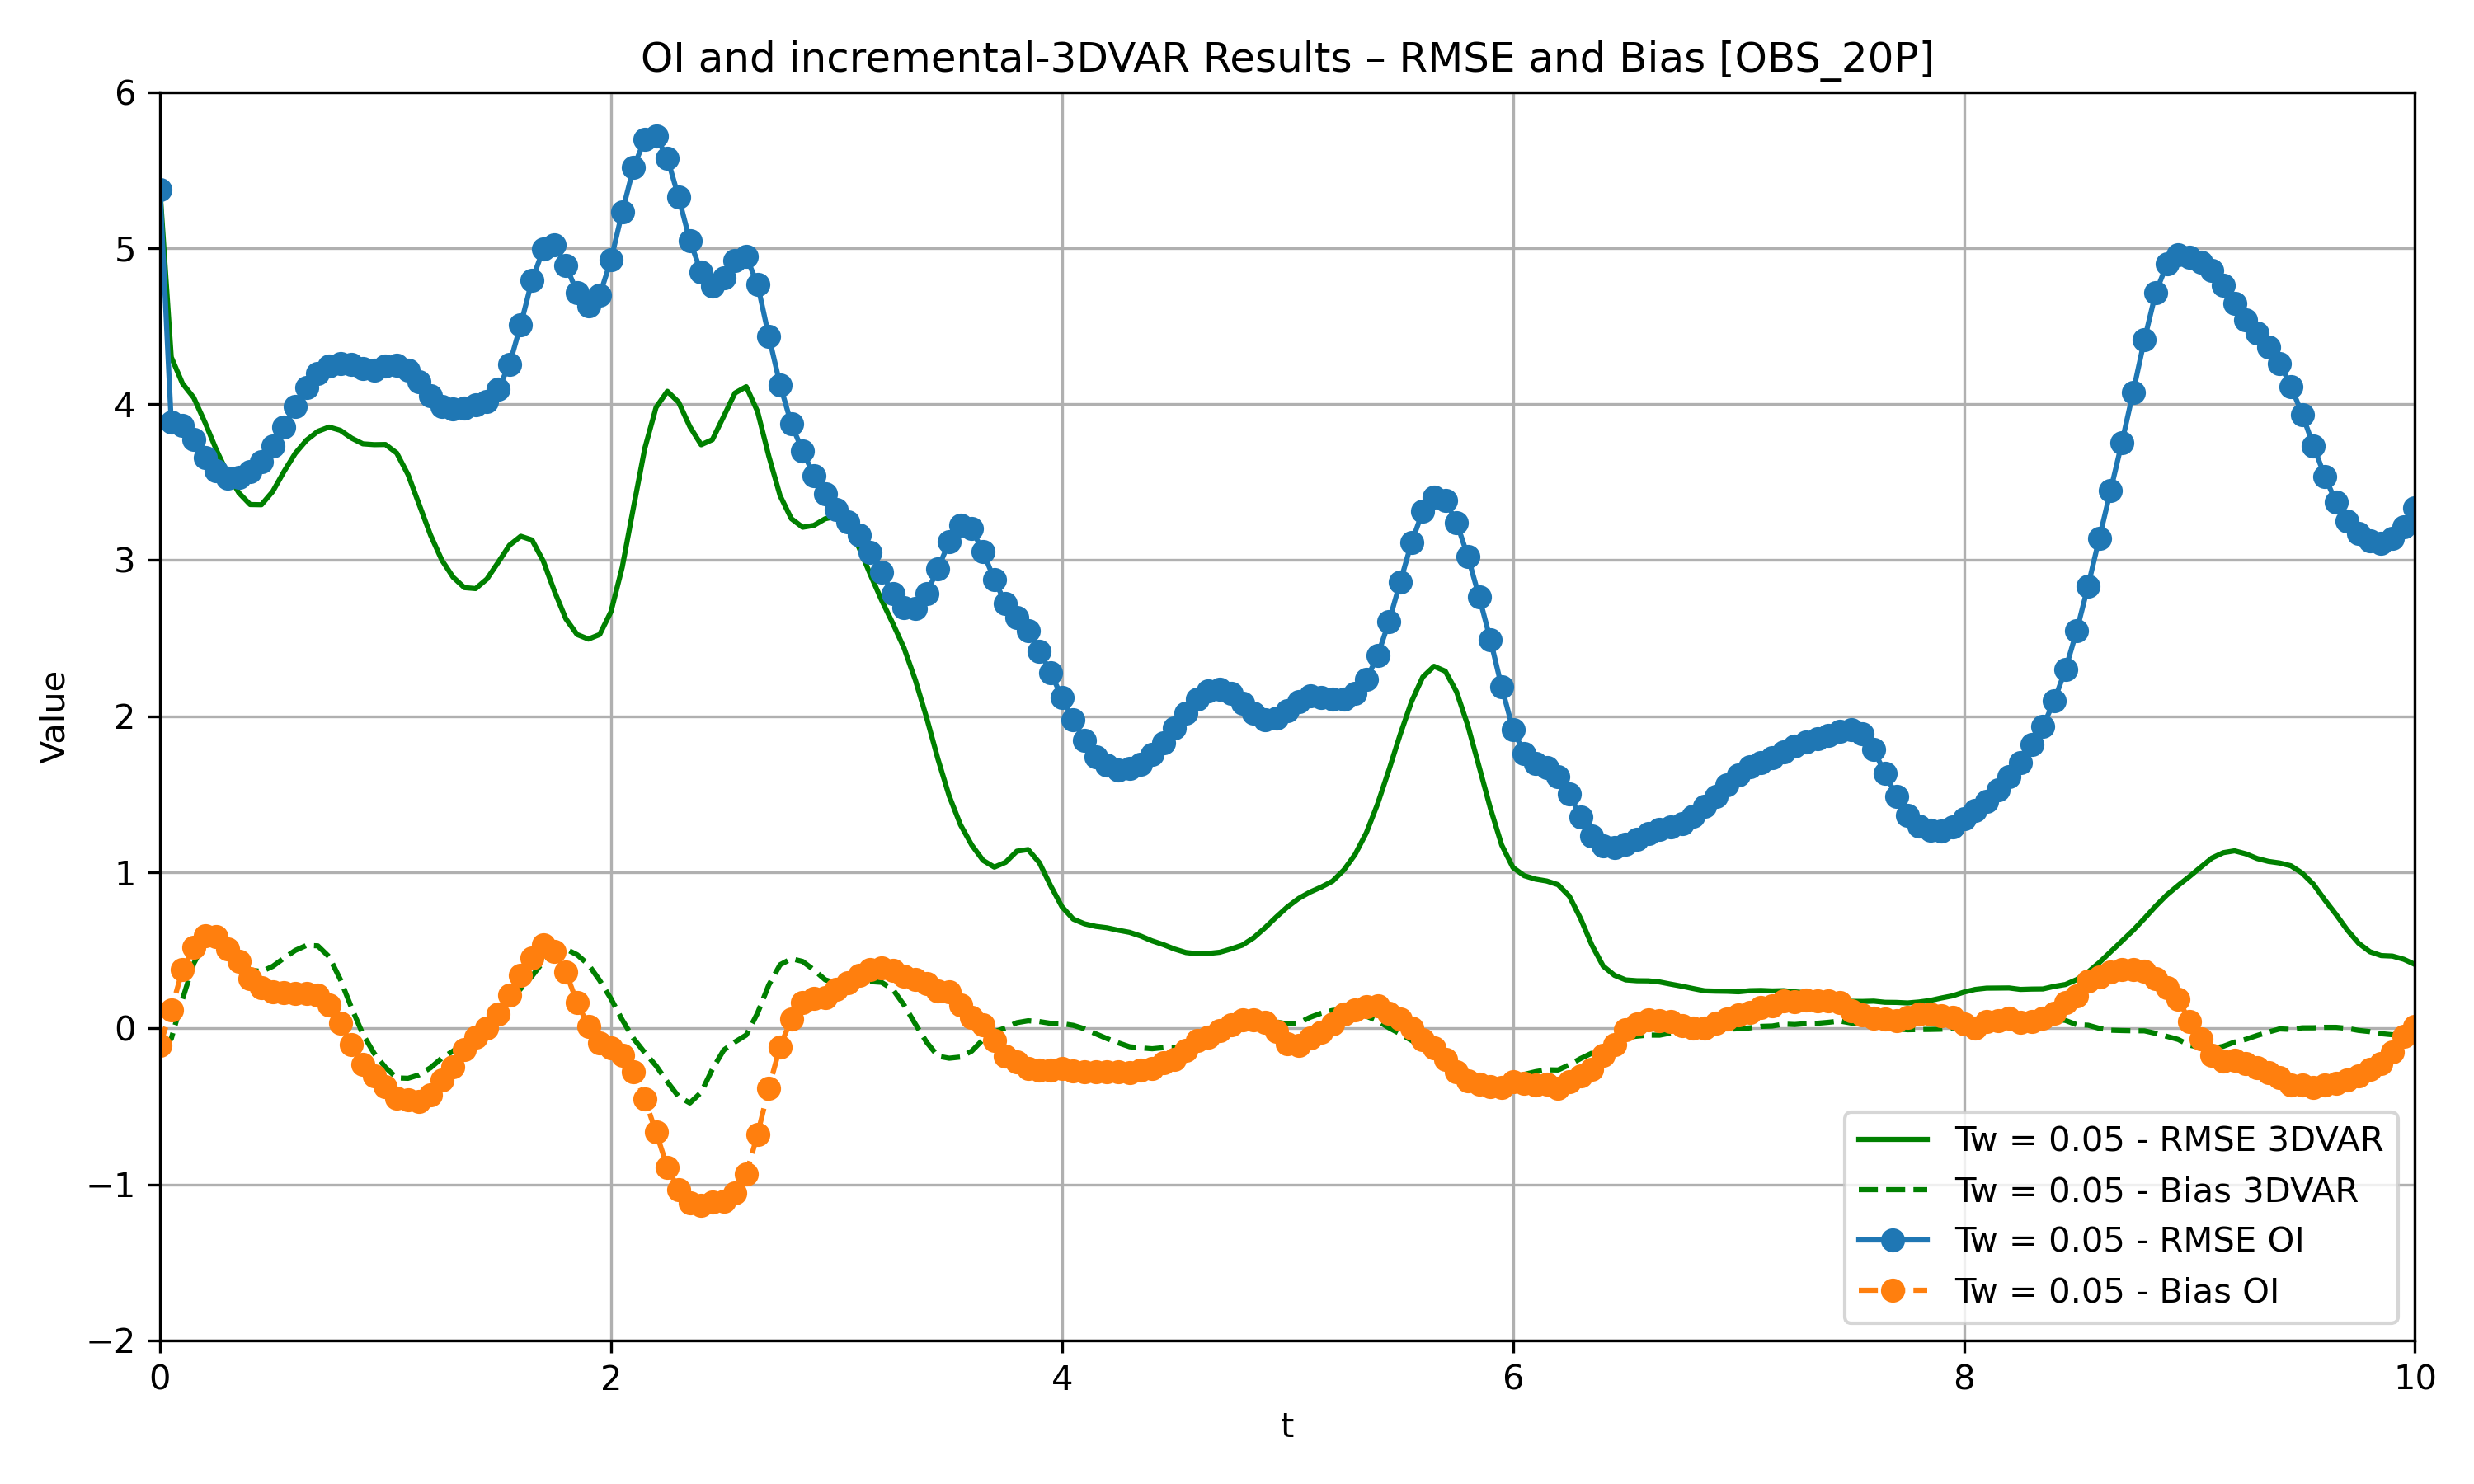
Data assimilation
Comparison
OI v.s. incre 3Dvar
obs = 20P
R12229001
Yu Ming, Liu
Notes:
給到0.01會爆掉，無法收斂
迴圈大概跑個100上下

Slide 12
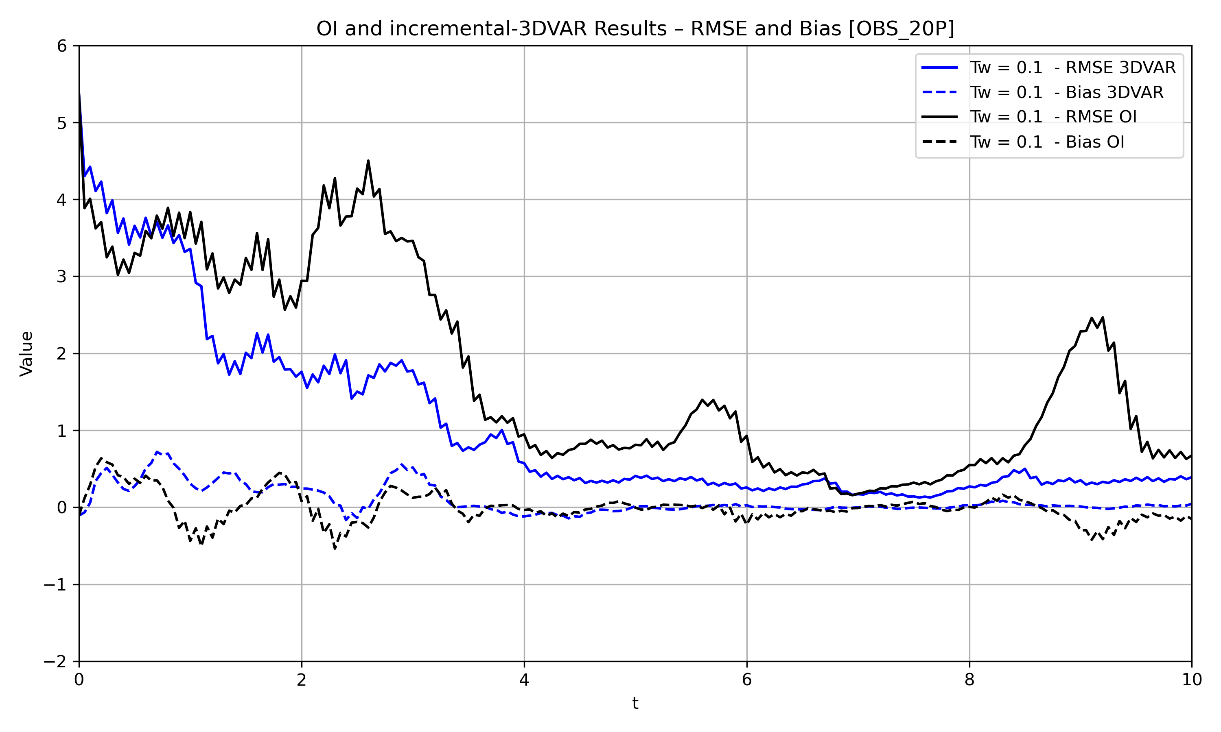
Data assimilation
Comparison
OI v.s. incre 3Dvar
obs = 20P
R12229001
Yu Ming, Liu
Notes:
給到0.01會爆掉，無法收斂
迴圈大概跑個100上下

Slide 13
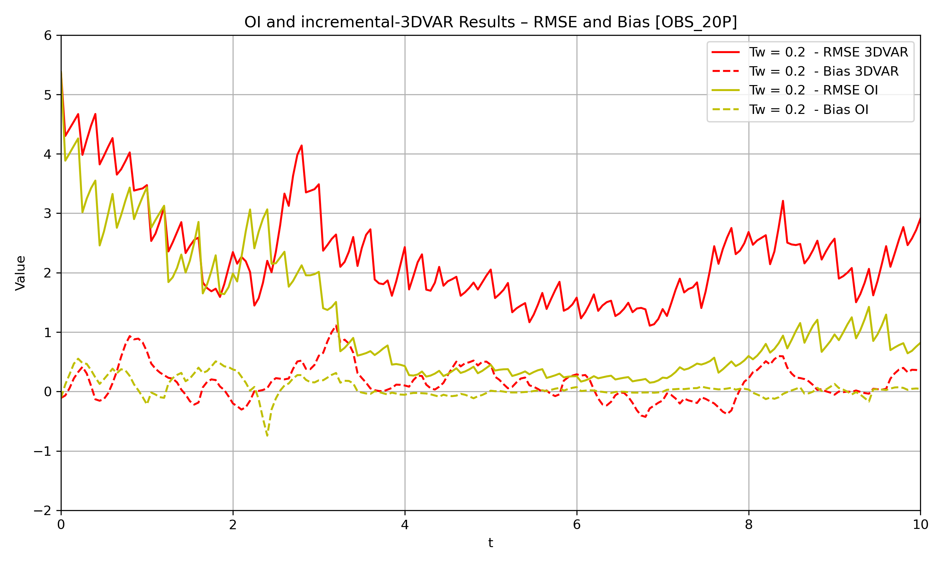
Data assimilation
Comparison
OI v.s. incre 3Dvar
obs = 20P
R12229001
Yu Ming, Liu
Notes:
給到0.01會爆掉，無法收斂
迴圈大概跑個100上下

Slide 14
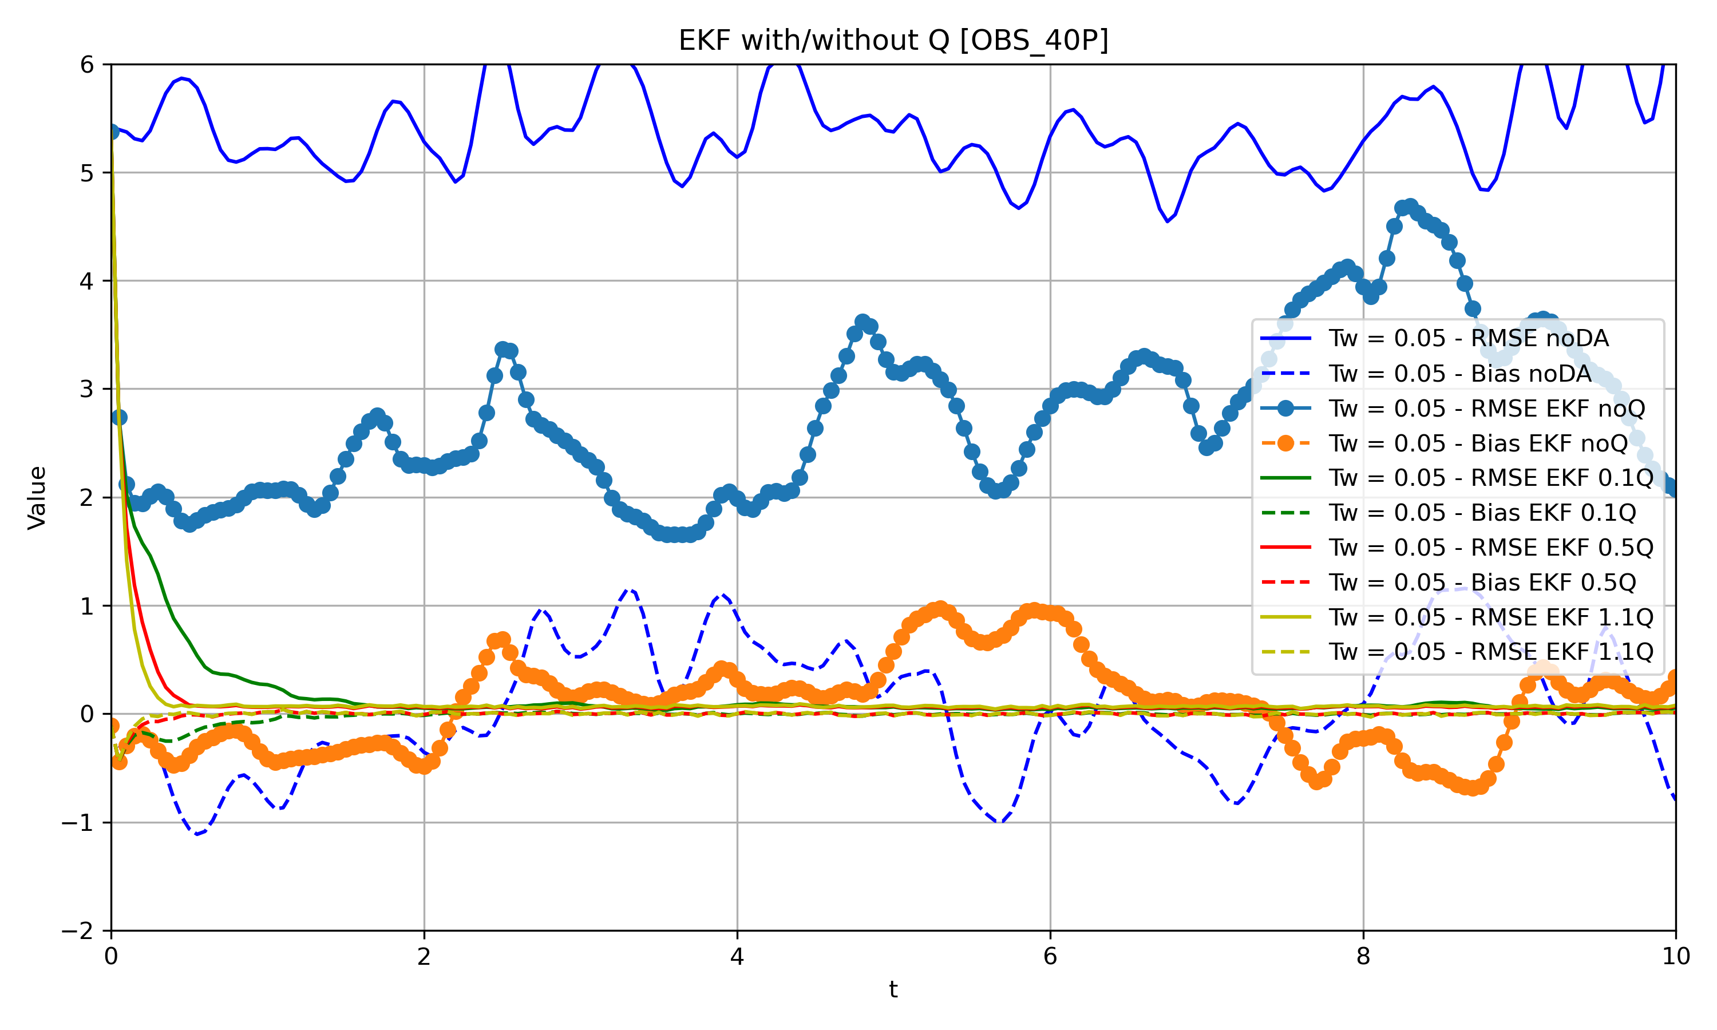
Data assimilation
EKF
With/without Q
OBS = 40P
R12229001
Yu Ming, Liu
Notes:
給到0.01會爆掉，無法收斂
迴圈大概跑個100上下

Slide 15
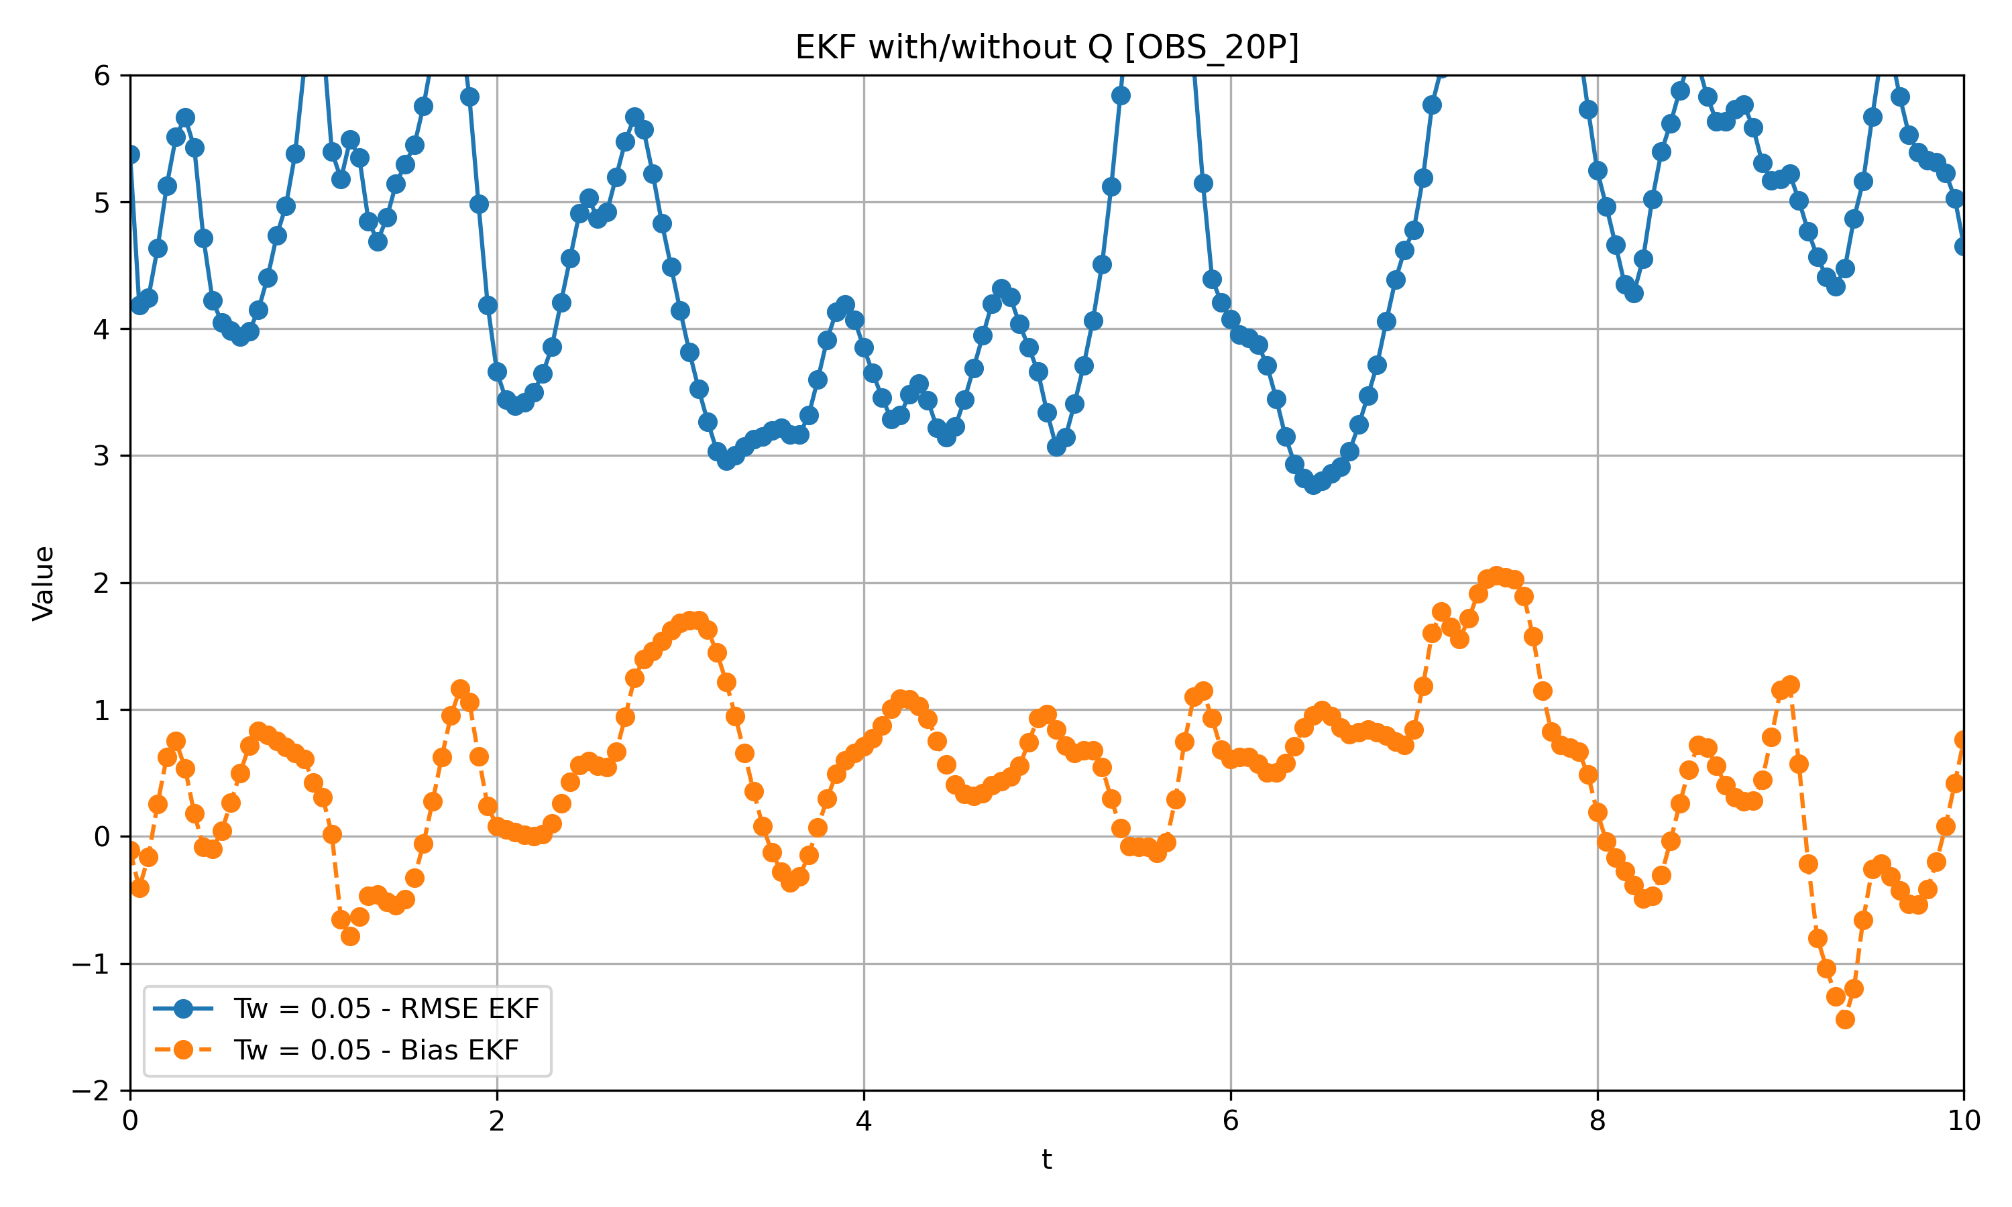
Data assimilation
EKF
Q = 0.0561
OBS = 20P
R12229001
Yu Ming, Liu
Notes:
給到0.01會爆掉，無法收斂
迴圈大概跑個100上下

Slide 16
Data assimilation
EKF v.s OI v.s 3Dvar
Q = 1.1
OBS = 40P
R12229001
Yu Ming, Liu
Notes:
給到0.01會爆掉，無法收斂
迴圈大概跑個100上下

Slide 17
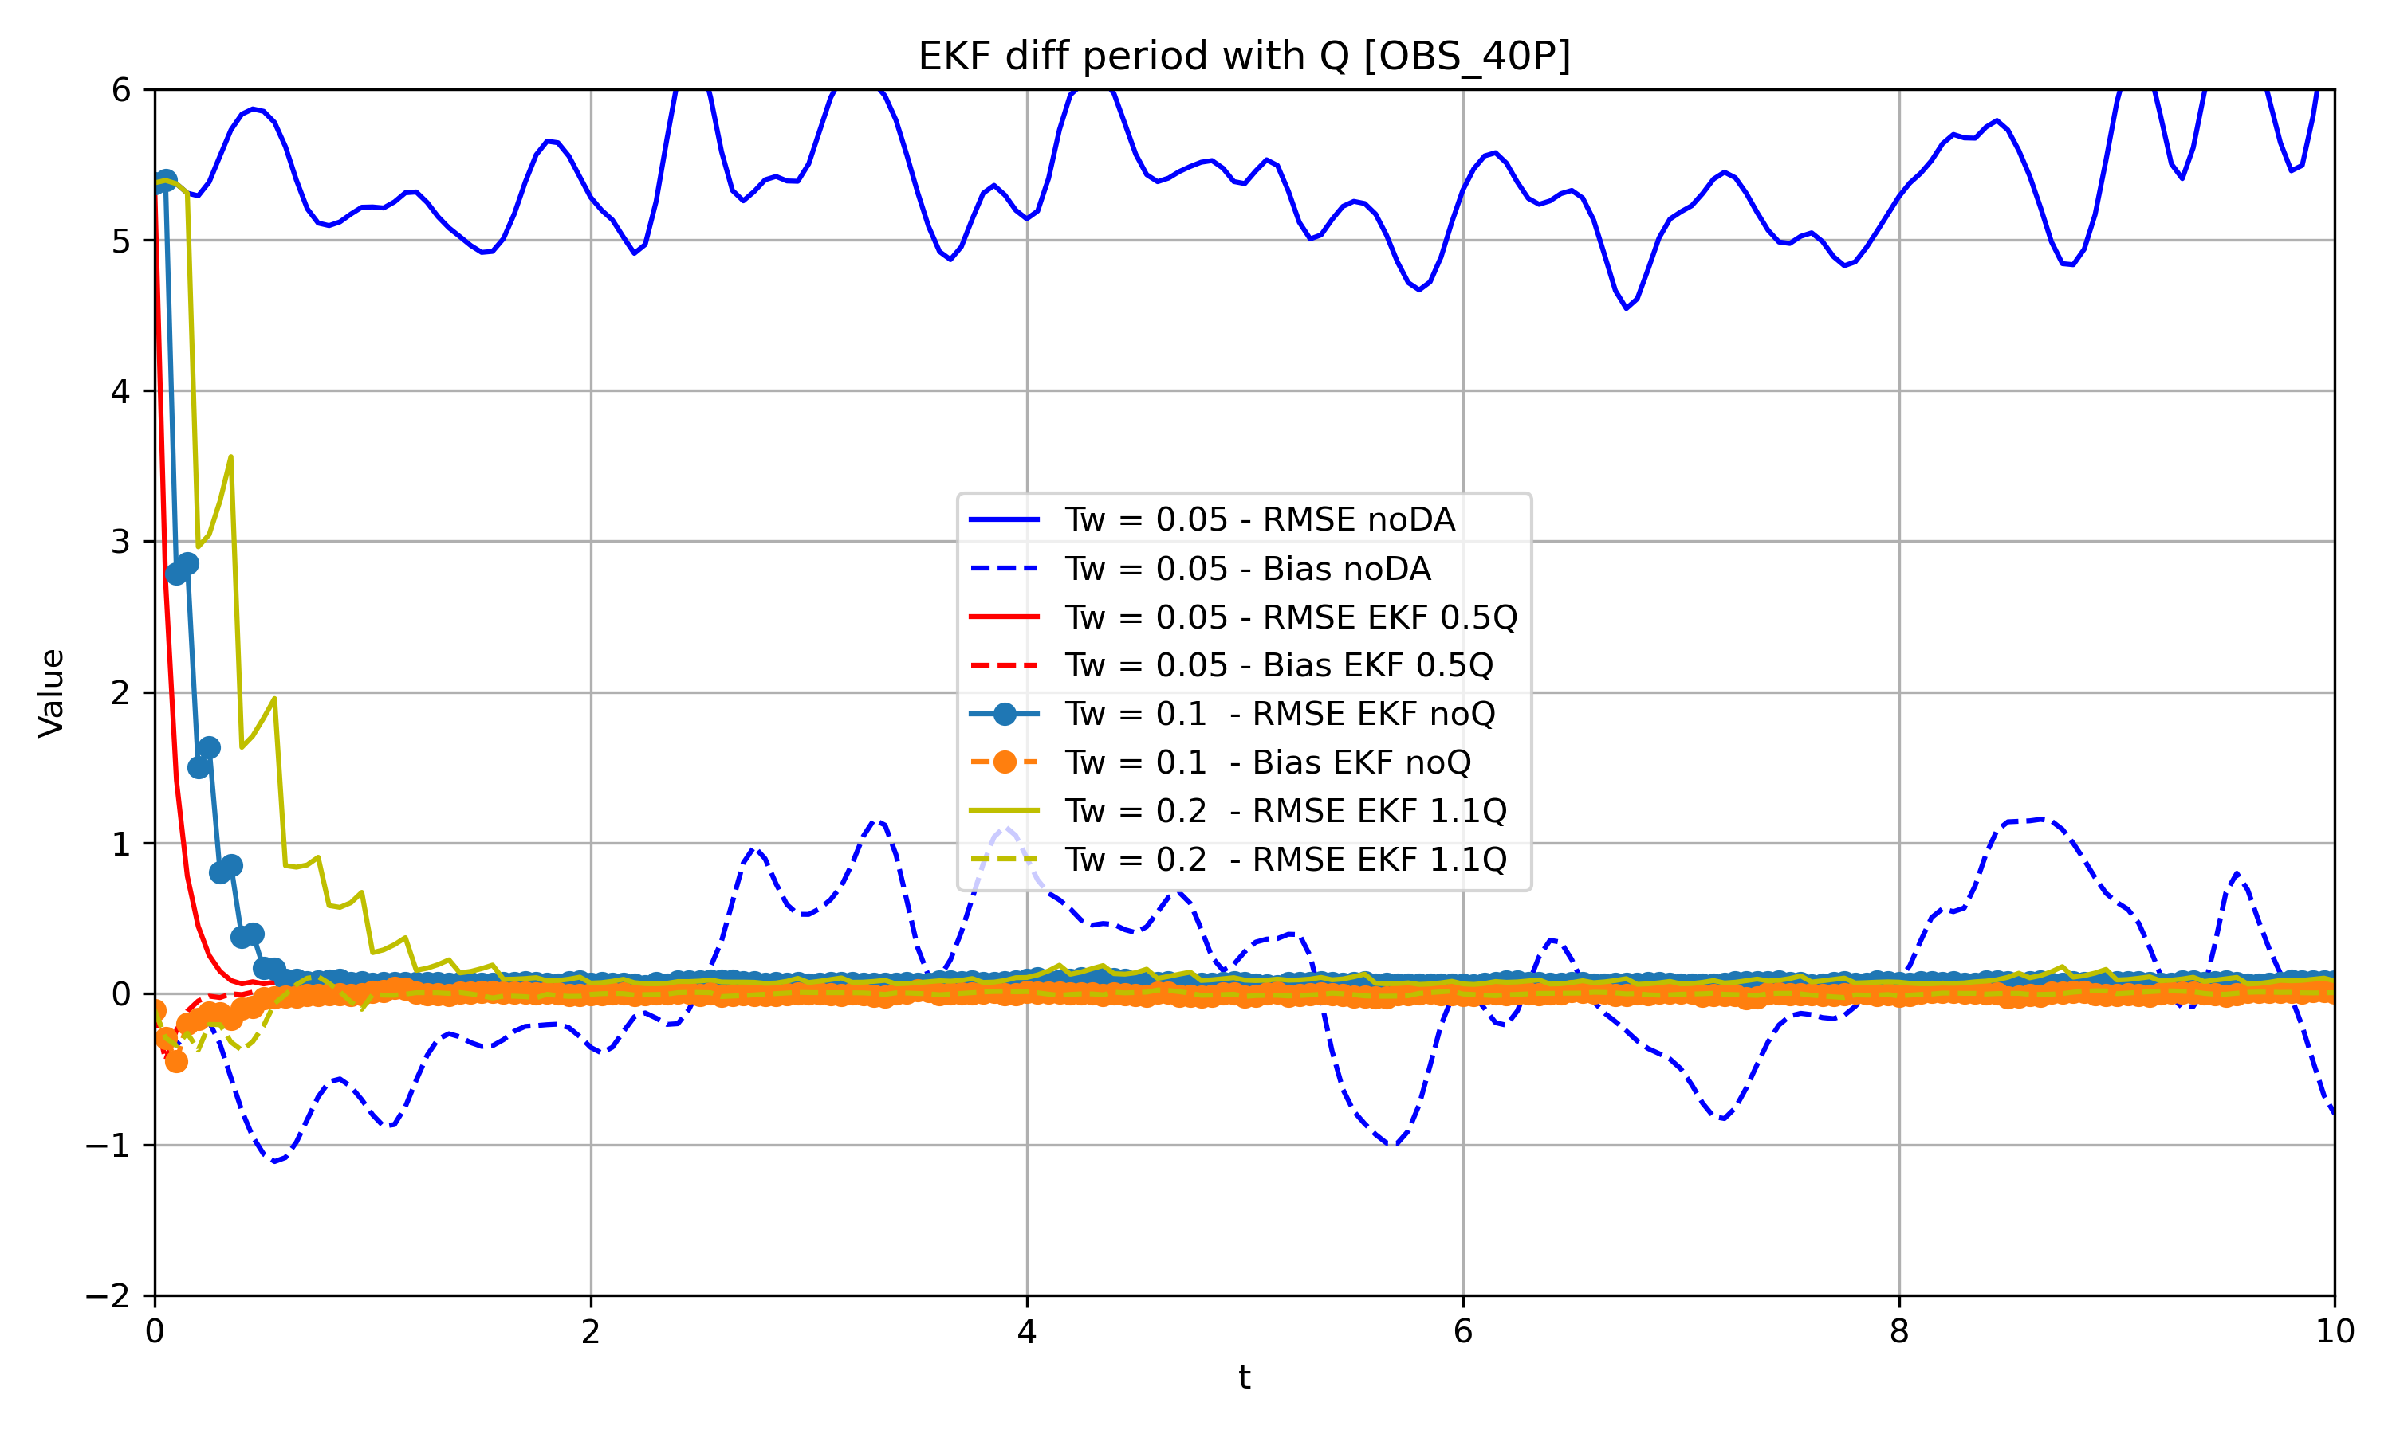
Notes:
給到0.01會爆掉，無法收斂
迴圈大概跑個100上下

Slide 18
Data assimilation
In most cases, as the assimilation cycle length increases and the number of observations decreases, the results tend to worsen.
For some results, similar to OI, the performance may improve with longer assimilation cycles under different numbers of observations. This might be due to the influence of the background error covariance 𝐵, which is static in this case. If 𝐵 were modified using the NMC method, the results might show some differences.
For EKF, the results appear reasonable when assimilating the same number of observations. However, there still seems to be an issue because, when the number of observations is reduced, the results are worse than those of OI and 3DVAR, regardless of how 𝑄 is adjusted (ranging from 0.001 to 1.1).
Conclusions
R12229001
Yu Ming, Liu
Notes:
給到0.01會爆掉，無法收斂
迴圈大概跑個100上下

Slide 19
Data assimilation
Thank you
for your listening!
R12229001
Yu Ming, Liu
Notes:
給到0.01會爆掉，無法收斂
迴圈大概跑個100上下

