Slide 1
N
a
t
u
r
e
The future of digital health with federated learning
Nicola Rieke1,2, Jonny Hancox3, Wenqi Li 4, Fausto Milletarì1, Holger R. Roth 5, Shadi Albarqouni 2,6, Spyridon Bakas7, Mathieu N. Galtier8, Bennett A. Landman 9, Klaus Maier-Hein 10,11, Sébastien Ourselin12, Micah Sheller13, Ronald M. Summers 14, Andrew Trask15,16,17, Daguang Xu5, Maximilian Baust1 and M. Jorge Cardoso
1NVIDIA GmbH, Munich, Germany. 2Technical University of Munich (TUM), Munich, Germany. 3NVIDIA Ltd, Reading, UK. 4NVIDIA Ltd, Cambridge, UK. 5NVIDIA Corporation, Bethesda, USA. 6Imperial College London, London, UK. 7University of Pennsylvania (UPenn), Philadelphia, PA, USA. 8Owkin, Paris, France. 9Vanderbilt University, Nashville, TN, USA. 10German Cancer Research Center (DKFZ), Heidelberg, Germany. 11Heidelberg University Hospital, Heidelberg, Germany. 12King’s College London (KCL), London, UK. 13Intel Corporation, Santa Clara, CA, USA. 14Clinical Center, National Institutes of Health (NIH), Bethesda, MD, USA. 15OpenMined, Oxford, UK. 16University of Oxford, Oxford, UK. 17Centre for the Governance of AI (GovAI), Oxford, UK. email: nrieke@nvidia.com
Seoul National University Bundang Hospital
Notes:
电子健康方向对联邦学习的要求与期待

Slide 2

CONTENT
Introduction
Data-driven
Medicine
Requires
Federated
Efforts
Federated
Learning
in Digital
Health
Technical
Consideration

Slide 3

01
Introduction

Slide 4
DL / FL / Med
Disruptive Innovation
AI uses on radiology, pathology, genomics:
From: Sufficiently large curated datasets
Do: To learn millions of parameters from the models feature
Goal:
Achieve clinical-grade accuracy
Safe, fair, equitable and generalizing well to unseen data
Notes:
disruptive引起混乱的; 扰乱性的; 破坏性的;
Curated 精选的、特定的
Ai对radiology, pathology, genomics 放射学 病理学 基因学
Dl模型对几百万的参数需要被学习，从充分大的数据集中，获得clinical-grade accuracy临床评分准确度
特别是对新数据的泛化
健康数据敏感度、监控 移除敏感信息就有效吗？CT重建人脸 大量的时间精力 商业价值导致不免费 细粒度控制
FL解决了隐私与数据管控

Slide 5
Clinical / GMP Grade
Clinical Grade is used to describe products or materials that are suitable for direct therapeutic use, such as, injectable grade.
Such materials are required to show to safety and efficacy for human use through appropriate clinical trials and regulatory approvals. Usually, clinical-grade products are approved as drugs by regulators, and labeling or product documentation should state sterility and safety profile. GMP grade refers to products manufactured under Current Good Manufacturing Practices which require manufacturers ensure that their products are traceable, safe, pure and effective. This term therefore denotes that a product has been prepared under GMP guidelines to ensure proper design, monitoring and control of the manufacturing processes, facilities and the final product. Regional differences exist where some national regulatory agencies provide GMP certificates to manufacturers of GMP AMs and others do not.
Ref: Current perspectives on the use of ancillary materials for the manufacture of cellular therapies. Cytotherapy, 2016; 18: 1-12
Notes:
临床级用于描述适合直接治疗的产品或材料，如注射级。这些材料需要通过适当的临床试验和监管部门的批准来证明其安全性和有效性。通常，临床级产品由监管机构批准为药品，标签或产品文件应说明无菌性和安全性。 GMP等级是指按照现行良好生产规范生产的产品，要求制造商确保其产品可追溯、安全、纯净和有效。因此，这一术语是指产品已经按照GMP指南准备，以确保生产过程、设施和最终产品的正确设计、监控和控制。有些国家的监管机构向GMP-AMs的制造商提供GMP证书，而另一些则没有。
符合GMP的临床级产品GMP-compliant Clinical Grade Products

Slide 6
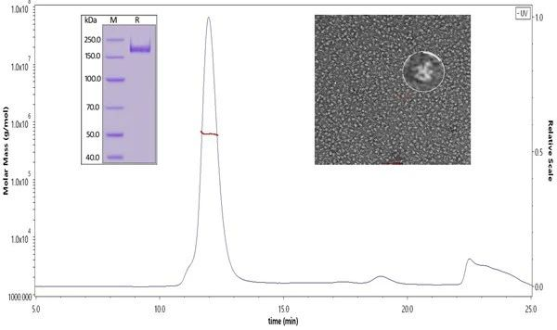
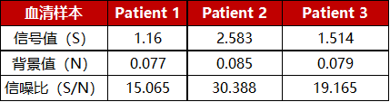
疫苗临床评价——IgG抗体滴度检测
https://www.who.int/publications/m/item/draft-landscape-of-covid-19-candidate-vaccines
SARS-CoV-2 S trimer蛋白纯度、分子量和具体形式验证结果
将S trimer蛋白用于康复病人血清抗体滴度检测的结果
Notes:
应用场景1：疫苗临床评价——IgG抗体滴度检测 推荐产品： 货号：SPN-C52H9 名称：SARS-CoV-2 S protein, His Tag, Super stable trimer (MALS & NS-EM verified) 用途：可用SARS-CoV-2 S trimer蛋白（货号：SPN-C52H9）进行ELISA实验，检测疫苗接种后，血液样本中结合SARS-CoV-2 S trimer的抗体滴度。
左上图
SARS-CoV-2 S trimer蛋白(Cat. No.SPN-C52H9)在SDS-PAGE上显示大于90%的纯度；在SEC-MALS上显示分子量在550-660 kDa左右；该蛋白颗粒的大小和外观与已发表文献中报道的SARS-CoV-2三聚体相似，并通过负染色电子显微镜检查得到了证实。
右下图
SARS-CoV-2 S trimer蛋白(Cat. No.SPN-C52H9)用康复病人的血清代替疫苗血清进行滴度检测，SARS-CoV-2 S trimer蛋白呈现了良好的信噪比，可以很好地检测出血清中的抗体滴度。

Slide 7
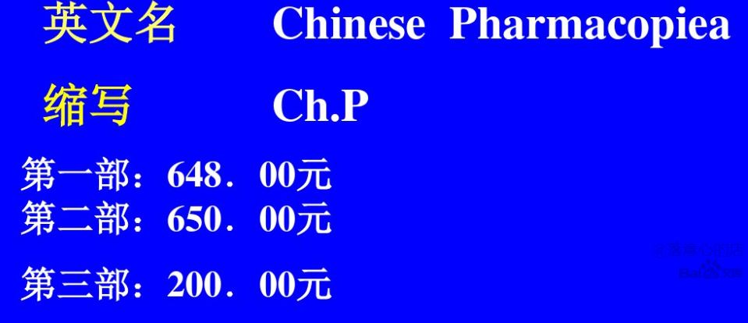

Slide 8
AI-based tumour detector
Data: A large database encompassing the full spectrum of possible anatomies, pathologies, and input data types.
Hard to obtain data. Reason:
Highly Sensitive
Regulated usage I: technical, motivational, economic, (deeply rooted in well-known challenges of health information systems for which structural solutions have yet to be found)
Regulated usage II: Political, legal and ethical (an international dialogue aimed at generating consensus on policies and instruments for data sharing.)
Ref: Van Panhuis, W. G. et al. A systematic review of barriers to data sharing in public health. BMC Public Health 14, 1144 (2014).
Notes:
基于AI的肿瘤探测器
一个大型数据库，包含可能的解剖、病理学和输入数据类型的全谱
六类：技术、动机、经济、政治、法律和道德。前三类问题深深植根于卫生信息系统的众所周知的挑战，而这些挑战尚未找到结构性解决办法；后三类问题的解决办法在于国际对话，旨在就数据共享的政策和手段达成共识。

Slide 9
AI-based tumour detector
Data: A large database encompassing the full spectrum of possible anatomies, pathologies, and input data types.
Hard to obtain data. Reason:
Highly Sensitive
Regulated usage
Considerable time, effort, and expense for collecting, curating, and maintaining a high-quality data set
Significant business value
Have to retain fine-grained control over the data that they have gathered.
Notes:
computed tomography (CT) or magnetic resonance imaging (MRI) data8.

Slide 10
AI-based tumour detector
Data: A large database encompassing the full spectrum of possible anatomies, pathologies, and input data types.
Hard to obtain data.
Highly Sensitive
Regulated usage
Cost and values of data - Retainment
Removing metadata to preserve privacy.
Such as patient name or date of birth.
Enough? - reconstruct a patient’s face from CT or MRI data.
Federated Learning!
Notes:
computed tomography (CT) or magnetic resonance imaging (MRI) data8.
Removing metadata such as patient name or date of birth is often not enough to preserve privacy.

Slide 11
FL
Data governance and privacy?
algorithms collaboratively without exchanging the data itself
FL from edge devices to healthcare apps
In the form of a consensus model
without moving patient data beyond the firewalls of the institutions
Successful Impl.
Precision medicine at large-scale
Unbiased decisions
Optimally reflect an individual’s physiology
Sensitive to rare diseases (under governance and privacy concerns).
Without compromising safety or patient privacy (Rigorous technical consideration).
Notes:
Consensus 共识
rigorous technical consideration 严格技术考虑
Pros:
overcome the limitations of approaches that require a single pool of centralised data.

Slide 12
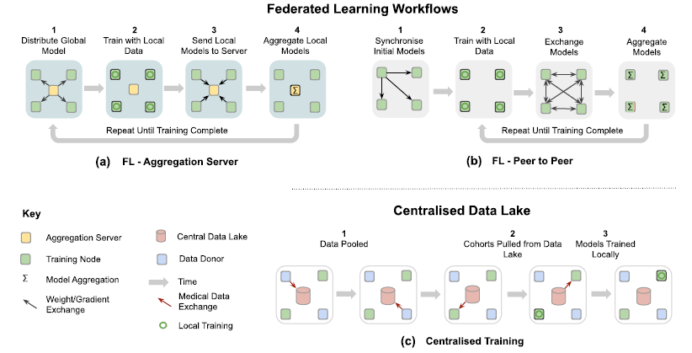
FL
Models trained by FL can achieve performance levels:
comparable to ones trained on centrally hosted data sets
superior to models that only see isolated single-institutional data.
Notes:
Consensus 共识

Slide 13
02
Data-driven Medicine Requires
Federated Efforts

Slide 14
DATA-DRIVEN MEDICINE REQUIRES FEDERATED EFFORTS
DL: current knowledge discovery approach
But… large and diverse data sets – difficult to obtain
Data-driven approaches rely on data that truly represent the underlying data distribution of the problem.
Current Algo: carefully curated data sets
Notes:
Substantial, albeit smaller, initiatives
patient reidentification7
实质性的，尽管规模较小的倡议患者再鉴定7
carefully curated data sets精心策划的数据集

Slide 15
DATA-DRIVEN MEDICINE REQUIRES FEDERATED EFFORTS
Curated dataset problem:
Data skew - affect the accuracy for certain groups or sites
Demographics: gender, age
Technical imbalances: acquisition protocol, equipment manufacturer
Subtle relationships between disease patterns – more diverse cases model
Socioeconomic and genetic factors
Complex and rare cases
Notes:
Substantial, albeit smaller, initiatives
patient reidentification7
实质性的，尽管规模较小的倡议患者再鉴定7
carefully curated data sets精心策划的数据集

Slide 16
Dataset (Ref. 21-37)
Commercial
IBM’s Merge Healthcare acquisition21
Economic growth and scientific progress
NHS Scotland’s National Safe Haven22
French Health Data Hub23
Health Data Research UK24
Medical grand challenges32
CAMELYON challenge33
the International multimodal Brain Tumor Segmentation (BraTS) challenge 34-36
the Medical Segmentation Decathlon37.
Substantial (smaller though)
the Human Connectome25,
the UK Biobank26,
the Cancer Imaging Archive (TCIA)27
NIH CXR8 28
NIH DeepLesion29
the Cancer Genome Atlas (TCGA)30
the Alzheimer’s Disease Neuroimaging Initiative (ADNI)31
License?
Notes:
Can be used?
License?

Slide 17
A generative copula-based method that can accurately estimate the likelihood of a specific person to be correctly re-identified,
On 210 populations, AUC =from 0.84 to 0.97,
99.98% of Americans would be correctly re-identified in any dataset using 15 demographic attributes.
Centralising or releasing data
regulatory, ethical and legal challenges, privacy and data protection,
technical challenge.
Anonymising, controlling access and safely transferring healthcare data
non-trivial, and sometimes impossible
Anonymised data from the electronic health record, genomic data and medical images
innocuous and GDPR/PHI compliant
just a few data elements may allow for patient reidentification
Q: How to destroy the fidelity of the data when anomalously?
Practical Sol. Gated access for approved users. But only if unconditional, which cannot recall.
7. Rocher, L., Hendrickx, J. M. & De Montjoye, Y.-A. Estimating the success of reidentifications in incomplete datasets using generative models. Nat. Commun. 10, 1–9 (2019).
Notes:
Innocuous无害的
for patient reidentification 用于患者识别
General Data Protection Regulation，简称GDPR
Fidelity 准确度
The resulting 210 populations cover a large range of uniqueness values (0–0.96), numbers of attributes (2–47), and records (7108–9M individuals).
尽管丰富的医学，行为和社会人口统计学数据是现代数据驱动研究的关键，但其收集和使用却引发了合理的隐私问题。在共享数据集之前通过取消标识和采样使其匿名化已成为解决这些问题的主要工具。我们在这里提出一种基于生成系法的方法，即使在数据集不完整的情况下，也可以准确地估计特定人被正确重新识别的可能性。在210个人口中，我们的方法获得的AUC分数用于预测个体唯一性，范围从0.84到0.97，错误发现率低。使用我们的模型，我们发现使用15个人口统计属性的任何数据集都可以正确地重新识别99.98％的美国人。我们的研究结果表明，即使采样量很大的匿名数据集也不太可能满足GDPR设定的现代匿名标准，并严重挑战去身份识别后遗忘模型的技术和法律适用性。
（15个即可恢复，即使采样很多也能打标签）

Slide 18
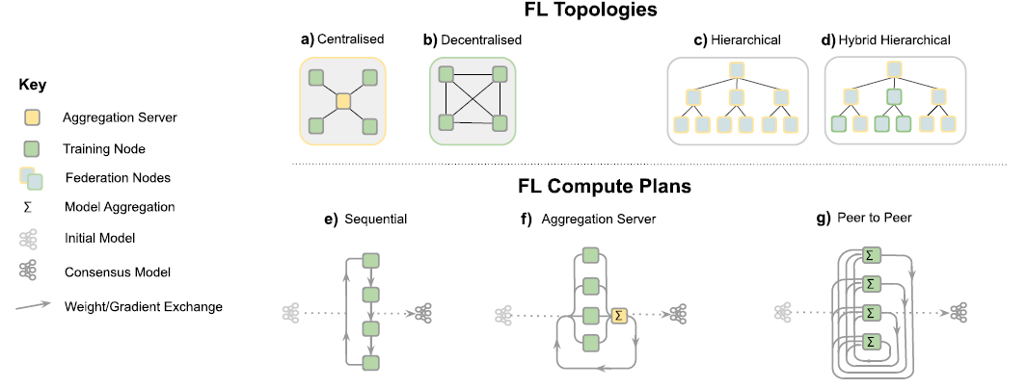

Common way for health apps
The promise of FL:
to address privacy and data governance challenges by enabling ML from non-co-located data.
Privacy: memorized information – differential privacy
Dwork, Cynthia, et al. "Our data, ourselves: Privacy via distributed noise generation." Annual International Conference on the Theory and Applications of Cryptographic Techniques. Springer, Berlin, Heidelberg, 2006.
Notes:
相邻数据集
对于一个随机化算法 A （所谓随机化算法，是指对于特定输入，该算法的输出不是固定值，而是服从某一分布），其分别作用于两个相邻数据集得到的两个输出分布难以区分。差分隐私形式化的定义为：{…}
也就是说，如果该算法作用于任何相邻数据集，得到一个特定输出 O 的概率应差不多，那么我们就说这个算法能达到差分隐私的效果。也就是说，观察者通过观察输出结果很难察觉出数据集一点微小的变化，从而达到保护隐私的目的。
Laplace mechanism gaussian mechanism
N(0, s_h^2 * σ^2 )
Lap(b) := Lap(x|b) = 1 / 2 * exp(− |x| / b )
[1] Dwork, Cynthia, et al. "Our data, ourselves: Privacy via distributed noise generation." Annual International Conference on the Theory and Applications of Cryptographic Techniques. Springer, Berlin, Heidelberg, 2006. Martín Abadi, Andy Chu, Ian J. Goodfellow, H. Brendan McMahan, Ilya Mironov, Kunal Talwar, Li Zhang: Deep Learning with Differential Privacy. CoRR abs/1607.00133 (2016)

Slide 19
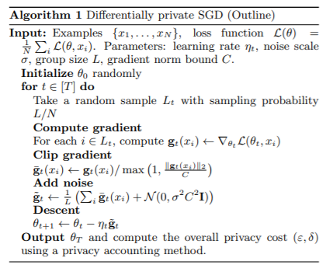
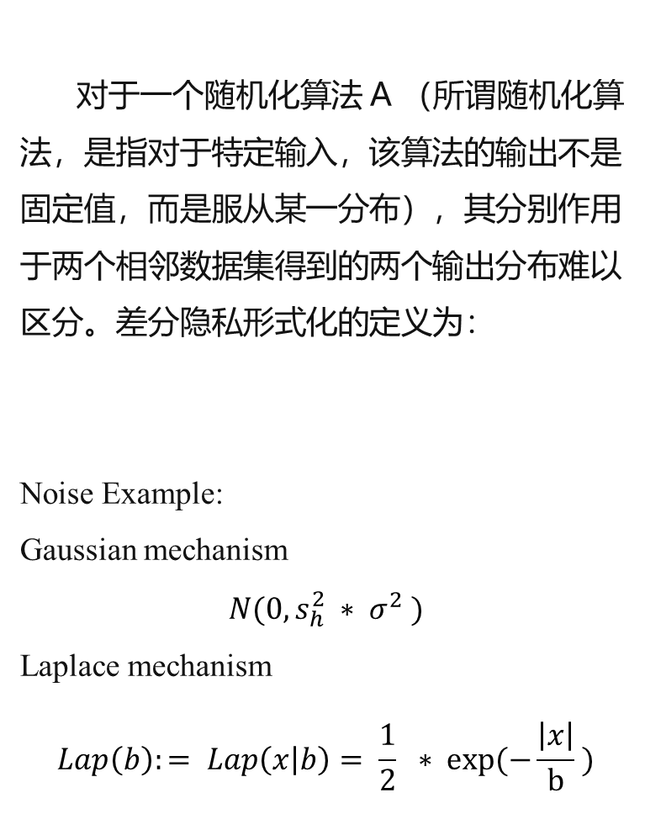
对于一个随机化算法 A （所谓随机化算法，是指对于特定输入，该算法的输出不是固定值，而是服从某一分布），其分别作用于两个相邻数据集得到的两个输出分布难以区分。差分隐私形式化的定义为：
Noise Example:
Gaussian mechanism
$$N(0, s_{h}^{2} ∗ σ^{2} )$$
Laplace mechanism
$$Lap\left(b\right):= Lap\left(x | b\right)= \frac{1}{2} ∗ exp⁡(−\frac{\left|x\right|}{b} )$$
Martín Abadi, Andy Chu, Ian J. Goodfellow, H. Brendan McMahan, Ilya Mironov, Kunal Talwar, Li Zhang: Deep Learning with Differential Privacy. CoRR abs/1607.00133 (2016)
Notes:
也就是说，如果该算法作用于任何相邻数据集，得到一个特定输出 O 的概率应差不多，那么我们就说这个算法能达到差分隐私的效果。也就是说，观察者通过观察输出结果很难察觉出数据集一点微小的变化，从而达到保护隐私的目的。

Slide 20
03
Federated Learning in digital health (Apps and Benefits)

Slide 21
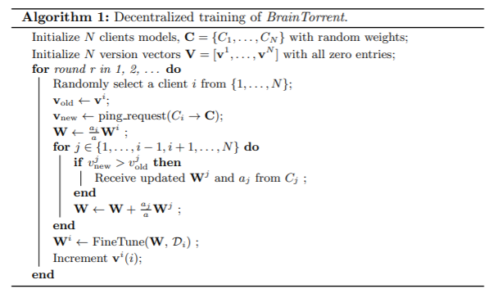
Electronic health records (EHR)
represent and find clinically similar patients
predicting hospitalizations due to cardiac events, mortality and ICU stay time.
medical imaging: for whole-brain segmentation in MRI, and brain tumour segmentation
Abhijit Guha Roy, Shayan Siddiqui, Sebastian Pölsterl, Nassir Navab, Christian Wachinger: BrainTorrent: A Peer-to-Peer Environment for Decentralized Federated Learning. CoRR abs/1905.06731 (2019)
Notes:
在这种情况下，当今的大规模计划确实是明天制定医疗保健应用安全，公平和创新协作标准的先驱。
代表和发现临床上相似的病人
预测心脏事件、死亡率和ICU住院时间。
医学影像学：用于MRI全脑分割和脑肿瘤分割

Slide 22
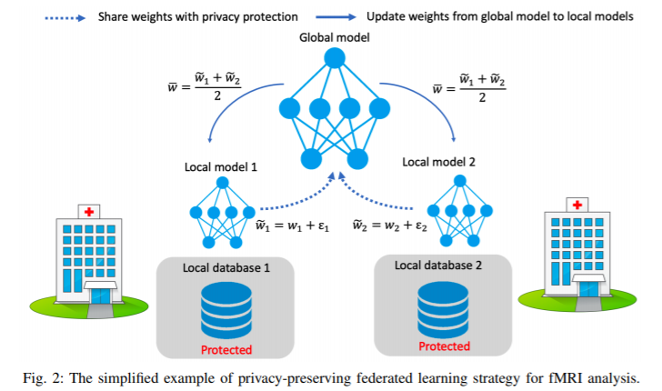
fMRI classification to find reliable disease-related biomarkers
In this context, today’s large-scale initiatives really are the pioneers of tomorrow’s standards for safe, fair and innovative collaboration in healthcare applications.
Ref. Li, X. et al. Multi-site fmri analysis using privacy-preserving federated learning and domain adaptation: abide results. arXiv preprint arXiv:2001.05647 (2020).
Notes:
可靠的疾病相关生物标志物
在这种情况下，当今的大规模计划确实是明天制定医疗保健应用安全，公平和创新协作标准的先驱.
It is worth noting that FL efforts require agreements to define
the scope, aim and technologies used which, since it is still novel,
can be difficult to pin down. In this context, today’s large-scale
initiatives really are the pioneers of tomorrow’s standards for safe,
fair and innovative collaboration in healthcare applications.

Slide 23
Consortia
To advance academic research
the Trustworthy Federated Data Analytics (TFDA) project
the German Cancer Consortium’s Joint Imaging Platform,
Example:
an international research collaboration
uses FL for the development of AI models for the assessment of mammograms.
more generalisable, and still performed well on other institutes’ data.
Impact
Notes:
Consortia 财团
Con.1.2 enable decentralised research across German medical imaging research institutions.
https://blogs.nvidia.com/blog/2020/04/15/federated-learning-mammogram-assessment/

Slide 24
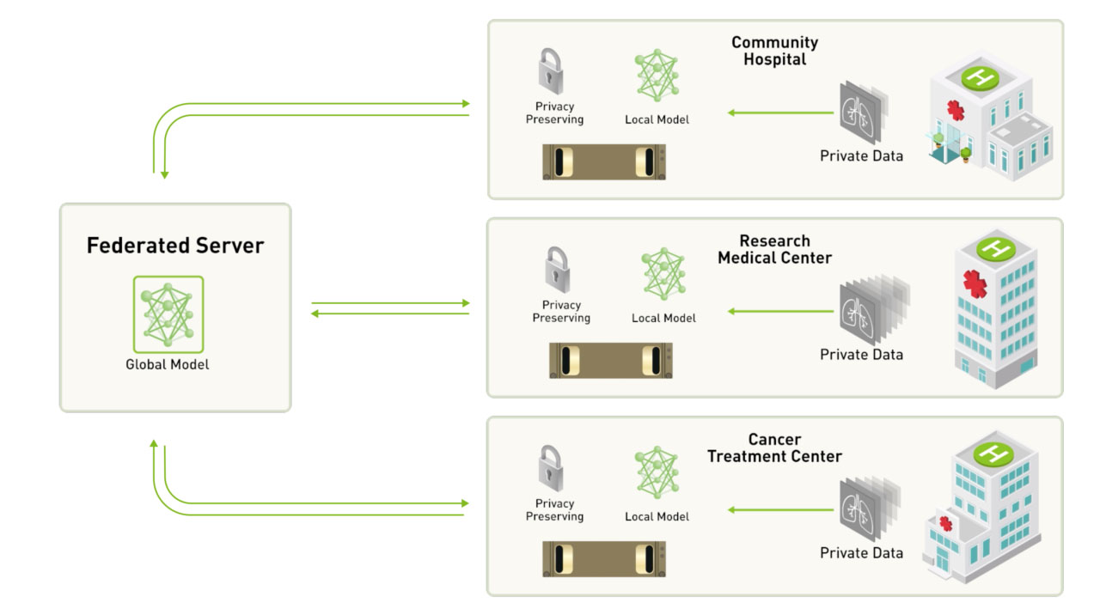
Improvement on 2D mammography classification model
The university’s researchers used the NVIDIA DGX-1 server for training and inference of its AI models.
https://blogs.nvidia.com/blog/2020/04/15/federated-learning-mammogram-assessment/
Notes:
In under six weeks, each institution used federated learning to improve a 2D mammography classification model, achieving better predictive power on their local dataset than the original neural network trained on their local data alone.
each institution set up a secure, in-house server for its data. One centralized server held the global deep neural network, and each participating radiology department got a copy to train on their own dataset.每个机构都为自己的数据建立了一个安全的内部服务器，而不需要将这些扫描集中到一个单独的位置。一个集中的服务器拥有全球深度神经网络，每个参与的放射科都得到一个副本，在他们自己的数据集上进行训练。
a better performing model without ever seeing any data except their own.

Slide 25
Healthcare institutions
Direct clinical impact
on-going HealthChain project
predict treatment response for breast cancer and melanoma patients
helps oncologists to determine the most effective treatment for each patient from their histology slides or dermoscopy images
the Federated Tumour Segmentation (FeTS) initiative
an international federation of 30 committed healthcare institutions using an open-source FL framework
Impact
Notes:
预测乳腺癌和黑色素瘤患者的治疗效果
帮助肿瘤学家根据组织学切片或皮肤镜图像确定对每个患者最有效的治疗方法
联合肿瘤分割（FeTS）启动
一个由30个承诺的医疗机构组成的国际联合会，使用开源FL框架

Slide 26
Impact
Industrial research and translation
collaborative research for, even competing, companies.
The Melody project
deploy multi-task FL across the data sets of 10 pharmaceutical companies
training a common predictive model, which infers how chemical compounds bind to proteins
intend to optimise the drug discovery process without revealing their highly valuable in-house data.
Notes:
在10家制药公司的数据集中部署多任务FL
训练一个共同的预测模型，它可以推断化合物是如何与蛋白质结合的
打算优化药物发现过程，而不透露其非常有价值的内部数据。

Slide 27
Stakeholders
Clinicians.
A second reader, augment their own expertise with expert knowledge from other institutions, ensuring a consistency of diagnosis not attainable today.
less biased decisions
higher sensitivity to rare cases (as they were likely exposed to a more complete data distribution.)
Compliance with agreements
the data structure, annotation and report protocol
Notes:
第二个读者，利用其他机构的专家知识来增强自己的专业知识，确保诊断的一致性，这在今天是无法实现的。
较少偏见的决定
对罕见病例的敏感度更高（因为他们可能接触到更完整的数据分布。）
遵守协议
·数据结构、注释和报告协议

Slide 28
Stakeholders
Patients.
Have high quality of clinical decisions regardless of the treatment location.
patients requiring medical attention in remote areas? ML-aided diagnoses with a large number of cases.
rare, or geographically uncommon, diseases,
milder consequences if faster
more accurate diagnoses can be made.
becoming a data donor? can be revoked.
Notes:
患者。
无论治疗地点如何，都能做出高质量的临床决策。
偏远地区需要医疗护理的病人？
ML对大量病例的辅助诊断。
罕见或地理上不常见的疾病，如果更快，后果会更轻可以做出更准确的诊断。
成为数据捐赠者？可以撤销共享到本数据处，而且仅共享本数据。

Slide 29
Stakeholders
Hospitals and practices.
In full control and possession of their patient data with complete traceability of data access
limiting the risk of misuse by third parties.
require investment in on-premise computing infrastructure or private-cloud service provision and adherence to standardised and synoptic data formats
ML models can be trained and evaluated seamlessly.
Even relatively small institutions can participate and they will still benefit from collective models generated.
Notes:
Seemlessly 无缝的
需要投资于本地计算基础设施或私有云服务，并遵守标准化和概要数据格式
ML模型可以无缝地训练和评估。
即使是相对较小的机构也可以参与，它们仍将受益于所产生的集体模式。

Slide 30
Stakeholders
Researchers and AI developers.
Access to a potentially vast collection of real world data
particularly impact smaller research labs and start-ups.
Resources can be directed towards solving clinical needs and associated technical problems rather than relying on the limited supply of open data sets.
algorithmic strategies for federated training,
e.g., how to combine models or updates efficiently,
how to be robust to distribution shifts11,12,20.
Regulation:
cannot investigate or visualise all of the data on which the model is trained,
e.g., it is not possible to look at an individual failure case to understand why the current model performs poorly on it.

Slide 31
Stakeholders
Healthcare providers.
fee-for-service-based vs value-based healthcare
increase the accuracy and robustness of healthcare AI
reduce costs and improving patient outcomes
be vital to precision medicine

Slide 32
Stakeholders
Manufacturers.
combine the learning from many devices and applications, without revealing patient-specific information,
significant upgrades to local compute, data storage, networking capabilities and associated software.

Slide 33
04
Technical Consideration

Slide 34

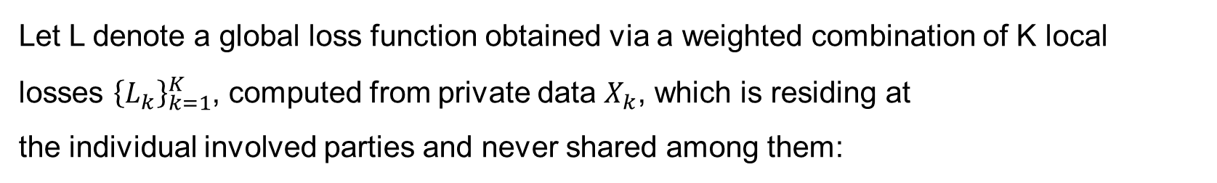
Definition
Let L denote a global loss function obtained via a weighted combination of K local
losses ${\left\{L_{k}\right\}}_{k=1}^{K}$, computed from private data $X_{k}$, which is residing at
the individual involved parties and never shared among them:

Slide 35
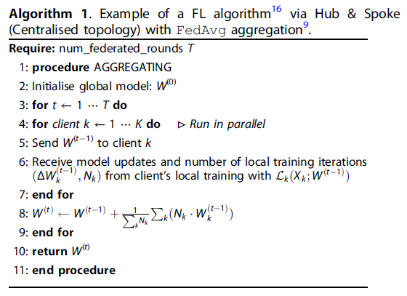
Aggregation Function
NB: clients might choose to share only a subset of the model parameters for the sake of reducing communication overhead, ensure better privacy preservation or to produce multi-task learning algorithms having only part of their parameters learned in a federated manner.

Slide 36
Challenges
Data heterogeneity.
Medical data is particularly diverse
the variety of modalities, dimensionality and characteristics in general
under a specific protocol due to factors such as acquisition differences, brand of the medical device or local demographics.
FL-increased diversity of data sources,
but inhomogeneous data distribution (vs IID)
FedAvg may fail.
Improvement: FedProx57, part-data-sharing strategy58 and FL with domain adaptation18.
Global optimal solution vs. optimal for an individual local participant. - Sol. Agreement
Notes:
另一个挑战是数据异质性可能导致全局最佳解决方案对于单个本地参与者可能不是最佳的情况。 因此，在培训之前，所有参与者均应同意模型训练最优性的定义

Slide 37
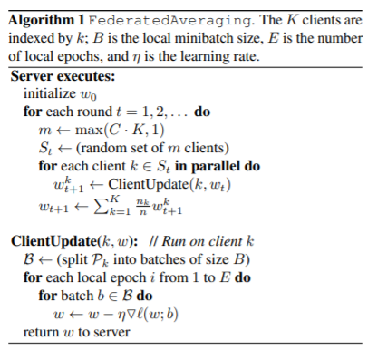
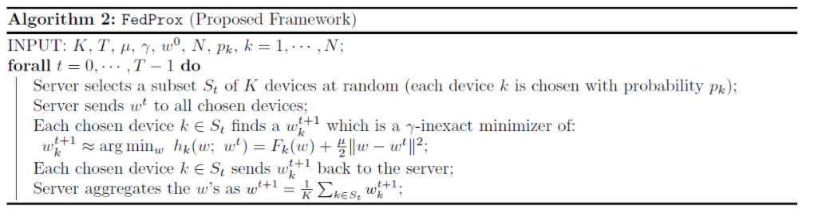
Algorithms
Ref. Tian Li, Anit Kumar Sahu, Manzil Zaheer, Maziar Sanjabi, Ameet Talwalkar, Virginia Smith:
Federated Optimization in Heterogeneous Networks. MLSys 2020
Ref. Brendan McMahan, Eider Moore, Daniel Ramage, Seth Hampson, Blaise Agüera y Arcas:
Communication-Efficient Learning of Deep Networks from Decentralized Data. AISTATS 2017: 1273-1282
Notes:
另一个挑战是数据异质性可能导致全局最佳解决方案对于单个本地参与者可能不是最佳的情况。 因此，在培训之前，所有参与者均应同意模型训练最优性的定义
在McMahan 17年文章的基础上，对FedAvg做的改进，增加了一个修正项，称为proximal term，其本质是对本地模型权重参数和全局模型权重参数的一个差异限制，一次来增加模型训练的稳定性和模型的收敛性。

Slide 38
Challenges
Privacy and security.
Privacy vs. performance
Trusted (Agreement)
eliminate many of the more nefarious motivations,
reduces the need for sophisticated counter-measures
Non-trusted (mitigate risks)
advanced encryption of model submissions, secure authentication of all parties, traceability of actions, differential privacy, verification systems, execution integrity, model confidentiality and protections against adversarial attacks.

Slide 39
Challenges
Privacy and security.
Information leakage
By model inversion60 of the model updates, the gradients themselves61 or adversarial attacks62,63.
Sol.
limiting the granularity of the updates
adding noise
ensuring adequate differential privacy
Still, an active area of research

Slide 40
Challenges
Traceability and accountability.
measure the amount of contribution from each participant, such as computational resources consumed, quality of the data used for local training, etc.
determine relevant compensation, and establish a revenue model among the participants
provide some sort of secure intra-node viewing facility to cater for this need or may provide some other way to increase explainability and interpretability of the global model.

Slide 41
Challenges
System architecture.
ensuring data integrity when communicating by use of redundant nodes,
designing secure encryption methods to prevent data leakage
designing appropriate node schedulers to make best-use of the distributed computational devices
reduce idle time.
Administration: honest broker
Cons: Additional cost
Pros: Abstract the precise internal mechanisms - more agile and simpler to update
Agreement vs lock cryptographically (significant computational overheads).

Slide 42
2
0
2
0
Thanks

