Slide 1
Duolingo Growth & Marketing Operations Analytics
Case Study / Product Operations / User Operations / Growth Operations / General Operations
As Duolingo's audience grew, did engagement and monetisation strengthen too?
Across 2023-2025, daily activity and monetisation grew faster than MAU. This case
translates that pattern into priorities for product, user and growth operations.
12 quarters
Public data
Tableau
2023-2025
March 2026
Open the published interactive Tableau dashboard
Notes:
Corporate evidence: official Duolingo IR/SEC disclosures only, Q1 2023-Q4 2025. Analysis as of March 2026. Raw values preserved at disclosed precision; all ratios and growth are transparent calculations.
2023-Q1: Duolingo Q1 2023 Results
https://investors.duolingo.com/news-releases/news-release-details/duolingo-reports-62-dau-growth-42-revenue-growth-and-increased
2023-Q2: Duolingo Q2 2023 Results
https://investors.duolingo.com/news-releases/news-release-details/duolingo-reports-62-dau-growth-44-revenue-growth-and-stronger
2023-Q3: Duolingo Q3 2023 Results
https://investors.duolingo.com/news-releases/news-release-details/duolingo-reports-63-dau-growth-and-43-revenue-growth-third
2023-Q4: Duolingo Q4/FY2023 Results
https://investors.duolingo.com/news-releases/news-release-details/duolingo-reports-65-dau-growth-45-revenue-growth-and-record
2024-Q1: Duolingo Q1 2024 Results
https://investors.duolingo.com/news-releases/news-release-details/duolingo-reports-45-revenue-growth-and-record-profitability
2024-Q2: Duolingo Q2 2024 Results
https://investors.duolingo.com/news-releases/news-release-details/duolingo-hits-100m-maus-reports-59-dau-growth-and-41-revenue
2024-Q3: Duolingo Q3 2024 Results
https://investors.duolingo.com/news-releases/news-release-details/duolingo-achieves-54-dau-growth-and-40-revenue-growth-third
2024-Q4: Duolingo Q4/FY2024 Shareholder Letter
https://www.sec.gov/Archives/edgar/data/1562088/000156208825000039/q4fy24duolingo12-31x24shar.htm
2025-Q1: Duolingo Q1 2025 Shareholder Letter
https://www.sec.gov/Archives/edgar/data/1562088/000156208825000098/q1fy25duolingo3-31x25share.htm
2025-Q2: Duolingo Q2 2025 Shareholder Letter
https://investors.duolingo.com/static-files/0b55110c-2eb9-466d-8549-5459e0851290
2025-Q3: Duolingo Q3 2025 Shareholder Letter
https://investors.duolingo.com/static-files/c9bf5861-b19d-4396-b060-c0dbeefd34f5
2025-Q4: Duolingo Q4/FY2025 Shareholder Letter
https://www.sec.gov/Archives/edgar/data/1562088/000162828026012246/q4fy25duolingo12-31x25shar.htm
2025-Q4: Duolingo 2025 Form 10-K (supplemental definitions and ratio evidence)
https://www.sec.gov/Archives/edgar/data/1562088/000162828026012494/duol-20251231.htm
Definitions/formulas: docs/methodology.md and docs/data_dictionary.md. Corporate source lineage: docs/source_manifest.csv. Competitor website snapshot: February 2026; social snapshot: March 2026. Inherited historical coursework values; original dated captures are absent and historical provenance cannot be independently verified. These are contextual snapshots, not a longitudinal dataset, market share, conversion or retention evidence. No current observations replace these dates.
Final visualisation: two completed Tableau dashboards. Tableau Public: https://public.tableau.com/views/Duolingo_Growth_Marketing_Analytics/P1_Growth_Monetisation_Overview?:language=en-US&:sid=&:redirect=auth&:display_count=n&:origin=viz_share_link
SQL formulas checked through a SQLite compatibility adaptation; native MySQL execution unverified.

Slide 2
1. Business Question, Data & Method
Audience growth alone gives an incomplete view of operating performance. This project compares reach with daily
activity, paid subscribers and revenue to identify what an operations team should monitor and investigate next.
Business questions
Data & method
1. How did audience, daily activity and monetisation change
across 12 quarters?
12 quarters: Q1 2023-Q4 2025. Official Duolingo IR / SEC
disclosures.
2. Did DAU, paid subscribers and revenue grow faster than
MAU?
Compare DAU/MAU, QoQ, YoY and indexed growth (Q1
2023 = 100).
3. What does the historical competitor context add?
Website: February 2026. Social: March 2026. Historical
context only.
4. Which operational priorities need further internal evidence?
Source alignment and SQL / Python checks support two
final Tableau pages.
Sources: Duolingo IR / SEC. Definitions and full links: methodology, source manifest and speaker notes
Notes:
Corporate evidence: official Duolingo IR/SEC disclosures only, Q1 2023-Q4 2025. Analysis as of March 2026. Raw values preserved at disclosed precision; all ratios and growth are transparent calculations.
2023-Q1: Duolingo Q1 2023 Results
https://investors.duolingo.com/news-releases/news-release-details/duolingo-reports-62-dau-growth-42-revenue-growth-and-increased
2023-Q2: Duolingo Q2 2023 Results
https://investors.duolingo.com/news-releases/news-release-details/duolingo-reports-62-dau-growth-44-revenue-growth-and-stronger
2023-Q3: Duolingo Q3 2023 Results
https://investors.duolingo.com/news-releases/news-release-details/duolingo-reports-63-dau-growth-and-43-revenue-growth-third
2023-Q4: Duolingo Q4/FY2023 Results
https://investors.duolingo.com/news-releases/news-release-details/duolingo-reports-65-dau-growth-45-revenue-growth-and-record
2024-Q1: Duolingo Q1 2024 Results
https://investors.duolingo.com/news-releases/news-release-details/duolingo-reports-45-revenue-growth-and-record-profitability
2024-Q2: Duolingo Q2 2024 Results
https://investors.duolingo.com/news-releases/news-release-details/duolingo-hits-100m-maus-reports-59-dau-growth-and-41-revenue
2024-Q3: Duolingo Q3 2024 Results
https://investors.duolingo.com/news-releases/news-release-details/duolingo-achieves-54-dau-growth-and-40-revenue-growth-third
2024-Q4: Duolingo Q4/FY2024 Shareholder Letter
https://www.sec.gov/Archives/edgar/data/1562088/000156208825000039/q4fy24duolingo12-31x24shar.htm
2025-Q1: Duolingo Q1 2025 Shareholder Letter
https://www.sec.gov/Archives/edgar/data/1562088/000156208825000098/q1fy25duolingo3-31x25share.htm
2025-Q2: Duolingo Q2 2025 Shareholder Letter
https://investors.duolingo.com/static-files/0b55110c-2eb9-466d-8549-5459e0851290
2025-Q3: Duolingo Q3 2025 Shareholder Letter
https://investors.duolingo.com/static-files/c9bf5861-b19d-4396-b060-c0dbeefd34f5
2025-Q4: Duolingo Q4/FY2025 Shareholder Letter
https://www.sec.gov/Archives/edgar/data/1562088/000162828026012246/q4fy25duolingo12-31x25shar.htm
2025-Q4: Duolingo 2025 Form 10-K (supplemental definitions and ratio evidence)
https://www.sec.gov/Archives/edgar/data/1562088/000162828026012494/duol-20251231.htm
Definitions/formulas: docs/methodology.md and docs/data_dictionary.md. Corporate source lineage: docs/source_manifest.csv. Competitor website snapshot: February 2026; social snapshot: March 2026. Inherited historical coursework values; original dated captures are absent and historical provenance cannot be independently verified. These are contextual snapshots, not a longitudinal dataset, market share, conversion or retention evidence. No current observations replace these dates.
Final visualisation: two completed Tableau dashboards. Tableau Public: https://public.tableau.com/views/Duolingo_Growth_Marketing_Analytics/P1_Growth_Monetisation_Overview?:language=en-US&:sid=&:redirect=auth&:display_count=n&:origin=viz_share_link
SQL formulas checked through a SQLite compatibility adaptation; native MySQL execution unverified.

Slide 3
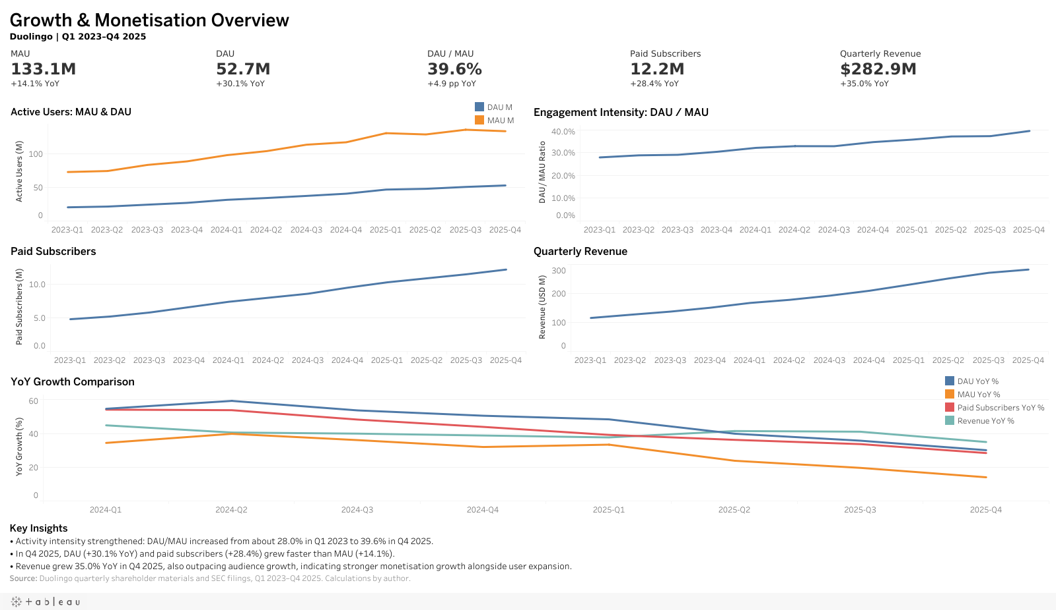
2. Dashboard - Growth & Monetisation Overview
Final published Tableau view. Click to open the interactive dashboard
Notes:
Corporate evidence: official Duolingo IR/SEC disclosures only, Q1 2023-Q4 2025. Analysis as of March 2026. Raw values preserved at disclosed precision; all ratios and growth are transparent calculations.
2023-Q1: Duolingo Q1 2023 Results
https://investors.duolingo.com/news-releases/news-release-details/duolingo-reports-62-dau-growth-42-revenue-growth-and-increased
2023-Q2: Duolingo Q2 2023 Results
https://investors.duolingo.com/news-releases/news-release-details/duolingo-reports-62-dau-growth-44-revenue-growth-and-stronger
2023-Q3: Duolingo Q3 2023 Results
https://investors.duolingo.com/news-releases/news-release-details/duolingo-reports-63-dau-growth-and-43-revenue-growth-third
2023-Q4: Duolingo Q4/FY2023 Results
https://investors.duolingo.com/news-releases/news-release-details/duolingo-reports-65-dau-growth-45-revenue-growth-and-record
2024-Q1: Duolingo Q1 2024 Results
https://investors.duolingo.com/news-releases/news-release-details/duolingo-reports-45-revenue-growth-and-record-profitability
2024-Q2: Duolingo Q2 2024 Results
https://investors.duolingo.com/news-releases/news-release-details/duolingo-hits-100m-maus-reports-59-dau-growth-and-41-revenue
2024-Q3: Duolingo Q3 2024 Results
https://investors.duolingo.com/news-releases/news-release-details/duolingo-achieves-54-dau-growth-and-40-revenue-growth-third
2024-Q4: Duolingo Q4/FY2024 Shareholder Letter
https://www.sec.gov/Archives/edgar/data/1562088/000156208825000039/q4fy24duolingo12-31x24shar.htm
2025-Q1: Duolingo Q1 2025 Shareholder Letter
https://www.sec.gov/Archives/edgar/data/1562088/000156208825000098/q1fy25duolingo3-31x25share.htm
2025-Q2: Duolingo Q2 2025 Shareholder Letter
https://investors.duolingo.com/static-files/0b55110c-2eb9-466d-8549-5459e0851290
2025-Q3: Duolingo Q3 2025 Shareholder Letter
https://investors.duolingo.com/static-files/c9bf5861-b19d-4396-b060-c0dbeefd34f5
2025-Q4: Duolingo Q4/FY2025 Shareholder Letter
https://www.sec.gov/Archives/edgar/data/1562088/000162828026012246/q4fy25duolingo12-31x25shar.htm
2025-Q4: Duolingo 2025 Form 10-K (supplemental definitions and ratio evidence)
https://www.sec.gov/Archives/edgar/data/1562088/000162828026012494/duol-20251231.htm
Definitions/formulas: docs/methodology.md and docs/data_dictionary.md. Corporate source lineage: docs/source_manifest.csv. Competitor website snapshot: February 2026; social snapshot: March 2026. Inherited historical coursework values; original dated captures are absent and historical provenance cannot be independently verified. These are contextual snapshots, not a longitudinal dataset, market share, conversion or retention evidence. No current observations replace these dates.
Final visualisation: two completed Tableau dashboards. Tableau Public: https://public.tableau.com/views/Duolingo_Growth_Marketing_Analytics/P1_Growth_Monetisation_Overview?:language=en-US&:sid=&:redirect=auth&:display_count=n&:origin=viz_share_link
SQL formulas checked through a SQLite compatibility adaptation; native MySQL execution unverified.

Slide 4
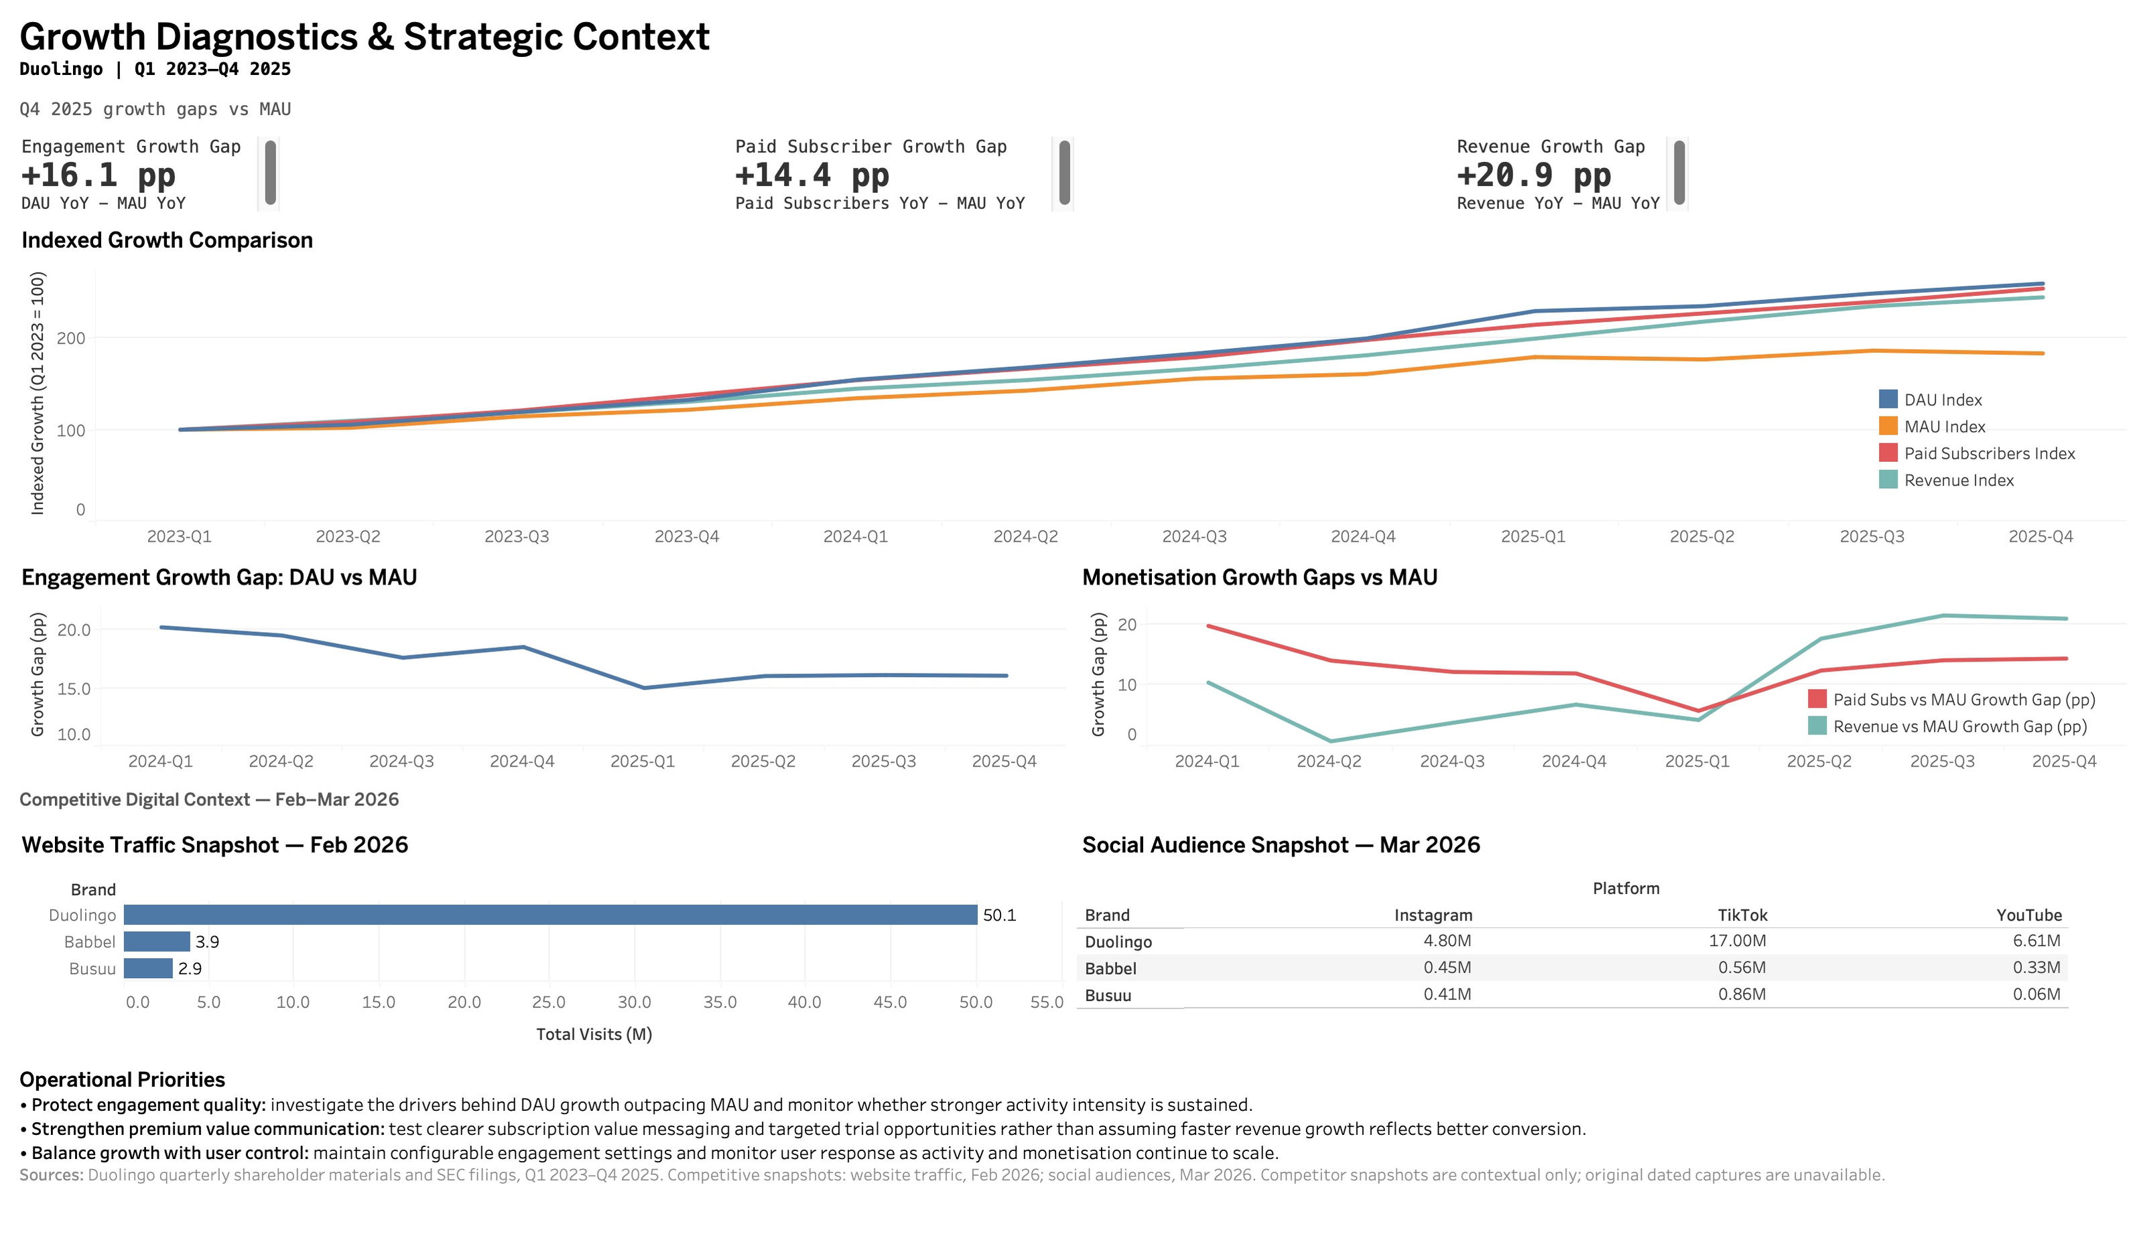
3. Dashboard - Growth Diagnostics & Strategic Context
Final published Tableau view. Click to open the interactive dashboard
Notes:
Corporate evidence: official Duolingo IR/SEC disclosures only, Q1 2023-Q4 2025. Analysis as of March 2026. Raw values preserved at disclosed precision; all ratios and growth are transparent calculations.
2023-Q1: Duolingo Q1 2023 Results
https://investors.duolingo.com/news-releases/news-release-details/duolingo-reports-62-dau-growth-42-revenue-growth-and-increased
2023-Q2: Duolingo Q2 2023 Results
https://investors.duolingo.com/news-releases/news-release-details/duolingo-reports-62-dau-growth-44-revenue-growth-and-stronger
2023-Q3: Duolingo Q3 2023 Results
https://investors.duolingo.com/news-releases/news-release-details/duolingo-reports-63-dau-growth-and-43-revenue-growth-third
2023-Q4: Duolingo Q4/FY2023 Results
https://investors.duolingo.com/news-releases/news-release-details/duolingo-reports-65-dau-growth-45-revenue-growth-and-record
2024-Q1: Duolingo Q1 2024 Results
https://investors.duolingo.com/news-releases/news-release-details/duolingo-reports-45-revenue-growth-and-record-profitability
2024-Q2: Duolingo Q2 2024 Results
https://investors.duolingo.com/news-releases/news-release-details/duolingo-hits-100m-maus-reports-59-dau-growth-and-41-revenue
2024-Q3: Duolingo Q3 2024 Results
https://investors.duolingo.com/news-releases/news-release-details/duolingo-achieves-54-dau-growth-and-40-revenue-growth-third
2024-Q4: Duolingo Q4/FY2024 Shareholder Letter
https://www.sec.gov/Archives/edgar/data/1562088/000156208825000039/q4fy24duolingo12-31x24shar.htm
2025-Q1: Duolingo Q1 2025 Shareholder Letter
https://www.sec.gov/Archives/edgar/data/1562088/000156208825000098/q1fy25duolingo3-31x25share.htm
2025-Q2: Duolingo Q2 2025 Shareholder Letter
https://investors.duolingo.com/static-files/0b55110c-2eb9-466d-8549-5459e0851290
2025-Q3: Duolingo Q3 2025 Shareholder Letter
https://investors.duolingo.com/static-files/c9bf5861-b19d-4396-b060-c0dbeefd34f5
2025-Q4: Duolingo Q4/FY2025 Shareholder Letter
https://www.sec.gov/Archives/edgar/data/1562088/000162828026012246/q4fy25duolingo12-31x25shar.htm
2025-Q4: Duolingo 2025 Form 10-K (supplemental definitions and ratio evidence)
https://www.sec.gov/Archives/edgar/data/1562088/000162828026012494/duol-20251231.htm
Definitions/formulas: docs/methodology.md and docs/data_dictionary.md. Corporate source lineage: docs/source_manifest.csv. Competitor website snapshot: February 2026; social snapshot: March 2026. Inherited historical coursework values; original dated captures are absent and historical provenance cannot be independently verified. These are contextual snapshots, not a longitudinal dataset, market share, conversion or retention evidence. No current observations replace these dates.
Final visualisation: two completed Tableau dashboards. Tableau Public: https://public.tableau.com/views/Duolingo_Growth_Marketing_Analytics/P1_Growth_Monetisation_Overview?:language=en-US&:sid=&:redirect=auth&:display_count=n&:origin=viz_share_link
SQL formulas checked through a SQLite compatibility adaptation; native MySQL execution unverified.

Slide 5
4. Key Findings
Engagement
Monetisation
DAU grew 160% versus MAU 83% from Q1 2023 to Q4
2025. DAU/MAU rose from 28.0% to 39.6% (+11.6 pp),
indicating deeper aggregate activity.
Paid subscribers grew 154% and quarterly revenue 145%,
both faster than MAU. The data supports further review of
monetisation drivers.
Growth mix
Competitive context
By Q4 2025, MAU growth moderated to 14% YoY while
DAU, paid subscribers and revenue grew 30%, 28% and
35%.
The inherited February/March 2026 snapshots show
greater Duolingo digital reach among the three observed
brands. This is context only, with unverified historical
captures.
Sources: Duolingo IR / SEC. Definitions and full links: methodology, source manifest and speaker notes
Notes:
Corporate evidence: official Duolingo IR/SEC disclosures only, Q1 2023-Q4 2025. Analysis as of March 2026. Raw values preserved at disclosed precision; all ratios and growth are transparent calculations.
2023-Q1: Duolingo Q1 2023 Results
https://investors.duolingo.com/news-releases/news-release-details/duolingo-reports-62-dau-growth-42-revenue-growth-and-increased
2023-Q2: Duolingo Q2 2023 Results
https://investors.duolingo.com/news-releases/news-release-details/duolingo-reports-62-dau-growth-44-revenue-growth-and-stronger
2023-Q3: Duolingo Q3 2023 Results
https://investors.duolingo.com/news-releases/news-release-details/duolingo-reports-63-dau-growth-and-43-revenue-growth-third
2023-Q4: Duolingo Q4/FY2023 Results
https://investors.duolingo.com/news-releases/news-release-details/duolingo-reports-65-dau-growth-45-revenue-growth-and-record
2024-Q1: Duolingo Q1 2024 Results
https://investors.duolingo.com/news-releases/news-release-details/duolingo-reports-45-revenue-growth-and-record-profitability
2024-Q2: Duolingo Q2 2024 Results
https://investors.duolingo.com/news-releases/news-release-details/duolingo-hits-100m-maus-reports-59-dau-growth-and-41-revenue
2024-Q3: Duolingo Q3 2024 Results
https://investors.duolingo.com/news-releases/news-release-details/duolingo-achieves-54-dau-growth-and-40-revenue-growth-third
2024-Q4: Duolingo Q4/FY2024 Shareholder Letter
https://www.sec.gov/Archives/edgar/data/1562088/000156208825000039/q4fy24duolingo12-31x24shar.htm
2025-Q1: Duolingo Q1 2025 Shareholder Letter
https://www.sec.gov/Archives/edgar/data/1562088/000156208825000098/q1fy25duolingo3-31x25share.htm
2025-Q2: Duolingo Q2 2025 Shareholder Letter
https://investors.duolingo.com/static-files/0b55110c-2eb9-466d-8549-5459e0851290
2025-Q3: Duolingo Q3 2025 Shareholder Letter
https://investors.duolingo.com/static-files/c9bf5861-b19d-4396-b060-c0dbeefd34f5
2025-Q4: Duolingo Q4/FY2025 Shareholder Letter
https://www.sec.gov/Archives/edgar/data/1562088/000162828026012246/q4fy25duolingo12-31x25shar.htm
2025-Q4: Duolingo 2025 Form 10-K (supplemental definitions and ratio evidence)
https://www.sec.gov/Archives/edgar/data/1562088/000162828026012494/duol-20251231.htm
Definitions/formulas: docs/methodology.md and docs/data_dictionary.md. Corporate source lineage: docs/source_manifest.csv. Competitor website snapshot: February 2026; social snapshot: March 2026. Inherited historical coursework values; original dated captures are absent and historical provenance cannot be independently verified. These are contextual snapshots, not a longitudinal dataset, market share, conversion or retention evidence. No current observations replace these dates.
Final visualisation: two completed Tableau dashboards. Tableau Public: https://public.tableau.com/views/Duolingo_Growth_Marketing_Analytics/P1_Growth_Monetisation_Overview?:language=en-US&:sid=&:redirect=auth&:display_count=n&:origin=viz_share_link
SQL formulas checked through a SQLite compatibility adaptation; native MySQL execution unverified.

Slide 6
5. Operational Implications
01
02
03
Protect engagement
quality
Strengthen premium
value communication
Balance growth with user
control
Investigate the drivers behind
DAU growth outpacing MAU and
monitor whether stronger activity
intensity is sustained.
Test clearer subscription value
messaging and targeted trial
opportunities rather than
assuming faster revenue growth
reflects better conversion.
Maintain configurable
engagement settings and monitor
user response as activity and
monetisation continue to scale.
Sources: Duolingo IR / SEC. Definitions and full links: methodology, source manifest and speaker notes
Notes:
Corporate evidence: official Duolingo IR/SEC disclosures only, Q1 2023-Q4 2025. Analysis as of March 2026. Raw values preserved at disclosed precision; all ratios and growth are transparent calculations.
2023-Q1: Duolingo Q1 2023 Results
https://investors.duolingo.com/news-releases/news-release-details/duolingo-reports-62-dau-growth-42-revenue-growth-and-increased
2023-Q2: Duolingo Q2 2023 Results
https://investors.duolingo.com/news-releases/news-release-details/duolingo-reports-62-dau-growth-44-revenue-growth-and-stronger
2023-Q3: Duolingo Q3 2023 Results
https://investors.duolingo.com/news-releases/news-release-details/duolingo-reports-63-dau-growth-and-43-revenue-growth-third
2023-Q4: Duolingo Q4/FY2023 Results
https://investors.duolingo.com/news-releases/news-release-details/duolingo-reports-65-dau-growth-45-revenue-growth-and-record
2024-Q1: Duolingo Q1 2024 Results
https://investors.duolingo.com/news-releases/news-release-details/duolingo-reports-45-revenue-growth-and-record-profitability
2024-Q2: Duolingo Q2 2024 Results
https://investors.duolingo.com/news-releases/news-release-details/duolingo-hits-100m-maus-reports-59-dau-growth-and-41-revenue
2024-Q3: Duolingo Q3 2024 Results
https://investors.duolingo.com/news-releases/news-release-details/duolingo-achieves-54-dau-growth-and-40-revenue-growth-third
2024-Q4: Duolingo Q4/FY2024 Shareholder Letter
https://www.sec.gov/Archives/edgar/data/1562088/000156208825000039/q4fy24duolingo12-31x24shar.htm
2025-Q1: Duolingo Q1 2025 Shareholder Letter
https://www.sec.gov/Archives/edgar/data/1562088/000156208825000098/q1fy25duolingo3-31x25share.htm
2025-Q2: Duolingo Q2 2025 Shareholder Letter
https://investors.duolingo.com/static-files/0b55110c-2eb9-466d-8549-5459e0851290
2025-Q3: Duolingo Q3 2025 Shareholder Letter
https://investors.duolingo.com/static-files/c9bf5861-b19d-4396-b060-c0dbeefd34f5
2025-Q4: Duolingo Q4/FY2025 Shareholder Letter
https://www.sec.gov/Archives/edgar/data/1562088/000162828026012246/q4fy25duolingo12-31x25shar.htm
2025-Q4: Duolingo 2025 Form 10-K (supplemental definitions and ratio evidence)
https://www.sec.gov/Archives/edgar/data/1562088/000162828026012494/duol-20251231.htm
Definitions/formulas: docs/methodology.md and docs/data_dictionary.md. Corporate source lineage: docs/source_manifest.csv. Competitor website snapshot: February 2026; social snapshot: March 2026. Inherited historical coursework values; original dated captures are absent and historical provenance cannot be independently verified. These are contextual snapshots, not a longitudinal dataset, market share, conversion or retention evidence. No current observations replace these dates.
Final visualisation: two completed Tableau dashboards. Tableau Public: https://public.tableau.com/views/Duolingo_Growth_Marketing_Analytics/P1_Growth_Monetisation_Overview?:language=en-US&:sid=&:redirect=auth&:display_count=n&:origin=viz_share_link
SQL formulas checked through a SQLite compatibility adaptation; native MySQL execution unverified.
Recommendations are proposed internal reviews, not claims that Duolingo lacks tracking or that any tactic is effective.

Slide 7
6. Method & Limitations
How the analysis was built
Analytical guardrails
• Official disclosures cover six corporate metrics across 12
quarters. Sources and definitions are documented.
• Public aggregates cannot measure cohort retention or a
free-to-paid funnel.
• Compare period growth, QoQ, YoY, DAU/MAU and indexed
growth. Rate gaps use percentage points.
• Competitor snapshots have no original dated captures and
provide context only.
• SQL and Python checks reconcile the 16 derived fields and
preserve unavailable comparisons as missing.
• DAU/MAU describes aggregate activity. Paid and revenue
growth do not isolate conversion or pricing.
• Two completed Tableau dashboards are the final visualisation.
Both language versions use the same views.
• Relationships are descriptive. Recommendations have no
measured business impact.
The project delivers operational priorities and a monitoring framework. Proposed reviews and experiments
require internal data and validation.
Sources: Duolingo IR / SEC. Definitions and full links: methodology, source manifest and speaker notes
Notes:
Corporate evidence: official Duolingo IR/SEC disclosures only, Q1 2023-Q4 2025. Analysis as of March 2026. Raw values preserved at disclosed precision; all ratios and growth are transparent calculations.
2023-Q1: Duolingo Q1 2023 Results
https://investors.duolingo.com/news-releases/news-release-details/duolingo-reports-62-dau-growth-42-revenue-growth-and-increased
2023-Q2: Duolingo Q2 2023 Results
https://investors.duolingo.com/news-releases/news-release-details/duolingo-reports-62-dau-growth-44-revenue-growth-and-stronger
2023-Q3: Duolingo Q3 2023 Results
https://investors.duolingo.com/news-releases/news-release-details/duolingo-reports-63-dau-growth-and-43-revenue-growth-third
2023-Q4: Duolingo Q4/FY2023 Results
https://investors.duolingo.com/news-releases/news-release-details/duolingo-reports-65-dau-growth-45-revenue-growth-and-record
2024-Q1: Duolingo Q1 2024 Results
https://investors.duolingo.com/news-releases/news-release-details/duolingo-reports-45-revenue-growth-and-record-profitability
2024-Q2: Duolingo Q2 2024 Results
https://investors.duolingo.com/news-releases/news-release-details/duolingo-hits-100m-maus-reports-59-dau-growth-and-41-revenue
2024-Q3: Duolingo Q3 2024 Results
https://investors.duolingo.com/news-releases/news-release-details/duolingo-achieves-54-dau-growth-and-40-revenue-growth-third
2024-Q4: Duolingo Q4/FY2024 Shareholder Letter
https://www.sec.gov/Archives/edgar/data/1562088/000156208825000039/q4fy24duolingo12-31x24shar.htm
2025-Q1: Duolingo Q1 2025 Shareholder Letter
https://www.sec.gov/Archives/edgar/data/1562088/000156208825000098/q1fy25duolingo3-31x25share.htm
2025-Q2: Duolingo Q2 2025 Shareholder Letter
https://investors.duolingo.com/static-files/0b55110c-2eb9-466d-8549-5459e0851290
2025-Q3: Duolingo Q3 2025 Shareholder Letter
https://investors.duolingo.com/static-files/c9bf5861-b19d-4396-b060-c0dbeefd34f5
2025-Q4: Duolingo Q4/FY2025 Shareholder Letter
https://www.sec.gov/Archives/edgar/data/1562088/000162828026012246/q4fy25duolingo12-31x25shar.htm
2025-Q4: Duolingo 2025 Form 10-K (supplemental definitions and ratio evidence)
https://www.sec.gov/Archives/edgar/data/1562088/000162828026012494/duol-20251231.htm
Definitions/formulas: docs/methodology.md and docs/data_dictionary.md. Corporate source lineage: docs/source_manifest.csv. Competitor website snapshot: February 2026; social snapshot: March 2026. Inherited historical coursework values; original dated captures are absent and historical provenance cannot be independently verified. These are contextual snapshots, not a longitudinal dataset, market share, conversion or retention evidence. No current observations replace these dates.
Final visualisation: two completed Tableau dashboards. Tableau Public: https://public.tableau.com/views/Duolingo_Growth_Marketing_Analytics/P1_Growth_Monetisation_Overview?:language=en-US&:sid=&:redirect=auth&:display_count=n&:origin=viz_share_link
SQL formulas checked through a SQLite compatibility adaptation; native MySQL execution unverified.

