Slide 1






ML in Cybersecurity
WORKSHOP - 4
2:14 PM login
NORMAL
Known device · 4 km
Can AI detect a suspicious login?
3:02 AM login
SUSPICIOUS
New device · 8 fails
HOSTED BY
Mukul Sharma
Ivan Khan
6:40 PM login
UNSURE
Head of AI
Head of Cybersecurity
New device · 800 km
Room C221 · 2:00–4:00 PM
Notes:
Welcome everyone. Introduce hosts: Mukul Sharma (Head of AI) and Ivan Khan (Head of Cybersecurity). Today's question: can AI detect a suspicious login? The three cards on the right preview the idea: some logins are clearly fine, some clearly risky, and some are genuinely unsure.

Slide 2






Today's Roadmap
1. Make data
2. Explore
3. Train
Multiple fictional logins
Spot what looks different
Teach a Decision Tree
4. Evaluate
5. Test
6. Break it
Check accuracy and mistakes
Try login scenarios
Can you confuse the model?
Notes:
The whole session follows the notebook top to bottom. Six simple steps: data, explore, train, evaluate, test, and then try to break it.

Slide 3



Why ML for Security?
Too many logins
Subtle patterns
Attackers adapt
Thousands of attempts a day are impossible to review by hand.
Risky behaviour hides in combinations of small signals.
Models can be retrained as new patterns appear.
Today: build a model that scores logins by risk, then question its mistakes.
Notes:
Why bother? Volume, subtlety, and adaptation. ML is a tool for triage, not a replacement for people.

Slide 4






Our Fictional Data
1,000 made-up login attempts. No real passwords, accounts or IP addresses.
Login hour
Failed attempts
New device
login_hour
failed_attempts
new_device
Distance from home
VPN used
Recent attempts
distance_from_home_km
vpn_used
attempts_last_10_minutes
Notes:
Each row in the dataset is one fictional login with six features. Everything is synthetic so nobody's real data is involved.

Slide 5
How We Label Logins
6+
points = labelled suspicious
A flag is a risk signal, not proof. A VPN, travel or late-night login alone does not make someone an attacker.
Notes:
Key message: a suspicious label is a risk signal, not proof. In this workshop we assign points to unusual behaviour; in real life labels would come from verified incidents.

Slide 6
Train, Then Test
Training · 800 logins
Test · 200
Revision material: the model learns from this
The exam
Decision Tree
5+ failed attempts?
Yes
No
Learns a chain of yes/no questions. Depth is capped at 4 so it stays explainable.
Higher risk
Lower risk
Simplified example
Notes:
Training data is the revision material; test data is the exam, which the model never saw. The Decision Tree is a sequence of yes/no questions, easy to explain to a non-technical audience.

Slide 7
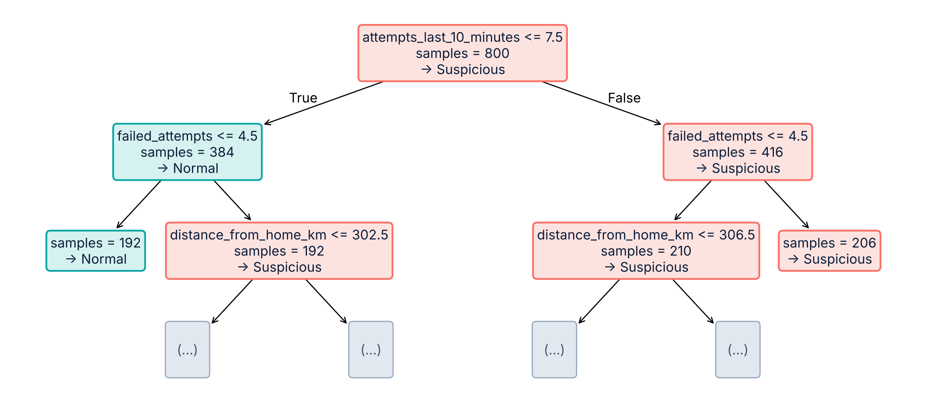
The Decision Tree
Follow one route from top to bottom. Top 3 levels of the real model.
Notes:
This is the actual tree trained in the notebook, trimmed to three levels. First question: more than about 7 attempts in 10 minutes? Then failed attempts, then distance. Pick one path and read it aloud.

Slide 8
How Did It Do?
89.5%
Predicted Normal
Predicted Suspicious
Actual Normal
73
15
accuracy on 200 unseen logins
Correctly allowed
False alarm
Actual Suspicious
6
106
88%
95%
Precision
Recall
Missed attack
Correctly flagged
False alarms cause alert fatigue. Missed attacks let risky access through. Both matter.
Notes:
Accuracy alone hides the type of mistake. 15 normal logins were wrongly flagged and 6 suspicious ones were missed. Ask the room: which error is worse for a bank? For a university?

Slide 9
What Matters Most?
Three signals do almost all the work.
VPN and login hour barely matter here. Importance describes this model, not cause and effect.
Notes:
Failed attempts, attempts in the last 10 minutes and distance carry nearly all the weight. VPN use and login hour add little in this fitted tree. This describes the model and dataset only; it does not prove causation.

Slide 10
Try Three Scenarios
A
Clearly normal
B
Several red flags
C
Likely traveller
2 PM · known device
4 km away · no VPN
0 failed attempts
3 AM · new device
500 km away · VPN on
8 failed · 12 tries / 10 min
6 PM · new device
800 km away · no VPN
0 failed attempts
NORMAL · 0%
SUSPICIOUS · 100%
NORMAL · 0%
Allow and keep monitoring
Request MFA, notify the user
Model allows it. Would you?
Notes:
Scenario A and B are easy. Scenario C is the real discussion: someone far from home on a new device with no failed attempts. The model gives it a score of 0%, but a human might ask for MFA rather than block or accuse. What context is missing?

Slide 11


Your Turn: Break It
Change the values
TRY THIS FIRST
Edit the check_login() inputs. Fictional data only.
10 AM · new device
700 km away · VPN on
0 failed attempts
Confuse the model
Look suspicious to a human but score normal, or the reverse.
Model says
NORMAL
Explain why
What context is missing? What response is proportionate?
Would you trust that?
Notes:
Hands-on time. Participants edit values in the notebook, using fictional information only. The example is the notebook's challenge scenario. Optional: use an AI assistant to explain code, debug, or generate five safe test scenarios.

Slide 12
Key Takeaways
1
ML learns patterns from examples
LAYERS OF DEFENCE
ML detection
2
A suspicious prediction is not proof
MFA
3
Accuracy alone can hide mistakes
Rate limiting
4
False positives and negatives both matter
Alerts
Context
5
Real security is layered
Human review
Thank you · Questions?
Notes:
Close with the layered-defence idea: ML detection plus MFA, rate limiting, alerts, contextual information and human review. Then open for questions.

