Slide 1
Unit 4 For Live Session Assignment
Isabella Westlauer
1/26/2026

Slide 2
Web Scraping
Run the example code in the file Unit 4 Web Scraping.R This will help tremendously with the web scraping in Part 1. You will have to learn the grep and grepl functions which I think you will find very useful and we will extend on in the future. (1 hour)
Scrape the XML page for name, zipcode and city council district. (Use either the XML or rvest package.)
Make a dataframe with just those columns.
Are there any Sushi restaurants in Baltimore? (Where the dataset is from.)
If so, can you estimate how many?
Filter the dataframe for just downtown restaurants (Council District 11).
Are there any Sushi restaurants downtown? # research the “grep” function
If so, estimate how many “Sushi” restaurants are in Downtown
Make a barplot of the estimated number of restaurants (Sushi or otherwise) in each council.

Slide 3
Scrape the XML page for name, zipcode and city council district. (Use either the XML or rvest package.)

Slide 4
Make a dataframe with just those columns.

Slide 5
Tidy Data
“There are three interrelated rules that make a dataset tidy:
Each variable is a column; each column is a variable.
Each observation is a row; each row is an observation.
Each value is a cell; each cell is a single value.”
(Hadley)

Slide 6
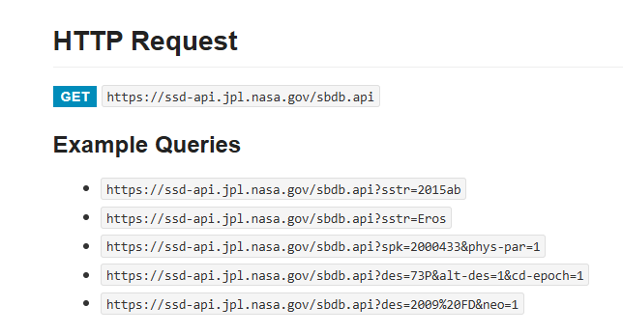
NASA SBDB (Small-Body DataBase) API

