Slide 1

CapStone Project
News Popularity in Multiple Social Media Platforms
DSI 13: wILSON LIM

Slide 2
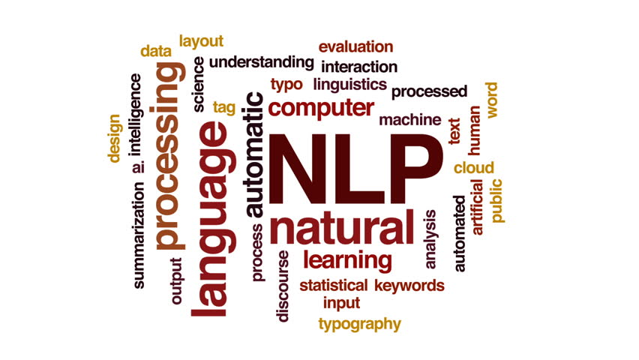
Problem Statement
Analysing news headline using Natural Language Processing (NLP) from various notable publishers and understanding of the underlying sentiment of headlines and predicting its popularity from social media.

Slide 3
01.
Data Description
02.
Data Cleaning/EDA
03.
Modelling
04.
Evaluation
05.
Conclusion

Slide 4
Purpose
1
The model would be useful for marketing strategy by gaining an understanding of readers preference based on article sentiment and keywords and provide insight for writers and editors on the ideal format of their articles.
2
And provide additional assistance in putting the right title into the most effective social media platform so as to get the best readers reception by targeting the correct audience.

Slide 5


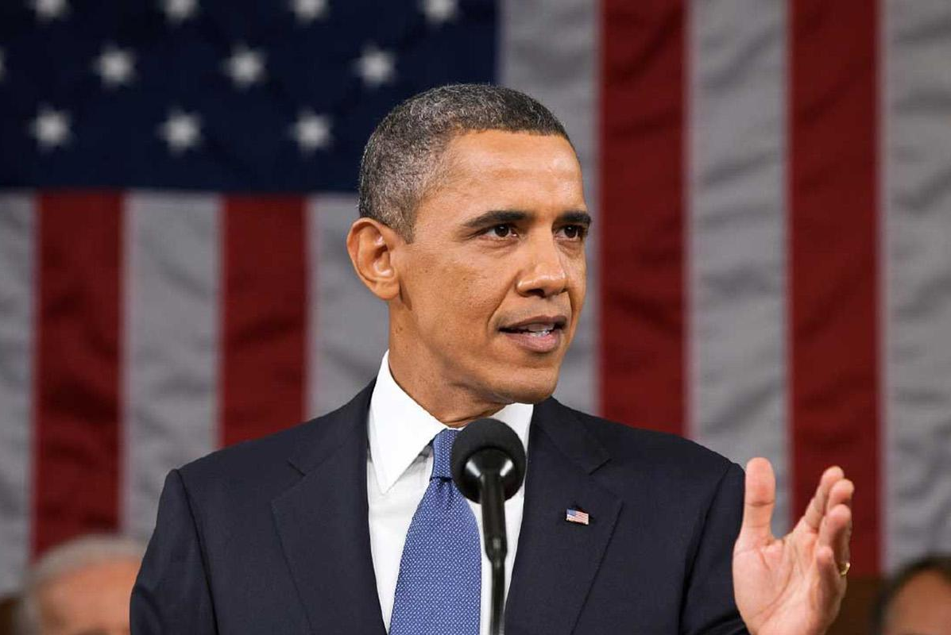

Economy
Global economy news.
Data Description
Microsoft
Consist of all Microsoft new product release such as the new Surface Book and the company annual report.
Data is extracted from UCI Machine Learning Repository and the main features of the data are publisher article Titles and Number of Shares per social media platform collected between 2015 to 2016.
Data consists of four main topics:
Economy
Microsoft
Obama
Palestine
Obama
Political news with regards to Obama and his team.
Palestine
Political turmoil news happening in Palestine.

Slide 6
Data Cleaning
As the data was extracted directly from UCI Machine Learning Repository it is generally clean however, it has to be preprocess before any form of EDA can be done on it.
Stop words removal
Non-alphabetic character removal

Slide 7
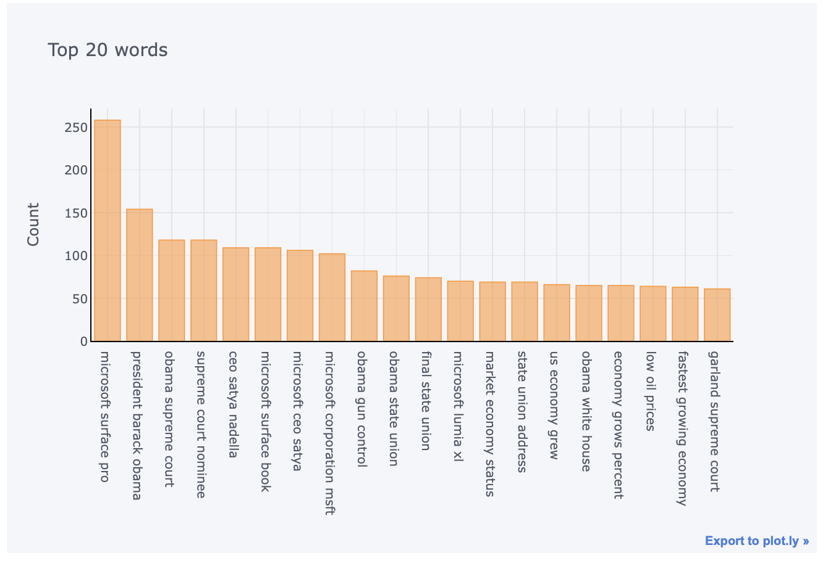
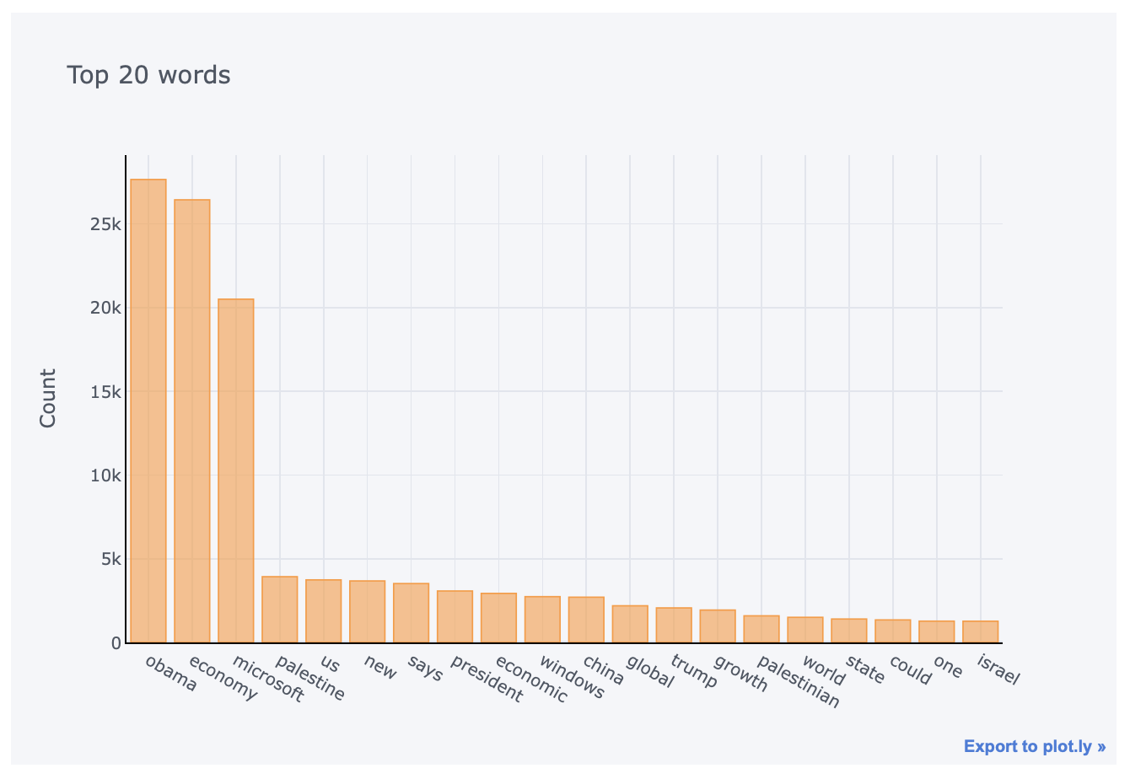
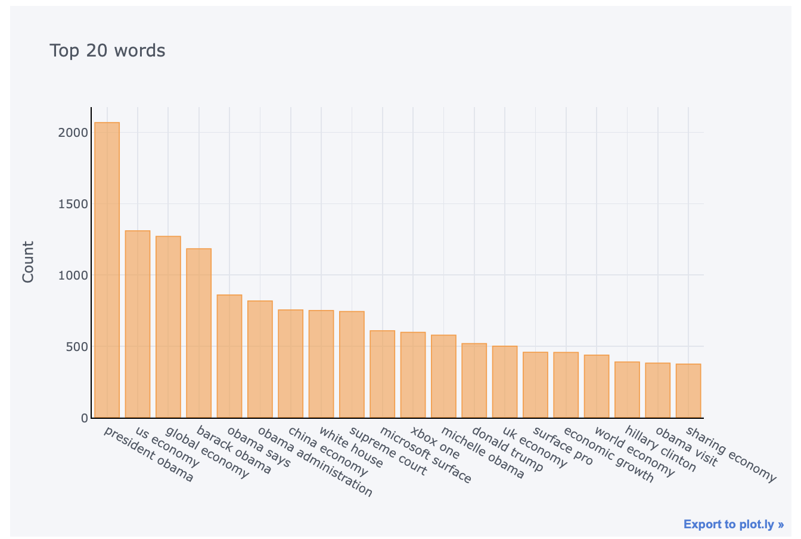
TriGram
EDA
N-Gram
UniGram
BiGram

Slide 8
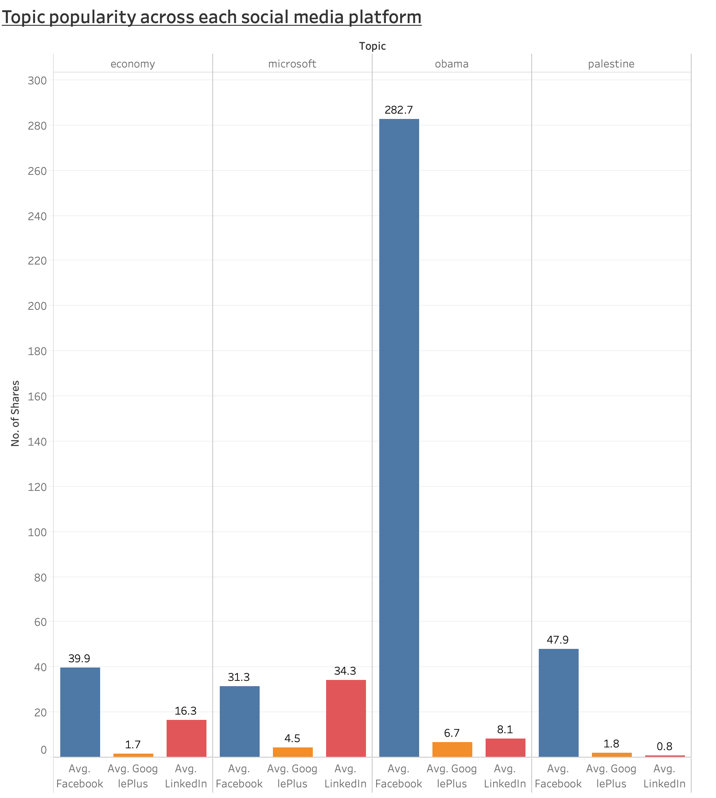
EDA

Slide 9
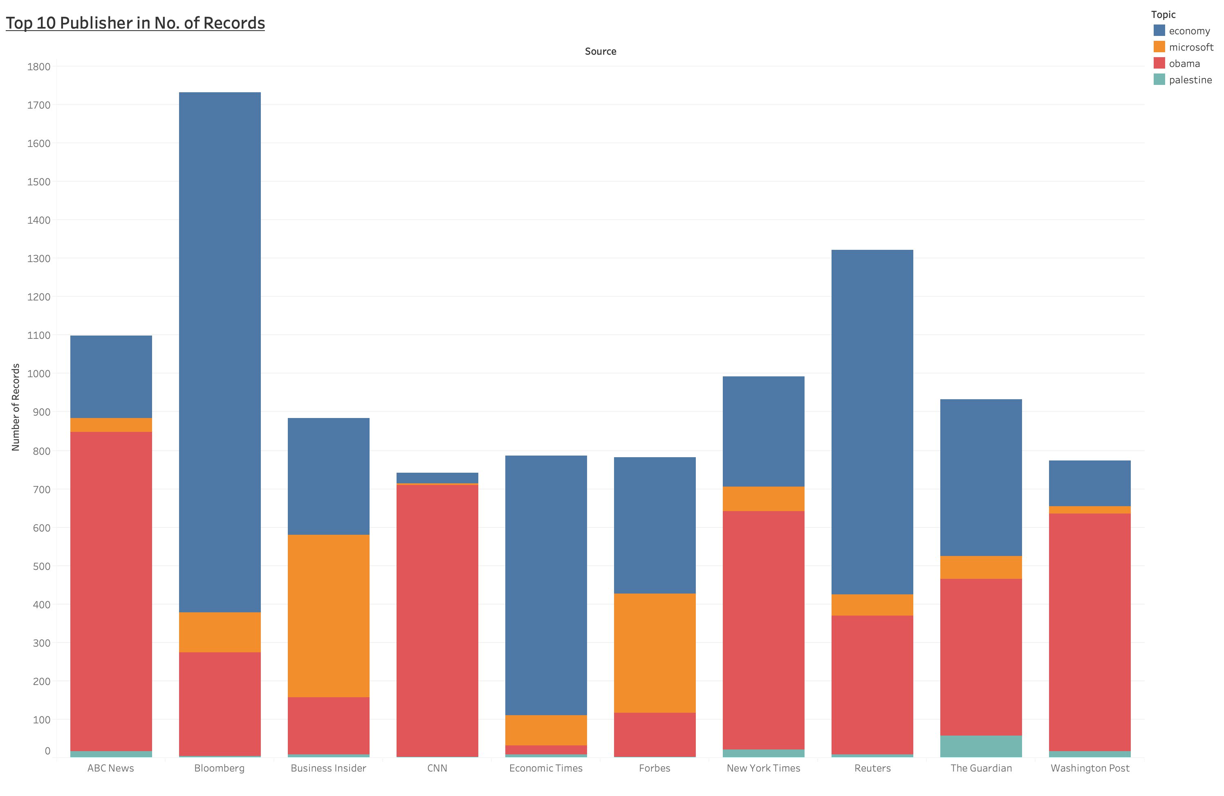
EDA

Slide 10
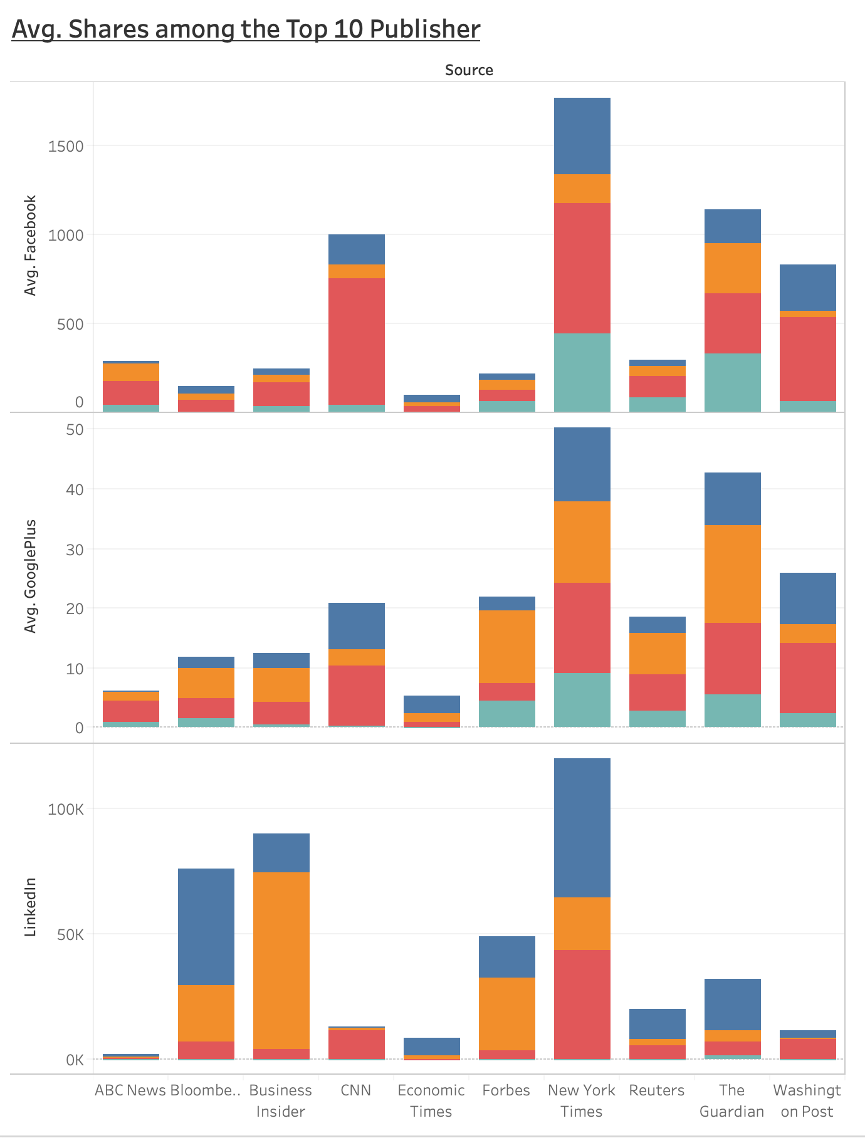
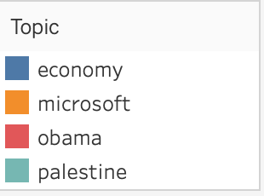
EDA

Slide 11
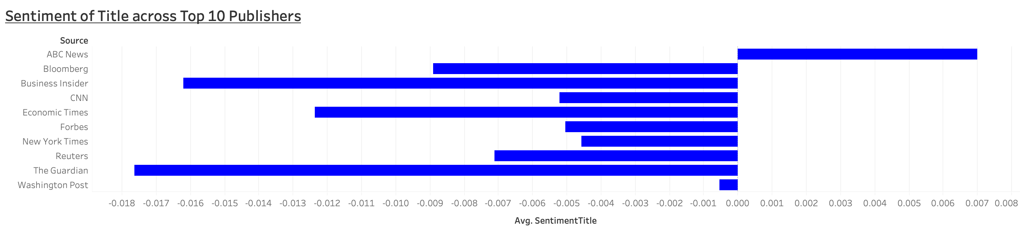
EDA

Slide 12
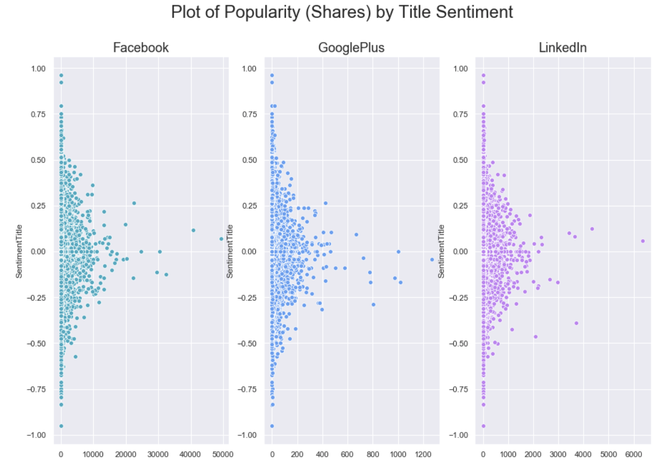
EDA

Slide 13
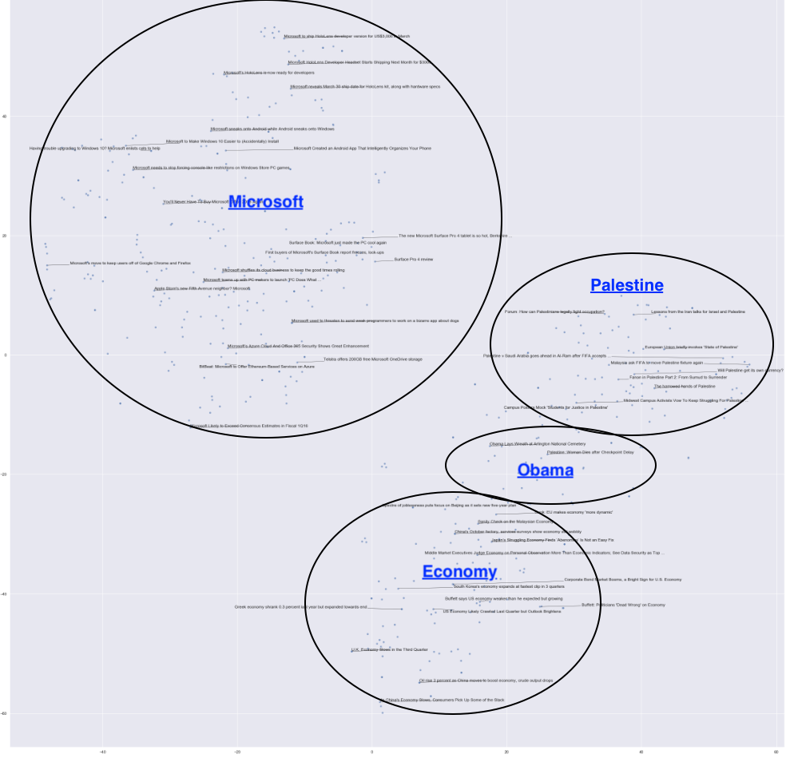
EDA
T-SNE

Slide 14
Model
Word2Vec
TFIDF
XGBClassifier
MultinomialNB
Basemodel
GridSearch
Basemodel
GridSearch
1
1
2
2
RandomForest
KNN
Basemodel
GridSearch
Basemodel
GridSearch
KNN
SVM
Basemodel
GridSearch
mACHINE LEARNING
MODEL
Basemodel
GridSearch
3
3
4
SVM
Basemodel
GridSearch

Slide 15
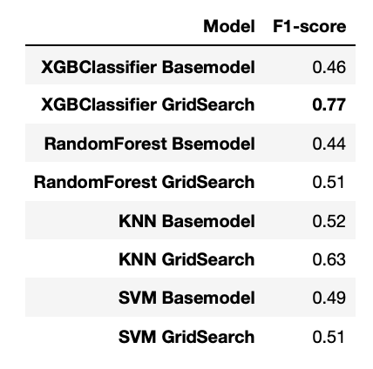
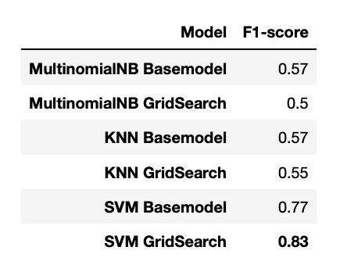
Evaluation Results
Best performing
Word2Vec
TFIDF

Slide 16
Conclusion
The final model selected would be SVM GridSearch (TFIDF) as it has the best F1-score and lowest Type-error in the confusion matrix.
The better accuracy result might be due to the weightage that was applied into the model that helps to classify the importance of words within the text body.
While Word2Vec due to the limitation of hardware many data had to be removed to run the model. Thus, affecting the overall accuracy of the model due to lost of information.

