Slide 2
21 | 1 | 2 | 3 | 4 | 5 | 6 | 7 | 8 | 9 | 10 | 11 | 12 | 13 | 14 | 15 | 16 | 17 | 18 | 19 | 20
1 | 2 | 3 | 4 | 5 | 6 | 7 | 8 | 9 | 10 | 11 | 12 | 13 | 14 | 15 | 16 | 17 | 18 | 19 | 20 | 21
Creditability | Account Balance | Duration of Credit (month) | Payment Status of Previous Credit | Purpose | Credit Amount | Value Savings/Stocks | Length of current employment | Instalment per cent | Sex & Marital Status | Guarantors | Duration in Current address | Most valuable available asset | Age (years) | Concurrent Credits | Type of apartment | No of Credits at this Bank | Occupation | No of dependents | Telephone | Foreign Worker
B | Q | N | Q | Q | N | Q | Q | N | Q | Q | N | Q | N | Q | Q | N | Q | N | B | B
B | N | I | N | N | I | N | N | I | N | N | I | N | I | N | N | I | N | I | B | B
interval=c(2,5,8,11,13,16,18), nominal=c(1,3,4,6,7,9,10,12,14,15,17),binary=c(19,20)
Dataset Attribute Types
B: BINARY | Q: QUANTITATIVE | N: NUMERIC

Slide 3
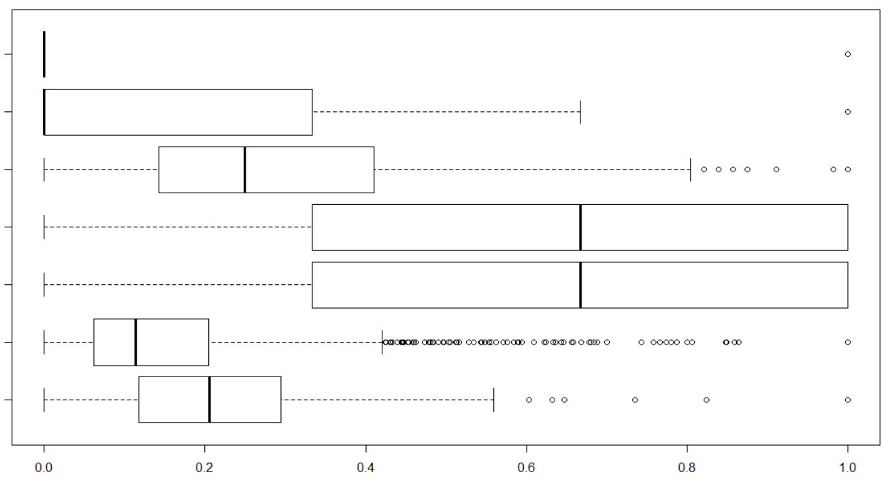
No of dependents
No of Credits at this Bank
Age (years)
Duration in Current address
Instalment percent
Credit Amount
Duration of Credit (month)

Slide 4
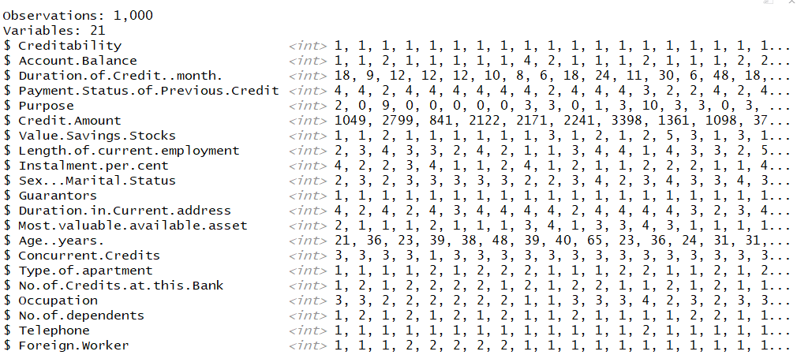

Slide 5
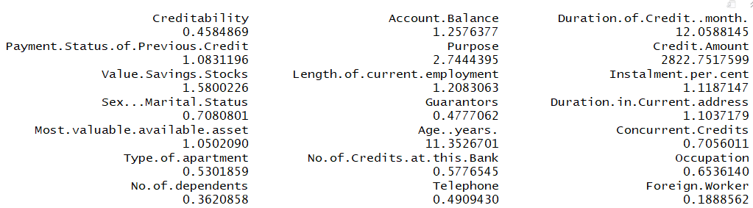
Standard deviations

Slide 6
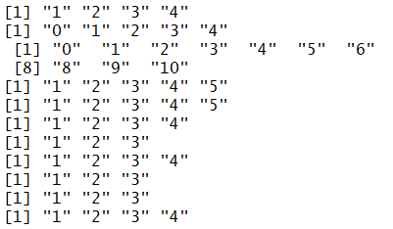
To identify the outliers of the quantitative attributes one can identify the values that do not fall under the allowed values. For example the attribute “Account Balance” can only take the values “1”, “2”, “3”, “4”. If there is any observation that has data other than these allowed values, it is removed.
Account Balance
Payment Status of Previous Credit
Purpose
Value Savings/Stocks
Length of current employment
Sex & Marital Status
Guarantors
Most valuable available asset
Concurrent Credits
Type of apartment
Occupation

Slide 7
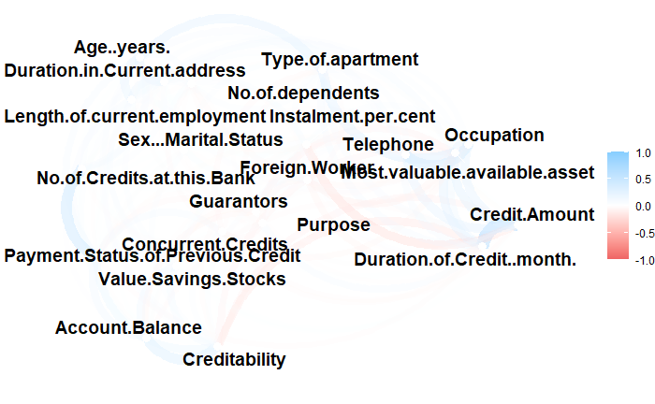

Slide 8
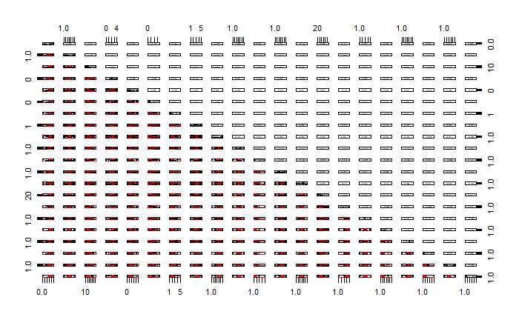

Slide 9
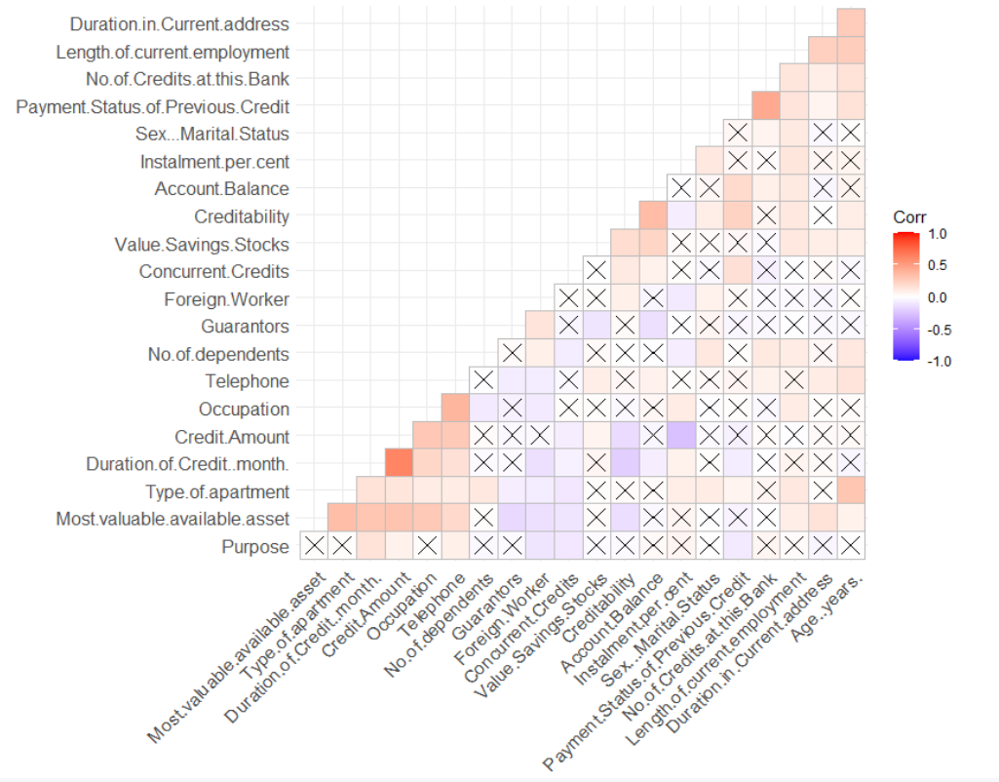

Slide 10
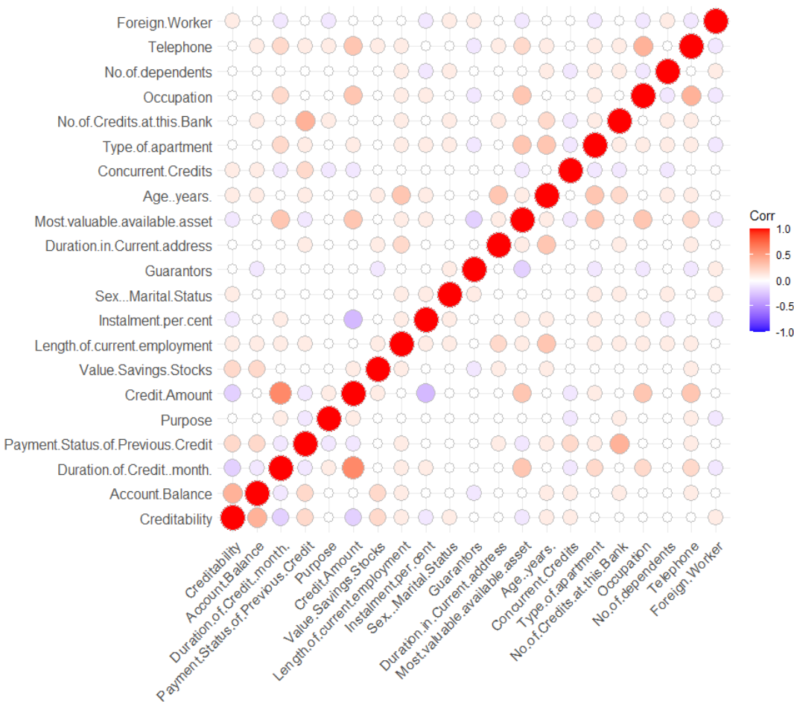

Slide 11
3 Duration of Credit (month) | 3 Duration of Credit (month)
5 Purpose | 11 Guarantors
13 Most valuable available asset | 9 Instalment per cent
11 Guarantors | 13 Most valuable available asset
16 Type of apartment | 1 Creditability
18 Occupation | 19 No of dependents
9 Instalment per cent | 20 Telephone
1 Creditability | 5 Purpose
10 Sex & Marital Status | 18 Occupation
 | 10 Sex & Marital Status

Slide 12
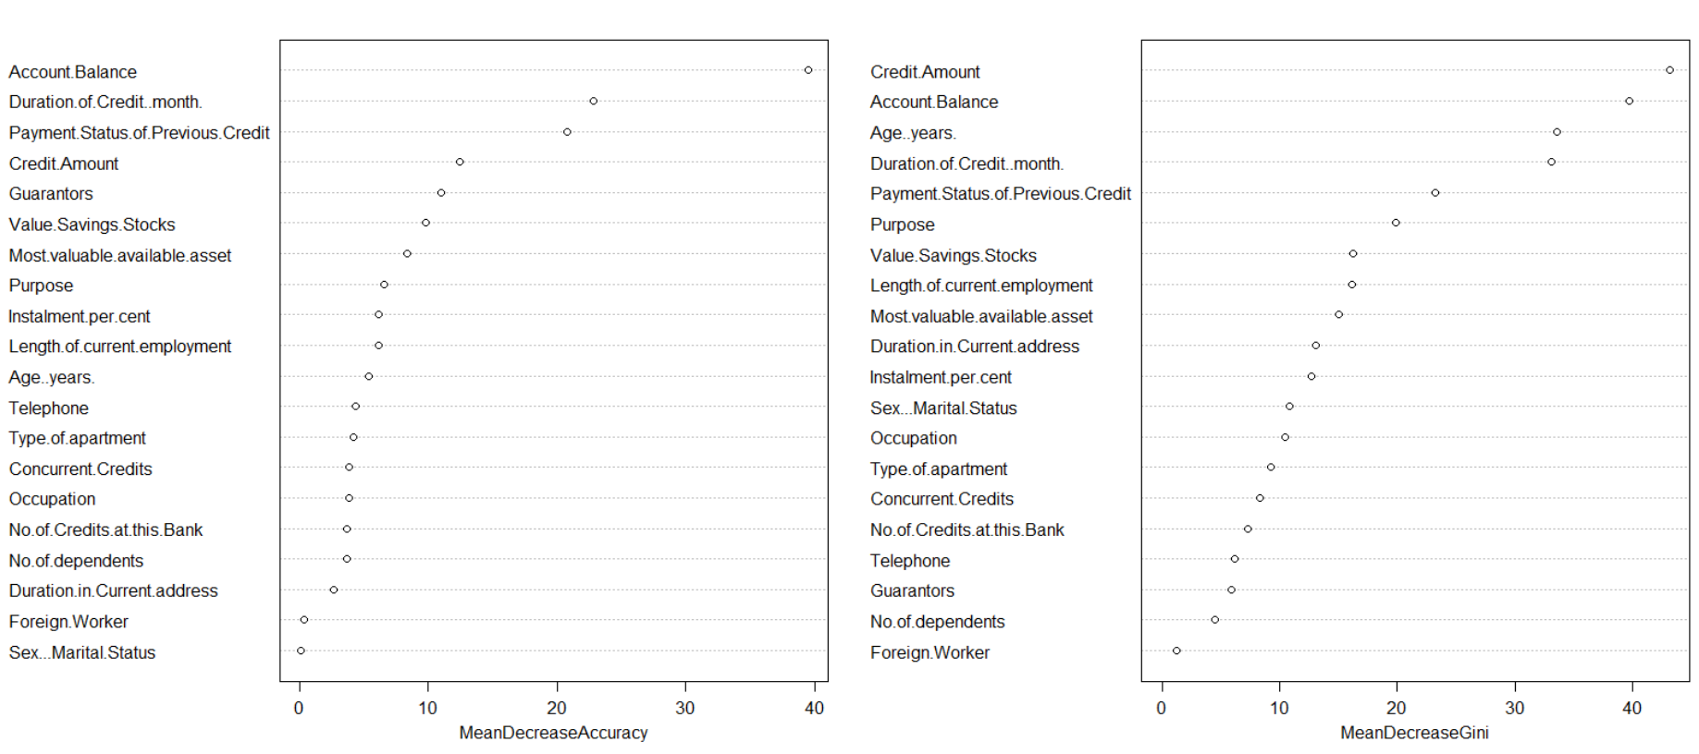
Random Forest Feature Selection

Slide 13
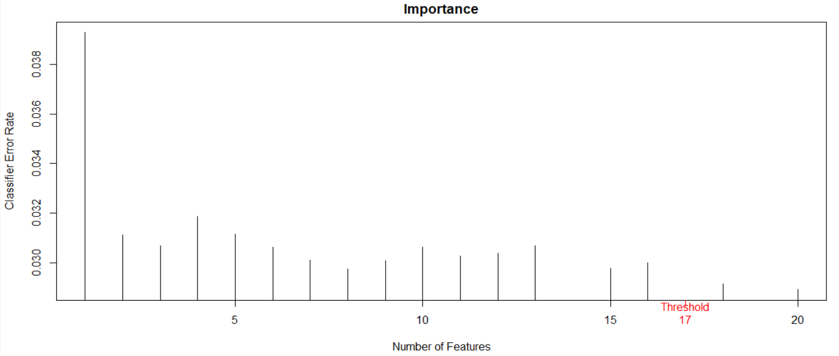

Slide 14
Account.Balance
Duration.of.Credit..month.
Payment.Status.of.Previous.Credit
Credit.Amount
Guarantors
Value.Savings.Stocks
Most.valuable.available.asset
Purpose
Instalment.per.cent
Length.of.current.employment
Age..years.
Telephone
Type.of.apartment
Concurrent.Credits
Occupation
No.of.Credits.at.this.Bank
No.of.dependents

Slide 15
