Slide 1
Phase 1 Complete
• Official Elections Alberta shapefiles received; analysis complete
• 50,000 neutral maps generated, all 3 pre-registered test channels executed
• 4 OSF pre-registrations filed; Fisher combined result in hand
A computational comparison of two proposed 2026 maps against a distribution of 50,000 maps drawn by purely population-constrained random redistricting.

Slide 2
One Question
Does the minority map fall within the distribution of maps a neutral, unbiased redistricting process would produce?
(The majority map and the minority map start from the same legal constraints. The question is whether their outcomes are statistically interchangeable.)

Slide 3
50,000 Neutral Maps
• ReCom algorithm (MGGG/Tufts) — random redistricting, no partisan knowledge
• 4,765 VA polygons (Elections Alberta official geometry)
• ±25% population constraint — same rule the commission used
• Scored on 4 metrics: Efficiency Gap, Mean-Median, Declination, Seats@50/50
• Pre-registered before shapefiles arrived; thresholds locked to drand beacon
Pre-registration = the goalposts cannot move after seeing the data

Slide 4
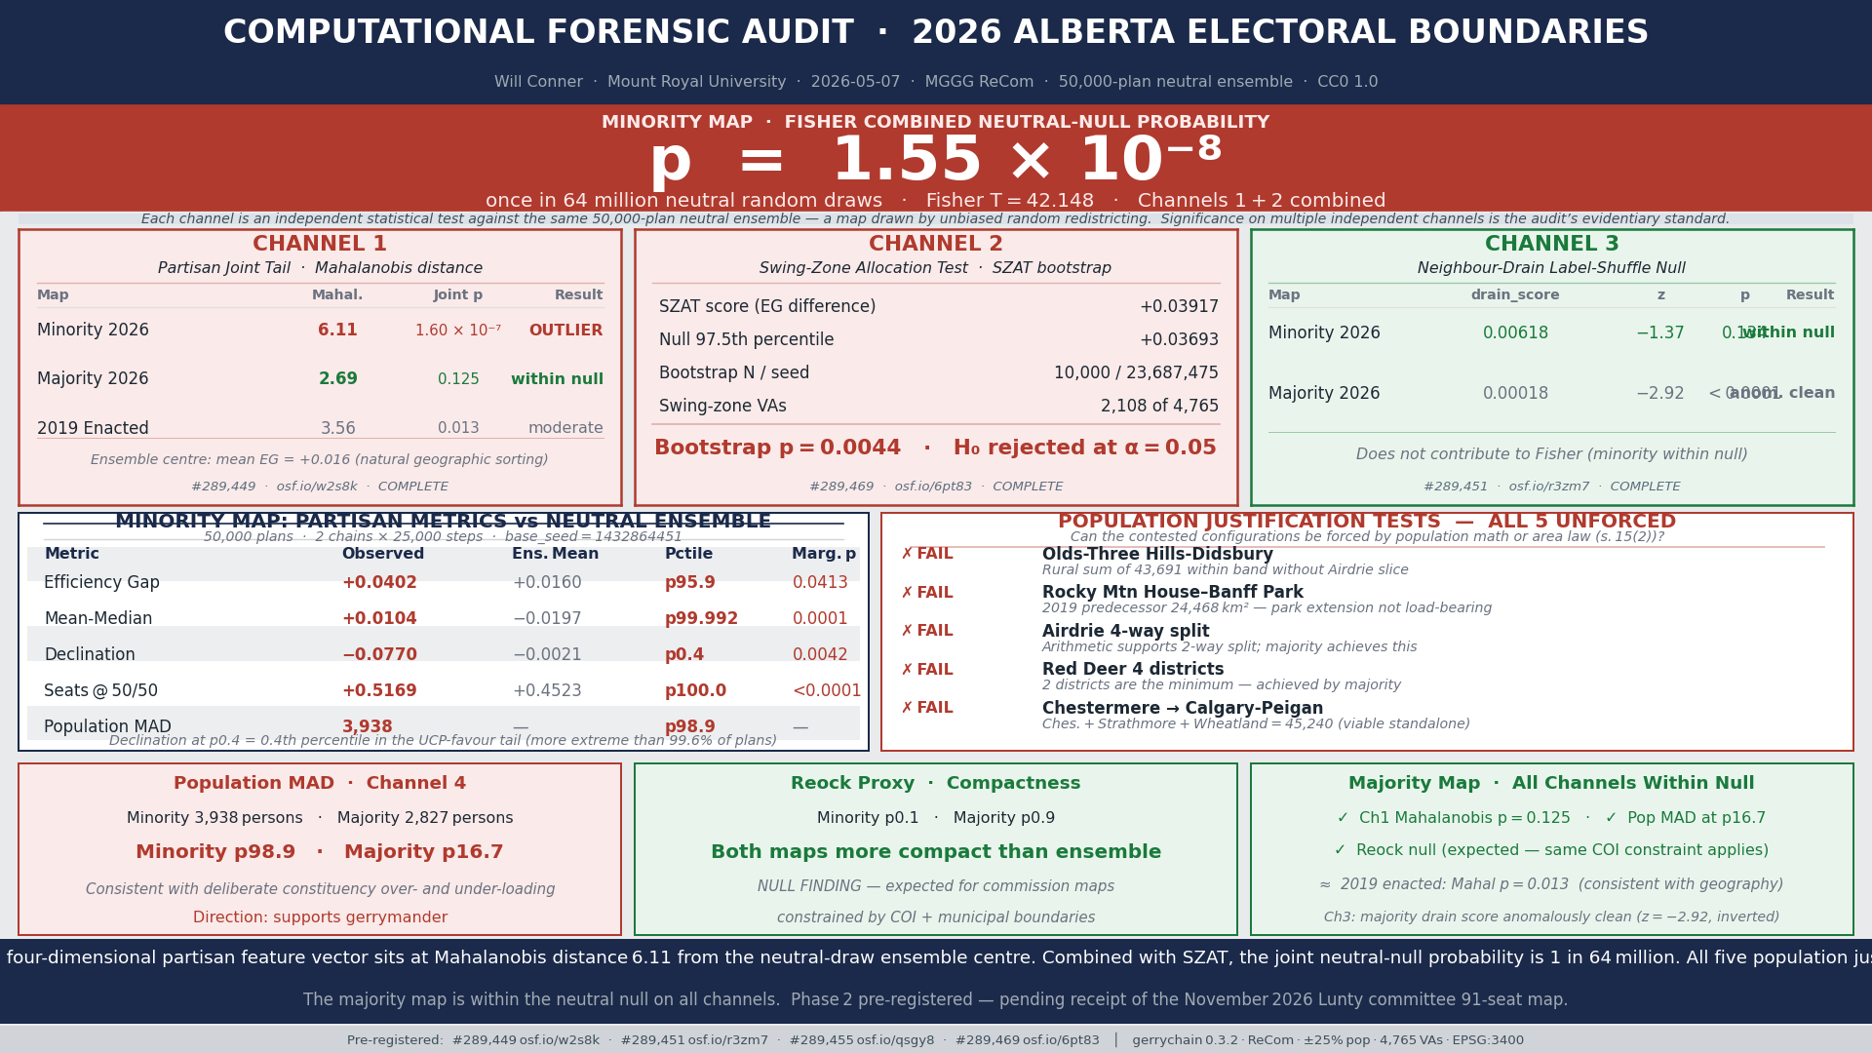
Channel 1: Joint Partisan Tail
Minority 2026: Mahalanobis = 6.11 | p = 1.60 × 10⁻⁷ | Outside null
Majority 2026: Mahalanobis = 2.69 | p = 0.125 | Within null
2019 Enacted: Mahalanobis = 3.56 | p = 0.013 | Modest lean
Ensemble centre is already +1.6 pp UCP-leaning due to Alberta's geography. The minority map is an outlier beyond that natural baseline.
(n_eff-adjusted via Hotelling T²: p = 7.9 × 10⁻⁷ — survives ESS correction)
p = 1.60 × 10⁻⁷

Slide 5
Channel 2 + Fisher Combined
• SZAT: 2,108 of 4,765 VAs assigned differently between the two maps
• Bootstrap null (10,000 reshuffles): p = 0.0044
• Fisher combined (Channels 1 + 2): p = 1.55 × 10⁻⁸
1 in 64 million
Fisher combined was the pre-registered primary outcome — not post-hoc
Directional context: Minority map population variance: 98.9th percentile of ensemble

Slide 6
Channel 3: Neighbour-Drain — Null Result
• Tests pack-crack coupling mechanism (not outcome)
• Minority map: within null (p = 0.134)
• Majority map: anomalously clean (p < 0.0001, inverted)
• Pre-registered predictions A and B not confirmed
The mechanism is not confirmed. The outcome findings (Ch1, Ch2) stand independently. All three channels are disclosed.

Slide 7
Five Justification Tests — All Fail
Could the minority map's configurations be explained by population math or area law?
1. Olds–Three Hills–Didsbury
2. Rocky Mountain House–Banff extension
3. Airdrie 4-way split
4. Red Deer 4 districts
5. Chestermere into Calgary-Peigan
The math does not force these choices. Cleaner alternatives exist in every case, and the majority map found them.

Slide 8
What This Does and Does Not Say
DOES SAY:
• The minority map sits at an extreme statistical position relative to neutral redistricting
• Two independent pre-registered tests reject the null
• Five contested configurations have simpler neutral alternatives
DOES NOT SAY:
• Who drew the map with what intent
• Whether this constitutes a gerrymander in law
• Anything about individual MLAs or cabinet ministers
This is a statistical instrument. Legal and political conclusions belong to others.

Slide 9
Phase 2: Pre-Registered and Waiting
• Lunty committee (91-seat map, tabling late 2026) already pre-registered
• AsPredicted #289,455 / OSF osf.io/qsgy8
• 17-point signature scorecard locked to April 27 drand beacon
• Within 72 hours of tabling: automatic evaluation
• The criteria exist before the map exists
• Total chain: 4 pre-registrations, all public since May 7, 2026

Slide 10
The Ask
1. Academic review of methodology before SSRN submission
2. Brief commentary or framing note for the public report
3. Referral into CPSA or Canadian electoral studies community
The Phase 1 analysis is done. The Phase 2 trigger is pre-registered. I'm not going to the press until I've had academic review.

