Slide 1
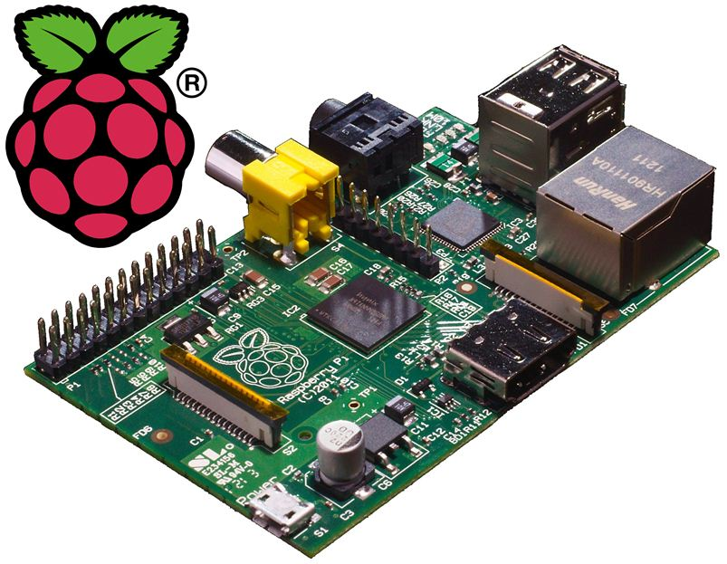
House
Garage
Sensors
Power Line

