Slide 1


Slide 2

THE PYTHON PROJECT PRESENTATION IN POWERPOINT
Istanbul Traffic Accidents Analysis
Section One
Fall 2025-2026
Presentator : Iyad Kabel
GROUP MEMBERS 8 (APWP): Iyad Kabel, Yousef Raiyan, Amro Jamal, Christ Barhith, Muzammal Yaquib

Slide 3
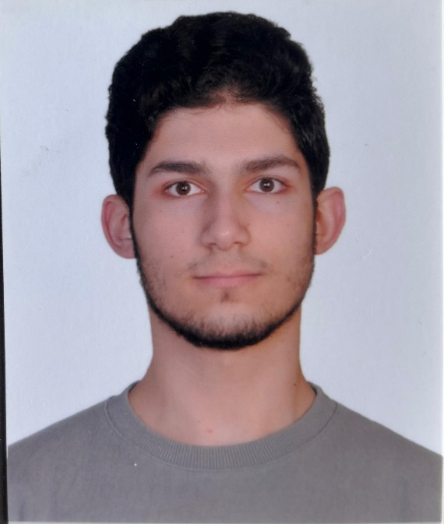
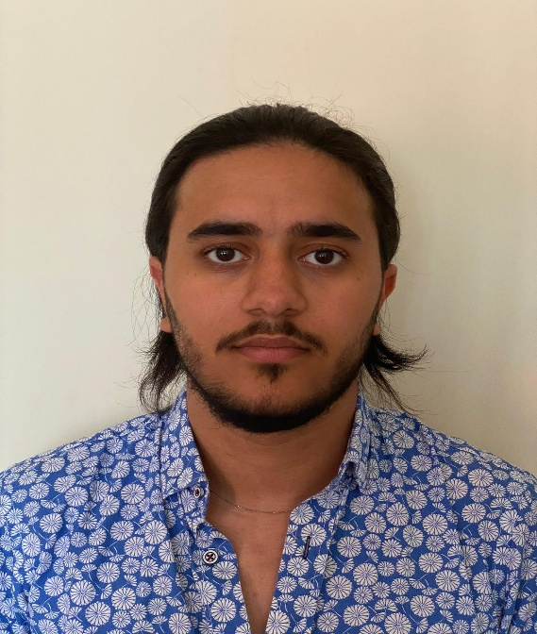
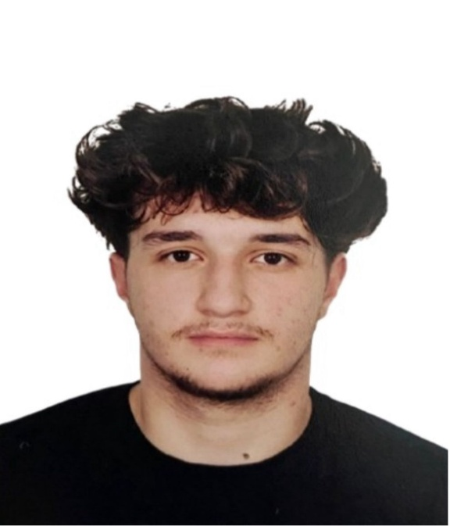
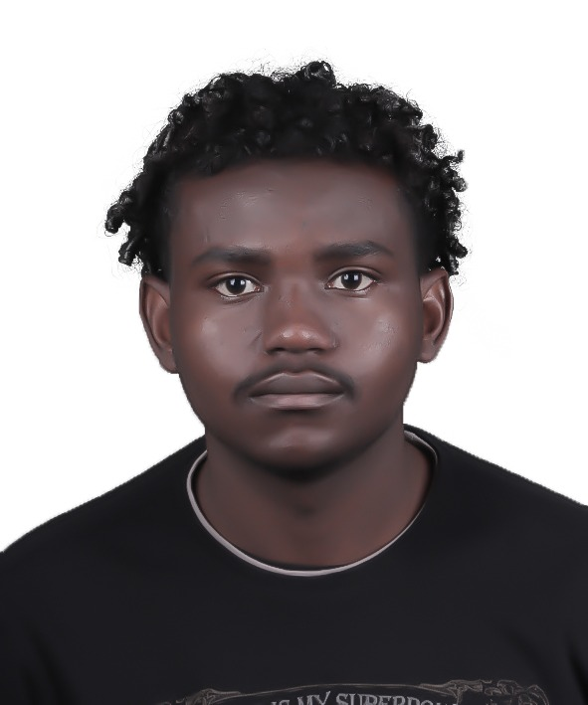
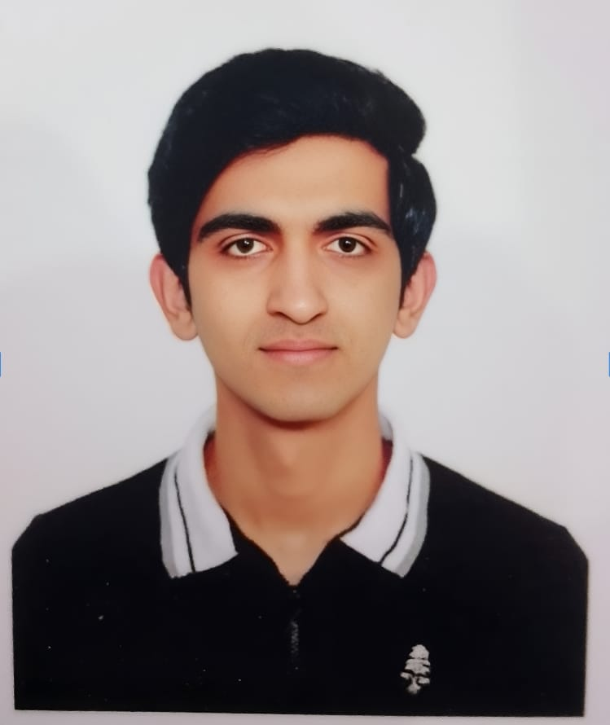
Names and Images of the team members
Iyad Kabel
Yousef Raiyan
Amro Jamal
Barhith
Muzammal Yaquib

Slide 4
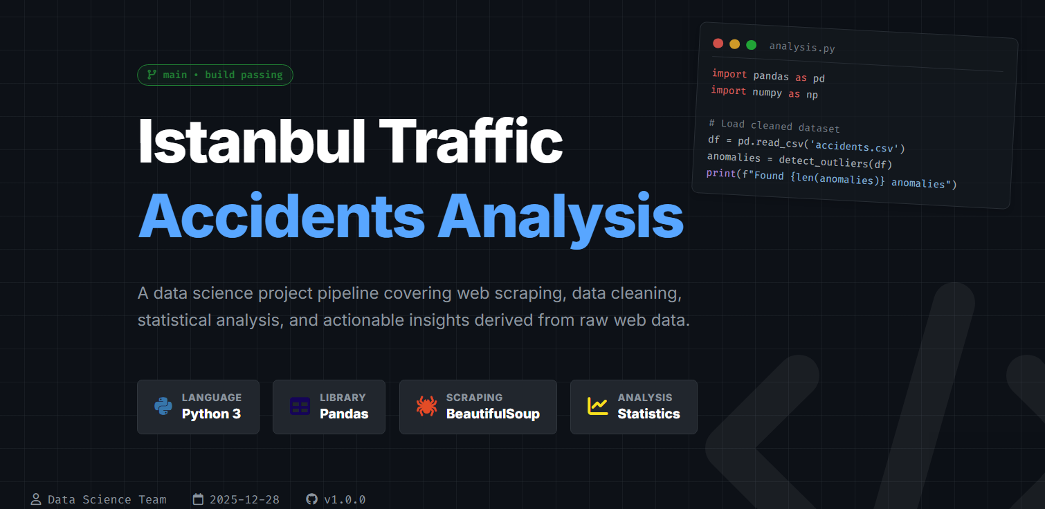

Slide 5
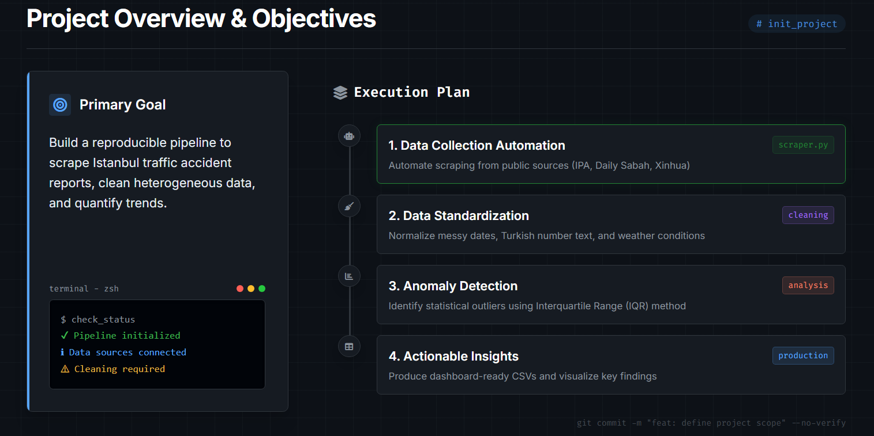

Slide 6
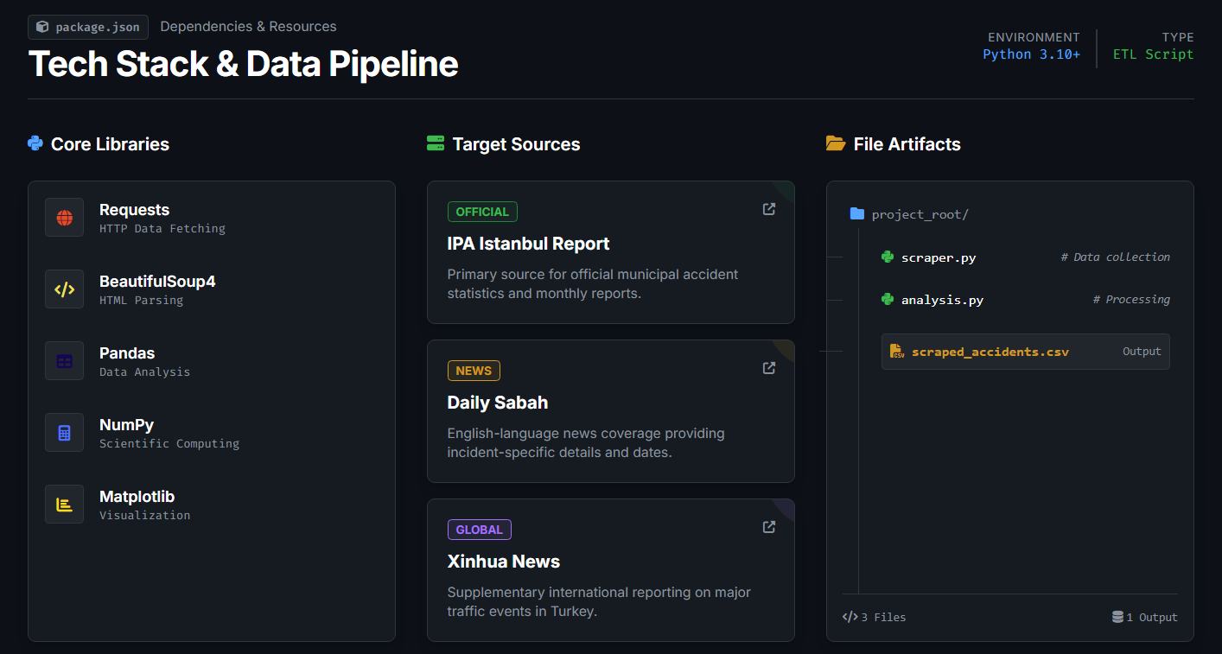

Slide 7
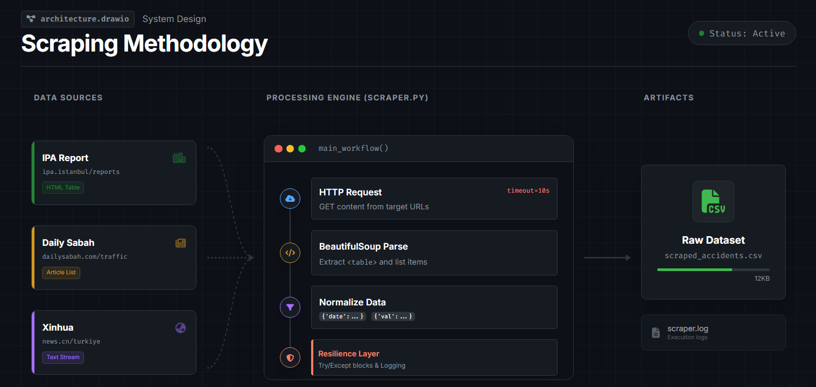

Slide 8
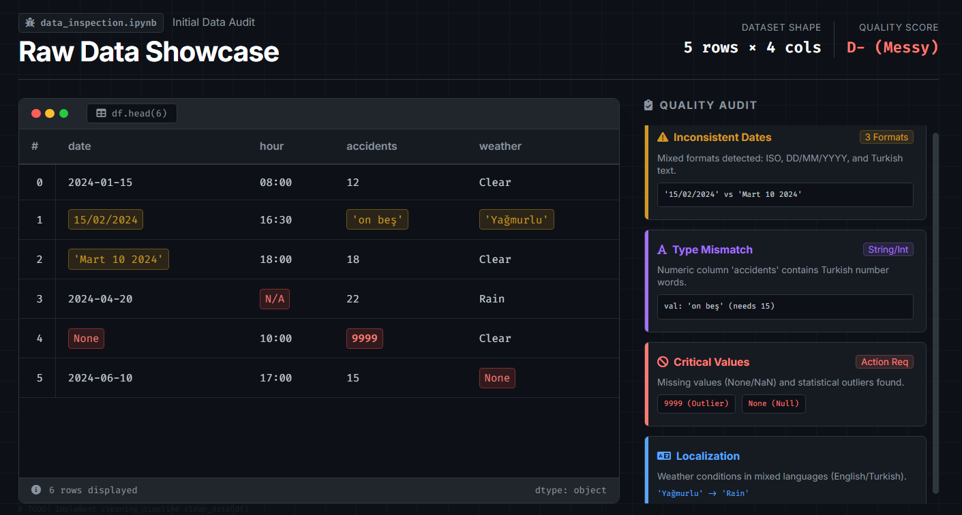

Slide 9
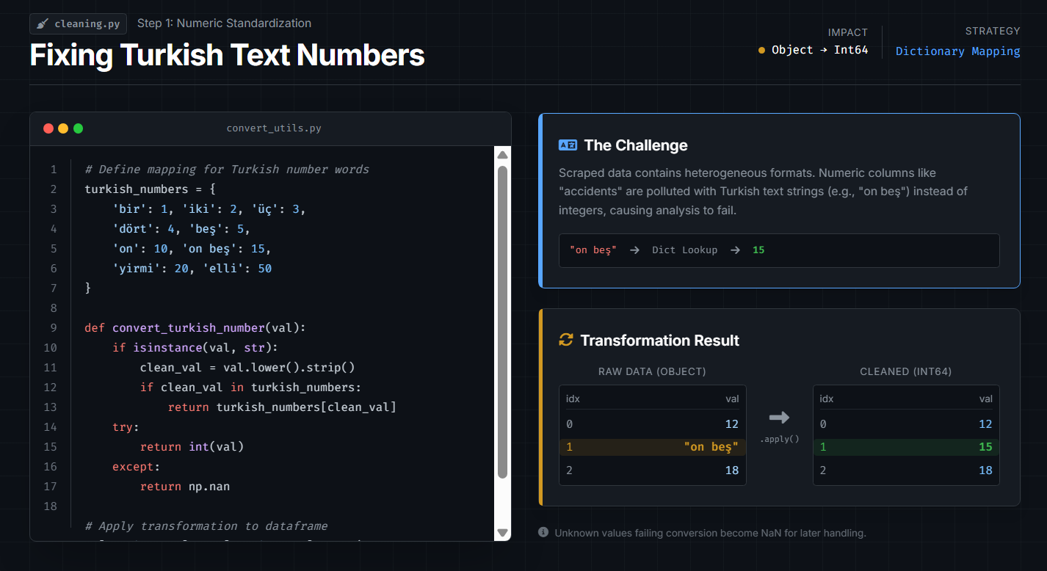

Slide 10
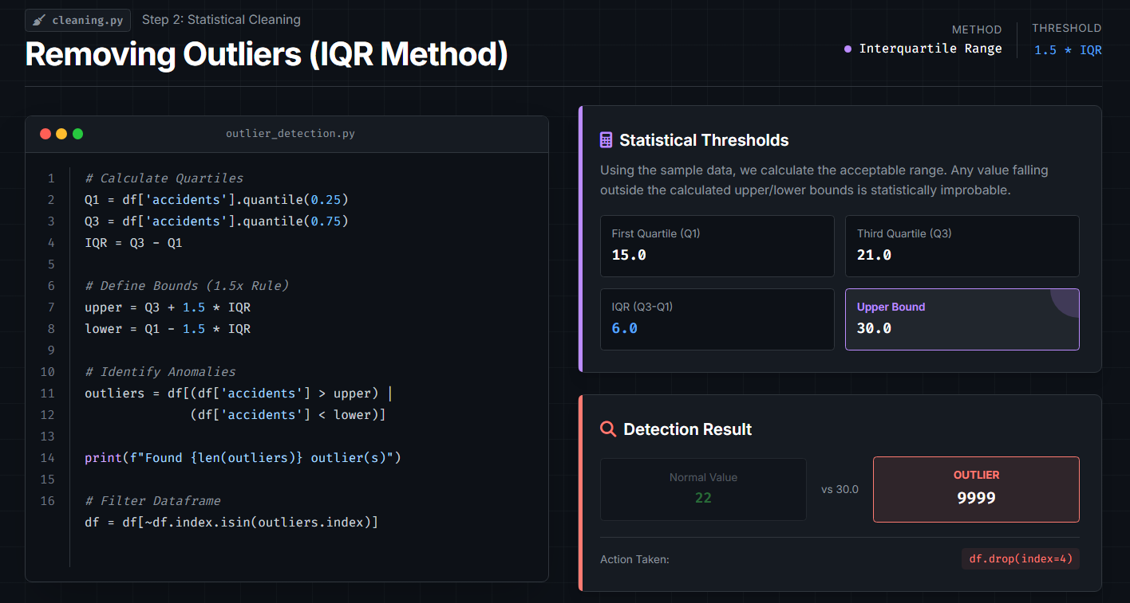

Slide 11
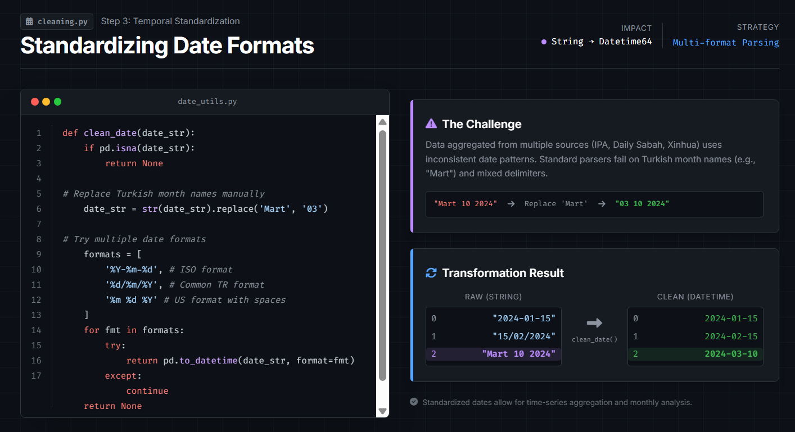

Slide 12
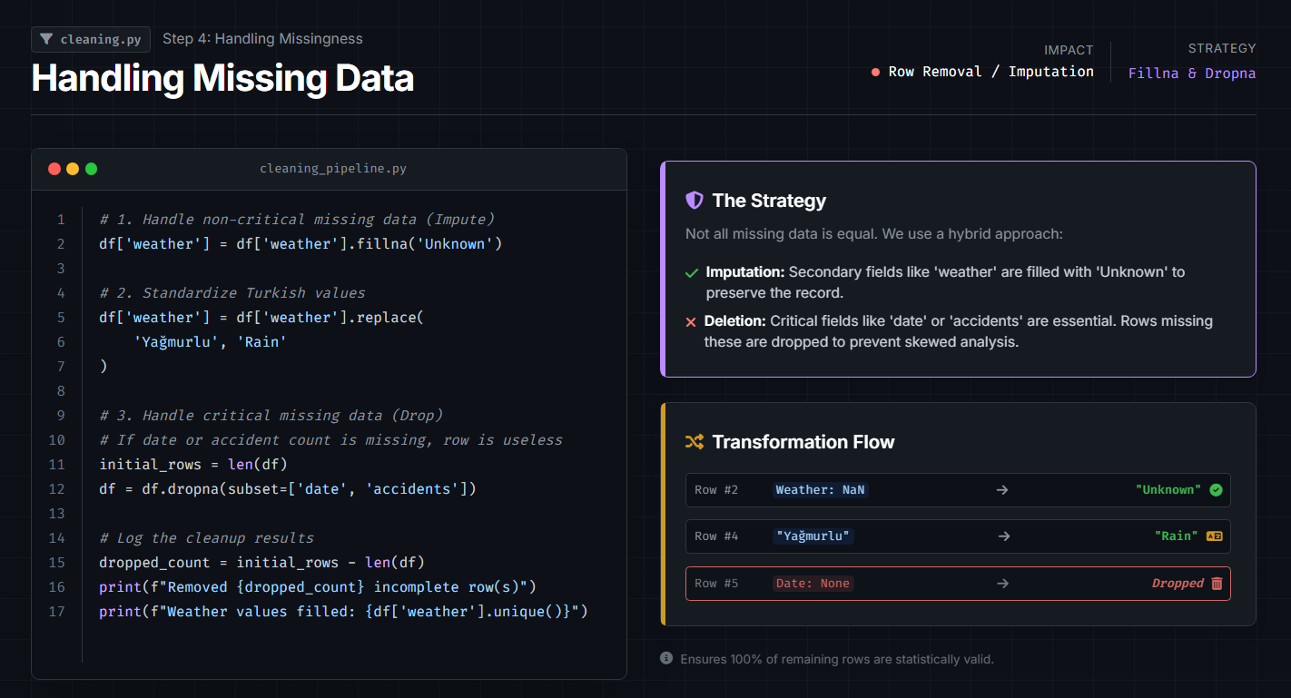

Slide 13
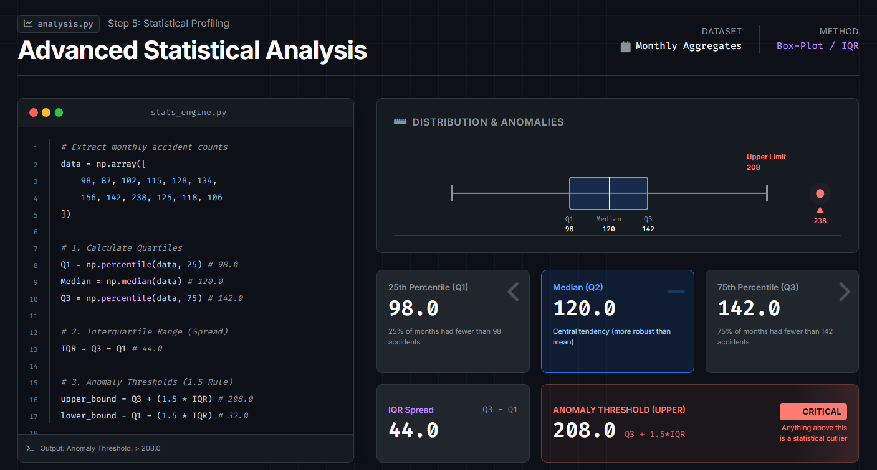

Slide 14
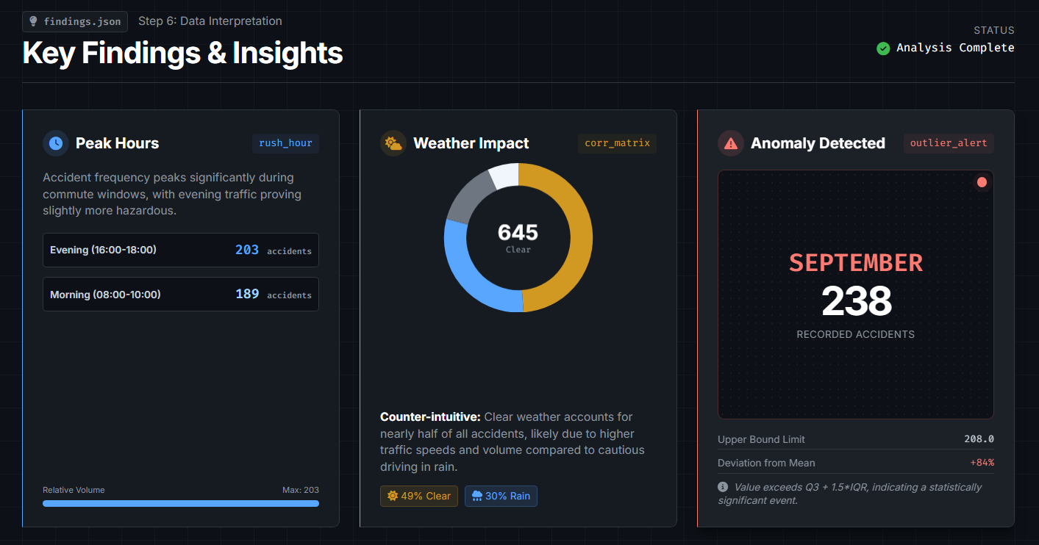

Slide 15
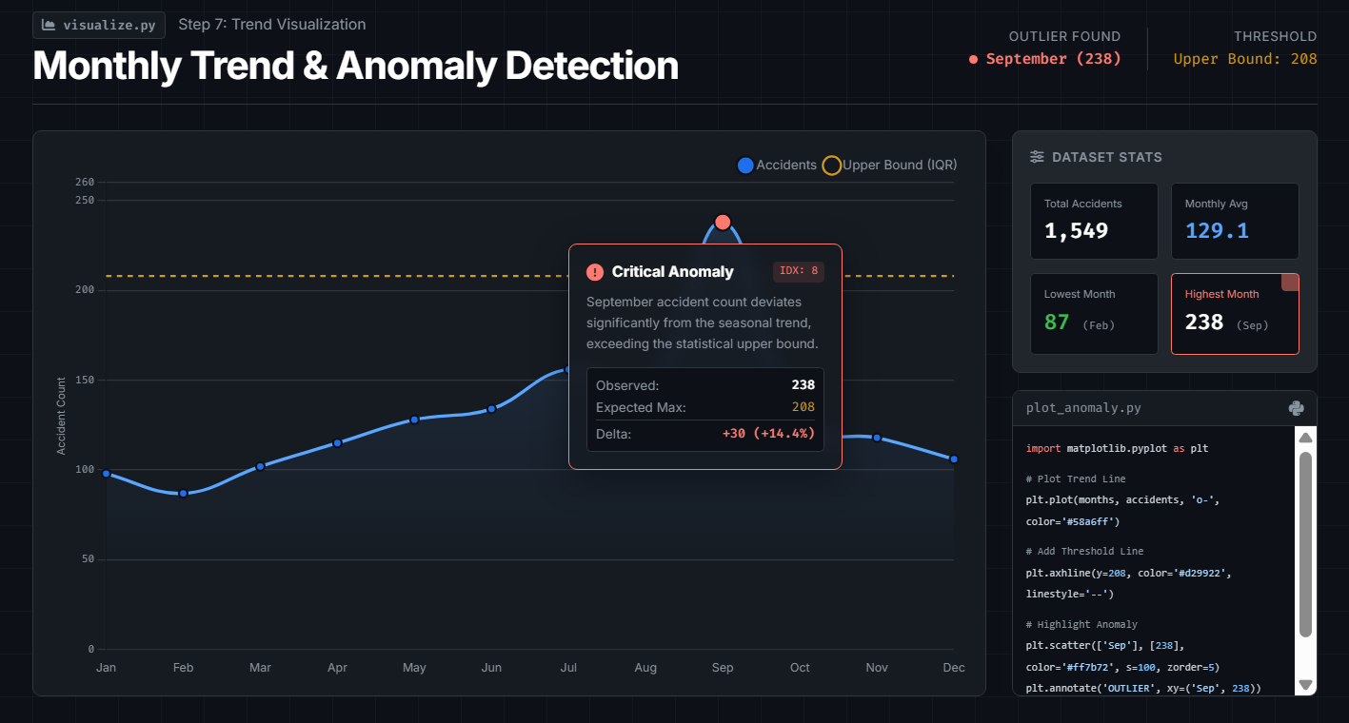

Slide 16
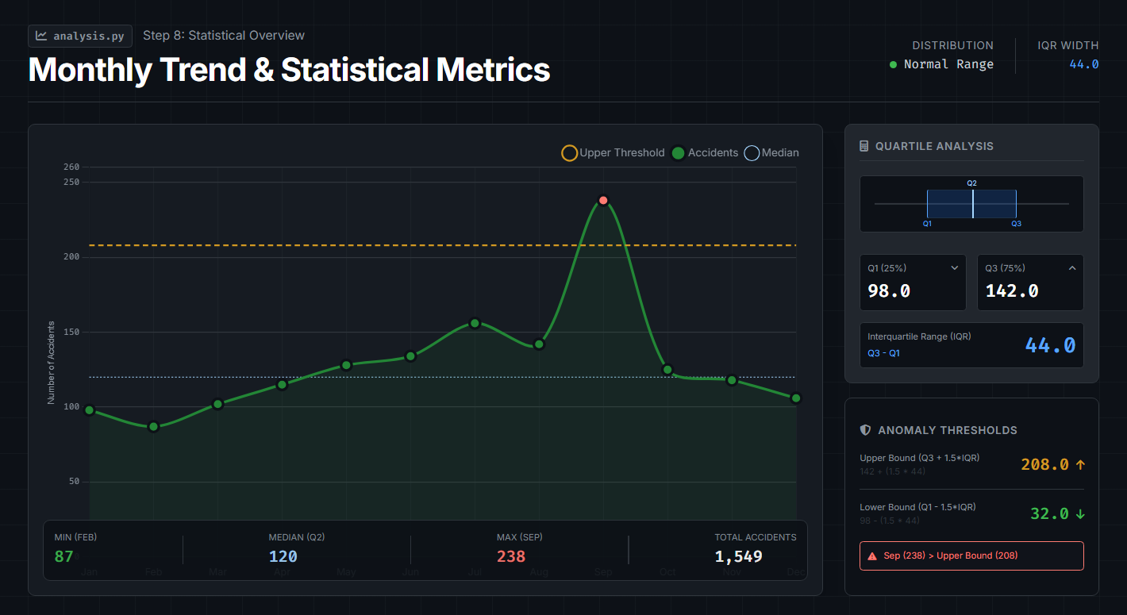

Slide 17
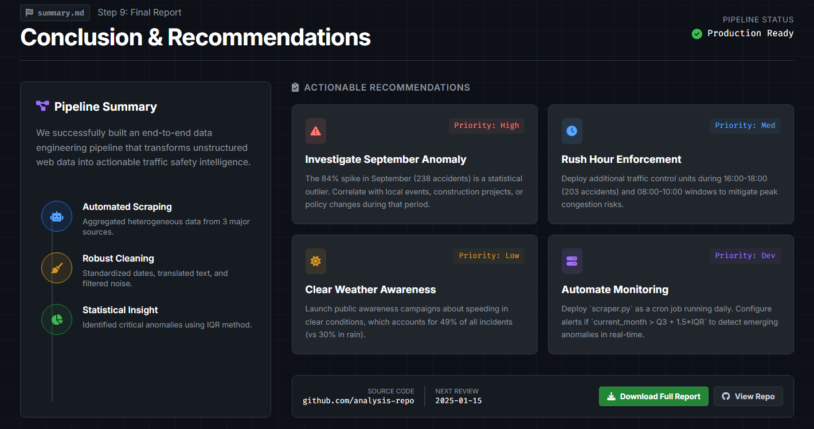

Slide 18
THANK YOU

