Slide 1

Nord-Cloud Interview

Slide 2









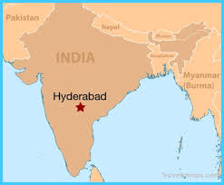

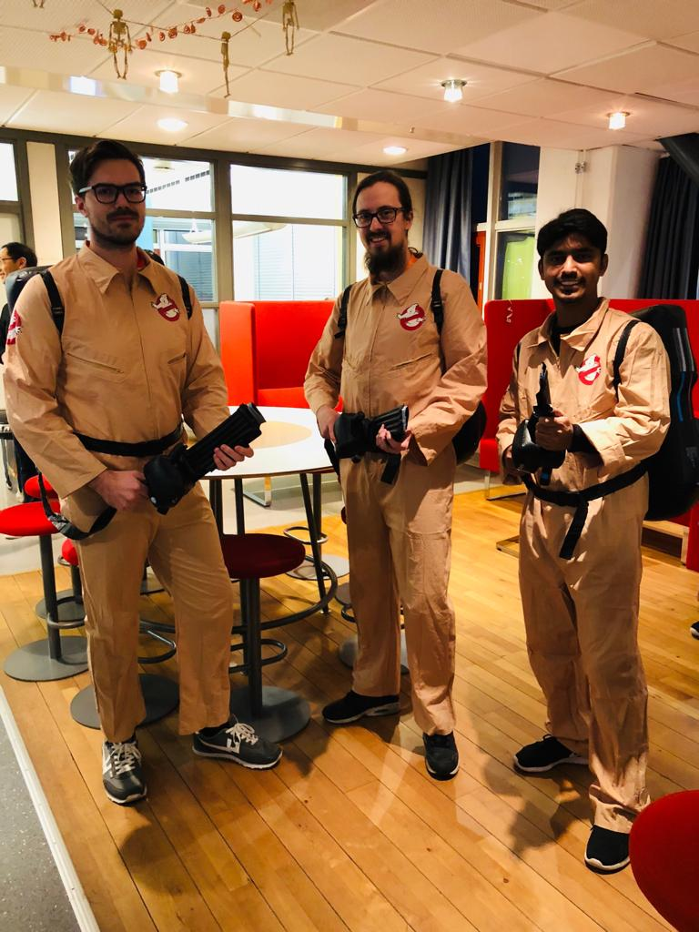
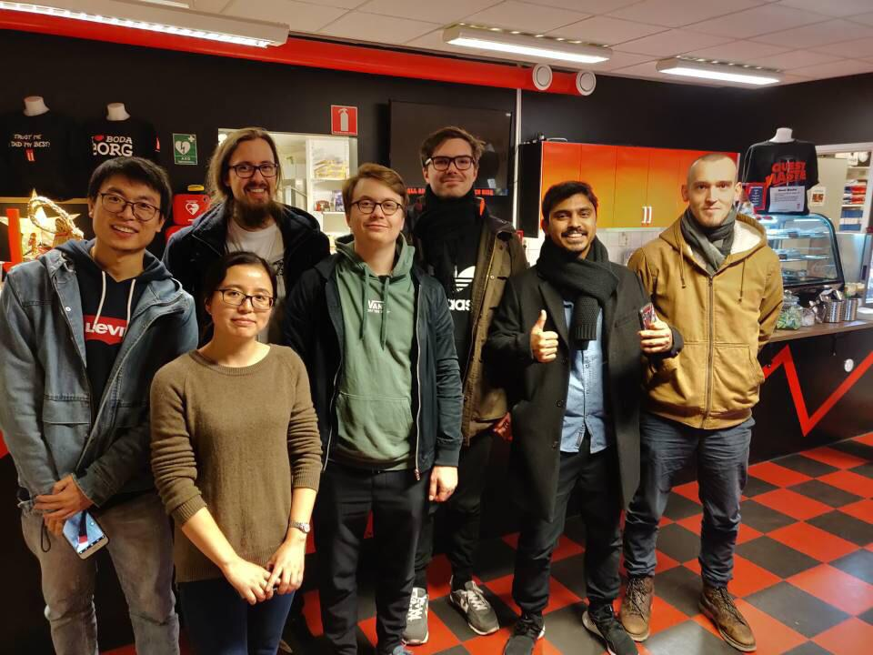
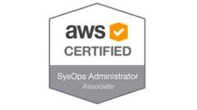

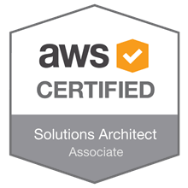
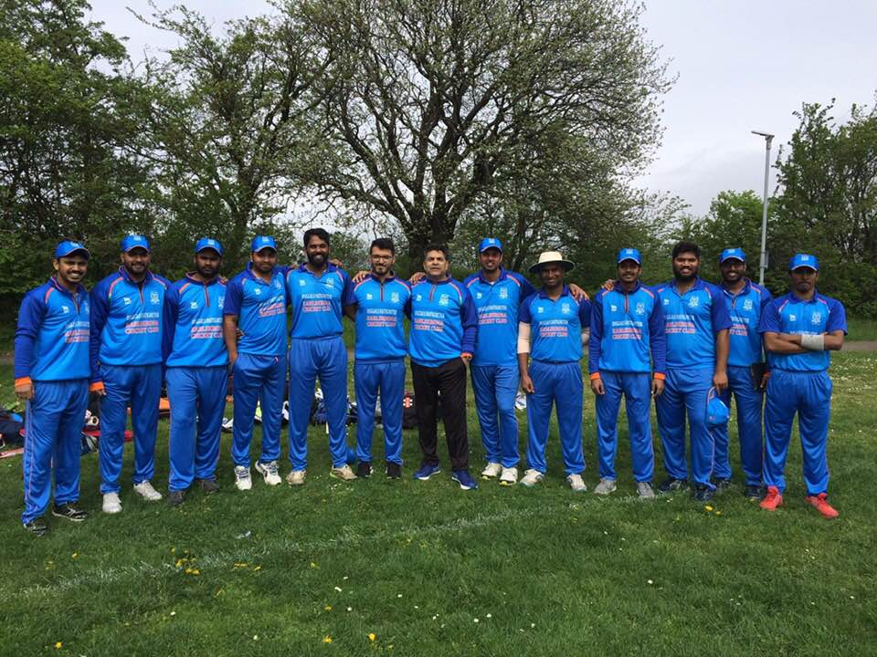
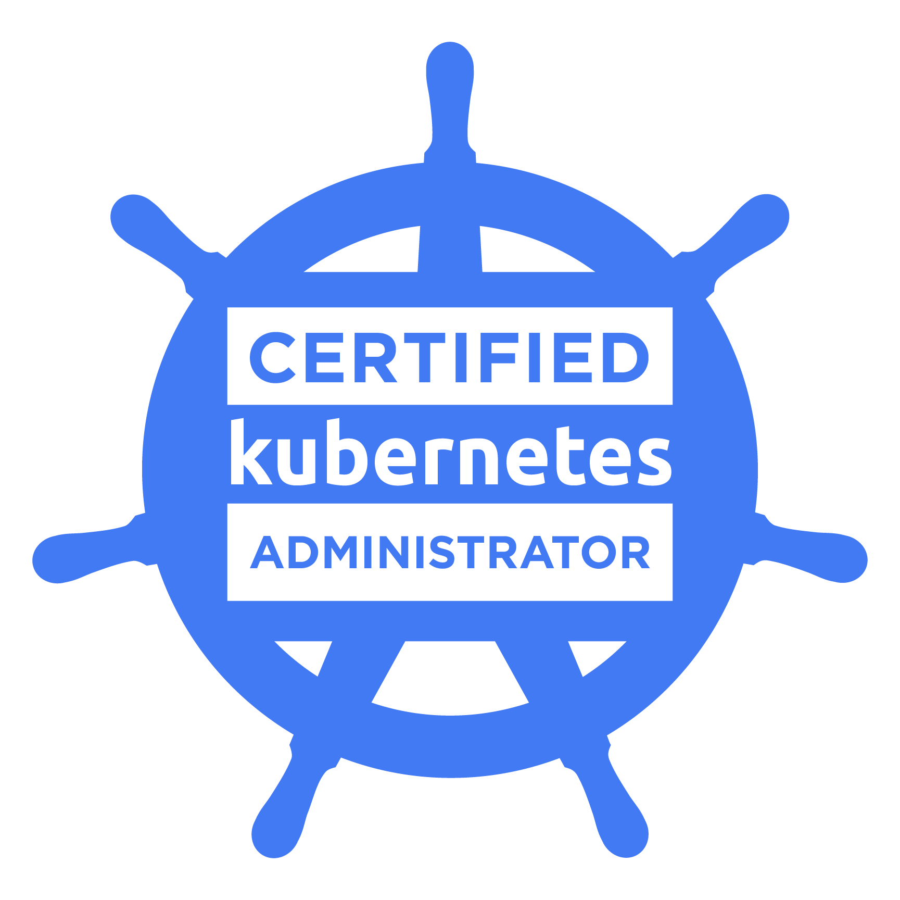

About me
Notes:
From South India
Bachelors at JNTU (CSE)
Masters at BTH (SE)
Got into

Slide 3

Assumptions
Customer is in AWS region: us-east-1
User/Dev has an AWS account
User/Dev has prior knowledge of: - Terraform - AWS CLI - Using EKS cluster

Slide 4


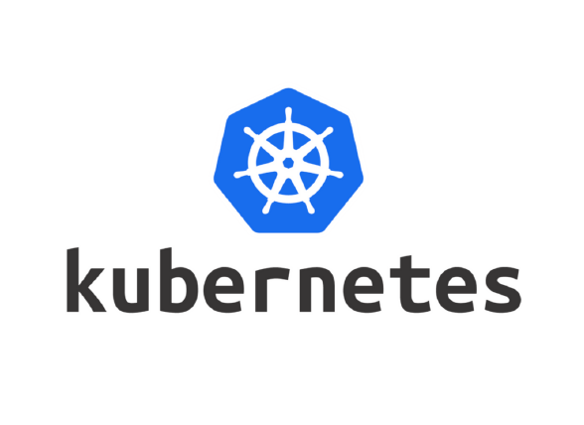

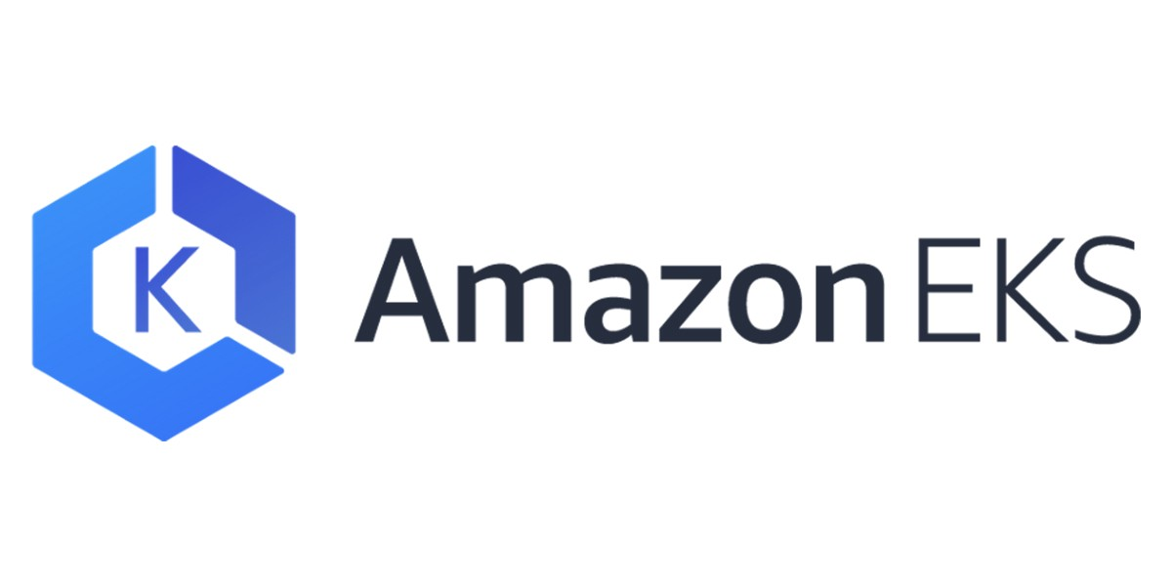
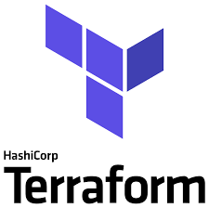
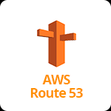
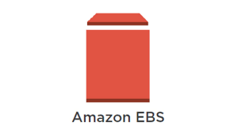




Tools
SCM – Gitlab & Gitlab CI pipeline
Kubernetes cluster – AWS EKS
IaC – Terraform
Terraform workflow
Atlantis
Application - Ghost
Helm chart
AWS Services
S3 Bucket
DynamoDB
Route53
Lambda function
EKS
IAM
Monitoring and Visualisation
Prometheus
Grafana
Logging
Loki
Certificate issuer
Cert-manager
Ingress controller
Nginx ingress controller
Notes:
SCM
Future working for you so used it
High Performance
Kubernetes Cluster – AWS EKS
Only orchestration service available in AWS
Certified Kubernetes Adminstrator
Terraform
Simple task
Depict IAC
Wanted to try it out
Future working for you, might as well learn it from now
Application
Coming from Java world
Sinch uses it
Backend
Integration Testing
Something simple, didn’t want to complicate as testing was not the focus here
Partly, wanted to show you that I can use python
AWS Services
For easy user management choose Codeartifact
ECR, for image scanning
Also requirement to use cloud services
Also Certified AWS associate solution architect

Slide 5
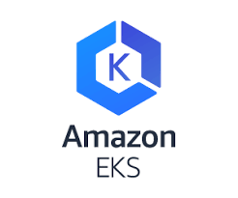







Architecture Overview
AWS Lambda Function
Custom VPC
Public Subnet
Private Subnet
Autoscaling group
https://ghost.<env>.goprix.xyz/ghost/api/canary/db
https://ghost.<env>.goprix.xyz
Subnet zone a
Ghost App
Subnet zone a
K8s worker node 1 (us-east-2a)
Load balancer
Nginx Ingress Controller
SVC
Ghost App
Subnet zone b
NAT Gateway
Subnet zone b
K8s worker node 2 (us-east-2b)
Ghost App
Subnet zone c
Subnet zone c
K8s worker node 3 (us-east-2c)

Slide 6

Overivew of Deployment
Infra
EKS
EKS - addons
Code
Ghost deployment
Lambda function

Slide 7

List of Repos
IaC/Terraform
eks-tf
eks – addons
Code
ghost-helm
ghost-infra

Slide 8



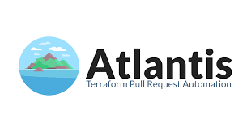

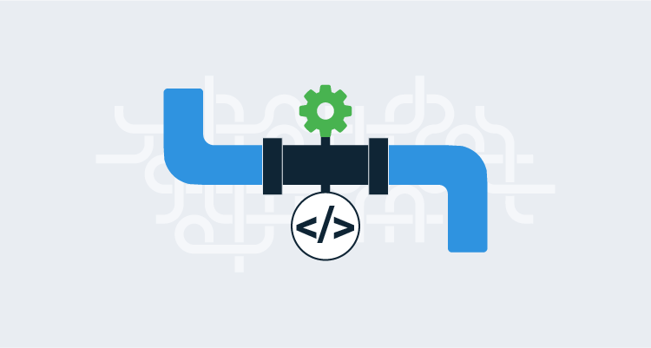


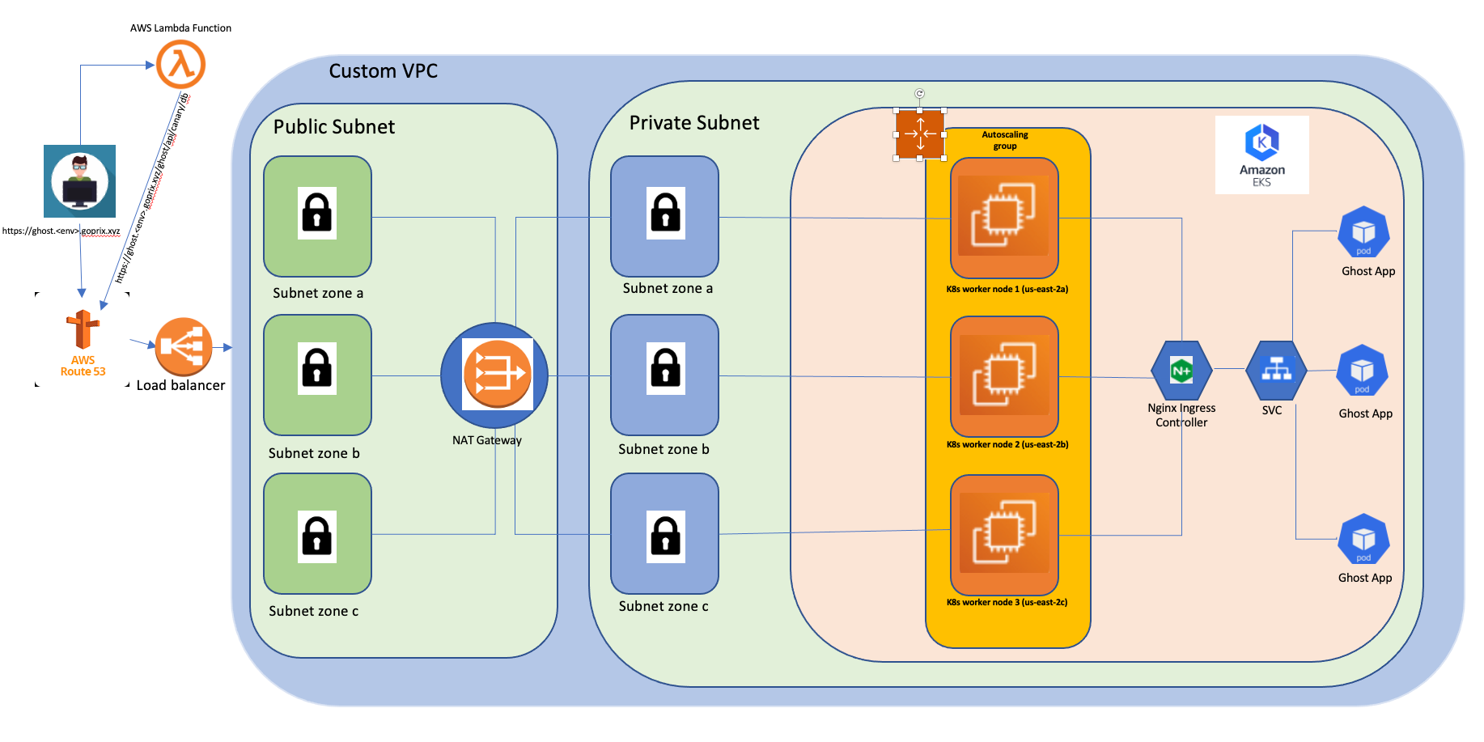
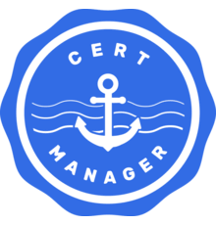
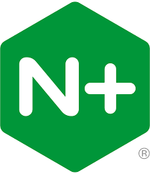
Deployment Overview
EKS Addons and Ghost App
Deployed using helm charts
CI/CD Pipeline
Deploy
Deploy
Provision Serverless function
Staging Environment EKS Cluster
Production Environment EKS Cluster
Dev Environment EKS Cluster
Reach Ghost Website
Provision Environment using terraform

Slide 9
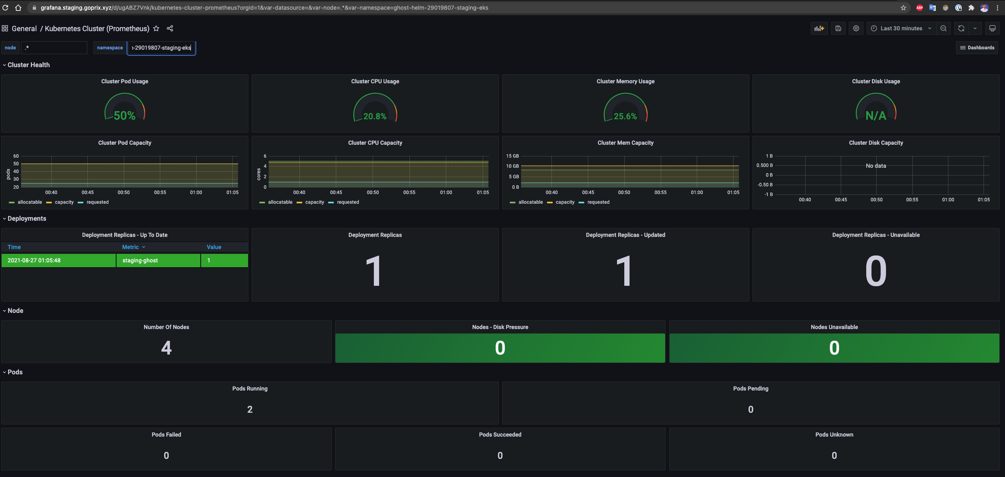
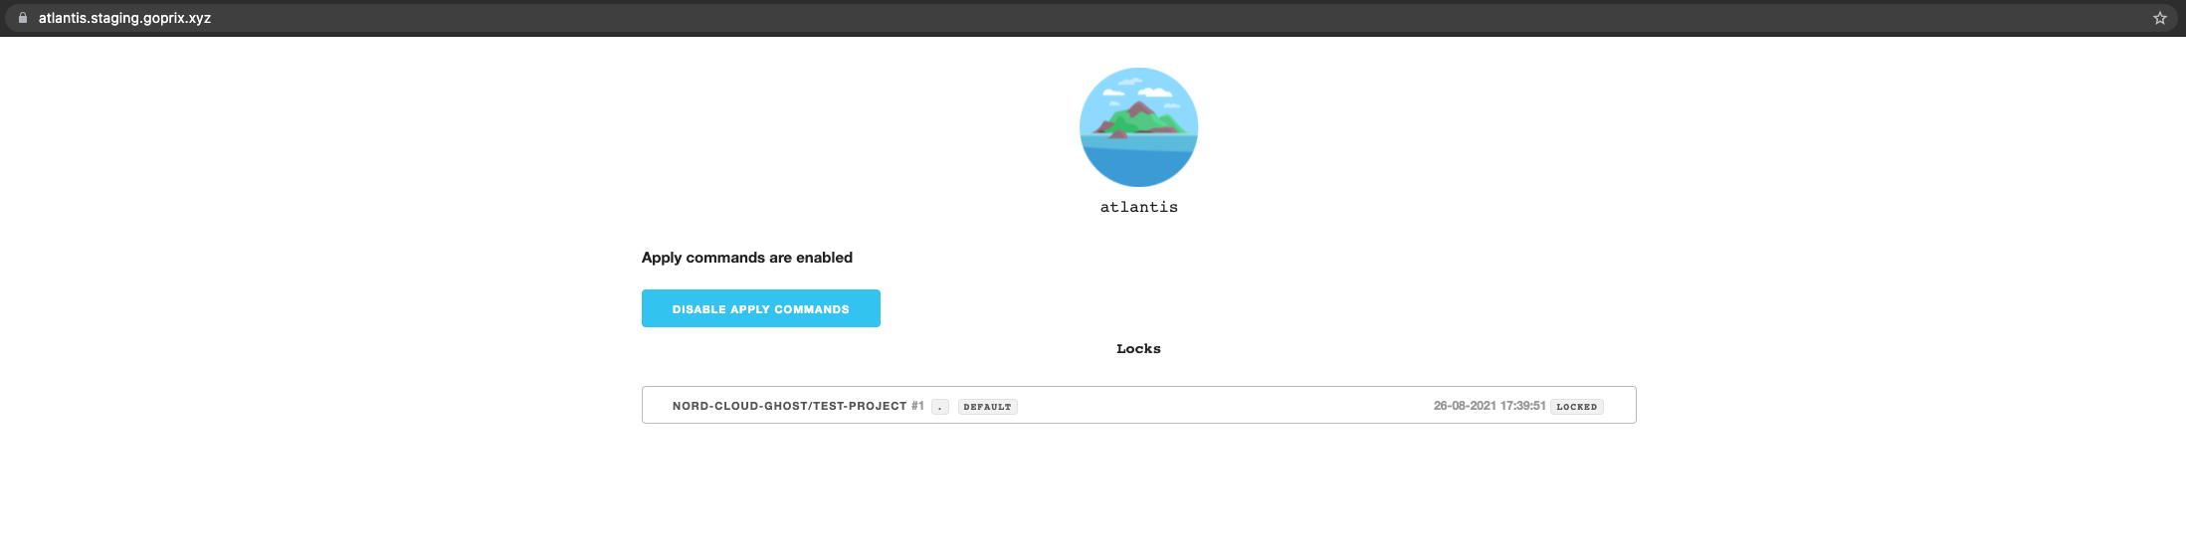
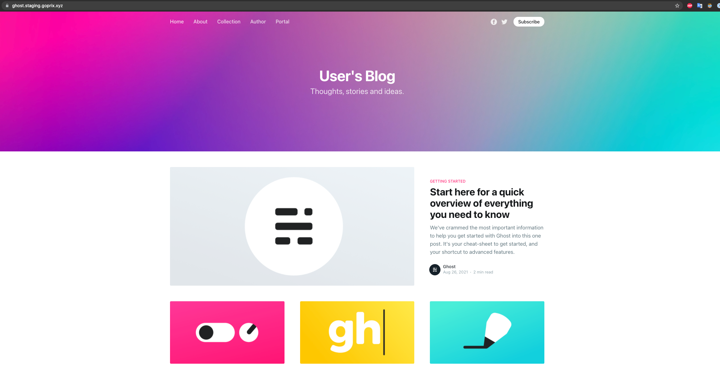
EKS Workloads Interaction with AWS Services
Namespace: gitlab-managed-apps
Namespace: ghost-helm-<gitlab-prefix>
Namespace: cert-manager
Prometheus
Loki-stack
Ghost pods
Autoscaler
Namespace: ingress-controller
cluster-autoscaler
Grafana
Grafana dashboard: https://grafana.<env>.goprix.xyz
Velero
Atlantis
Atlantis dashboard: https://atlantis.<env>.goprix.xyz
S3 Bucket
Gitlab Repos
Load Balancer
Ghost Website: https://ghost.<env>.goprix.xyz

Slide 10

Disaster Recovery
Velero for eks
Run Cronjobs for creating backups
Terraform code
Deploy the cluster in different site and use velero to restore workloads

Slide 11
AWS Well Architected
Operational Excellence
Security
Reliability
Performance Efficiency
Cost Optimization

Slide 12

Scope for Improvement
Create alerts for the application using metrics from prometheus
Add service mesh for example Istio to manage traffic
Automate deployment of the whole infrastructure
Add Pod Distribution Budgets

Slide 13
Task Breakdown
Infra
Terraform EKS modules
Terraform EKS Addons modules
Helm chart for EKS Addons
Tf modules per site
Gitlab-ci pipeline to deploy eks-addons
Eks-addons
Configure and test velero DR for EKS
Configure and test Cert-manager interaction with Route53
Configure Grafana to add Prometheus and Loki as Data sources
Configure Atlantis to automate terraform workflow in gitlab
Code
Ghost helm chart
Gitlab-ci pipeline to deploy/undeploy ghost into k8s cluster
Serverless function
Implement Py Code to delete all posts in Ghost app
Deploy in AWS using terraform
Documentation
Add doc in Ghost-helm
Add doc in Eks-tf
Add doc in Eks-addons
Add doc in ghost-infra

Slide 14


Thank You!
Shoot your Questions

