Slide 1

Nord-Cloud Interview

Slide 2









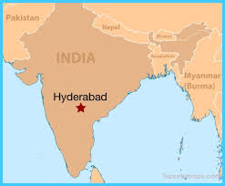


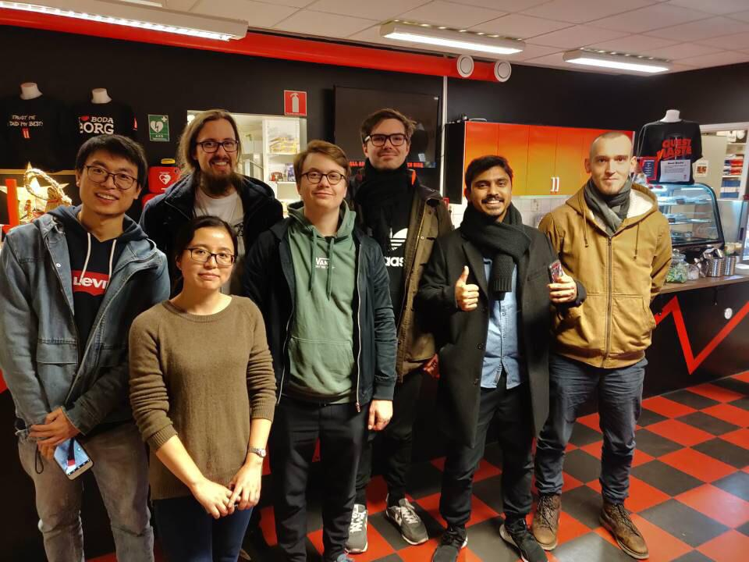
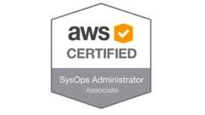

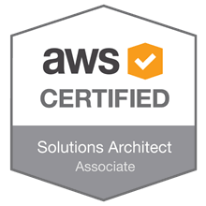
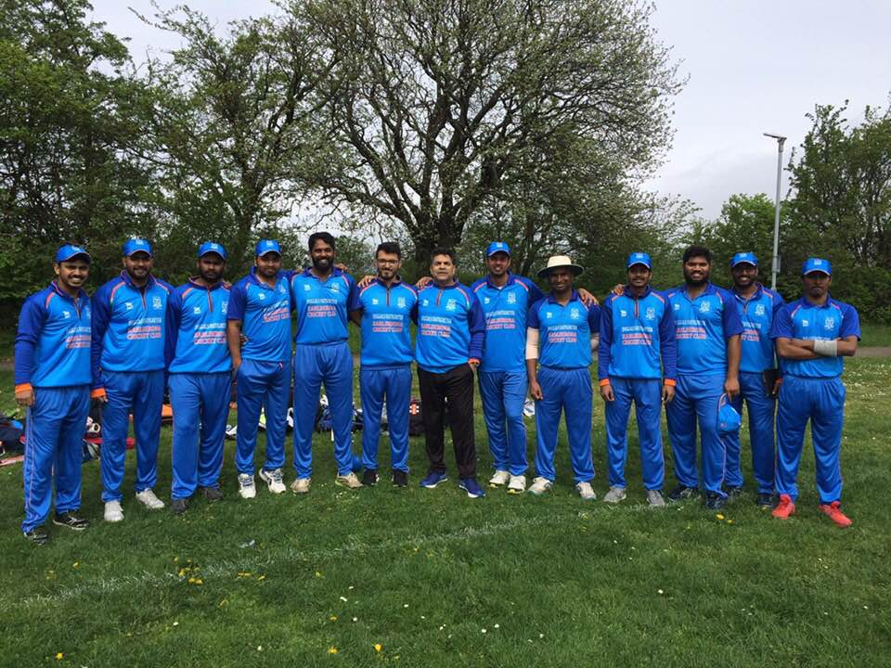
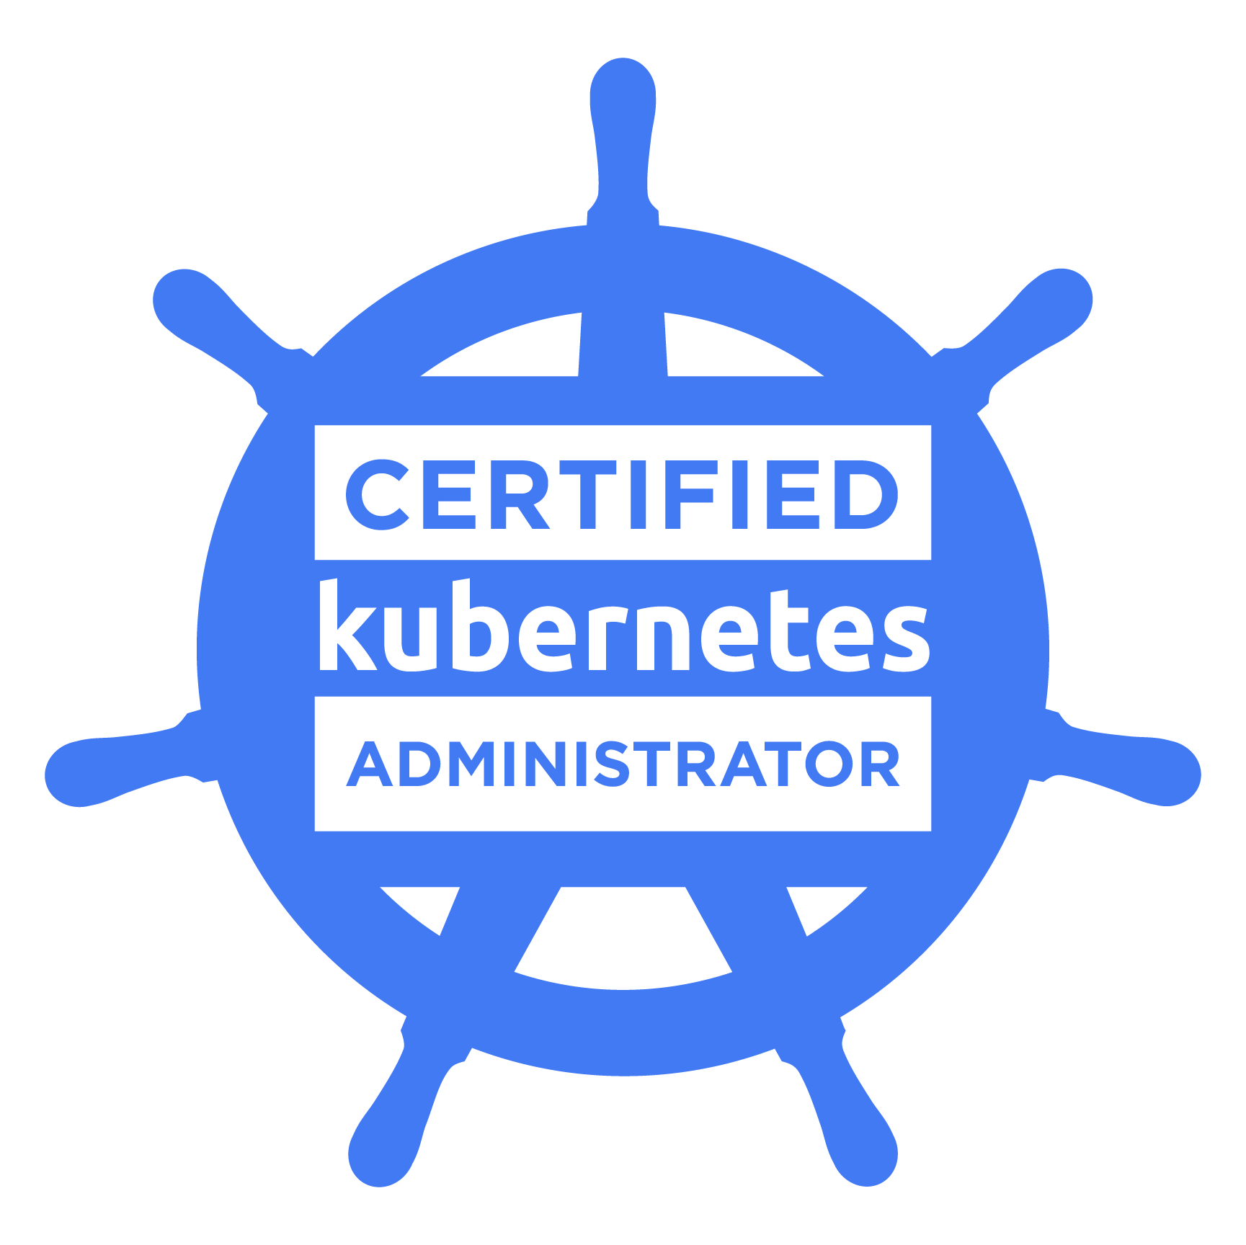

About me
Notes:
From South India
Bachelors at JNTU (CSE)
Masters at BTH (SE)
Got into Ericsson after finishing my master at BTH
Worked initially as Java dev and later moved on to devops
From Ericsson I swtiched to Sinch AB
Married in 2019
Wife works at IKEA
I like:
Cricket
Ps4 gaming especially fifa
Padel and badminton
Certifications:
-Solution architect associate
Sysops administrator
CKA

Slide 3
Problem Statement
Host Drones Shuttles Ltd. using Ghost blog platform for marketing campaign
Adapt to traffic spikes
Infrastructure should remain online even in case of a significant geographical failure (Multi-AZ)
Disaster recovery capabilities in case of region failure
Support development effort
CI/CD to automate deployment
Support monitoring of environment
Serverless function to delete all posts

Slide 4


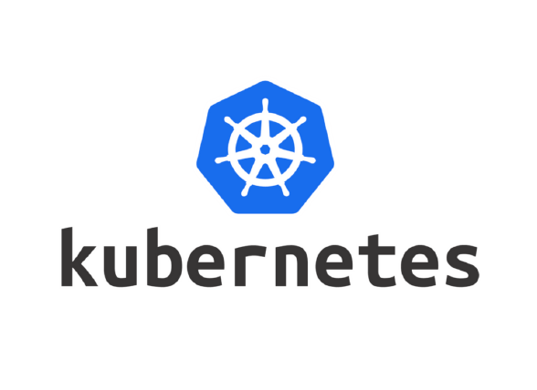

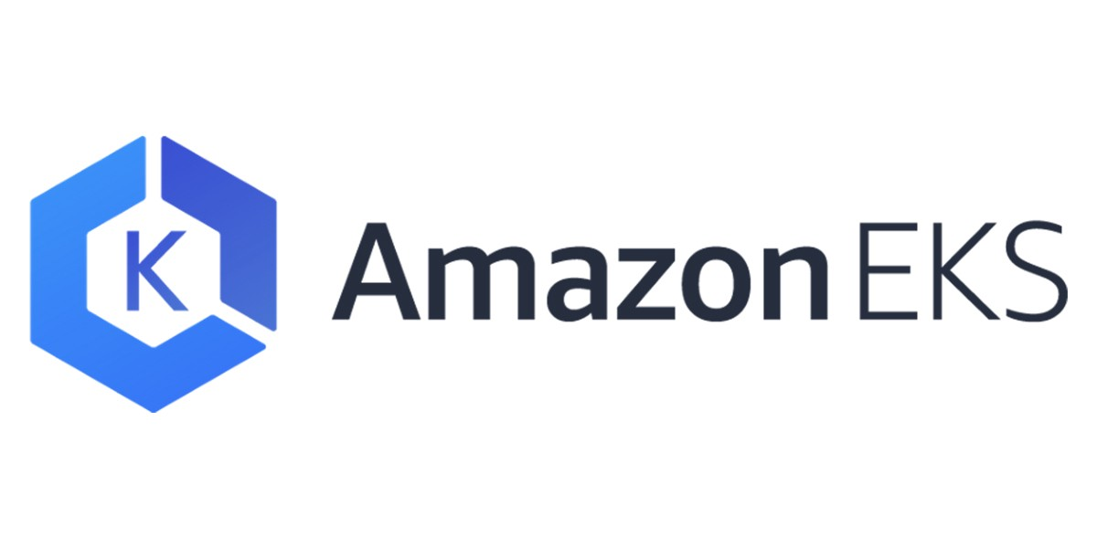

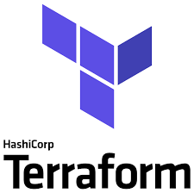
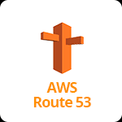
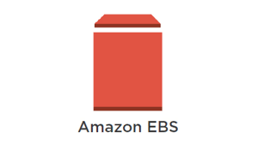



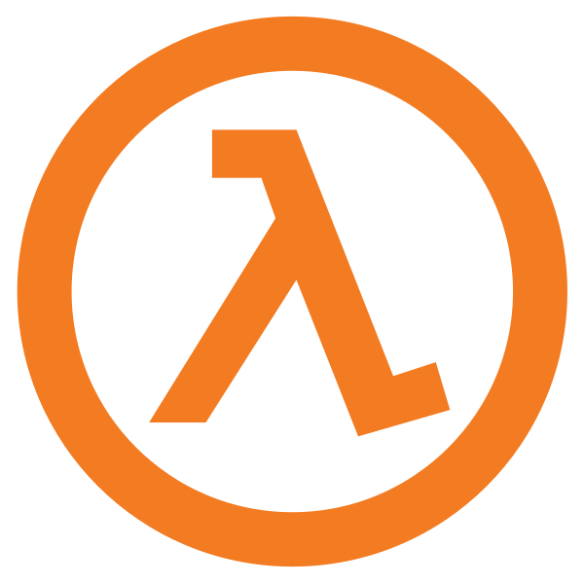
Tools
SCM – Gitlab & Gitlab CI pipeline
Kubernetes cluster – AWS EKS
IaC – Terraform
Terraform workflow
Atlantis
Application - Ghost
Helm chart
AWS Services
S3 Bucket
DynamoDB
Route53
Lambda function
EKS
IAM
Logging
Loki
Monitoring and Visualisation
Prometheus
Grafana
Certificate issuer
Cert-manager
Ingress controller
Nginx ingress controller
Velero - DR
Notes:
Source Code management – gitlab
CI/CD – Gitlab pipeline
IaC – Terraform – cloud agnostic, remote statefile
Terraform workflow – atlantis –
AWS services
- S3 - For storing remote statefile
- Velero backups
- Lambda function code
- DynamoDB - Storing lock information
- Route53 - DNS
- Lambda - Serverless function
- EKS - container orchestration
- IAM - User and access management
- Loki - Unlike Elasticsearch it is not resource-intensive
- integrates seamlessly with multiple platforms,
including Docker, Kubernetes, Grafana, Helm, and Percona
- simplifies storage by storing logs as plain texts and only indexing the metadata,
thereby providing significant savings on storage costs
- Prometheus - Easy to Deploy
- Prometheus supports scraping Kubernetes metrics natively and is well integrated with API server for autoscaling
- Can be used in another Kubernetes managed clusters
- Grafana - Easy to integrate with prometheus and Loki
- Velero - For Disaster recovery of eks

Slide 5
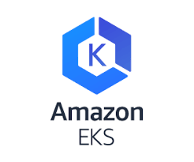






Architecture Overview
AWS Lambda Function
Custom VPC
Public Subnets
Private Subnets
Autoscaling group
https://ghost.<env>.goprix.xyz/ghost/api/canary/db
https://ghost.<env>.goprix.xyz
us-east-1a
Ghost App
us-east-1a
K8s worker node 1 (us-east-2a)
Load balancer
Nginx Ingress Controller
SVC
Ghost App
us-east-1b
us-east-1b
K8s worker node 2 (us-east-2b)
Ghost App
us-east-1c
us-east-1c
K8s worker node 3 (us-east-2c)
Notes:
1. User hits route53 -> loadbalancer -> worker nodes -> nginx ingress controller -> k8s svc -> pod

Slide 6
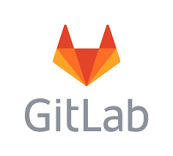
List of Repos
IaC/Terraform
eks-tf – mainly used to deploy eks cluster
eks-addons – used to deploy eks addons for monitoring
Code
ghost-helm – used deploy ghost blogging platform
ghost-infra – used to deploy serverless function

Slide 7
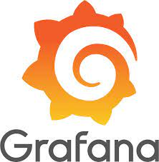


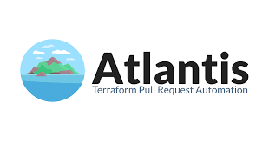

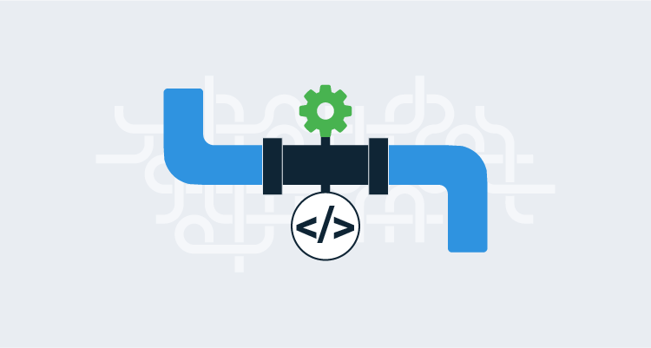

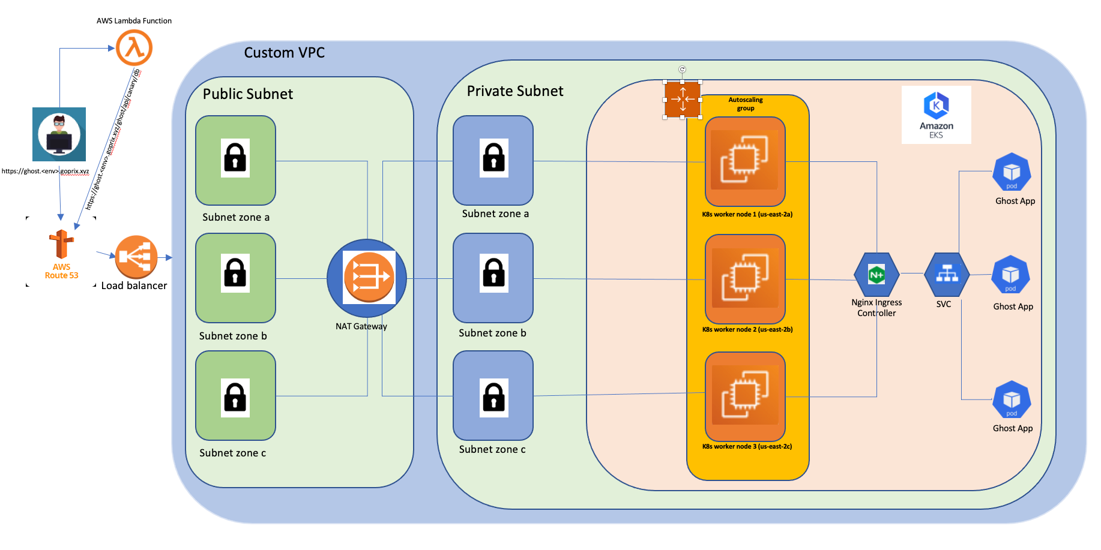
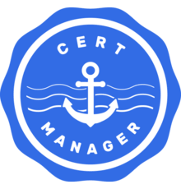
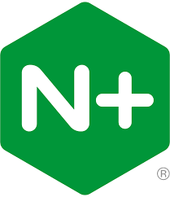
Deployment Overview
EKS Addons and Ghost App
Deployed using helm charts
CI/CD Pipeline
Deploy
Deploy
Provision Serverless function
Staging Environment EKS Cluster
Production Environment EKS Cluster
Dev Environment EKS Cluster
Reach Ghost Website
Provision Environment using terraform
Notes:
Terraform :
1. Deploy lambda
2. EKS cluster
3. Nginx ingress controller – create cname record under a hosted zone (env.goprix.xyz) to route traffic into its external-ip
4. Cert-manager - needed hosted zone id for it list records in a hosted zone
Integrate clusters in gitlab-ci
Gitlab pipeline
Ghost application
Eks-addons – velero, prometheus, atlantis and others

Slide 8

Demo

Slide 9
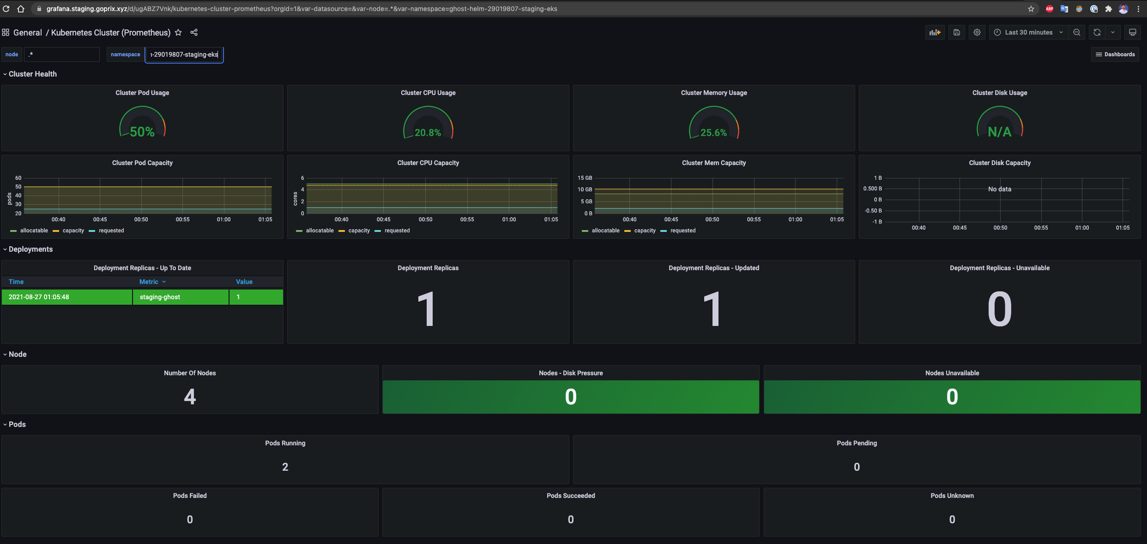
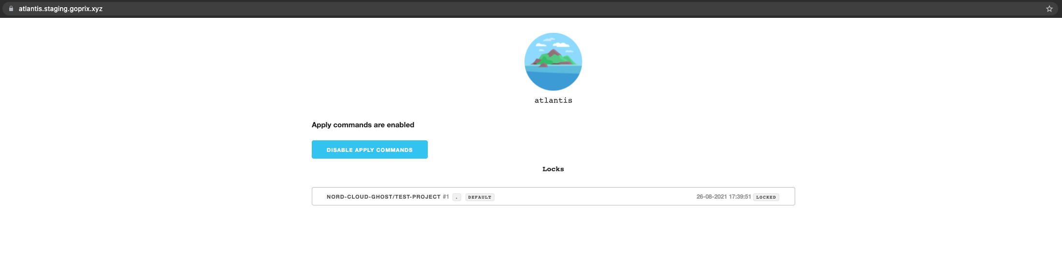
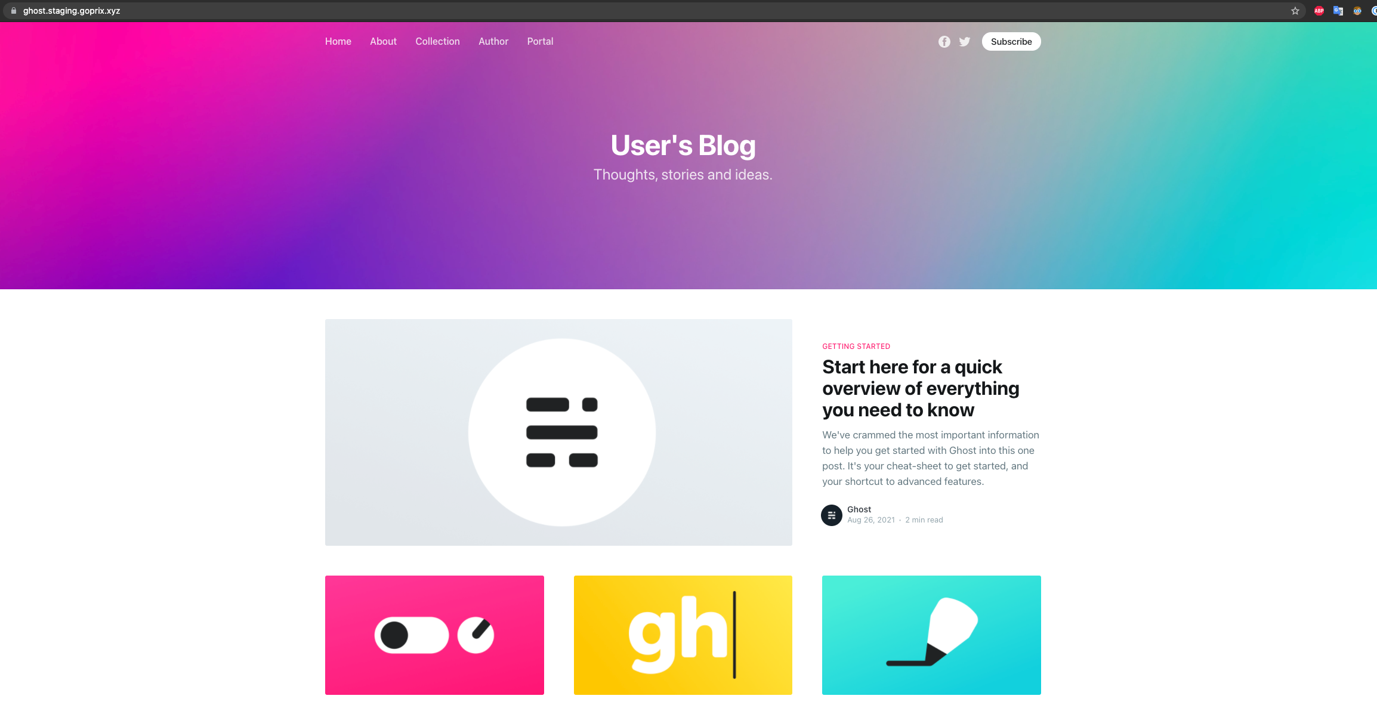
EKS Workloads Interaction with AWS Services
Namespace: gitlab-managed-apps
Namespace: ghost-helm-<gitlab-prefix>
Namespace: cert-manager
Prometheus
Loki-stack
Ghost pods
Autoscaler
Namespace: ingress-controller
cluster-autoscaler
Grafana
Grafana dashboard: https://grafana.<env>.goprix.xyz
Velero
Atlantis
Atlantis dashboard: https://atlantis.<env>.goprix.xyz
S3 Bucket
Gitlab Repos
Load Balancer
Ghost Website: https://ghost.<env>.goprix.xyz
Notes:
Velero – interacts with s3 and ebs to store snashopts
Cluster-autoscaler – interacts with autoscaling group
Grafan exposed using ingress which in tunr uses nginx controller
Certmanager using route53

Slide 10

Disaster Recovery
Velero for eks
Run Cronjobs for creating backups
Terraform code
Deploy the cluster in different site and use velero to restore workloads
Notes:
Based on SLAs
- I willk have two strategies
1. identical environments
2 resources less env migrate db

Slide 11

Scope for Improvement
Create alerts for the application using metrics from prometheus
Add service mesh for example Istio to
manage traffic
Secure communication
Automate deployment of the whole infrastructure
Add Resource Quotas
Decouple the database

Slide 12
Task Breakdown
Infra
Terraform EKS modules
Terraform EKS Addons modules
Helm chart for EKS Addons
Tf modules per site
Gitlab-ci pipeline to deploy eks-addons
Eks-addons
Configure and test velero DR for EKS
Configure and test Cert-manager interaction with Route53
Configure Grafana to add Prometheus and Loki as Data sources
Configure Atlantis to automate terraform workflow in gitlab
Code
Ghost helm chart
Gitlab-ci pipeline to deploy/undeploy ghost into k8s cluster
Serverless function
Implement Py Code to delete all posts in Ghost app
Deploy in AWS using terraform
Documentation
Add doc in Ghost-helm
Add doc in Eks-tf
Add doc in Eks-addons
Add doc in ghost-infra

Slide 13


Thank You!
Shoot your Questions

