Slide 2

The Road To Node

Slide 3


Slide 4


Slide 5


Slide 6
HTML
<!DOCTYPE html> <html> <head> <title>Page Title</title> </head> <body> <h1>This is a Heading</h1> <p>This is a paragraph.</p> </body> </html>

Slide 7
HTML - Hyper Text Markup Language
<!DOCTYPE html> <html> <head> <title>Page Title</title> </head> <body> <h1>This is a Heading</h1> <p>This is a paragraph.</p> </body> </html>

Slide 8
HTML - Hyper Text Markup Language
<!DOCTYPE html> <html> <head> <title>Page Title</title> </head> <body> <h1>This is a Heading</h1>
<br> <p>This is a paragraph.</p> </body> </html>

Slide 9
HTML - Hyper Text Markup Language
<!DOCTYPE html> <html> <head> <title>Page Title</title> </head> <body> <img id=“some_id" src=“some_image.png“> </body> </html>

Slide 10
HTML - Hyper Text Markup Language
<!DOCTYPE html> <html> <head> <title>Page Title</title> </head> <body> <button class="btn" type="button“>Press Me</button> </body> </html>

Slide 11
HTML - Hyper Text Markup Language
<!DOCTYPE html> <html> <head> <title>Page Title</title> </head> <body> <form action="#“ >
<label for="fname">Name:</label><br>
<input class="form-label" type="text“>
<br>
<input class="btn" type="submit" value="Start Game">
</form> </body> </html>
Triggers action

Slide 12
CSS - Cascading Style Sheets
REMEMBER !!!
<!DOCTYPE html> <html> <head> <title>Page Title</title> </head> <body> <h1 class=‘heading_class’ >This is a Heading</h1>
<h1 class=‘heading_class’ >This is another Heading</h1> <p id=‘paragraph_id’ >This is a paragraph.</p> </body> </html>

Slide 13
CSS - Cascading Style Sheets
.heading_class {
Color: blue
}

Slide 14
CSS - Cascading Style Sheets
#paragraph_id{
Color: blue
}

Slide 15
Some CSS Attributes to manipulate:
Background-color
Font-family
Margin
Padding
Border-radius
Text-align
Height
Width

Slide 16
Connect CSS to HTML ?
<html lang="en"> <head> <meta charset="UTF-8"> <title>Title</title> </head> <link rel="stylesheet" href=“myfolder/style.css"> <body>
…….Some Html

Slide 17
Get Fonts from google ?
Go to: https://fonts.google.com/
<html lang="en"> <head> <meta charset="UTF-8"> <title>Title</title> </head> <link rel="stylesheet" href=“myfolder/style.css">
<body>
…….Some Html
<link rel="preconnect" href="https://fonts.googleapis.com"> <link rel="preconnect" href="https://fonts.gstatic.com" crossorigin> <link href="https://fonts.googleapis.com/css2?family=Architects+Daughter&family=
Indie+Flower&family=Montserrat:wght@100&family=Russo+One&display=swap" rel="stylesheet">

Slide 18
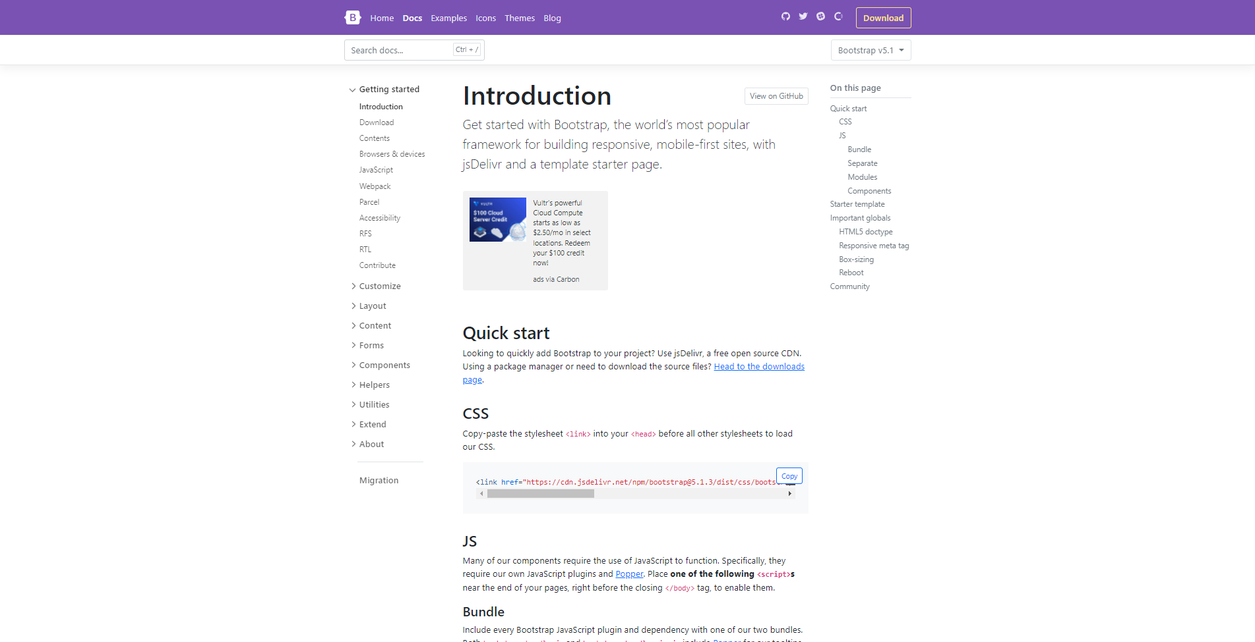
Bootstrap ???
Go to: https://getbootstrap.com/

Slide 19
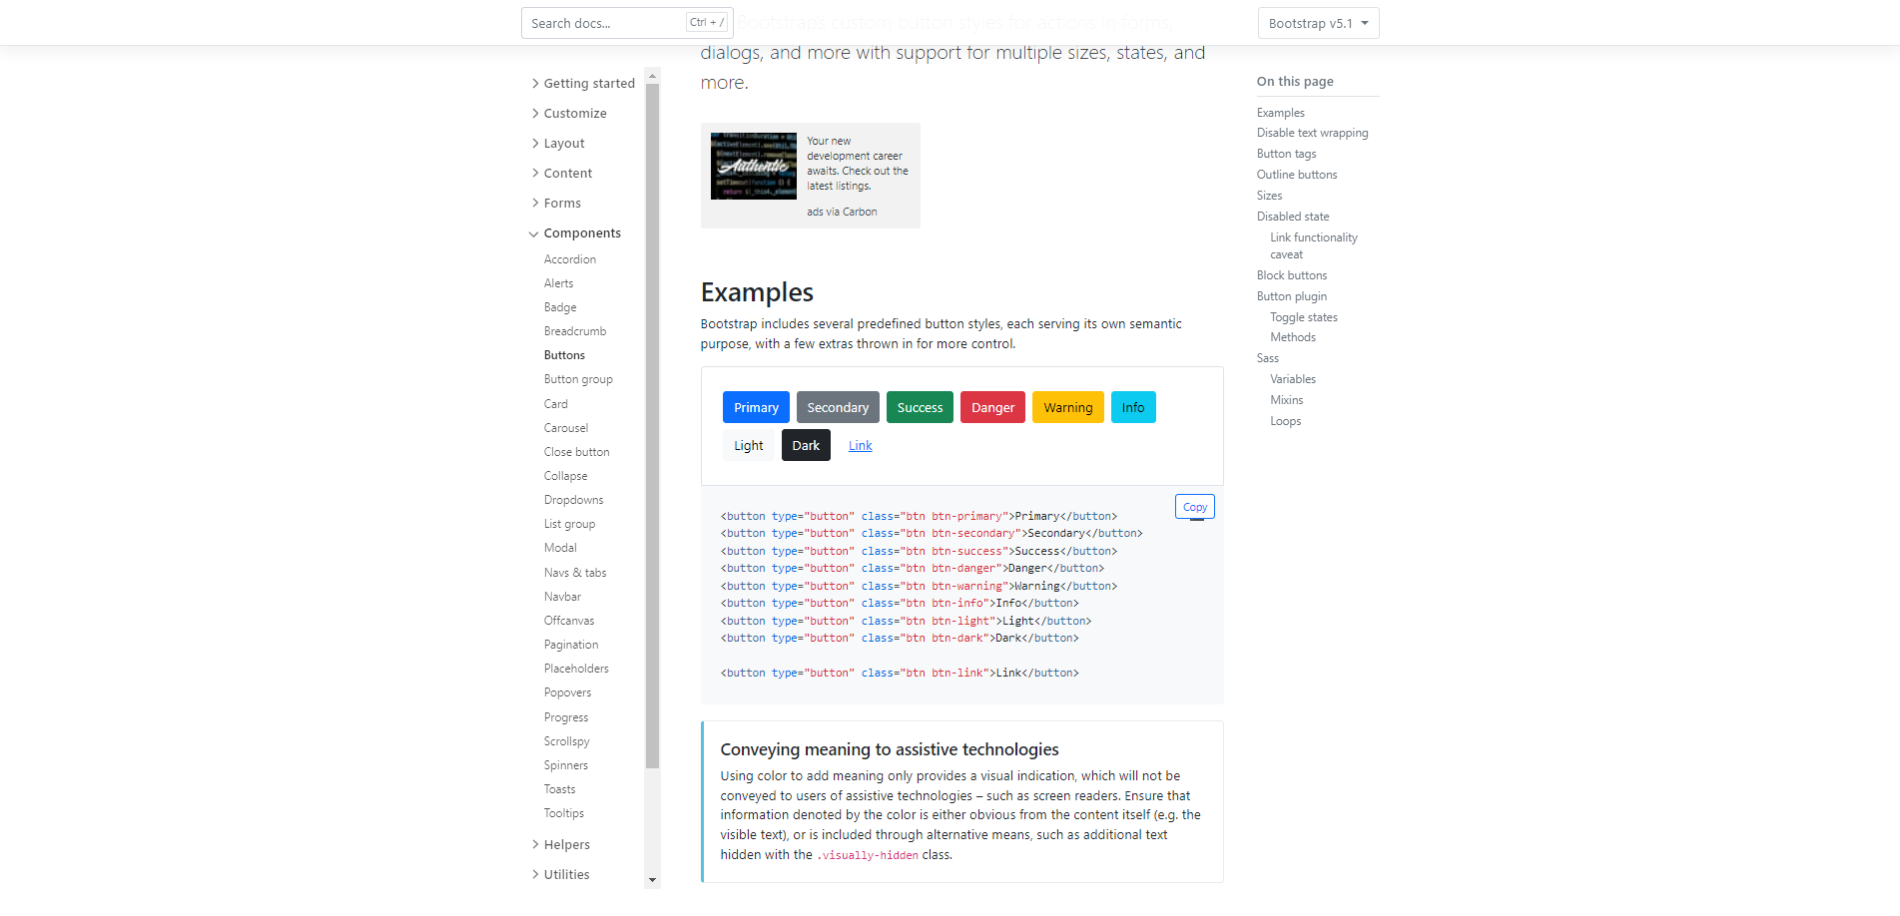
Bootstrap ???

Slide 20
How do I add Bootstrap ?
<link href="https://cdn.jsdelivr.net/npm/bootstrap@5.1.3/dist/css/bootstrap.min.css" rel="stylesheet" integrity="sha384-1BmE4kWBq78iYhFldvKuhfTAU6auU8tT94WrHftjDbrCEXSU1oBoqyl2QvZ6jIW3" crossorigin="anonymous">

Slide 21
For next time please watch:
https://www.youtube.com/watch?v=W6NZfCO5SIk
Then
https://www.youtube.com/watch?v=TlB_eWDSMt4

