Slide 2
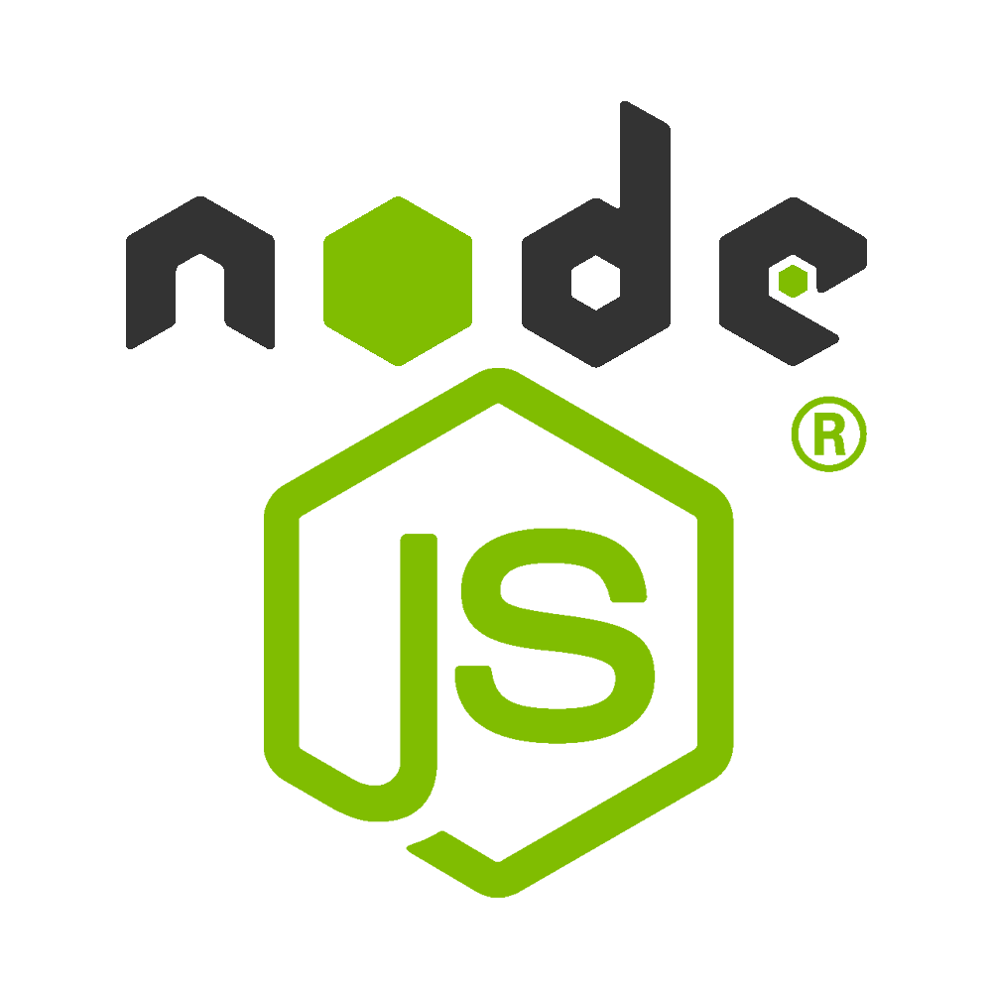
The Road To Node (No theory – only practical)

Slide 3

NPM (Node Package Manager)
Package Manager for Javascript
npm is the world's largest Software Registry
contains over 800,000 code packages
npm is installed with Node.js
All npm packages are defined in files called package.json
The content of package.json must be written in JSON

Slide 4
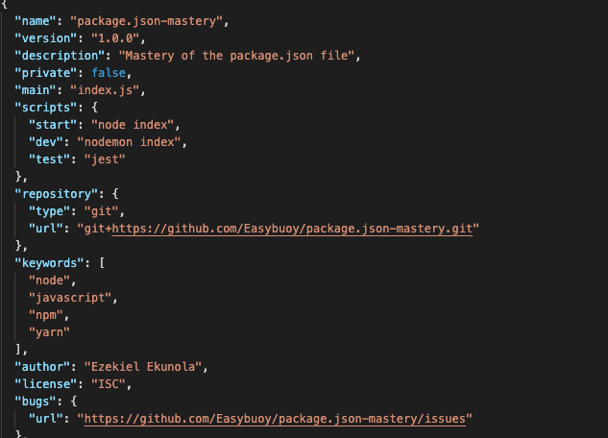
JSON
{ "employees" :[ {"firstName":"John", "lastName":"Doe"}, {"firstName":"Anna", "lastName":"Smith"}, {"firstName":"Peter", "lastName":"Jones"} ] }
JSON stands for JavaScript Object Notation
a lightweight format for storing and transporting data
often used when data is sent from a server to a web page
"self-describing" and easy to understand
JSON Syntax Rules
Data is in name/value pairs
Data is separated by commas
Curly braces hold objects
Square brackets hold arrays

Slide 5
Create node app & install express
npm init
Will create Package.json
npm install express
dependencies section of your package.json will now appear at the end of the package.json file and will include Express
package-lock.json: automatically generated for any operations where npm modifies either the node_modules tree, or package. json .
It describes the exact tree that was generated, such that subsequent installs are able to generate identical trees, regardless of intermediate dependency updates
{ "name": "trivia", "version": "1.0.0", "description": "", "main": "index.js", "scripts": { "test": "echo \"Error: no test specified\" && exit 1" }, "author": "", "license": "ISC" }

Slide 6
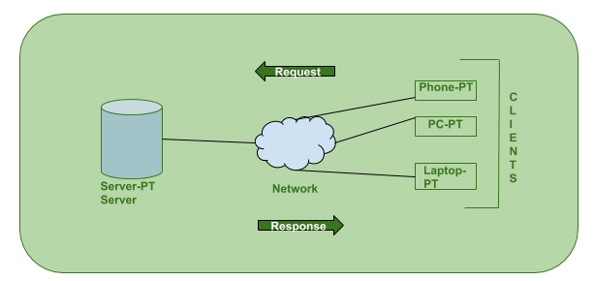
Client – Server Model
Client is a computer (Host) i.e. capable of receiving information or using a particular service from the service providers (Servers)
Server is a remote computer which provides information (data) or access to particular services.
User enters the URL(Uniform Resource Locator) of the website or file. The Browser then requests the DNS(DOMAIN NAME SYSTEM) Server.
DNS Server lookup for the address of the WEB Server.
DNS Server responds with the IP address of the WEB Server.
Browser sends over an HTTP/HTTPS request to WEB Server’s IP (provided by DNS server).
Server sends over the necessary files of the website.
Browser then renders the files and the website is displayed.

Slide 7
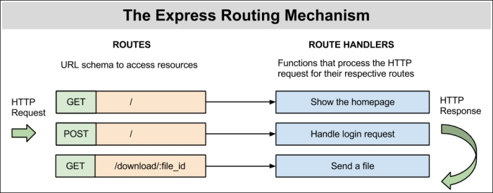
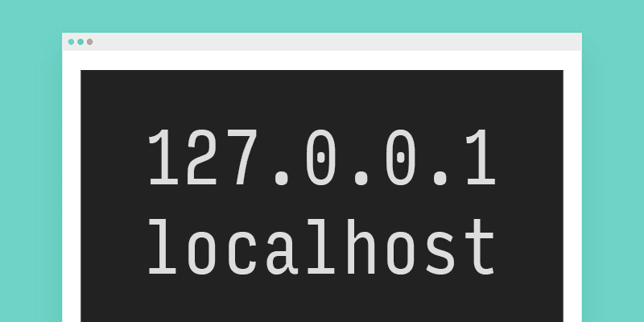
Routes, Hosts & Ports
Routes are defined using an HTTP verb and a path pattern
Any request to the server that matches a route definition is routed to the associated route handler
In computer networking talk, localhost refers to “this computer”
You want to reach a specific office in a company
As an illustration, think of a port number as a telephone extension for the company
The company telephone number is like the host (+20 100 382 ----)
The port will define which office you want to reach
(+20 100 382 ----) -> Microsoft
(+20 100 382 3484) -> HR Office of Microsoft
http://127.0.0.1:3000

Slide 8
Express
const express = require('express') const app = express(); const port = 3000; const router = express.Router(); router.get('/', (req, res) => { res.send('Hello World!') }); app.use(router); app.listen(port, () => { console.log(`Example app listening on port ${port}!`) });
Express is the most popular Node web framework
Write handlers for requests with different HTTP verbs at different URL paths (GET, POST, DELETE, etc.)
In a traditional data-driven website, a web application waits for HTTP requests from the web browser
When a request is received the application works out what action is needed based on the URL pattern and associated information contained in POST or GET request

Slide 9
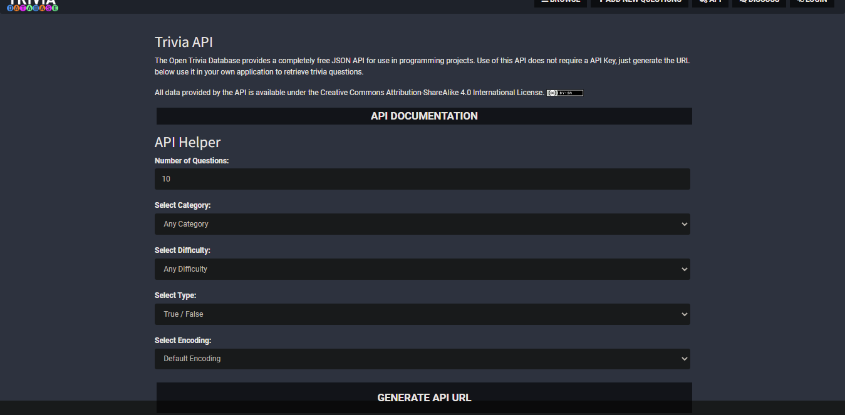
How will we get our data ?
https://opentdb.com/api_config.php

Slide 10
We will use the Trivia API ?
To get started using the Open Trivia DB API, use this URL: https://opentdb.com/api.php?amount=1
{ "response_code": 0, "results": [ { "category": "Science & Nature", "type": "multiple", "difficulty": "hard", "question": "How many types of quarks are there in the standard model of physics?", "correct_answer": "6", "incorrect_answers": [ "2", "3", "4" ] } ] }

Slide 11
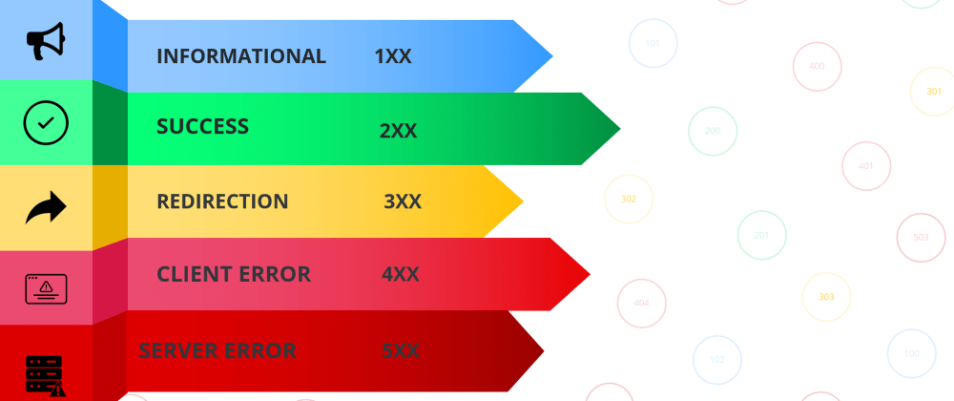
Response Codes
The API appends a "Response Code" to each API Call to help tell developers what the API is doing.
Code 0: Success Returned results successfully.
Code 1: No Results Could not return results. The API doesn't have enough questions for your query. (Ex. Asking for 50 Questions in a Category that only has 20.)
Code 2: Invalid Parameter Contains an invalid parameter. Arguements passed in aren't valid. (Ex. Amount = Five)

Slide 12
Synchronous Programming
In traditional programming practice, most I/O operations happen synchronously. ( 1 then 2 then 3)
public static void main(String[] args) {
File myObj = new File("filename.txt");
if (myObj.exists()) {
System.out.println("File name: " + myObj.getName());
} else {
System.out.println("The file does not exist.");
}
System.out.println(“Hello From Java");
}
First print file name
Then print “Hello From Java”
What if I don’t want to wait for the file to be read to continue the next block ?

Slide 13
Async - Await
Asynchronous I/O is a form of input/output processing that permits other processing to continue before
the transmission has finished.
Let’s say I want to load the user’s image from my server but I want to load the user’s
name and details in the meantime
How it works
An async function returns a promise, like in this example:
const doSomethingAsync = () => { return new Promise(resolve => { setTimeout(() => resolve('I did something'), 3000); }); };
The Promise object represents the eventual completion (or failure) of an asynchronous operation and its resulting value
const doSomething = async () => { console.log(await doSomethingAsync()); };
When you want to call this function you prepend await, and the calling code will stop until the promise is resolved or rejected. One caveat: the client function must be defined as async. Here's an example:

