Slide 2

The Road To Node (No theory – only practical)

Slide 3

NPM (Node Package Manager)
Package Manager for Javascript
npm is the world's largest Software Registry
contains over 800,000 code packages
npm is installed with Node.js
All npm packages are defined in files called package.json
The content of package.json must be written in JSON

Slide 4
We need a way to save the user’s game data…
The localStorage object allows you to save key/value pairs in the browser.
localStorage.setItem("lastname", "Smith"); localStorage.getItem("lastname");

Slide 5

Now let us connect the HTML to our node backend…

Slide 6
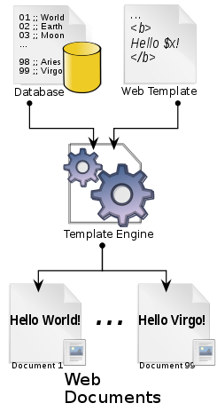
Pug
A template engine is a program which is responsible for compiling a template (that can be written using any one of a number of languages) into HTML
The template engine will normally receive data from an external source, which it will inject into the template
This approach allows you to reuse static web page elements, while defining dynamic elements based on your data
npm i pug

Slide 7
Syntax…Indentation is the word!
<!DOCTYPE html> <html lang="en"> <head> <title>Hello, World!</title> </head> <body> <h1>Hello, World!</h1> <div class="remark"> <p>Pug rocks!!</p> </div> </body> </html>
doctype html html(lang='en’) head title Hello, World! body h1 Hello, World! div.remark p Pug rocks!
VS

Slide 8
Syntax…Indentation is the word!
<!DOCTYPE html> <html lang="en"> <head> <title>Hello, World!</title> </head> <body> <h1>Hello, World!</h1> <div class="remark"> <p>Pug rocks!!</p> </div> </body> </html>
doctype html html(lang='en’) head title Hello, World! body h1 Hello, World! div.remark p Pug rocks!
VS
Pug doesn’t have any closing tags and relies on indentation for nesting

Slide 9
Classes, IDs and Attributes
Classes and IDs are expressed using a .className and #IDname notation
<nav id="navbar-default"> <div class="container-fluid"> <h1 class="navbar-header">My Website!</h1> </div> </nav>
nav#navbar-default div.container-fluid h1.navbar-header My Website!

Slide 10
Classes, IDs and Attributes
Attributes are added using brackets:
ul li a(href='/') Home li a(href='/page-1') Page 1 li a(href='/page-2') Page 2 input.search( type='text' name='search' placeholder='Enter a search term...’ )
<ul> <li><a href="/">Home</a></li> <li><a href="/page-1">Page 1</a></li> <li><a href="/page-2">Page 2</a></li> </ul> <input class="search" type="text" name="search" placeholder="Enter a search term..."/>

Slide 11

I don’t want to convert my HTML to Pug cause I’m lazy…
You don’t have to.

Slide 12
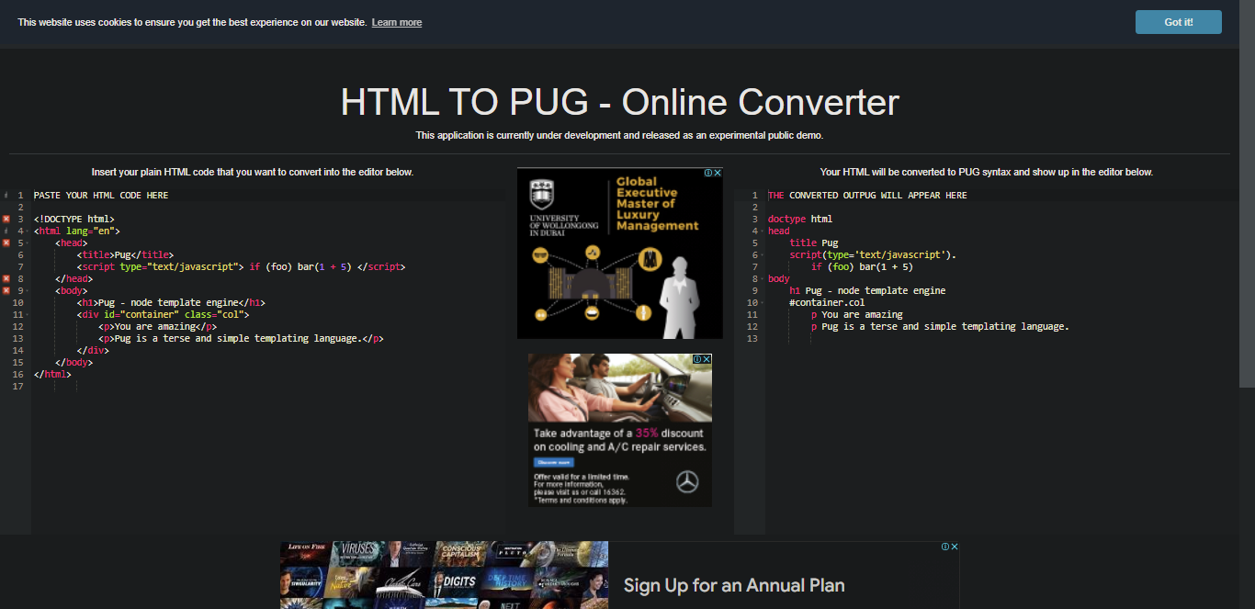
https://html-to-pug.com/

Slide 13
You have to tell express that you’re using Pug…
app.set('view engine', 'pug’);
app.set('views', path.join(__dirname, '/../views')); app.use(express.static(__dirname + '/../public'));
Install Pug using NPM
Set the view engine (Templating engine)
Set the public folder where all the static assets live

Slide 14
More Changes…
Static folder -> Public folder
link(rel='stylesheet' href=‘../Static/css/style.css')
->
link(rel='stylesheet' href=‘/css/style.css')
By default Pug looks at the Public folder for the css & javascript files

Slide 15
More More Changes…
router.get('/', (req, res) => { res.render('Home'); }); router.get('/startgame', async (req, res) => { const result = await fetch('https://opentdb.com/api.php?amount=50&type=boolean'); const x = await result.json(); res.render('Game', { questions: JSON.stringify(x) }); }); router.get('/gameover', (req, res) => { res.render('Score'); });
Use render to send PUG files or similar

Slide 16
Now what’s going on here ?
const fetch = require('node-fetch');
We want to send a request to the Trivia API and get the questions
router.get('/startgame', async (req, res) => { const result = await fetch('https://opentdb.com/api.php?amount=50&type=boolean'); const x = await result.json(); res.render('Game', { questions: JSON.stringify(x) }); });
We define the function as async
We give fetch the url
We await the response
We send the Pug with the questions as a STRING

Slide 17
Why as a STRING ?
We will give any element in our PUG file an extra attribute called data-questions
This is a special attribute where we can add the data- prefix and then get the data using javascript
h1(id='questions' data-questions=`${questions}`) Here comes the question ?
We use simple javascript to inject the questions variable, we had just rendered into this attribute

Slide 18
We need FRONT END Javascript
We need JS for the Starting Page
When the user clicks on start game we want to save his name and initial score
Then open the next page
We need JS for the Game Page
We want to keep track of the points
We want to load and keep track of the questions
We want to change the score, question after each round
We want to validate the player’s answers and act accordingly
We need JS for the Game Over Page
We want to load the player’s score
We need 3 JS files for 3 Pug files

Slide 19
Resources…
Github
https://www.youtube.com/watch?v=3RjQznt-8kE&list=PL4cUxeGkcC9goXbgTDQ0n_4TBzOO0ocPR
Node+Express
https://www.youtube.com/watch?v=zjb-D2cQrvI&list=PLakAmVjYWIY6pmQi-1ef-3PfXuBtqbvA-
Pug
https://www.youtube.com/watch?v=kt3cEjjkCZA
Javascript
https://www.youtube.com/watch?v=W6NZfCO5SIk&t=38s
HTML CSS
https://www.youtube.com/watch?v=qz0aGYrrlhU&t=12s

