Slide 1

CBC Procedure Analysis

Slide 2
IMPC Pipelines
40 main pipelines
80 pipelines
40 alternative pipelines
Notes:
* File: extract_data

Slide 3
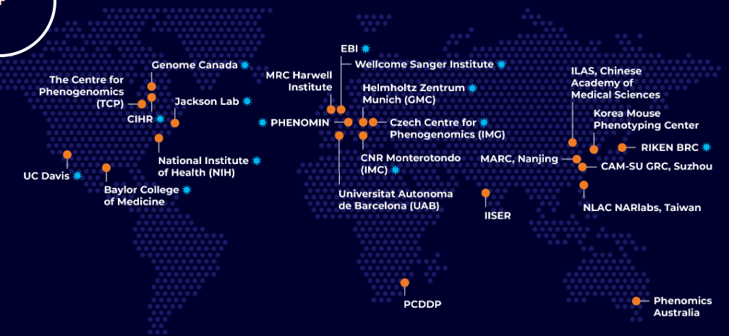
IMPC Institutional Members

Slide 4
IMPC Pipelines
The IMPC pipelines are grouped into 5 categories:
Early Adult
Late Adult
Interval
Legacy and Specialist
Alternative
Notes:
* File: analysis_procedures

Slide 5
IMPC Pipelines
The IMPC pipelines’ categories:
Category | Prefix | Suffix | Example
Early Adult |  |  | MGP_001
Late Adult |  | LA | HMGULA_002
Interval |  | IP | KMPCIP_001
Legacy and Specialist |  |  | SLM_001
Alternative | ALT |  | ALTMGP_001 ALTHMGULA_002 ALTKMPCIP_001 ALTSLM_001

Slide 6
IMPC Procedures
Number of procedures that could be extracted from the IMPC API: 1158
A pipeline may contain several procedures
The same procedure could be used by multiple pipelines
The relation between pipelines and procedures is: many-to-many.

Slide 7
IMPC Procedures
Many procedures can be grouped together, even though their keys are not identical.
Ex. Procedures with “Dysmorphology” and/or “SHIRPA”
Procedures’ keys have the format ABC_XYZ_NNN
ABC: Project/Center Name
XYZ: A unique code for the procedure (the new naming convention)
NNN: Procedures’ version
The procedure keys have been unified to match the new naming convention. (Demo in both Excel & Python)

Slide 8
IMPC Procedures
There are 106 unique procedures (based on the adopted grouping
The most repetitive procedure (having multiple versions) is:
GEM, which denotes any of the following:
Embryo LacZ
Gross Morphology Embryo E12.5
Gross Morphology Embryo E14.5-E15.5
Gross Morphology Embryo E18.5
Gross Morphology Embryo E9.5

Slide 9
CBC Procedures
The “clinical chemistry” Procedures have been extracted.
There are 45 such procedures.
The table of parameters that are used by the above Procedures have been retrieved.
There are 869 such unique parameters.
Notes:
* File: CBC_Procedures

Slide 10
CBC Parameters’ Statistics
The statistical data contain several p-value fields:
'p_value',
'sex_effect_p_value',
'weight_effect_p_value',
'female_ko_effect_p_value',
'male_ko_effect_p_value',
'genotype_effect_p_value’,
Notes:
* File: CBC_Procedures

Slide 11
CBC Parameters’ Statistics
A portion of the “clinical chemistry” parameters statistical data have been extracted.
39,984 URL’s were prompted
86,460 non-empty responses were obtained.
There are 15,937 statistically significant (i.e., having p-value < 0,05) parameters out of 86,460 parameters that have been pulled.
The parameters name “Alkaline phosphatase” appears the most in parameters that are statistically significant (i.e., having p-value < 0,05)
Notes:
* File: CBC_Procedures

Slide 12
Thank You

