Slide 1



SIOP 2026 · GLOBAL HEALTH SESSION
AI at the Bedside
A practical introduction for the whole childhood-cancer team. One hour, ten short blocks, every demo runnable at home.
Iyad Sultan, MD · King Hussein Cancer Center
Quick Access
Open your phone camera and scan to bookmark the companion site. Every demo in this deck is there, runnable at home.
SAN ANTONIO · 15–18 SEPTEMBER 2026
1:03 AM

Slide 2

AI at the Bedside
RUN OF SHOW
SIOP 2026 · GLOBAL HEALTH SESSION · KHCC
1:03 AM
SIXTY MINUTES · TIMES ARE MINUTES FROM THE START
Run of show
0
Open — no conflicts, four similar tools
00:00
1
Prompting like a guru
00:04
Disclosures, four similar tools, Wachter, Chat versus Cowork.
Build the prompt: role, context, constraints, format.
2
Reading the literature
00:12
3
Skills — your house style
00:22
One guideline: NotebookLM, infographic, video, artifact, mermaid.
Build one skill. Find a stats library. A sample-size calculator.
4
MCP — connect your own work
00:29
5
CLAUDE.md — the kitchen contract
00:34
USB for AI. Haiku with and without a medical-terms plug.
Standing orders for a folder. Five policies in; a wiki and a review out.
6
Small models & the edge
00:37
7
A small app in five minutes
00:43
Four places a model can live. Fine-tune here. Federate across hospitals.
A prompt, a PRD, a roster app — then eight jobs a hospital still owes.
8
AI for research
00:48
9
What we learned at KHCC
00:54
Plug the chat into your own Zotero library. The model writes the code; you remain the author.
People first. Then agents, with their own rules. Cybersecurity before everything.
10
Close — what to try on Monday
00:57
+
Companion sessions
Crash cart, patient guide, six point-of-care tools. One task per role.
Precision medicine tool, then Q&A with an AI avatar.
aibedside.io · https://iyadsultan.github.io/AIBedside.io/
2

Slide 3

0
OPEN · 00:00
Open — no conflicts,
four similar tools
Disclosures, then Claude / ChatGPT / Gemini / Perplexity, then Wachter, then Chat versus Cowork.
This lesson — scan to open
1:03 AM

Slide 4
DISCLOSURE
This lesson
1:03 AM
No conflicts.
Only KHCC.
I have no conflict of interest. I am not affiliated with Anthropic, OpenAI, Google, Perplexity, or any other AI company. My only institutional affiliation is King Hussein Cancer Center.

Slide 5
AI at the Bedside
OPEN · 00:00
SIOP 2026 · GLOBAL HEALTH SESSION · KHCC
LANGUAGE MODELS
Four names. Same work.
This lesson
1:03 AM
ANTHROPIC
OPENAI
GOOGLE
PERPLEXITY
Claude
ChatGPT
Gemini
Perplexity
ALL FOUR NOW OFFER
Skills
Tools (MCP)
Internet
Deep research
Large context window
Pick the one your hospital allows. The way of working is the same in all four.
aibedside.io · https://iyadsultan.github.io/AIBedside.io/
5

Slide 6
This lesson
1:03 AM
And they all hallucinate.
Right often enough to be useful. Wrong often enough not to be trusted.

Slide 7
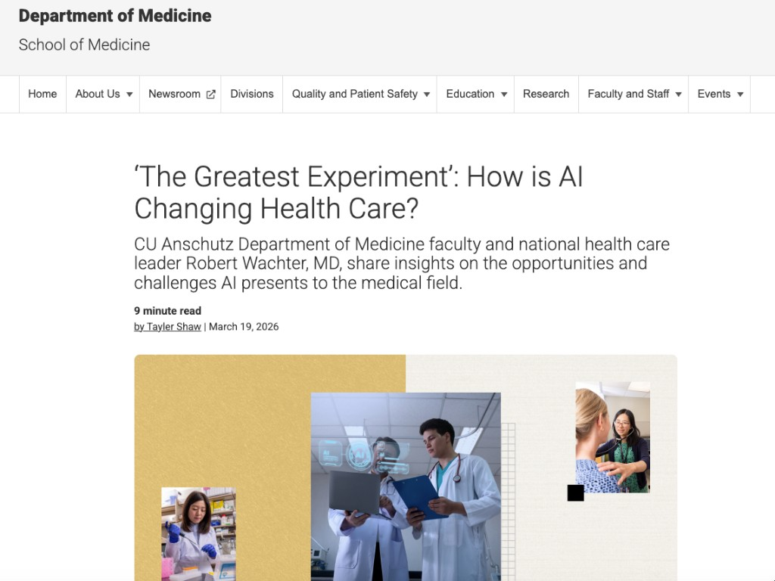
AI at the Bedside
OPEN · 00:00
SIOP 2026 · GLOBAL HEALTH SESSION · KHCC
CU ANSCHUTZ · 19 MARCH 2026
‘The greatest experiment in the history of medicine’
This lesson
1:03 AM
“I think we are in the early stages of probably the greatest experiment in the history of medicine.”
Robert Wachter, MD · UCSF
Interviewed by Tayler Shaw, Department of Medicine, CU Anschutz
Right often enough to be useful.
Wrong often enough not to be trusted.
Hear it in his own voice: instagram.com/reels/DVrUy7okp2N
Article: news.cuanschutz.edu/department-of-medicine/artificial-intelligence-health-care-impact
aibedside.io · https://iyadsultan.github.io/AIBedside.io/
7

Slide 8
This lesson
1:03 AM
We are not here to pick a brand.
We are here to learn a way of working.
First: two seats at the same desk.

Slide 9
AI at the Bedside
OPEN · 00:00
SIOP 2026 · GLOBAL HEALTH SESSION · KHCC
CLAUDE.AI
Chat versus Cowork
This lesson
1:03 AM
Chat
Cowork
A conversation in the window.
You pick a folder on your computer.
You type. It answers.
Attach a file if you need one.
Good for thinking, a draft, a quick check.
It can read and write those files.
A report, a protocol, a set of slides.
Like a colleague at your desk, not a chat box.
Same model. Different job.
aibedside.io · https://iyadsultan.github.io/AIBedside.io/
9

Slide 10
AI at the Bedside
OPEN · 00:00
SIOP 2026 · GLOBAL HEALTH SESSION · KHCC
CHAT VERSUS COWORK
What actually changes
This lesson
1:03 AM
 | Chat | Cowork
Files stay on your computer | No — you attach them | Yes — they stay in the folder
File size limit | Upload cap | No upload cap
Data still goes to Anthropic | Yes | Yes
Rules so PHI does not leave | Too late — you already pasted it | Possible. Needs work.
Organizing a project | One long chat | A folder. Easier.
Skills and extra tools | In the window | Easier to import and use
Work from anywhere | Everywhere | Everywhere
aibedside.io · https://iyadsultan.github.io/AIBedside.io/
10

Slide 11
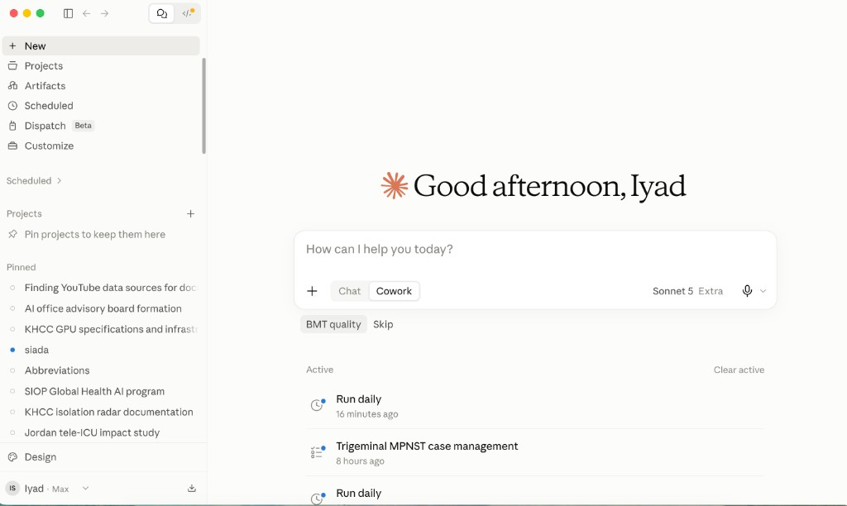
AI at the Bedside
OPEN · 00:00
SIOP 2026 · GLOBAL HEALTH SESSION · KHCC
CLAUDE.AI HOME
The same switch, on the screen
This lesson
1:03 AM
aibedside.io · https://iyadsultan.github.io/AIBedside.io/
11

Slide 12

1
BLOCK 1 · 00:04
Prompting
like a guru
Build the prompt in four pieces: role, context, constraints, format.
This lesson — scan to open
1:03 AM

Slide 13
AI at the Bedside
BLOCK 1 · 00:04
SIOP 2026 · GLOBAL HEALTH SESSION · KHCC
SYNTHETIC CASE · NOT A REAL PATIENT
6-year-old — fever on day 10
This lesson
1:03 AM
SYNTHETIC CASE
NOT A REAL PATIENT
THE JOB
Write a note the parents can take home about tonight.
The same request, sent four ways. Each piece you add changes the answer.
B-ALL, day 10 after intensification. Tunneled central line.
Temperature 38.8 °C at home for 2 hours. ANC this morning: 80 /µL.
Penicillin allergy (rash). Parents ask: can we wait for the morning clinic?
Never paste a real patient into a consumer AI tool.
aibedside.io · https://iyadsultan.github.io/AIBedside.io/
13

Slide 14
AI at the Bedside
BLOCK 1 · 00:04
SIOP 2026 · GLOBAL HEALTH SESSION · KHCC
THE PROMPT
Four pieces. Add them one at a time.
This lesson
1:03 AM
1
Role
2
Context
You are a pediatric oncology nurse writing for a parent who finished primary school.
Synthetic case (not a real patient): 6-year-old, B-ALL, day 10 after intensification · tunneled central line · fever 38.8 °C at home for 2 hours · ANC this morning 80 /µL · penicillin allergy (rash) · the child is coming to the unit now; the parents asked if they could wait until morning clinic.
3
Constraints
4
Format
Do not invent citations · do not use a patient name · grade 6 reading level · this is teaching, not a discharge order · do not tell them they can wait at home.
A short note they can keep: 1) what is happening · 2) what we will do tonight · 3) what they should watch for · 4) one sentence they can repeat to family.
aibedside.io · https://iyadsultan.github.io/AIBedside.io/
14

Slide 15
AI at the Bedside
BLOCK 1 · 00:04
SIOP 2026 · GLOBAL HEALTH SESSION · KHCC
SAME CASE · THE PIECES CHANGE THE ANSWER
What comes back
This lesson
1:03 AM
NO PIECES — JUST THE JOB
ALL FOUR PIECES
Your child has a fever after chemotherapy. Give paracetamol and bring them to the morning clinic if they are otherwise well. A 2019 Smith review found most of these episodes settle at home.
What is happening. Your child has a fever and a very low infection-fighting count. They also have a central line. We treat that as urgent.
What we will do tonight. Come to the unit now. We will take blood, look at the line, and start antibiotics that are safe with the penicillin rash.
What to watch for. New shivering, looking much more tired, fast breathing, or a red line site — tell the nurse at once.
One sentence for family. “Fever with a low count and a line means we come in tonight, not in the morning.”
This is a teaching note, not a discharge order.
Wrong advice, invented citation, no facts. This is the lazy answer.
ROLE + CONTEXT + CONSTRAINTS
Your child has a fever and a very low white-cell count, and they have a central line. That combination is treated as urgent. We want them on the unit tonight, not at home until morning. We will take blood tests and start antibiotics that are safe with the penicillin rash. I am not quoting a paper; we will follow the unit protocol.
Correct, safe, and in the shape the family can keep.
Never paste a real patient into a consumer AI tool.
aibedside.io · https://iyadsultan.github.io/AIBedside.io/
15

Slide 16

2
BLOCK 2 · 00:12
Reading the
literature
One guideline, five outputs: NotebookLM, infographic, video, artifact, mermaid.
This lesson — scan to open
1:03 AM

Slide 17
AI at the Bedside
BLOCK 2 · 00:12
SIOP 2026 · GLOBAL HEALTH SESSION · KHCC
THE SOURCE
One paper for the whole block
This lesson
1:03 AM
JCO 2023
Guideline for the Management of Fever and Neutropenia in Pediatric Patients With Cancer and HCT Recipients: 2023 Update
Lehrnbecher et al. · J Clin Oncol. 2023;41(9):1774-1785 · doi 10.1200/JCO.22.02224
1
Paper
2
Upload
3
Notebook
4
Infographic
5
Video
6
Artifact
7
Mermaid
Open the PDF.
New NotebookLM notebook.
Ask it questions.
Studio → Infographic.
Studio → Video overview.
Claude + paper-to-artifact skill.
Claude + mermaid connector.
Same guideline every time. Only the output changes.
Never paste a real patient into a consumer AI tool.
aibedside.io · https://iyadsultan.github.io/AIBedside.io/
17

Slide 18
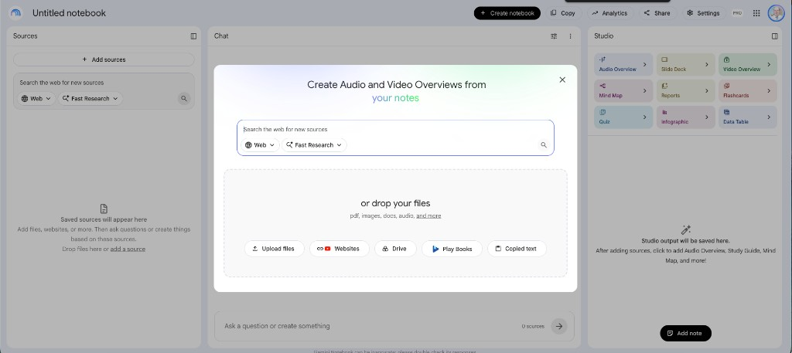
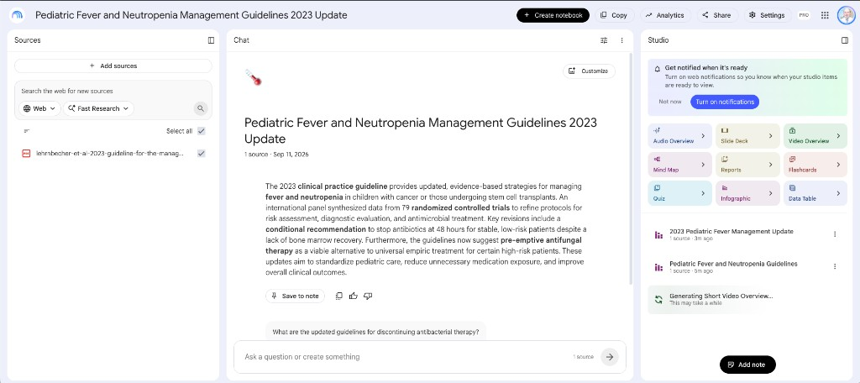
AI at the Bedside
BLOCK 2 · 00:12
SIOP 2026 · GLOBAL HEALTH SESSION · KHCC
STEPS 2 AND 3
NotebookLM — before and after the PDF is in
This lesson
1:03 AM
NEW NOTEBOOK
AFTER THE GUIDELINE IS LOADED
Ask it the question you argue about on the ward. The answer cites the page.
aibedside.io · https://iyadsultan.github.io/AIBedside.io/
18

Slide 19
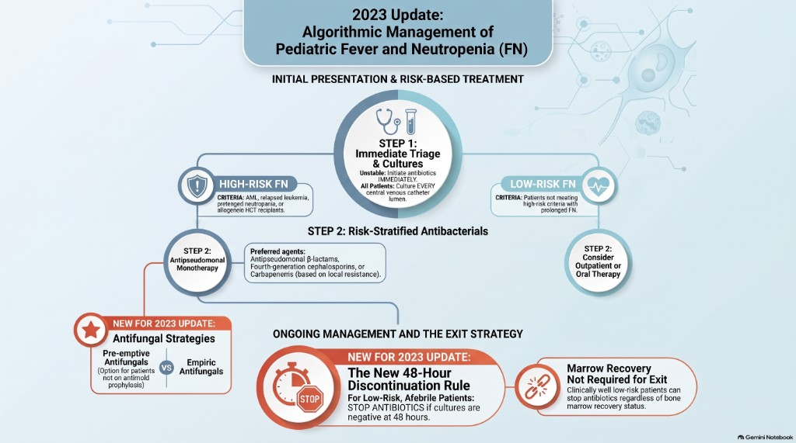
AI at the Bedside
BLOCK 2 · 00:12
SIOP 2026 · GLOBAL HEALTH SESSION · KHCC
STEP 4
Studio → Infographic
This lesson
1:03 AM
aibedside.io · https://iyadsultan.github.io/AIBedside.io/
19

Slide 20
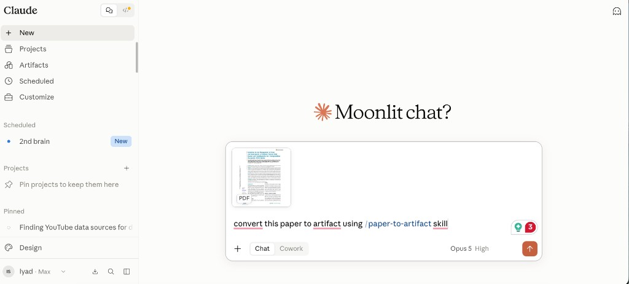
AI at the Bedside
BLOCK 2 · 00:12
SIOP 2026 · GLOBAL HEALTH SESSION · KHCC
STEPS 5 AND 6
Studio → Video overview, then paper → artifact
This lesson
1:03 AM
CLAUDE — PAPER TO ARTIFACT
VIDEO OVERVIEW
NotebookLM turned the same guideline into a short explainer video.
It opens on Google’s site; the companion page links to it. Play it from the site if the network allows.
Same source. Different medium for a different learner.
The prompt: “convert this paper to an artifact using the paper-to-artifact skill.” The result is a clickable explainer of the 2023 algorithm — open it from the Block 2 page on the site.
aibedside.io · https://iyadsultan.github.io/AIBedside.io/
20

Slide 21
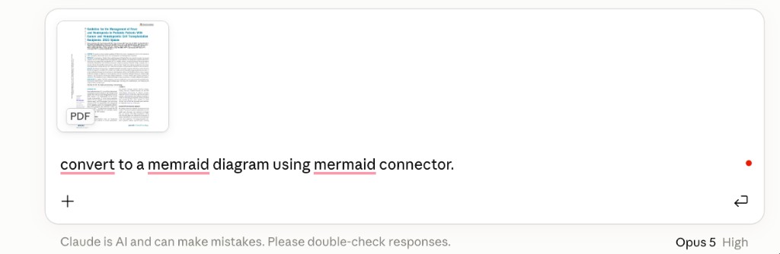
AI at the Bedside
BLOCK 2 · 00:12
SIOP 2026 · GLOBAL HEALTH SESSION · KHCC
STEP 7
Mermaid connector — the algorithm as a diagram
This lesson
1:03 AM
Fever and neutropenia
Blood cultures from every CVC lumen
Unstable? → antibiotics now. Stable? → empiric antibiotics after cultures
The prompt: “convert to a mermaid diagram using the mermaid connector.” The site draws it live. The boxes on the right are the same flow, drawn by hand.
Validated risk rule: high-risk → antipseudomonal monotherapy · low-risk → consider outpatient / oral
48 hours: well, afebrile 24 h, cultures negative?
Marrow recovery → stop · low-risk → consider stop · high-risk → no recommendation · fever to 96 h → IFD pathway
Never paste a real patient into a consumer AI tool.
aibedside.io · https://iyadsultan.github.io/AIBedside.io/
21

Slide 22

3
BLOCK 3 · 00:22
Skills —
your house style
A skill is a prompt you save once and run with /name. Build one. Find a stats library. Open the calculator.
This lesson — scan to open
1:03 AM

Slide 23
AI at the Bedside
BLOCK 3 · 00:22
SIOP 2026 · GLOBAL HEALTH SESSION · KHCC
ON CLAUDE.AI — NO PAID PLAN
What a skill is
This lesson
1:03 AM
Sidebar → Customize → Skills.
A skill is a Markdown file: a prompt, plus a short header that names it.
Simple ones are only text. Fancier ones can carry a bit of code, the way an annual-report skill can run a table.
Either way, it is a saved briefing, not a new product.
Long prompts do not sit in every chat. They load only when you trigger them. That is why twenty skills do not drown one conversation.
THE PATH THIS BLOCK FOLLOWS
1
What
2
Ask
3
File
4
Test
5
Run
6
Everywhere
7
Share
A skill is your SOP written once, applied every time.
aibedside.io · https://iyadsultan.github.io/AIBedside.io/
23

Slide 24
AI at the Bedside
BLOCK 3 · 00:22
SIOP 2026 · GLOBAL HEALTH SESSION · KHCC
PLUS → CREATE SKILL → CREATE WITH CLAUDE
Create with Claude — paste this
This lesson
1:03 AM
YOU
Given a long email or WhatsApp thread among our childhood-cancer team — consultant, registrar, CNC, pharmacist — summarize the main points, list action items by role, and draft a reply in our unit voice. Do not invent patients, labs, or decisions. What else should I clarify?
The last sentence stops it guessing. It will ask you questions before it writes.
When it asks about triggers: pick the slash name. Auto-detect is getting better. Slash is what you can trust.
If it keeps asking questions, say “Create the skill.”
aibedside.io · https://iyadsultan.github.io/AIBedside.io/
24

Slide 25
AI at the Bedside
BLOCK 3 · 00:22
SIOP 2026 · GLOBAL HEALTH SESSION · KHCC
THE FILE CLAUDE WROTE
Front matter, then the prompt
This lesson
1:03 AM
---
name: ward-thread
description: Summarize a team thread, list actions by role, draft a reply in unit voice.
---
You are helping a pediatric oncology clinician catch up on a long thread.
Rules:
- Use only what is in the thread. If a lab or decision is missing, say so.
- No real names, MRNs, or dates of birth in the output.
- Voice: short sentences, no "I hope this email finds you well."
- End with action items grouped as Consultant / Registrar / CNC / Pharmacy.
Output:
1. Five-line summary
2. Action items
3. Two draft replies — one to the team, one the CNC can send to the family
The yellow block at the top is the label. The rest is the briefing.
Claude only loads this file when the skill is on.
The real work is the feedback you type next. “Do not sign off with Best” is a skill update, not a new skill.
Save skill. Three dots → Try in chat. Type /ward-thread, paste the thread, send.
aibedside.io · https://iyadsultan.github.io/AIBedside.io/
25

Slide 26
AI at the Bedside
BLOCK 3 · 00:22
SIOP 2026 · GLOBAL HEALTH SESSION · KHCC
NOT A REAL PATIENT
Test on a synthetic thread
This lesson
1:03 AM
WHATSAPP — NIGHT REGISTRAR, CNC, PHARMACY
/WARD-THREAD — WHAT CAME BACK
Summary. High-risk FN. Family wanted to wait. Team agrees: come in now, cultures, then first-line covering the rash.
Actions. Consultant — ER. Registrar — cultures, then antibiotics. CNC — call the family. Pharmacy — first-line that respects the rash.
Draft to family. Please come to ER tonight. We need cultures and antibiotics the same evening. This is the safe plan after a fever on treatment.
Registrar: 6 yo B-ALL, day 10, fever 38.8 at home 2 h, line in, ANC 80 this morning. Parents ask to wait until clinic.
CNC: I can call them now. Do we bring them in tonight?
Pharmacy: penicillin rash on file. Confirm if we still use our FN first-line.
Consultant: do not wait. Cultures, then antibiotics. I will see them in ER.
Never paste a real patient thread — names, MRNs, photos — into a consumer AI tool.
aibedside.io · https://iyadsultan.github.io/AIBedside.io/
26

Slide 27
AI at the Bedside
BLOCK 3 · 00:22
SIOP 2026 · GLOBAL HEALTH SESSION · KHCC
CHAT, COWORK, CLAUDE CODE
One skill, three places
This lesson
1:03 AM
1
Chat
2
Cowork
3
Claude Code
Slash, paste the thread, go. Install Claude Desktop and the same skill is already there. You do not install it three times.
Point it at a local folder — unit SOP, house voice, last month’s report. The skill can use that folder as context.
Skills live in .claude/skills/ward-thread/. Download from the web app as a zip, drop in that folder, start a new session. Global skills are for every project on your laptop. Project skills stay with the folder you share.
FOUR WAYS TO SHARE — ONE TO AVOID
Way | What happens
Zip file | Works once. Then you have two copies. The next edit splits the team.
Organization skills | Claude Team or Enterprise. Admin uploads once. Everyone can run it. They cannot edit it.
Shared folder | Cowork on a synced drive, plus a CLAUDE.md that points at the skills. Fiddly. Useful with no Team plan.
Git | Skills are text. Version history means you can undo the edit that made it worse.
aibedside.io · https://iyadsultan.github.io/AIBedside.io/
27

Slide 28
AI at the Bedside
BLOCK 3 · 00:22
SIOP 2026 · GLOBAL HEALTH SESSION · KHCC
DOWNLOAD THE .SKILL FILE FROM THE SITE → CUSTOMIZE → SKILLS → UPLOAD A SKILL
Four skills you can take home
This lesson
1:04 AM
/PAPER-TO-ARTIFACT
/PEER-REVIEW
/PRD-BUILDER
/SCIENTIFIC-WRITING
paper-to-artifact
peer-review
prd-builder
scientific-writing
Turns a paper into a clickable explainer — the same move as the fever-and-neutropenia artifact in Block 2.
A structured review of a manuscript or grant: methods, statistics, and reporting checklists such as CONSORT or STROBE.
Turns messy notes or a meeting transcript into a product requirements document — clinical or generic.
Drafts a paper, review, or grant with real citations, instead of a generic chat reply.
Download .skill on the site
Download .skill on the site
Download .skill on the site
Download .skill on the site
Same zip works in Claude Code if you drop the folder into .claude/skills/. Files are at aibedside.io → Block 3.
aibedside.io · https://iyadsultan.github.io/AIBedside.io/
28

Slide 29
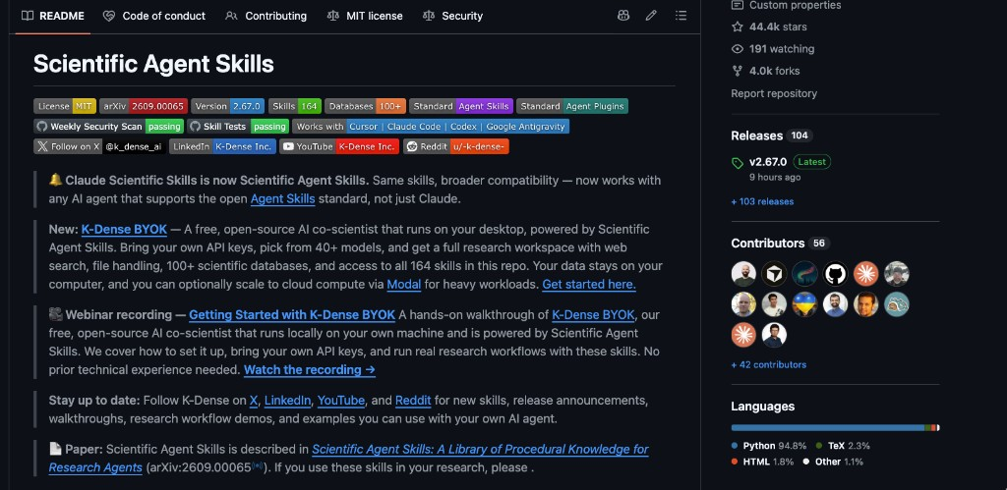
AI at the Bedside
BLOCK 3 · 00:22
SIOP 2026 · GLOBAL HEALTH SESSION · KHCC
SEARCH → LIBRARY → ASK → FINDINGS → ARTIFACT
Find a skill the way you find a paper
This lesson
1:04 AM
GOOGLE — SAME HABIT AS A LITERATURE SEARCH
scientific agent skills github
Skills live in public GitHub folders. You are not looking for an app to buy. Other searches that work: claude scientific skills, agent skills statistics, claude skills sample size.
GITHUB
Scientific Agent Skills
k-dense-ai/scientific-agent-skills · 164 skills · MIT · works with Claude, Cursor, Codex. Statistics, survival, papers, protocols. Do not install all 164. Ask which three you need.
aibedside.io · https://iyadsultan.github.io/AIBedside.io/
29

Slide 30
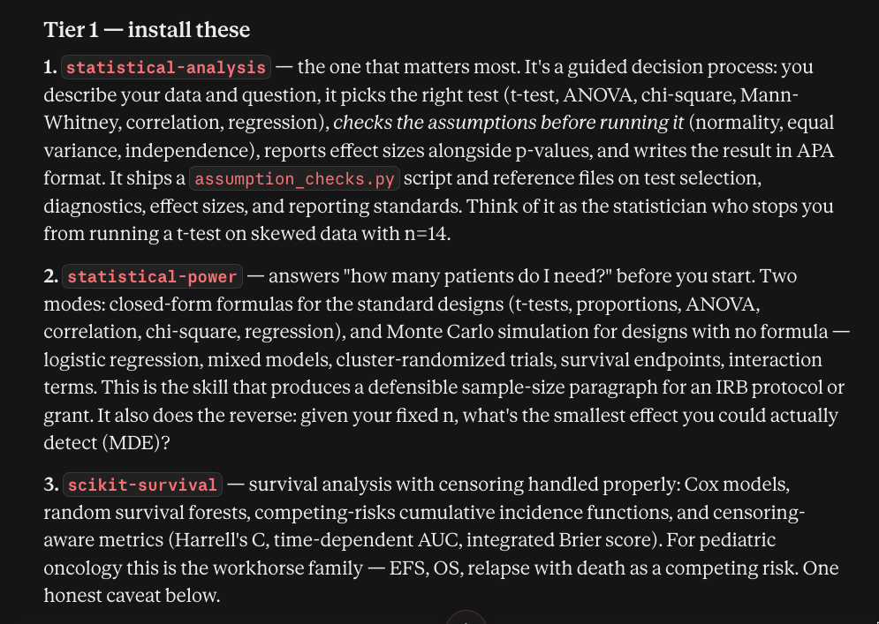
AI at the Bedside
BLOCK 3 · 00:22
SIOP 2026 · GLOBAL HEALTH SESSION · KHCC
PASTE THE LIBRARY LINK. ASK FOR A RANKING, NOT A DUMP.
Ask Claude which statistics skills to install
This lesson
1:04 AM
YOU
I do pediatric oncology research. Look at https://github.com/k-dense-ai/scientific-agent-skills and tell me the best statistics skills to install first.
I need:
1. the right test for my data
2. a sample size before I start a study
3. survival analysis — EFS, OS, competing risks
Rank the top three and say why. Do not install everything.
Then: “proceed with installation in this folder.” Twenty-six files land in .claude/skills/. They only load in that project unless you copy them to your global skills folder.
aibedside.io · https://iyadsultan.github.io/AIBedside.io/
30

Slide 31
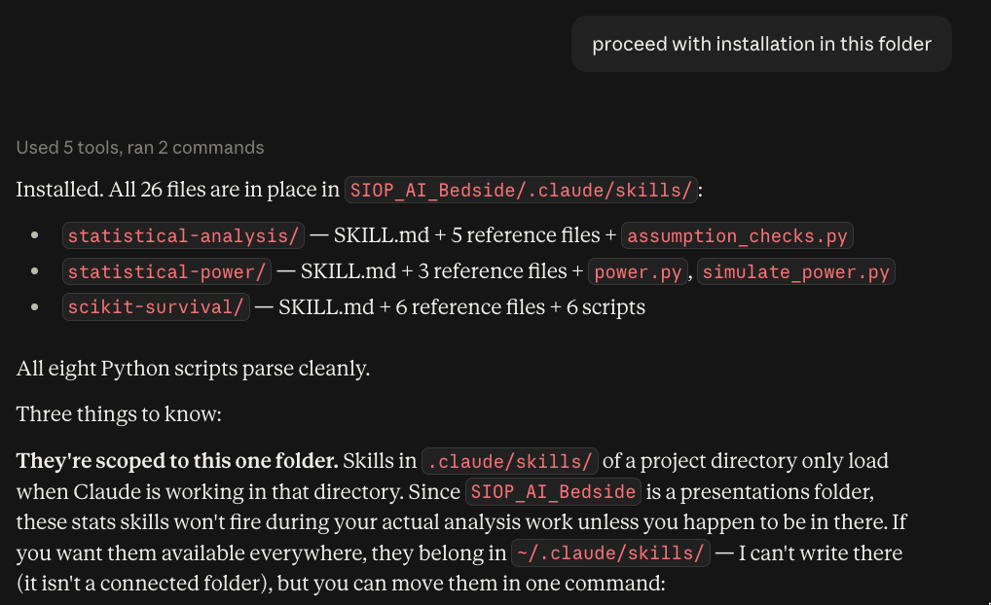
AI at the Bedside
BLOCK 3 · 00:22
SIOP 2026 · GLOBAL HEALTH SESSION · KHCC
NOT 164 SKILLS. THREE.
What Claude picked — install these three
This lesson
1:04 AM
1
statistical-analysis
2
statistical-power
3
scikit-survival
Picks the right test, checks assumptions first, reports effect size with the p-value. Stops you running a t-test on skewed data with n = 14.
Answers “how many patients do I need?” before you start. Also the reverse: with this n, what is the smallest effect you could actually detect.
Survival with censoring handled properly. For this audience: EFS, OS, relapse with death as a competing risk.
aibedside.io · https://iyadsultan.github.io/AIBedside.io/
31

Slide 32
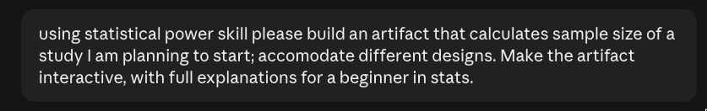
AI at the Bedside
BLOCK 3 · 00:22
SIOP 2026 · GLOBAL HEALTH SESSION · KHCC
THE SKILL DID THE FORMULAS. YOU STILL OWN THE PROTOCOL.
One skill, one artifact
This lesson
1:04 AM
The skill is installed. You do not re-explain statistics. You ask for the thing you need.
Result: an interactive sample-size calculator, several study designs, written for someone who is not a statistician. It opens on Claude’s site — link on the Block 3 page.
Search → pick a library → ask which three → run one. That is how a skill becomes a tool.
aibedside.io · https://iyadsultan.github.io/AIBedside.io/
32

Slide 33

4
BLOCK 4 · 00:29
MCP — connect
your own work
MCP is a USB port for AI. Show it first, then name the parts — on a childhood-cancer unit, not a sales database.
This lesson — scan to open
1:04 AM

Slide 34
AI at the Bedside
BLOCK 4 · 00:29
SIOP 2026 · GLOBAL HEALTH SESSION · KHCC
WHAT MCP IS
One sentence, then stop
This lesson
1:04 AM
MCP (Model Context Protocol) is a shared plug. It lets the chat model reach a file, a mailbox, or a spreadsheet — and do something, not just talk about it.
Drive — protocols
Gmail — drafts
You, in the chat
Claude · ChatGPT · Gemini
MCP
Calendar — tumour board
Unit log — FN list
Before USB-C, every camera had its own cable. Before MCP, every hospital tool needed its own custom hook-up. One plug shape now works across brands. Anthropic published it. OpenAI put it in ChatGPT. Google is doing the same with Gemini. You do not pick a vendor to use the idea.
aibedside.io · https://iyadsultan.github.io/AIBedside.io/
34

Slide 35
AI at the Bedside
BLOCK 4 · 00:29
SIOP 2026 · GLOBAL HEALTH SESSION · KHCC
YOU OPEN ORDINARY CHATGPT — NOTHING CONNECTED — AND ASK ABOUT YOUR WARD.
Same question, no plug
This lesson
1:04 AM
YOU
How many febrile neutropenia admissions did our unit have in August, and how many were high-risk?
CHATGPT — NOT CONNECTED
I don’t have access to your hospital records. If you paste the table or describe the columns, I can tally it. In general, fever during neutropenia is an emergency: high-risk children should get antibiotics quickly, and…
That answer is not wrong. It is a textbook. It has never seen your list. Here it is the FN log it cannot read.
aibedside.io · https://iyadsultan.github.io/AIBedside.io/
35

Slide 36
AI at the Bedside
BLOCK 4 · 00:29
SIOP 2026 · GLOBAL HEALTH SESSION · KHCC
A READ-ONLY CONNECTOR TO A SYNTHETIC FN LOG — A SPREADSHEET, NOT A LIVE EMR
Same question, unit log connected
This lesson
1:04 AM
TOOL — UNIT-LOG CONNECTOR
SYNTHETIC UNIT LOG · NOT KHCC DATA · NOT A REAL PATIENT
Read-only query: count August episodes, split by high-risk vs low-risk. [Continue]
Date | Age | Diagnosis | ANC | Line | Risk | Door-to-abx
3 Aug | 6 | B-ALL, day 10 | 80 | Yes | High — admitted | 38 min
7 Aug | 14 | Osteosarcoma, cycle 3 | 420 | No | Low — outpatient | 55 min
12 Aug | 4 | AML | 40 | Yes | High — admitted | 29 min
18 Aug | 9 | Burkitt | 210 | Yes | High — admitted | 44 min
22 Aug | 11 | Hodgkin | 580 | No | Low — outpatient | 62 min
28 Aug | 3 | Neuroblastoma | 90 | Yes | High — admitted | 41 min
CLAUDE — CONNECTED
Six episodes in August. Four high-risk, all admitted. Two low-risk, both outpatient. The 6-year-old with B-ALL on day 10 is in this list — penicillin rash, house alternative used. Median door-to-antibiotic in the extract: 41 minutes.
The model asks to run a lookup. You click Continue. Then it answers from the rows — and you can check the table.
aibedside.io · https://iyadsultan.github.io/AIBedside.io/
36

Slide 37
AI at the Bedside
BLOCK 4 · 00:29
SIOP 2026 · GLOBAL HEALTH SESSION · KHCC
CLIENT, SERVER, PROTOCOL — ON THE WARD THEY ARE JUST:
Three names, then stop
This lesson
1:04 AM
You type in the chat
Claude · ChatGPT · Gemini
MCP plug
Drive connector
Protocol PDF
Gmail connector
Inbox
Calendar connector
Friday slot
Unit-log connector
FN spreadsheet
Each connector talks to one place. The chat is not “inside” Drive. The connector is. That is why you can add Gmail tomorrow without rewriting the model. Below this walkthrough on the site is a list of medical plugs — PubMed, NICE, trials, imaging, even FHIR. Same idea. Different sockets.
aibedside.io · https://iyadsultan.github.io/AIBedside.io/
37

Slide 38
AI at the Bedside
BLOCK 4 · 00:29
SIOP 2026 · GLOBAL HEALTH SESSION · KHCC
EVERY CONNECTOR ADVERTISES THREE KINDS OF THING. THE MODEL CAN ONLY USE WHAT THAT CONNECTOR LISTED.
What a connector is allowed to do
This lesson
1:04 AM
ACTIONS
THINGS TO READ
STARTER QUESTIONS
Tools
Resources
Prompts
Look up the FN log. Search Drive for the protocol. Draft a Gmail. Book Room 4. Same idea as “run a SQL query” — except the jobs are ours.
Last month’s census. The 2023 fever-and-neutropenia PDF. A de-identified extract. Read-only. Context, not a change.
Saved briefs the connector offers: “Prep Friday tumour board from this week’s FN list.” You still send it. You still read the draft.
A read-only FN log cannot discharge a child. If the Calendar connector cannot delete events, the model cannot cancel clinic. The list of tools is the list of verbs.
aibedside.io · https://iyadsultan.github.io/AIBedside.io/
38

Slide 39
AI at the Bedside
BLOCK 4 · 00:29
SIOP 2026 · GLOBAL HEALTH SESSION · KHCC
SAME JOB: FIND THE 2023 JCO FEVER AND NEUTROPENIA GUIDELINE
Same question, two plugs — PubMed API versus PubMed MCP
This lesson
1:04 AM
PUBMED API — BUILT FOR A PROGRAM
PUBMED MCP — BUILT FOR YOU AND THE MODEL
GET eutils.ncbi.nlm.nih.gov/entrez/eutils/esearch.fcgi
?db=pubmed&term=fever+neutropenia+pediatric+2023+Lehrnbecher
&retmode=json
then efetch with the PMIDs → XML / JSON
You: Find the 2023 JCO fever and neutropenia guideline.
Tool: search_pubmed query: fever neutropenia pediatric JCO 2023 Lehrnbecher
[Continue] → PMID 36626595 · Lehrnbecher et al. J Clin Oncol 2023
You write code, or click the website. The machine speaks HTTP. Errors are status codes. A model can only use this if someone taught it the URL, the parameters, and how to parse the reply.
You speak. You approve. The model fills in the tool. Errors come back as a sentence. The connector still calls Entrez; it just advertises tools with names the model can read, and a Continue button you can refuse.
Same core: NCBI Entrez under pubmed.gov, under every script, and under mcp-simple-pubmed. MCP is not a new PubMed. It is a plug that both a human and an LLM can hold.
aibedside.io · https://iyadsultan.github.io/AIBedside.io/
39

Slide 40
AI at the Bedside
BLOCK 4 · 00:29
SIOP 2026 · GLOBAL HEALTH SESSION · KHCC
RUN ONE SENTENCE ACROSS PLUGS YOU ALREADY HAVE
One sentence, three connectors
This lesson
1:04 AM
YOU
Find the tumour-board template on Drive, draft Friday’s note from this week’s FN list, and put the meeting on my calendar Friday 08:00, Room 4.
1
Drive
2
Unit log
3
Gmail
4
Calendar
Found Tumour-board-note-template.docx in the shared protocols folder.
Three high-risk FN this week, including the day-10 B-ALL with the penicillin rash.
Draft to the team — not sent. You read it the way you read a letter before you sign it.
Friday 08:00, Room 4, title: Paediatric tumour board.
Continue
Continue
Continue
Continue
Continue is the same habit as signing the order. The model proposes. You release it.
aibedside.io · https://iyadsultan.github.io/AIBedside.io/
40

Slide 41
AI at the Bedside
BLOCK 4 · 00:29
SIOP 2026 · GLOBAL HEALTH SESSION · KHCC
A CONNECTOR WORKS BECAUSE IT USES YOUR LOGIN
The point, and the risk
This lesson
1:04 AM
If you can open the shared Drive, so can the model once the plug is in. If you can send mail as the unit, so can a Gmail connector — if you click Continue on send.
Fine on Monday
Not this week
Claude or ChatGPT connected to a folder of public guidelines, or a synthetic / de-identified spreadsheet on your laptop.
A live EMR, a pharmacy system, or anyone’s real inbox, plugged into a consumer chat. That is an IT project, not a conference demo.
A connector inherits your access — that is the point and the risk.
Never paste a real patient list — names, MRNs, dates of birth — into a consumer AI tool, even through a connector.
aibedside.io · https://iyadsultan.github.io/AIBedside.io/
41

Slide 42
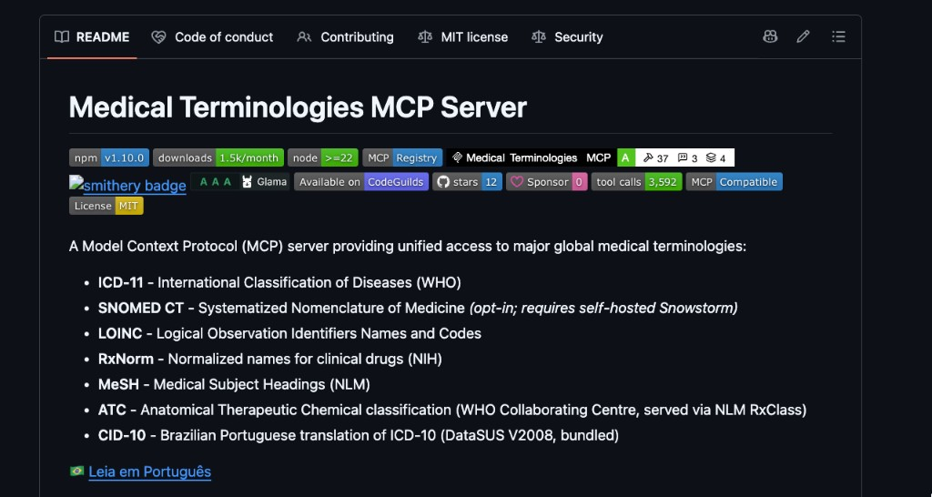
AI at the Bedside
BLOCK 4 · 00:29
SIOP 2026 · GLOBAL HEALTH SESSION · KHCC
LIVE ON THE SITE: CLAUDE HAIKU 4.5 WITH AND WITHOUT THE MEDICAL-TERMINOLOGIES PLUG
Same question, two Claudes
This lesson
1:04 AM
YOU — SENT TO BOTH PANES
What is the ICD-11 code for febrile neutropenia, and the RxNorm name for the first-line antipseudomonal we would use with a penicillin rash?
HAIKU — NO PLUG
HAIKU + MEDICAL-TERMINOLOGIES MCP
Recalls from memory. Gives a plausible-looking code and a drug name. No lookup happens. You cannot tell from the answer whether the code is current.
Calls a named tool for ICD-11 and one for RxNorm. Shows the tool call, then the answer built from what came back. You can open the same code in the source.
One connector, seven code systems: ICD-11, LOINC, RxNorm, MeSH, ATC, CID-10, and SNOMED CT if you host it. github.com/SidneyBissoli/medical-terminologies-mcp. Watch which side looks a code up.
aibedside.io · https://iyadsultan.github.io/AIBedside.io/
42

Slide 43
AI at the Bedside
BLOCK 4 · 00:29
SIOP 2026 · GLOBAL HEALTH SESSION · KHCC
COMMUNITY CONNECTORS, NOT A KHCC INSTALL LIST · CATALOGUE: GITHUB.COM/SUNANHE/AWESOME-MEDICAL-MCP-SERVERS
Medical MCP examples
This lesson
1:04 AM
Group | Examples | Try where?
Literature and evidence | mcp-simple-pubmed · pubmedmcp · mcp-pubmed-server · medrxiv-mcp-server · medadapt-content-server | Your laptop
Guidelines and decision support | medical-terminologies-mcp (ICD-11, LOINC, RxNorm, MeSH, ATC) · chris-lovejoy/medical-mcp (NICE) · Medical_calculator_MCP · JamesANZ/medical-mcp (FDA, WHO, PubMed) | Your laptop
Records (FHIR, EMR) | agentcare-mcp / langcare-mcp-fhir · wso2/fhir-mcp-server · openehr-mcp-server · FHIR care-plan toolkits | IT, not a conference laptop
Imaging and radiology | dicom-mcp · dicom-mcp-server · mcp-slicer (3D Slicer) | IT / PACS team
Biomedical databases, trials, terms | pascalwhoop/medical-mcps (100+ tools) · bio-mcp · clinicaltrialsgov-mcp-server · fhir-mcp-suite · Keragon (commercial) | Public ones on a laptop
Public literature plugs are the ones you can try on a laptop. Anything that touches an EMR, PACS, or real identifiers stays with IT.
aibedside.io · https://iyadsultan.github.io/AIBedside.io/
43

Slide 44

5
BLOCK 5 · 00:34
CLAUDE.md —
the kitchen contract
Standing orders for a folder. Five policies in. A wiki and a quality review out.
This lesson — scan to open
1:04 AM

Slide 45
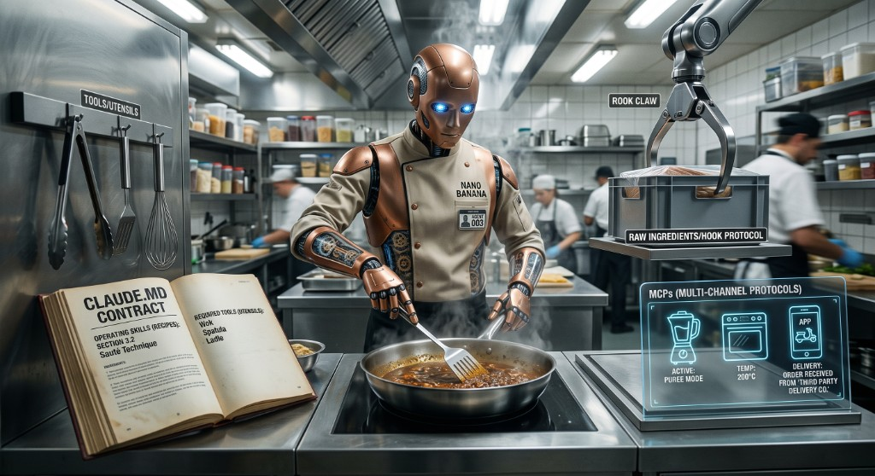
AI at the Bedside
BLOCK 5 · 00:34
SIOP 2026 · GLOBAL HEALTH SESSION · KHCC
THE ROBOT IS NOT THE POINT. THE BOOK ON THE LEFT IS.
One picture, then the names
This lesson
1:04 AM
The book
CLAUDE.md — the contract. Standing orders read at the start of every session. You do not re-explain the job.
The recipes
Skills — Block 3.
The appliances
MCP — the plug, Block 4.
The ingredients
Whatever you drop in the folder.
aibedside.io · https://iyadsultan.github.io/AIBedside.io/
45

Slide 46
AI at the Bedside
BLOCK 5 · 00:34
SIOP 2026 · GLOBAL HEALTH SESSION · KHCC
THE WHOLE BRIEF: READ THE FOLDER, MAKE A WIKI, WRITE A SUMMARY. DO NOT INVENT A RULE.
A short file, left in the project
This lesson
1:04 AM
# Cedar Ward — standing orders
You are the unit's second brain for written policy.
This folder is a teaching copy. It is not KHCC policy.
## When files land in policies/
1. Read every document, including appendices.
2. Convert each into one wiki note in wiki/.
3. Link notes wherever they share a topic.
4. Write summary.html for the quality committee.
## The summary must include
- Inventory of the documents
- Contradictions, with the quoted sentences
- Errors, duplications, and suggestions
- Who should own each fix
## Hard rules
- Do not invent a rule that is not in the files.
- If you are unsure, say so.
- Never paste a real patient name or MRN.
Read at the start of every session — in Cowork or Claude Code.
It names the job, the outputs, and the lines it must not cross.
Skills are the recipes. MCP is the appliances. This is the book the chef follows every shift.
Full file on the site: Block 5 → Open the full CLAUDE.md.
aibedside.io · https://iyadsultan.github.io/AIBedside.io/
46

Slide 47
AI at the Bedside
BLOCK 5 · 00:34
SIOP 2026 · GLOBAL HEALTH SESSION · KHCC
CEDAR WARD, RIVERSIDE CHILDREN’S CANCER CENTRE. MADE UP ON PURPOSE. THEY DO NOT AGREE WITH EACH OTHER.
Five policies, dropped in a folder
This lesson
1:04 AM
POL-CW-01
POL-CW-02
POL-CW-03
POL-CW-04
POL-CW-05
Febrile neutropenia
Central lines
Visitors & isolation
Chemo safety
Discharge fever leaflet
ID · Mar 2024 · ages 0–18
Vascular access · Jan 2026 · under 16
IPC · Jun 2023 · review overdue
Pharmacy · Nov 2025 · ages 0–21
Nursing education · ID has not signed
WHAT THE MODEL FOUND
Three age bands
Two ANC cut-offs
Two first-line antibiotics
The leaflet says wait
0–18, under 16, 0–21. Which ward is this?
The policies disagree on who is neutropenic.
Pharmacy and ID name different drugs.
The family leaflet tells parents to wait until morning.
aibedside.io · https://iyadsultan.github.io/AIBedside.io/
47

Slide 48
AI at the Bedside
BLOCK 5 · 00:34
SIOP 2026 · GLOBAL HEALTH SESSION · KHCC
A WIKI NOTE IS NOT A REWRITE. IT IS THE RULES, THE LINKS, AND THE OPEN QUESTIONS.
Second brain — one note per file, linked
This lesson
1:04 AM
Central lines
Heparin rule disagrees with itself
Visitors
Review overdue · unlimited adults
Dark dots are notes. Pale dots are the files they came from.
Febrile neutropenia sits in the middle because every other note argues with it.
On the site the map is clickable — a dot opens the file.
Febrile neutropenia
the hub
SUMMARY.HTML
Chemo safety
Warm pack on doxorubicin
Discharge leaflet
Links to the rule it undoes
The file the committee actually opens
Not a chat reply. A briefing: inventory, quoted contradictions, errors, duplications, and who should fix what. First screen: the family leaflet next to the ID rule.
A skill is a recipe. MCP is a plug. CLAUDE.md is the standing orders for the folder. That is how a drop of policies becomes a wiki and a quality review, instead of another chat you cannot find next week.
aibedside.io · https://iyadsultan.github.io/AIBedside.io/
48

Slide 49

6
BLOCK 6 · 00:37
Small models
& the edge
Four places a model can live. Fine-tune here. Federate across hospitals — scans never leave.
This lesson — scan to open
1:04 AM

Slide 50
AI at the Bedside
BLOCK 6 · 00:37
SIOP 2026 · GLOBAL HEALTH SESSION · KHCC
FOUR PLACES. FAR TO NEAR.
Where does the program sit when you send it a note?
This lesson
1:04 AM
1 · Public cloud
2 · Contracted cloud
3 · Hospital servers
4 · On this device
Large model on the cloud, via a connector API
Large model, HIPAA path with a BAA
Large model on-premise
Small model on the edge (1–8B)
Notes leave the hospital
Notes leave — under contract
Notes stay inside the walls
Notes stay on this laptop
ChatGPT, Claude, Gemini in the browser. Usually no hospital contract.
Azure OpenAI, AWS Bedrock, Google Vertex through a private encrypted link.
Computers in the hospital’s own data centre. You own the box, so you own the rules.
Small enough for a laptop, a phone, a browser tab. Compute stays where the notes already are.
A BAA (Business Associate Agreement) is a contract that says the vendor must protect patient information the way the hospital must. HIPAA is the US name. Outside the US you still want the same kind of contract under your own law.
aibedside.io · https://iyadsultan.github.io/AIBedside.io/
50

Slide 51
AI at the Bedside
BLOCK 6 · 00:37
SIOP 2026 · GLOBAL HEALTH SESSION · KHCC
SMALL AND LOCAL FOR THE ROUTINE AND THE SENSITIVE; LARGE AND REMOTE FOR THE DIFFICULT.
Pros and cons, square by square
This lesson
1:04 AM
 | Pros | Cons
1 · Public cloud | Strongest models, ready this afternoon · nothing to install; connectors to Drive, mail, PubMed · cheap to try | Patient notes leave the hospital · consumer terms, no BAA · needs the internet
2 · Contracted cloud | Large-model quality with a legal contract · encrypted, logged, access-controlled · IT can switch it off for a unit | Notes still leave the building, to a named vendor · needs IT, money, and months · not a conference-laptop demo
3 · Hospital servers | Data never leaves the hospital · you set who can use it · keeps working if the public internet is down | GPUs and staff cost real money · usually a step behind ChatGPT · hard for a small unit to own alone
4 · On this device | Notes never leave this device · works with the wi-fi off · no per-token bill; answers the sovereignty question | Weaker at hard, open-ended questions · best at narrow jobs, not a second opinion · first download is large — cache it before you demo
aibedside.io · https://iyadsultan.github.io/AIBedside.io/
51

Slide 52
AI at the Bedside
BLOCK 6 · 00:37
SIOP 2026 · GLOBAL HEALTH SESSION · KHCC
THE NEXT MOVE
Teach it on our data. Do not ship the notes.
This lesson
1:04 AM
A general model is a new intern from a good school. It can write. It has not rotated on your ward. Fine-tuning is that extra month of practice on your examples — your reports, your language, your habit. You are not building a new intern from scratch. You are sending this one to your unit.
EXTRA PRACTICE ON LOCAL EXAMPLES
THE INTERN GOES ON ROTATION
Fine-tune · one hospital
Federate · many hospitals
Show the model a few hundred of your reports. It copies the local habit. Notes never leave the building. This is square 3 or 4 with homework.
The same extra practice, at every site. Each hospital trains on its own scans. Only the updated lesson — not the images, not the names — comes back.
Pediatric data is the hard case: rare enough that no single centre has enough, sensitive enough that you cannot post the archive to a shared drive. Data-use agreements and de-identification eat years. So turn the arrow around.
aibedside.io · https://iyadsultan.github.io/AIBedside.io/
52

Slide 53
AI at the Bedside
BLOCK 6 · 00:37
SIOP 2026 · GLOBAL HEALTH SESSION · KHCC
BRING THE DATA TO THE MODEL · BRING THE MODEL TO THE DATA
Turn the arrow around
This lesson
1:04 AM
Usual study
Federated learning
Bring the data to the model
Bring the model to the data
Site A
Site B
Site C
Site A
scans stay
Site B
scans stay
Site C
scans stay
ONE BOX · all the scans · contracts, de-id, years
MODEL visits · only the lesson travels
Copy every MRI into one computer. Lawyers first. Imaging later. A 19-hospital pediatric archive almost never leaves the building this way.
Each hospital trains on what it already holds. You still need an ethics board. You do not assemble one giant copy of everyone’s MRI archive.
aibedside.io · https://iyadsultan.github.io/AIBedside.io/
53

Slide 54
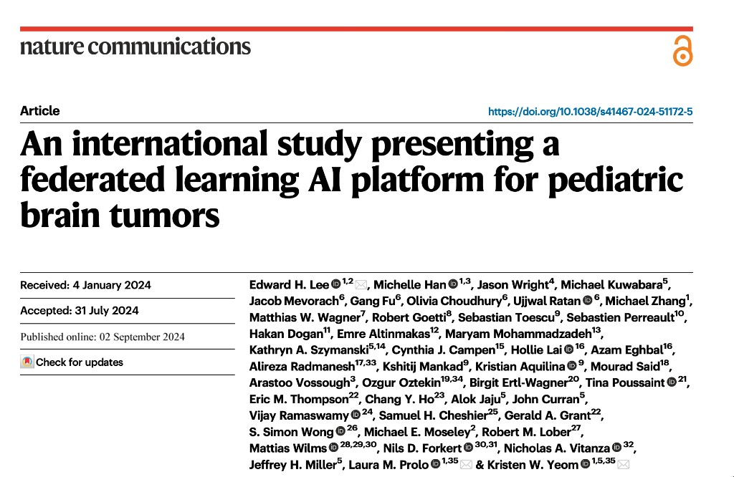
AI at the Bedside
BLOCK 6 · 00:37
SIOP 2026 · GLOBAL HEALTH SESSION · KHCC
NATURE COMMUNICATIONS 2024 · DOI 10.1038/S41467-024-51172-5
FL-PedBrain — the scans never sat in one folder
This lesson
1:04 AM
An international study presenting a federated learning AI platform for pediatric brain tumors
Lee, Han, Wright, Prolo, Yeom et al. · Nat Commun 15, 7615 (2024)
19
1,468
sites, five continents
children, posterior fossa tumours
<1.5%
20–30%
off pooling everything (classification)
better than one hospital alone (segmentation)
Medulloblastoma, ependymoma, pilocytic astrocytoma, DIPG. The model learned to classify the tumour and draw its outline on MRI. That is the SIOP problem, and the SIOP opening.
aibedside.io · https://iyadsultan.github.io/AIBedside.io/
54

Slide 55
AI at the Bedside
BLOCK 6 · 00:37
SIOP 2026 · GLOBAL HEALTH SESSION · KHCC
ON THE SITE: LOAD ONCE (~290 MB), THEN SWITCH THE WI-FI OFF
Square 4, live — Bonsai 1.7B in a browser tab
This lesson
1:04 AM
Prism ML’s 1-bit Bonsai 1.7B, weights from onnx-community/Bonsai-1.7B-ONNX. After the first download it stays in the browser.
The demo: paste a sentence with language errors and ask it to fix the English. Nothing is sent to a cloud.
It is not a second opinion. It is the fourth square: a narrow job, on the computer that already has the note.
Chrome or Edge works best. Cache it before you demo.
YOU → BONSAI (WI-FI OFF)
Fix the English: “the patient have fever since 2 hour and the ANC are 80, we brought him in the ER”.
BONSAI 1.7B — IN THIS TAB
The patient has had a fever for two hours and the ANC is 80. We brought him to the ER.
(Illustrative of the demo output; the live model rephrases slightly each run.)
Small and local for the routine and the sensitive; large and remote for the difficult. When the notes cannot travel, send the model. Fine-tune on one hospital. Federate across the network.
aibedside.io · https://iyadsultan.github.io/AIBedside.io/
55

Slide 56

7
BLOCK 7 · 00:43
A small app
in five minutes
A saved skill writes the brief. The brief writes the app. You still own the rules.
This lesson — scan to open
1:04 AM

Slide 57
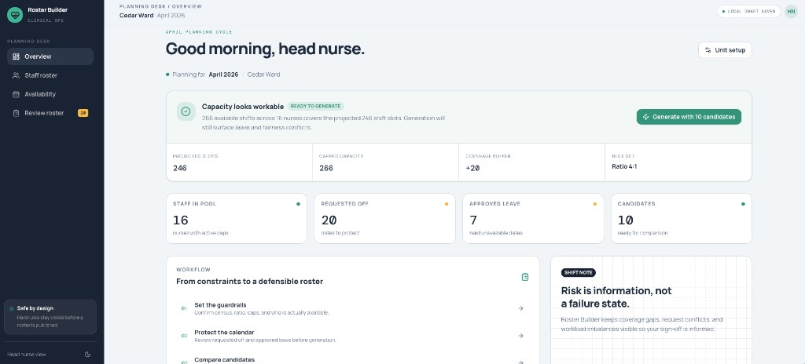
AI at the Bedside
BLOCK 7 · 00:43
SIOP 2026 · GLOBAL HEALTH SESSION · KHCC
A HEAD NURSE’S MONTHLY HEADACHE, AS SOMETHING YOU CAN SHOW IT ON MONDAY
Roster Builder, live — Cedar Ward, April 2026
This lesson
1:04 AM
Staff list, requested days off, and approved leave are in. Capacity is green. Generate ten candidates. Compare. Export. Live at roster-builder-iyadsultan.replit.app — no patient names anywhere.
aibedside.io · https://iyadsultan.github.io/AIBedside.io/
57

Slide 58
AI at the Bedside
BLOCK 7 · 00:43
SIOP 2026 · GLOBAL HEALTH SESSION · KHCC
BLOCK 1 TAUGHT THE PROMPT. BLOCK 3 GAVE YOU PRD-BUILDER. HERE THEY EARN THEIR KEEP.
Five beats. Do not skip the last one.
This lesson
1:04 AM
1
Prompt
2
Skill
3
PRD
4
App
5
Still
Name the job. Name the input. Name the constraint. Ask it not to guess.
The skill asks the missing pieces before it writes a word.
Who it is for. What it must do. What it must never do.
Ten candidate rosters, ranked, on Replit.
Screens, server, locks, store, who may look, a real address, a hosting bill, and talking to other apps.
The app is the proof. The PRD is the thing you keep. The last beat is what IT will ask you on Monday.
aibedside.io · https://iyadsultan.github.io/AIBedside.io/
58

Slide 59
AI at the Bedside
BLOCK 7 · 00:43
SIOP 2026 · GLOBAL HEALTH SESSION · KHCC
CUSTOMIZE → SKILLS → TURN ON PRD-BUILDER
On Claude.ai — prd-builder on. Paste this.
This lesson
1:04 AM
YOU
THE SKILL STOPS AND ASKS
Write a PRD for a nurse call-scheduling tool.
Input: a list of nurses with name, seniority level, the maximum number of call shifts each can take, and the October dates they've asked not to be on duty.
The tool should generate ten or more candidate call schedules and rank them on how evenly they distribute workload — total shifts, day versus night, and weekends — and on how many of the requested days off they satisfy.
Constraint: keep the patient-to-nurse ratio at 4 patients per nurse per shift. The unit holds 20 patients on weekdays and 15 on weekends.
Ask me if anything is unclear.
How many shifts in a day?
Three 8-hour shifts: Morning 07:00–15:00, Evening 15:00–23:00, Night 23:00–07:00. Not two.
Are requested days off a hard block?
No. Requested off is a preference. Approved leave is a hard block — never schedule through it.
Must every shift have a senior nurse?
Yes. A candidate that leaves a shift without a Senior is never shown.
aibedside.io · https://iyadsultan.github.io/AIBedside.io/
59

Slide 60
AI at the Bedside
BLOCK 7 · 00:43
SIOP 2026 · GLOBAL HEALTH SESSION · KHCC
ROSTER BUILDER — A SMALL DJANGO APP FOR ONE UNIT
What the skill wrote
This lesson
1:04 AM
The head nurse types the staff list, marks leave, and gets ten legal October schedules, ranked on coverage, fairness, and requests honoured. Export to Excel or PDF. No patient names anywhere. Census is just a number.
Never break — no one works approved leave · one shift per nurse per day · stay under the monthly cap · a Senior on every shift · night → off the next calendar day · no evening then next morning · no more than 5 days in a row
WEEKDAY
WEEKEND
OCTOBER 2026
20 patients
15 patients
438
5 nurses × 3 shifts × 22 days
4 nurses × 3 shifts × 9 days
nurse-shifts to fill
At a 21-shift cap you need about 21 nurses with no leave — realistically 24 or more. Senior cover on all 93 shifts is usually the binding constraint, not headcount.
Rank on these — requested days off honoured · even share of total shifts · even nights · even weekends
A schedule that breaks a hard rule is not a candidate. Soft rules are scored, not guaranteed.
Full PRD on the site: Block 7 → Read the full PRD / Download .md. Then open Replit and paste it.
aibedside.io · https://iyadsultan.github.io/AIBedside.io/
60

Slide 61
AI at the Bedside
BLOCK 7 · 00:43
SIOP 2026 · GLOBAL HEALTH SESSION · KHCC
REPLIT — EASY TO START, A MONTHLY BILL, NOT A HOSPITAL SYSTEM
Then hand the PRD to a builder
This lesson
1:04 AM
Easy to use
Prompt an app
Any coding skill
Backend + database
Type what you want in ordinary words. Watch a working page appear.
Paste the PRD. That is the whole brief. Do not start from a blank file.
A head nurse and a resident can both try. You do not need the same background.
Not just a pretty page. It can save the staff list and serve it next time.
Affordable, not free
Secure, not HIPAA
Right job
Five minutes is the demo
A small monthly bill. Ask who pays before you promise the unit a tool.
Login and HTTPS, but no hospital contract. Do not put real patients here.
A proof of concept, a first working version, or a place to develop. Not the ward on Monday.
The week of checking it against a real month is still yours.
Never paste a real staff roster — names, leave dates, employee numbers — into a consumer cloud builder unless your hospital has already said that hosting is allowed.
aibedside.io · https://iyadsultan.github.io/AIBedside.io/
61

Slide 62
AI at the Bedside
BLOCK 7 · 00:43
SIOP 2026 · GLOBAL HEALTH SESSION · KHCC
A QUICK APP STILL HAS EIGHT JOBS. SKIP ONE AND YOU HAVE A DEMO, NOT A HOSPITAL TOOL.
What five minutes did not buy you
This lesson
1:04 AM
1
Front end
2
Back end
3
Security
4
Database
The screens people click. If a head nurse cannot read it from a ward computer, it is not done.
The hidden work. Saving the staff list. Running the generator. Building the Excel file.
Locks. Encrypted traffic. No passwords in the code. A log of who opened what.
Where the lists live after you close the tab. A file on someone’s laptop is not a database.
5
Who may look
6
Domain name
7
Hosting — and the bill
8
Talking to other apps
Authorization — permission, not just a login. The head nurse sees Cedar Ward. Not every ward.
roster.yourhospital.org can live on a badge. A Replit link is a temporary street.
The computer the app lives on is a monthly cost. Backups, and a promise it stays up overnight.
A live roster should speak to HR, email, or the record. That is integration.
Roster Builder is the conversation with IT. These eight are the work after the conversation.
aibedside.io · https://iyadsultan.github.io/AIBedside.io/
62

Slide 63
AI at the Bedside
BLOCK 7 · 00:43
SIOP 2026 · GLOBAL HEALTH SESSION · KHCC
HIPAA IN THE US, GDPR IN EUROPE, AND YOUR OWN NATIONAL LAW ALL SAY THE SAME FIRST MOVE
If the app holds patient data: de-identify before it lands
This lesson
1:04 AM
WHAT YOU MUST NOT STORE
WHAT THE DATABASE HOLDS
142-04-6697
34321226754342423
US Social Security number — or your local national ID. This example is made up.
becomes
A token. Only the hospital vault knows the pairing.
Swap the real identifier for a token the hospital vault can map back, and the app cannot. Names, dates of birth, national IDs, and medical record numbers all count.
Roster Builder sidesteps this on purpose: census is a number, not a patient list. Staff names and leave are still personal data. The moment you add an MRN, this swap is required.
Write the brief first. A prototype starts the conversation with IT; it does not replace screens, a server, a database, security, who may look, a real address, a hosting bill, or a way to talk to other apps. Patient IDs go in as tokens, not as the real number.
aibedside.io · https://iyadsultan.github.io/AIBedside.io/
63

Slide 64

8
BLOCK 8 · 00:48
AI for
research
Plug the chat into your own Zotero library, step by step — then the model writes the code; you remain the author.
This lesson — scan to open
1:04 AM

Slide 65
AI at the Bedside
BLOCK 8 · 00:48
SIOP 2026 · GLOBAL HEALTH SESSION · KHCC
ZOTERO-MCP — A FREE COMMUNITY CONNECTOR THAT TALKS TO THE ZOTERO APP ALREADY RUNNING ON YOUR MACHINE
Five steps. Ten minutes. Nothing leaves your laptop.
This lesson
1:04 AM
1
Zotero
2
Install
3
Connect
4
Check
5
Ask
Zotero 7 open, with one tick-box turned on.
Two lines in a terminal. One installs the tool runner, one installs the plug.
One command writes the Claude Desktop config for you. Restart Claude.
Ask Claude for your five most recent items. If it lists them, you are done.
The real question: find, summarise, cite — from your own library.
No account, no upload, no key needed for reading. Works in Claude Desktop on Mac or Windows — not in the browser tab.
The terminal is the only unfamiliar part. It is three pasted lines. Everything else is clicking.
aibedside.io · https://iyadsultan.github.io/AIBedside.io/
65

Slide 66
AI at the Bedside
BLOCK 8 · 00:48
SIOP 2026 · GLOBAL HEALTH SESSION · KHCC
ZOTERO KEEPS ITS LOCAL DOOR SHUT BY DEFAULT. OPEN IT ONCE.
Step 1 · Let Zotero answer the door
This lesson
1:04 AM
1
Install or update to Zotero 7
zotero.org/download. Zotero 6 does not have the local door. Check the version under Help → About Zotero.
2
Open Settings
Mac: Zotero → Settings. Windows: Edit → Settings.
3
Advanced → tick one box
“Allow other applications on this computer to communicate with Zotero.” That is the whole setting. Close Settings.
4
Leave Zotero running
The plug only works while Zotero is open. If Claude later says it cannot reach Zotero, this is the first thing to check.
“Other applications on this computer” means exactly that. Nothing on the internet can use this door. It is the chat app on your laptop talking to the Zotero app on your laptop.
aibedside.io · https://iyadsultan.github.io/AIBedside.io/
66

Slide 67
AI at the Bedside
BLOCK 8 · 00:48
SIOP 2026 · GLOBAL HEALTH SESSION · KHCC
PASTE LINE ONE. CLOSE AND REOPEN THE TERMINAL. PASTE LINE TWO.
Step 2 · Two lines in a terminal
This lesson
1:04 AM
MAC — TERMINAL (SPOTLIGHT, TYPE TERMINAL)
WINDOWS — POWERSHELL (START, TYPE POWERSHELL)
Line 1 — install uv, the tool runner
Line 1 — install uv, the tool runner
curl -LsSf https://astral.sh/uv/install.sh | sh
powershell -ExecutionPolicy ByPass -c "irm https://astral.sh/uv/install.ps1 | iex"
Close the terminal, reopen it. Line 2 — install the plug
Close the terminal, reopen it. Line 2 — install the plug
uv tool install zotero-mcp-server
uv tool install zotero-mcp-server
Then confirm it landed. This should print a version number, nothing else.
zotero-mcp version
What uv is
“command not found”
A small program that installs and runs Python tools without you touching Python. The App Store for command-line plugs. Install once and forget it.
You did not reopen the terminal after line 1. Close it fully, open a new one, try again. On Mac, uv tool update-shell then reopen also fixes it.
aibedside.io · https://iyadsultan.github.io/AIBedside.io/
67

Slide 68
AI at the Bedside
BLOCK 8 · 00:48
SIOP 2026 · GLOBAL HEALTH SESSION · KHCC
CLAUDE DESKTOP KEEPS A SMALL FILE LISTING ITS PLUGS. YOU DO NOT HAVE TO EDIT IT BY HAND.
Step 3 · One command writes the config
This lesson
1:04 AM
zotero-mcp setup
THE ENTRY IT ADDED
{
"mcpServers": {
"zotero": {
"command": "zotero-mcp",
"env": { "ZOTERO_LOCAL": "true" }
}
}
}
1
“Use local Zotero API?” → press Enter
Yes is the default. Local means the door you opened in Step 1. No key, no account.
2
“Configure semantic search?” → skip for today
It offers to build an AI index of your PDFs. Useful later, slow now. Keyword search works without it.
3
It writes the Claude Desktop file
You will see a path ending in claude_desktop_config.json.
Reading only, by design. Adding an API key from zotero.org lets the plug write to your library too (add items, notes, tags). Do that on a day you have time to check what it wrote.
4
Quit Claude Desktop fully, then reopen
Mac: ⌘Q, not the red dot. Windows: right-click the tray icon → Quit. Claude reads the plug list only on launch.
aibedside.io · https://iyadsultan.github.io/AIBedside.io/
68

Slide 69
AI at the Bedside
BLOCK 8 · 00:48
SIOP 2026 · GLOBAL HEALTH SESSION · KHCC
NEW CHAT → TOOLS ICON UNDER THE MESSAGE BOX → ZOTERO SHOULD BE IN THE LIST
Step 4 · Prove it
This lesson
1:04 AM
YOU
IF IT DOES NOT WORK
List the five most recent items in my Zotero library. Title, first author, year.
No zotero in the tools list
Claude was not fully quit. ⌘Q or tray-icon Quit, reopen. Still missing: run zotero-mcp setup-info and check the path it prints exists.
TOOL — ZOTERO
zotero_get_recent · limit 5 → [Allow]
CLAUDE — CONNECTED
“Cannot connect to Zotero”
Five items, newest first: the 2023 JCO fever and neutropenia guideline (Lehrnbecher), the 2024 Lancet Oncology paper on…
Zotero is not open, or the Step 1 tick-box is off. Open Zotero, check Settings → Advanced, ask again.
Claude lists papers you do not own
If those are your papers, you are done. Same habit as Block 4: the model asks, you press Allow, then it answers from your rows.
It is guessing, not reading. The tool call never happened. Look for the Allow prompt. If there was none, the plug is not loaded.
aibedside.io · https://iyadsultan.github.io/AIBedside.io/
69

Slide 70
AI at the Bedside
BLOCK 8 · 00:48
SIOP 2026 · GLOBAL HEALTH SESSION · KHCC
A GENERAL CHAT READS THE INTERNET. THIS ONE READS THE FOLDER YOU CURATED OVER TEN YEARS.
Step 5 · Now the question you came for
This lesson
1:04 AM
YOU
Search my Zotero library for guidelines on fever and neutropenia in children.
For each hit, give me the title, first author, year, and the one recommendation on time-to-antibiotics.
Quote the recommendation from the PDF; do not paraphrase. If a paper has no PDF attached, say so instead of guessing.
The last two sentences are the Block 1 habit. The plug can read the attached PDF; make it quote, not summarise. Where a citation is thin, add Consensus (consensus.app) in the same chat for what the wider literature says — then put the paper you like into Zotero, and it is in the next search.
Fine on Monday
Not this week
Your own library on your own laptop. Guidelines, reviews, your published work. Nothing patient-level is in Zotero, so nothing patient-level leaves.
Turning on write access and letting it retag or merge your library unattended. Read first. Add write when you have an afternoon to check it.
aibedside.io · https://iyadsultan.github.io/AIBedside.io/
70

Slide 71
AI at the Bedside
BLOCK 8 · 00:48
SIOP 2026 · GLOBAL HEALTH SESSION · KHCC
DO AND DO NOT WHEN YOU USE AI FOR RESEARCH
Before Monday · the rules around the plug
This lesson
1:04 AM
Do | Don’t
Brainstorm with it. Questions, outlines, angles you had not named yet. | Fabricate data. Not a number, not a patient, not a p-value.
Review the manuscript with it before you submit. | Let the model rewrite or “tidy” your results.
Write analysis code with it — only if you understand the statistic it is running. | Generate statistics you cannot explain, or cannot change later when a reviewer asks.
Let it teach you a new tool until you can run it yourself. Kaplan–Meier. A model. A plot. | Trust a reference it fetched until you have read it and know why it was cited.
Draft a strict blueprint of the paper. Then augment or review the references you already chose. | Hide that you used AI. Journals will ask. Your IRB already does.
That is the line. One side is transparent, reproducible, honest, legitimate research. Cross it and the work is uninformed, unethical, dangerous — and it is plagiarism.
aibedside.io · https://iyadsultan.github.io/AIBedside.io/
71

Slide 72
AI at the Bedside
BLOCK 8 · 00:48
SIOP 2026 · GLOBAL HEALTH SESSION · KHCC
WHY A MODEL THAT PASSED ITS STUDIES CAN STILL FAIL ON YOUR PATIENTS
The governance brief
This lesson
1:04 AM
Your hospital, your ethics board, and your journal each have a view on this.
The brief covers: why validation does not transfer, what the reporting rules ask of you, and what a health system should actually do. Six tabs. Start with Action plan if you have two minutes.
Built the same way as the Block 2 guideline explainer: a paper-to-artifact prompt, then a person checking every number. The footnote on the recall figure is the honest part — keep it.
Open it from the site: Block 8 → Open the brief.
The model writes the code; you remain the author. Plug it into the library you already trust before you plug it into anything else.
aibedside.io · https://iyadsultan.github.io/AIBedside.io/
72

Slide 73

9
BLOCK 9 · 00:54
What we learned
at KHCC
People first. Then agents, with their own rules. Cybersecurity before everything else.
This lesson — scan to open
1:04 AM

Slide 74
AI at the Bedside
BLOCK 9 · 00:54
SIOP 2026 · GLOBAL HEALTH SESSION · KHCC
SIX HABITS, THEN A FLOOR
We did not start with a model.
This lesson
1:04 AM
01
Listen
02
Buy-in
03
Write a PRD
Clinicians, pharmacists, and nurses help build the tool.
People adopt what they helped shape.
Who it is for. What it must never do.
04
Ask for the code
05
One data store
06
Govern first
You do not have to write it to own the question.
One number the team can trust.
Policy and permission, then the work.
aibedside.io · https://iyadsultan.github.io/AIBedside.io/
74

Slide 75
THE FLOOR
This lesson
1:04 AM
Cybersecurity comes first. Everything else comes after.
A clever tool that leaks a name is not a clever tool.

Slide 76
THE NEW STAFF
This lesson
1:04 AM
Agents need
their own rules
A chatbot answers. An agent does work.

Slide 77
AI at the Bedside
BLOCK 9 · 00:54
SIOP 2026 · GLOBAL HEALTH SESSION · KHCC
NOT THE SAME THING
A chatbot answers. An agent does work.
This lesson
1:04 AM
A generic language model
A hospital agent
Sits in a browser tab
Forgets you tomorrow
Cannot act on a chart
Not allowed near a child
Has a named job
Reads, remembers, learns
Can face a family — or build the hospital’s AI
Works only with a human in the loop
PATIENT-FACING
INFRASTRUCTURE
With the family
With the hospital
Explain a protocol in the language the ward actually uses.
Read notes, keep tables, help build the AI the centre runs on.
aibedside.io · https://iyadsultan.github.io/AIBedside.io/
77

Slide 78
AI at the Bedside
BLOCK 9 · 00:54
SIOP 2026 · GLOBAL HEALTH SESSION · KHCC
WHAT THEY MUST BE ABLE TO DO
Learn. Read. Be corrected.
This lesson
1:04 AM
Keep humans in the loop
Learn
A person signs off before anything touches a child.
From the work, not only from a prompt.
Read
Take feedback
Talk to each other
The chart, the guideline, the last message.
A nurse can say “wrong,” and it sticks.
Hand-offs in writing, the way teams already do.
aibedside.io · https://iyadsultan.github.io/AIBedside.io/
78

Slide 79
AI at the Bedside
BLOCK 9 · 00:54
SIOP 2026 · GLOBAL HEALTH SESSION · KHCC
WHEN IT FAILS
An agent error is an incident.
This lesson
1:04 AM
Not a glitch. Not “the model was having a day.” The same investigation as a missed dose.
NAME IT
Who owns this agent?
A person, not a vendor slide.
WATCH IT
Life cycle, in the open
Born, supervised, updated, retired.
SEE IT
Output is visible
If you cannot see the work, you cannot govern it.
INVESTIGATE
Full incident review
Document. Learn. Change the rule.
aibedside.io · https://iyadsultan.github.io/AIBedside.io/
79

Slide 80
AI at the Bedside
BLOCK 9 · 00:54
SIOP 2026 · GLOBAL HEALTH SESSION · KHCC
WORDS THE HOSPITAL DOES NOT HAVE YET
This becomes a new language on the ward.
This lesson
1:04 AM
Administration may not know these words. The work will, soon.
Old question | Which consultant is the primary for this patient?
New question | Which agent owns this task — and who supervises it?
Old meeting | Morbidity and mortality.
New meeting | The same room, with the agent’s log on the table.
aibedside.io · https://iyadsultan.github.io/AIBedside.io/
80

Slide 81
IF YOU REMEMBER ONE LINE
This lesson
1:04 AM
Treat agents as a new breed of staff.
Watch the life cycle. Make the output visible. Keep a human in the loop.
Next — three minutes. Three pictures, then what to try on Monday.

Slide 82

10
BLOCK 10 · 00:57
What to try
on Monday
Three pictures of where this hour was going. Then one task per role. This is your handout.
This lesson — scan to open
1:04 AM

Slide 83
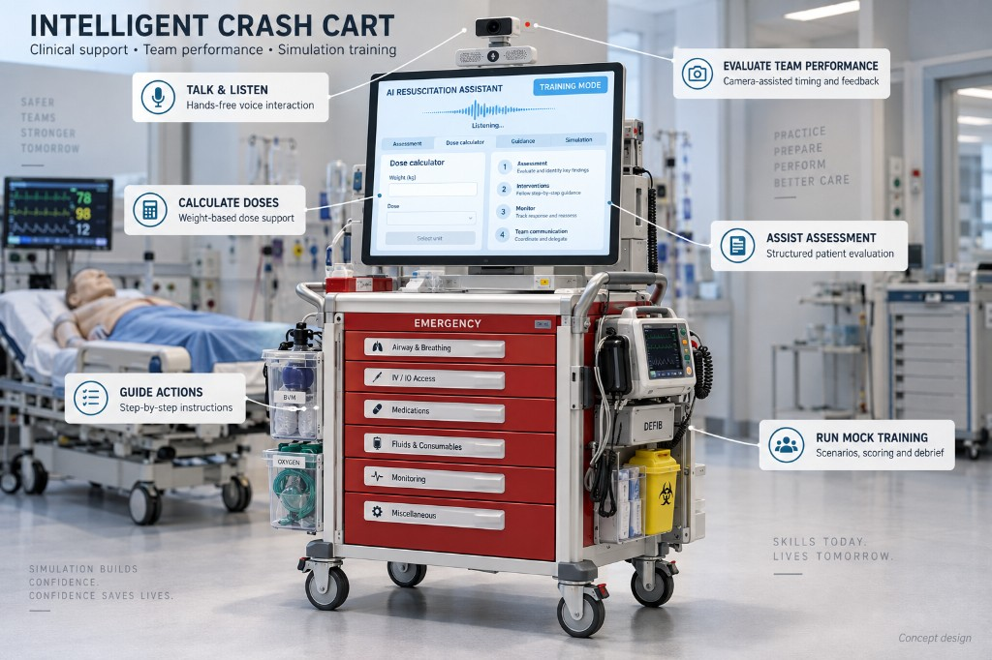
AI at the Bedside
BLOCK 10 · 00:57
SIOP 2026 · GLOBAL HEALTH SESSION · KHCC
WHERE THIS HOUR IS GOING · CONCEPT DESIGN, NOT A PRODUCT
An intelligent crash cart
This lesson
1:04 AM
Every tool in this hour has a place on a cart. This is a concept drawing, not a product you can order. The six jobs are already in your notes.
1
Talk & listen
Hands-free voice. The team keeps their hands on the child.
2
Calculate doses
Weight in. Dose out. The math is not the job during a code.
3
Guide actions
Step-by-step, the way the protocol is written.
4
Assist assessment
A structured look at the child, not a free-form chat.
5
Evaluate the team
Camera-assisted timing and feedback after the event.
6
Run mock training
Scenarios, scoring, and debrief when the corridor is quiet.
aibedside.io · https://iyadsultan.github.io/AIBedside.io/
83

Slide 84
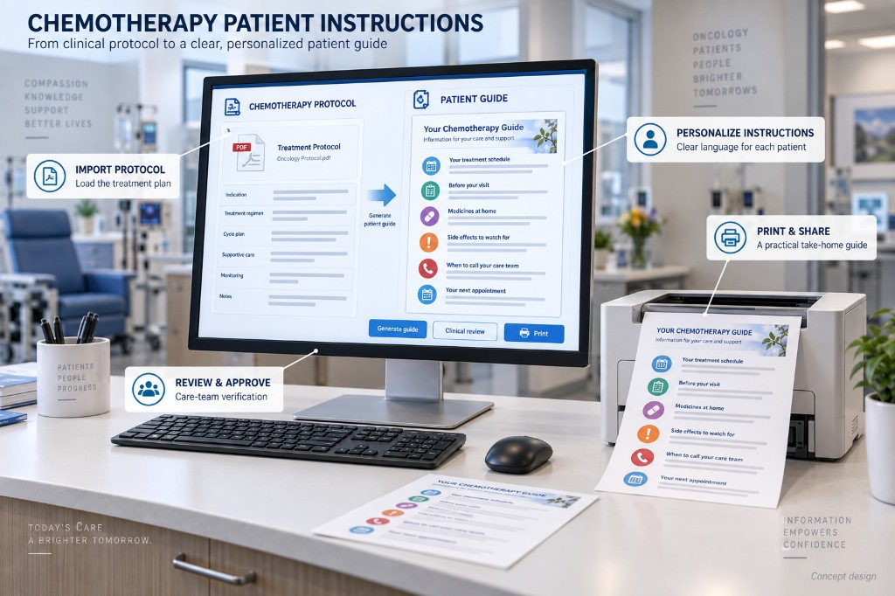
AI at the Bedside
BLOCK 10 · 00:57
SIOP 2026 · GLOBAL HEALTH SESSION · KHCC
AND AT THE CLINIC DESK · CONCEPT DESIGN
Intelligent patient instructions
This lesson
1:04 AM
A protocol is written for the team. A family needs a guide they can take home. You already practiced this when you turned a guideline into something a parent can read.
1
Import protocol
Load the treatment plan. Do not type it from memory.
2
Review & approve
A person on the care team signs off before it leaves the clinic.
3
Personalize
Clear language for this patient, not a photocopy of the protocol.
4
Print & share
A take-home guide. Paper still works.
aibedside.io · https://iyadsultan.github.io/AIBedside.io/
84

Slide 85
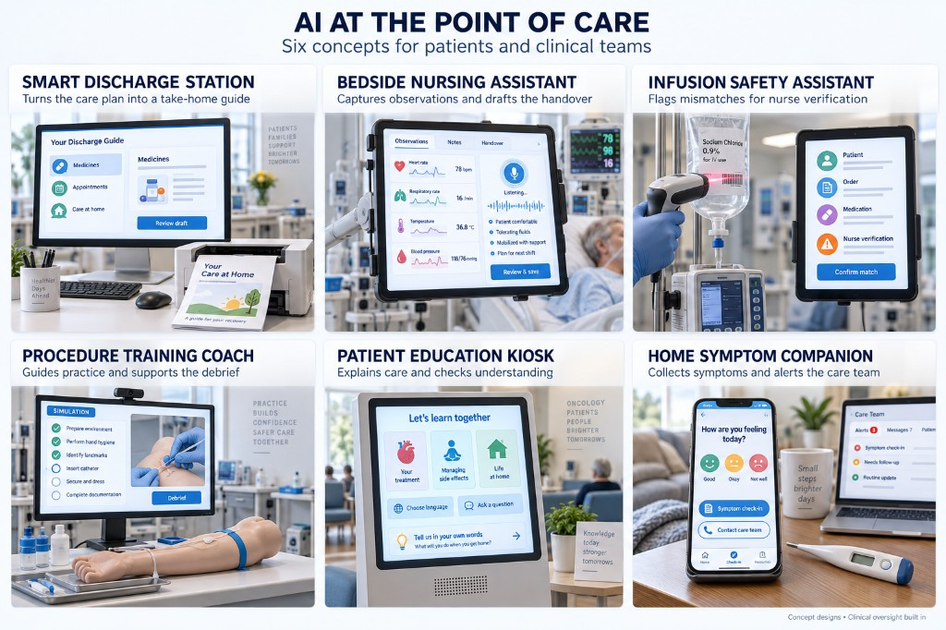
AI at the Bedside
BLOCK 10 · 00:57
SIOP 2026 · GLOBAL HEALTH SESSION · KHCC
SIX MORE PLACES THE WORK ALREADY LIVES · CONCEPT DESIGNS, CLINICAL OVERSIGHT BUILT IN
AI at the point of care
This lesson
1:04 AM
Not one cart. Not one desk. Discharge. The handover. The infusion. Practice. The waiting-room kiosk. The phone at home. A person still signs off.
1
Smart discharge station
Turns the care plan into a take-home guide.
2
Bedside nursing assistant
Captures observations and drafts the handover.
3
Infusion safety assistant
Flags mismatches for a nurse to verify.
4
Procedure training coach
Guides practice and supports the debrief.
5
Patient education kiosk
Explains care and checks understanding.
6
Home symptom companion
Collects symptoms and alerts the care team.
aibedside.io · https://iyadsultan.github.io/AIBedside.io/
85

Slide 86
AI at the Bedside
BLOCK 10 · 00:57
SIOP 2026 · GLOBAL HEALTH SESSION · KHCC
THE PICTURES ARE THE DESTINATION. MONDAY IS THE FIRST STEP.
Until then — pick the card that matches your job
This lesson
1:04 AM
MONDAY
MONDAY
MONDAY
MONDAY
Physicians
Nurses
Pharmacists
Data managers & researchers
Put one guideline you argue about into NotebookLM; query it instead of remembering it.
Draft a parent-facing explanation of one procedure at a reading level your families actually use.
Turn one dosing protocol into an interactive artifact; see if it catches the recurring error.
Hand a de-identified extract to a model and ask for the table-one you keep postponing.
Skills today. Lives tomorrow. The pictures are drawings. The Monday task is real.
Everyone — never paste patient-identifiable data into a consumer AI tool.
aibedside.io · https://iyadsultan.github.io/AIBedside.io/
86

Slide 87
AI at the Bedside
COMPANION SESSIONS
SIOP 2026 · GLOBAL HEALTH SESSION · KHCC
1:04 AM
THE 30 MINUTES THAT FOLLOW THE CORE HOUR
Companion sessions
01:00 – 01:15
01:15 – 01:30
Precision medicine tool for all — Capricorn
Q&A with an AI avatar
An AI avatar of Uri Ilan (Princess Máxima), moderated by Jorge Campos — answers the room and is itself the closing demonstration.
Confirm likeness approval; rehearse on venue AV and network; keep a pre-recorded fallback.
aibedside.io · https://iyadsultan.github.io/AIBedside.io/
87

Slide 88
AIBEDSIDE.IO — THE COMPANION SITE
Every demo in this deck is runnable at home.
The four .skill files, the PRD, the CLAUDE.md folder, the wiki, and the governance brief.
The live demos: prompt builder, Haiku with and without MCP, Bonsai in the browser.
The closing page is the handout — Save as PDF.
Scan to open the site.
Save to your home screen.
1:04 AM
https://iyadsultan.github.io/AIBedside.io/
Iyad Sultan, MD · King Hussein Cancer Center · SIOP 2026, San Antonio

