Slide 1

Heap memory manager
By: Iyad Wael Sayed
Under Supervision of Eng: Reda Maher
(STMicroelctronics)

Slide 2
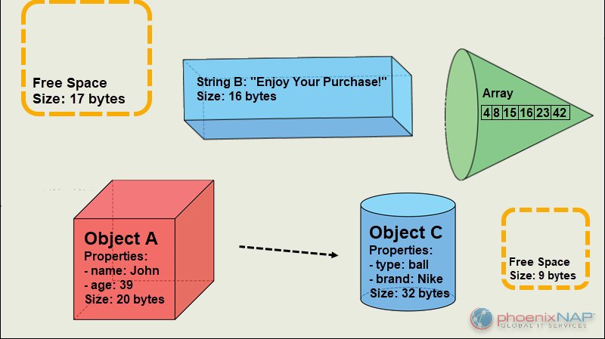
Agenda: 1) Project overview 2) APIs 3)Flowcharts 4)Project Testing 5)Conclusion

Slide 3
HMM Overview
A heap memory manager is responsible for the management of heap memory.
The heap memory manager performs the following fundamental memory operations:
Allocation - performed by malloc and calloc
Deallocation - performed by free
Reallocation - performed by realloc

Slide 4
Implmenting HMM on Linux
brk(addr)
Modifies the size of the heap directly; the addr parameter specifies the new value of current->mm->brk, and the return value is the new ending address of the memory region (the process must check whether it coincides with the requested addr value).
sbrk(incr)
Is similar to brk( ), except that the incr parameter specifies the increment or decrement of the heap size in bytes.

Slide 5
Project APIs
void* HmmAlloc(size_t num_bytes);
static boolean HmmAlloc_allocate(void);
metadata* split (metadata * current, int num_bytes);
void HmmFree(void* ptr);
void merge (metadata* current);
void* HMM_Calloc(size_t numitems, size_t size);
void* HMM_Realloc(void* ptr , size_t size );

Slide 6
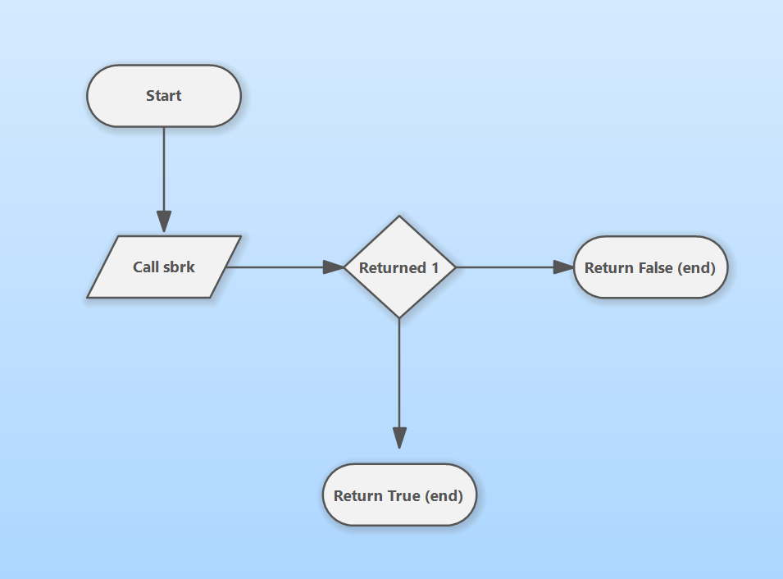
HmmAlloc_allocate
It is The Function that Pushes Program break (128 KB)When needed, It is used in only 2 Cases 1) Initializing the Program
2) There is no appropriate node in Heap So we can allocate in.

Slide 7
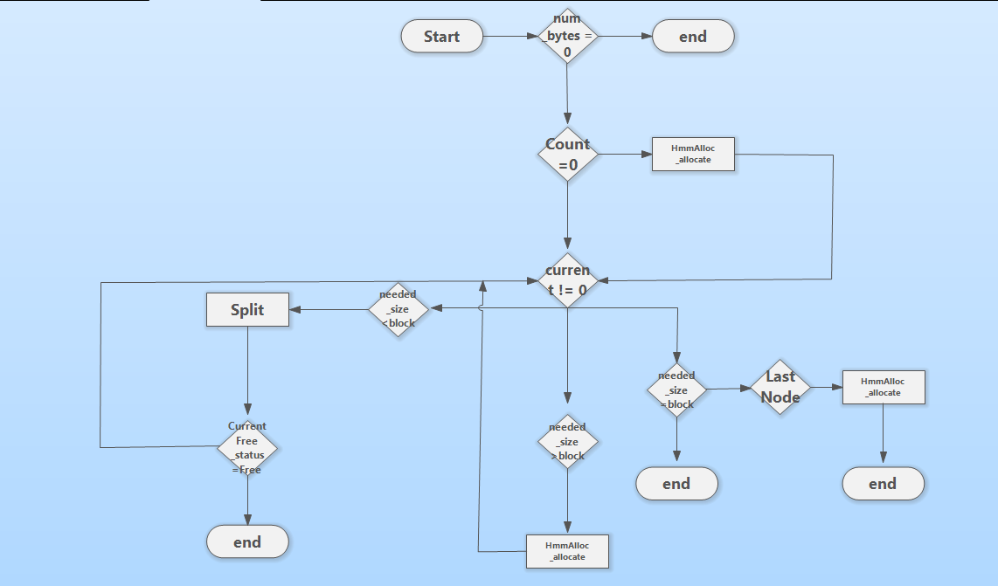
HmmAlloc
This Function is one of the main Functions in the HMM. It traverses over the List to get the appropriate block for the needed Data.
It checks on many conditions according to the size of the block needed
Block Size = Needed size
Block size > Needed Size
Block size < Needed Size
This Function Calls inside 1)HmmAlloc_allocate
2) Split (The next API we will talk about)

Slide 8
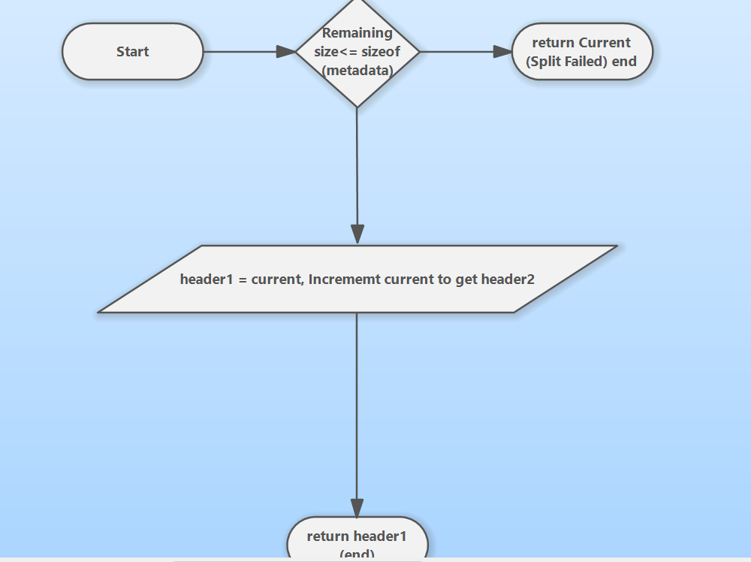
Split
This Function is used in HmmAlloc when the free block is Larger than the needed Size.
It manipulates the pointers and data in order to get the needed size from the block.

Slide 9
HmmFree
This Function frees the specified block if it was RESERVED in first place then it manipulates the pointers to keep the List connected with each other.
HmmFree has an additional Feature where it lowers the Program break in case the Last block is big enough(500*128kb) and is FREE then it will Lower the Program break.
HmmFree call merge Function (The next API)

Slide 10
HmmFree Flowchart

Slide 11
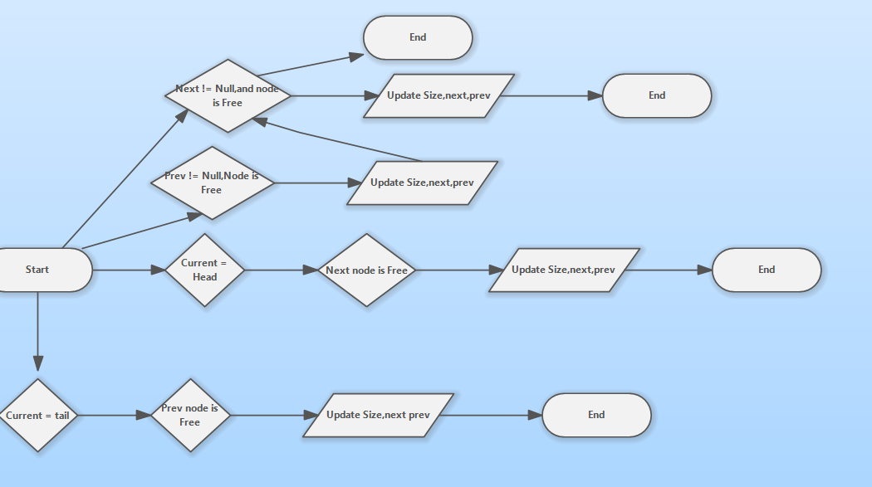
Merge
This Function looks at the adjacent blocks and checks if there is any of them is free to merge with

Slide 12
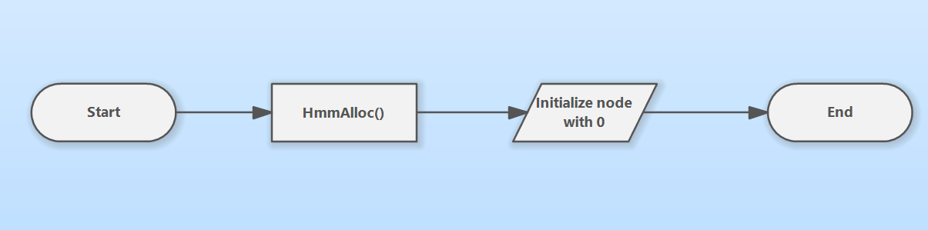
Hmm_Calloc
The same functionality as hmm_Allocate but initializes the Block with Zeros.

Slide 13
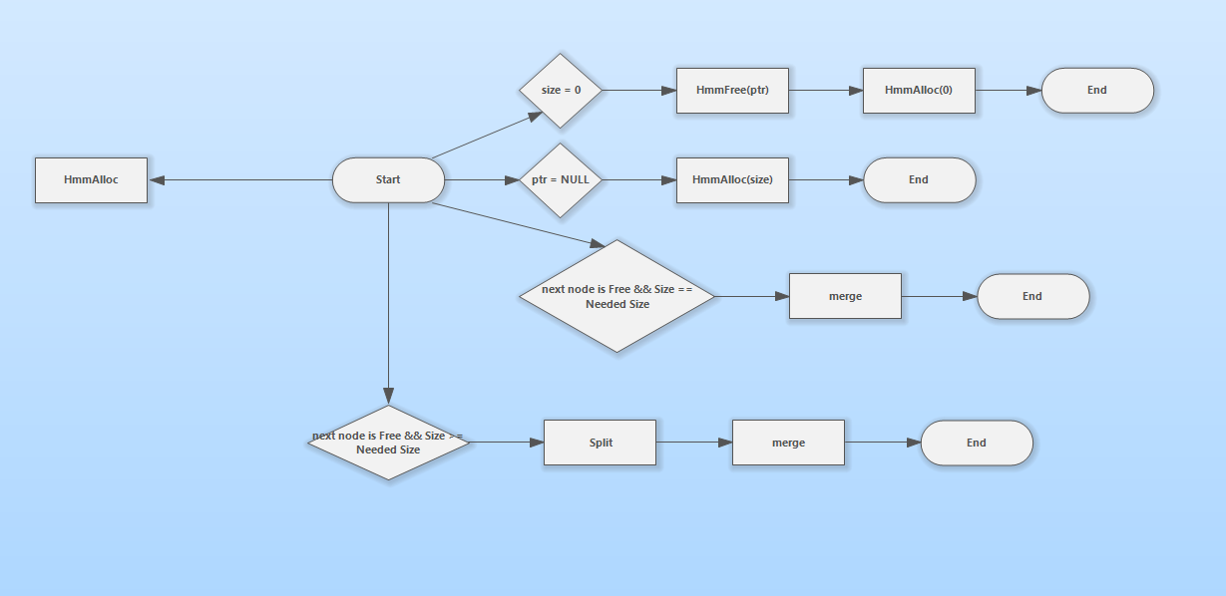
Hmm_Realloc
This Functions used when needed to change the size of a block , It checks first the next block Free_status to see if it can merge with ,If not it calls Hmm_Alloc

Slide 14
Testing Scripts
I have tested this with three Testing Scripts which call all of the HMM Functions in a very large number randomly and our HMM Stood in every challenge.

Slide 15

Conclusion
The HMM project is about making a Library as stdlib which includes Functions helps us in Dynamic allocation of data so we made our APIs that allocate,deallocate,reallocate data during run time as the Functions in stdlib library.

Slide 16

Thank You Any questions?

