Slide 1


MAD_Project1
Due:
October 31, 2026
Janiya Green and Iyana Halliburton

Slide 2

Team
Janiya Green
jgreen156@student.gsu.edu
002831712
Undergraduate
Iyana Halliburton
ihalliburton1@student.gsu.edu
002765290
Undergraduate

Slide 3
App Purpose
As a college student you are usually encouraged to utilize all resources and get involved, but it can be hard to do that with a busy college schedule, especially at a school with many commuters like GSU. This app helps better than a poster or pin add could because it gives students a clear place to pick challenges, log progress toward a target, and see completed goals.

Slide 4

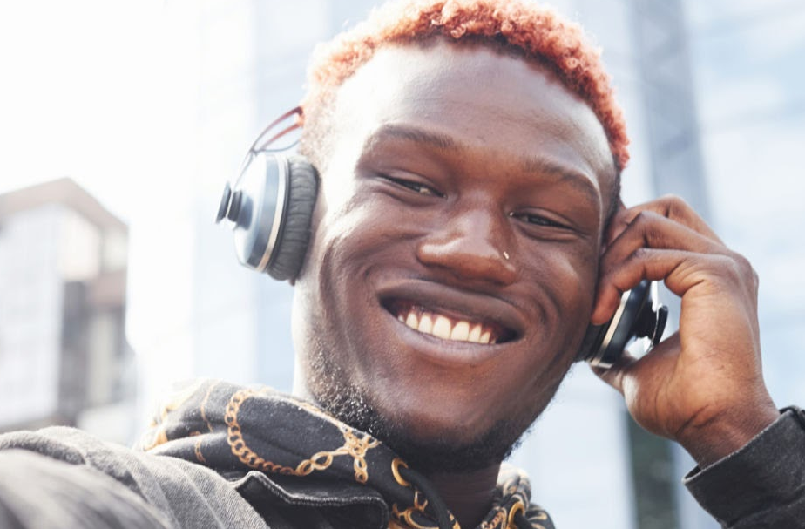

Target Users
Professors
Student
Faculty
Goal

Slide 5
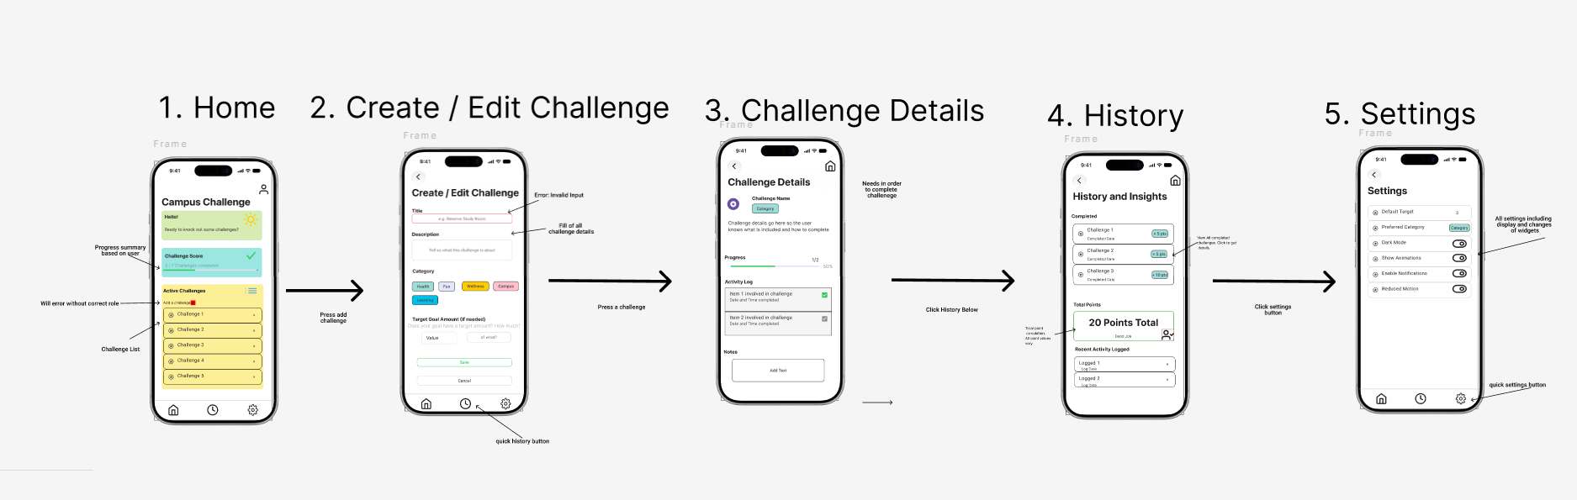

Wireframe decisions

Slide 6
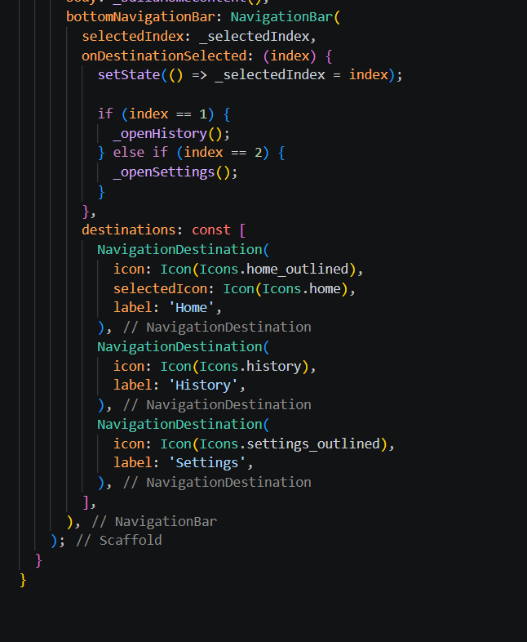
Code & Logic Walkthrough
2

Slide 7
Code & Logic Walkthrough
2

Slide 8
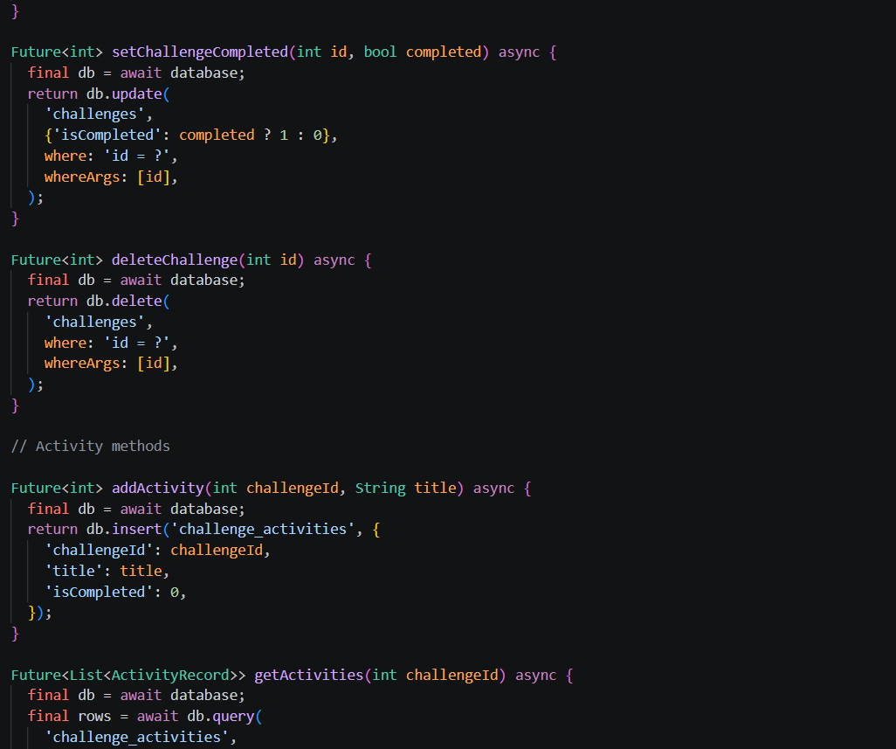
Code & Logic Walkthrough
2

Slide 9

Q&A & Test Evidence
4
Provide an overview of this internal operational challenge. Talk about the context and the causes that led to this issue. Describe the lessons learned and most important takeaways to prevent the issue from recurring.
Takeaway
Takeaway
Takeway

Slide 10

Demo!

Slide 11

Thank you

