Slide 1

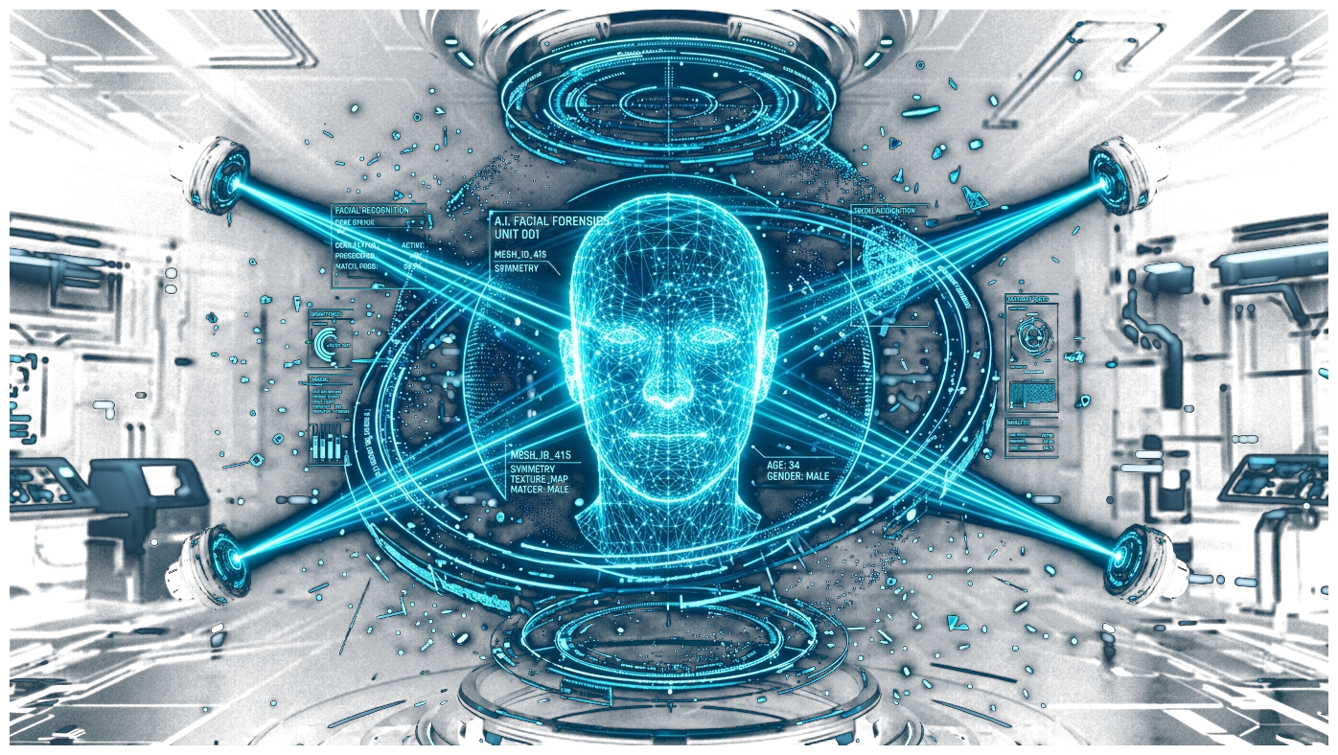
⚡ NEXT-GEN AI FORENSICS & VERIFICATION
◉ Cross-Efficient-ViT Core
Vision Transformer spatial attention
VERIFRAME
Real-Time Deepfake Detection & Video Authenticity Verification
Engineered with a high-precision Cross-Efficient-ViT neural architecture, adaptive multi-scale frame sampling, triple-engine face detection fallback (MTCNN + MediaPipe), and Platt temperature-calibrated forensic reporting.
◉ 68-Point Facial Landmark Mesh
MTCNN + MediaPipe tracking
97.68%
ROC-AUC SCORE
DFDC & FaceForensics++
91.0%
MODEL ACCURACY
Balanced Test Corpus
< 300ms
EDGE LATENCY
Rolling Window FP16
◉ Platt Temperature Calibration
Confidence smoothing & SHA-256 hash
VeriFrame Forensic Core v2.4 • Final Year Capstone Project • Deep Learning & Media Forensics • 2026

Slide 2

⚡ DEEP DIVE: END-TO-END FORENSIC PIPELINE
CORE ARCHITECTURE
Multi-Stage Spatial Attention, Temporal Calibration & Forensic Output
01. Cross-Efficient-ViT Vision Transformer
Fuses EfficientNet spatial convolution with multi-head self-attention. Detects subtle high-frequency artifacts, compression incongruities, and synthetic facial warping with 97.68% ROC-AUC.
02. Adaptive Frame Sampling & 3-Tier Face Tracking
Intelligently samples 20-40 informative frames (scene shifts, motion peaks). Triple fallback (MTCNN -> MediaPipe -> Haar) guarantees continuous tracking across extreme yaw, pitch, and partial occlusions.
03. Temporal Smoothing & Cryptographic Verification
A 30-frame rolling window with Platt temperature scaling stabilizes predictions and eliminates isolated false triggers. Automatically issues SHA-256 tamper-evident forensic verification certificates.
VeriFrame Architecture Overview • Slide 02 • Morph Transition Active

Slide 3
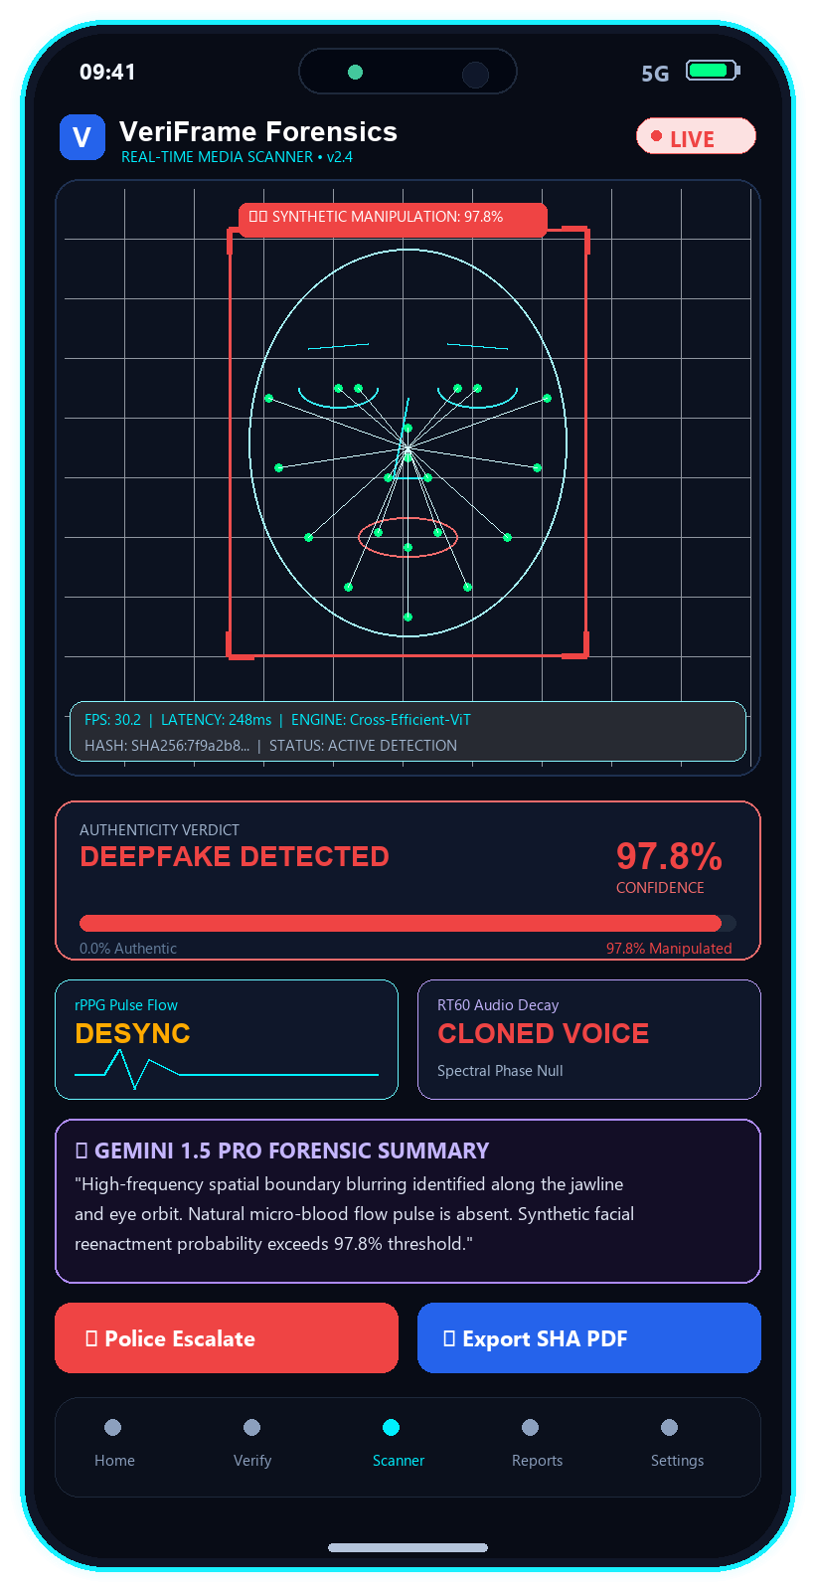
⚡ SYSTEM DEMONSTRATION & LIVE EXECUTION
Demonstration of Mobile APP
Interactive Real-Time Forensics, Multi-Modal Ingestion & Legal Reporting
01. Multi-Modal Media Ingestion & Live Stream
Supports real-time 30 FPS camera feeds, local gallery video uploads, and URL scrapers for social platforms (YouTube, TikTok, Reels).
02. Real-Time Neural Forensics & Visual Heatmaps
Cross-Efficient-ViT extracts spatial manipulation heatmaps, 68-point facial meshes, and evaluates biological rPPG pulse desynchronization.
03. Calibrated Scoring & Gemini Multimodal Reasoning
Calculates Platt temperature-calibrated authenticity confidence (97.8%) and uses Gemini 1.5 Pro to explain facial/audio anomalies.
04. Law Enforcement Escalation & SHA-256 PDF
Exports court-admissible forensic audit dossiers sealed with SHA-256 hashes, tamper timestamps, and 1-tap police incident dispatch.
▶ LIVE DEMO SHORTCUT: Run launch_live_preview.bat or execute Flutter app for interactive inspection
VeriFrame Mobile App Demonstration • Slide 03 • Morph Transition Active

