Slide 1
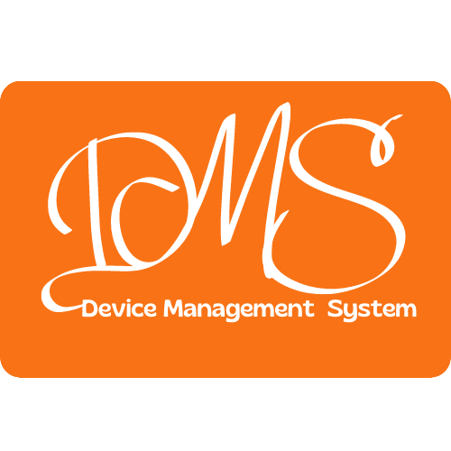
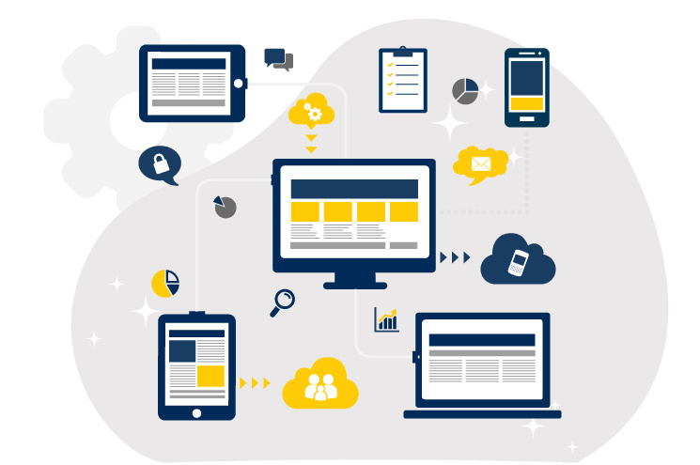



DMS
By:
Bit_Borg

Slide 2


PROBLEM DEFINITION
The Yapahuwa Maha Vidyalaya faces the challenge of efficiently managing and monitoring their multiple computer laboratories, offices, and interconnected equipment. Currently, there is a need for a comprehensive web application that can provide a centralized platform to display devices within labs and offices, connection details between labs and offices, device faults, faculty connections, and real-time data visualization. The application should also incorporate features such as the ability to add, update, and delete devices and labs, customize dashboards, receive fault notifications, and scale to accommodate a large number of devices. The lack of such a system hampers the school administration's ability to effectively track and maintain the network infrastructure, resulting in potential
Page 1

Slide 3


SOLUTION
Our comprehensive Device Management System (DMS) addresses the challenges faced by Yapahuwa Maha Vidyalaya in managing and monitoring their computer laboratories, offices, and interconnected equipment. DMS provides an intuitive web application interface with a wide range of key features:
Device Tracking and Management:
Each device is assigned a unique reference number generated by DMS, enabling easy identification and tracking of devices.
The dashboard prominently displays recently added devices, ensuring administrators stay updated on network expansions.
Page 2

Slide 4
Fault Detection and Notification:
DMS proactively detects device faults and displays them in the dashboard, allowing administrators to quickly identify and resolve issues.
Upon selecting a faulty device in DMS, administrators can notify the relevant technician through their preferred communication method (e.g., text messages, calls, emails).
Device Repair History:
DMS maintains a comprehensive repair history for each device, providing insights into the frequency and nature of faults.
This information aids in identifying recurring issues, determining maintenance patterns, and optimizing device performance.
Page 3

Slide 5
Laboratory Availability and Booking:
DMS includes a dedicated section that showcases real-time laboratory availability, streamlining scheduling for faculty and students.
Administrators can efficiently manage and update booking options within DMS, ensuring optimal utilization of the school's facilities.
Customizable Dashboard:
DMS offers a user-friendly, customizable dashboard where administrators can personalize the displayed information and statistics.
Users can select relevant widgets and arrange them based on their preferences, enhancing the user experience.
Page 4

Slide 6
With the Device Management System (DMS), we offer Yapahuwa Maha Vidyalaya a comprehensive solution to optimize their network management processes. By providing efficient device tracking, timely fault detection, streamlined communication with technicians, comprehensive device repair history, a customizable dashboard, and real-time data visualization, DMS empowers the school administration to enhance device uptime, improve network efficiency, and make informed decisions. Furthermore, DMS's scalability ensures it can support the school's future growth, making it a valuable tool for Yapahuwa Maha Vidyalaya's ongoing success.
Page 5

Slide 7

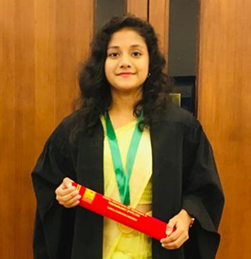
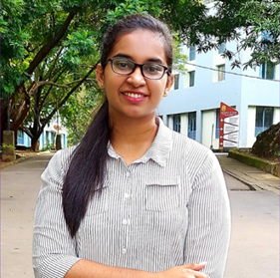

Meet Our Best Team
Pasan Kavinda Abeysekara pasankavindaabey@gmail.com https://lk.linkedin.com/in/pasan-kavinda
071 900 0492
University of Ruhuna
Athukoralage Uduli Taneesha Iyenshi iyenshiaut@gmail.com
http://linkedin.com/in/taneesha-iyenshi
076 470 9893
University of Ruhuna
Dampage Nawodhi Mabheesha Fernando nawomabhee22@gmail.com
https://linkedin.com/in/mabheesha-fernando
077 534 9863
University of Ruhuna

