Slide 1



ELCTRAC
BY:
bit_borg
2023

Slide 2
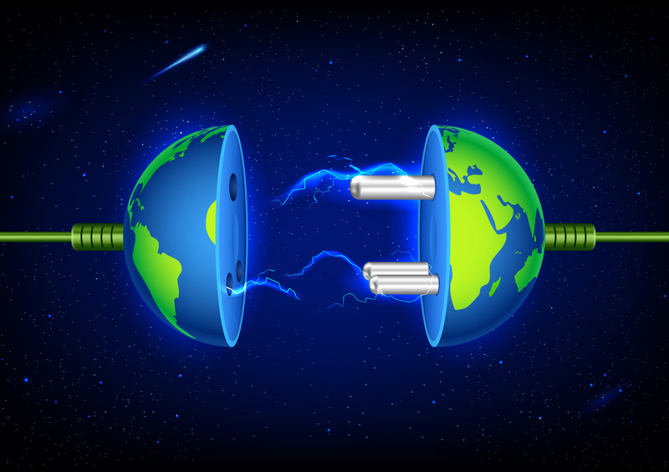

Problem Definition
One of the energy-related problems in Sri Lanka is the lack of awareness among households regarding their energy usage. This lack of awareness leads to wastage and higher electricity bills, exacerbating the existing energy crisis. Many households are unaware of how their daily activities impact their energy consumption and are unable to make informed decisions on energy conservation. This issue is prevalent across the country and contributes to the strain on the energy infrastructure and the environment.

Slide 3
Solution
To address this issue, we propose the development of a mobile application called "ElcTrack." EcoTrack features a smart energy meter that tracks real-time energy usage and sends notifications to users about their consumption patterns. The app also provides personalized energy-saving tips based on users' habits, empowering them to make informed decisions and conserve energy effectively. Additionally, ElcTrack allows users to compare their energy usage with households all over the country, fostering a sense of nationwide competition and encouraging energy conservation. By partnering with energy companies, ElcTrack can provide rewards and incentives to users who consistently save energy, further promoting economic growth and sustainability.
Overall, ElcTrack aims to increase awareness, empower users, and promote energy conservation in Sri Lanka, helping households reduce wastage, lower electricity bills, and contribute to a sustainable energy future for the country.

Slide 4
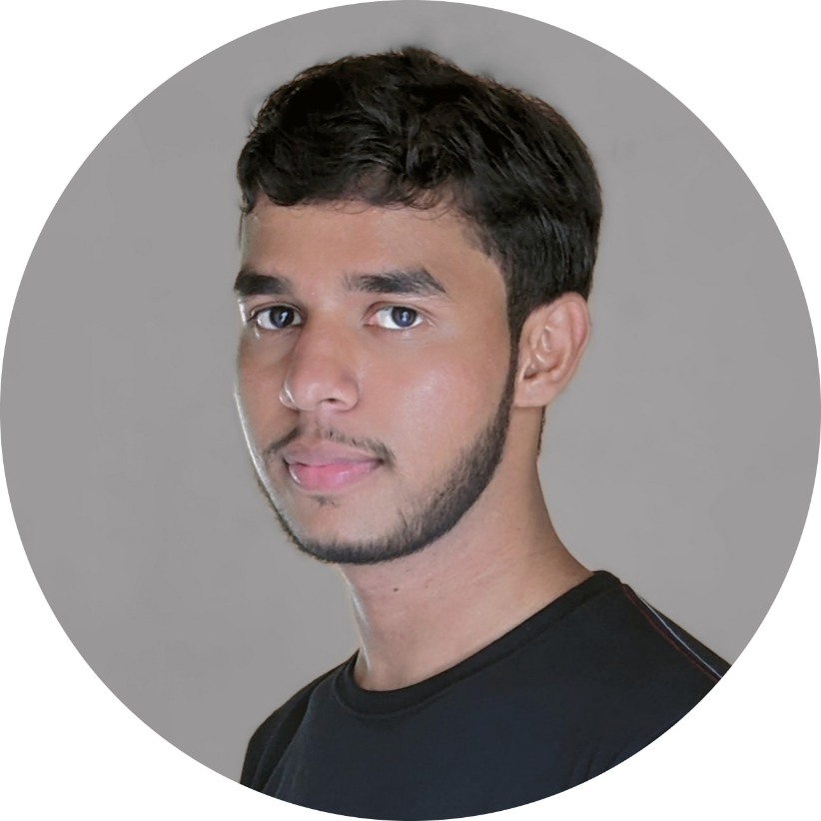
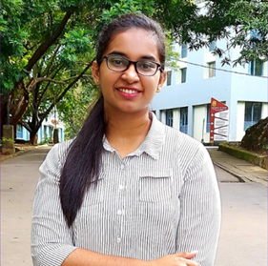
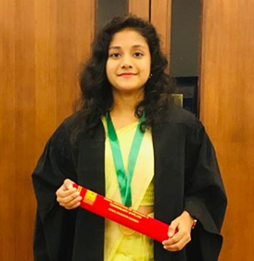
Meet Our Best Team
PASAN KAVINDA ABEYSEKARA
pasankavindaabey@gmail.com
HTTPS://LK.LINKEDIN.COM/IN/PASAN-KAVINDA
071 900 0492
UNIVERSITY OF RUHUNA
DAMPAGE NAWODHI MABHEESHA FERNANDO
nawomabhee22@gmail.com
HTTPS://LINKEDIN.COM/IN/MABHEESHA-FERNANDO
077 534 9863
UNIVERSITY OF RUHUNA
ATHUKORALAGE UDULI TANEESHA IYENSHI
iyenshiaut@gmail.com
HTTP://LINKEDIN.COM/IN/TANEESHA-IYENSHI
076 470 9893
UNIVERSITY OF RUHUNA

