Slide 1


University
Team
: University of Ruhuna
: NICK

Slide 2



Slide 3

Problem?
Inability to regulate medical treatment and medicine dosage regularly.

Slide 4
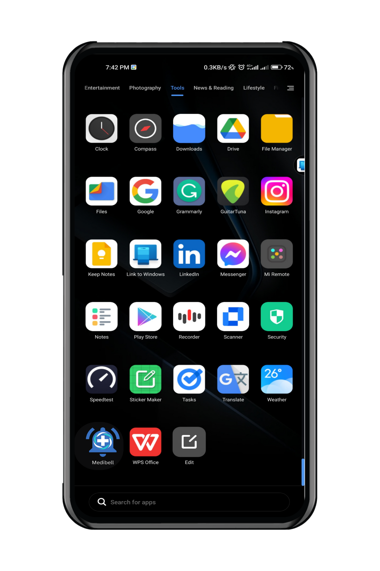
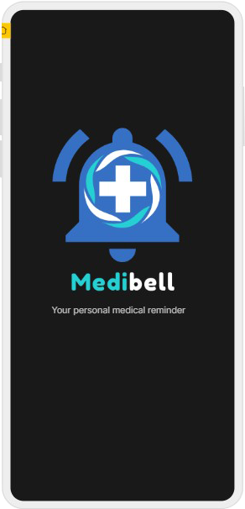
Mobile App
Medibell

Slide 5
Reminder
Database

Slide 6

Features……
Remind them of their upcoming appointment's date (Med Calendar) - The app sends a reminder for a patient's upcoming clinic appointment.
Bring up the precise timing of the drug (Bell) –
The app serves as a reminder to remind you to take the medication.
drug as summarized and preview (Medication Box) -
The total quantity of untaken medications is always given as a preview.
The number of days remaining for each medication (refill) –
The app provides a countdown to the end of each medicine in days.
The method to save all records and reports (Reports) –
This is a unique function of the app. The relevant report can be saved in the app as a pdf file.
A detailed description of each drug –
A brief summary of each medicine in any language will be provided by the app.

Slide 7
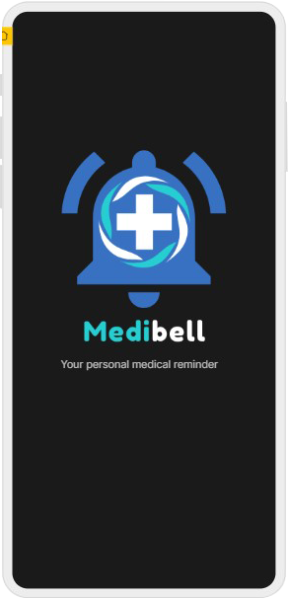
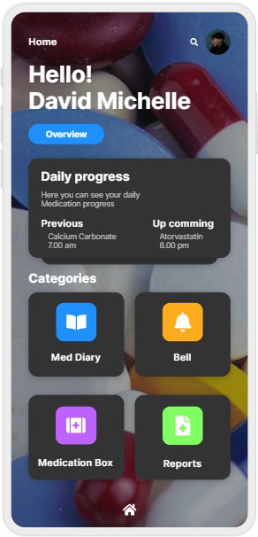
1
2

Slide 8
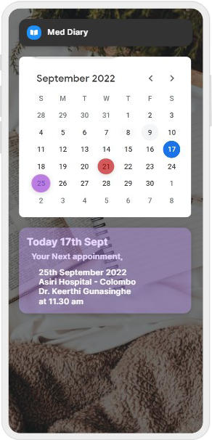
3

Slide 9
4

Slide 10
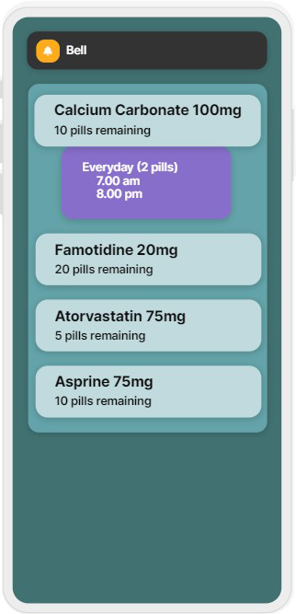
5

Slide 11
6

Slide 12
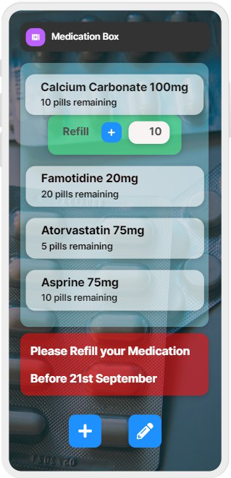
7

Slide 13
8

Slide 14
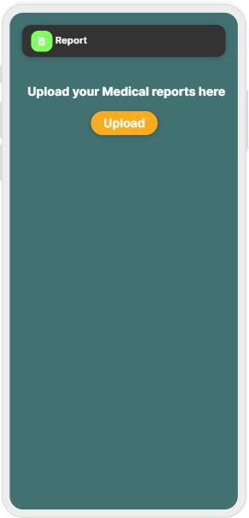
9

Slide 15
Thank
You

