Slide 1

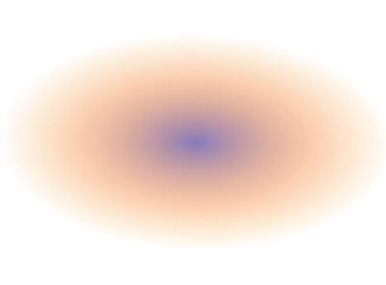
EDA and Predictive modelling of FIFA Data of Women's World Cup Tournament from 1991 to 2019
Submission for WiDA Datathon Event
By
Team_Data_Benders:
1) Esther EMOEKPERE
2) Ifeoluwa ADEWUNMI

Slide 2

OUTLINE
1.0 INTRODUCTION
1.0 Introduction
1.1 Goals for the EDA
1.2 Summary of steps
2.0 Dataset Exploration
3.0 Data Cleaning and Transformation
3.1 Initial Set-up
3.2 Analysis and Visualization
3.2.1 Visualizations
3.2.2 Predictive Model
4.0 Recommendations and parting words.
The dataset contains FIFA Women’s World Cup Stats from 1991 to 2019.
1.1 Goals of the EDA
This EDA’S main objective is to investigate the dataset to determine if there are any trends that we might be able to highlight through visualizations, as well as to predict the total number of matches that each squad will play in light of certain features.
1.2 Summary of Steps
We went through the following five main steps:
Exploring datasets
Python-based data cleaning
Analysis and visualizations using PowerBi
Python based predictive modeling
Additional ideas for future research directions

Slide 3
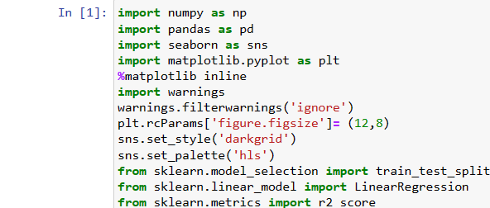
2.0 DATASET EXPLORATION
We are utilizing a dataset that @mattop uploaded to Kaggle, it was gotten from Sports Reference. Python exploration reveals that the dataset has already been prepared for data analysis. The dataset is mostly ready for usage, despite the missing values in the yellow cards, red cards and possession columns respectively.
Only a very small amount of cleaning was needed, so we moved on to cleaning the dataset. The missing values in the red cards, yellow cards and possession columns needed to be filled in for the cleaning procedure.
In contrast to the possession column, where the missing values were filled with the median of the column’s values, the red/yellow card columns’ missing values were filled with zero.
The data type for the year column was transformed from integer to string
3.0 DATA CLEANING AND TRANSFORMATION
The data cleaning ad transformation was done using Jupyter Notebook.
3.1 Initial Set-Up
Our working environment was initially prepared by importing the necessary libraries for the analysis before we started the data cleaning and transformation procedure.
The dataset was read into the work environment after setting up.

Slide 4
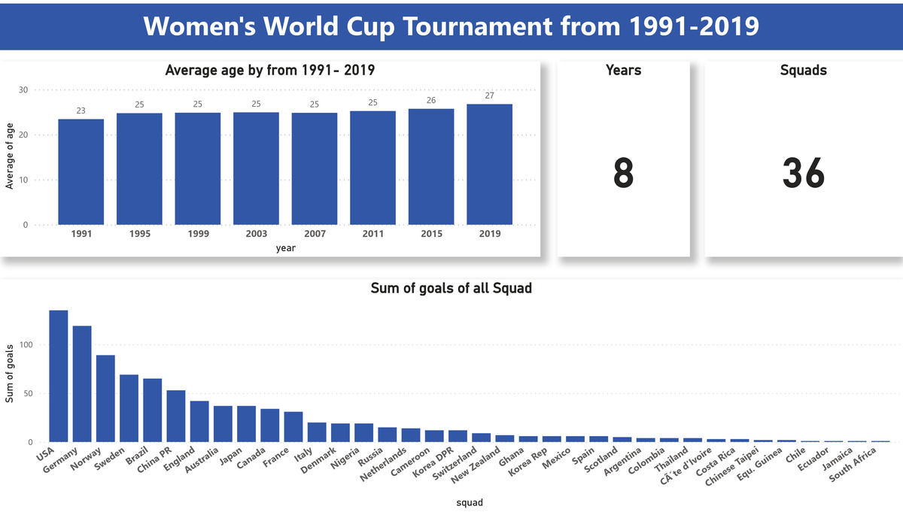
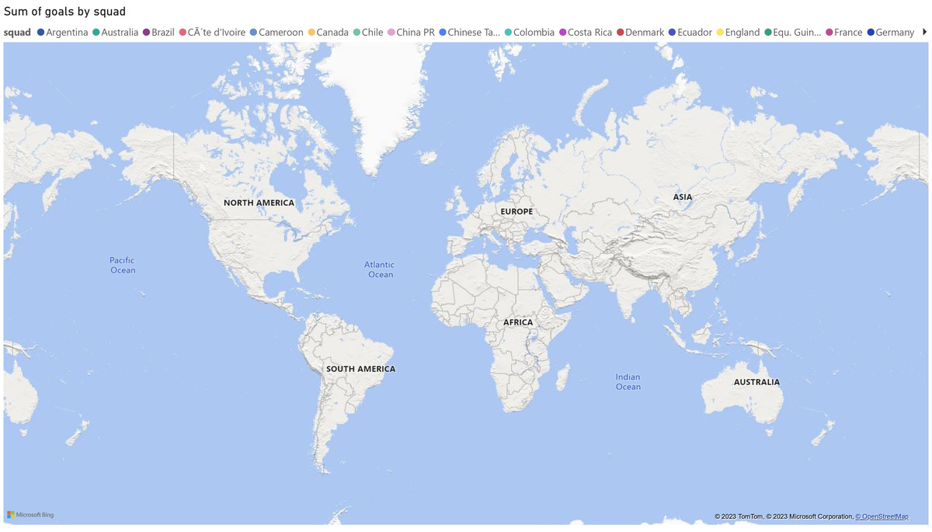
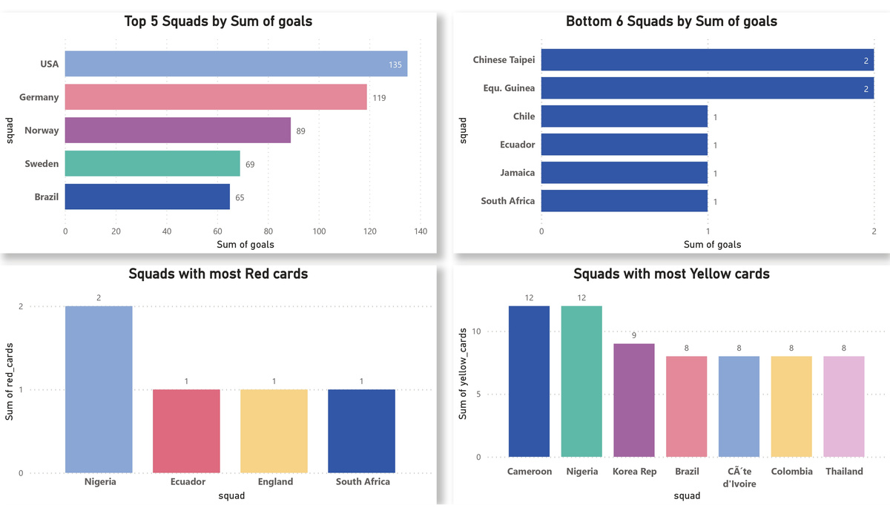
3.2 Analysis and Visualization
After the dataset was cleaned and transformed, we performed some analysis and produced visualizations with PowerBi aimed at helping viewers gain insights at first glance from the dataset.
3.2.1 Visualizations
Here are visualizations giving a summary of the general dataset. We also visualized the performance of the top 3 squads with with the highest sum of goals from 1991- 2019 to check for an increase or decline in their performance.

Slide 5
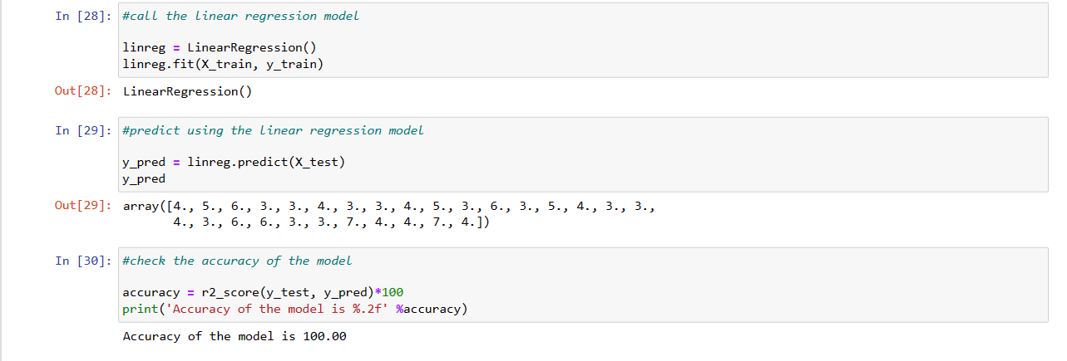
3.2.2 Predictive Model
In Jupyter Notebook, a forecast model was built using a linear regression model. The model’s objective was to forecast the number of matches each team will play at the world cup based on a number of significant features.
The model was created and provided a 100% accuracy rating. The model passed testing and accurately predicted the matches that were played.
4.0 RECOMMENDATIONS AND PARTING WORDS
It would have been preferable if the dataset had included information on each squad’s progress in each world cup as well as the winner for that specific year . This would have allowed researchers to delve deeper to determine what made the successful squad different from the other squads.

