Slide 1
MY CAP STONE PROJECT

Slide 2
1.0 INTRODUCTION/BUSINESS SECTION This project is to determine the number of schools available for the less-privileged children in Toronto. My target audience are orphanages and people on a below average income. At the end of the report, the number of affordable schools in Toronto would be determined, and a proposal would be made to provide more affordable schools for the residents of Toronto.

Slide 3
1.1 PROBLEM There is an inadequacy in the number of schools in the vicinity of Toronto that are accessible to less privileged students and those living below an average income. This project aims to give a report on how many schools the Foursquare app can find for the residents of Toronto, without requiring them to change geographic location.

Slide 4
2. DATA ACQUISITION AND CLEANING Data about the list of schools and their respective tuitions can be found on Kaggle datasets and other online resources.

Slide 5
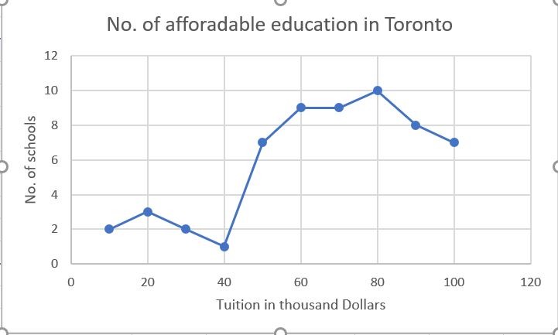
3. EXPLORATORY DATA ANALYSIS The scatter plot below shows the number of schools available and their respective fees in the vicinity of Toronto.

Slide 6
4. CONCLUSION From the above, it can be seen that there are little or no available schools with affordable tuition fees. For the Foursquare app to be useful in sourcing affordable schools for the low-income earners in Toronto, there must be a provision of these schools by the government.

Slide 7
5. RECOMMENDATION It is recommended that attention be paid to the educational sector for the provision of quality, affordable education to all, to increase the quality of our leaders of tomorrow.

