Slide 1
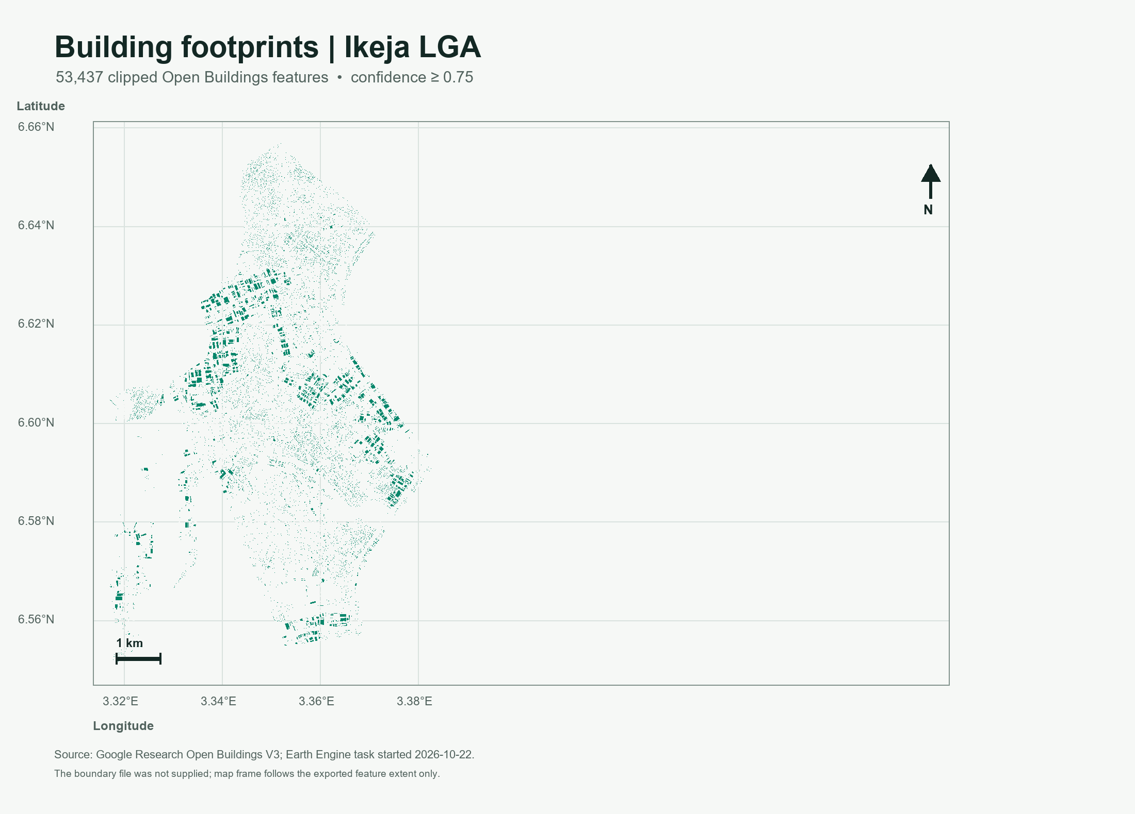
PROJECT 02 • GEOSPATIAL MACHINE LEARNING
Lagos building
footprint mapping
A cloud-first workflow for selecting, auditing, and explaining building-footprint predictions in Lagos LGAs
IKEJA SAMPLE EXPORT | 53,437 PREDICTIONS | CONFIDENCE ≥ 0.75
Project demonstration using an existing model-derived layer; no local accuracy claim is made.
Notes:
Project 2 builds a repeatable Lagos LGA workflow around an existing building-footprint prediction layer. The Ikeja export is the supplied worked example. This project does not train a model or independently verify buildings.
Sources: Open Buildings V3 https://developers.google.com/earth-engine/datasets/catalog/GOOGLE_Research_open-buildings_v3_polygons; FAO GAUL 2025 level 2 https://developers.google.com/earth-engine/datasets/catalog/FAO_GAUL_2025_level2

Slide 2
01 / PURPOSE AND SCOPE
Project brief
Research question
The project delivers
What footprints does Open Buildings V3 predict inside a selected Lagos LGA at a chosen confidence cutoff, and what can be verified about the export?
•
A Colab and Earth Engine workflow for any listed Lagos LGA.
•
Clipped footprint GeoJSON, exact boundary GeoJSON, and provenance CSV.
•
A local QA report, machine-readable metrics, log, figures, and slide deck.
Scope boundary
This is geospatial data processing and audit of existing model predictions. It does not train a neural network or measure local precision and recall.
Use the outputs as an exploratory footprint layer, not a census or an accuracy-validated inventory.
LAGOS BUILDING FOOTPRINT MAPPING • 02 / 12
Notes:
The question is deliberately framed around prediction and export audit. Local accuracy needs an independent reference sample and sampling design. The project answers where the supplied model layer places predictions and what properties can be checked from the exported files.

Slide 3
02 / DATA
Data provenance and inputs
SOURCE
ROLE IN PROJECT
WHAT IS EXPORTED
Open Buildings V3
Google Research building-footprint predictions; source inference year recorded as 2023.
Model confidence score; polygon geometry; clipped area in m².
FAO GAUL 2025
level 2
Provides administrative boundaries; notebook filters to Lagos and prompts for an LGA.
Selected boundary geometry and boundary area metadata.
Run settings
User selects the LGA and a confidence cutoff from 0.00 to 1.00.
Threshold, count, export time, source name, year, and license in CSV.
Reuse credits: Google Research Open Buildings V3 and FAO GAUL 2025 under CC BY 4.0.
LAGOS BUILDING FOOTPRINT MAPPING • 03 / 12
Notes:
The Earth Engine collection is GOOGLE/Research/open-buildings/v3/polygons. The notebook filters it by confidence and intersects each selected feature with the chosen FAO GAUL 2025 level 2 boundary. The source year and CC BY 4.0 credit are recorded in the supplied CSV.
Official dataset references: https://developers.google.com/earth-engine/datasets/catalog/GOOGLE_Research_open-buildings_v3_polygons
Boundary collection: https://developers.google.com/earth-engine/datasets/catalog/FAO_GAUL_2025_level2

Slide 4
03 / STUDY AREA
Study area: Ikeja LGA
46.016 km²
boundary area reported in export CSV
53,437
clipped predictions at confidence ≥ 0.75
Boundary caveat
The supplied files omit the matching boundary GeoJSON. The map shows the exported feature extent; exact LGA containment is pending.
Coordinates are WGS 84 longitude and latitude.
LAGOS BUILDING FOOTPRINT MAPPING • 04 / 12
Notes:
The boundary area is from the supplied one-row summary CSV. The current map uses exported feature coordinates only. It does not draw a GAUL boundary line because the matching boundary file was absent. The updated notebook exports that boundary as a separate small file.

Slide 5
04 / METHOD
Processing workflow
01
02
03
04
05
06
Authenticate
Choose AOI
Filter
Intersect
Export
Audit
Earth Engine Cloud Project ID
Select Lagos LGA
Confidence ≥ chosen cutoff
Clip to LGA geometry
Features + boundary + CSV
Local checks + outputs
Cloud processing
Local analysis
Filtering and geometry intersection run on Earth Engine. Colab previews server-rendered map tiles.
Download only the vector exports. Python checks feature and geometry integrity and creates presentation assets.
The workflow does not download a multi-gigabyte imagery archive.
LAGOS BUILDING FOOTPRINT MAPPING • 05 / 12
Notes:
The export workflow uses Earth Engine server-side filtering and clipping. It displays rasterized tile previews. Three small-or-moderate outputs go to Drive: footprint vectors, matching boundary, and a one-row CSV. Local audit requires downloading these vector outputs, not the imagery archive.

Slide 6
05 / OPERATING FEATURES
Efficient by design
The notebook supports
01
Any listed Lagos LGA
Boundary names are queried from FAO GAUL rather than embedded in code.
02
Adjustable confidence
Cutoff can be changed in 0.01 increments; export names encode the selected value.
03
Tile preview
Earth Engine serves preview tiles; feature geometries are not pulled into Colab for display.
04
Lightweight refresh
The final cell can re-export the boundary and metadata without repeating the footprint export.
Resource choice: reuse the public footprint layer; avoid training and bulk image downloads for this scope.
LAGOS BUILDING FOOTPRINT MAPPING • 06 / 12
Notes:
The confidence cutoff is used consistently in filtering, output naming, summary metadata, and local analysis. The final notebook cell is separated so a missing boundary export can be repaired without repeating the much larger footprint table export. In a fresh notebook runtime, authenticate and select the boundary first.

Slide 7
06 / RESULTS
Ikeja export profile
53,437
1,161
predictions per km² of reported boundary area
model-derived footprint predictions
53,434
3
Polygon geometries
MultiPolygon geometries
Interpretation
The count and density describe filtered model output. They do not establish how many buildings exist or how many the model missed.
LAGOS BUILDING FOOTPRINT MAPPING • 07 / 12
Notes:
The export has 53,437 features, comprising 53,434 Polygon and 3 MultiPolygon geometries. Density is a simple feature count divided by boundary area from the supplied CSV. It is not population density, completeness, or an accuracy metric.

Slide 8
07 / MODEL OUTPUT
Confidence distribution
Mean 0.8536
Median 0.8575
Minimum retained score 0.75
Scores cluster from 0.85 to 0.95 in this export. Confidence is a model score, not locally calibrated correctness.
LAGOS BUILDING FOOTPRINT MAPPING • 08 / 12
Notes:
The bar chart is editable and embeds the five source counts. Counts: 12,628; 12,142; 13,945; 14,057; and 665. These sum to 53,437. Mean and median are computed from all supplied feature confidence values. A high score alone does not demonstrate local accuracy.
Source model layer: https://developers.google.com/earth-engine/datasets/catalog/GOOGLE_Research_open-buildings_v3_polygons

Slide 9
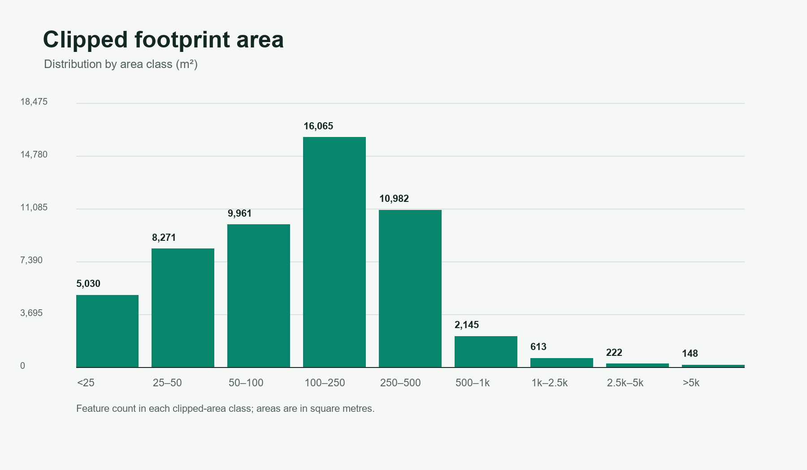
08 / GEOMETRY
Footprint area distribution
124.1 m²
median clipped feature area
399.7 m²
90th percentile
19,394 m²
largest feature
The 11.854 km² feature-area sum is not coverage: overlaps are not dissolved.
LAGOS BUILDING FOOTPRINT MAPPING • 09 / 12
Notes:
The area property is clipped_area_m2. Median is 124.1 m², P90 is 399.7 m², and the maximum is approximately 19,394.0 m². The sum across features is 11.854 km², but overlapping geometries were not dissolved. It must not be presented as built-up coverage.

Slide 10
09 / VALIDATION
Quality controls and current status
8 checks pass on the supplied export
Pending evidence
PASS
Feature count matches summary CSV
Independent containment against the matching GAUL boundary. The supplied export did not include that file.
PASS
All confidence values meet cutoff
PASS
Confidence scores lie in [0, 1]
PASS
Unique nonempty feature IDs
Also outside the current QA
PASS
Closed rings and finite WGS 84 coordinates
No local reference labels, field survey, precision/recall, or completeness assessment.
PASS
Geometries are present and nonempty
PASS
Polygon topology is valid
PASS
Clipped areas are finite and positive
Passing geometry checks verifies file integrity, not model accuracy.
LAGOS BUILDING FOOTPRINT MAPPING • 10 / 12
Notes:
The local validation checks count match, confidence minimum and range, unique IDs, closed coordinate rings in WGS 84, positive finite clipped areas, present geometries, and valid polygon topology. Because the selected boundary GeoJSON was not supplied, exact containment could not be evaluated. None of these checks measure precision or recall.

Slide 11
10 / REPRODUCIBILITY
Reproducibility and project structure
One local command set rebuilds the audit
Repository map
python -m pip install -r results/lagos/requirements-analysis.txt
python results/lagos/analyze_export.py
python -m unittest discover -s tests -v
notebooks/
Earth Engine workflow
docs/
Project and method guides
results/lagos/
Source exports and QA
results/presentation/
Presentation and figures
tests/
Focused unit checks
Drive output
7 unit tests pass
My Drive/Lagos_Open_Buildings/
The QA run records source hashes and Python, Pillow, and Shapely versions.
For another LGA, pass its footprint, summary, and boundary paths to the same analyzer.
No live credentials or API keys are stored in the repository.
LAGOS BUILDING FOOTPRINT MAPPING • 11 / 12
Notes:
Reproduction: install the two direct analysis dependencies, run the local analyzer, and run seven focused unittest cases. The analysis JSON records input byte sizes, SHA-256 hashes, and runtime versions. Earth Engine credentials are supplied interactively in Colab and are not written to source files. The analyzer now accepts explicit paths for other LGA exports.

Slide 12
11 / REVIEW
Project assessment and next steps
7 / 10
Highest-value next steps
reproducible project demonstration
1 Add the matching boundary file and rerun exact containment.
Equal-weight review rubric
2 Compare a documented sample with recent independent reference data.
Scope and provenance
8/10
Reproducibility
8/10
3 Report precision, recall, omission and commission errors with uncertainty.
QA and engineering
8/10
Presentation
9/10
Research boundary
Local accuracy evidence
2/10
This project can explain the exported predictions. Strong local accuracy claims require independent labels and a sampling design.
LAGOS BUILDING FOOTPRINT MAPPING • 12 / 12
Notes:
The rating is an internal, equal-weight readiness rubric for a reproducible project demonstration, not an external grade and not model accuracy. Current scores: 8 for scope/provenance, 8 for reproducibility, 8 for QA/engineering, 9 for presentation, and 2 for local accuracy evidence. The mean is 7.0. The largest research upgrade is independent reference validation.

