Slide 1
Lagos Wildfire
Risk Screening
SIWES geospatial machine learning capstone
Project 3 | Historical fire patterns and climate
Nigeria • 2003–2016 training baseline
Satellite fire labels are proxies; the map is an exploratory screen.
Notes:
The project adapts Project 3 from the supplied SIWES proposal to Lagos. The output is a historical screening product, not an operational warning.

Slide 2
Study question and scope
Question
Study design
Where do historical fire patterns and climate suggest higher vegetation-fire potential around Lagos?
Train on Nigeria-wide fire history, then score Lagos cells using their location and monthly climate profile.
Target
Not the target
Satellite-observed monthly fire occurrence
Confirmed incidents, daily forecasts, or property-level risk
02
Notes:
The model learns a satellite-derived occurrence proxy from Nigeria and transfers broad patterns to Lagos. Local geocoded fire-service records are still needed for validation.

Slide 3
Data inputs
Fire history
Weather
Global Fire Atlas monthly fire-number rasters
2003–2016
0.25° source cells aggregated to 0.5° model cells
ERA5 reanalysis via Open-Meteo
Daily temperature, rainfall, and wind
Monthly summaries from four regional anchors
Training sample
50,568 grid-month records · 301 Nigeria land cells · 29.1% fire-positive
Lagos boundary: open Nigeria state polygon data
03
Notes:
Sources: Global Fire Atlas updated record, https://zenodo.org/records/14065246 ; Open-Meteo Historical Weather API, https://open-meteo.com/en/docs/historical-weather-api ; Nigeria state polygon source, https://gist.github.com/segebee/ff4a2f75be560462c369 .

Slide 4
Model workflow
01
02
03
04
05
Align
Engineer
Fit
Validate
Score Lagos
Monthly fire counts
and climate
Season, lagged rain
and dryness
Class-weighted
Random Forest
2° spatial blocks
5 held-out folds
Quarter-degree display
from half-degree model
Validation separates entire geographic blocks so nearby cells cannot appear in both train and test.
04
Notes:
The final Lagos display uses 0.25° cells inside the state polygon. The classifier is trained at 0.5°, so the Lagos scores are spatially interpolated screening estimates.

Slide 5
Spatial validation results
Five spatial folds · 2° blocks · 50,568 records
Score (%)
ROC AUC 0.935 ± 0.029
ROC AUC
93.5
Average precision 0.857
Average precision
Brier score 0.092
85.7
At 0.50 threshold
Precision 0.765 · Recall 0.821
F1 0.792
1 − Brier score
90.8
0
20
40
60
80
100
Average precision should be read against 29.1% fire prevalence.
05
Notes:
Metrics are averages across held-out geographic folds. Brier is lower-is-better, so the chart shows 1 minus Brier for visual comparability; the reported Brier score is 0.092.

Slide 6
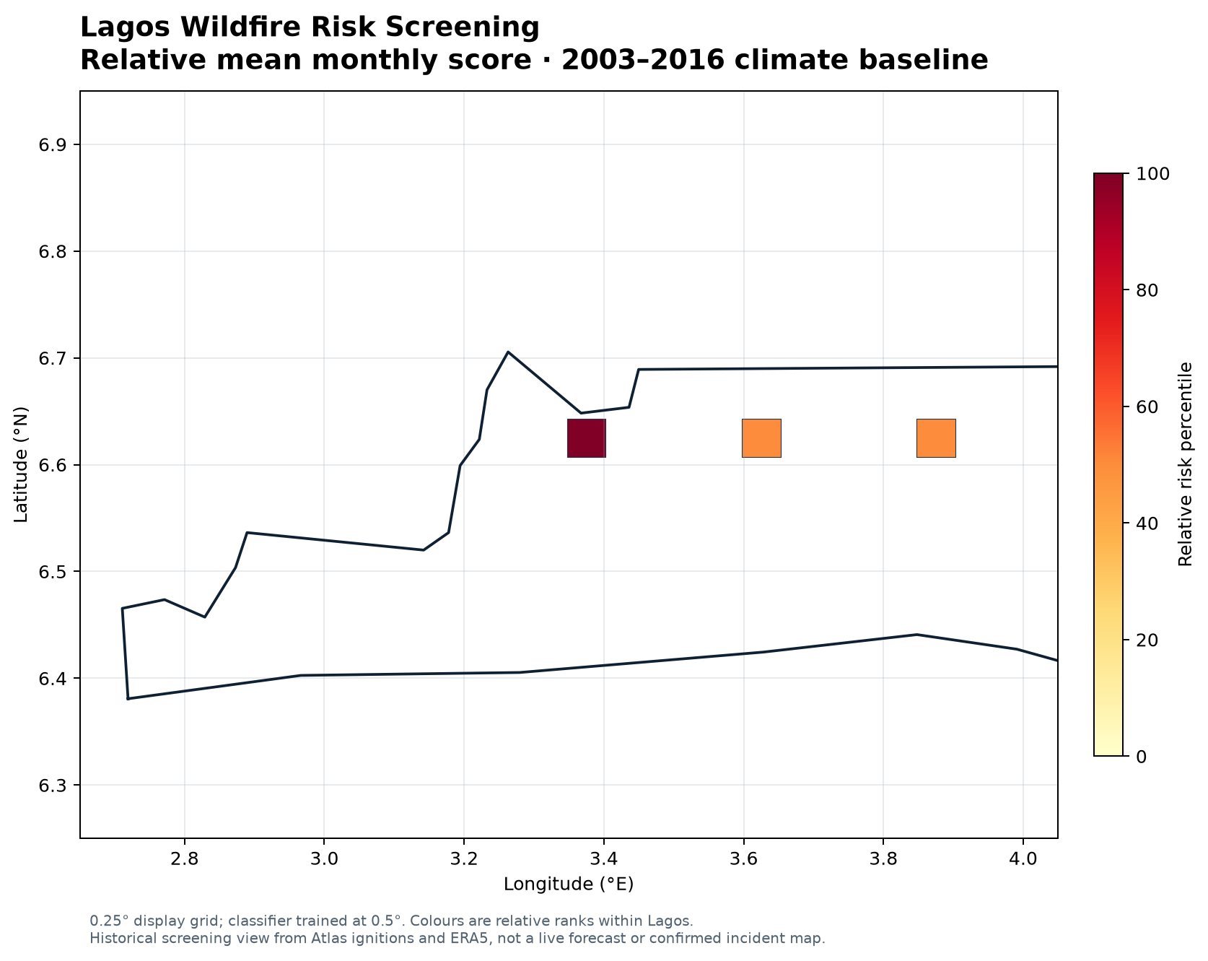
Lagos screening map
Displayed cells
3
0.25° display grid
0.5° training grid
Mean model scores
0.244 · 0.236 · 0.236
Percentiles are relative within Lagos, not calibrated incident probabilities.
06
Notes:
The three display cells inside the Lagos polygon receive mean monthly model scores of approximately 0.244, 0.236, and 0.236. The percentile ranking is only relative across these cells. See outputs/maps/lagos_wildfire_risk.png.

Slide 7
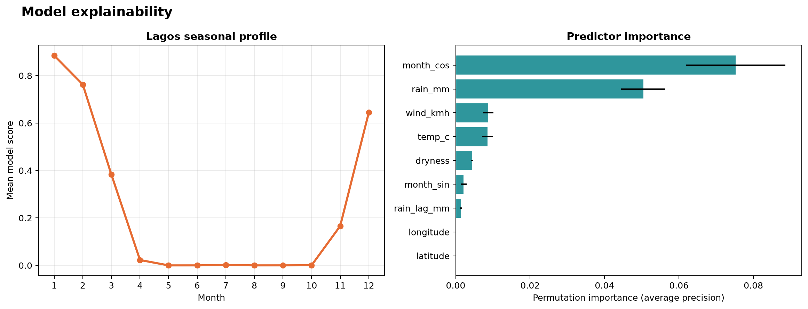
What drives the model
Leading predictors
1 Month seasonality
2 Monthly rainfall
3 Wind speed
4 Temperature
Importance uses permutation on a spatially held-out block.
Association supports interpretation; it does not establish cause.
07
Notes:
Permutation importance was calculated using average precision on a spatial holdout. Month cosine and rainfall have the largest measured importance. The figure also shows the modelled monthly profile.

Slide 8
Interpretation and limits
01
Historical window
Fire Atlas model labels cover 2003–2016.
02
Spatial scale
0.5° training cells; Lagos display is interpolated to 0.25°.
03
Weather sampling
Four regional climate anchors represent broad gradients.
04
Fire labels
Satellite detections can miss small burns or flag other heat sources.
Use as a regional screening exercise until checked against local incident records.
08
Notes:
The map is not operational. The most important next validation source is geocoded incident data from the Lagos State Fire and Rescue Service.

Slide 9
Reproduce and extend
Run
Outputs
python run.py
maps · figures · metrics · model · logs · report
Next validation step
Join local fire-service incidents, add recent satellite data, then repeat spatial and time-based evaluation.
Source archive and weather cache stay local; generated outputs are saved in the repository.
09
Notes:
Reproduction instructions are in README.md. Source attribution: Global Fire Atlas, Open-Meteo ERA5 reanalysis, and the cited Nigeria state polygon source. Do not use for operational decisions without local validation.

