Slide 1
Lagos Wildfire
Risk Screening
SIWES geospatial machine learning capstone
Project 3 | Historical fire patterns and climate
Nigeria • MODIS + ERA5 + satellite fires • 2003–2016
HistGradientBoosting trained across Nigeria; Lagos map uses three native 0.25° cells.
Notes:
The full model compares Random Forest and HistGradientBoosting; five-fold spatial validation selected HistGradientBoosting. The map summarizes three native 0.25-degree Lagos cell scores for the 2003–2016 historical period.

Slide 2
Study question and scope
Question
Study design
Where do historical satellite fire observations and environmental conditions indicate stronger monthly fire-occurrence patterns around Lagos?
Train and spatially validate across Nigeria, then summarize model scores for the Lagos cells.
Target
Not the target
Satellite-observed monthly fire occurrence
Confirmed incidents, daily forecasts, or property-level risk
02
Notes:
The model learns a monthly satellite-observed fire-occurrence target across Nigeria and summarizes scores for Lagos. The saved evaluation is geographic holdout validation against Global Fire Atlas labels.

Slide 3
Data inputs
Fire history
Weather
Global Fire Atlas monthly fire-number rasters
2003–2016 · 0.25° native model grid
ERA5 reanalysis via Open-Meteo
Temperature, rainfall, wind, humidity
Monthly summaries from four regional anchors
Training sample
191,976 complete grid-month records · 1,188 Nigeria land cells · 19.4% fire-positive
MODIS MOD13Q1 NDVI/EVI + MOD11A2 day/night LST; Lagos boundary from open Nigeria state polygons
03
Notes:
Sources: Global Fire Atlas, https://zenodo.org/records/14065246 ; Open-Meteo Historical Weather API / ERA5, https://open-meteo.com/en/docs/historical-weather-api ; MODIS MOD13Q1 NDVI/EVI, https://developers.google.com/earth-engine/datasets/catalog/MODIS_061_MOD13Q1 ; MODIS MOD11A2 LST, https://developers.google.com/earth-engine/datasets/catalog/MODIS_061_MOD11A2 ; Nigeria state polygons, https://gist.github.com/segebee/ff4a2f75be560462c369 . MODIS monthly means were quality-masked and reduced to cell-month summaries in Earth Engine.

Slide 4
Model workflow
01
02
03
04
05
Align
Engineer
Fit
Validate
Score Lagos
0.25° fire, climate
and MODIS inputs
Season, rainfall lags,
vegetation and LST
HistGradient
Boosting
2° spatial blocks
5 held-out folds
Native 0.25° cells
clipped to Lagos
Five-fold spatial validation holds out entire 2° blocks across Nigeria.
04
Notes:
HistGradientBoosting is a histogram-based gradient-boosted decision tree classifier from scikit-learn. Model candidates use balanced sample weights. GroupKFold holds out 2-degree geographic blocks. The same 0.25-degree Global Fire Atlas grid is used for training and Lagos prediction.

Slide 5
Spatial validation results
Five spatial folds · 2° blocks · 191,976 complete records
Score (%)
ROC AUC 0.944 ± 0.013
ROC AUC
94.4
Average precision 0.809
Average precision
Brier score 0.092
80.9
At 0.50 threshold
Precision 0.613 · Recall 0.873
F1 0.721
1 − Brier score
90.8
0
20
40
60
80
100
Average precision is relative to the 19.4% fire-positive rate.
05
Notes:
Five-fold GroupKFold results on 191,976 complete rows: ROC AUC 0.944 (fold SD 0.013), average precision 0.809, Brier 0.092. At threshold 0.50, precision is 0.613, recall 0.873, F1 0.721. The chart displays 1 minus Brier (0.908) so all bars share a higher-is-better direction.

Slide 6
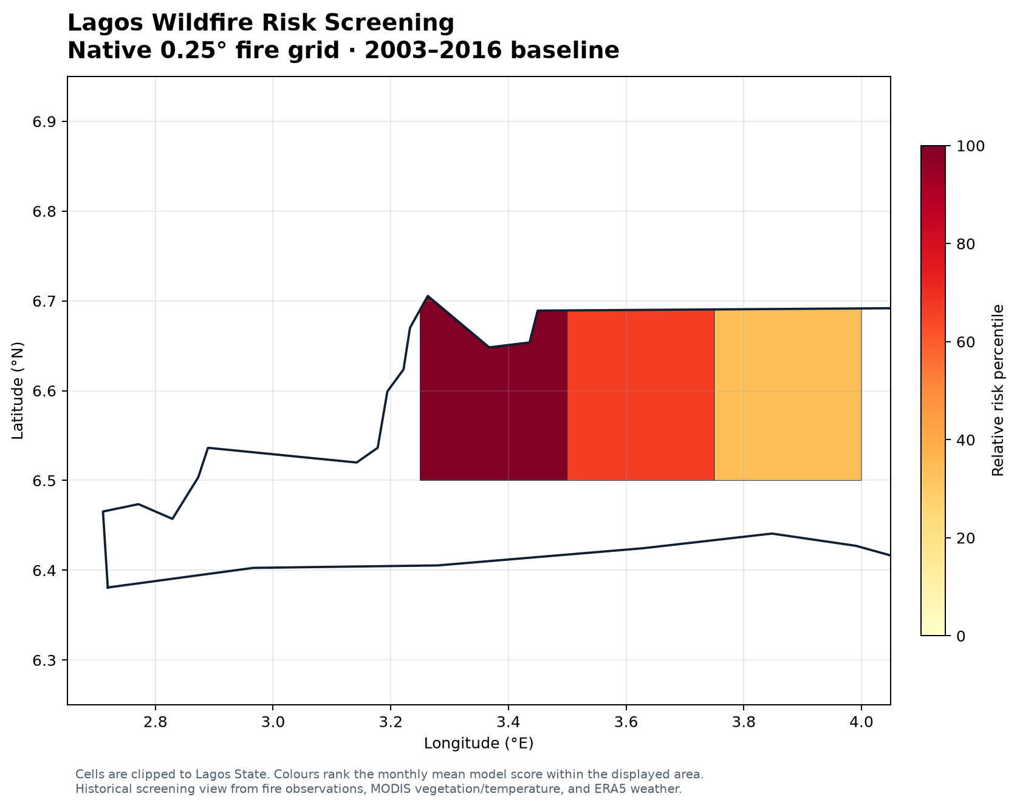
Lagos screening map
Displayed cells
3
Native 0.25° model grid|Three cell centers in Lagos
Mean model scores
0.240 · 0.233 · 0.153
Mean model scores by cell. Percentiles rank only the three displayed Lagos cells.
06
Notes:
The three Lagos grid-cell centers have mean model scores 0.2398, 0.2331, and 0.1530. The map uses relative percentiles across only those displayed cells. Scores are historical model outputs, not calibrated incident probabilities.

Slide 7
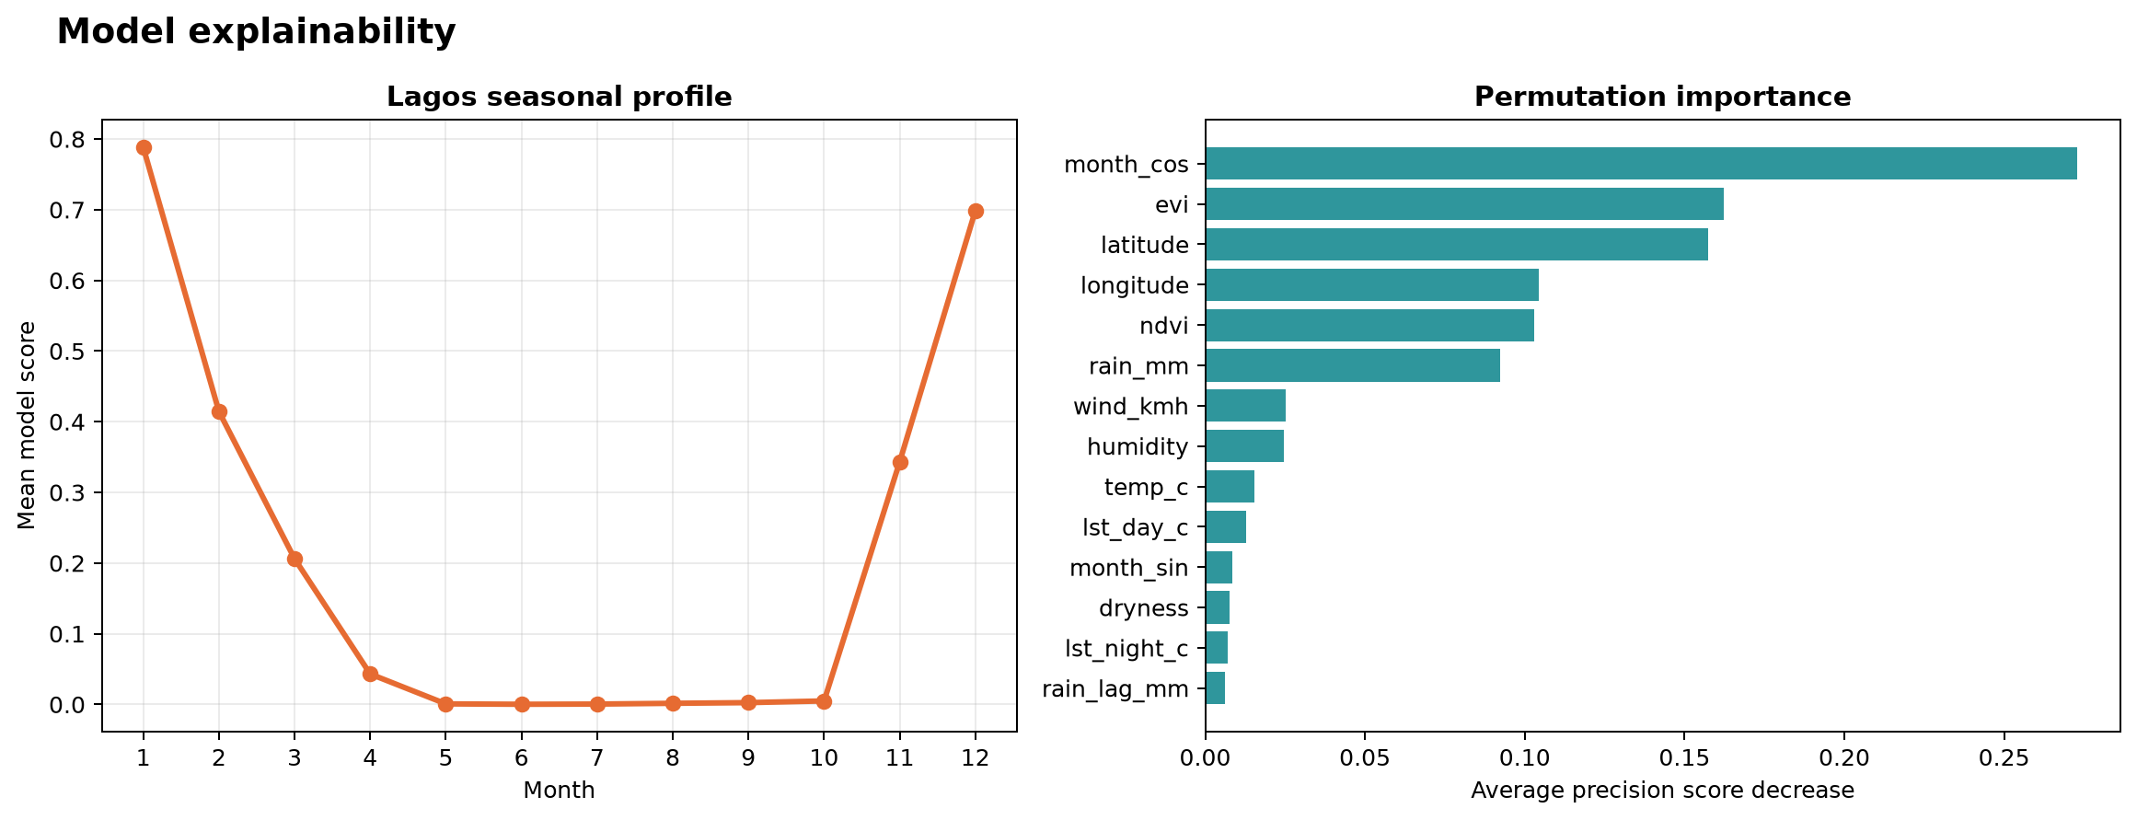
What drives the model
Leading predictors
Seasonality · EVI · latitude · longitude
Permutation importance; this run used a labelled fallback because SHAP was unavailable.
Permutation importance; labelled fallback used because SHAP was unavailable.
07
Notes:
The seasonal profile and permutation importance come from the current full model. The four leading features are month_cos, EVI, latitude, and longitude. Importance is not a causal effect. SHAP was unavailable in this runtime, so permutation importance is the labelled method.

Slide 8
Study scope and interpretation
01
Historical window
Global Fire Atlas satellite fire observations, 2003–2016.
02
Spatial scale
0.25° training and prediction grid; map polygons clipped to Lagos.
03
Weather sampling
ERA5 weather plus monthly MODIS NDVI, EVI and day/night LST.
04
Validation
Nigeria spatial folds + 2017–2024 Lagos VIIRS holdout.
Lagos map: historical relative model scores, summarized over calendar months.
08
Notes:
Two evaluation tracks are presented separately. Nigeria-wide five-fold spatial cross-validation tests the Global Fire Atlas target in spatially held-out blocks. The independent temporal/sensor holdout applies the frozen 2003–2016 model to three Lagos cells for 2017–2024 and compares with NASA VIIRS VNP14A1 detections. This is satellite-proxy evaluation, distinct from local fire-service records.

Slide 9
Reproduce and extend
Run
Outputs
python run.py
maps · figures · metrics · model · logs · report
Next evaluation
2017–2024 VIIRS holdout: AUC 0.856, AP 0.894, Brier 0.396. Next: geocoded Lagos fire-service records.
Saved: model · metrics · folds · VIIRS holdout · Lagos map · importance · report · app
09
Notes:
The later-period Lagos VIIRS holdout is complete: 284 complete cell-months, ROC AUC 0.856, average precision 0.894, Brier score 0.396. The local service-record comparison is the next evaluation step. Reproduction instructions: README.md and scripts/validate_lagos_viirs.py. Source: NASA VIIRS VNP14A1, https://developers.google.com/earth-engine/datasets/catalog/NASA_VIIRS_002_VNP14A1 .

