Slide 1
PROOF OF CONCEPT · COTIVITI GENAI INTERN ASSESSMENT
◆
Clinical Policy RAG
Source-grounded answers, claim adjudication, and a working guardrail over healthcare
billing & coding policy — 100% local, $0 cost.
Iyman Ahmed · Topic 3 — Content Management in Health Care
github.com/Iyman-Ahmed/clinical-rag-poc

Slide 2
THE TOPIC — CONTENT MANAGEMENT IN HEALTH CARE
Policy is dense, always changing, and unforgiving.
Payment-integrity analysts read long CMS and Medicare policy documents to answer routine questions — is this service covered, which code applies, what changed this year. Getting it wrong is costly. And an AI that confidently invents a code or a coverage rule isn’t a shortcut — it’s a compliance liability.
Billing & coding policies
Clinical practice guidelines
Payer–provider contracts
LCDs, NCDs, CPT/ICD-10 rules that decide payment.
Evidence-based criteria for medical necessity.
Terms that must be read, compared, and enforced.
CLINICAL POLICY RAG
02 / 15

Slide 3
WHERE THE FIELD IS GOING
From keyword search to grounded reasoning.
01
NLP → LLMs & LMMs
02
RAG as the trust layer
Extraction, summarization and coding shift from brittle rules to general-purpose models.
Retrieval grounds every answer in the source text, with citations — not model memory.
03
Policy-as-code & agents
04
Guardrails & auditability
Written policy is converted into rules, features, and models; agents chain the reasoning.
Refusal, provenance and evaluation are now table stakes for healthcare AI.
CLINICAL POLICY RAG
03 / 15

Slide 4
THE PROOF OF CONCEPT
A grounded policy assistant you can actually audit.
One small system that answers policy questions with citations, judges real claims against coverage rules, and flags what changed between policy versions — with a guardrail that refuses when the evidence isn’t there.
Cited Q&A
Hallucination guardrail
Claim adjudication
Multi-policy reasoning
Policy change detector
$0
100%
6
API / inference cost
local & private
policy corpora indexed
CLINICAL POLICY RAG
04 / 15

Slide 5
HOW IT WORKS
Retrieve → ground → cite. Nothing is invented.
→
→
→
→
1
2
3
4
5
Embed
Search
Ground
Reason
Answer
the question
ChromaDB vectors
whole source docs
local LLM
+ cited sources
The model is only allowed to answer from the retrieved policy text — so every answer is grounded, traceable, and free of invented codes or dates.
CLINICAL POLICY RAG
05 / 15

Slide 6
ARCHITECTURE & STACK
Four small, swappable, well-known parts.
LM Studio
ChromaDB
all-MiniLM-L6-v2
FastAPI + dashboard
Local LLM — no API keys, no per-token cost.
Persistent vector store over policy chunks.
80 MB embeddings, CPU-friendly, free.
Thin backend, one UI, same rag/ core.
LOCAL
FREE
PRIVATE
REPRODUCIBLE
CLINICAL POLICY RAG
06 / 15

Slide 7
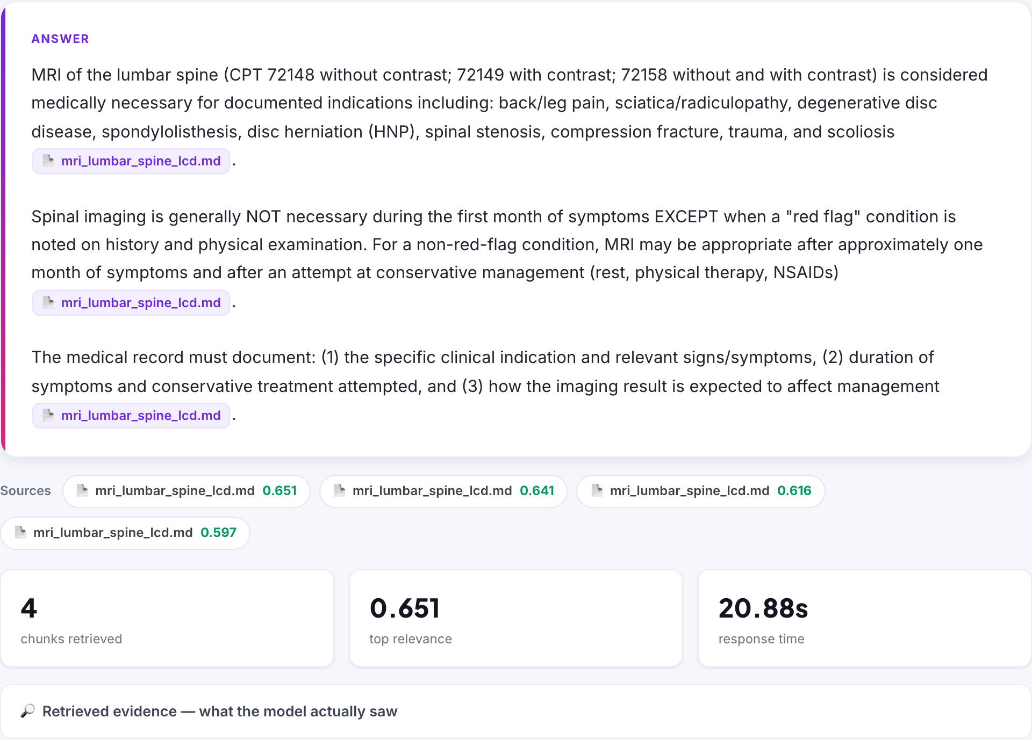
LIVE DEMO · CITED ANSWER
Every claim in the answer, traced to a source.
LIVE APP — “Coverage requirements for a lumbar spine MRI?” → grounded answer, cited to LCD L34220.
CLINICAL POLICY RAG
07 / 15

Slide 8
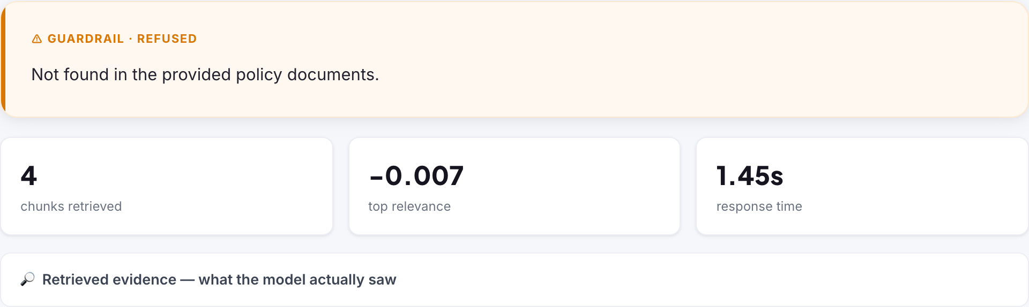
LIVE DEMO · THE GUARDRAIL
It refuses before it lies.
LIVE APP — asked “What is the capital of France?” → negative relevance → the system says so instead of guessing.
CLINICAL POLICY RAG
08 / 15

Slide 9
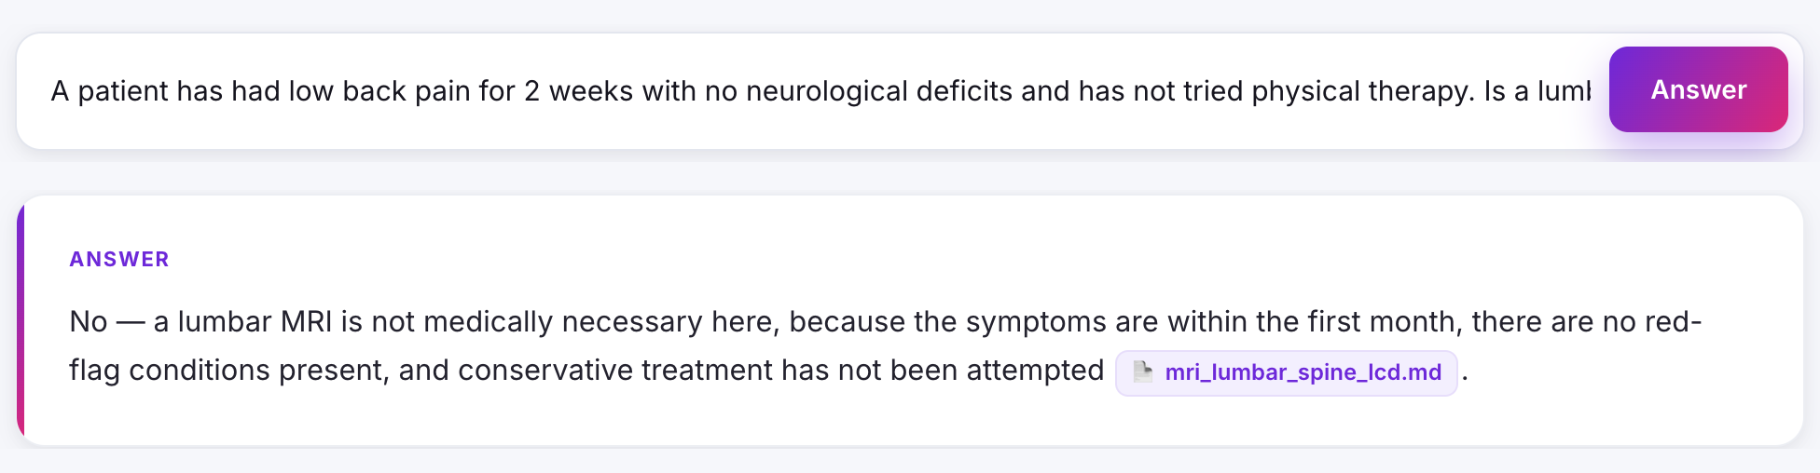
LIVE DEMO · MULTI-POLICY REASONING
It combines the rules to reach a determination.
LIVE APP — 2 weeks of pain, no red flags, no conservative care. A reviewer flagged this exact case; retrieval + prompt fixes now reason it to a grounded “No.”
CLINICAL POLICY RAG
09 / 15

Slide 10
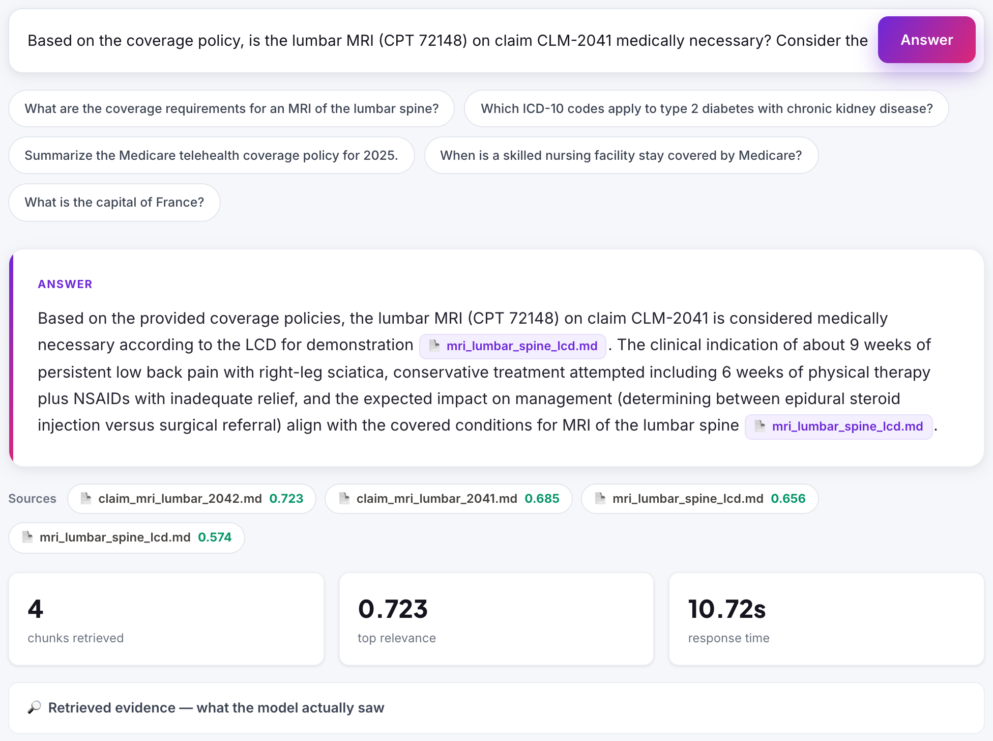
LIVE DEMO · CLAIM ADJUDICATION
CLM-2041 — Payable.
Indication, symptom duration, and conservative care are all documented — the tool confirms medical necessity and cites the policy line.
CLINICAL POLICY RAG
10 / 15

Slide 11
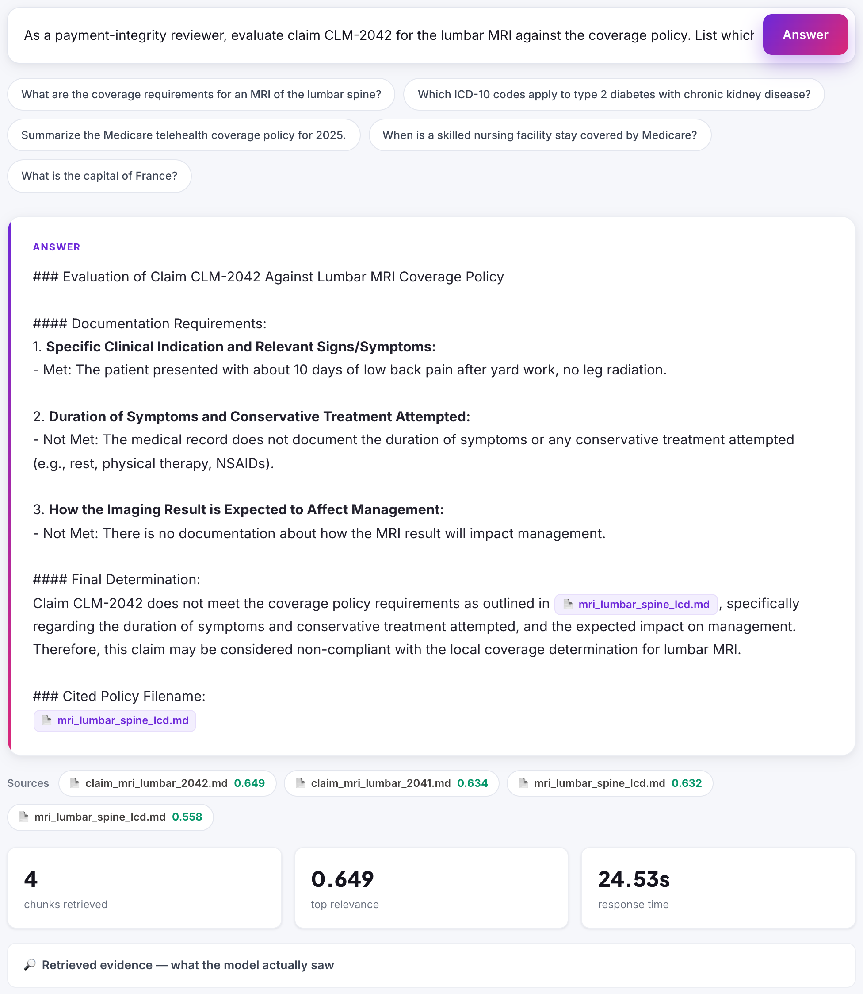
LIVE DEMO · CLAIM ADJUDICATION · CLM-2042 = FLAG / DENY
CLM-2042 — Flag / Deny.
CLINICAL POLICY RAG
11 / 15

Slide 12
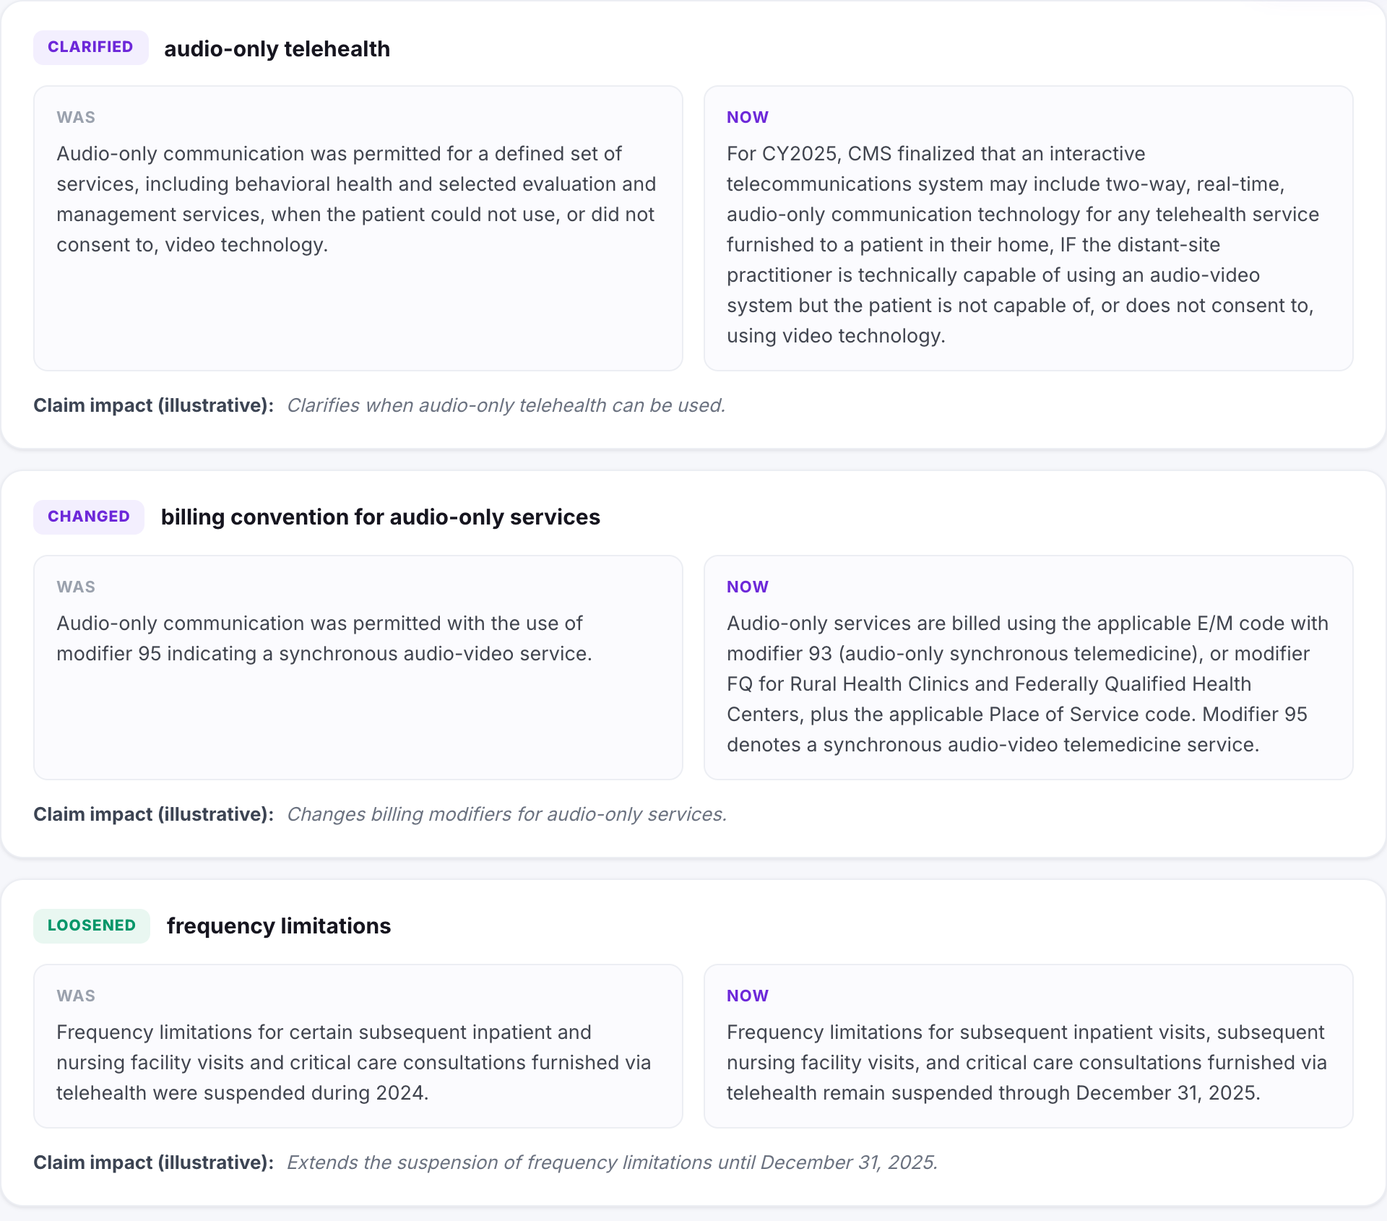
LIVE DEMO · POLICY CHANGE DETECTOR · telehealth 2024 → 2025
Every revision becomes a structured, plain-English diff.
CLINICAL POLICY RAG
12 / 15

Slide 13
FOR COTIVITI — OPPORTUNITY, RISK, RECOMMENDATION
Where this creates value — and where to be careful.
OPPORTUNITIES
THREATS / RISKS
Research compresses from minutes to seconds, every answer cited.
Hallucinated codes or rules — a compliance liability if ungrounded.
Claim-vs-policy adjudication with the evidence shown — the core workflow.
Stale policy: answers must track the current source of truth.
Automatic monitoring of policy revisions across a living rule library.
Over-automation without a human in the loop on payment decisions.
RECOMMENDATION
Pilot a retrieval-grounded, human-in-the-loop policy assistant on one bounded coding domain. Measure analyst time-to-answer and citation accuracy before widening scope.
CLINICAL POLICY RAG
13 / 15

Slide 14
HONESTY & ROADMAP
Clear about today’s limits, deliberate about what’s next.
BEING HONEST — NOW
WHERE THIS GOES NEXT
Sample claims (CLM-2041/2042) are synthetic — no real patient data.
Bigger corpus + a labeled eval benchmark for retrieval precision.
The corpus is a summarized excerpt, but every file cites its real CMS source.
A cross-encoder reranker for multi-document questions.
Within-policy reasoning works; reasoning across separate documents still benefits from reranking or agentic retrieval.
Human-in-the-loop review before any adjudication reaches a rules engine.
Role-based access and full audit logging on every answer.
CLINICAL POLICY RAG
14 / 15

Slide 15
THANK YOU
Clinical Policy RAG
Cited answers, claim adjudication, and a working guardrail — built local and free.
github.com/Iyman-Ahmed/clinical-rag-poc iyman12393@gmail.com Iyman Ahmed · Cotiviti — GenAI Research Engineer Intern Assessment

