Slide 1
Tsunami
CAPSTONE PROJECT
Presented By:
Yoshua .I
9513- Jayaraj Annapackiam CSICollege of Engineering
B.E Mechanical Engineering

Slide 2
OUTLINE
Problem Statement
Proposed System/Solution
System Development Approach
Algorithm & Deployment
Result
Conclusion
Future Scope
References

Slide 3
Problem Statement
Develop a robust and accurate tsunami prediction system that can forecast the occurrence, magnitude, and impact of tsunamis in coastal regions. The system should utilize historical seismic data, oceanographic data, meteorological data, and other relevant environmental factors to provide early warnings and mitigate the potential devastation caused by tsunamis. The objective is to minimize loss of life, property damage, and ensure timely evacuation and disaster preparedness measures.

Slide 4
Proposed Solution
Data Collection and Preprocessing: Gather relevant data from sources such as credit bureaus, financial institutions, and other relevant sources. This data may include information about past loan applicants, their credit scores, income levels, employment status, loan amounts, loan terms, and whether they defaulted or not. Preprocess the data by handling missing values, encoding categorical variables, and scaling numerical features if necessary.
Model Selection: Choose appropriate machine learning models for the loan prediction task. Commonly used models for binary classification tasks like this include logistic regression, decision trees, random forests, support vector machines (SVM), and gradient boosting algorithms like XGBoost or LightGBM.
Model Training and Evaluation: Split the data into training and testing sets (or use cross-validation) and train the selected models on the training data. Evaluate the models using appropriate evaluation metrics such as accuracy, precision, recall, F1 score, ROC-AUC, etc. Optimize hyperparameters using techniques like grid search or random search.
Model Interpretation: Interpret the trained models to understand which features are most important in predicting loan defaults. This can help in explaining the model's predictions to stakeholders and identifying actionable insights.
Deployment: Once a satisfactory model is trained and evaluated, deploy it into a production environment where it can be used to predict loan defaults for new loan applicants in real-time.
Monitoring and Maintenance: Continuously monitor the model's performance in production, retrain it periodically with new data, and update the model as needed to ensure its effectiveness over time.

Slide 5
System Approach
Building a tsunami prediction system requires a comprehensive approach that integrates various data sources, employs advanced modeling techniques, and incorporates early warning mechanisms. Here's an outline of the approach for developing a tsunami system:
Data Collection:
Seismic Data: Gather seismic activity data from seismographs and earthquake monitoring stations to detect underwater earthquakes, which are a common trigger for tsunamis.
Oceanographic Data: Collect oceanographic data such as sea level measurements, water temperature, and current patterns to understand the state of the ocean and potential changes that could lead to tsunami formation.
Meteorological Data: Include meteorological data like wind speed, atmospheric pressure, and precipitation to assess weather conditions that may influence tsunami generation.
Model Development:
Utilize machine learning and statistical modeling techniques to develop a predictive model for tsunami occurrence and magnitude estimation.
Train the model using historical data that includes instances of past tsunamis and non-tsunami events to capture patterns and correlations.
Early Warning System:
Implement thresholds and triggers based on the model's predictions to generate alerts and warnings when conditions indicative of a potential tsunami are detected.
Incorporate geographical mapping and visualization tools to display warning zones and evacuation routes for at-risk coastal areas.

Slide 6
Algorithm & Deployment
Data Collection:
Gather historical seismic data, oceanographic data, and meteorological data from reliable sources such as seismic monitoring stations, ocean buoys, weather stations, satellites, and government agencies.
Data Preprocessing:
Cleanse the data to handle missing values, outliers, and inconsistencies.
Perform feature engineering to extract relevant features like earthquake magnitude, depth, water temperature, wind speed, atmospheric pressure, etc.
Model Development:
Choose an appropriate machine learning algorithm or ensemble of algorithms for tsunami prediction. Options include:
Train the model using historical data, where instances are labeled as either tsunami events or non-tsunami events.
Early Warning System Integration:
Integrate the trained model into an early warning system that continuously monitors real-time data streams from seismic, oceanographic, and meteorological sensors.
Set thresholds and triggers based on model predictions to generate alerts when conditions indicative of a potential tsunami are detected.
Validation and Testing:
Validate the predictive model using validation data sets and conduct testing to assess its accuracy, sensitivity, specificity, and overall performance.
Perform sensitivity analysis to evaluate the model's robustness under different scenarios and input variations.

Slide 7
deployment
Real-Time Data Processing:
Implement a system for real-time data processing to handle incoming data from various sensors and update predictions continuously.
Use scalable and efficient data processing frameworks or technologies to handle large volumes of data in real-time.
Cloud-Based Infrastructure:
Consider deploying the tsunami prediction system on cloud infrastructure for scalability, reliability, and accessibility.
Utilize cloud services for data storage, processing, and deployment to ensure high availability and performance.
API Integration:
Develop APIs (Application Programming Interfaces) for seamless integration with existing disaster management systems, government agencies, and emergency response teams.
Provide APIs for receiving real-time data, delivering alerts and warnings, and accessing prediction results.
Visualization and User Interface:
Design a user-friendly interface with interactive visualizations, maps, and dashboards to display prediction results, warning zones, evacuation routes, and other relevant information.
Ensure accessibility and usability across different devices and platforms for stakeholders and the general public.
Monitoring and Maintenance:
Implement monitoring tools and logging mechanisms to track system performance, data quality, and model accuracy over time.

Slide 8
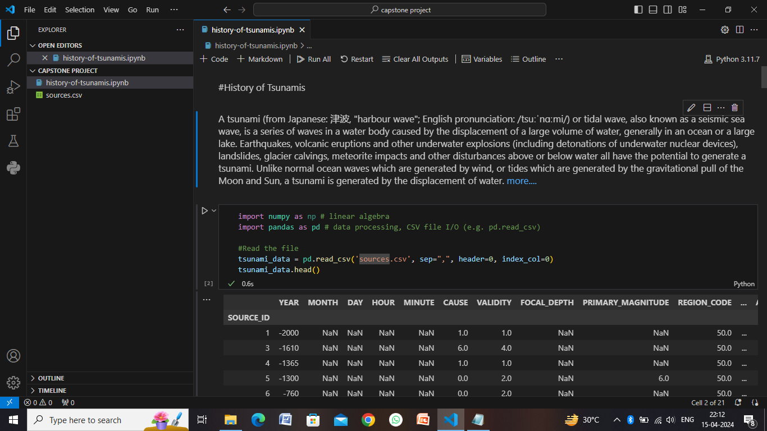
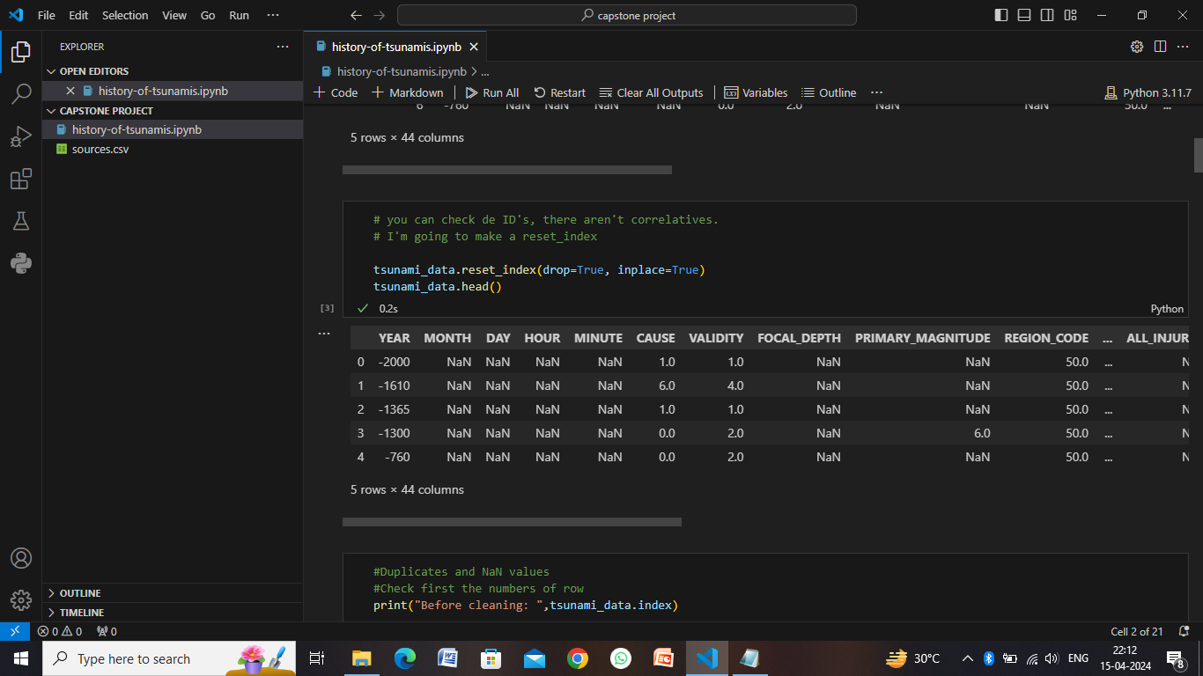
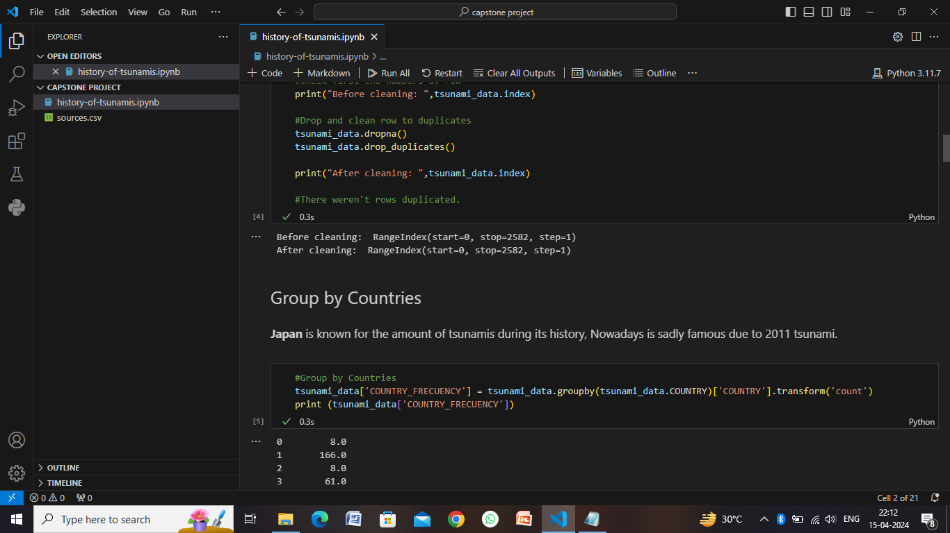
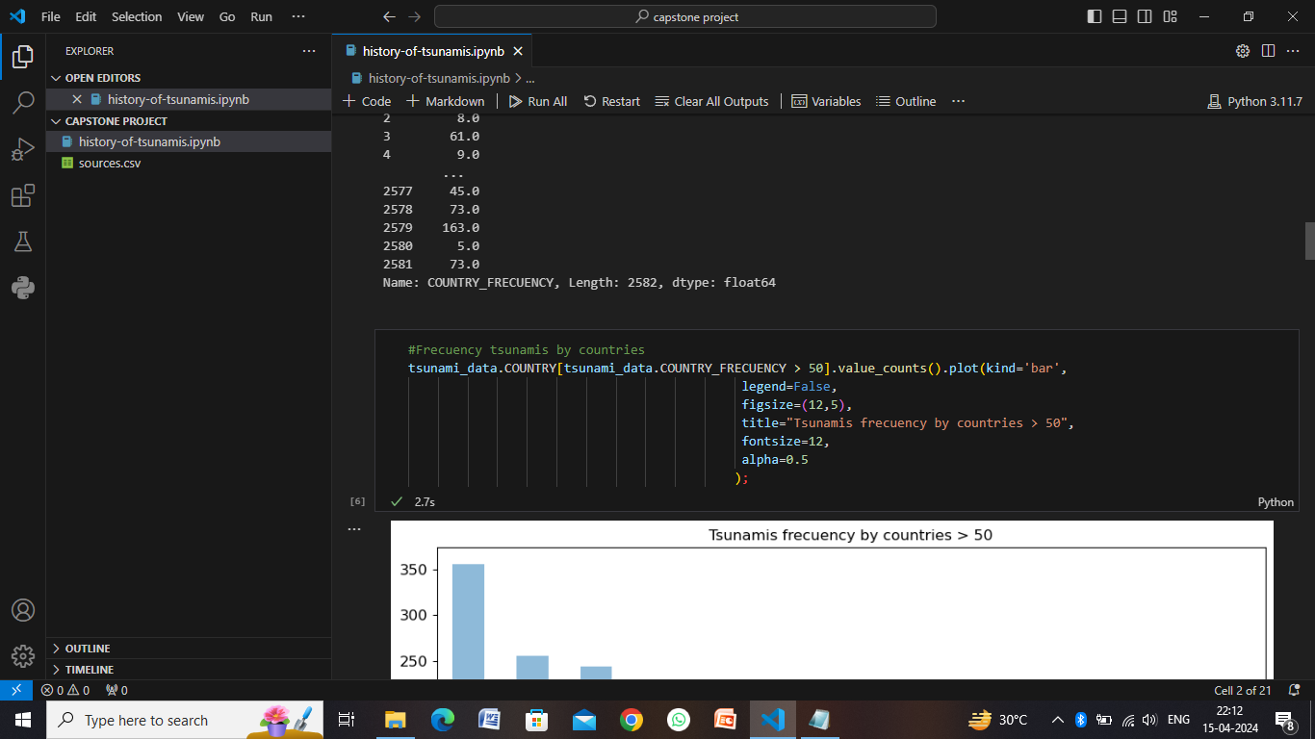
Result

Slide 9
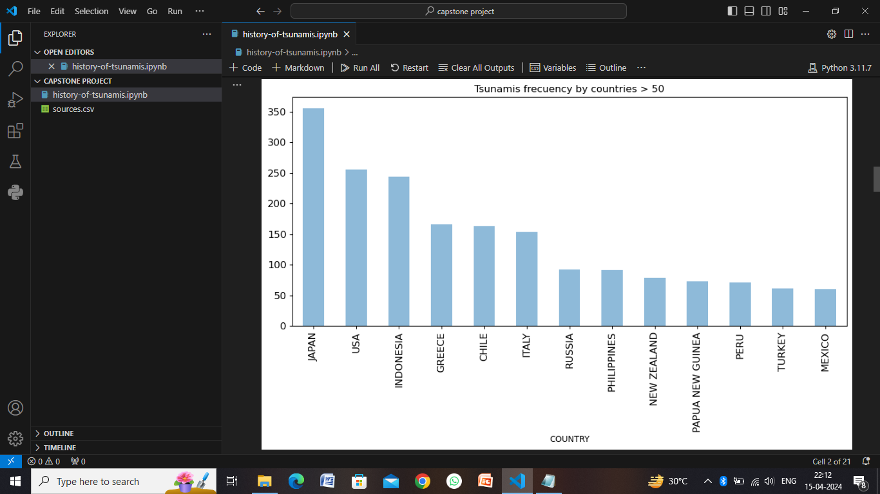
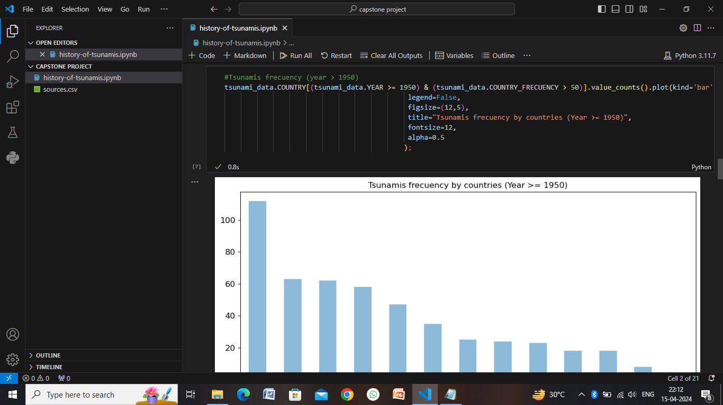
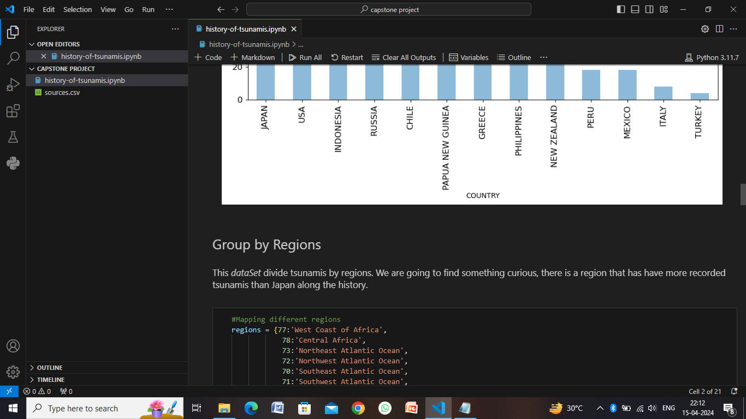
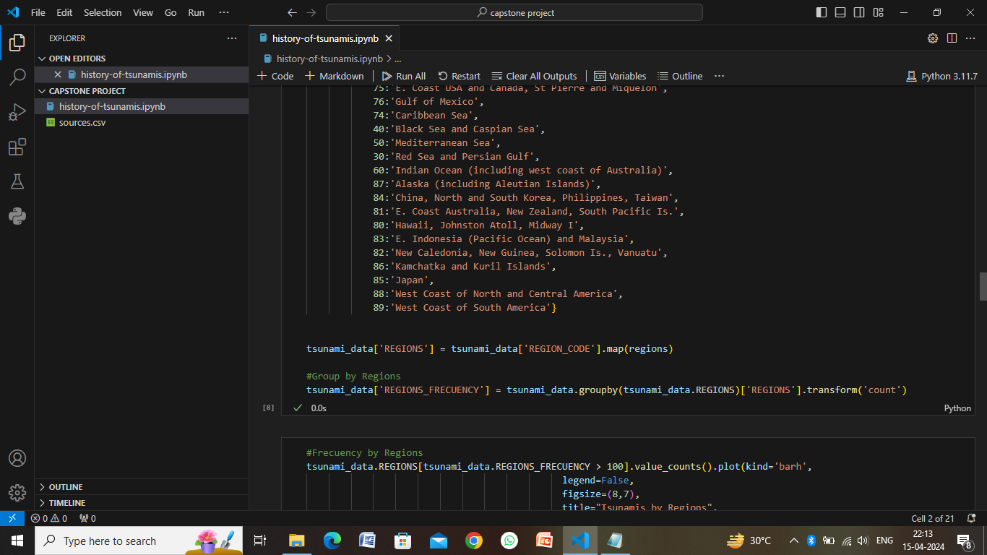
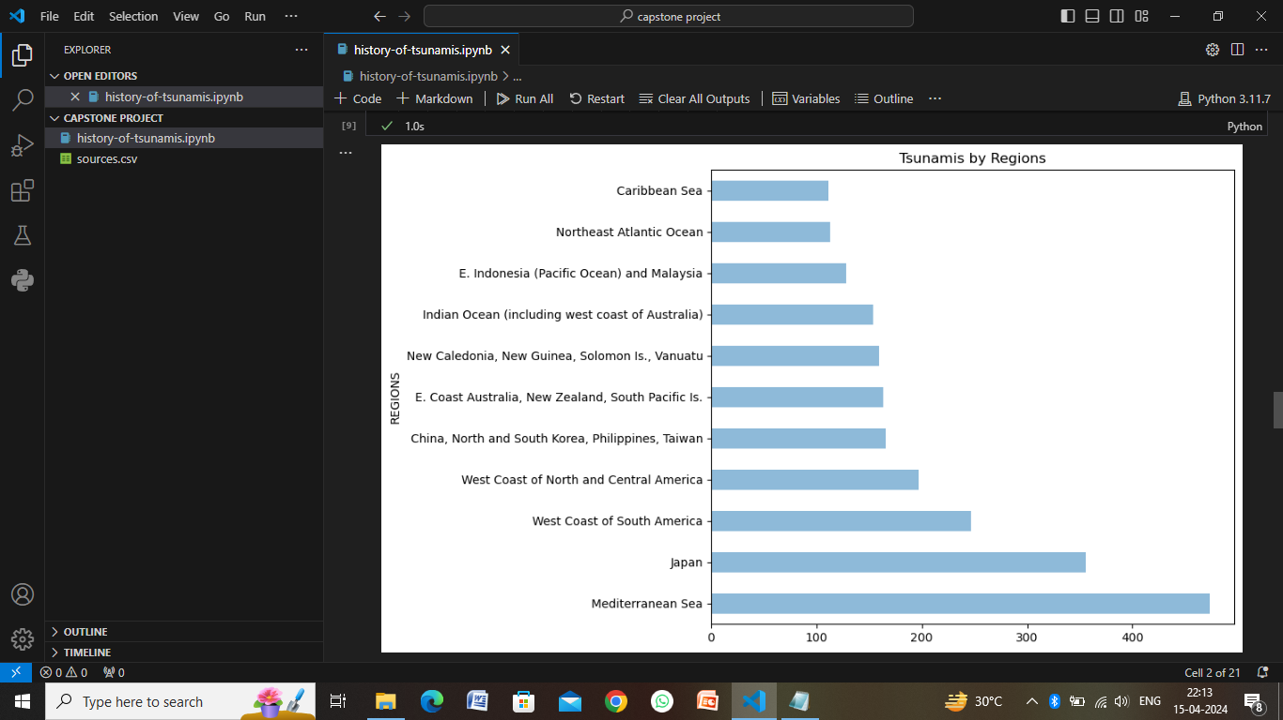
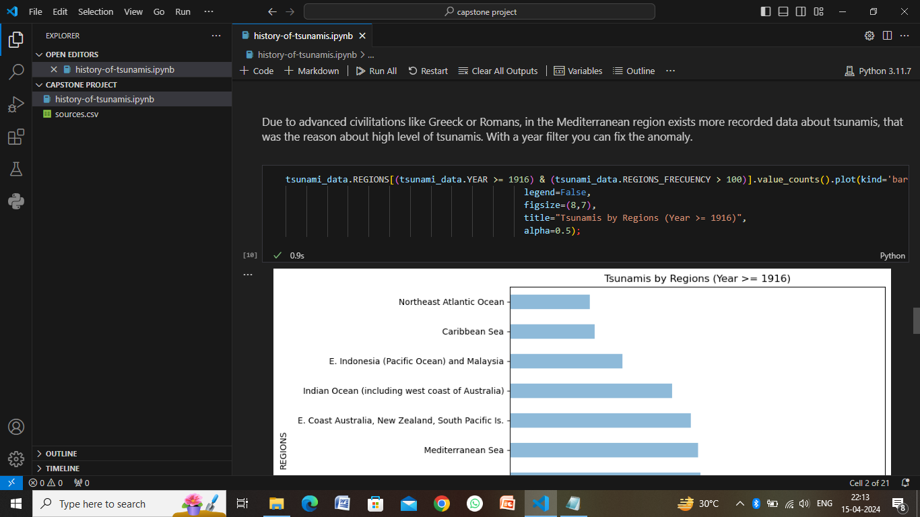

Slide 10
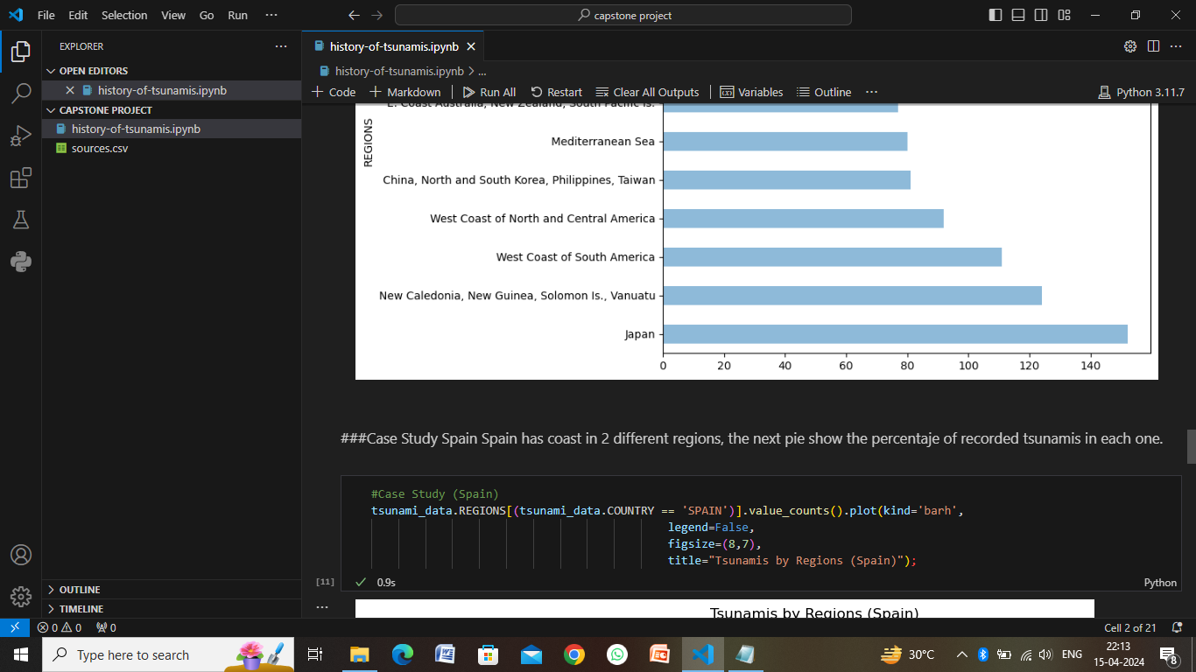
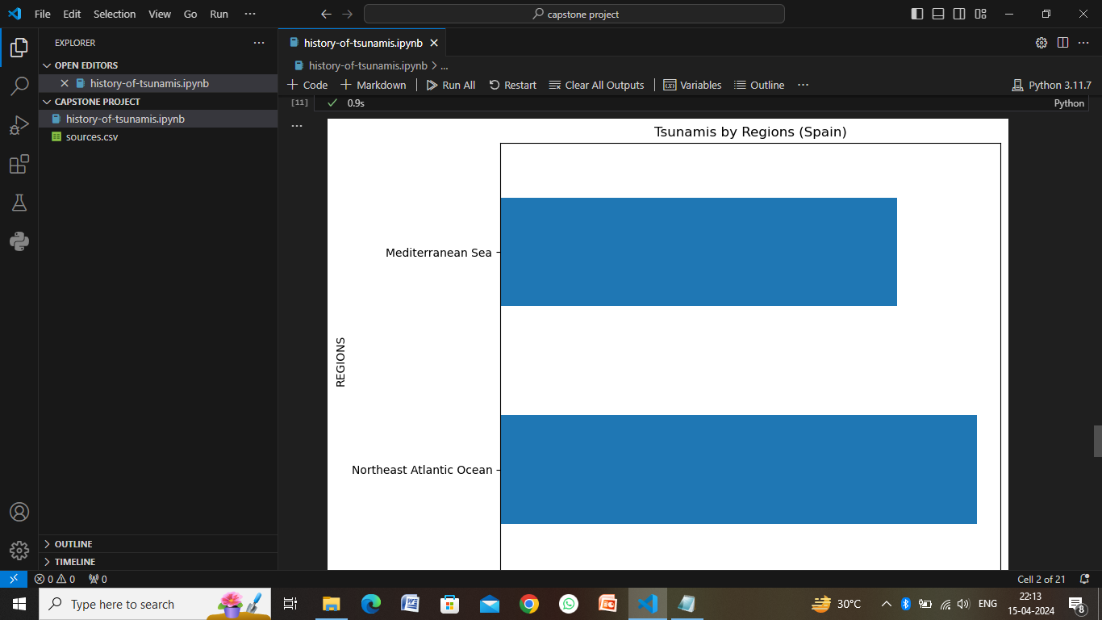

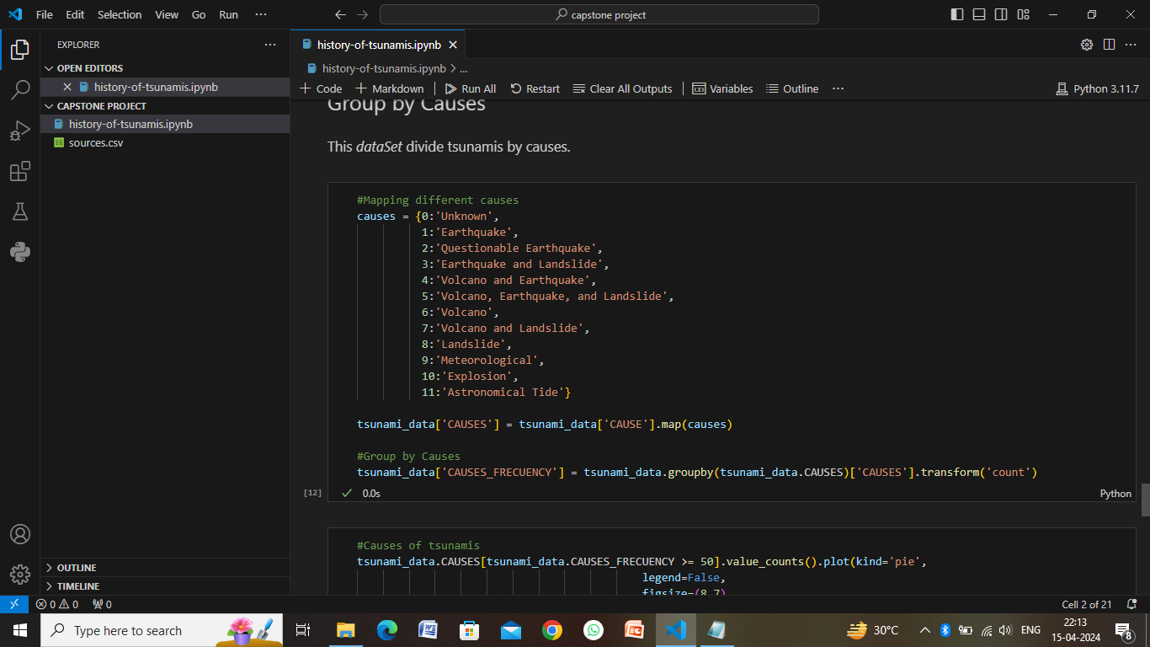
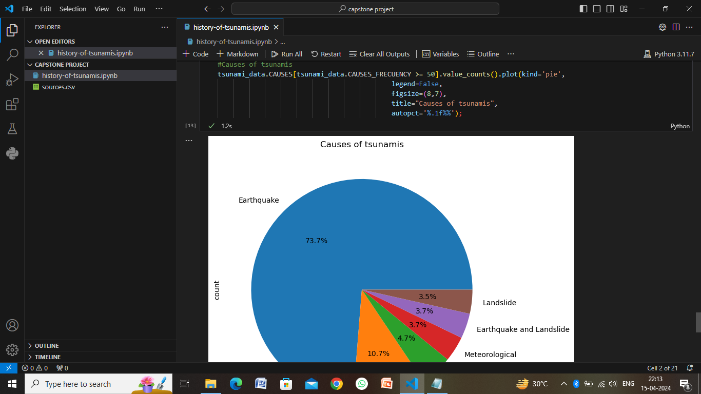
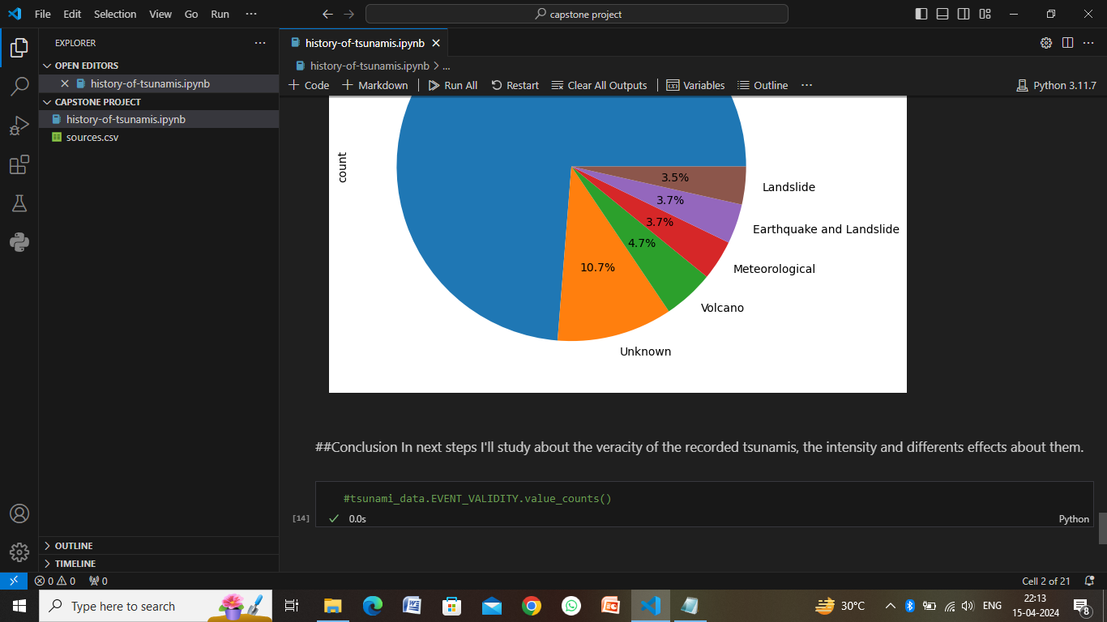

Slide 11
Conclusion
In conclusion, developing a tsunami prediction system is a complex yet crucial endeavor that requires a multidisciplinary approach involving data science, machine learning, environmental science, and disaster management. By following a systematic algorithmic approach and considering key deployment considerations, such as real-time data processing, cloud infrastructure, API integration, visualization, and maintenance, a robust and effective tsunami prediction system can be developed and deployed.Such a system holds immense potential to mitigate the impact of tsunamis by providing early warnings, alerting authorities and communities, and facilitating timely evacuation and disaster preparedness measures. It can significantly contribute to enhancing disaster resilience in coastal regions and safeguarding lives, property, and infrastructure against the devastating effects of tsunamis.
However, it's essential to acknowledge the ongoing challenges and limitations in tsunami prediction, including the inherent uncertainties associated with natural disasters, the need for continuous data monitoring and updates, and the importance of public education and awareness. Despite these challenges, advancements in technology, data analytics, and predictive modeling offer promising opportunities to improve the accuracy and reliability of tsunami prediction systems in the future.Overall, the development and deployment of a tsunami prediction system represent a proactive and innovative approach to disaster risk reduction and emergency management, emphasizing the importance of leveraging data-driven solutions to enhance resilience and save lives in vulnerable coastal communities.

Slide 12
Future scope
The future scope of tsunami prediction and mitigation encompasses several areas of research, technological advancements, and collaborative efforts aimed at improving the effectiveness, accuracy, and timeliness of tsunami warning systems. Here are some key areas of future development and innovation in tsunami prediction:
Enhanced Data Integration
Machine Learning and AI
High-Resolution Modeling
Early Detection Technologies
Remote Sensing and Geospatial Analysis
Community Engagement and Education
International Collaboration

Slide 13
References
National Oceanic and Atmospheric Administration (NOAA): NOAA provides comprehensive information on tsunamis, including historical data, monitoring systems, research publications, and educational resources. Their Tsunami Program website (https://www.tsunami.gov/) is a valuable source of information.
United States Geological Survey (USGS): The USGS offers extensive resources on earthquakes, seismic activity, and tsunamis. Their Tsunami Information website (https://www.usgs.gov/natural-hazards/tsunami) provides scientific data, reports, and publications related to tsunami research.
International Tsunami Information Center (ITIC): ITIC, operated by UNESCO's Intergovernmental Oceanographic Commission (IOC), serves as a global hub for tsunami information, research, and capacity building. Their website (https://itic.ioc-unesco.org/) offers access to technical documents, reports, and international collaboration initiatives.
Journal of Geophysical Research (JGR) - Oceans: JGR-Oceans is a reputable scientific journal that publishes research articles, reviews, and studies on oceanography, including tsunami modeling, prediction techniques, and hazard assessment. You can explore their website (https://agupubs.onlinelibrary.wiley.com/journal/21699275) for relevant publications.
Pacific Tsunami Warning Center (PTWC): PTWC, operated by NOAA, provides tsunami warnings, bulletins, and information for the Pacific Ocean region. Their website (https://www.tsunami.gov/) offers technical data, reports, and resources related to tsunami monitoring and forecasting.
Scientific Reports: This multidisciplinary open-access journal from Nature Research publishes research articles across various scientific disciplines, including earth sciences, oceanography, and natural hazards. You can search their website (https://www.nature.com/srep/) for relevant studies on tsunami prediction and mitigation

Slide 14
THANK YOU

