Slide 1
Muzix App
Our Music Playlists
Search
Home
Library
By- Mrityunjai Singh Ishvinder Chhabra Richa

Slide 2






Table of Contents
DESIGN-OVERVIEW
INTRODUCTION
OUR MODEL
TECHNOLOGIES USED
TECHNOLOGIES
CONCLUSION

Slide 3

INTRODUCTION
Our Music Playlists
Search
Home
Library
Muzix app is a platform where you can browse through the tunes from across the world.
The platform is very simple to use for people from all walks of the life and of any age.

Slide 4
OUR MODEL These are the features our users can access-
1
5
2
6
3
7
4
Register & Log-in
Save Favourites
Continue without logging in
Recommend the songs
Search by artist/album
Add Comments
Search country-wise

Slide 5

Register and Log-in
We used JWT token service to authorize the user.
Registered User can access additional features of the platform.

Slide 6

Continue without Logging in
User can play the music of his/her choice with no sign up and sign-in formalities, thus making it more accessible and simple to use.

Slide 7

Search by artist/album
User can simply search for
an artist/album and he is
provided with all the relevant
searches.

Slide 8

Search country-wise
Music from all over the world is presented at the finger tips of the user.

Slide 9

Save Favorites
User can save his/her favorites and play it later.
This feature is made accessible to registered users.

Slide 10

Recommend the songs
A registered user can also recommend songs to his/her fellow users. The most recommended songs can be seen along with the number of recommendations.

Slide 11
Angular
Microservices
MySQL
TECHNOLOGIES
Spring
MongoDB

Slide 12
OVERALL DESIGN OVERVIEW
Authentication
API
Favorite API
Recommendation API
Login
HOME
Register
Search
SQL Server
Mongo DB
Mongo DB

Slide 13

Project Flow
Home
Login
Register
Search
Add to Favorites
Favorites
Recommendations

Slide 14







TECHNOLOGIES AND TOOLS USED

Slide 15
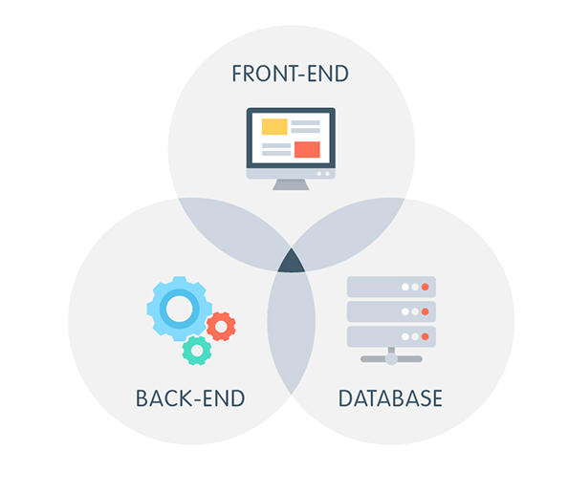
CONCLUSION
This application in whole encompasses these elements

Slide 16
THANK YOU

